Slide 1
Server side technology

Slide 2
server-side technologies
It is worth noting that the stack must include four components: a operating system; a web-server instance; a database management system and a server-side scripting language.
The essential combination of technologies required to build a service is known as a 'software-solution stack' and the original and most commonly used web-service software solution stack is known as LAMP (An acronym for Linux, Apache, MySQL and PHP).
The components of the stack are interchangeable and hundreds of other acronyms exist to encompass different technologies (WAMP uses Windows for example, MAMP uses Mac OS X).

Slide 3
LAMP (An acronym for Linux, Apache, MySQL and PHP)
L – This component refers to the server's operating system, in the case of dialogplus; Linux. Now commonly interchangeable with Windows (WAMP), or Mac OS X (MAMP).
A – Apache is still the most commonly used web-server software; however others are available such as NGINX.
M – MySQL is an open-source and widely used Relational Database Management System (RDBMS). It is now commonly interchangeable with PostgreSQL, SQLite or Oracle.
P – PHP is a server side scripting language that has the ability to connect to and query a database using query language (such as SQL for MySQL, or PGSQL for PostgreSQL). PHP has extensive functionality and is now interchangeable with other server-side scripting languages such as Ruby, Python or Perl.

Slide 4
The Apache HTTP Server
The second component of the web-service solution stack is the Apache HTTP web server. Apache is a free and open source cross-platform web server and is currently the world's most commonly used web server software. Released in 1995, Apache was originally based on the NCSA HTTPd server, one of the earliest web servers, and was developed by Robert McCool. When development on the NCSA HTTPd code stalled, development on Apache began and it quickly established itself as the dominant HTTP server, remaining popular ever since. Over 54% of web servers currently run Apache. The Apache software and its documentation are developed and maintained by the Apache Software Foundation; a group of volunteers located across the world. Apache was the first web server software to serve more than 100 million websites and played a crucial role in the initial growth of the World Wide Web.

Slide 5
Database Management Systems (DBMS)
A Database Management System (DBMS) is a piece of software that sits in front of the database and allows a user to interact with the data itself. The terms DBMS and Database are often used interchangeably, but in reality the DBMS is the Graphical User Interface (GUI) and the Database is the data holding software itself.
There are several of DBMS such as MySQL (Well-known), Microsoft SQL Server and PostgreSQL.

Slide 6
PHP: Hypertext Preprocessor
PHP is a server side scripting language which was originally created for web development but is also a general purpose programming language.
PHP development began in 1994 when Rasmus Lerdorf wrote a number of Common Gateway Interface (CGI) binaries to maintain his personal homepage. These slowly turned from being independent tools to being function calls in a scripting language. Rasmus admits that he never intended to write a programming language; "...I have no idea how to write a programming language, I just kept adding the next logical step..." (Rasmus Lerdorf, 2003). The source code was originally released on the Usenet community discussion forum as a way to locate bugs and improve the code.

Slide 7
PHP: Hypertext Preprocessor
Syntax and Functionality
As PHP is executed on the server it can be used for a number of functions such as: evaluating form data sent from the client; sending and receiving cookies (to remember user data on the web), connecting to / querying databases with SQL, open / read /delete files on the server. Although PHP commonly returns plain HTML files, it can also output images, PDF files and videos.

Slide 8
PHP: Hypertext Preprocessor
PHP code should be encased in the script tags <?PHP and ?> and saved with the file extension .php. You can access the PHP script directly from the browser and the browser will render output from the PHP file as plain text and display it, or the .php file can be a mix of PHP scripts and HTML if you wish to create a structured page. Often .php files are just HTML pages with PHP wired in (the PHP interpreter will send out the HTML in the .php file with the PHP language elements converted to HTML as well):

Slide 9
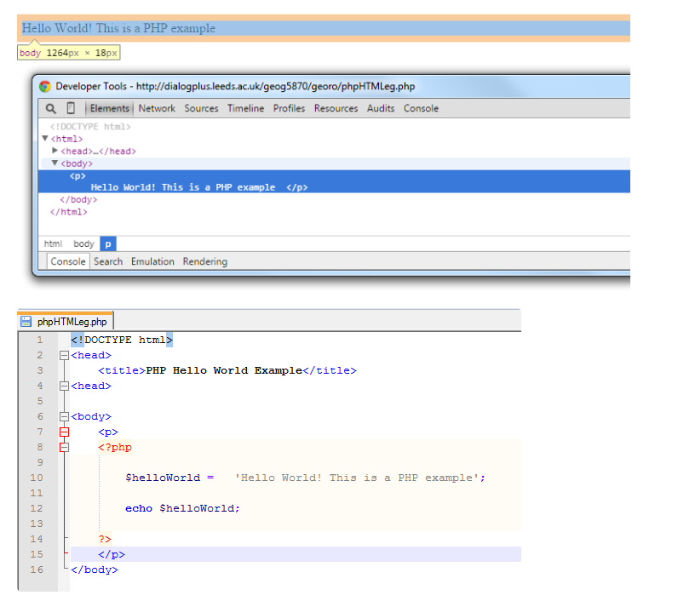
PHP: Hypertext Preprocessor

