Slide 1
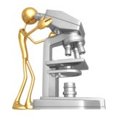
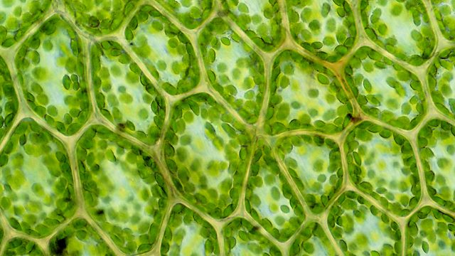
Light microscope
Biology 102 practical session

Slide 2
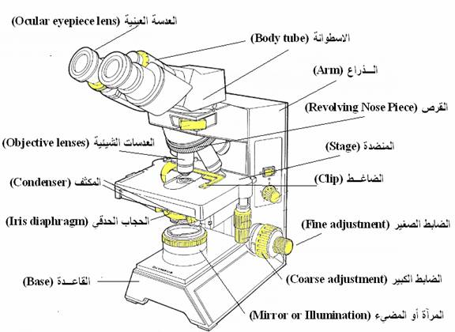

Slide 3
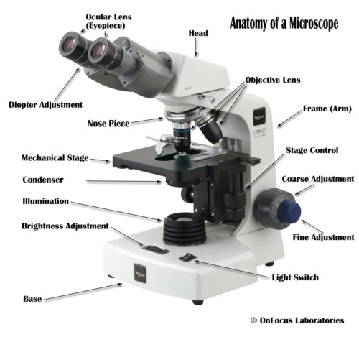

Slide 4
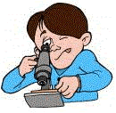
Microscope Care
Always carry with 2 hands
Only use lens paper for cleaning
Do not force knobs
Always store covered
Keep objects clear of desk and cords
Notes:
Teacher demonstrates how to hold the microscope, where the lens paper is located and how to use it. Students will be invited to turn the knobs and observe the stage as it moves up and down. Teacher will demonstrate how to store the microscope.

Slide 5
Parts of a Compound Microscope

Slide 6
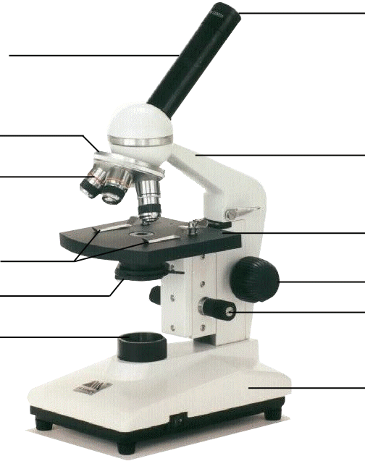
Microscope Parts
Eyepiece
Body Tube
Revolving Nosepiece
Arm
Objective Lens
Stage
Stage Clips
Coarse Focus
Diaphragm
Fine Focus
Light
Base
Notes:
This is the exact version of the microscope used in class. Students will be identifying the parts on the microscopes at their desks as we go along and what their functions are.

Slide 7
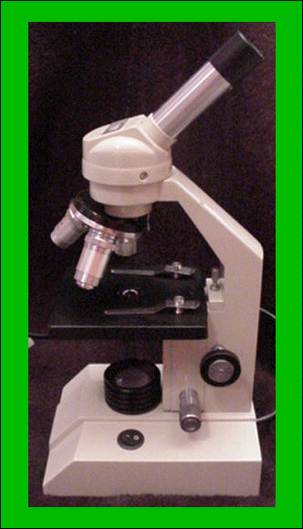
Compound Microscope
A microscope is a very powerful magnifying glass
A microscope helps you see things like cells up close

Slide 8
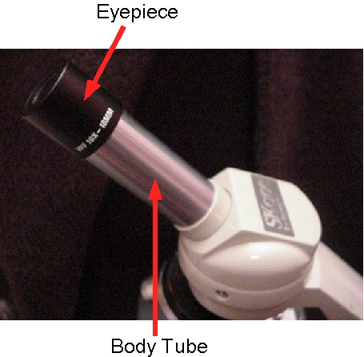
Eyepiece
View the specimen through the eyepiece

Slide 9
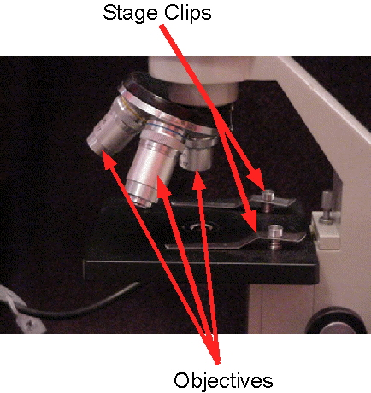
Stage Clips & Objectives
Stage clips hold the slide in place
Low power objective is used to focus the microscope (short & fat)
High power objective is used to view details of a specimen

Slide 10
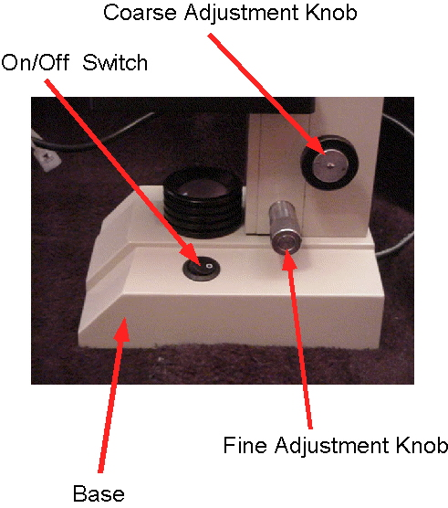
Coarse Adjustment, Fine Adjustment, & Base
Coarse adjustment focuses adjustment
Fine adjustment fine tunes & gives detailed focus(usually smaller than coarse adjustment knob)
Base is where the microscope rests

Slide 11
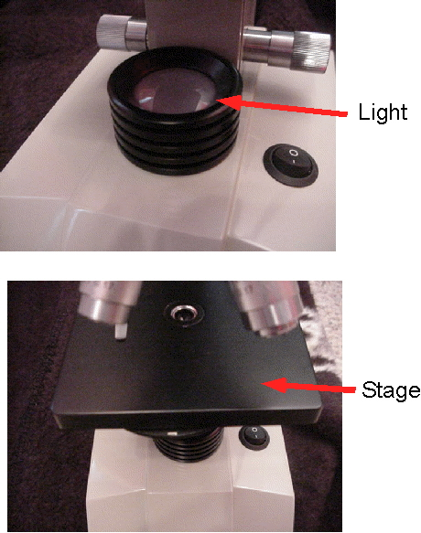
Stage
Stage is part where the slide rests
Mirror (or light source) directs light upwards onto the slide.

Slide 12
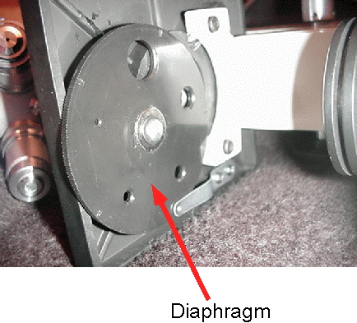
Diaphragm
Diaphragm allows light in

Slide 13
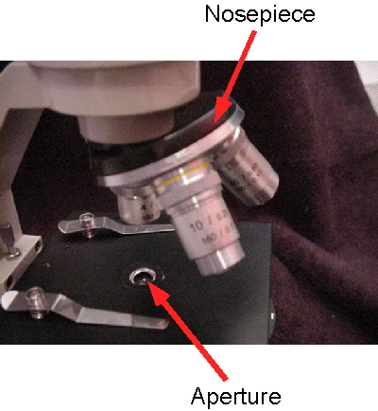
Nosepiece
Nosepiece is the rotating device that holds the objectives (lenses)

Slide 14
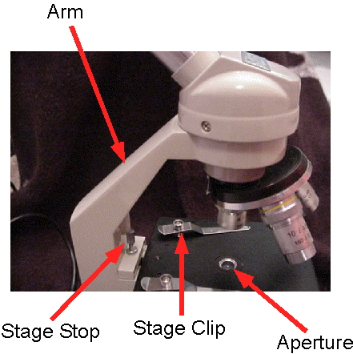
Arm
Arm is the part where you carry the microscope

Slide 15
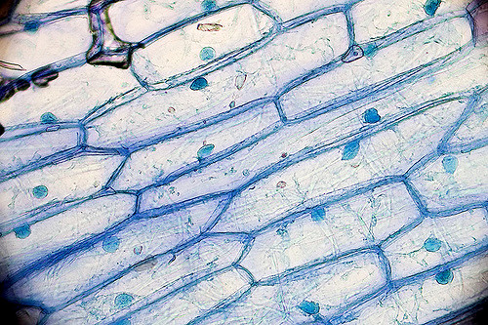
Onion cells under light microscope

Slide 16
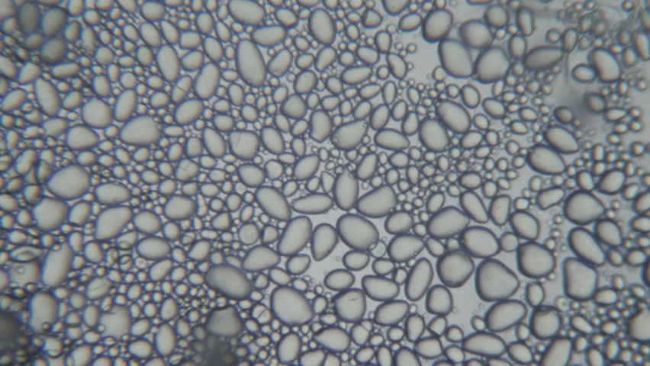
Potato starch grains
under light microscope

