Slide 1
Corporate Finance Thirteenth Edition Stephen A. Ross / Randolph W. Westerfield / Jeffrey F. Jaffe / Bradford D. Jordan
Chapter 8
Interest Rates and Bond Valuation
© McGraw Hill LLC. All rights reserved. No reproduction or distribution without the prior written consent of McGraw Hill LLC.

Slide 2
Key Concepts and Skills
Know the important bond features and bond types.
Understand bond values and why they fluctuate.
Understand bond ratings and what they mean.
Understand the impact of inflation on interest rates.
Understand the term structure of interest rates and the determinants of bond yields.

Slide 3
Chapter Outline
8.1 Bonds and Bond Valuation
8.2 Government and Corporate Bonds
8.3 Bond Markets
8.4 Inflation and Interest Rates
8.5 Determinants of Bond Yields

Slide 4
8.1 Bonds and Bond Valuation
A bond is a legally binding agreement between a borrower and a lender that specifies the:
Par (face) value.
Coupon rate.
Coupon payment.
Maturity date.
The yield to maturity is the required market interest rate on the bond.

Slide 5
Bond Valuation
Primary Principle:
Value of financial securities = PV of expected future cash flows.
Bond value is, therefore, determined by the present value of the coupon payments and par value.
Interest rates are inversely related to present values (i.e., bond prices).

Slide 6
The Bond-Pricing Equation
Bond value = Present value of the coupons + Present value of the face amount
Notes:
This formalizes the present value calculation.

Slide 7
Bond Example - I
Consider a U.S. government bond with as 6.375 percent coupon that expires in December 2025.
The par value of the bond is $1,000.
Coupon payments are made semiannually (June 30 and December 31 for this particular bond).
Since the coupon rate is 6.375 percent, the semiannual payment is $31.875.
On January 1, 2021, the size and timing of cash flows are:
Access the text alternative for slide images
Notes:
Note that the assumed starting date is January 2021.

Slide 8
Bond Example – II
On January 1, 2021, the required yield is 5 percent.
The current value is:
Notes:
Note that this example illustrates a premium bond (i.e., coupon rate is larger than the required yield).

Slide 9
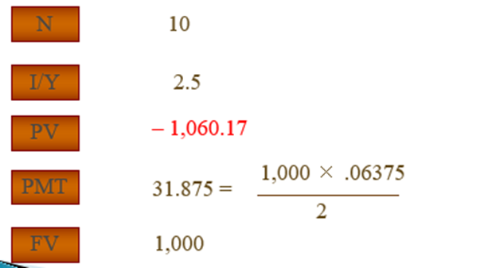
Bond Example: Calculator
Find the present value (as of January 1, 2021) of a 6.375 percent coupon bond with semiannual payments and a maturity date of December 2025 if the YTM is 5 percent.
Access the text alternative for slide images
Notes:
Note that the interest rate is specified as a periodic rate, which assumes the payments setting is equal to one.

Slide 10
Bond Example: Price Change
Now assume that the required yield is 11 percent.
How does this change the bond’s price?
Notes:
Note that this example illustrates a discount bond (i.e., coupon rate is smaller than the required yield).

Slide 11
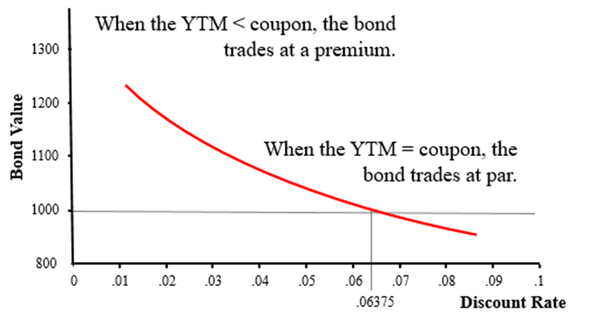
Y T M and Bond Value
When the Y T M > coupon, the bond trades at a discount.
Access the text alternative for slide images

Slide 12
Bond Concepts
Bond prices and market interest rates move in opposite directions.
When coupon rate = YTM, price = par value
When coupon rate > YTM, price > par value (premium bond)
When coupon rate < YTM, price < par value (discount bond)

Slide 13
Interest Rate Risk
Price Risk:
Change in price due to changes in interest rates.
Long-term bonds have more price risk than short-term bonds.
Low-coupon-rate bonds have more price risk than high coupon rate bonds.
Reinvestment Rate Risk:
Uncertainty concerning rates at which cash flows can be reinvested.
Short-term bonds have more reinvestment rate risk than long-term bonds.
High-coupon-rate bonds have more reinvestment rate risk than low coupon rate bonds.

Slide 14
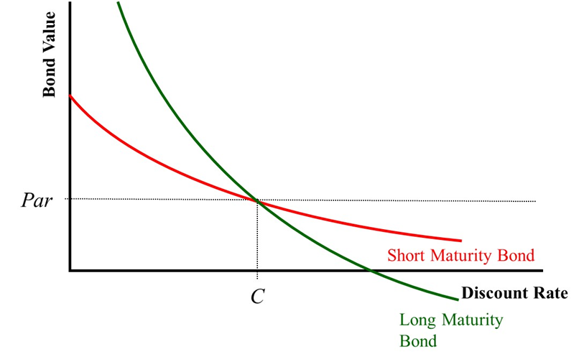
Maturity and Bond Price Volatility
Consider two otherwise identical bonds.
The long-maturity bond will have much more volatility with respect to changes in the discount rate.
Access the text alternative for slide images

Slide 15
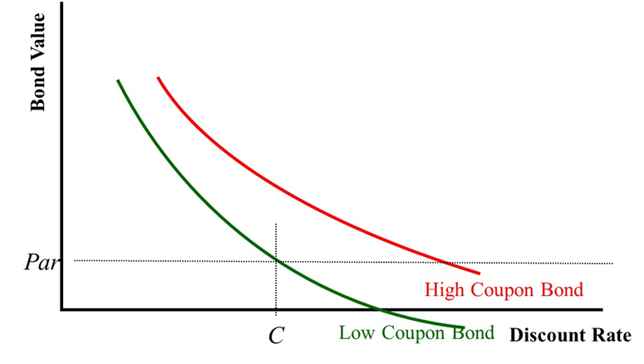
Coupon Rates and Bond Prices
Consider two otherwise identical bonds.
The low-coupon bond will have more volatility with respect to changes in the discount rate.
Access the text alternative for slide images

Slide 16
Computing Yield to Maturity
Yield to maturity is the rate implied by the current bond price.
Finding the Y T M requires trial and error if you do not have a financial calculator, and it is similar to the process for finding r with an annuity.
If you have a financial calculator, enter N, P V, P M T, and F V, remembering the sign convention (P M T and F V need to have the same sign, P V the opposite sign).

Slide 17
Y T M with Annual Coupons
Consider a bond with a 10 percent annual coupon rate, 15 years to maturity, and a par value of $1,000. The current price is $928.09.
Will the yield be more or less than 10 percent?
N = 15; PV = −928.09; FV = 1,000; PMT = 100
CPT
Notes:
The students should be able to recognize that the YTM is more than the coupon since the price is less than par.

Slide 18
Y T M with Semiannual Coupons
Suppose a bond with a 10 percent coupon rate and semiannual coupons has a face value of $1,000, 20 years to maturity, and is selling for $1,197.93.
Is the YTM more or less than 10 percent?
What is the semiannual coupon payment?
How many periods are there?
N = 40; P V = −1,197.93; P M T = 50; F V = 1,000; C P T
(Is this the YTM?)
YTM = 4% × 2 = 8%

Slide 19
Current Yield versus Yield to Maturity
Yield to maturity = Current yield + Capital gains yield
Example: 10 percent coupon bond, with semiannual coupons, face value of 1,000, 20 years to maturity, $1,197.93 price
Price in one year, assuming no change in YTM = 1,193.68
YTM = 8.35% − .35% = 8%, which is the same YTM computed earlier
Notes:
This is the same information as the YTM calculation on the previous slide. The YTM computed on that slide was 8%

Slide 20
Bond Pricing Theorems
Bonds of similar risk (and maturity) will be priced to yield about the same return, regardless of the coupon rate.
If you know the price of one bond, you can estimate its Y T M and use that to find the price of the second bond.
This is a useful concept that can be transferred to valuing assets other than bonds.

Slide 21
Zero Coupon Bonds
Make no periodic interest payments (coupon rate = 0%)
The entire yield to maturity comes from the difference between the purchase price and the par value
Cannot sell for more than par value
Sometimes called zeroes, deep discount bonds, or original issue discount bonds (O I D s)
Treasury bills and principal-only Treasury strips are good examples of zeroes

Slide 22
Pure Discount Bonds
Information needed for valuing pure discount bonds:
Time to maturity (T) = Maturity date − Today’s date
Face value (F)
Discount rate (r)
Present value of a pure discount bond at Time 0:

Slide 23
Pure Discount Bonds: Example
Find the value of a 15-year zero coupon bond with a $1,000 par value and a YTM of 12 percent.
Notes:
Note the assumption of semiannual compounding.

Slide 24
Bond Pricing with a Spreadsheet 1
There are specific formulas for finding bond prices and yields on a spreadsheet.
PRICE(Settlement, Maturity, Rate, Yld, Redemption, Frequency, Basis)
YIELD(Settlement, Maturity, Rate, Pr, Redemption, Frequency, Basis)
Settlement and maturity need to be actual dates.
The redemption and Pr need to given as % of par value.
Notes:
Please note that you have to have the analysis tool pack add-ins installed to access the PRICE and YIELD functions. If you do not have these installed on your computer, you can use the PV and the RATE functions to compute price and yield as well. Click on the TVM tab to find these calculations.

Slide 25
Bond Pricing with a Spreadsheet 2
Example:
You are looking at a bond that has 22 years to maturity. The coupon rate is 8 percent and coupons are paid semiannually. The yield-to-maturity is 9 percent. What is the current price?
RATE | 4.50% | (9%/2)
NPER | 44 | (22*2)
PMT | 4 | (8%*100/2)
FV | 100 | (Using 100 par so that PV will give price as % of par)
Price | $90.49 | Formula: −PV(4.50%,44,4,100)
You are looking at a bond that has 22 years to maturity. The coupon rate is 8 percent and coupons are paid semiannually. The current price is $960.17. What is the yield to maturity?
NPER | 44 | (22*2)
PMT | 4 | (8%*100/2)
PV | −96.017 | (Entered as a % of par and negative for sign convention)
FV | 100
YTM | 8.40% | (Returns as a whole percent, format to get decimal places)
 | Formula: | =2*RATE(44,4,-96.017,100) (Have to multiply by 2 because it returns a semiannual rate)
Notes:
Please note that you have to have the analysis tool pack add-ins installed to access the PRICE and YIELD functions. If you do not have these installed on your computer, you can use the PV and the RATE functions to compute price and yield as well. Click on the TVM tab to find these calculations.

Slide 26
8.2 Government and Corporate Bonds
Treasury Securities:
Federal government debt.
T-bills—pure discount bonds with original maturity less than one year.
T-notes—coupon debt with original maturity between one and ten years.
T-bonds—coupon debt with original maturity greater than ten years.
Municipal Securities:
Debt of state and local governments.
Varying degrees of default risk, rated similar to corporate debt.
Interest received is exempt from tax at the federal level.

Slide 27
Aftertax Yields
A taxable bond has a yield of 8 percent, and a municipal bond has a yield of 6 percent.
If you are in a 30 percent tax bracket, which bond do you prefer?
.08(1 − .3) = .056, or 5.6%
The aftertax return on the corporate bond is 5.6 percent, compared to a 6 percent return on the municipal.
At what tax rate would you be indifferent between the two bonds?
.08(1 − T) = .06, or 6%
T = .25, or 25%
Notes:
You should be willing to accept a lower stated yield on municipals because you do not have to pay taxes on the interest received. You will want to make sure the students understand why you are willing to accept a lower rate of interest. It may be helpful to take the example and illustrate the indifference point using dollars instead of just percentages. The discount you are willing to accept depends on your tax bracket.
Consider a taxable bond with a yield of 8 percent and a tax-exempt municipal bond with a yield of 6 percent.
Suppose you own one $1,000 bond in each, and both bonds are selling at par. You receive $80 per year from the corporate and $60 per year from the municipal. How much do you have after taxes if you are in the 30 percent tax bracket? Corporate: $80 – $80(.3) = $56; Municipal = $60
Lecture Tip: The lower tax rates as a result of the Tax Cuts and Jobs Act of 2017 will make municipal bonds relatively less attractive to investors.

Slide 28
Corporate Bonds
Greater default risk relative to government bonds
The promised yield (Y T M) may be higher than the expected return due to this added default risk

Slide 29
Bond Ratings—Investment Quality
High Grade:
Moody’s Aaa and S&P A A A—capacity to pay is extremely strong.
Moody’s Aa and S&P A A—capacity to pay is very strong.
Medium Grade:
Moody’s A and S&P A—capacity to pay is strong, but more susceptible to changes in circumstances.
Moody’s Baa and S&P BBB—capacity to pay is adequate, adverse conditions will have more impact on the firm’s ability to pay.

Slide 30
Bond Ratings—Speculative
Low Grade:
Moody’s Ba and B.
S&P B B and B.
Considered speculative with respect to capacity to pay.
Very Low Grade:
Moody’s Caa, Ca and C.
S&P C C C, C C, C, and D.
Highly uncertain repayment and, in many cases, already in default, with principal and interest in arrears.
Notes:
It is a good exercise to ask students which bonds will have the highest yield to maturity (lowest price), all else equal. Debt rated C by Moody’s is typically in default.

Slide 31
8.3 Bond Markets
Primarily over-the-counter transactions with dealers connected electronically.
Extremely large number of bond issues, but generally low daily volume in single issues.
Makes getting up-to-date prices difficult, particularly on a small company or municipal issues.
Treasury securities are an exception.

Slide 32
Treasury Quotations
2028 Aug 15 | 2.875 | 118.116 | 118.126 | -.03 | .517
What is the coupon rate on the bond?
When does the bond mature?
What is the bid price? What does this mean?
What is the ask price? What does this mean?
How much did the price change from the previous day?
What is the yield based on the ask price?
Notes:
Coupon rate = 2.875%
Matures in August 15, 2028 (assumes 2020 pricing date)
Bid price is 118.116. If you want to sell $100,000 par value T-bonds, the dealer is willing to pay $118,116.
Ask price is 118.126. If you want to buy $100,000 par value T-bonds, the dealer is willing to sell them for $118,126.
The difference between the bid and ask prices is called the bid-ask spread, and it is how the dealer makes money.
The price decreased by .03 percent, or $.30, in value from the previous day, so $30 on $100,000 worth of bonds.
The yield is .517%.

Slide 33
Clean versus Dirty Prices
Clean price: quoted price.
Dirty price: price actually paid = quoted price plus accrued interest.
Example: Suppose you buy a bond with a 12 percent annual coupon, payable semiannually; you pay $1,080; and the next coupon is due in four months.
$1,080 is the dirty, or invoice, price.
The next coupon will be $60.
Clean price = $1,080 − 20 = $1,060.

Slide 34
8.4 Inflation and Interest Rates
Real rate of interest—change in purchasing power
Nominal rate of interest—quoted rate of interest, change in purchasing power and inflation
The ex ante nominal rate of interest includes our desired real rate of return plus an adjustment for expected inflation.
Notes:
Be sure to ask the students to define inflation to make sure they understand what it is.

Slide 35
Real versus Nominal Rates
(1 + R) = (1 + r) × (1 + h), where,
R = nominal rate.
r = real rate.
h = expected inflation rate.
Approximation,
R = r + h.
Notes:
The approximation works pretty well with “normal” real rates of interest and expected inflation. If the expected inflation rate is high, then there can be a substantial difference.

Slide 36
Inflation-Linked Bonds
Most government bonds face inflation risk
T I P S (Treasury inflation-protected securities), however, eliminate this risk by providing promised payments specified in real, rather than nominal, terms

Slide 37
The Fisher Effect: Example
If we require a 10 percent real return and we expect inflation to be 8 percent, what is the nominal rate?
R = (1.1) × (1.08) − 1 = .188, or 18.8%
Approximation: R = 10% + 8% = 18%
Because the real return and expected inflation are relatively high, there is a significant difference between the actual Fisher Effect and the approximation.
Notes:
1+R=(1+r)×(1+i) where R
R is the nominal rate.
Rearranging for R gives:
R=(1+r)×(1+i)−1
R=(1+r)×(1+i)−1

Slide 38
8.5 Determinants of Bond Yields
Term structure is the relationship between time to maturity and yields, all else equal.
It is important to recognize that we pull out the effect of default risk, different coupons, etc.
Yield curve—graphical representation of the term structure
Normal—upward-sloping, long-term yields are higher than short-term yields.
Inverted—downward-sloping, long-term yields are lower than short-term yields.

Slide 39
Factors Affecting Required Return
Default risk premium—remember bond ratings
Taxability premium—remember municipal versus taxable
Liquidity premium—bonds that have more frequent trading will generally have lower required returns (remember bid-ask spreads)
Anything else that affects the risk of the cash flows to the bondholders will affect the required returns.

Slide 40
Quick Quiz
How do you find the value of a bond, and why do bond prices change?
What are bond ratings, and why are they important?
How does inflation affect interest rates?
What is the term structure of interest rates?
What factors determine the required return on bonds?

Slide 41
End of Main Content
© McGraw Hill LLC. All rights reserved. No reproduction or distribution without the prior written consent of McGraw Hill LLC.

Slide 42
Accessibility Content: Text Alternatives for Images

Slide 43
Bond Example - I – Text Alternative
Return to parent-slide containing images
The time line has the following values. 1/1/21; 6/30/21 payout of $31.875; 21/31/21 payout of $31.875; 6/30/25 payout of $31.875; 12/311/25 F V of $1,031.875.
Return to parent-slide containing images

Slide 44
Bond Example: Calculator – Text Alternative
Return to parent-slide containing images
N = 10
PV = negative 1,060.17
PMT = 31.875, equals 1,000 times 0.06375 all divided by 2
FV = 1,000
Return to parent-slide containing images

Slide 45
Y T M and Bond Value – Text Alternative
Return to parent-slide containing images
Downward sloping red line shows 3 relationships between Y T M and coupon rate. Area to left of 6.38% discount rate (horizontal axis) but above 1000 bond value (vertical axis) indicates when Y T M < coupon, bond trades at a premium. Area to right of 6.38% discount rate (horizontal axis) but below 1000 bond value (vertical axis) indicates when Y T M > coupon, bond trades at a discount. The point at which the discount rate is equal to 6.38% (horizontal axis) and bond value is equal to 1000 (vertical axis) indicates that when Y T M =coupon, bond trades par value.
Return to parent-slide containing images

Slide 46
Maturity and Bond Price Volatility – Text Alternative
Return to parent-slide containing images
Downward sloping green (red) line represents long term (short term) bonds. Steeper slope of the green line means long term bonds have more volatility for a given change in the discount rate.
Return to parent-slide containing images

Slide 47
Coupon Rates and Bond Prices – Text Alternative
Return to parent-slide containing images
Downward sloping green (red) line represents low coupon (high coupon) bonds. Steeper slope of green line means low coupon bonds have more volatility for a given change in the discount rate.
Return to parent-slide containing images

