Slide 1
Corporate Finance Thirteenth Edition Stephen A. Ross / Randolph W. Westerfield / Jeffrey F. Jaffe / Bradford D. Jordan
Chapter 3
Financial Statements Analysis and Financial Models
© McGraw Hill LLC. All rights reserved. No reproduction or distribution without the prior written consent of McGraw Hill LLC.

Slide 2
Key Concepts and Skills
Know how to standardize financial statements for comparison purposes.
Know how to compute and interpret important financial ratios.
Be able to develop a financial plan using the percentage of sales approach.
Understand how capital structure and dividend policies affect a firm’s ability to grow.

Slide 3
Chapter Outline
3.1 Financial Statements Analysis
3.2 Ratio Analysis
3.3 The DuPont Identity
3.4 Financial Models
3.5 External Financing and Growth
3.6 Some Caveats Regarding Financial Planning Models

Slide 4
3.1 Financial Statements Analysis
Standardized statements make it easier to compare financial information, particularly as the company grows.
They are also useful for comparing companies of different sizes, particularly within the same industry.
Common-Size Balance Sheets
Compute all accounts as a percent of total assets.
Common-Size Income Statements
Compute all line items as a percent of sales.

Slide 5
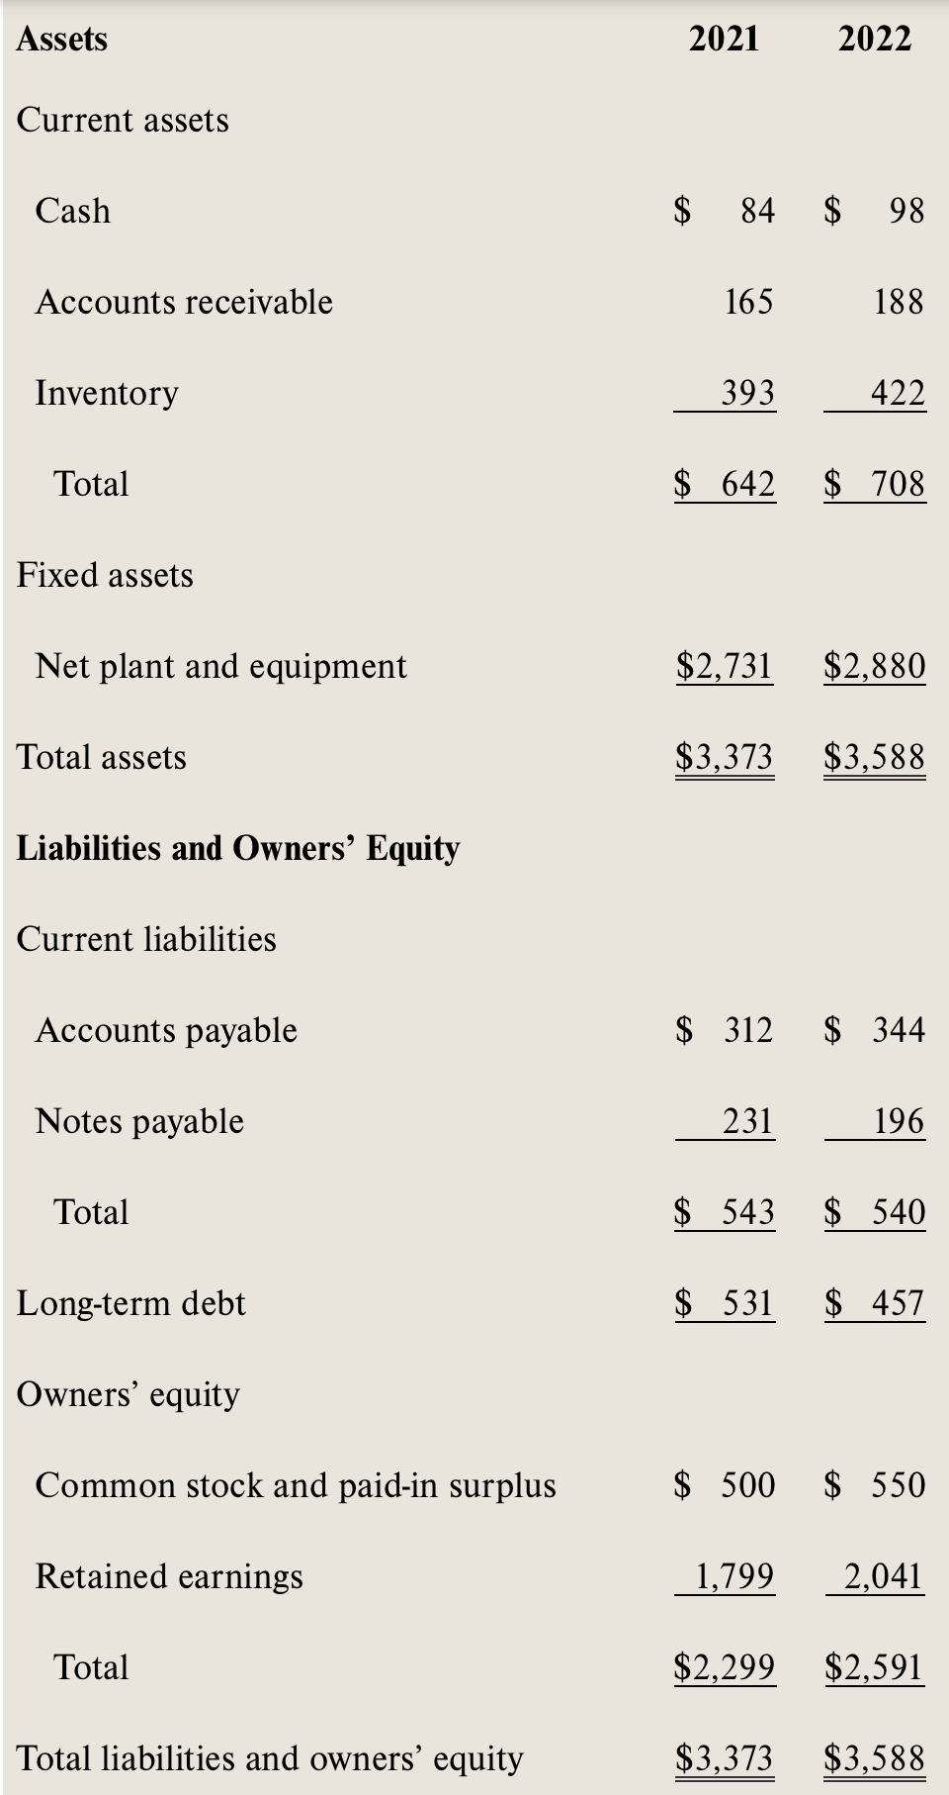
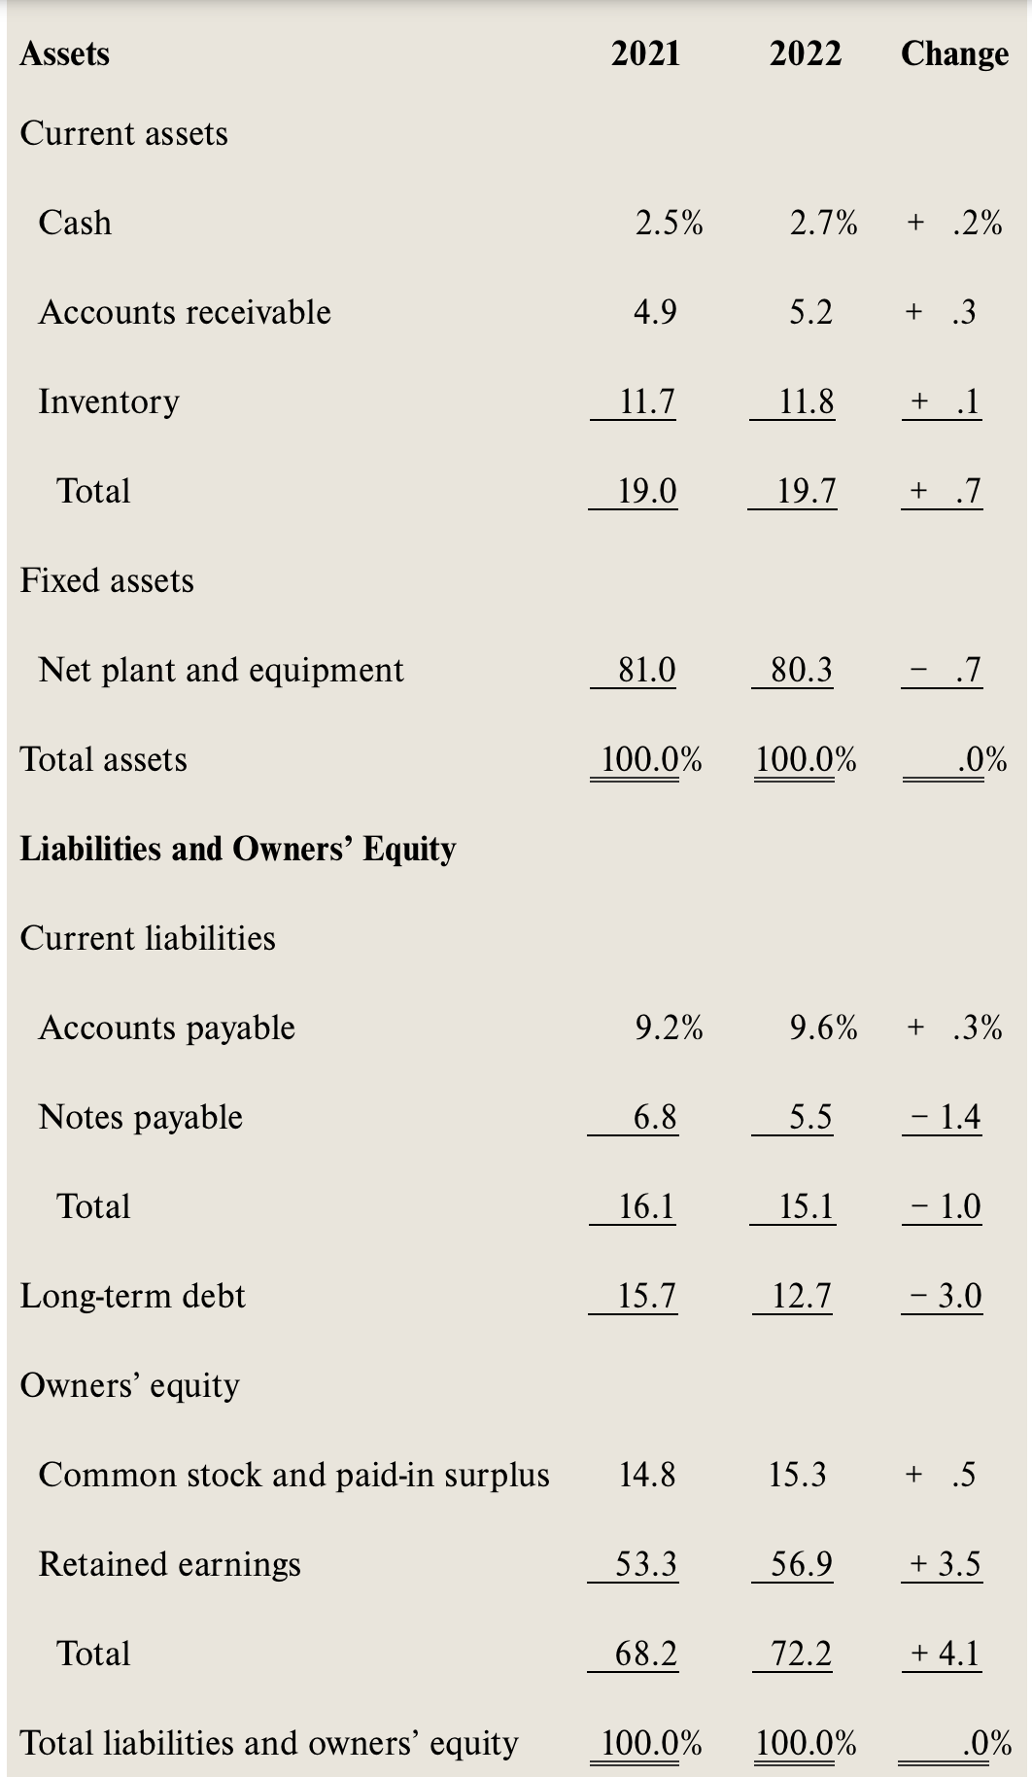

Slide 6
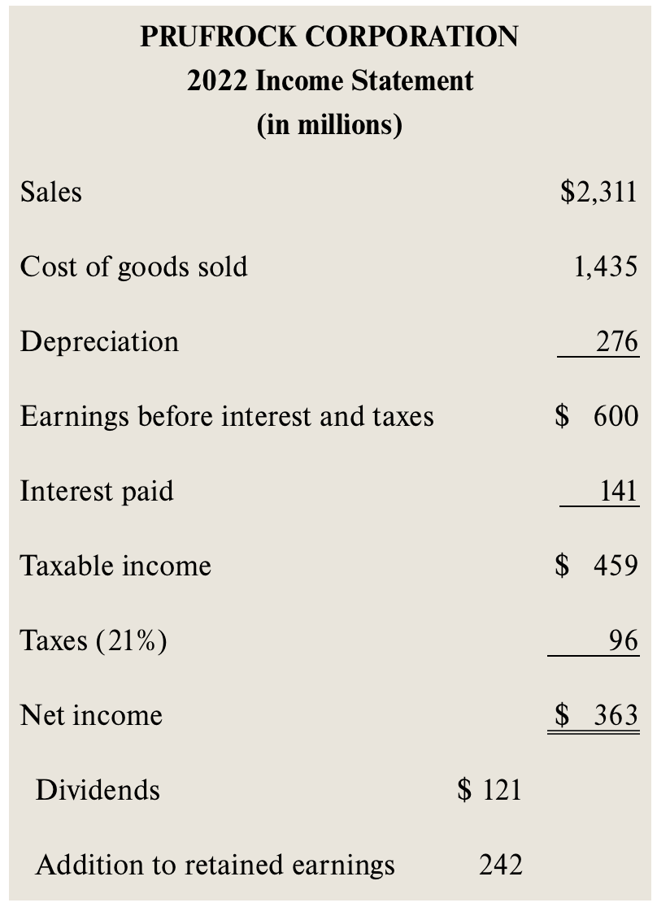
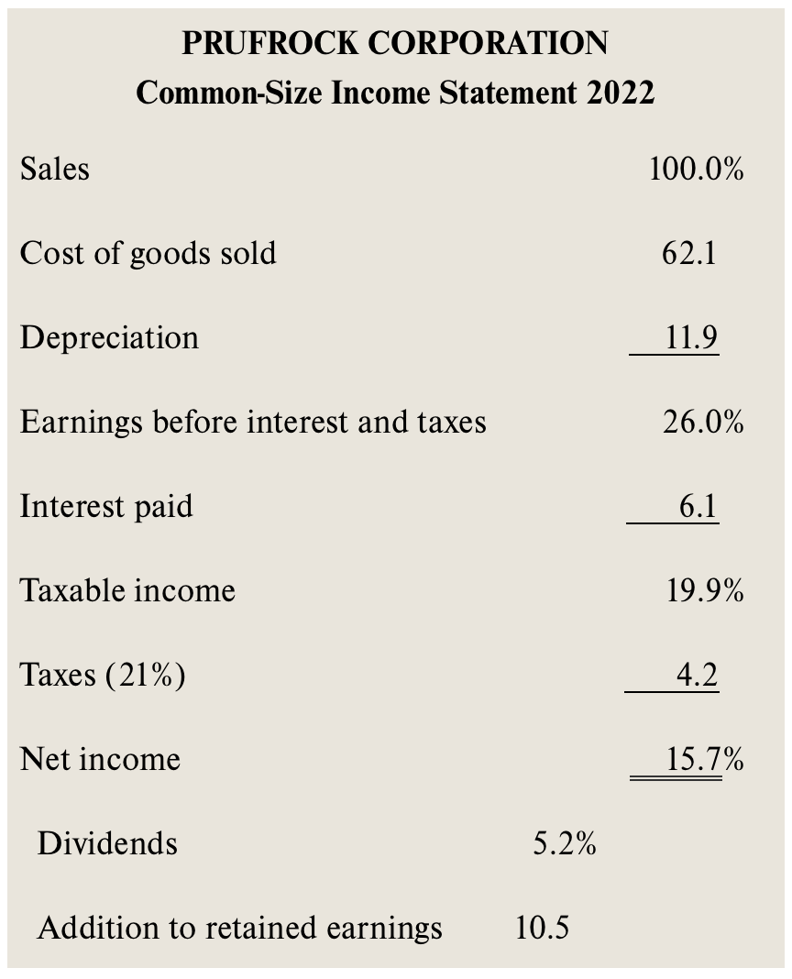

Slide 7
3.2 Ratio Analysis
Ratios also allow for better comparison through time or between companies.
As we look at each ratio, ask yourself:
How is the ratio computed?
What is the ratio trying to measure and why?
What is the unit of measurement?
What does the value indicate?
How can we improve the company’s ratio?

Slide 8
Categories of Financial Ratios
Short-term solvency, or liquidity, ratios.
Long-term solvency, or financial leverage, ratios.
Asset management, or turnover, ratios.
Profitability ratios.
Market value ratios.
Notes:
The ratios in the following slides will be computed using the 2022 information from the Balance Sheet (Table 3.1) and Income Statement (Table 3.4) given in the text.

Slide 9
Computing Liquidity Ratios
Notes:
The firm is able to cover current liabilities with its current assets by a factor of 1.3 to 1. The ratio should be compared to the industry—it’s possible that this industry has a substantial amount of cash flow and that they can meet their current liabilities out of cash flow instead of relying solely on the liquidation of current assets that are on the books.
The quick ratio is quite a bit lower than the current ratio, so inventory seems to be an important component of current assets.
This company carries a low cash balance. This may be an indication that it is aggressively investing in assets that will provide higher returns. We need to make sure that we have enough cash to meet our obligations, but too much cash reduces the return earned by the company.

Slide 10
Computing Leverage Ratios
Notes:
Note that these are often called solvency ratios.
TE = total equity, and TA = total assets. The numerator in the total debt ratio could also be found by adding all of the current and long-term liabilities.
The firm finances approximately 28 percent of its assets with debt.
Another way to compute the D-E ratio if you already have the total debt ratio:
D/E = Total debt ratio/(1 – total debt ratio) = $.28/$.72 = .38
The EM is one of the ratios that is used in the DuPont identity as a measure of the firm’s financial leverage.
EM, a high equity multiplier indicates that a company is using a high amount of debt to finance assets. A low equity multiplier means that the company has less reliance on debt.
* Investors will often modify the D/E ratio to focus on long-term debt only because the risks associated with long-term liabilities are different than short-term debt and payables.

Slide 11
Computing Coverage Ratios
Notes:
Remember that depreciation (and amortization) is a noncash deduction. A better indication of a firm’s ability to meet interest payments may be to add back the depreciation and amortization to get an estimate of cash flow before taxes.
You can also calculate a type of inverse value as follows:
Interest-Bearing Debt/EBITDA = ($196 + 457)/$876 = .75
Values less than one are indicative of a stable position.

Slide 12
Computing Inventory Ratios
Notes:
Inventory turnover can be computed using either ending inventory or average inventory when you have both beginning and ending figures. It is important to be consistent with whatever benchmark you are using to analyze the company’s strengths or weaknesses.
It is also important to consider seasonality in sales. If the balance sheet is prepared at a time when there is a large inventory build-up to meet seasonal demand, then the inventory turnover will be understated and you might believe that the company is not performing as well as it is. On the other hand, if the balance sheet is prepared when inventory has been drawn down due to seasonal sales, then the inventory turnover would be overstated and the company may appear to be doing better than it really is. Averages using annual data may not fix this problem. If a company has seasonal sales, you may want to look at quarterly averages to get a better indication of turnover.

Slide 13
Computing Receivables Ratios
Notes:
Technically, the sales figure should be credit sales. This is often difficult to determine from the income statements provided in annual reports. If you use total sales instead of credit sales, you will overstate your turnover level. You need to recognize this bias when credit sales are unavailable, particularly if a large portion of the sales are cash sales.
As with inventory turnover, you can use either ending receivables or an average of beginning and ending.
You also run into the same seasonal issues as discussed with inventory.
Probably the best benchmark for days’ sales in receivables is the company’s credit terms. If the company offers a discount (1/10 net 30), then you would like to see days’ sales in receivables less than 30. If the company does not offer a discount (net 30), then you would like to see days’ sales in receivables close to the net terms. If days’ sales in receivables is substantially larger than the net terms, then you first need to look for biases, such as seasonality in sales. If this does not provide an explanation for the difference, then the company may need to take another look at its credit policy (who it grants credit to and its collection procedures).

Slide 14
Computing Total Asset Turnover
It is not unusual for T A T < 1, especially if a firm has a large amount of fixed assets.
Notes:
Having a TAT of less than one is not a problem for most firms. Fixed assets are expensive and are meant to provide sales over a long period of time. This is why the matching principle indicates that they should be depreciated instead of immediately expensed.
This is one of the ratios that will be used in the Du Pont identity.
For every Riyal in Assets, we generate 0.64 Halalas.
In other words, The total asset turnover ratio of 0.64 means that for every Riyal of assets a company has, it generates 64 Halalas in sales.

Slide 15
Computing Profitability Measures
Notes:
You can also compute the gross profit margin and the operating profit margin.
GPM = (Sales – COGS)/Sales
OPM = EBIT/Sales
Profit margin is one of the components of the Du Pont identity and is a measure of operating efficiency. It measures how well the firm controls the costs required to generate the revenues. It tells how much the firm earns for every dollar in sales. In the example, the firm earns almost $.16 for each dollar in sales.
Note that the ROA and ROE are returns on accounting numbers. As such, they are not directly comparable with returns found in the marketplace. ROA is sometimes referred to as ROI (return on investment). As with many of the ratios, there are variations in how they can be computed. The most important thing is to make sure that you are computing them the same way as the benchmark you are using.
ROE will always be higher than ROA as long as the firm has debt (and ROA is positive). The greater the leverage, the larger the difference will be. ROE is often used as a measure of how well management is attaining the goal of owner wealth maximization. The Du Pont identity is used to identify factors that affect the ROE.

Slide 16
Computing Market Value Measures
Notes:
See Table 3.6, as well as the instructor’s manual (chapter 3 appendix), for a summary list of financial ratios.
Notice that book value per share is total equity (not just common stock) divided by the number of shares outstanding.
Book value per share is an accounting number that reflects historical costs. In a loose sense, the market-to-book ratio therefore compares the market value of the firm's investments to their cost. A value less than I could mean that the firm has not been successful overall in creating value for its stockholders.
Enterprise Value
Enterprise value is a measure of firm value that is very closely related to market capitalization. Instead of focusing on only the market value of outstanding shares of stock, it measures the market value of outstanding shares of stock plus the market value of outstanding interest-bearing debt less cash on hand. We know the market capitalization of Prufrock but we do not know the market value of its outstanding interest-bearing debt. In this situation, the common practice is to use the book value of outstanding interest-bearing debt less cash on hand as an approximation. For Prufrock, enterprise value is (in millions):
EV = Market capitalization + Market value of interest-bearing debt - Cash
=
$2.904 ÷ (196 + 457) - 98 = $3,459 million
The purpose of the EV measure is to better estimate how much it would take to buy all of the outstanding stock of a firm and also to pay off the debt. The adiustment for cash is to recognize that if we were a buyer, the cash could be used immediately to buy back debt or pay a dividend.
For every dollar of EBITDA the company generates, the company is valued at $3.95 in the market

Slide 17
Using Financial Statements
Ratios are not very helpful by themselves: they need to be compared to something
Time Trend Analysis
Used to see how the firm’s performance is changing through time.
Peer Group Analysis
Compare to similar companies or within industries.

Slide 18
3.3 The DuPont Identity
Multiply by 1 and then rearrange:
Multiply by 1 again and then rearrange:

Slide 19
Using the DuPont Identity
R O E = P M × T A T × E M
Profit margin is a measure of the firm’s operating efficiency—how well it controls costs.
Total asset turnover is a measure of the firm’s asset use efficiency—how well it manages its assets.
Equity multiplier is a measure of the firm’s financial leverage.
Notes:
If ROE is unsatisfactory by some measure , then the dupont ideneity tells you where to start looking for the reasons.
Improving our operating efficiency or our asset use efficiency will improve our return on equity. If the TAT is low compared to our benchmark, then we can break it down into more detail by looking at inventory turnover and receivables turnover. If those areas are strong, then we can look at fixed asset turnover and cash management.
We can also improve our ROE by increasing our leverage—up to a point. Debt affects a lot of other factors, including profit margin, so we have to be a little careful here. We want to make sure we have enough debt to utilize our interest tax credit effectively, but we don’t want to overdo it.

Slide 20
Calculating the DuPont Identity
R O A = .1011 and E M = 1.38
R O E = .1011 × 1.385 = .1399, or 13.99%
P M = .1569 and T A T = .64
R O E = .1569 × .64 × 1.38 = .1399, or 13.99%

Slide 21
Potential Problems
There is no underlying theory, so there is no way to know which ratios are most relevant.
Benchmarking is difficult for diversified firms.
Globalization and international competition make comparison more difficult because of differences in accounting regulations.
Firms use varying accounting procedures.
Firms have different fiscal years.
Extraordinary, or one-time, events.

Slide 22
3.4 Financial Models
Investment in new assets—determined by capital budgeting decisions.
Degree of financial leverage—determined by capital structure decisions.
Cash paid to shareholders—determined by dividend policy decisions.
Liquidity requirements—determined by net working capital decisions.

Slide 23
Financial Planning Ingredients
Sales Forecast—many cash flows depend directly on the level of sales (often estimate sales growth rate)
Pro Forma Statements—setting up the plan as projected (pro forma) financial statements allows for consistency and ease of interpretation
Asset Requirements—the additional assets that will be required to meet sales projections
Financial Requirements—the amount of financing needed to pay for the required assets
Plug Variable—determined by management decisions about what type of financing will be used (makes the balance sheet balance)
Economic Assumptions—explicit assumptions about the coming economic environment

Slide 24
Percentage of Sales Approach - I
Some items vary directly with sales, others do not.
Income Statement
Costs may vary directly with sales—if this is the case, then the profit margin is constant.
Depreciation and interest expense may not vary directly with sales—if this is the case, then the profit margin is not constant.
Dividends are a management decision and generally do not vary directly with sales—this affects additions to retained earnings.

Slide 25
Percentage of Sales Approach – II
Balance Sheet
Initially assume all assets, including fixed, vary directly with sales.
Accounts payable also normally vary directly with sales.
Notes payable, long-term debt, and equity generally do not vary with sales because they depend on management decisions about capital structure.
The change in the retained earnings portion of equity will come from the dividend decision.
External Financing Needed (E F N)
The difference between the forecasted increase in assets and the forecasted increase in liabilities and equity.

Slide 26
Percentage of Sales and E F N
External Financing Needed (E F N) can also be calculated as:
= (Assets/Sales) × Change in sales – (Spontaneous liabilities/Sales) × Change in sales – Profit margin × Project sales for next year × (1 – Dividend payout ratio)
= ($3,000/$1,000) × ($250) – ($300/$1,000) × ($250) – (.132 × $1,250 × (1 – .3333)
= $565
Notes:
The first term measures the increase in assets, which is based on the capital intensity ratio. The second and third terms capture the increase in liabilities and equity, respectively.

Slide 27
3.5 External Financing and Growth
At low growth levels, internal financing (retained earnings) may exceed the required investment in assets.
As the growth rate increases, the internal financing will not be enough, and the firm will have to go to the capital markets for financing.
Examining the relationship between growth and external financing required is a useful tool in financial planning.

Slide 28
The Internal Growth Rate
The internal growth rate tells us how much the firm can grow assets using retained earnings as the only source of financing.
Using the information from the Hoffman Co.
Notes:
The information for these calculations is given in Table 3.14. This firm could grow assets at 9.64 percent without raising additional external capital.
Relying solely on internally generated funds will increase equity (retained earnings are part of equity) and assets without an increase in debt. Consequently, the firm’s leverage will decrease over time. If there is an optimal amount of leverage, as we will discuss in later chapters, then the firm may want to borrow to maintain that optimal level of leverage. This idea leads us to the sustainable growth rate.

Slide 29
The Sustainable Growth Rate
The sustainable growth rate tells us how much the firm can grow by using internally generated funds and issuing debt to maintain a constant debt ratio.
Using the Hoffman Co.
Notes:
Note that no new equity is issued.
The sustainable growth rate is substantially higher than the internal growth rate. This is because we are allowing the company to issue debt as well as use internal funds.
Commonly, sustainable growth is calculated as only the numerator of our formula (ROE × b), but this assumes we calculate ROE based on beginning, rather than ending, equity.

Slide 30
Determinants of Growth
Profit margin—operating efficiency.
Dividend policy—choice of how much to pay to shareholders versus reinvesting in the firm.
Financial leverage—choice of optimal debt ratio.
Total asset turnover—asset use efficiency.
Notes:
The first three components come from the ROE and the DuPont identity.
It is important to note at this point that growth is not the goal of a firm in and of itself. Growth is only important so long as it continues to maximize shareholder value.

Slide 31
3.6 Some Caveats Regarding Financial Planning Models
Financial planning models do not indicate which financial polices are the best.
Models are simplifications of reality, and the world can change in unexpected ways.
Without some sort of plan, the firm may find itself adrift in a sea of change without a rudder for guidance.

Slide 32
Quick Quiz – I
How do you standardize balance sheets and income statements?
Why is standardization useful?
What are the major categories of financial ratios?
How do you compute the ratios within each category?
What are some of the problems associated with financial statement analysis?

Slide 33
Quick Quiz - II
What is the purpose of financial planning?
What are the major decision areas involved in developing a plan?
What is the percentage of sales approach?
What is the internal growth rate?
What is the sustainable growth rate?
What are the major determinants of growth?

Slide 34
End of Main Content
© McGraw Hill LLC. All rights reserved. No reproduction or distribution without the prior written consent of McGraw Hill LLC.

