Slide 1
Radiation Heat Transfer

Slide 2
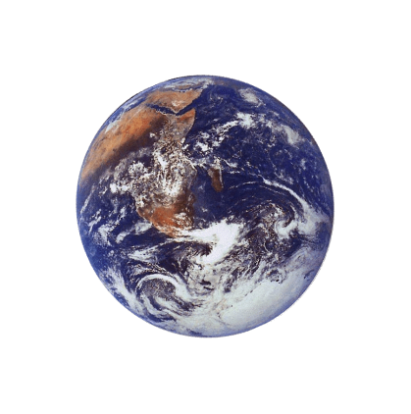
The third method of heat transfer
How does heat energy get from the Sun to the Earth?
There are no particles between the Sun and the Earth so it CANNOT travel by conduction or by convection.
RADIATION
?

Slide 3
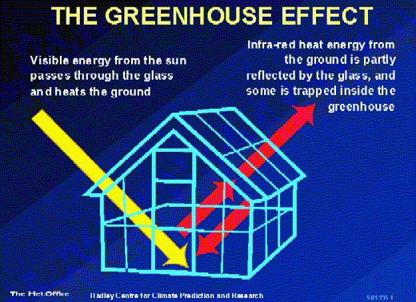
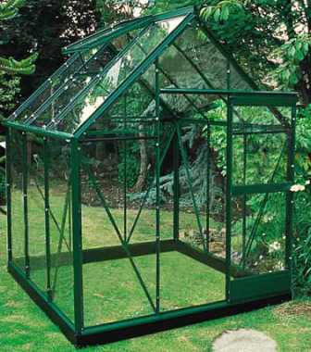
How can we relate our new understanding to the greenhouse effect?

Slide 4
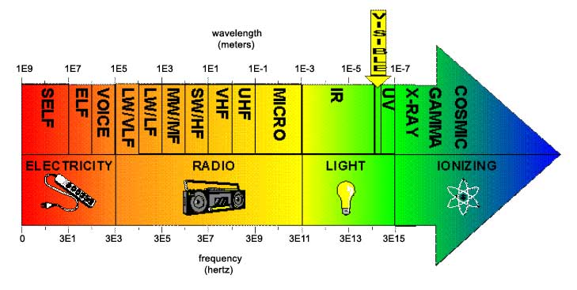
Electromagnetic Spectrum
Thermal or heat radiation is the transfer of energy basically by infra-red waves. These waves are part of the electromagnetic spectrum

Slide 5
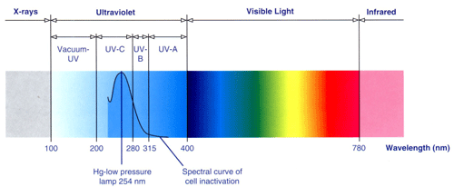
UV Radiation
The most lethal type of radiation is ultraviolet radiation with a wavelength of 260 nm. This is the wavelength most actively absorbed by DNA.
It is useful for disinfecting surfaces, air and liquids.

Slide 6
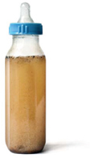
Unfortunately, this type of radiation does not penetrate dirt, glass, water, or other substances. If a surface is dusty, then complete inactivation of all microorganisms may not occur.
Due to its poor penetration, UV radiation is only useful for disinfecting outer surfaces.

Slide 7
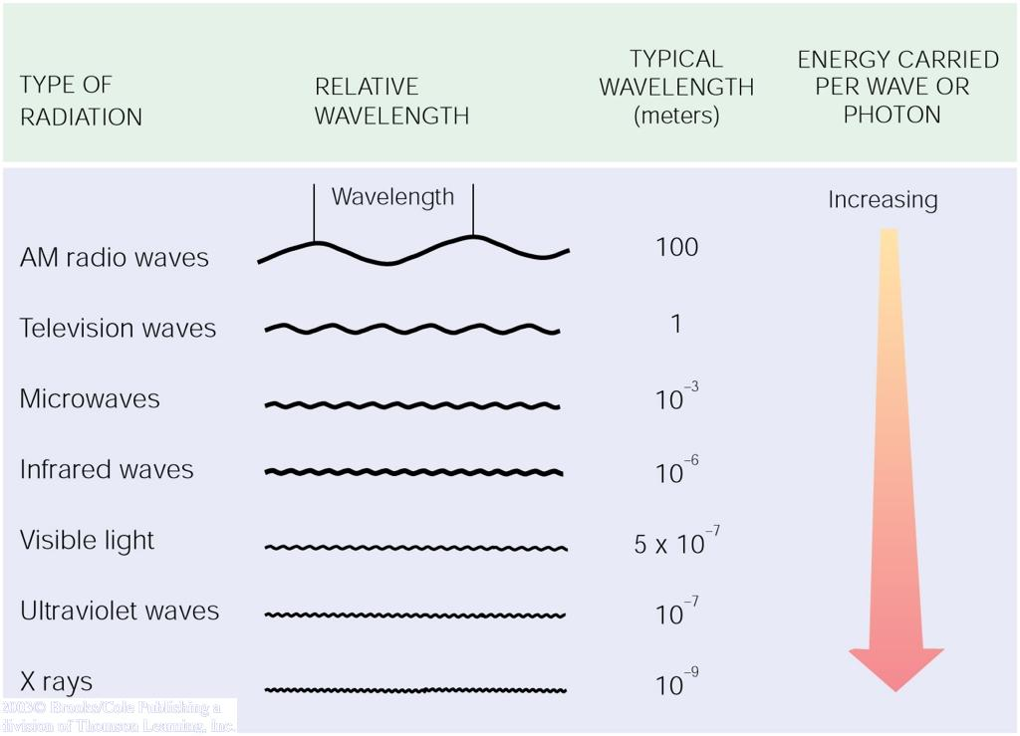
Radiation travels as waves of photons that release energy when absorbed.
All objects above 0° K release radiation, and its heat energy value increases to the 4th power of its temperature.

Slide 8
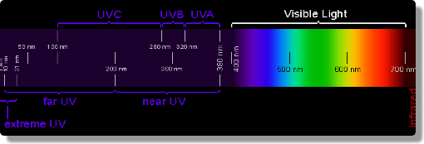
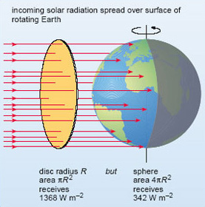

Slide 9
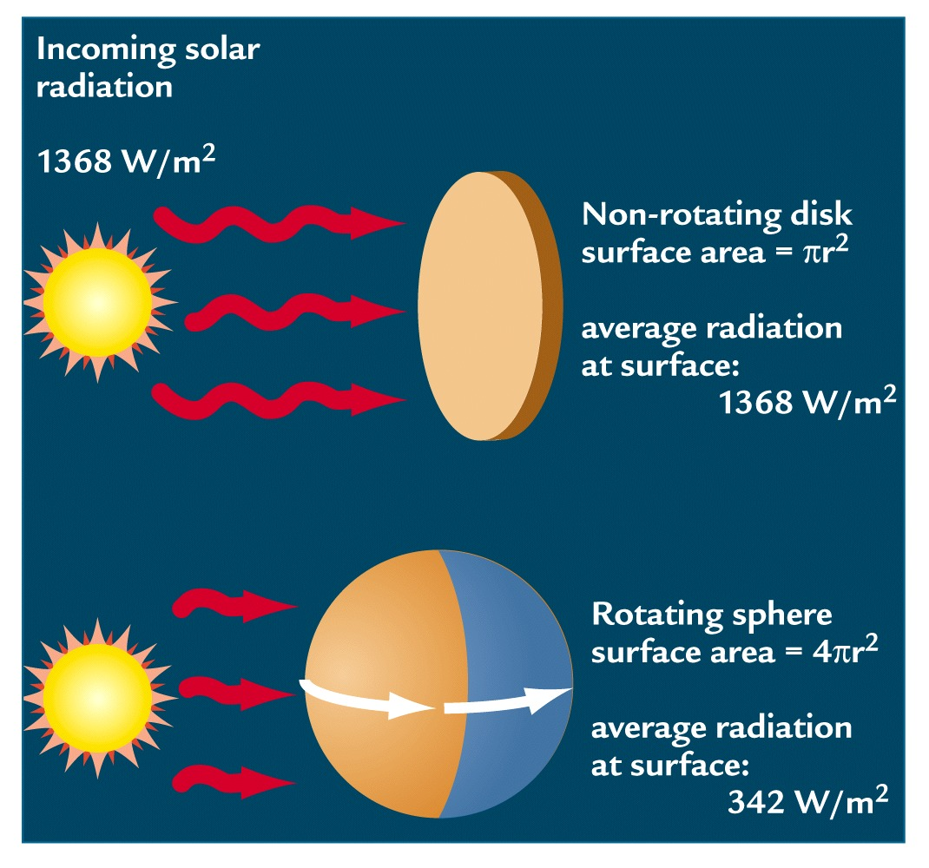
Incoming Solar Radiation (Insolation)
At the top of the atmosphere

Slide 10
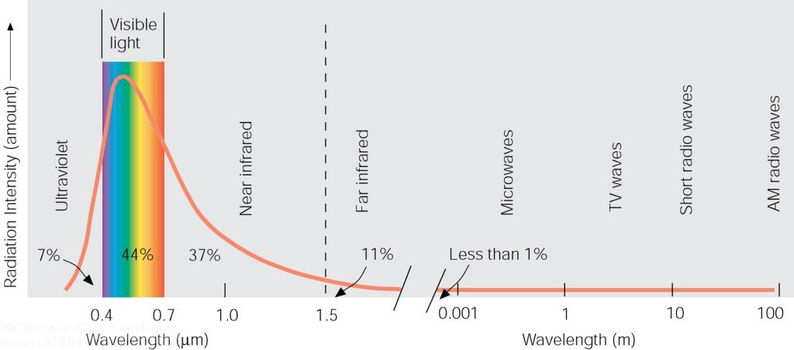
Electromagnetic Spectrum
Solar radiation
Solar radiation has peak intensities in the shorter wavelengths, dominant in the region we know as visible, but extends at low intensity into longwave regions.

Slide 11
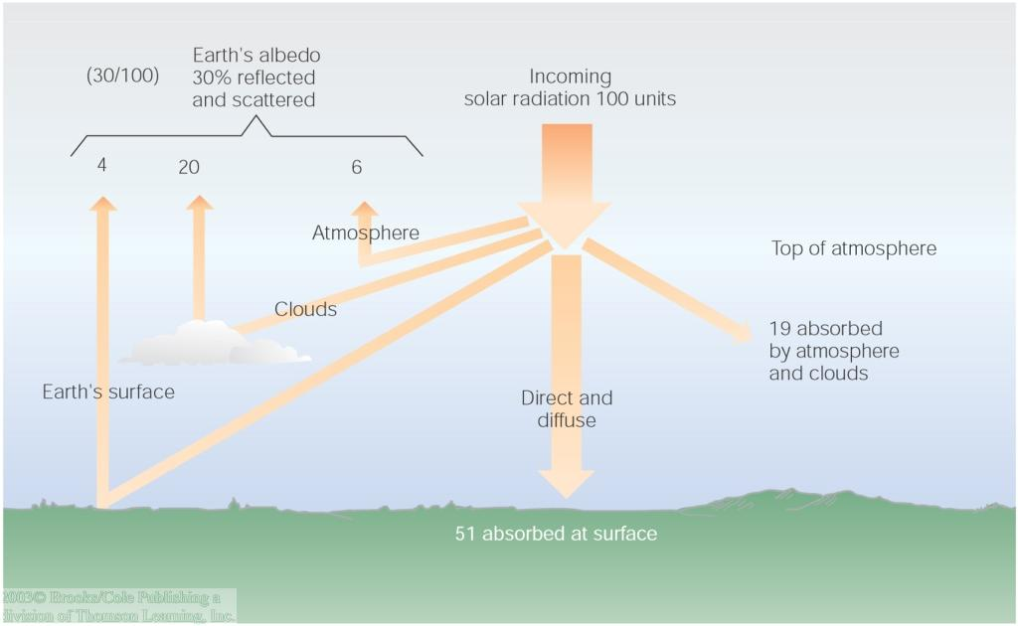
Incoming Solar Radiation
Solar radiation is scattered and reflected by the atmosphere, clouds, and earth's surface, creating an average albedo of 30%.
Atmospheric gases and clouds absorb another 19 units, leaving 51 units of shortwave absorbed by the earth's surface.

Slide 12
Albedo is the fraction of Sun’s radiation reflected from a surface.
It is quantified as the proportion, or percentage of solar radiation of all wavelengths reflected by a body or surface to the amount incident upon it.
An ideal white body has an albedo of 100% and an ideal black body, 0%. Visually we can estimate the albedo of an object’s surface from its tone or color.
This method suggests that albedo becomes higher as an object gets lighter in shade.

Slide 13
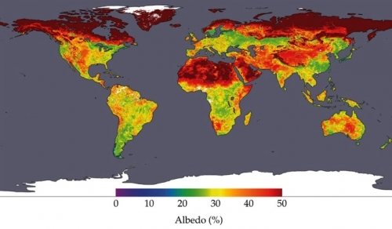
Albedo of the Earth's terrestrial surface as measured by the TERRA satellite. Data collected from the period April 7-22, 2002. (Source: NASA Earth Observatory).

Slide 14
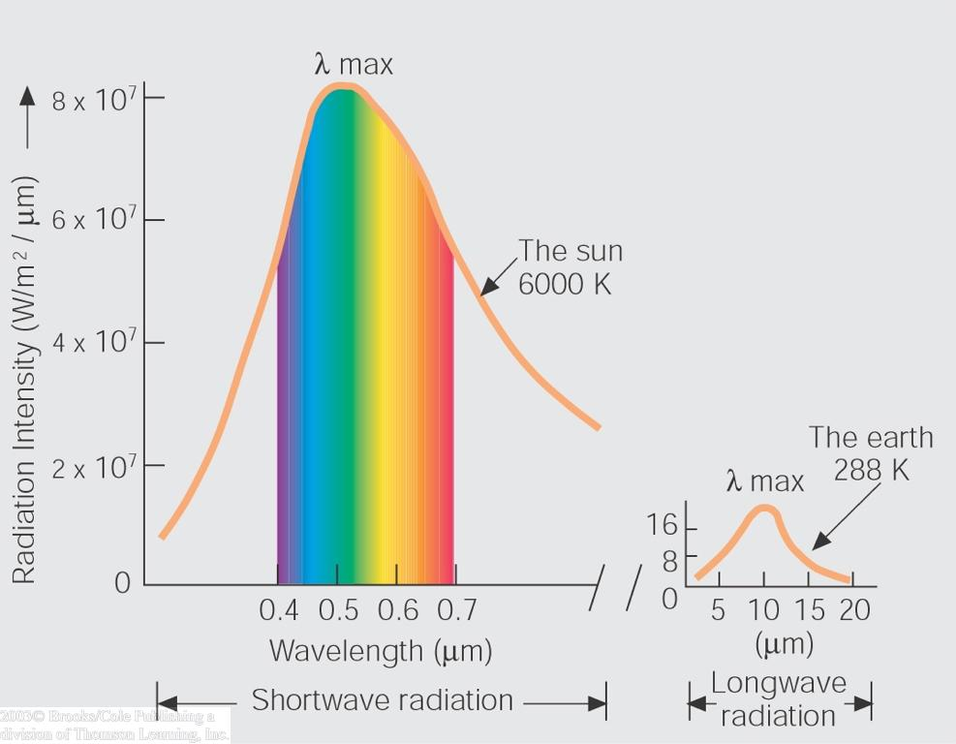
Longwave & Shortwave Radiation
The hot sun radiates at shorter wavelengths that carry more energy, and the fraction absorbed by the cooler earth is then re-radiated at longer wavelengths, as predicted by Wein's law.

Slide 15
INFRARED WAVES
Heat can move by travelling as infrared waves.
These are electromagnetic waves, like light waves, but with a longer wavelength.
This means that infrared waves act like light waves:
They can travel through a vacuum.
They travel at the same speed as light – 300,000,000 m/s.
They can be reflected and absorbed.
Infrared waves heat objects that absorb them and so can be called thermal radiation.

Slide 16
ABSORBING THERMAL RADIATION
Infrared waves heat objects that absorb (take in) them.
Some surfaces are better at absorbing thermal radiation than others – good emitters are also good absorbers.
best emitter
worst emitter
matt
black
white
silver
best absorber
worst absorber
Matt black surfaces are the best absorbers of radiation.
Shiny surfaces are the worst emitters because they reflect most of the radiation away.
Why are solar panels that are used for heating water covered in a black outer layer?

Slide 17
Radiation
Radiation travels in straight lines
True/False
Radiation can travel through a vacuum
True/False
Radiation requires particles to travel
True/False
Radiation travels at the speed of light
True/False

Slide 18
Emission experiment
Four containers were filled with warm water. Which container would have the warmest water after ten minutes?
Dull metal
Shiny black
Shiny metal
Dull black
The __________ container would be the warmest after ten minutes because its shiny surface reflects heat _______ back into the container so less is lost. The ________ container would be the coolest because it is the best at _______ heat radiation.
shiny metal
radiation
dull black
emitting

Slide 19
Absorption experiment
Four containers were placed equidistant from a heater. Which container would have the warmest water after ten minutes?
Dull metal
Shiny black
Shiny metal
Dull black
dull black
The __________ container would be the warmest after ten minutes because its surface absorbs heat _______ the best. The _________ container would be the coolest because it is the poorest at __________ heat radiation.
radiation
shiny metal
absorbing

Slide 20
Radiation Heat Transfer
e = emissive power
G = total irradiation
J = total radiosity
ε = emissivity
α=ε
In general:
α = absorptivity
ρ = reflectivity
τ = transmissivity
Opaque material:

Slide 21
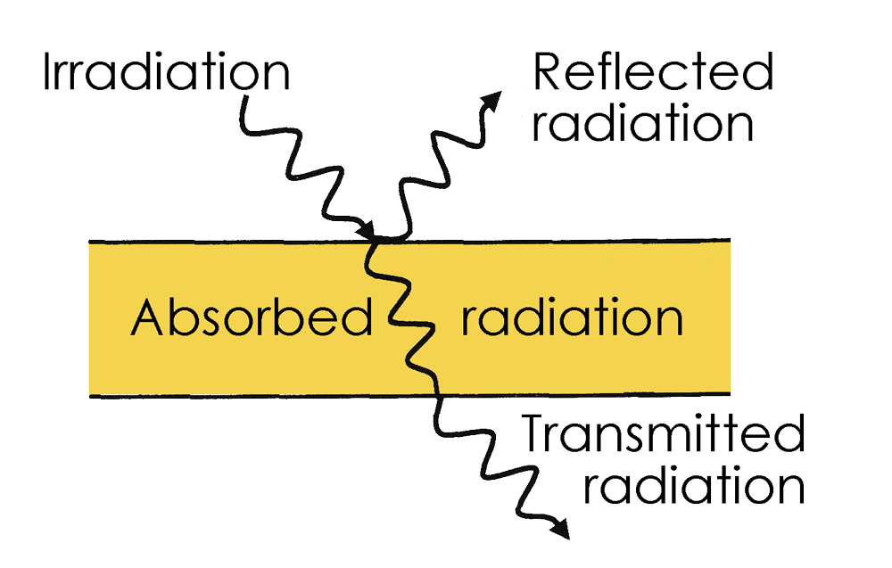

Slide 22
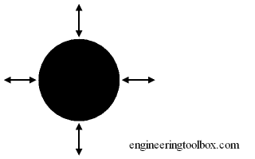
The Black Body
A black body is defined as a body that absorbs all radiation that falls on its surface. Actual black bodies don't exist in nature - though its characteristics are approximated by a hole in a box filled with highly absorptive material. The emission spectrum of such a black body was first fully described by Max Planck.

Slide 23
The radiation energy per unit time from a blackbody is proportional to the fourth power of the absolute temperature and can be expressed with Stefan-Boltzmann Law as
q = σ T⁴ A (1)
where
q = heat transfer per unit time (W)
σ = 5.6703 10⁻⁸ (W/m²K⁴) - The Stefan-Boltzmann Constant
T = absolute temperature Kelvin (K)
A = area of the emitting body (m²)
Example - Radiation from the surface of the Sun
If the surface temperature of the sun is 5800 K and if we assume that the sun can be regarded as a black body the radiation energy per unit time can be expressed by modifying (1) like
q / A = σ T⁴
= (5.6703 10⁻⁸ W/m²K⁴) (5800 K)⁴
= 6.42 10⁷ W/m²

Slide 24
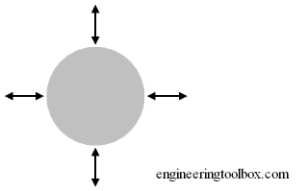
Gray Bodies and Emissivity Coefficients
For objects other than ideal blackbodies ('gray bodies') the Stefan-Boltzmann Law can be expressed as
q = ε σ T⁴ A (2)
where
ε = emissivity of the object (one for a black body)
For the gray body the incident radiation (also called irradiation) is partly reflected, absorbed or transmitted.

Slide 25
The emissivity coefficient - ε - for some common materials can be found in the table below. Note that the emissivity coefficients for some products varies with the temperature. As a guideline the emmisivities below are based on temperature 300 K.
Surface Material | Emissivity Coefficient - ε -
Alloy 24ST Polished | 0.09
Aluminum Commercial sheet | 0.09
Asphalt 0.93
Cadmium 0.02
Concrete | 0.85
Concrete, rough | 0.94
Concrete tiles | 0.63
Cotton Cloth | 0.77
http://www.engineeringtoolbox.com/emissivity-coefficients-d_447.html
Ice smooth 0.966
Water 0.95 - 0.963

Slide 26
Radiation Heat Transfer
Black Body
  absorptivity = α=1
  emissivity = ε=1
  ideal emissive power = e_{b}
Gray Body
  absorptivity < 1
  emissivity < 1
  emissive power<1

Slide 27
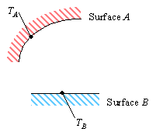
Radiative Heat Transfer
Consider the heat transfer between two surfaces, as shown in Figure.
What is the rate of heat transfer into Surface B?
To find this, we will first look at the emission from A to B.
Surface A emits radiation as described in
This radiation is emitted in all directions, and only a fraction of it will actually strike Surface B.
This fraction is called the shape factor, F.

