Slide 1
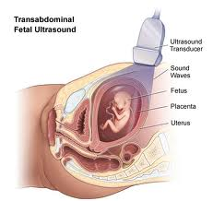
RAD 464
Amal Alsolai

Slide 2
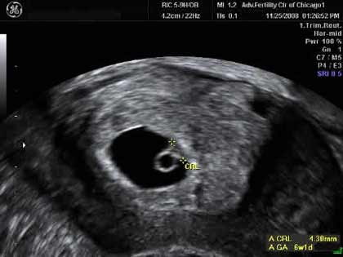
Obstetrics U/S
1 /First Trimester Scanning
6 wks TO 12 wks Scans

Slide 3
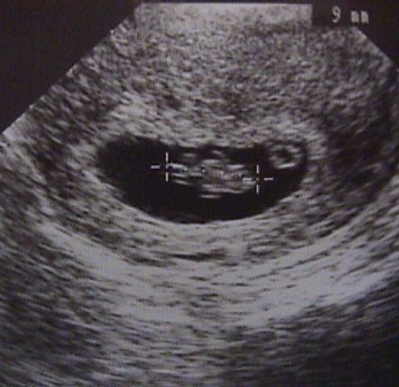
FETAL POLE /EMBERYO

Slide 4
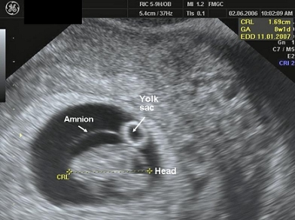
Sac with Embryo>CRL, yolk sac ,aminion

Slide 5
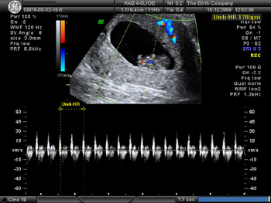
Fetal Viability .heart rate>doppler

Slide 6
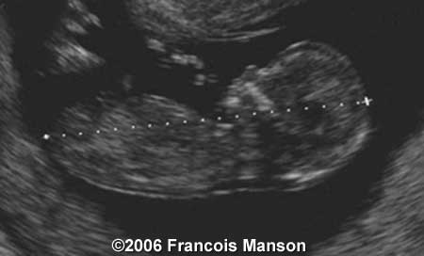
CRL, MEASUMENT

Slide 7
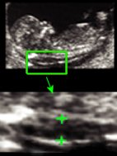
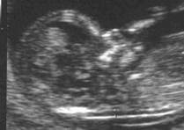
NT Measurment< nuchal translucency 10 to 14 weeks

Slide 8
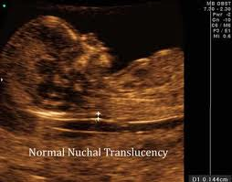

Slide 9
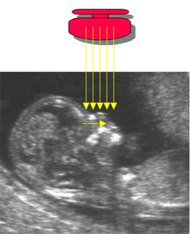
NASAL BONE

Slide 10
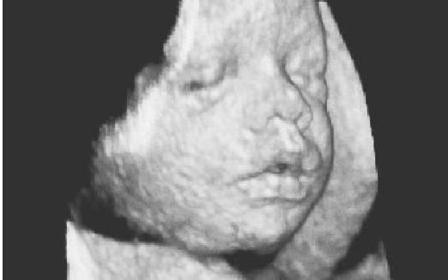
SECOND TRIMESTER SCANNING… 18 TO 40 WEEKS

Slide 11
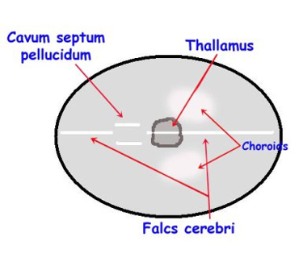
2/SECOND Trimester Scanning Fetal Measuments *Head circumferance

Slide 12
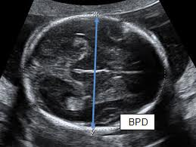

Slide 13
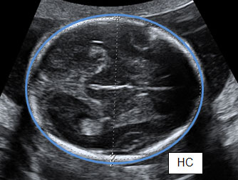

Slide 14
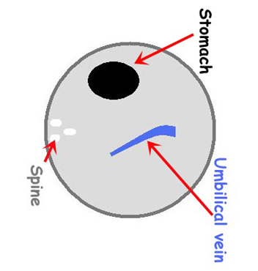
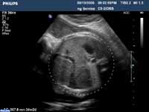
ABOMINAL CICUMFERANCE

Slide 15
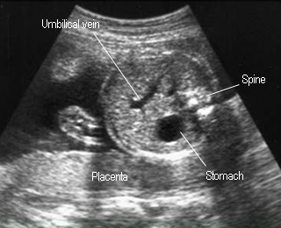

Slide 16
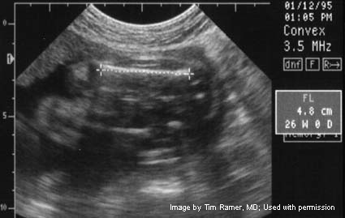
FEMURAL LENGTH

Slide 17
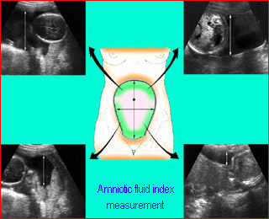
AMINIOTIC FLUID MEASUMENTS

Slide 18
