Slide 1
Qualitative Tests of Carbohydrate-II
BCH202 [Practical]

Slide 2
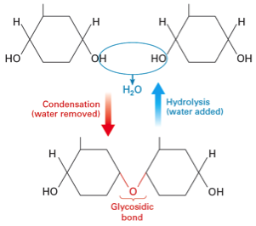
Complex carbohydrates :
Complex sugars consist of more than one unit of monosaccharide, it could be:
Disaccharides: contain two monosaccharide units.
Oligosaccharides: contain 3-9 monosaccharide units.
Polysaccharides: can contain more than 9 monosaccharide units.
Complex carbohydrates can be broken down into smaller sugar units through a process known as hydrolysis.

Slide 3
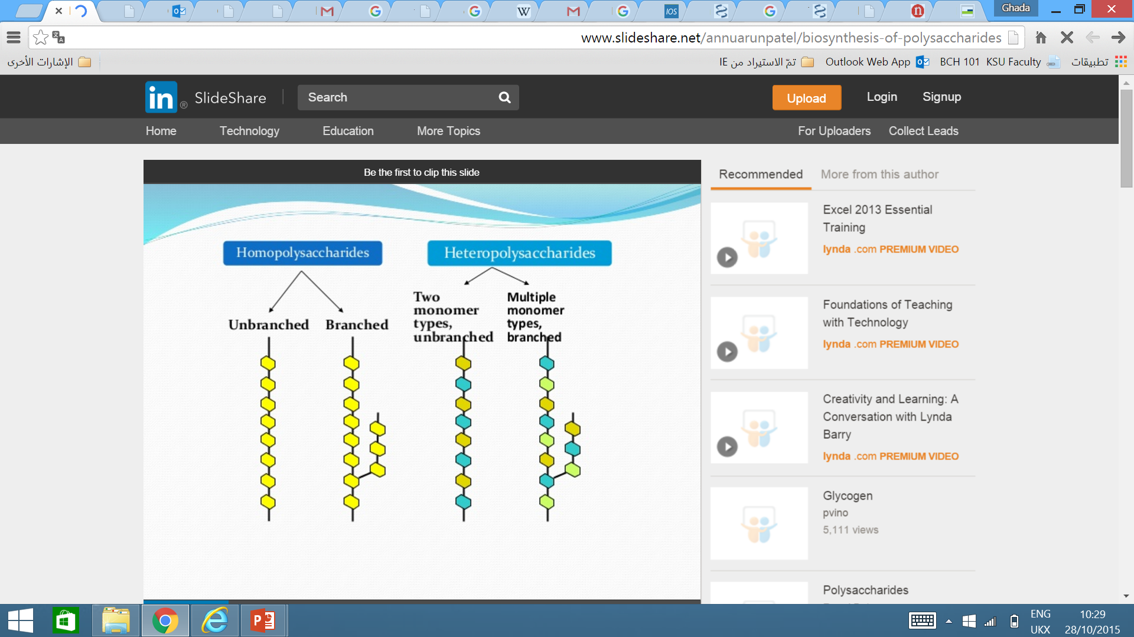
Polysaccharides:
Polysaccharides can either be :
homopolymeric (same repeating monosaccharide unit).
heteropolymeric (mixture of monosaccharaides).
Plants and animals store glucose in the form of very large
polysaccharide glucose homopolymers.
The glucose homopolymer present in plants to store glucose is called starch.
While the glucose homopolymer present in animal cells is called glycogen.

Slide 4
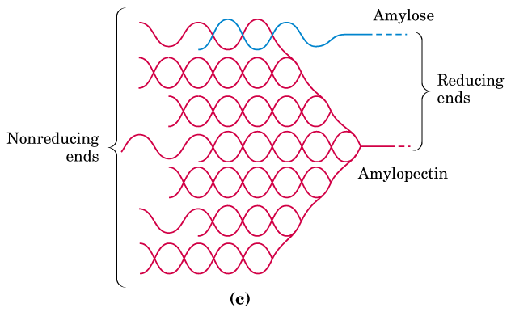
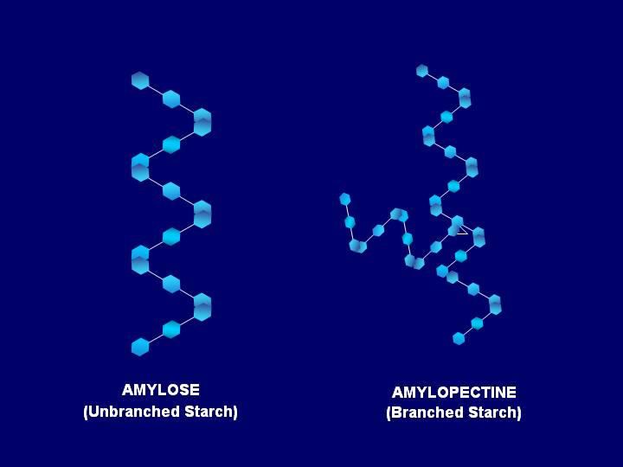
Starch:
Starch consists of two forms: amylose and amylopectin.
➔ Amylose is a Linear helical polymer of glucose linked by α-1,4 glycosidic bonds (100 units).
➔Amylopectin is a Branched polymer containing glucose linked by α-1,4 glycosidic bonds, branch points has α-1,6 glycosidic bonds, (100,000 units).

Slide 5
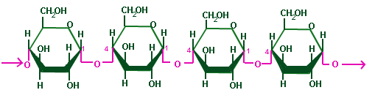
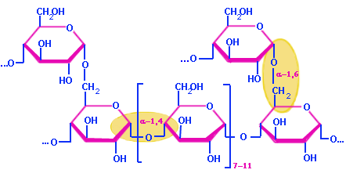
Amylose
Amylopectin

Slide 6
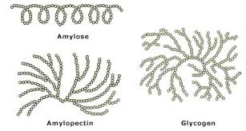
Glycogen:
Glycogen, is a branched polysacharide of D-glucose which contains both α(1→4) and α(1→6) is similar in structure to amylopectin.
➔ But glycogen has more α(1→6) branches.

Slide 7
Practical Part

Slide 8
Chemical properties of carbohydrates:
Sucrose hydrolysis Test.
The Iodine/Potassium Iodide Test.
Hydrolysis of Starch.
1
2
3

Slide 9
Experiment 1 : Sucrose hydrolysis Test
This test is used to hydrolyse sucrose (non-reducing disaccharide) to glucose and fructose (reducing monosaccharides).
Objective:
To identify the products of hydrolysis of sucrose (disaccharide).
Principle:
Sucrose is a non-reducing disaccharide, so it does not reduce the Cu++ solution (Bendict's) because the glycosidic bond is formed between the two hemiacetal bonds.
So, there is no free aldehydic or ketonic group to give positive reducing properties.
When glycosidic bond hydrolysed (in the presence of acid) the sucrose to: glucose + fructose (which are reducing sugars) are then able to give positive reducing test.

Slide 10
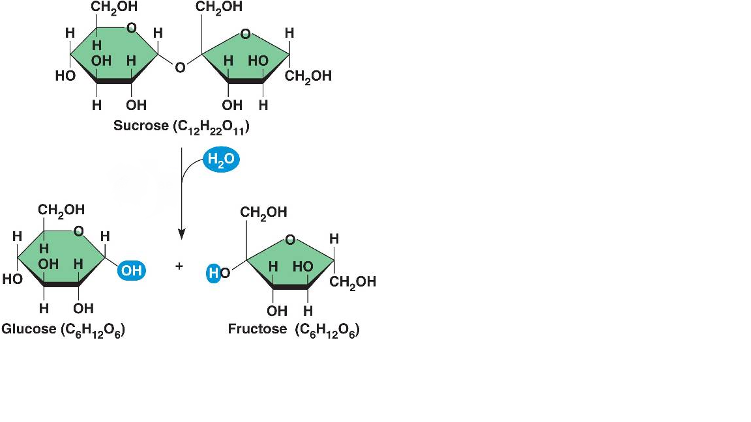
Non-reducing disaccharide
-ve result with benedict
Heating + acid
+ve result with benedict
Reducing monosaccharides

Slide 11
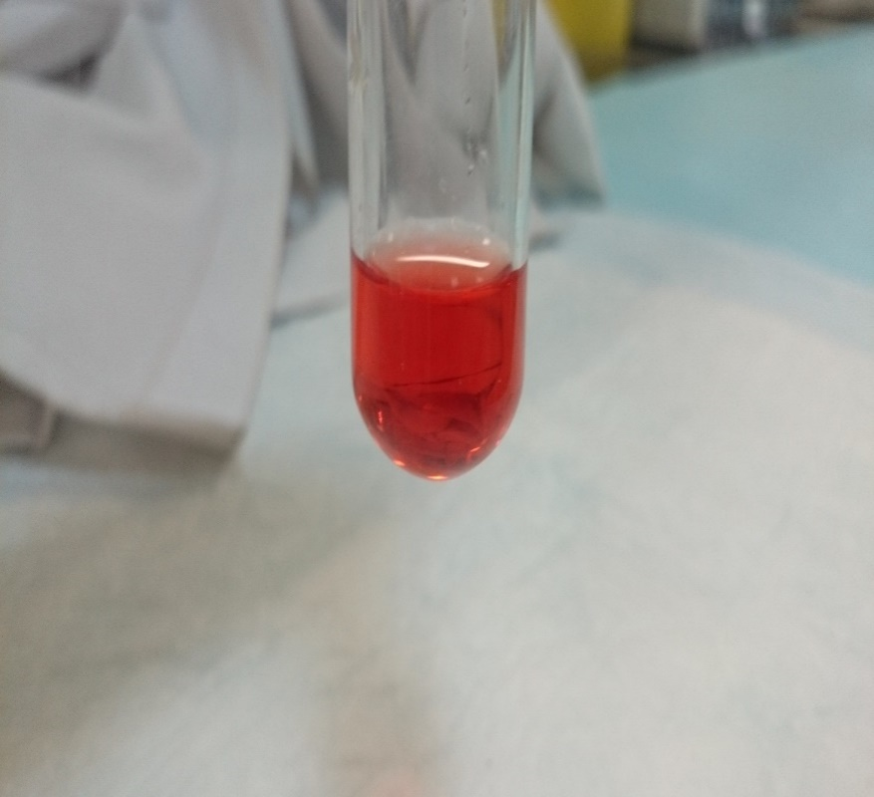
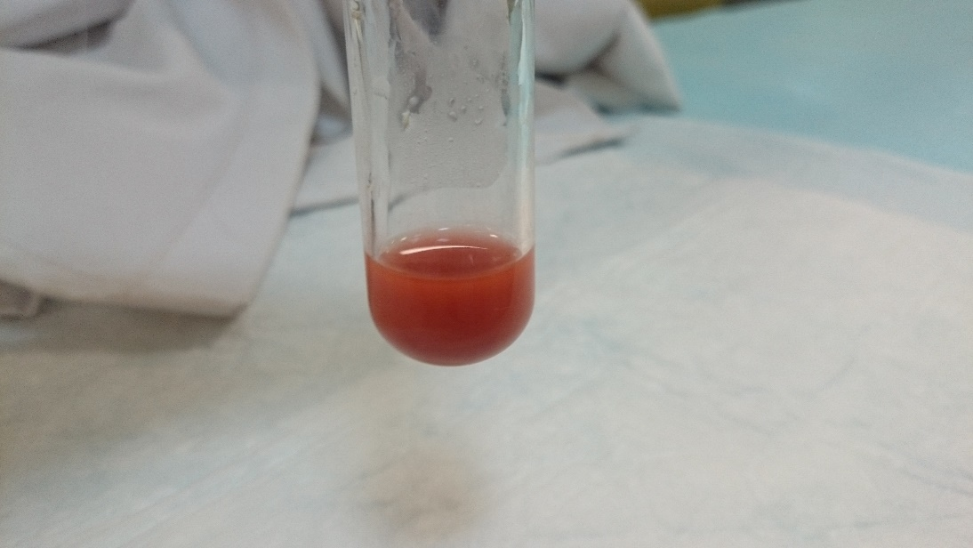
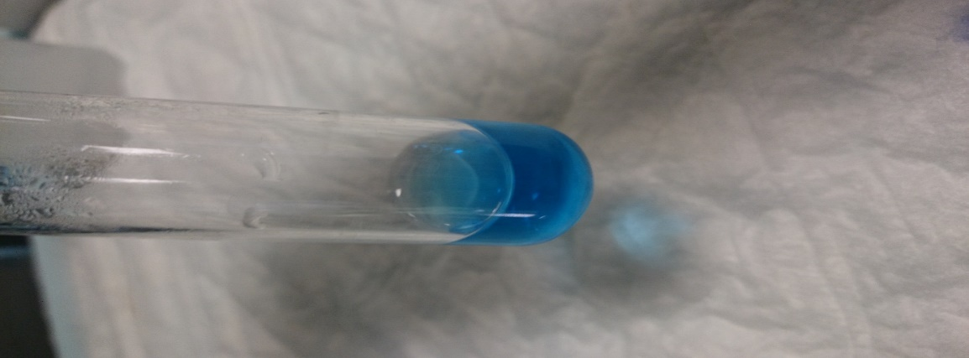
Sucrose + HCl
(+) Seliwanoff’s test
Sucrose + HCl
(+) Benedict’s test
Sucrose only
(-) Benedict’s test

Slide 12
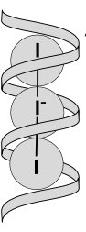
Experiment 2 : The Iodine/Potassium Iodide Test
Objective:
This test used to distinguish between polysaccharides and mono or oligosaccharides.
To detect the presence of starch in a sample.
Principle:
Starch forms deeply blue color complex with iodine.
Starch contains α- amylose, a helical saccharide polymer and amylopectin. Iodine forms a large complex with α-amylose helix.
This complex absorbs light and reflects the blue light only.
Simple oligosaccharides and mono saccharides do not form this complex.
Note:
Other polysaccharides like glycogen may give other colors (red).
Notes:
Amylose is a linear chain polymer that forms crystalline structures in the starch. When reacted with iodine, the iodine molecules enter the cavities of the crystalline structures and reflect the characteristic blue color. When you heat the starch solution, these crystalline structures are disrupted forming random chain, and hence, the loss of color. However, upon cooling, amylose has the ability, similar to many proteins, to refold into its crystalline form and hence the color is regained upon cooling.
Or
https://www.researchgate.net/post/Do_you_know_what_it_means_when_we_have_a_blue_black_color_with_lugol_but_it_disappears_few_minutes_later

Slide 13
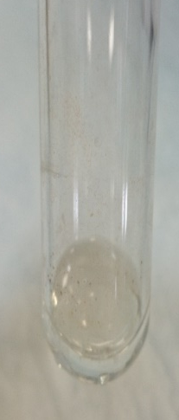
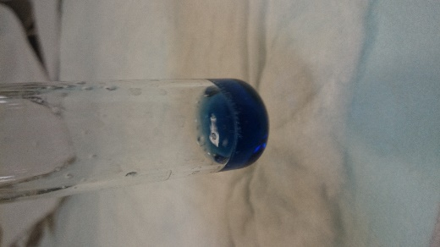
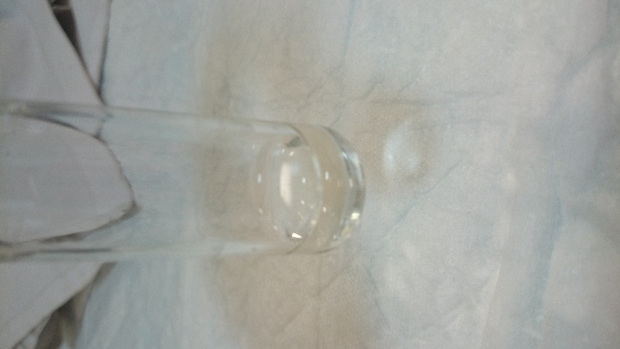
Heating
Glucose + iodine
(-ve)
Starch + iodine
(+ve)
Starch + iodine

Slide 14
Experiment 3: Hydrolysis of Starch
This experiment illustrates the conversion of starch (non-reducing sugar) to glucose (reducing sugar) by the action of hydrochloric acid at boiling point. The longer the starch is exposed to the acid the further hydrolysis proceeds.
Objective:
To establish the effect of concentrated HCl on a glycosidic bond in starch.
Principle:
Although starch has free hemiacetal in the terminal glucose residue, it has no reducing properties, because the percentage between the free residues is very low in comparison to the whole molecule.
Heating starch solution in acid medium hydrolysis the glycosidic bonds giving many free glucose residues ➔These glucose molecules give reducing properties to the hydrolysis product.

Slide 15
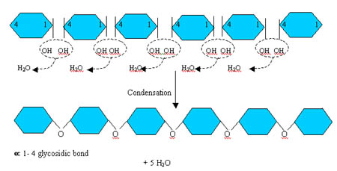
Non-reducing
Hydrolysis of glycosidic bond (HCl+heating)
Reducing

Slide 16
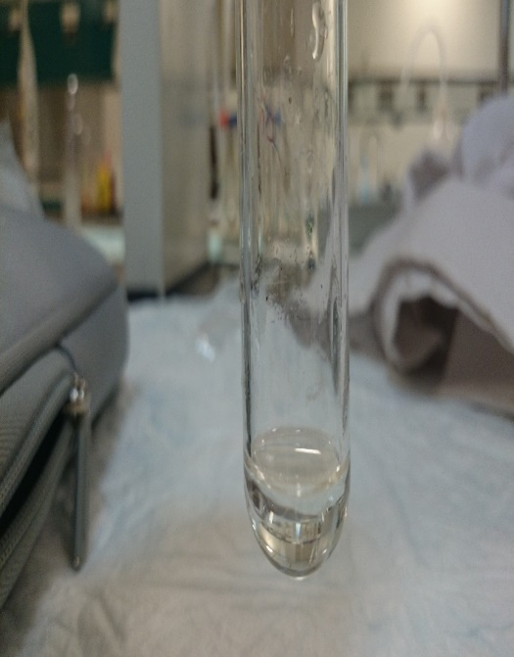

Starch with HCL
[After heating]
[-ve] Iodine test
[+] Benedict's test

