Slide 1
Principles of Surgical Treatment in Orthopedic Surgery
Dr. Abdulrahman Algarni, MD, SSC(Ortho), ABOS
Assist. Prof & Consultant Orthopedic and Arthroplasty Surgeon

Slide 2
Principles of Orthopedic Surgery
Orthopedic Procedures
Investigation

Slide 3
Principles of Orthopedic Surgery
PREPARATION
INTRAOPERATIVE RADIOGRAPHY
THE ‘BLOODLESS FIELD’
MEASURES TO REDUCE RISK OF INFECTION
THROMBOPROPHYLAXIS

Slide 4
PREPARATION
PLANNING : Operations must be carefully planned in advance.
Preoperative templating may be needed to help size and select the most appropriate implant.

Slide 5
PREPARATION
Preop templating is crucial in certain procedures eg THA, corrective osteotomies

Slide 6
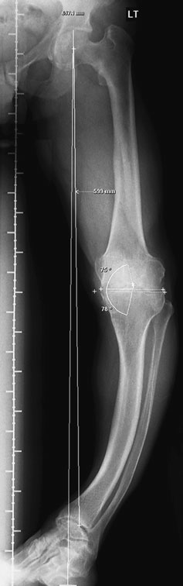
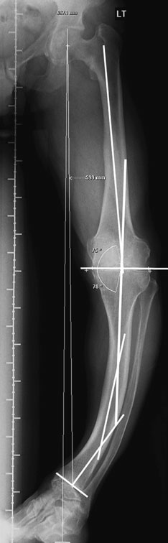
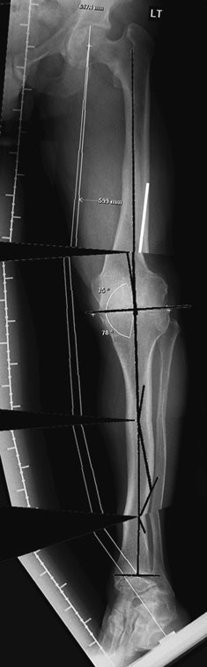
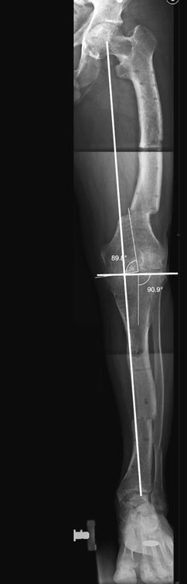
PREPARATION

Slide 7
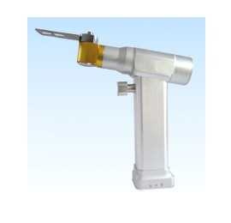
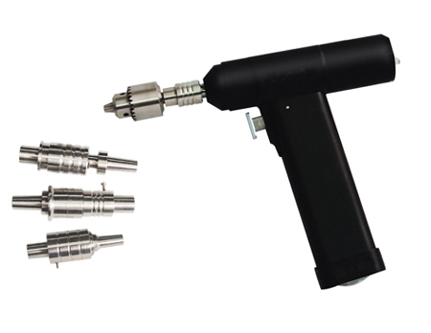
PREPARATION
EQUIPMENT
The basic set or requirements include: drills , osteotomes, saws, chisels, gouges
plates, screws and screwdrivers .

Slide 8
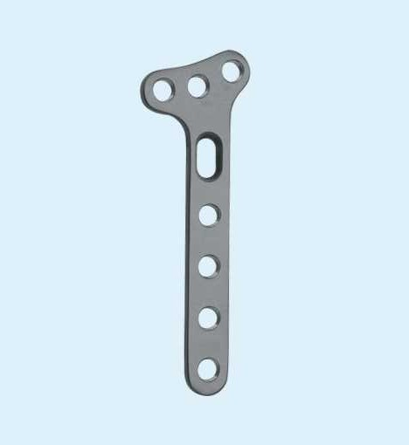
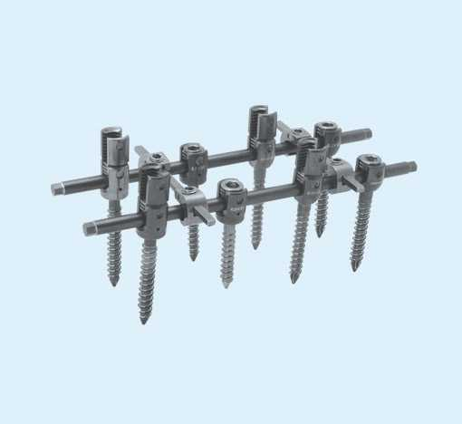
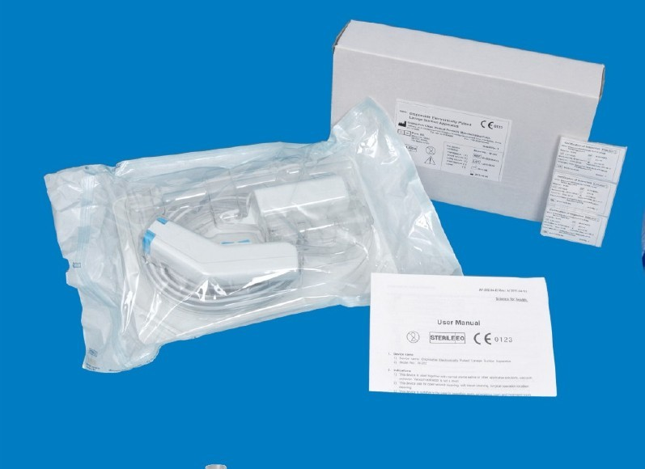
PREPARATION
Special implants and instruments : Arthroplasty, Spine Surgery

Slide 9
PREPARATION
Surgeon is responsible for ensuring that
the necessary instruments and implants are available in the OR before starting the surgery

Slide 10
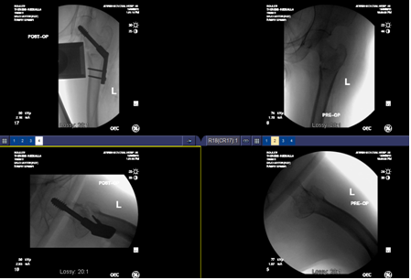
INTRAOPERATIVE RADIOGRAPHY
Often helpful and sometimes essential for certain procedures eg osteotomy, some ORIF, spine surgery

Slide 11
Intraoperative radiography
involves the risk of exposure to radiation; both the patient and surgeon are affected.
For the surgeon the risk is far greater
because of the repeated use of fluoroscopy.

Slide 12
Intraoperative radiography
Cumulative exposure
Total exposure varies with the type of procedure, number of the procedures
and the use protective measures.

Slide 13
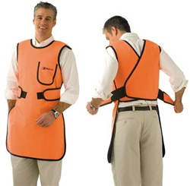
Intraoperative radiography
Lead aprons will reduce the effective dose received:
by a factor of 16 for AP projections
by a factor of 4–10 for lateral projections.

Slide 14
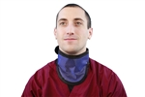

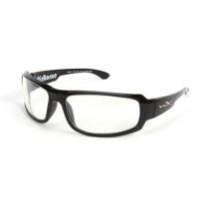
Intraoperative radiography
Using a thyroid shield decreases the dose 2.5 times.
Lead Glasses

Slide 15
MAGNIFICATION
Integral part of peripheral nerve and hand surgery.
Operating loupes range in power from 2–6 × magnification.

Slide 16
MAGNIFICATION
The operating microscope allows much greater magnification with a stable field of view.

Slide 17
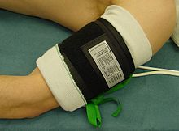
The Bloodless Field
Tourniquet :prevents bleeding and allows operations on limbs to be done more rapidly and accurately

Slide 18
The Bloodless Field
pneumatic cuff :at least as wide as the diameter of the limb.
Chemical burn risk: skin preparation fluid leaks beneath the cuff.

Slide 19
The Bloodless Field
EXSANGUINATION
Elevation of the lower limb at 60 degrees for 30 seconds will reduce the blood volume by 45%.
The ‘squeeze’ method: additional 20%.

Slide 20
The Bloodless Field
Tourniquet pressure of 100-150 mmHg above systolic BP.
hypertensive, obese or very muscular patients

Slide 21
The Bloodless Field
Tourniquet time: 2-3 hours
safer to keep this under 2 hours.
Time of application is recorded and the surgeon is informed of the elapsed time at regular intervals

Slide 22
The Bloodless Field
Complications :
nerve injury (due to ischaemia or compression ), skin burns

Slide 23
MEASURES TO REDUCE RISK OF
INFECTION
Prophylactic Antibiotic: broad-spectrum Abx, adequate dose, 20 min. before skin incision and repeated as needed.
Hair removal: cream or electric shaver

Slide 24

MEASURES TO REDUCE RISK OF
INFECTION
Skin cleaning: Alcohol-based, Iodine or Chlorhexidine
Chlorhexidine is more effective,having longer residual activity and maintaining efficacy in the presence of blood and serum.

Slide 25

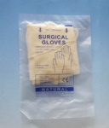
MEASURES TO REDUCE RISK OF
INFECTION
Drapes
Gowns
Gloves: latex and non-latex, Double gloving

Slide 26
THROMBOPROPHYLAXIS
Venous thromboembolism (VTE) is the commonest complication of lower limb surgery.
DVT,PE and the later complication of
chronic venous insufficiency.

Slide 27
THROMBOPROPHYLAXIS
Risk factors : history of previous thrombosis, increasing age and obesity.
The orthopedic surgery is highly thrombogenic.

Slide 28
THROMBOPROPHYLAXIS
DVT occurs most frequently in the veins of the calf
less often in the proximal veins of the thigh and pelvis ? PE ? Fatal PE

Slide 29
THROMBOPROPHYLAXIS
PREVENTION
General measures :individual patient risk assessment, neuraxial anaesthesia, avoid rough surgical technique and early mobilization

Slide 30
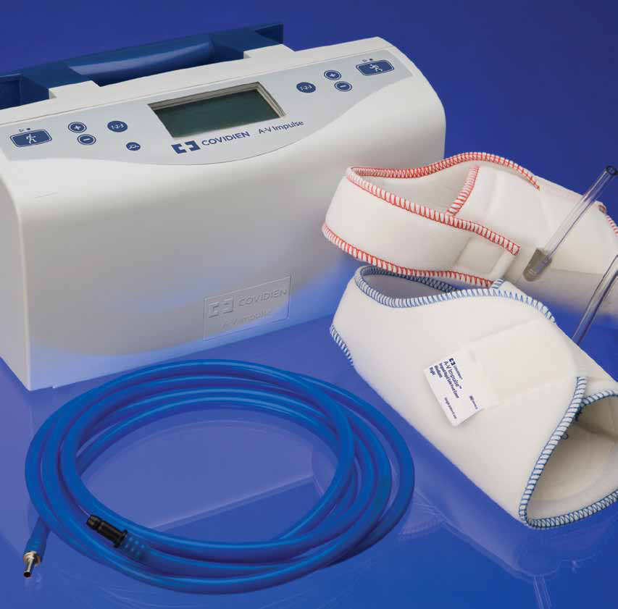
THROMBOPROPHYLAXIS
Physical methods
Graduated compression stockings
Foot pump
Inferior vena cava filters

Slide 31
THROMBOPROPHYLAXIS
Chemical methods
-Low molecular weight heparin (LMWH)
-Direct anti-Xa inhibitors and direct thrombin
Inhibitors :rivaroxaban (XARELTO®)
-Warfarin
-Aspirin
-Unfractionated heparin

Slide 32
Orthopedic Procedures
Reduction and Fixation
Osteotomy
Arthroscopy
Arthrotomy
Arthroplasty
Arthrodesis
Amputations

Slide 33
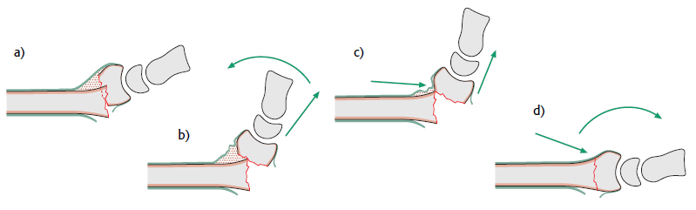
Reduction and Fixation
Reduction: closed or open

Slide 34
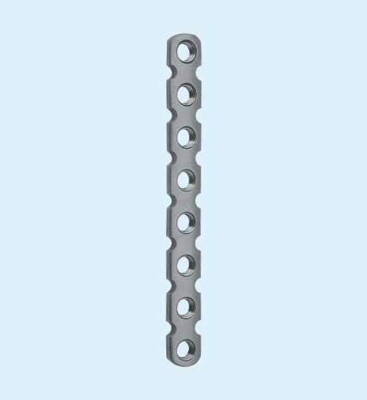
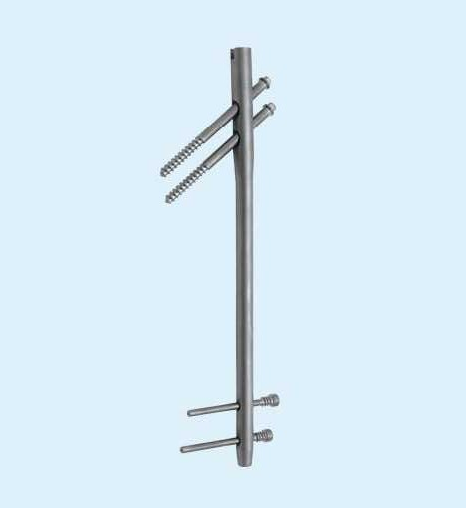
Reduction and Fixation
Fixation: Extramedullary or Intramedullary

Slide 35
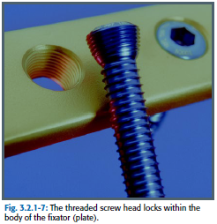
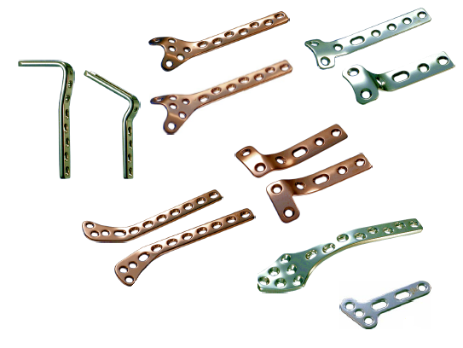
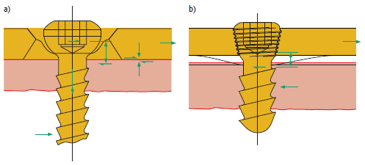
Reduction and Fixation
Extramedullary Fixation: K-wires, cables, screws, plates, external fixator

Slide 36
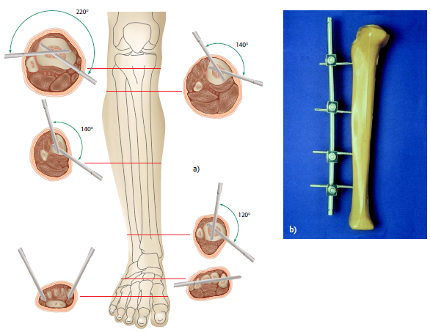
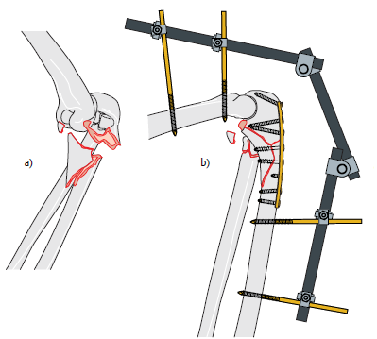
Reduction and Fixation
Extramedullary Fixation: external fixator

Slide 37
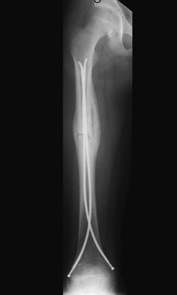
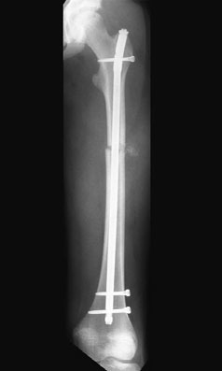
Reduction and Fixation
Intramedullary Fixation: flexible or rigid

Slide 38
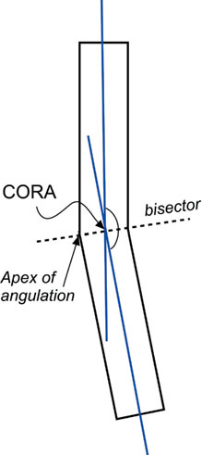
Osteotomy
-To correct deformity

Slide 39
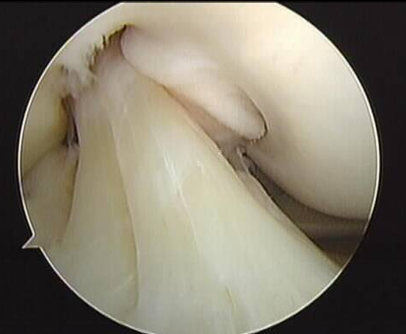
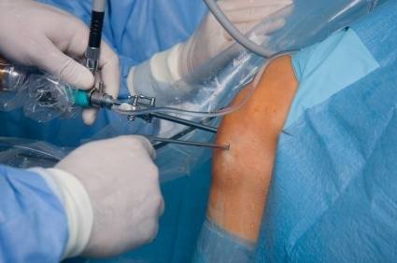
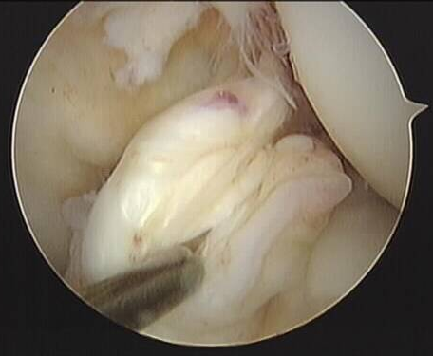
Arthroscopy
Diagnostic & therapeutic

Slide 40
Arthrotomy
Synovial biopsy
Synovectomy
Drainage of haematoma or an abscess
Removal of loose body

Slide 41
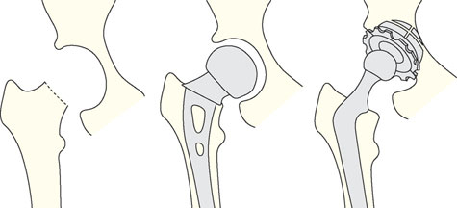
Arthroplasty
Excision Arthroplasty
Parital Arthroplasty
Total Arthroplasty

Slide 42
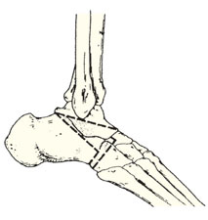
Arthrodesis
Rarely done
For foot

Slide 43
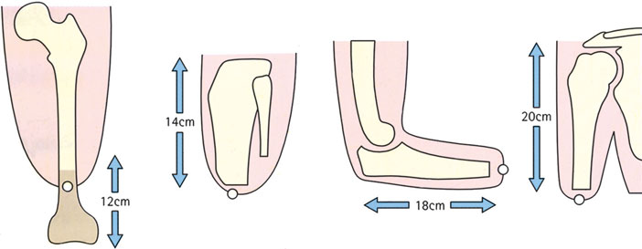
Amputation
Dead (or dying) limb: trauma, crush injury
Dngerous limb: malignant tumours,
Others: chronic Osteomyelitis or severe loss of function

Slide 44
Thank you

