Slide 1
Primer Design

Slide 2
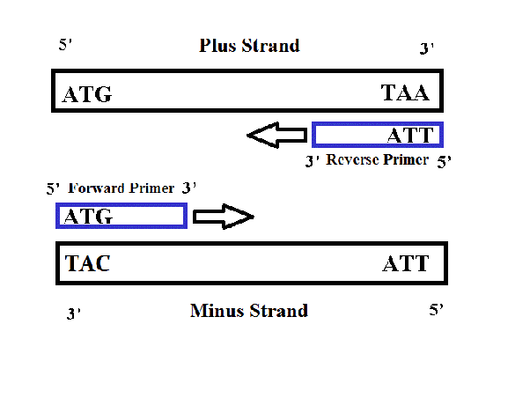
Primers, are short pieces of single-stranded DNA that are complementary to the target sequence in the template . are usually 17 to 28 nucleotides long . And are necessary because polymerase enzymes can not start replicating from nothing.
In the PCR method, a pair of primers hybridizes (anneal) with the sample DNA (template), and defines the region that will be amplified, resulting in millions and millions of copies in a very short timeframe. Primers are also used in DNA sequencing and other experimental processes.
Notes:
https://www.genome.gov/genetics-glossary/Primer
https://www.addgene.org/protocols/primer-design/

Slide 3
How to Design Primers for PCR

Slide 4
primers should generally have the following properties:
Length of e 17-28 bases in length.
50-60% G/C content. GC content:GC% = [(G + C) / (G + C + A + T)] x 100
End with 1-2 or(1-3) G/C, to promote binding. This is known as a GC Clamp. Be mindful not to have too many. repeating G or C bases, as this can cause primer-dimer formation.
Melting temperature (Tm) of 50-60°C. or 65-75 in some resources. Tm = 2(A+T) + 4(G+C)
Primers, should have a Tm within 5°C of each other
Do not forget to design forward and reverse primers. why?
The primer should be relatively simple, and contain no internal secondary structure to avoid internal folding.(Try to avoid regions of secondary structure and have a balanced distribution of GC-rich and AT-rich domains.
Notes:
https://www.thermofisher.com/blog/behindthebench/pcr-primer-design-tips/
Repeat (ex: ATATATAT) ➔ misprime.
Runs (ex: AGCGGGGGAT) ➔ misprime.

Slide 5
Annealing Temperature (Ta):
The primer melting temperature is the estimate of the DNA-DNA hybrid stability and critical in determining the annealing temperature.
Depends directly on length and GC composition of the primers.
Too high Ta ➔ produce insufficient primer-template hybridization.
Too low Ta ➔ lead to non-specific products caused by a high number of base pair mismatches.

Slide 6
Design Primers for PCR, using “primer 3” software:

Slide 7
What is BLAST?
Basic Local Alignment Search Tool(BLAST), finds regions of similarity between biological sequences. The program compares nucleotide or protein sequences to sequence databases and calculates the statistical significance.
https://blast.ncbi.nlm.nih.gov/Blast.cgi

Slide 8
5’-CTCCTTCCCCTAGTCCCCAGAAACAGGAGGTCCCTACTCCCGCCCGAGATCCCGACCCGGACCCCTAGGT GGGGGACGCTTTCTTTCCTTTCGCGCTCTGCGGGGTCACGTGTCGCAGAGGAGCCCCTCCCCCACGGCCT CCGGCACCGCAGGCCCCGGGATGCTAGTGCGCAGCGGGTGCATCCCTGTCCGGATGCTGCGCCTGCGGTA GAGCGGCCGCCATGTTGCAACCGGGAAGGAAATGAATGGGCAGCCGTTAGGAAAGCCTGCCGGTGACTAA CCCTGCGCTCCTGCCTCGATGGGTGGAGTCGCGTGTGGCGGGGAAGTCAGGTGGAGCGAGGCTAGCTGGC CCGATTTCTCCTCCGGGTGATGCTTTTCCTAGATTATTCTCTGGTAAATCAAAGAAGTGGGTTTATGGAG GTCCTCTTGTGTCCCCTCCCCGCAGAGGTGTGGTGGCTGTGGCATGGTGCCAAGCCGGGAGAAGCTGAGT-3’

Slide 9
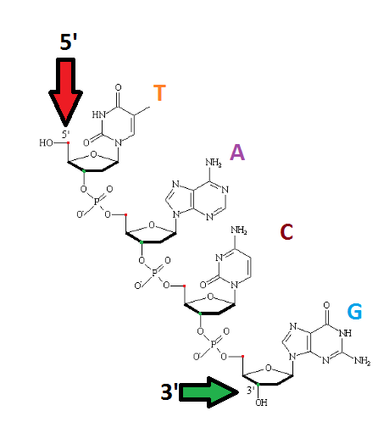

Slide 10
Example:
Determine your target region.
The segment that you want to amplified is in the red square
5’
3’
3’
5’

Slide 11
2. Design the primers:
5’
3’
3’
5’

Slide 12
5’
3’
3’
5’
5’
3’
3’
5’
Forward primer:
5’
3’
Reverse primer:
3’
5’

Slide 13
3. Extension:
72 °C
5’
3’
3’
5’
5’
3’
3’
5’
Taq DNA polymerase

Slide 14
3. Extension:
72 °C
5’
3’
3’
3’
5’
5’
3’
3’
3’
5’
Cycle # 1:
1 DNA amplified to 2 DNA

Slide 15
AGE results
Marker

Slide 16
PCR application:
Genotyping.
RT-PCR.
Cloning.
Mutation detection.
Sequencing.
Microarrays.
Forensics.
Paternity testing.

