Slide 1
Performance of Pumps in Series and in Parallel
The operating point of any pumping system depend on the system pressure head loss curve and the available pump characteristics.
If the losses are large the pump must be capable to produce the required head.
Sometimes it would be cheaper to have more than one pump than just one huge pump.
Pumps can be connected in series and in parallel
If the pumps are connected in series, for the same flow rate the total increase in pressure is higher than the case of a single pump

Slide 2
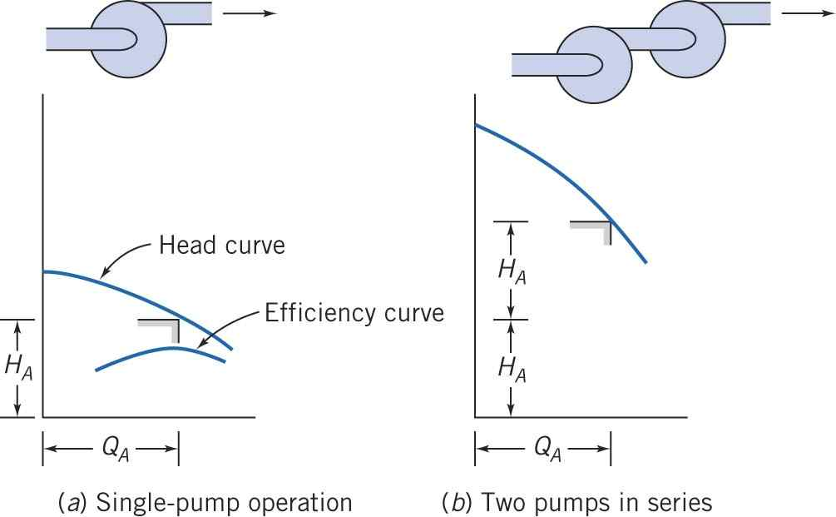
Performance of Pumps in Series and in Parallel
Pumps connected in series

Slide 3
Performance of Pumps in Series and in Parallel
Pumps connected in parallel

Slide 4
Performance of Pumps in Series and in Parallel
Fluid Machines:
How to compute the pumps’ performance ?
Use the energy equation
$$H_{p}={\left(\frac{p}{ρg}+\frac{{\overline{V}}^{2}}{2g}+z\right)}_{d}−{\left(\frac{p}{ρg}+\frac{{\overline{V}}^{2}}{2g}+z\right)}_{s}$$
Where the subscript d and s denote the discharge and suction sides, respectively. Write the energy equation for each pump.
If the pumps are connected in series, the flow rate is the same in both and the discharge conditions for the first one are the same as the suction for the second one.
If the pumps are connected in parallel the discharge conditions are the same.

Slide 5
Performance of Pumps in Series and in Parallel
Fluid Machines:
Similarity Rules
For two different pumps to be dynamically similar, assuming geometric similarity, we must have the flow coefficient satisfy the equality,
$$\frac{Q_{1}}{ω_{1}D_{1}^{3}}=\frac{Q_{2}}{ω_{2}D_{2}^{3}}$$
The dimensionless head and power coefficients are functions of the flow coefficient, such that
$$\frac{h}{ω^{2}D^{2}}=f_{1}\left(\frac{Q}{ωD^{3}},\frac{ωD^{2}}{μ}\right) and\frac{𝒫}{ρω^{3}D^{5}}=f_{2}\left(\frac{Q}{ωD^{3}},\frac{ωD^{2}}{μ}\right)$$
$H=h/g$. Hence for completely similar flow coefficient we have,
$$\frac{h_{1}}{ω_{1}^{2}D_{1}^{2}}=\frac{h_{2}}{ω_{2}^{2}D_{2}^{2}}$$
And
$$\frac{𝒫_{1}}{{ρω}_{1}^{3}D_{1}^{5}}=\frac{𝒫_{2}}{ρω_{2}^{3}D_{2}^{5}}$$

