Slide 1
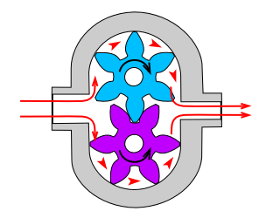
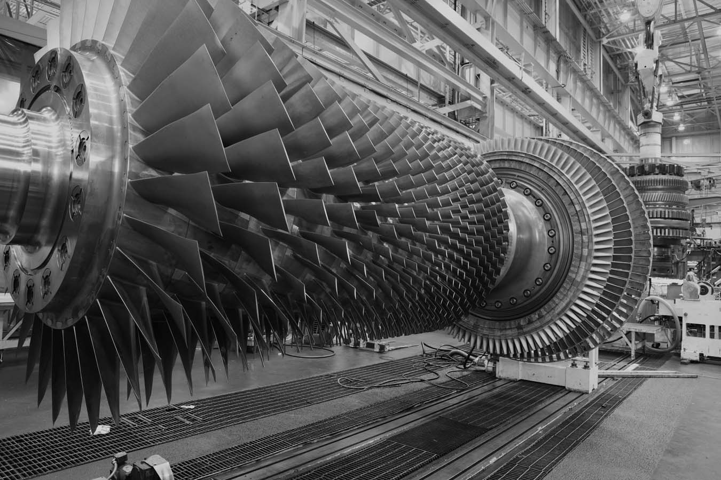
Performance of Centrifugal Pumps
Fluid Machines:
Positive displacement
Energy transfer occurs as a result of the movement of the volume boundaries in which the fluid is enclosed in.
Dynamic
These are devices that use vanes or blades to direct the fluid. The fluid is not confined to a volume
Dynamic
Positive Displacement Gear pump

Slide 2
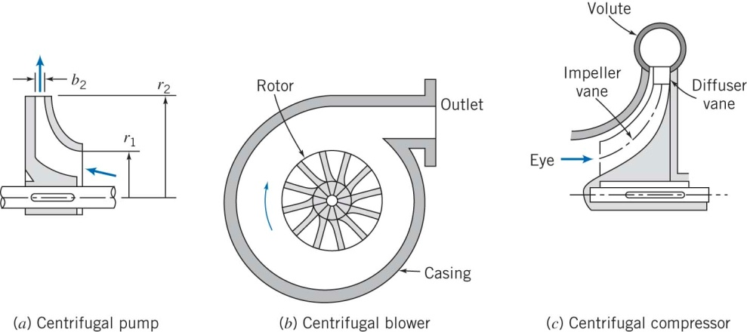
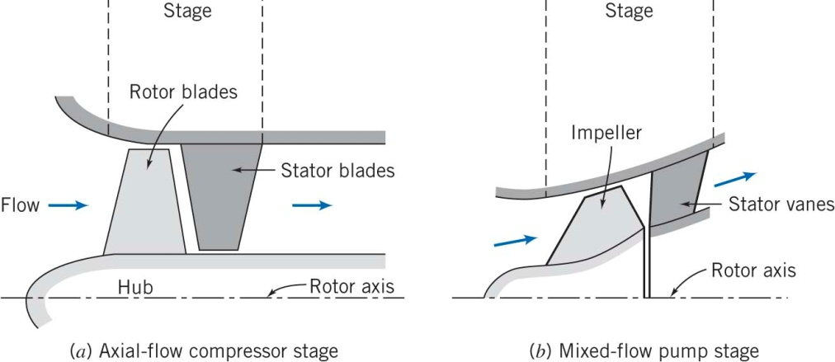
Performance of Centrifugal Pumps
Fluid Machines:
Fluid machines can also be categorized according to the geometry of the fluid path into,
Radial (centrifugal)
Flow direction is mainly in the radial direction
Axial
Flow direction is mainly in the axial direction

Slide 3
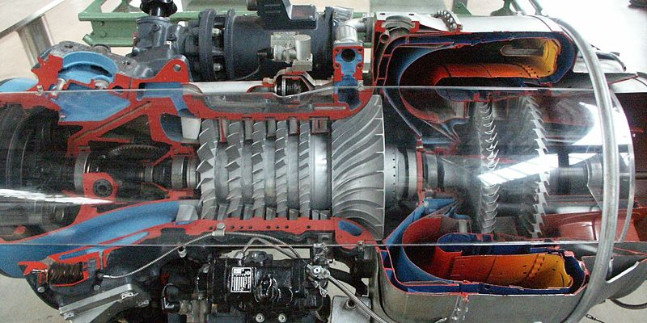
Performance of Centrifugal Pumps
Fluid Machines: Turboprop Engine
Centrifugal Compressor
Axial Compressor
Axial Turbine

Slide 4
Performance of Centrifugal Pumps
Fluid Machines:
Theoretical principle: Angular Momentum Concept
The angular momentum is defined as the moment of momentum
$$\vec{H}=\iiint_{𝒱}{\vec{r}×\vec{V}ρd𝒱}$$
The conservation of angular momentum applied to a CV
$$\frac{∂}{∂t}\iiint_{CV}{\vec{r}×\vec{V}ρd𝒱}+\iint_{CS}{\vec{r}×\vec{V}ρ\vec{V}∙d\vec{A}}={\vec{T}}_{Shaft}+\vec{r}×{\vec{F}}_{s}+\int_{CV}{\vec{r}×\vec{g}dm}$$
This is a general equation applied to any fluid machine. A much simpler equation can be obtained using few simplifying assumptions.

Slide 5
Performance of Centrifugal Pumps
Fluid Machines:
Theoretical principle: Angular Momentum Concept
$$\frac{∂}{∂t}\iiint_{CV}{\vec{r}×\vec{V}ρd𝒱}+\iint_{CS}{\vec{r}×\vec{V}ρ\vec{V}∙d\vec{A}}={\vec{T}}_{Shaft}+\vec{r}×{\vec{F}}_{s}+\int_{CV}{\vec{r}×\vec{g}dm}$$
Assumptions;
Steady flow
Torque due to body forces and viscous forces are negligible
Torque due to pressure changes is neglected
We get
$$\iint_{CS}{\vec{r}×\vec{V}ρ\vec{V}∙d\vec{A}}={\vec{T}}_{Shaft}$$
If we apply this equation to a CV enclosing the fluid machine and further assuming that the flow enters the machine at radius $r_{1}$ and exits at $r_{2}$.

Slide 6
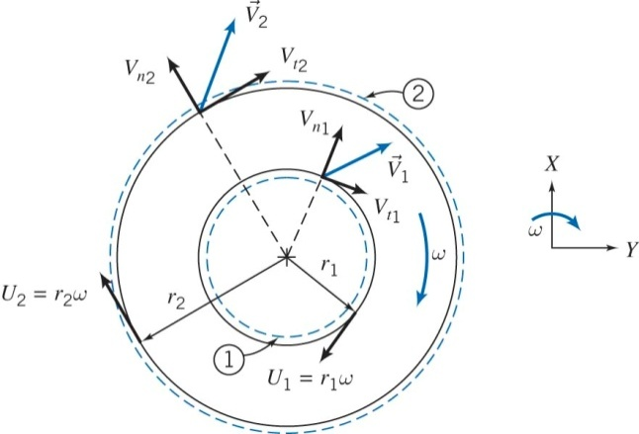
Performance of Centrifugal Pumps
Fluid Machines:
$$\iint_{CS}{\vec{r}×\vec{V}ρ\vec{V}∙d\vec{A}}={\vec{T}}_{Shaft}$$
Flow is uniform at inlet and exit.
Axe of rotation is in the z-direction.
Applying the above assumptions we get,
$${\vec{T}}_{Shaft}=T_{shaft}\hat{k}=\left(r_{2}V_{t_{2}}−r_{1}V_{t_{1}}\right)\dot{m}\hat{k}$$
Hence, in scalar form
$$T_{shaft}=\left(r_{2}V_{t_{2}}−r_{1}V_{t_{1}}\right)\dot{m}$$
This is called the , the Euler Turbomachine Equation
And the rate of work done is given by,
$$\dot{W}=\vec{ω}∙{\vec{T}}_{Shaft}$$
$$\dot{W}=ωT_{shaft}=ω\left(r_{2}V_{t_{2}}−r_{1}V_{t_{1}}\right)\dot{m}$$
OR
$$\dot{W}=\left(ωr_{2}V_{t_{2}}−ωr_{1}V_{t_{1}}\right)\dot{m}=\left(U_{2}V_{t_{2}}−U_{1}V_{t_{1}}\right)\dot{m}$$

Slide 7
Performance of Centrifugal Pumps
Fluid Machines:
$$\dot{W}=\left(ωr_{2}V_{t_{2}}−ωr_{1}V_{t_{1}}\right)\dot{m}=\left(U_{2}V_{t_{2}}−U_{1}V_{t_{1}}\right)\dot{m}$$
If we divide by $\dot{m}g$ we get,
$$H=\frac{\dot{W}}{\dot{m}g}=\frac{1}{g} \left(U_{2}V_{t_{2}}−U_{1}V_{t_{1}}\right)$$
This is defined as the theoretical pump head (rate of work done per rate of weight flow rate).
For a centrifugal pump assuming the inlet flow is axial, $V_{t_{1}}=0$, then
$$H=\frac{U_{2}V_{t_{2}}}{g}$$
How to evaluate $V_{t_{2}}$?

Slide 8
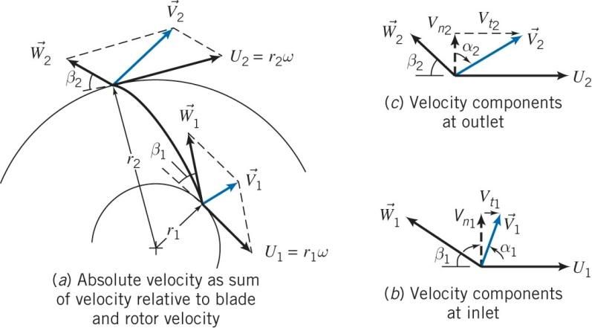
Performance of Centrifugal Pumps
Fluid Machines:
How to evaluate $V_{t_{2}}$?
$$V_{t_{2}}=U_{2}−W_{2}\cos{β_{2}}=U_{2}−\frac{V_{n_{2}}}{\sin{β_{2}}}\cos{β_{2}}=U_{2}−V_{n_{2}}\cot{β_{2}}$$
$$H=\frac{U_{2}\left(U_{2}−V_{n_{2}}\cot{β_{2}}\right)}{g}$$

Slide 9
Performance of Centrifugal Pumps
Fluid Machines:
How to evaluate $V_{t_{2}}$?
$$H=\frac{U_{2}\left(U_{2}−V_{n_{2}}\cot{β_{2}}\right)}{g}$$
For an impeller of width w, the volume flow rate is,
$$Q=πD_{2}w V_{n_{2}}$$
Hence, we can write the theoretical head as,
$$H=\frac{U_{2}^{2}}{g}−\frac{U_{2}\cot{β_{2}}}{πD_{2}wg} Q$$
Then we can write in general,
$$H=C_{1}−C_{2}Q$$
Where $C_{1}$ and $C_{2}$are functions of the machine geometry and speed.
$$C_{1}=\frac{U_{2}^{2}}{g}, C_{2}=\frac{U_{2}\cot{β_{2}}}{πD_{2}wg}$$

Slide 10
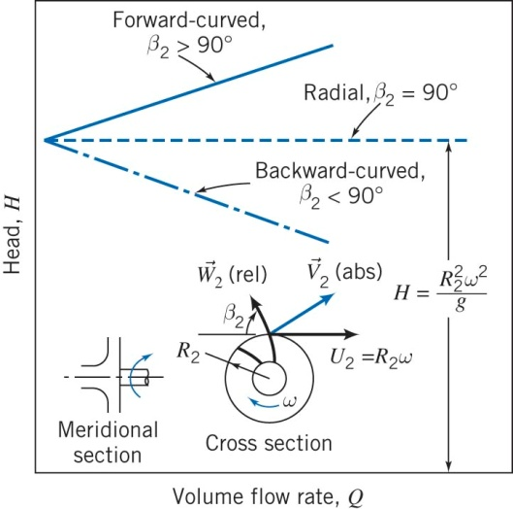
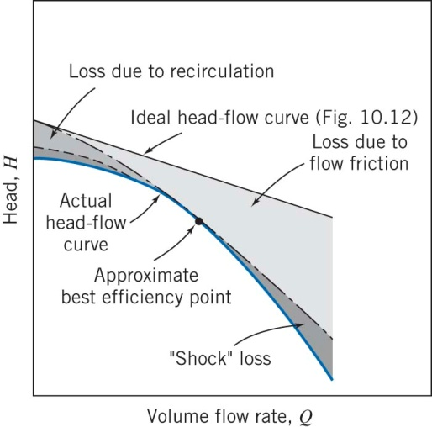
Performance of Centrifugal Pumps
Fluid Machines:

Slide 11
Performance of Centrifugal Pumps
Fluid Machines:
How to compute real pump performance ?
Use the energy equation
$$H_{p}={\left(\frac{p}{ρg}+\frac{{\overline{V}}^{2}}{2g}+z\right)}_{d}−{\left(\frac{p}{ρg}+\frac{{\overline{V}}^{2}}{2g}+z\right)}_{s}$$
Where the subscript d and s denote the discharge and suction sides, respectively.
$$H_{p}=\left(\frac{p_{d}−p_{s}}{ρg}\right)+\left(\frac{{\overline{V}}_{d}^{2}−{\overline{V}}_{s}^{2}}{2g}\right)+\left(z_{d}−z_{s}\right)$$
$$H_{p}=H_{static}+H_{kinetic}+H_{elevation}$$
In the current experiment, the total pressure head, $H_{p}$, is calculated by measuring $H_{static},H_{kinetic}, H_{elevation} at a constant speed.$

Slide 12
Performance of Centrifugal Pumps
Fluid Machines:
Similarity Rules
For two different pumps to be dynamically similar, assuming geometric similarity, we must have the flow coefficient satisfy the equality,
$$\frac{Q_{1}}{ω_{1}D_{1}^{3}}=\frac{Q_{2}}{ω_{2}D_{2}^{3}}$$
The dimensionless head and power coefficients are functions of the flow coefficient, such that
$$\frac{h}{ω^{2}D^{2}}=f_{1}\left(\frac{Q}{ωD^{3}}\right) and\frac{𝒫}{ρω^{3}D^{5}}=f_{2}\left(\frac{Q}{ωD^{3}}\right)$$
$H=h/g$. Hence for similar flow coefficient we have,
$$\frac{h_{1}}{ω_{1}^{2}D_{1}^{2}}=\frac{h_{2}}{ω_{2}^{2}D_{2}^{2}}$$
And
$$\frac{𝒫_{1}}{{ρω}_{1}^{3}D_{1}^{5}}=\frac{𝒫_{2}}{ρω_{2}^{3}D_{2}^{5}}$$

