Slide 1
Performance of A Gas Turbine Unit
Shereef sadek
ME 322
Thermo-Fluids Lab. 1

Slide 2
Performance of A Gas Turbine Unit
Engineering advancement pioneered the gas turbine in the early 1900s.
Gas turbines started to be for stationary electric power generation in 1930s. Gas turbines revolutionized airplane propulsion in the 1940s.
Since1990s are currently the economic and environmentally preferred choice for power generation plants particularly in the parts of the world where fuel supply is easy.

Slide 3

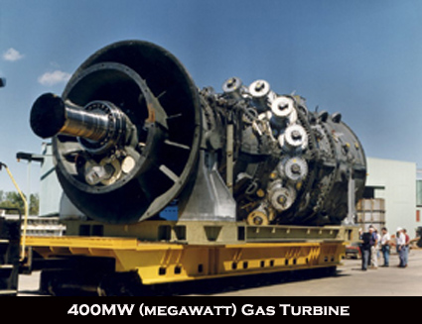
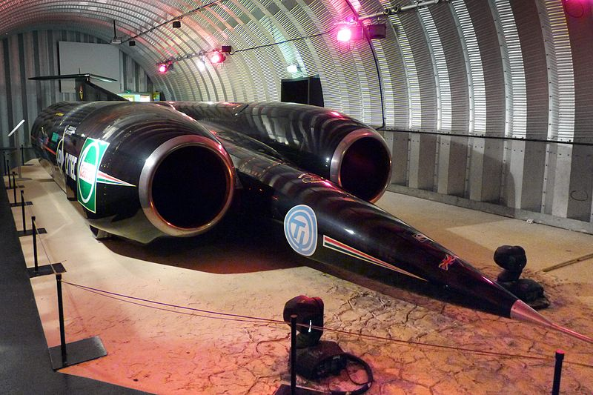
Performance of A Gas Turbine Unit
Uses of Gas Turbines

Slide 4
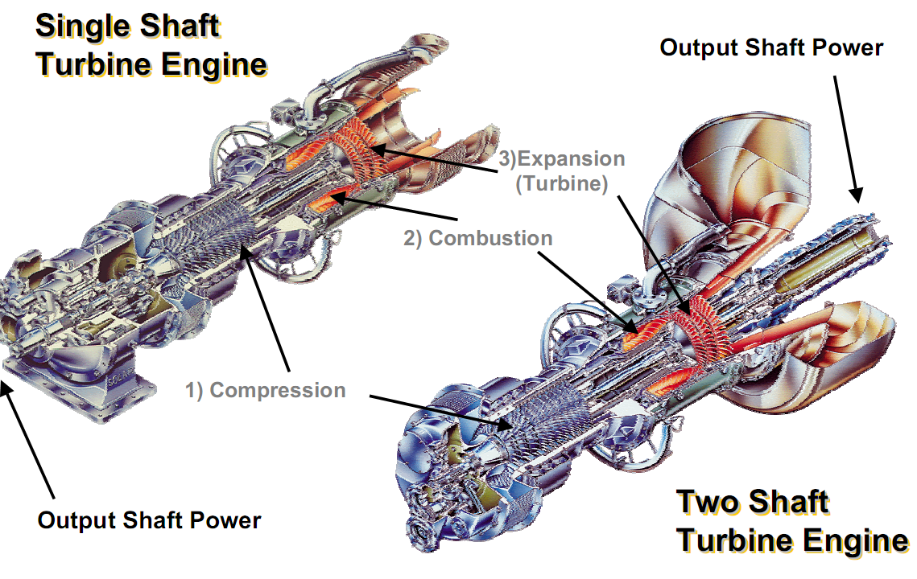
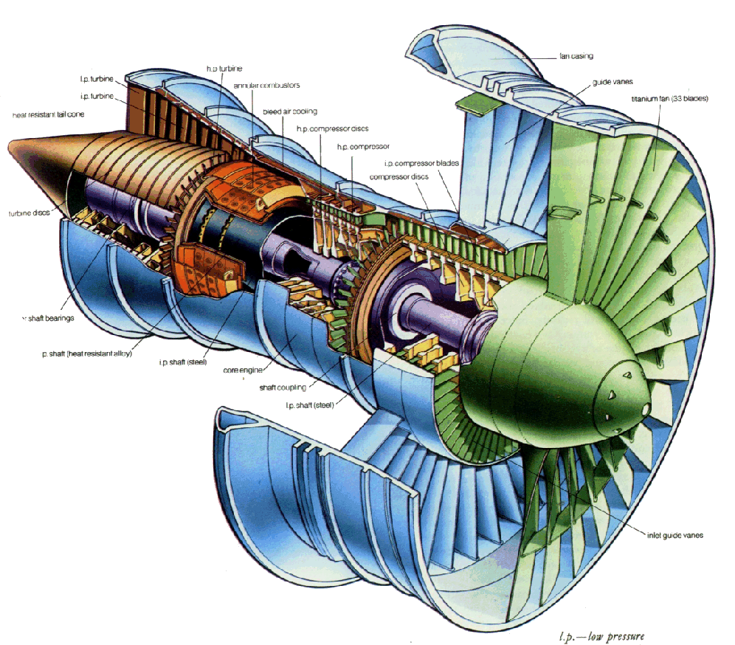
Performance of A Gas Turbine Unit
Types of Gas Turbine Engines
Turbojet
Turboshaft
TurboFan

Slide 5
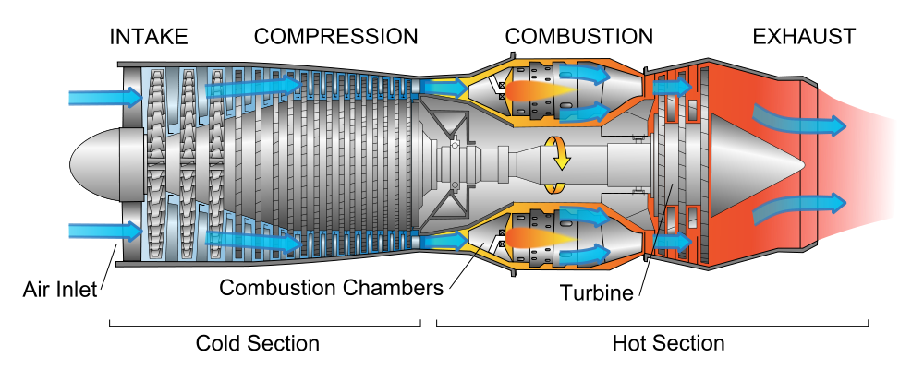
Performance of A Gas Turbine Unit
Basic Components (Gas Generator)

Slide 6
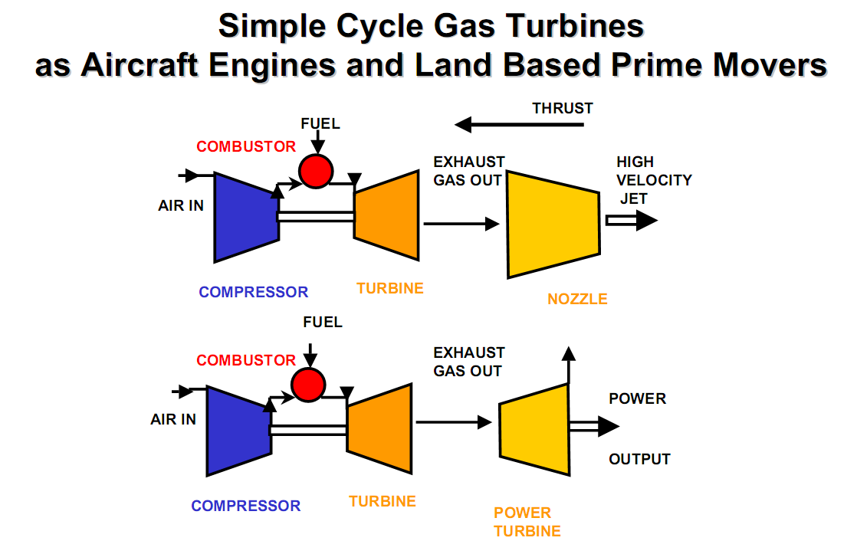
Performance of A Gas Turbine Unit

Slide 7
Performance of A Gas Turbine Unit
Components:
  Compressor
    The compressor sucks in air form the atmosphere and compresses it to pressures in the range of 15 to 20 bar. The compressor consists of a number of rows of blades mounted on a shaft. This is something like a series of fans placed one after the other. The pressurized air from the first row is further pressurized in the second row and so on. Stationary vanes between each of the blade rows guide the air flow from one section to the next section. The shaft is connected and rotates along with the main gas turbine.
  Combustor
    This is an annular chamber where the fuel burns and is similar to the furnace in a boiler. The air from the compressor is the Combustion air. Burners arranged circumferentially on the annular chamber control the fuel entry to the chamber. The hot gases in the range of 1400 to 1500 °C leave the chamber with high energy levels. The chamber and the subsequent sections are made of special alloys and designs that can withstand this high temperature.

Slide 8
Performance of A Gas Turbine Unit
Components:
  Turbine
    The turbine does the main work of energy conversion. The turbine portion also consists of rows of blades fixed to the shaft. Stationary guide vanes direct the gases to the next set of blades. The kinetic energy of the hot gases impacting on the blades rotates the blades and the shaft. The blades and vanes are made of special alloys and designs that can withstand the very high temperature gas. The exhaust gases then exit to exhaust system through the diffuser. The gas temperature leaving the turbine is in the range of 500 to 550 °C. The gas turbine shaft connects to the generator to produce electric power.

Slide 9
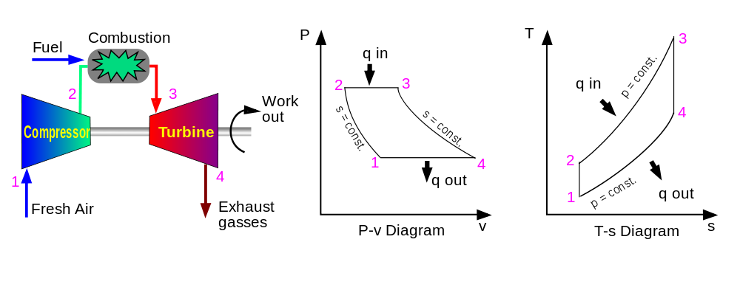
Performance of A Gas Turbine Unit
Principal of Operation
  The gas turbine is based on the Brayton Cycle

Slide 10
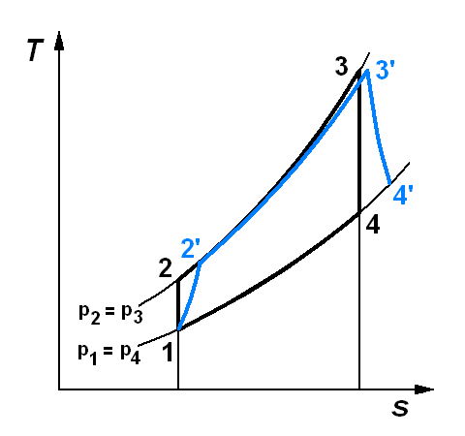
Performance of A Gas Turbine Unit
Principal of Operation
  The gas turbine is based on the Brayton Cycle

Slide 11
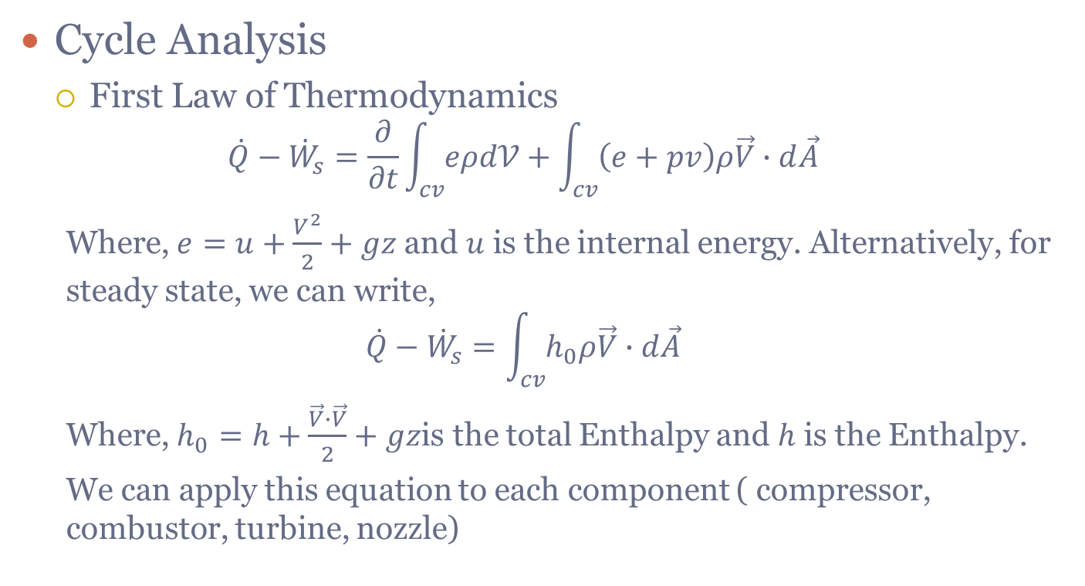
Performance of A Gas Turbine Unit
Cycle Analysis
  First Law of Thermodynamics
  $$\dot{Q}−{\dot{W}}_{s}=\frac{∂}{∂t}\int_{cv}{eρd𝒱}+\int_{cv}{\left(e+pv\right)ρ\vec{V}∙d\vec{A}}$$
  Where, $e=u+\frac{V^{2}}{2}+gz$ and $u$ is the internal energy. Alternatively, for steady state, we can write,
  $$\dot{Q}−{\dot{W}}_{s}=\int_{cv}{h_{0}ρ\vec{V}∙d\vec{A}}$$
  Where, $h_{0}=h+\frac{\vec{V}∙\vec{V}}{2}+gz$is the total Enthalpy and $h$ is the Enthalpy.
  We can apply this equation to each component ( compressor, combustor, turbine, nozzle)

Slide 12
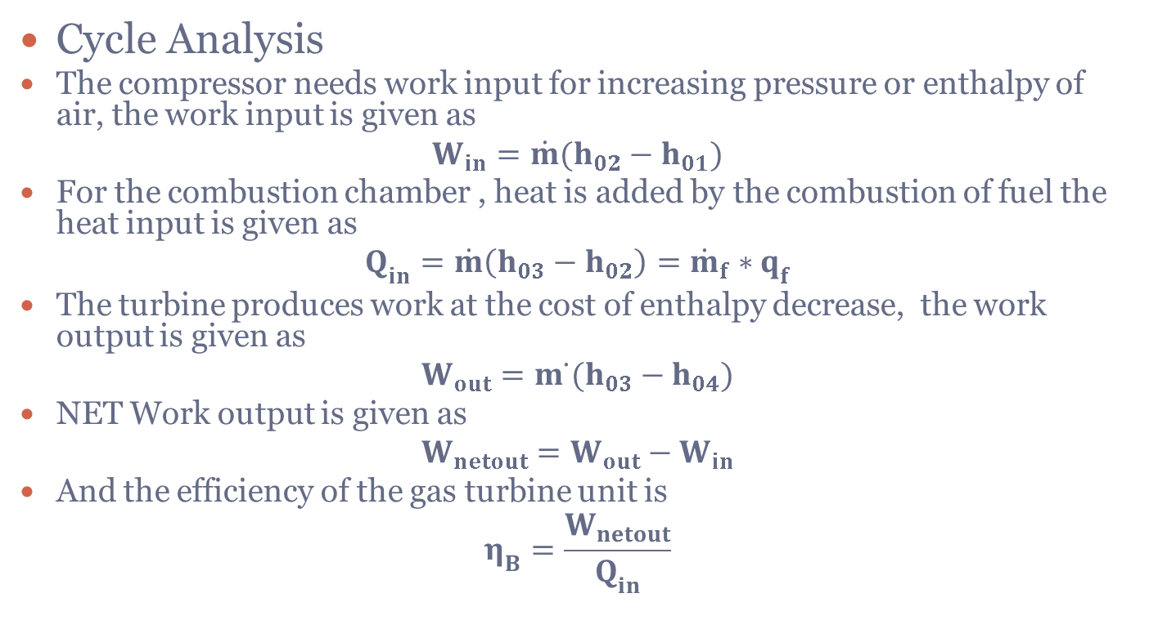
Performance of A Gas Turbine Unit
Cycle Analysis
The compressor needs work input for increasing pressure or enthalpy of air, the work input is given as
$$W_{in}=\dot{m}(h_{02}−h_{01})$$
For the combustion chamber , heat is added by the combustion of fuel the heat input is given as
$$Q_{in}=\dot{m}\left(h_{03}−h_{02}\right)={\dot{m}}_{f}∗q_{f}$$
The turbine produces work at the cost of enthalpy decrease, the work output is given as
$$W_{out}=m ̇(h_{03}−h_{04})$$
NET Work output is given as
$$W_{netout}=W_{out}−W_{in}$$
And the efficiency of the gas turbine unit is
$$η_{B}=\frac{W_{netout}}{Q_{in}}$$

Slide 13
Performance of A Gas Turbine Unit
Other configurations
  The output of a gas turbine unit is effected by:
    Low Inlet temperature of Compressor
    Regeneration
    Reheating
  Low inlet Compressor Temperature:
    It is observed from the hs diagram that as inlet temperature of the compressor decreases the enthalpy difference between the point 2 and point 1 decreases because isobaric lines on the hs diagram converges towards origin of this diagram. This is also proved from Gibbs equations. This means work input decrease as inlet temperature of the compressor decreases.
    This can be achieved cooling the air admitted to
    the compressor is cooled to approximately to 15⁰C by
    chillers.
    The most common methods of inlet cooling are,
    (1) Air Inlet Chillers
    (2) High Pressure Fogging
    (3) Evaporative Coolers
    (4) Fog Intercooling

Slide 14
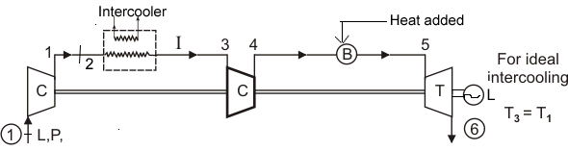
Performance of A Gas Turbine Unit
Brayton Cycle with intercooling
  The net work output of a gas turbine power plant is the difference of turbine power output minus the compressor power input. If compressor power input is decreased the net output of the power plant will increase and so also will the efficiency of the plant. To achieve this compressor is replaced by a two stage compressor and in between the air is cooled in an intercooler and it is again compressed in the second stage.

Slide 15
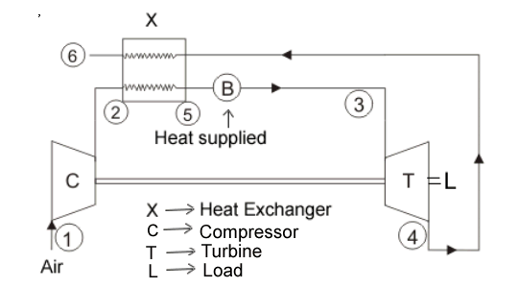
Performance of A Gas Turbine Unit
Brayton Cycle with regeneration
  In gas-turbine engines, the temperature of the exhaust gas leaving the turbine is often considerably higher than the temperature of the air leaving the compressor. Therefore, the high-pressure air leaving the compressor can be heated by transferring heat to it from the hot exhaust gases in a counter-flow heat exchanger, which is also known as a regenerator or recuperator. The thermal efficiency of the Brayton cycle increases as a result of regeneration since the portion of energy of the exhaust gases that is normally rejected to the surroundings is now used to preheat the air entering the combustion chamber. This, in turn, decreases the heat input (thus fuel) requirements for the same net work output. The highest temperature occurring within the regenerator is the temperature of the exhaust gases leaving the turbine and entering the regenerator.

Slide 16
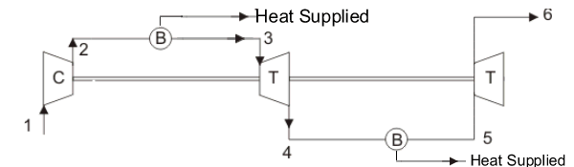
Performance of A Gas Turbine Unit
Brayton Cycle with reheating
  The work output of a turbine operating between two pressure levels can be increased by expanding the gas in stages and reheating it in between – that is, utilizing multistage expansion with reheating.1 This process involves dividing the turbine into two parts, a high-pressure and a low-pressure turbine. After the gas passes through the high-pressure turbine it is extracted from the turbine and admitted to a second combustor. Reheated gas flow into the low-pressure turbine, which may be on a separate shaft, or both turbines and the compressor, may be connected to a common shaft. This is accomplished without raising the maximum temperature in the cycle. As the number of stages is increased, the expansion process becomes nearly isothermal.

Slide 17
Performance of A Gas Turbine Unit
Brayton Cycle with intercooling, regeneration and reheating

Slide 18
Performance of A Gas Turbine Unit
Brayton Cycle with intercooling, regeneration and reheating
  The simple-cycle efficiencies of early gas turbines were practically doubled by Incorporating Intercooling, regeneration (or recuperation), and reheating. The back work ratio of a gas-turbine cycle improves as a result intercooling and reheating. In a gas-turbine power plants intercooling and reheating are always used in conjunction with cogeneration. These improvements, of course, come at the expense of increased initial and operation costs, and they cannot be justified unless the decrease in fuel costs offsets the increase in other costs.

Slide 19
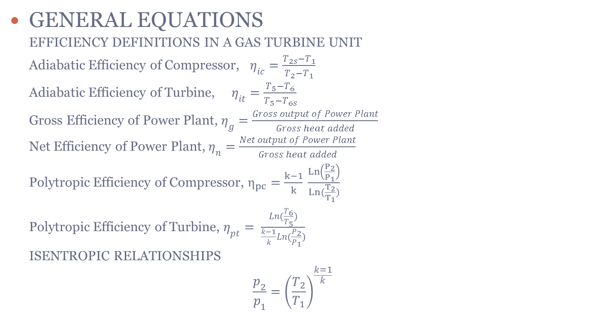
Performance of A Gas Turbine Unit
GENERAL EQUATIONS
  EFFICIENCY DEFINITIONS IN A GAS TURBINE UNIT
  Adiabatic Efficiency of Compressor, $η_{ic}=\frac{T_{2s}−T_{1}}{T_{2}−T_{1}}$
  Adiabatic Efficiency of Turbine, $η_{it}=\frac{T_{5}−T_{6}}{T_{5}−T_{6s}}$
  Gross Efficiency of Power Plant, $η_{g}=\frac{Gross output of Power Plant}{Gross heat added}$
  Net Efficiency of Power Plant, $η_{n}=\frac{Net output of Power Plant}{Gross heat added}$
  Polytropic Efficiency of Compressor, $η_{pc}=\frac{k−1}{k} \frac{Ln\left(\frac{P_{2}}{P_{1}}\right)}{Ln(\frac{T_{2}}{T_{1}})}$
  Polytropic Efficiency of Turbine, $η_{pt}= \frac{Ln(\frac{T_{6}}{T_{5}})}{\frac{k−1}{k}Ln(\frac{P_{2}}{P_{1}})}$
  ISENTROPIC RELATIONSHIPS
  $$\frac{p_{2}}{p_{1}}={\left(\frac{T_{2}}{T_{1}}\right)}^{\frac{k=1}{k}}$$

