Slide 1
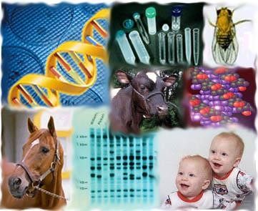
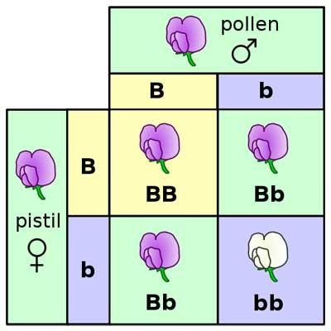
Molecular Genetics (342 Zoo)

Slide 2
Lecturer Information
General Information
Prof. Saad Alkahtani
Professor of molecular genetics
College of science/Zoology Department/Building 5 Basement Floor AB105
Email: salkahtani@ksu.edu.sa
Website: https://faculty.ksu.edu.sa/ar/salkahtani
Office hours: Sunday-Thursday 10am – 1pm

Slide 3
What is genetics?
The branch of biology that deals with heredity, especially the mechanisms of hereditary transmission , and the variation of inherited characteristics among similar or related organisms.
Genetics is the branch of biology that deals with heredity and variation.
Heredity : The genetic transmission of characteristics from parent to offspring.

Slide 4
Definitions of the gene
The gene is the unit of genetic information that controls a specific aspect of the phenotype.
The gene is the unit of genetic information that specifies the synthesis of one polypeptide.
The gene is segments of DNA that encode proteins (functional or structural product).
Each gene is located on a particular region of a chromosome and has a specific ordered sequence of nucleotides (the building blocks of DNA).
Genes are the basic functional units of heredity.

Slide 5
Genetic code and protein synthesis
(From gene to protein)
Before the primary transcript can leave the nucleus it is modified in various ways during RNA processing before the finished mRNA is go to the cytoplasm.

Slide 6
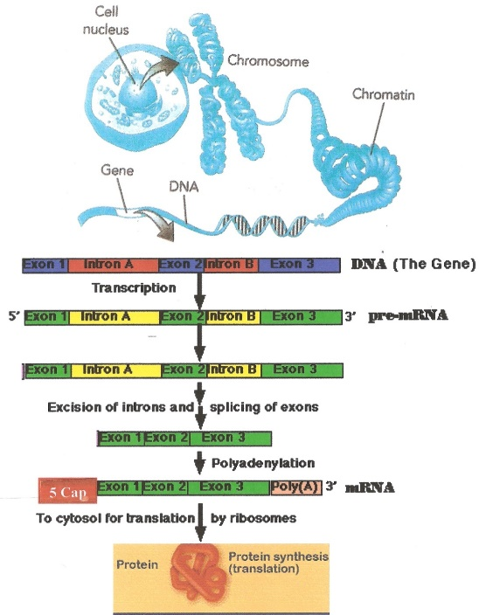

Slide 7
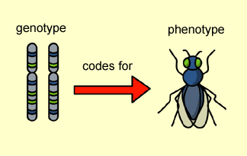
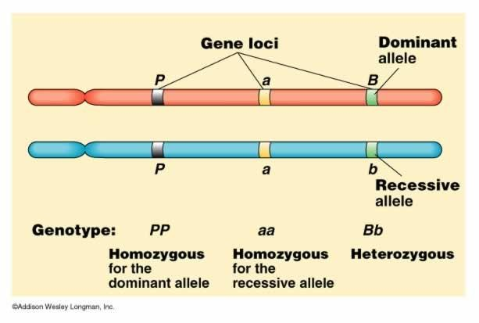

Slide 8
Genetic Material
Consisting of either RNA (a few viruses) or DNA (all other organisms), genetic material stores the fundamental information necessary to life. Information that controls reproduction, development, behavior, etc …

Slide 9
The Search for the Molecular Basis of Heredity
What is the genetic material?
Is it nucleic acid or protein?
Is it DNA or RNA?

Slide 10
Timeline of events
كيف تم اكتشاف أن الاحماض النووية هي المادة الوراثية ؟
عن طريق العديد من التجارب التي عملت منذ مطلع القرن العشرين. الجدول يوضح الطريق الى الحلزون المزدوج
الباحث | المساهمة | التاريخ
Friedrich Miescher | عزل مادة Nuclein من أنوية الخلايا الدموية البيضاء | 1869
F.Griffith | أثبت قدرة البكتيريا على التحول من سلالة إلى أخرى | 1928
Hershey, Chase | أثبتا ان رنا الفيروس هو المادة الوراثية وليس البروتين | 1950
Chargaff | اكتشف مكونات الدنا ونسبها (تركيزاتها) ومواقعها | 1950
Watson & Crick | أثبتا أن للدنا بنية حلزونية مزدوجة | 1953

Slide 11
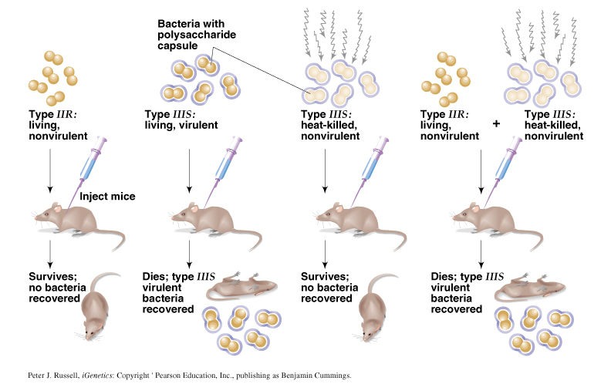
Frederick Griffith’s Transformation Experiment - 1928
“transforming principle” demonstrated with Streptococcus pneumoniae
Griffith hypothesized that the transforming agent was a “IIIS” protein.

Slide 12
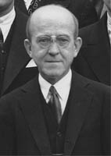
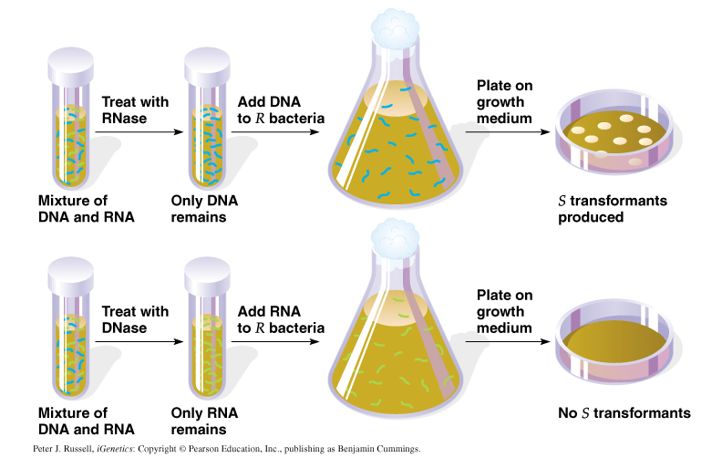
Oswald T. Avery’s Transformation Experiment - 1944
Determined that “IIIS” DNA was the genetic material responsible for Griffith’s results (not RNA).
Peter J. Russell, iGenetics: Copyright © Pearson Education, Inc., publishing as Benjamin Cummings.

Slide 13
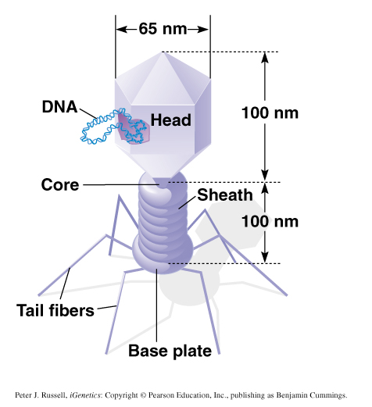
Hershey-Chase Bacteriophage Experiment - 1953
Bacteriophage = Virus that attacks bacteria and replicates by invading a living cell and using the cell’s molecular machinery.
Structure of T2 phage
DNA & protein

Slide 14
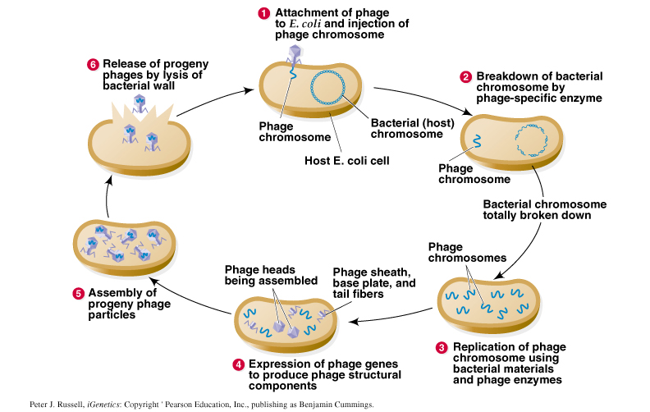
Life cycle of virulent T2 phage:

Slide 15
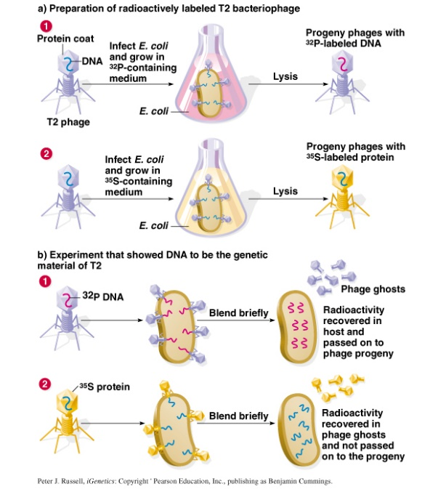
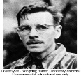
Hershey-Chase Bacteriophage Experiment - 1953
T2 bacteriophage is composed of DNA and proteins:
Set-up two replicates:
Label DNA with ³²P
Label Protein with ³⁵S
3. Infected E. coli bacteria with two types of labeled T2
4. ³²P is discovered within the bacteria and progeny phages, whereas ³⁵S is not found within the bacteria but released with phage ghosts.
1969: Alfred Hershey

Slide 16
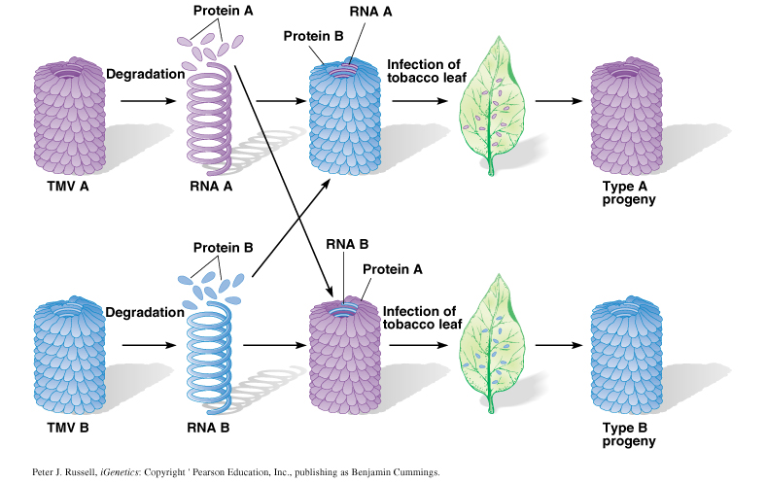
Gierer & Schramm Tobacco Mosaic Virus (TMV) Experiment – 1956 & Fraenkel-Conrat & Singer - 1957
Used 2 viral strains to demonstrate RNA is the genetic material of TMV

Slide 17
Conclusions about these early experiments:
Griffith 1928 & Avery 1944:
DNA (not RNA) is transforming agent.
Hershey-Chase 1953:
DNA (not protein) is the genetic material.
Fraenkel-Conrat & Singer 1957:
RNA (not protein) is genetic material of some viruses.

