Slide 1

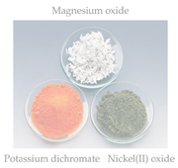
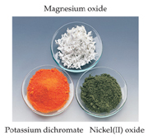
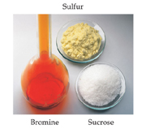
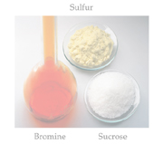
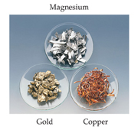
Chemical Bonds
Three basic types of bonds
  Ionic
    Electrostatic attraction between ions
  Covalent
    Sharing of electrons
  Metallic
    Metal atoms bonded to several other atoms

Slide 2
Ionic Bonding

Slide 3
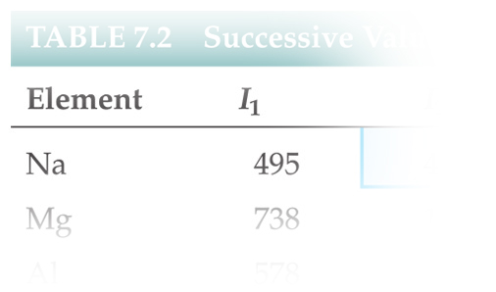
Energetics of Ionic Bonding
As we saw in the last chapter, it takes 495 kJ/mol to remove electrons from sodium.

Slide 4
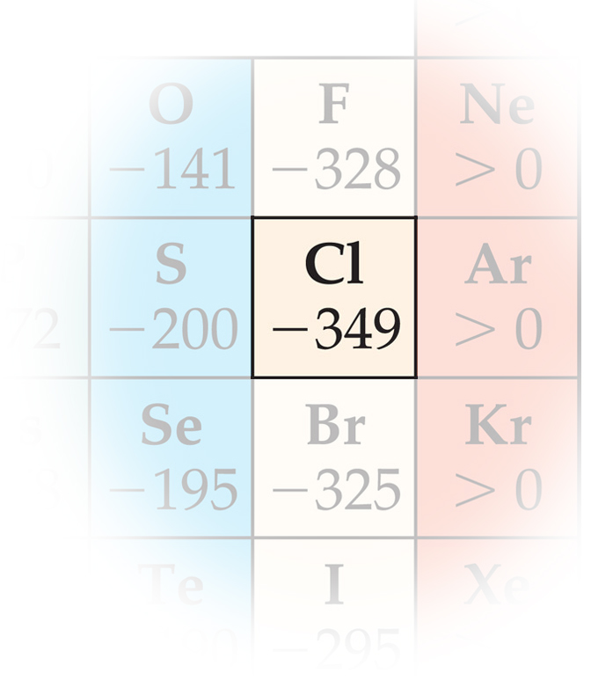
Energetics of Ionic Bonding
We get 349 kJ/mol back by giving electrons to chlorine.

Slide 5
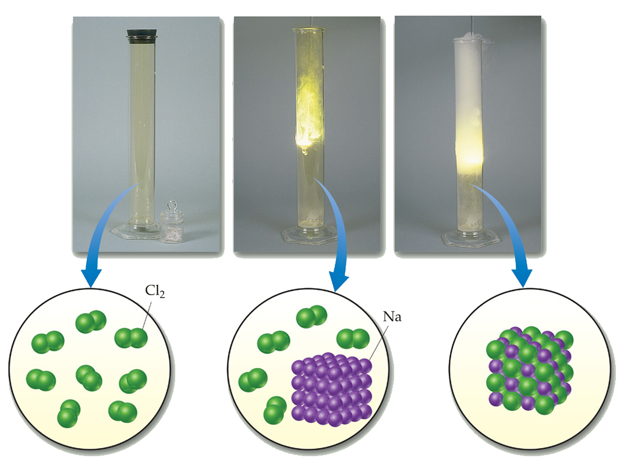
Energetics of Ionic Bonding
But these numbers don’t explain why the reaction of sodium metal and chlorine gas to form sodium chloride is so exothermic!

Slide 6
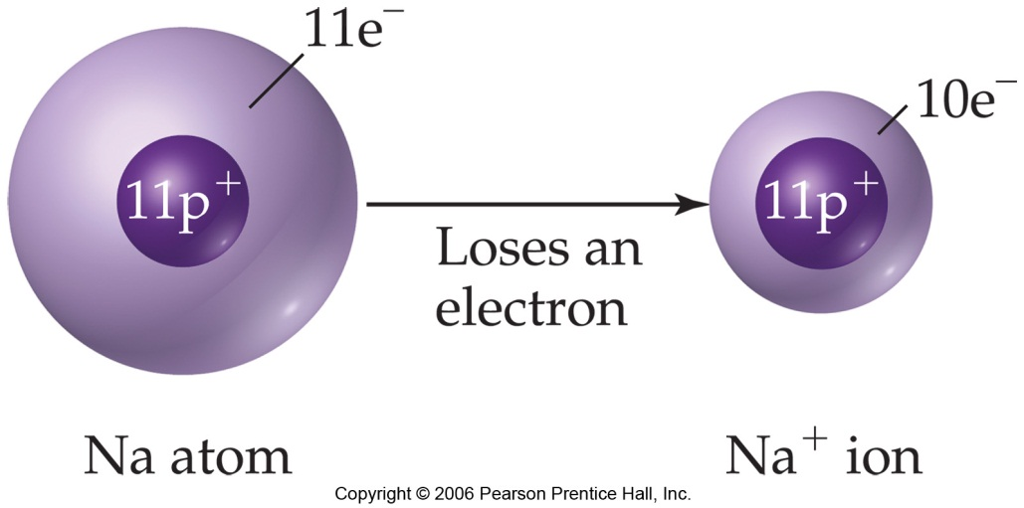
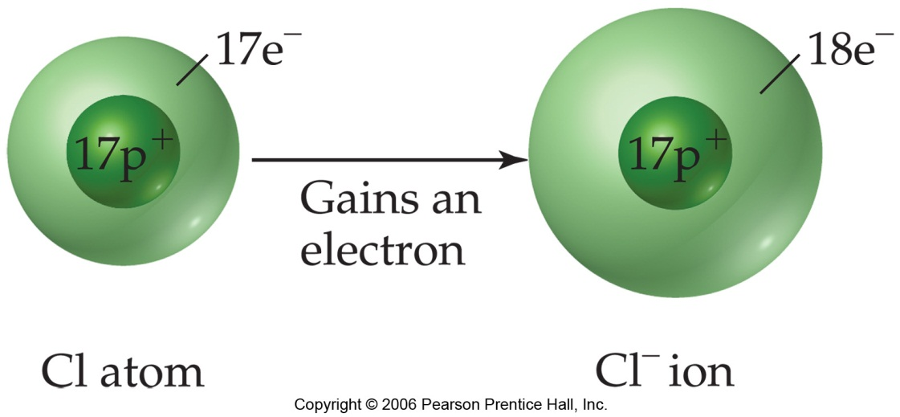
Energetics of Ionic Bonding
There must be a third piece to the puzzle.
What is as yet unaccounted for is the electrostatic attraction between the newly-formed sodium cation and chloride anion.

Slide 7
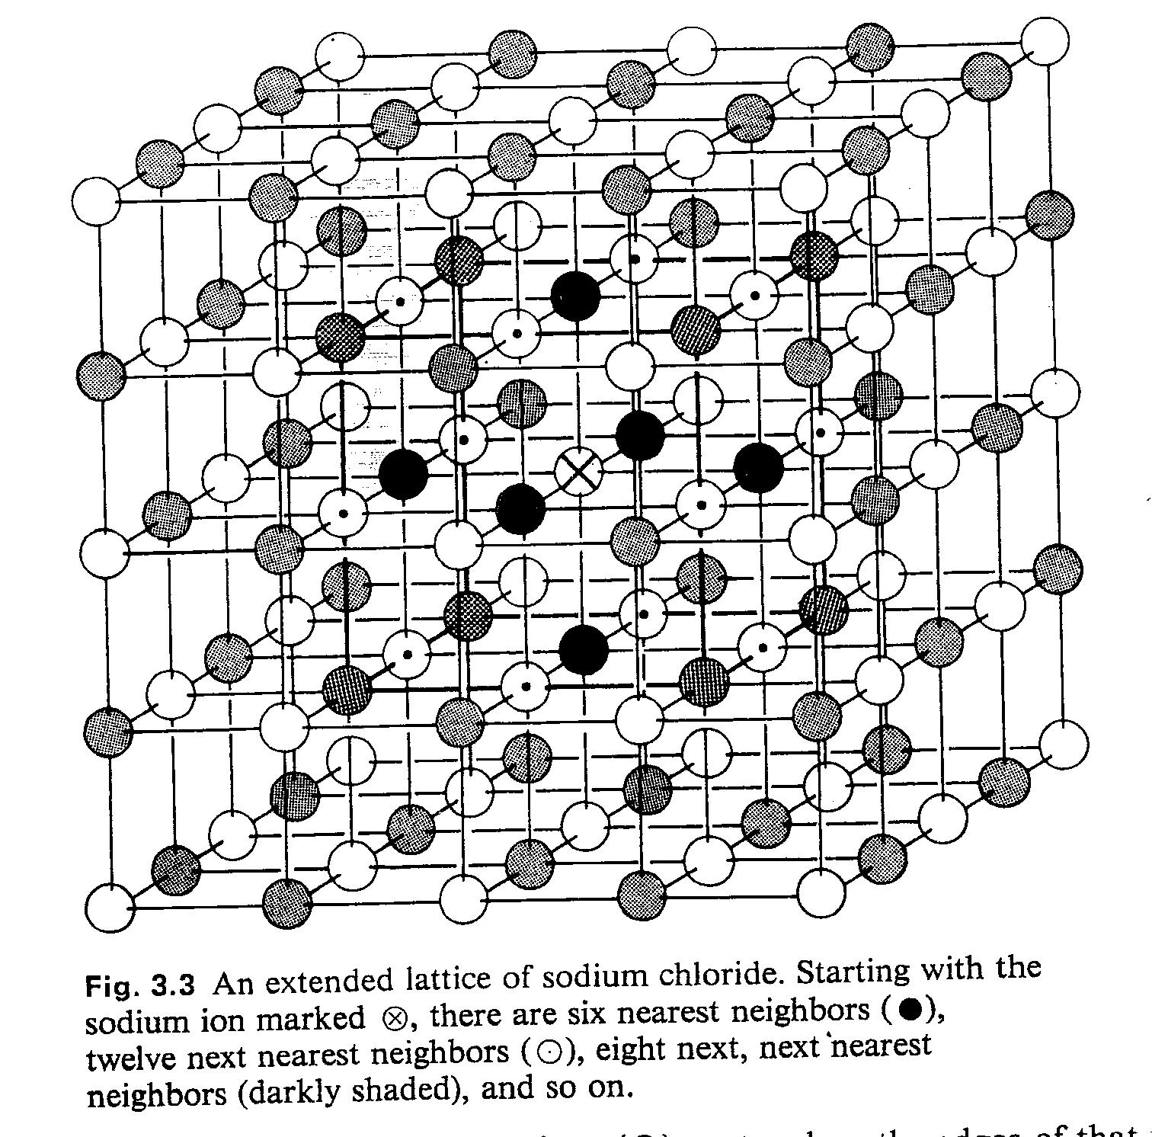

Slide 8
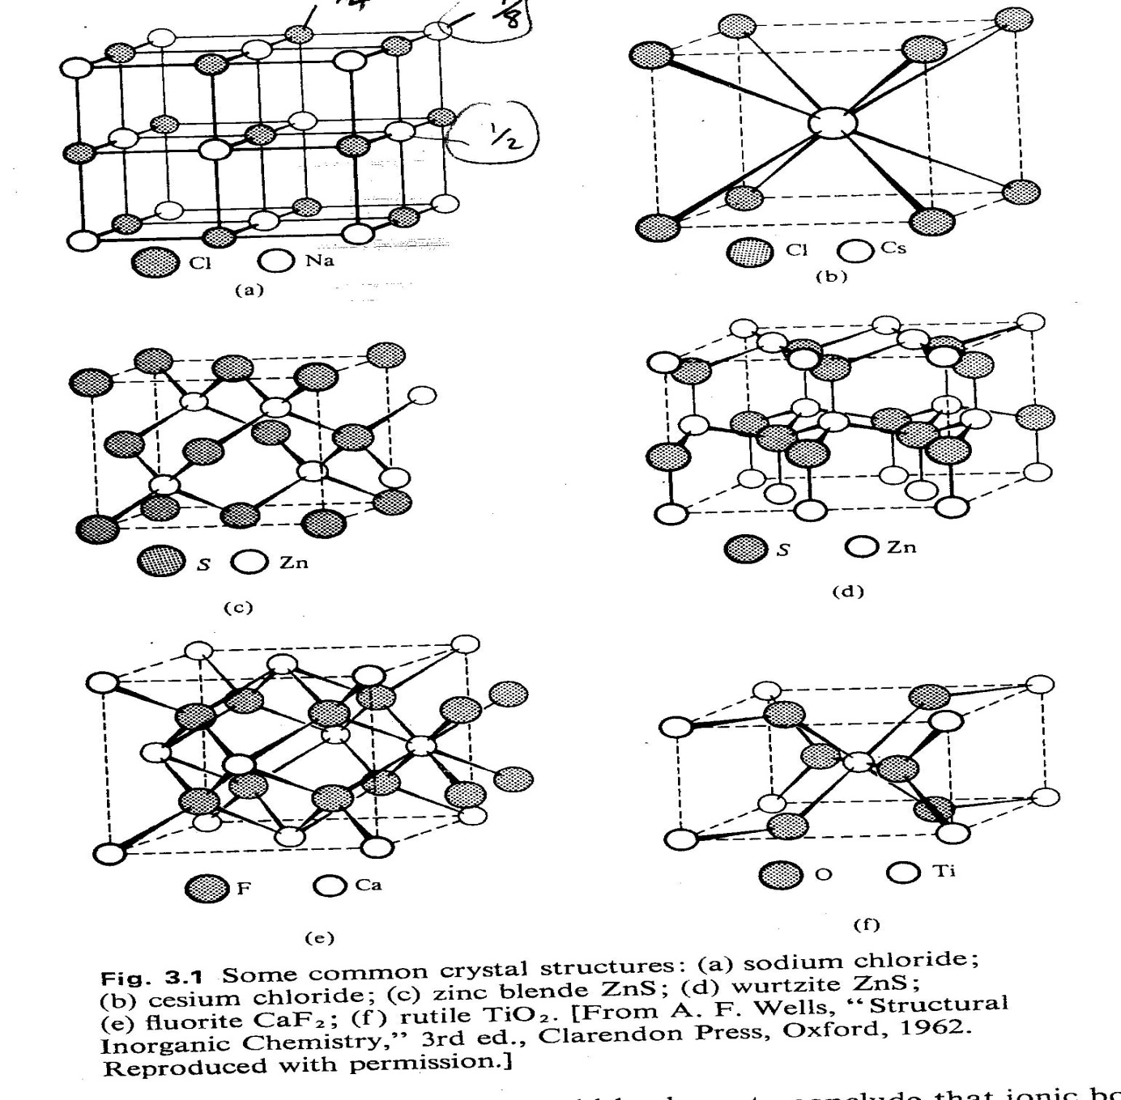
Types of Structures

Slide 9
Unit cells
For NaCl;
Na⁺; corner: 8 x 1/8 = 1
face center: 6 x 1/2 = 3 Total Na⁺ = 4
Cl⁻; mid edge: 12 x 1/4 = 3
center of cube: 1 = 1 Total Cl⁻ = 4

Slide 10
Lattice Energy
This third piece of the puzzle is the lattice energy:
  The energy required to completely separate a mole of a solid ionic compound into its gaseous ions.
The energy associated with electrostatic interactions is governed by Coulomb’s law:
Q₁Q₂
d
E_{el} = κ

Slide 11
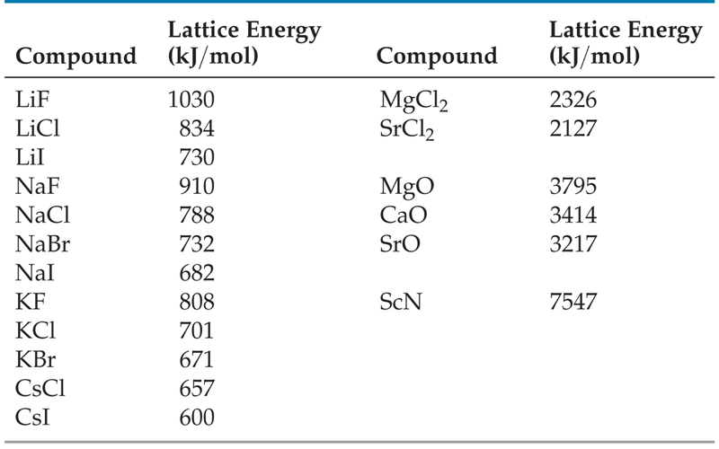

Slide 12
Derivation of Lattice Energy

Slide 13
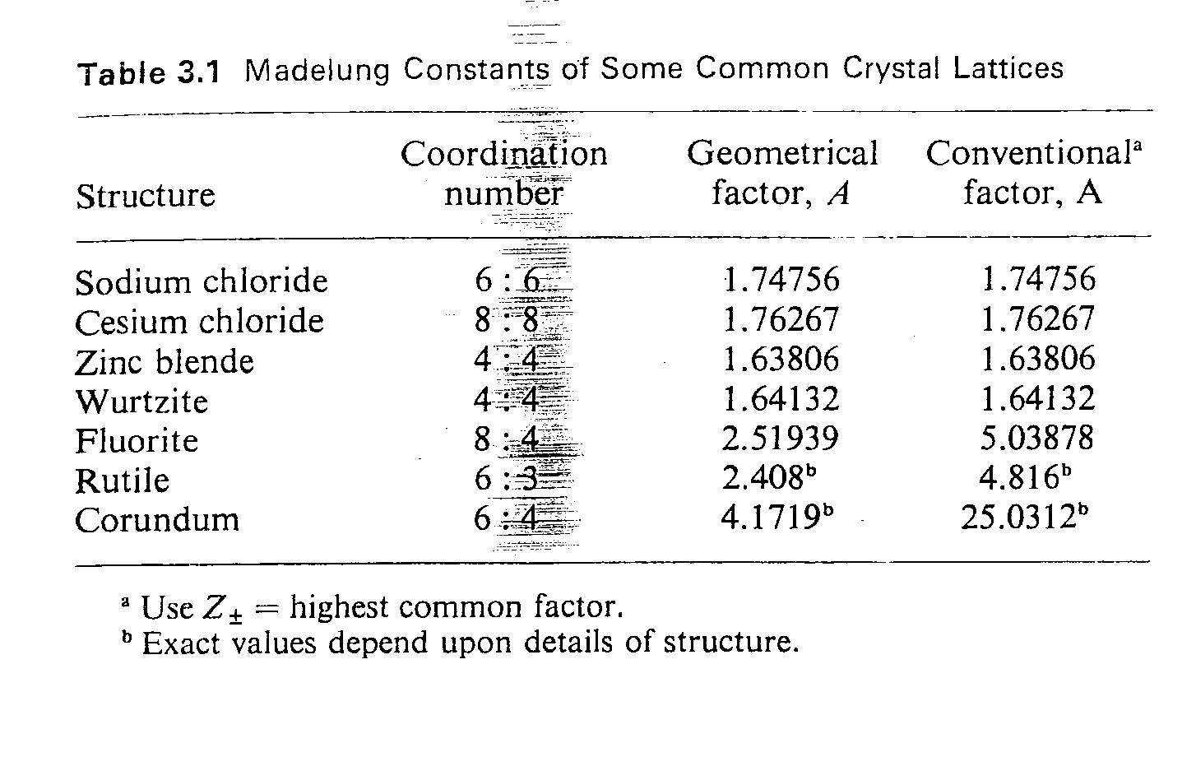

Slide 14
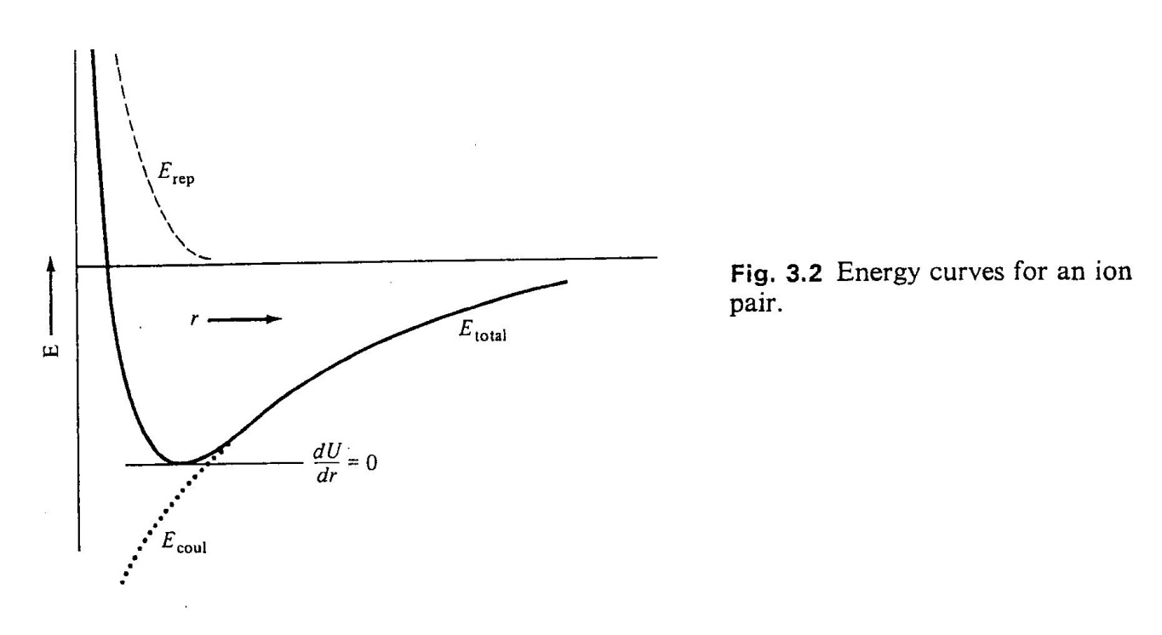

Slide 15
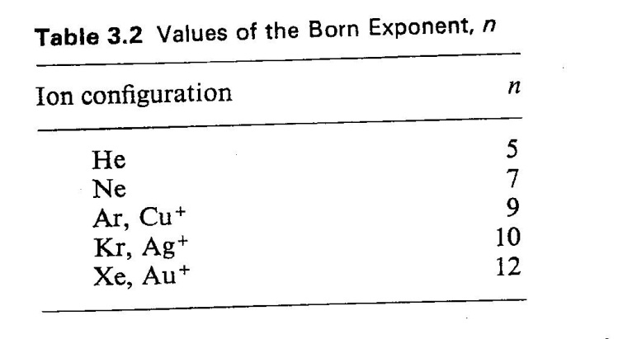

Slide 16

Solved example;
$$U_{0}= \frac{{A N Z}^{+}Z^{−}e^{2} }{4 π ε_{0} r_{0} } ( 1− \frac{1}{n} )$$

Slide 17
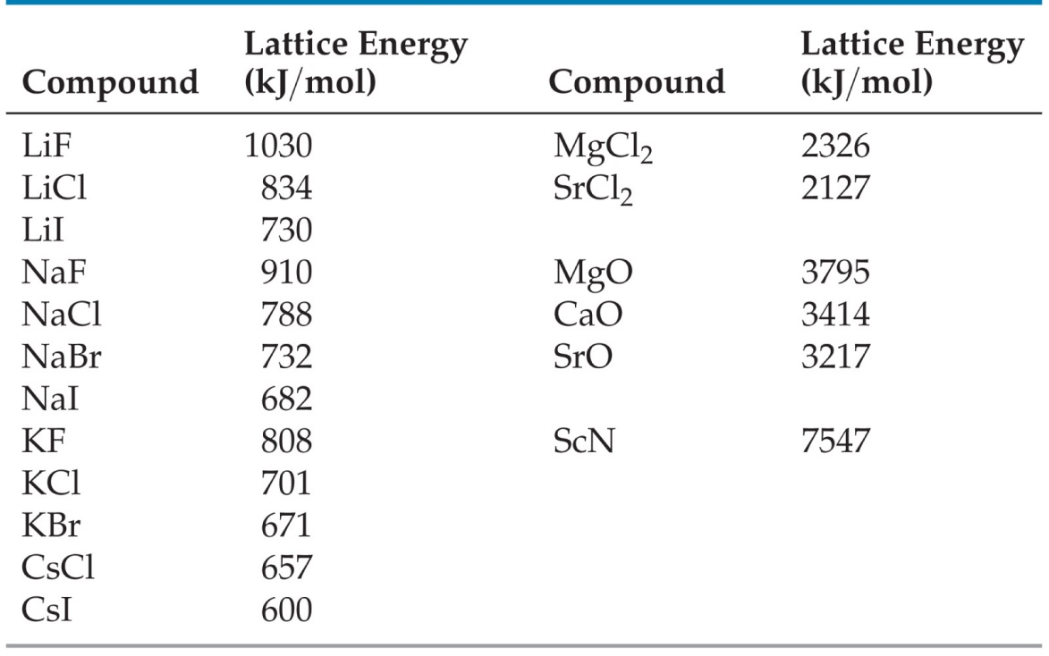
Lattice Energy
Lattice energy, then, increases with the charge on the ions.
It also increases with decreasing size of ions.

Slide 18
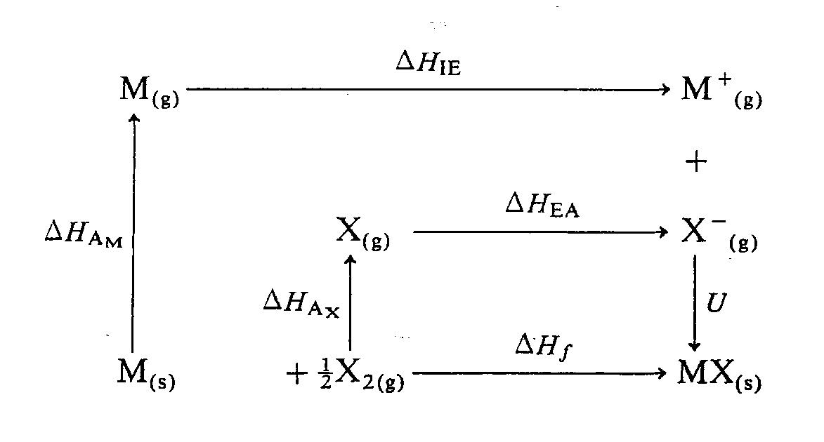
Born-Haber Cycle for the formation of Ionic Bond
So;

Slide 19
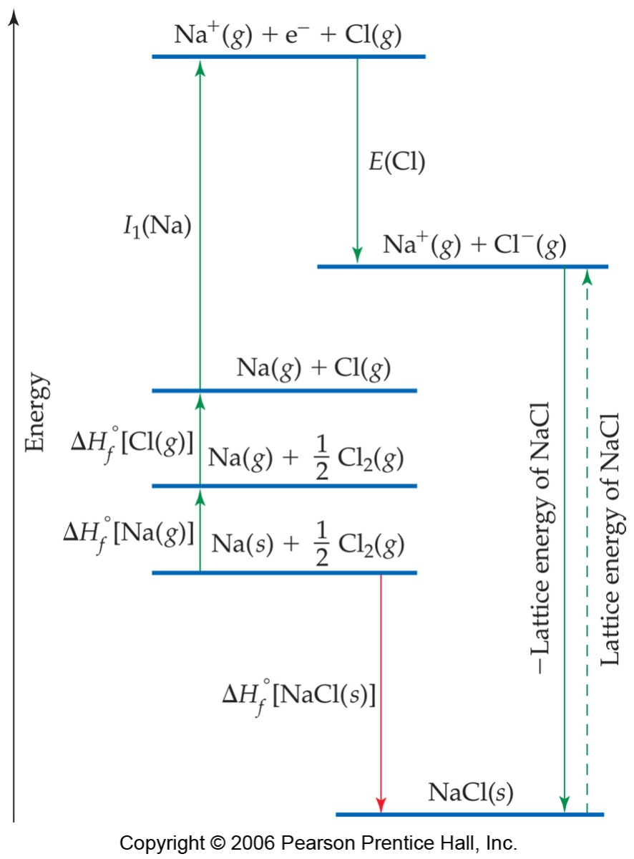
Energetics of Ionic Bonding
By accounting for all three energies (ionization energy, electron affinity, and lattice energy), we can get a good idea of the energetics involved in such a process.

Slide 20
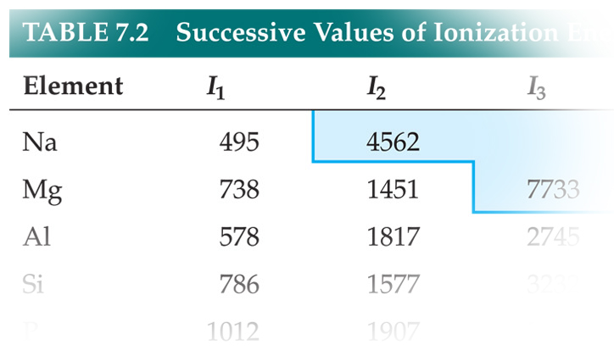
Energetics of Ionic Bonding
These phenomena also helps explain the “octet rule.”
Metals, for instance, tend to stop losing electrons once they attain a noble gas configuration because energy would be expended that cannot be overcome by lattice energies.

Slide 21
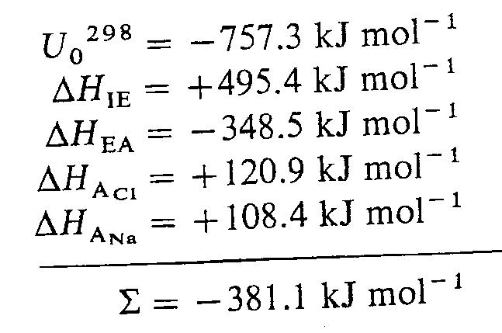
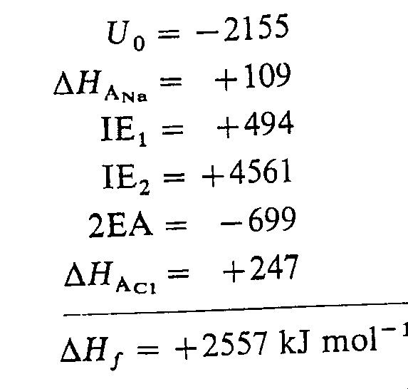
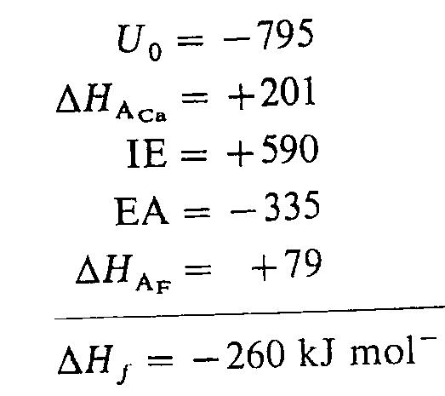
Usages of Lattice Energy
- To test The possibility of the formation of an ionic compound
NaCl
NaCl₂ ?
CaF ?

Slide 22
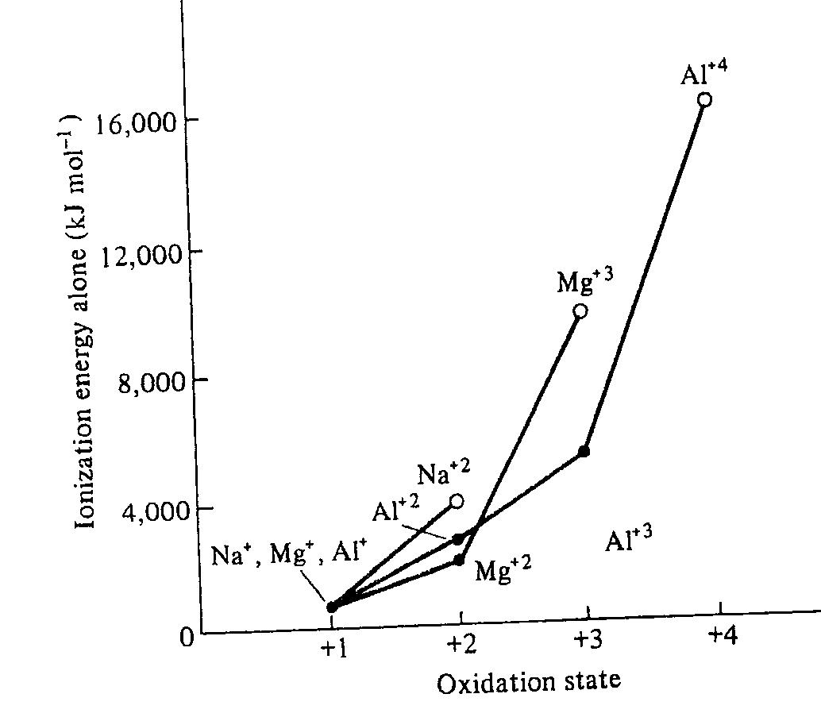
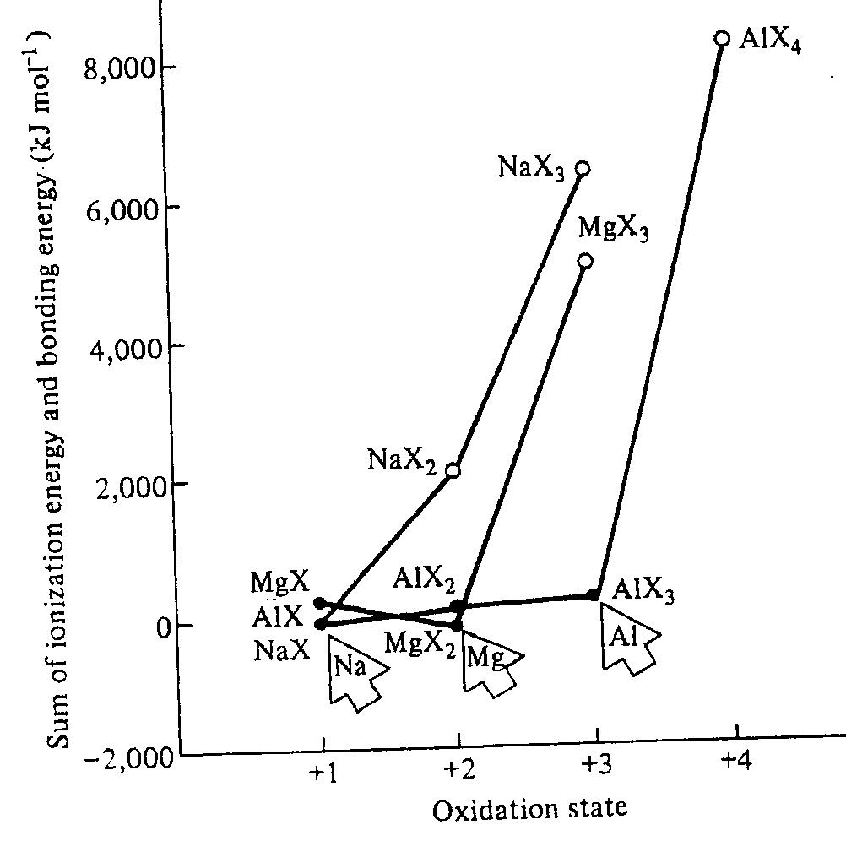
The importance of oxidation states
Ions
Compounds

Slide 23
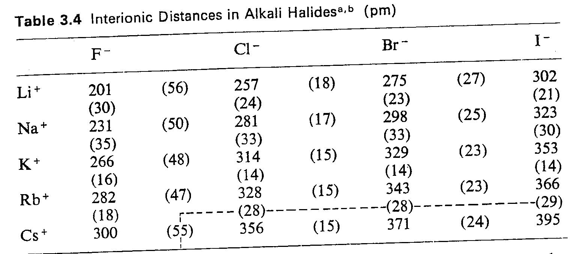
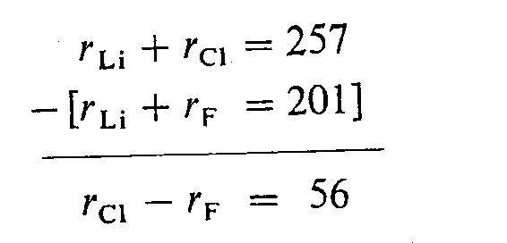
Ionic radii; Experimental part

Slide 24
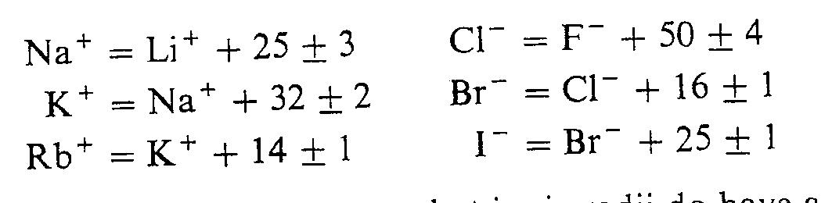

Slide 25
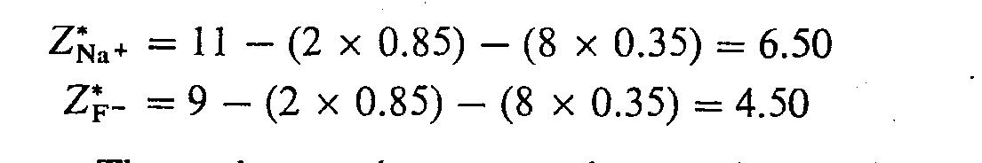
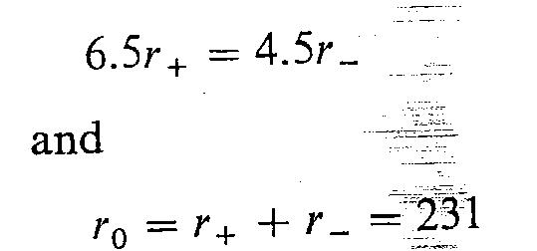

Ionic radii; Theoretical part
Pauling method;
1- Isoelectronic compounds, NaF
2- Effective Nuclear Charge
From experimental part*
So,

Slide 26
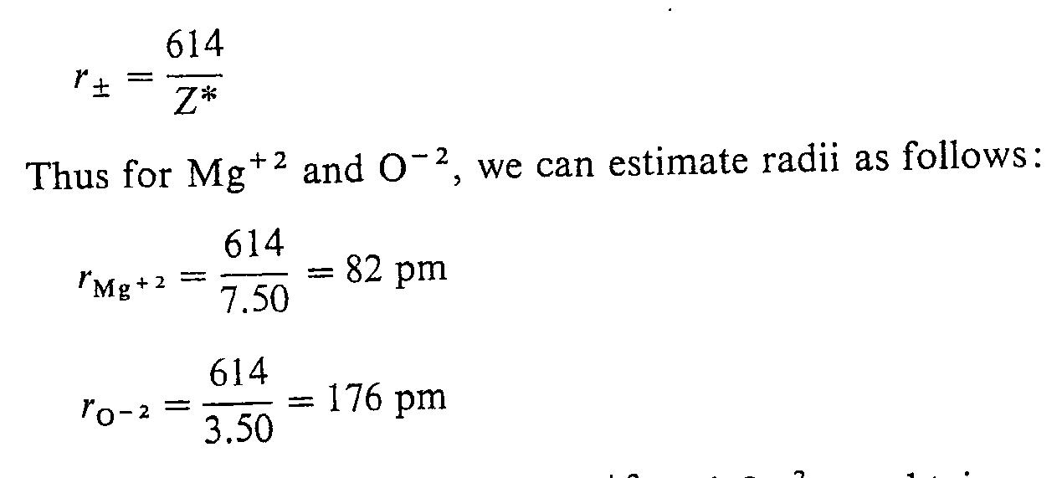
General equation;
Example:

Slide 27
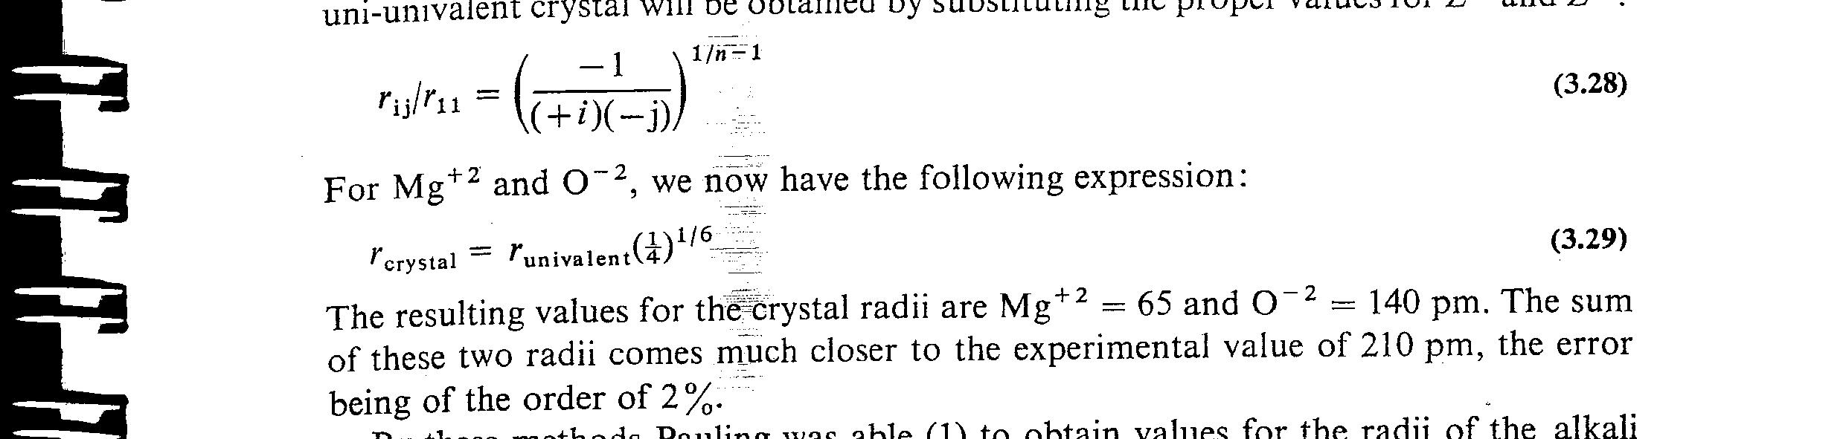
Correction;
But experimental bond length is : 210 pm, so we use the following equation for correction;
So;

Slide 28
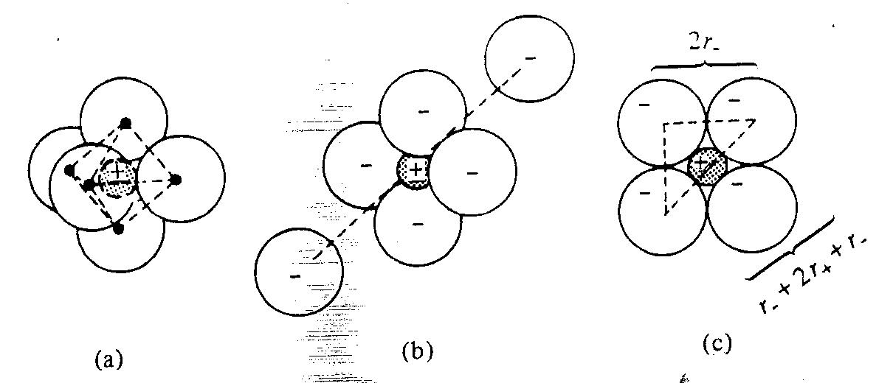
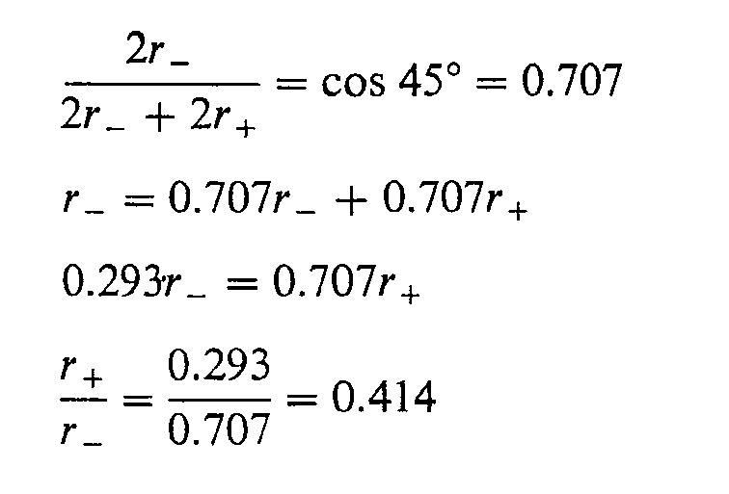
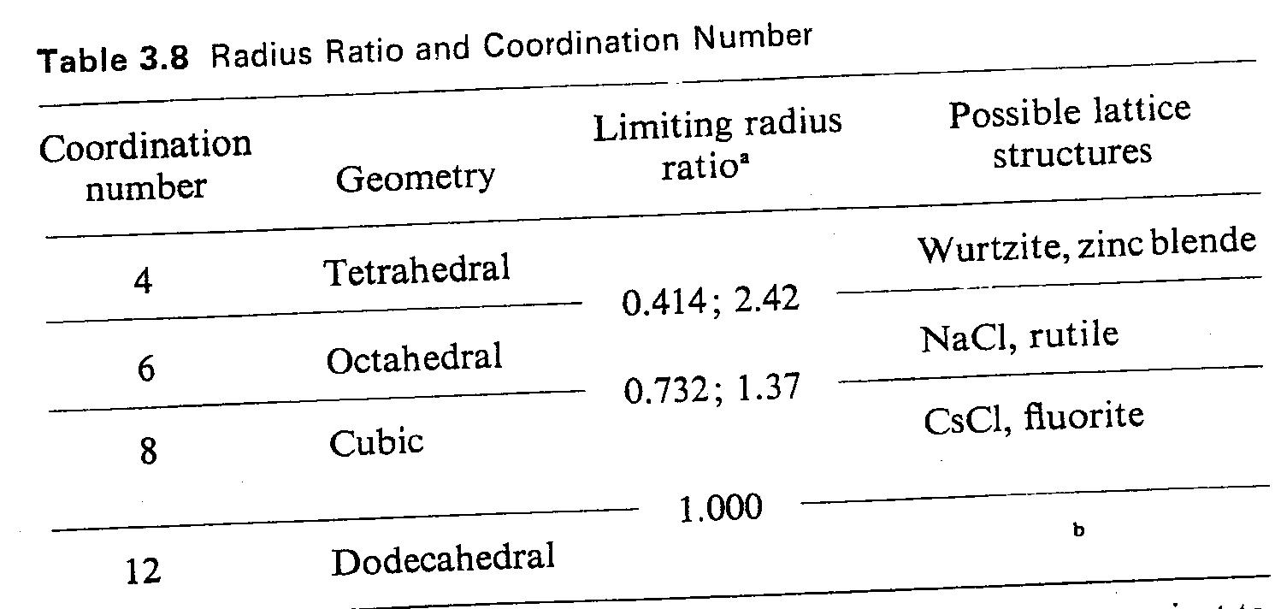
Radius ratio;

Slide 29





Examples;
Coordination numbers
1 -
6 : 6
8 : 4
2 -
3 -
4 : 4
After correction
4 -
Now 6 : 6
5 -
Now 6 : 6

Slide 30
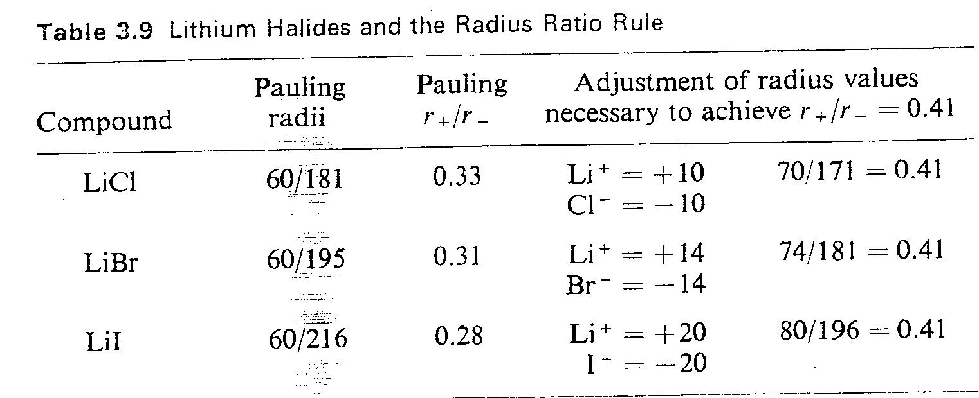

Slide 31
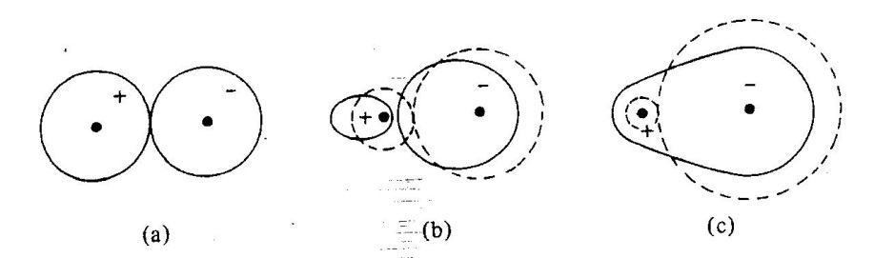
Covalent character in predominantly ionic bond
Fagan's rules , for increasing polarization;
1- High charge and small size of cation
2- High charge and large size anion
3- Electron configuration of the cation

Slide 32



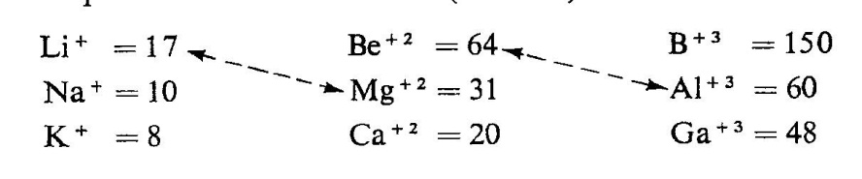
Ionic potential;
Where Z⁺ = charge on cation, and
= cation radius (nm)

Slide 33
So;
MgCl₂ is more covalent than LiCl (rule 1)
LiI is more covalent than LiF (rule 2)
HgCl₂ is more covalent than CaCl₂ (rule 3)

