Slide 1
PLPT 609
Title: Inter-Relationships Between Insects and Plants
Credit hours= 3 (2+1)
Instructor: Prof. Abdulrahman Saad Aldawood
Department of Plant Protection, college of Food and Agriculture Sciences, King Saud University, Riyadh, Saudi Arabia

Slide 2
Contents
Allelochemicals interactions among plants
Herbivores and their predators
Allelochemicals reflecting interactions between plants and pests
Role of plant allelochemicals in the survival strategy of herbivores
Rare plant-insect relationships
Plant stress and Insect interactions

Slide 3
Herbivores and their predators
Crops loss has been familiar to man as long as he has been growing them.
Probably not a single wild plant will complete its life cycle without being victim of herbivory by one or usually many more insect species during some stage of its life.
The worldwide loss of crop yield to insects is estimated to be 15 %.
Maxmen 2013

Slide 4
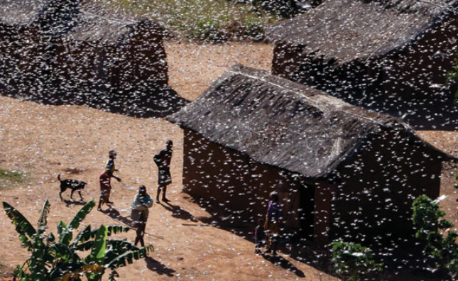
Herbivores and their predators-Contin---
Migratory locust (Locusta migratoria) belongs to
the most voracious pests and at the same time
the most difficult pests to control.
Locust swarms have been observed with an estimated number of 70 billion individuals, ten times as many individuals as the total human world population.
A swarm of locusts is landing, an insect pest develops. (Reproduced with permission by FAO (©FAO/Yasuyoshi Chibam))
Van der Meijden, 2014

Slide 5

Herbivores and their predators-Contin---
Locusts feed on Sorghum, maize and wheat and other grass species. A recent outbreak led to 42 % reduction in farmland grass production of 36,000 ha in Northern China in 2003 (Tanaka and Zhu 2005).
A total of 4,200 personnel were involved in insecticides spraying mission. As a result, further damage to crops and migration to other areas were prevented.
Approximately, for each plant species probably several hundreds of insect herbivore species exist that may grow into effective pest species.
Read above article to understand how China managed this outbreak?
Van der Meijden, 2014

Slide 6
Herbivores and their predators
Herbivory
“The consumption of all or parts of living plants”
herbivorous” is usually applied to hooved mammals, such as cows, sheep and goats, whereas “phytophagous” almost exclusively is used for invertebrate organisms.
They include species that attack roots, stems, leaves, flowers, and fruits, either as larvae or as adults or in both stages.
Leaf feeders may be external (exophytic) or they may mine the tissues, sometimes even specializing on a particular cell type.
The nectar and pollen feeders are not included.
Bernays 2009

Slide 7
Herbivores and their predators
Phytophagous insects are highly diverse and the total species number is at least 500,000. about 25% of known multicellular animals.
Monophagous
“Species that use only one plant genus or species”
Oligophagous
“Species that use plants within a tribe or family”
Polyphagous
Those species that use plants in several to many plant families.
Bernays 2009
What are “Stenophagous”?

Slide 8
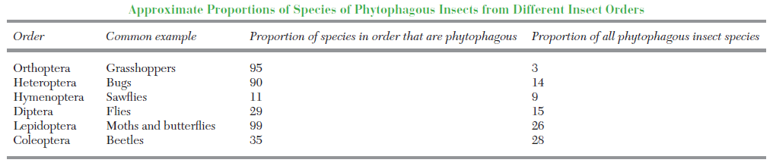
Herbivores and their predators
Bernays 2009

Slide 9
Herbivores and their predators-Contin---
Which Characteristics Make Insects Dangerous?
Plant, immune system provides protection against majority of potential herbivore species.
However, they are quite vulnerable to a much smaller group, the so-called specialists.
Specialists have ability to penetrate the plant’s immune system.
These particular plants have become their specific food plants. Specialist insects often use the defense substances of their food plants to recognize and locate these plants.
Van der Meijden, 2014

Slide 10
Herbivores and their predators-Contin---
Which Characteristics Make Insects Dangerous?
Brassica species like Cabbage and Oilseed rape contain a large group of specific chemical substances, the glucosinolates.
Because of their distinct “cabbage smell”, specialist insect herbivores like the
  Diamondback moth (Plutella xylostella),
  the Cabbage white butterflies (Pieris spec.), and
  the Crucifer flea beetle (Psylliodes chrysocephala)
  use these glucosinolates to find their food plants and to start feedings.
Find more similar examples--------------
Van der Meijden, 2014

Slide 11
Herbivores and their predators-Contin---
Which Characteristics Make Insects Dangerous? Contin--
Herbivores insects can multiply fast.
Large monocultures provide herbivores with excess of food.
Invaders herbivores like examples of the Grape phylloxera (Daktulosphaira vitifoliae), colonizing Europe from the United States, and the European corn borer colonizing the United States. These species enter a new continent without their natural enemies.
Find more similar examples--------------
Van der Meijden, 2014

Slide 12
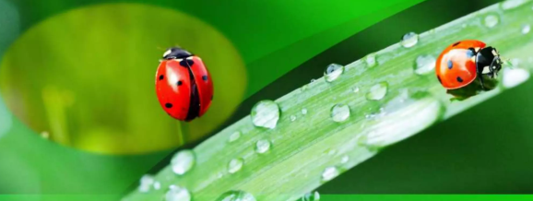
Herbivores and their predators-Contin---
Nearly all insect species are attacked by a suite of natural enemies.
Predators are mobile free living organisms that feed on many prey. Predators of insects include many vertebrate and invertebrate species.
Predators, usually kills its prey, larger than its prey and require more than one prey to complete its development.
Use of these predaceous/ insectivorus arthropods as biological control agent is very useful in insect pest management.

Slide 13
Herbivores and their predators-Contin---
Arthropod predators can be classified into two groups according their food habits.
Generalist predators that depend on prey of different insect families and feed on different stages of prey (egg, larva, pupa and adult). These generalist predator can be increased by conservation biocontrol techniques or augmentative releases.
2) Specialized predators can be introduced to new site as part of classical biological control programs.
Van Driesche et al 2008

Slide 14
Herbivores and their predators-Contin---
Beside insects, spiders are also act as predators and contribute an
effective role in insect pest management.
In many European countries, the predatory mite Phytoseilus persimilis was commercially mass multiplied and released in glasshouse cucumber for the management of two spotted mite Tetranychus urticae.
In Spain, predatory mite, Amblyseius swirskii and anthocorid bug, Orius laevigatus successfully manage the thrips and whiteflies on sweet peppers in greenhouses.

Slide 15
Herbivores and their predators-Contin---
Characteristics of a predator
Long life cycle,
Requires several prey to complete its development
Larger than its prey,
Kills the prey immediately,
Usually both immature and adult stages are predatory,
Very active,
Stronger and larger then prey,
Well developed locomotory organs and mouth parts.
Search for other characteristics
https://www.slideshare.net/slideshow/identification-of-predators-ppt/95913946#3

Slide 16
Herbivores and their predators-Contin---
Predation Methods
Predators follow various predation methods to catch preys in nature.
Hunters as well as chasers
Tiger beetles run down prey and catch it with their strong, curved jaws on the ground. In the air, dragonflies catch their prey by their strong spiny legs.
Hunters, collective attack
Ants are the example of collective work and they use chemical signals to garner other worker ants for attack.
Van Driesche et al 2008

Slide 17
Herbivores and their predators-Contin---
Predation Methods-Contin--
Hunters as well as waiters
These predators attack their prey by waiting. When the prey comes near to them, they catch them by their strong raptorial forelegs. Their shape and body coloring helps them to camouflage with surrounding nature eg. Praying mantids.
Trappers
The spiders trap their prey by making typical web. To trap the food from the water, caddisfly larvae use silk to make different types of ‘Capture nets’. When water passes through these nets, the food particles i.e., preys caught inside the nets.
Van Driesche et al 2008

Slide 18
Herbivores and their predators-Contin---
Important predatory insects order
Coleoptera,
Neuroptera,
Diptera,
Hemiptera,
Hymenoptera, and
Dictyoptera.
Reddy et al., 2022

Slide 19
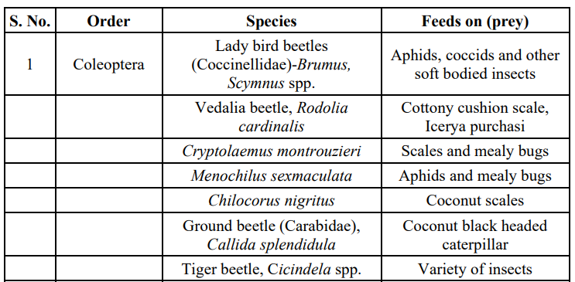
Herbivores and their predators-Contin---
Important predatory insects order
Reddy et al., 2022

Slide 20
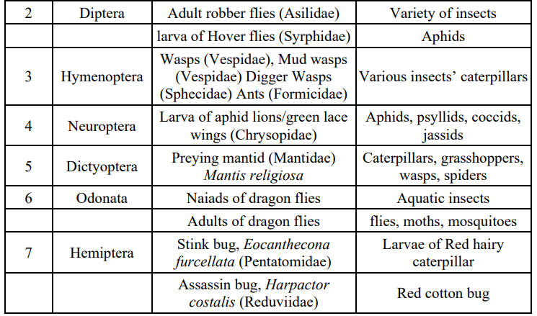
Herbivores and their predators-Contin---
Find more similar examples--
Reddy et al., 2022

Slide 21
Conclusion
Phytophagous insects pose a significant threat to agricultural crops and forest trees, with locusts being particularly destructive.
A single locust swarm can devastate hundreds to thousands of hectares of vegetation in just a few days.
To combat these pests, the use of predaceous and insectivorous arthropods as biological control agents offers a promising strategy in integrated pest management.
Utilizing these natural predators can help mitigate the damage caused by phytophagous insects and support sustainable agricultural practices.

Slide 22
References
Maxmen A (2013) Under attack. The threat of insects to agriculture is set to increase as the planet warms. What action can we take to safeguard our crops? Nature 501:15–17
Tanaka S, Zhu DH (2005) Outbreaks of the migratory locust Locusta migratoria (Orthoptera: Acrididae) and control in China. Appl Entomol Zool 40:257–263
van der Meijden, E. (2014). Herbivorous insects—a threat for crop production. In Principles of Plant-Microbe Interactions: Microbes for Sustainable Agriculture (pp. 103-114). Cham: Springer International Publishing.
Bernays, E. A. (2009). Phytophagous insects. In Encyclopedia of insects (pp. 798-800). Academic Press.
Reddy, A. V., Anusha, C., Ramprasad, B., Kumar, R. S., & Veeranna, D. 2022. Importance of Beneficial Insects in Agriculture.
Van Driesche, R., Hoddle, M. and Center, T. 2008. Control of pests and weeds by natural enemies: an introduction to biological control. Blackwell Publishing Ltd, MA, USA. pp 473.
Please open the link and read more about the Predators and their characteristic.
https://www.slideshare.net/slideshow/identification-of-predators-ppt/95913946

