Slide 1
PLPT 609 Title: Inter-Relationships Between Insects and Plants
Credit hours= 3 (2+1)
Instructor: Prof. Abdulrahman Saad Aldawood
Department of Plant Protection, college of Food and Agriculture Sciences, King Saud University, Riyadh, Saudi Arabia

Slide 2
Contents
Allelochemicals interactions among plants
Herbivores and their predators
Allelochemicals reflecting interactions between plants and pests
Role of plant allelochemicals in the survival strategy of herbivores
Rare plant-insect relationships
Plant stress and Insect interactions

Slide 3
Introduction to Inter-relationship
Inter-relationship refer to the various ways organisms interact within ecosystems.
In this course we will specifically focus on how insects and plants influence each other?
Understanding these interactions is crucial for
Agriculture
Pest management, and biodiversity
Ecosystem health

Slide 4
Types of Inter-relationships
Overview of key types of interactions between insects and plants
Mutualism
Herbivory (Phytophagy)
Parasitism
Competition

Slide 5
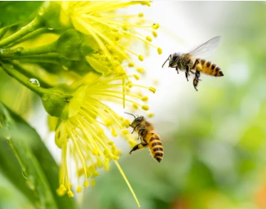
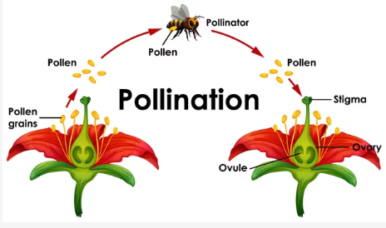
Mutualism
Definition: Both insects and plants benefit from their
interactions
Examples:
Pollination:
Bees: Collect nectar and pollen, facilitating
plant reproduction
Butterflies: Pollinate while seeking nectar
from flowers
Ant-Plant Mutualism:
Ants protect plants (e.g., acacia trees) from
Herbivores in exchange for food (nectar) and shelter

Slide 6
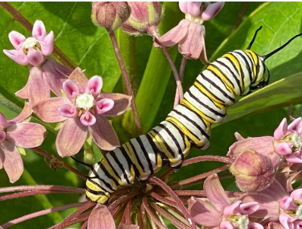
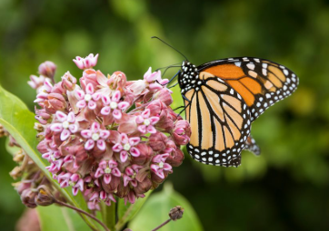
Case Study: The Monarch Butterfly and Milkweed
Mutualistic Relationship: Monarch butterflies rely on
milkweed for food during their larval stage.
Plant Defense: Milkweed produces toxins that deter many
herbivores, but monarchs have adapted to feed on it.
Impact: This relationship supports both the butterfly's life
cycle and the plant's evolutionary strategies.

Slide 7
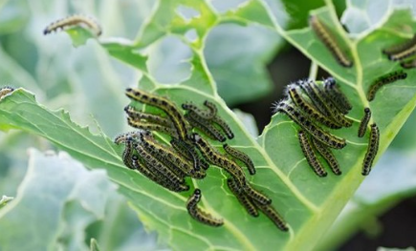
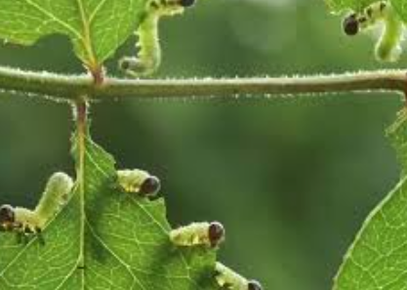
Herbivory (Phytophagy)
Herbivory, or phytophagy, refers to the consumption of
plant material by herbivores, primarily by insects.
This interaction has significant ecological, evolutionary, and
agricultural implications.
Insects feed on plants, which can lead to plant damage or
death.
Examples: Caterpillars: Feed on leaves, impacting plant growth and
reproduction
Aphids: Suck plant sap, weakening plants and potentially
spreading diseases

Slide 8
Herbivory (Phytophagy)
Understanding the different forms of herbivory, including
leaf chewing, sap-sucking, and seed predation (granivory).
Seed predation, also referred to as “granivory”, represents a particular type of herbivory in which a mobile predator consumes a sessile prey (the seed)
Plant Responses:
Direct defenses like physical barriers or toxins derived from secondary plant metabolites prevent herbivores from feeding.
Indirect defense of plants works by using herbivore-induced volatile compounds or extrafloral nectar to attract their natural enemies.
(nearly 2000 volatile compounds have been identified in species from over 90 plant families).

Slide 9
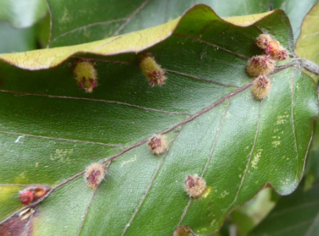
Parasitism
Parasitism is a type of symbiotic relationship where one
organism (the parasite) benefits at the expense of another
organism (the host).
In the context of insect-plant interactions, parasitism often
involves parasitic insects that can affect plant health, pest
populations, and agricultural practices.
Gall Midges: Lay eggs in plant tissues, causing galls to form, which provide nutrition for the larvae but harm the plant.
Scale Insects: Feed on plant sap and can weaken or kill host plants.
Galls caused by midges

Slide 10
Types of Parasitism
Ectoparasites: Parasites live on the surface of the host. For example, some parasitic wasps lay their eggs on or in the bodies of herbivorous insects.
Endoparasites: Parasites live inside the host. Examples include parasitic larvae that develop within a host insect, leading to the host's eventual death.
Examples
Parasitic Wasps: Many species of parasitoid wasps lay their eggs inside or on aphids, ultimately leading to the death of the aphid.
Flies: Certain flies, like the tachinid fly, are known to parasitize caterpillars and other insect pests, using them as hosts for their larvae.
Nematodes: Some nematodes are parasitic on insects and can be used as biological control agents against pest populations.
(Heterorhabditis indica and Steinernema carpocapsae species are used against red palm weevil management)

Slide 11
Parasitism Relationship with Pest Management
a. Biological Control
Natural Enemies: Parasitic insects are considered natural enemies of pest species. By introducing or conserving these parasites, farmers can manage pest populations without relying on chemical pesticides.
Integrated Pest Management (IPM): Parasitism is a key component of IPM strategies. By understanding the life cycles and behaviors of parasitic insects, agricultural practices can be designed to enhance their effectiveness in controlling pests.
b. Enhancing Parasitism
Habitat Management: Creating habitats that support the survival and reproduction of parasitic insects can improve biological control outcomes. This may include planting cover crops or maintaining flowering plants that attract parasitoids.
Conservation Biological Control: Emphasizing the conservation of existing natural enemies in the ecosystem can lead to more sustainable pest management practices.

Slide 12
Challenges in Implementing Parasitism in Pest Management
Host Specificity: Many parasitic insects are highly specialized and may only target specific pest species. This specificity can limit their effectiveness in controlling a broad range of pests.
Environmental Factors: The success of parasitic insects can be influenced by environmental conditions, such as temperature and humidity, which may affect their life cycles and interactions with hosts.
Research and Future Directions
Molecular Studies: Research is increasingly focusing on the molecular interactions between parasites and their hosts, which can provide insights into developing new pest management strategies.
Climate Change Impacts: Understanding how climate change affects parasitic relationships and their effectiveness in biological control is crucial for future agricultural practices.
Genetic Approaches: Exploring genetic engineering techniques to enhance the efficacy of parasitic wasps and other biological control agents.

Slide 13
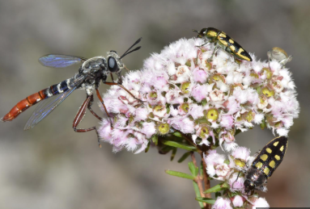
Competition
Insects and plants compete for resources in various ways,
impacting both the ecological balance and agricultural
productivity.
This competition primarily revolves around the availability
of essential resources such as nutrients, water, and space.
Types of Resources Competed For
Nutrients: Both plants and insects require nutrients for growth and reproduction. Insects, particularly herbivores, consume plant tissues, which can limit the nutrients available to the plant.
Water: In arid environments, competition for water can be intense. Insects may affect plant water uptake by feeding on roots or reducing leaf area through herbivory.
Light: Although primarily a competition among plants, some insects can influence light availability by causing defoliation or stunting plant growth, thus affecting neighboring plants’ access to sunlight.
Space: Insects may compete for physical space on a plant, such as leaves or stems, which can impact the plant’s ability to grow and reproduce.

Slide 14
Conclusion
The inter-relationship between insects and plants plays a crucial role in shaping ecosystems and influencing agricultural practices.
Insects can act as pollinators, facilitating plant reproduction and contributing to biodiversity, while also serving as prey for other organisms, thus playing vital roles in food webs.
Conversely, herbivorous insects can pose challenges to plant health, leading to reduced growth and lower yields.

