Slide 1
PCR- Optimization of Annealing Temperature

Slide 2
Objectives
• To know how to optimize different parameters that effects PCR results/performance.
• Optimization of PCR annealing temperature.
• Be familiar with PCR technique and thermal cycler device.

Slide 3
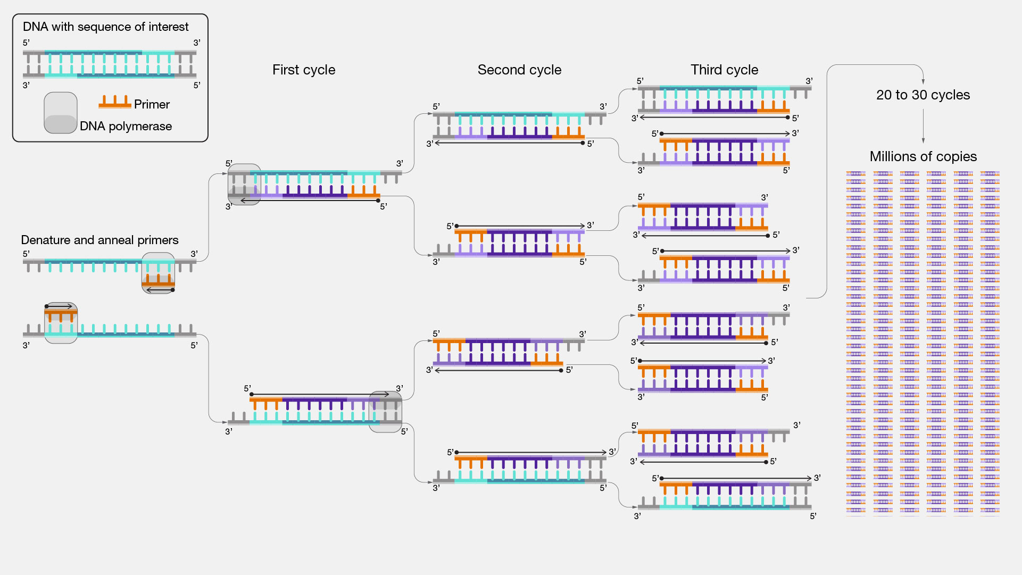
Polymerase chain reaction (PCR) → amplification.

Slide 4
Primers: Two synthetic oligonucleotides are synthesized, called primers each complementary to a stretch of DNA to the 3’ side of the target DNA, one oligonucleotide for each of the two DNA strands (DNA polymerase can add a nucleotide only onto a preexisting 3'-OH group).

Slide 5
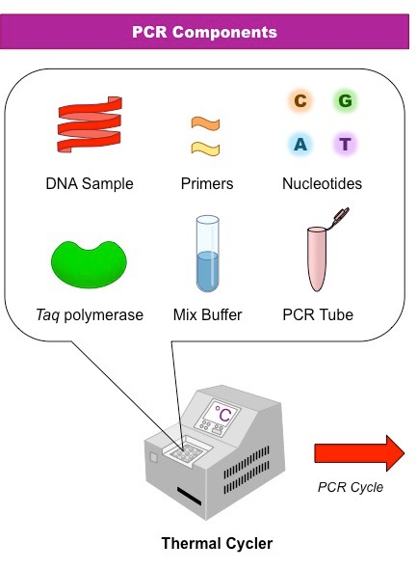
PCR components:
Basic PCR reaction requires four components:
(1) DNA template.
(2) Primers.
(3) Deoxynucleotide triphosphates (dNTPs).
(4) Thermostable DNA polymerase.
(5)Mgcl2.
(6) PCR buffer.
(7)Nuclease free water.
(template)
(d-NDPs)

Slide 6
PCR require a special PCR tubes and a device called thermal cycler to perform the heating and cooling cycles.

Slide 7
“N” cycle

Slide 8
Annealing Temperature (Ta):
annealing of the primers to the single-stranded DNA template. The single strands of the template are too long and complex to be able to reanneal during this rapid cooling phase. Stable hydrogen bonds are only formed when the primers anneal to sequences that are complementary to them.
What determine the annealing temperature?
The primer melting temperature, is the estimate of the DNA-DNA hybrid stability and critical in determining the annealing temperature.
Too high Ta → will produce insufficient primer-template hybridization resulting in low PCR product yield.
Too low Ta → may possibly lead to non-specific products caused by a high number of base pair mismatches.

Slide 9
Extension/elongation:
a new DNA strand complementary to the DNA template strand by adding dNTP's that are complementary to the template in 5' to 3' direction. The extension time depends both on the DNA polymerase used and on the length of the DNA fragment to be amplified.
Number of copies -amplicons- = 2 number of cycles

Slide 10
Primer length: long enough for adequate specificity and short enough for primers to bind easily to the template at the annealing temperature. It prefers that the two primers have a similar length.
GC content:GC% = [(G + C) / (G + C + A + T)] x 100
Melting temperature (Tm):Tm = [(G + C) x 4] + [(A + T) x 2]

Slide 11
PCR Optimization
There is no single set of conditions that is optimal for all PCR reactions. PCR optimization means to find the most effective condition.

Slide 12
PCR optimization means to find the most effective and optimum conditions.
PCR Optimization : In PCR optimization, you need to optimize:
(2) Thermal cycling condition.
(1) PCR components (reagents) concentration.
Duration of the steps
Temperatures
Number of cycles

Slide 13
PCR components concentration:
Optimization of PCR reagents aim to find out the most optimum concentration of all PCR component including, primer concentration, MgCl2 , DNA template…etc.
It is important to note that while optimization of one parameter, other parameters should be fixed and not changed (one factor at a time). Generally, the concentration of PCR components should be as shown in the Table.1
How you will know that you reached to the optimum conditions

Slide 14
Standard concentrations of PCR components
Component | Final concentration
Taq polymerase | 0.5–2.0 units, ideally 1.25 units.
Deoxy-nucleotides (dNTPs) | Typical concentration is 200 µM of each dNTP.
Magnesium Concentration | 1.5-2.0 mM is optimal for Taq DNA Polymerase.*
Forward Primers | Typically, 0.1-0.5 µM .
Reverse Primer | Typically, 0.1-0.5 µM.
DNA Template | 1ng–1µg of genomic templates.
Notes:
* One U is defined as the amount of the enzyme that produces a certain amount of enzymatic activity, that is, the amount that catalyzes the conversion of 1 micro-mole of substrate per minute

Slide 15
(2) Thermal cycling condition
Optimization of thermal cycling condition aims to reach optimum cycling temperatures, duration of each step in PCR and number of cycles.
Sitting up the thermal cycling conditions in the device is divided to three stages.
First stages, is initial denaturation, a typical reaction will start with a three minutes denaturation at 94-97°C, this stages aim to denature the template and activate “hot-start” DNA polymerase.
second stage, is the three PCR steps (denaturation, annealing and elongation), which will repeated from 25 to 35 cycles.
Last stage, is the final elongation phase; a period of 5 minutes or longer to allows synthesis of many uncompleted amplicons to finish.
Table.2 shows the general PCR thermal cycling condition.

Slide 16
General PCR thermal cycling condition
Step | Temperature | Duration | Cycle
Initial denaturation | 94–97 °C | 3 min | x1
Denaturation | 94–97 °C | 30 sec | x (25-35)
Annealing | 50-65 °C Depend on the primer annealing temperature. | 30 sec
Elongation | 72-80 °C Depend on DNA polymerase optimum temperature. | 30-60 sec
Final elongation | 75-80 °C | 5-7 min | x1
First stages,
second stage,
Last stage,

Slide 17
Optimization done by applying temperature gradient PCR, where PCR carried with different Ta. Starting at 5 °C below the lowest calculated melting temperature (Tm) of the primer pair.
For example, if your primer Tm is 58 °C, you will start from 53 °C and you will increase the temperature for 8 degree, so the Ta is often fall in the range of 53 - 60 °C.
PAUSE AND THINK ➔ When optimizing Ta what you should do with other PCR component?

Slide 18
Post-PCR analysis: Once the PCR has finished, you need to analyze the products (amplicons).
The concentration of agarose depends on the product size.
PAUSE AND THINK ➔ How you will make sure that you target sequence is amplified? By knowing the target sequence size (product size)

Slide 19
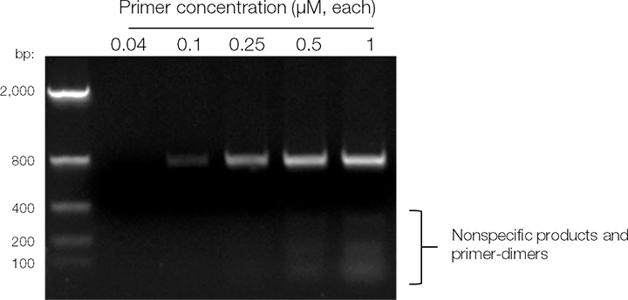
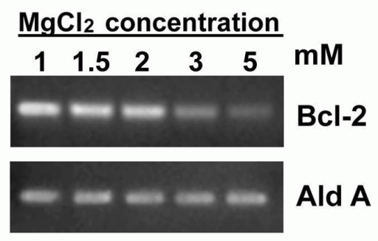
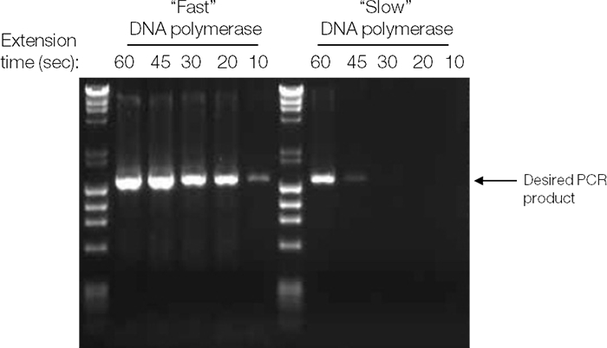
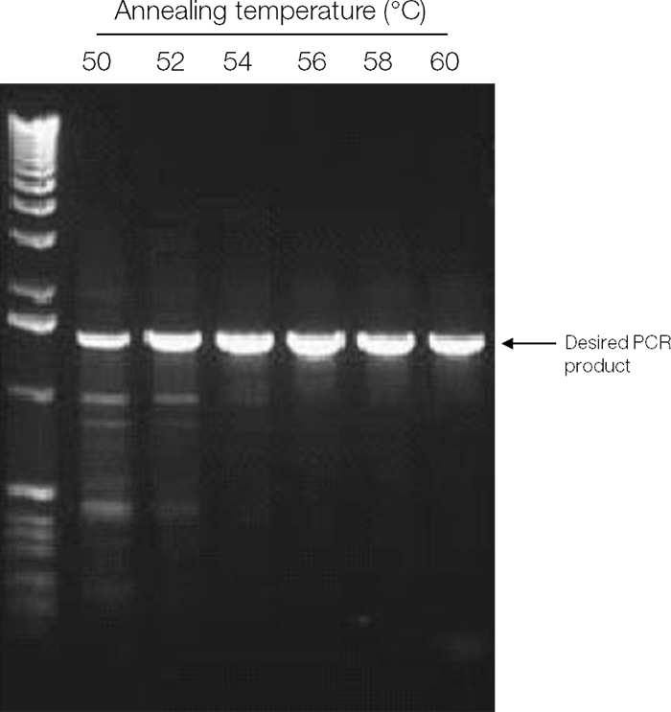
How will you know that you reached to the optimum conditions?

