Slide 1
Polymerase Chain Reaction (PCR)

Slide 2
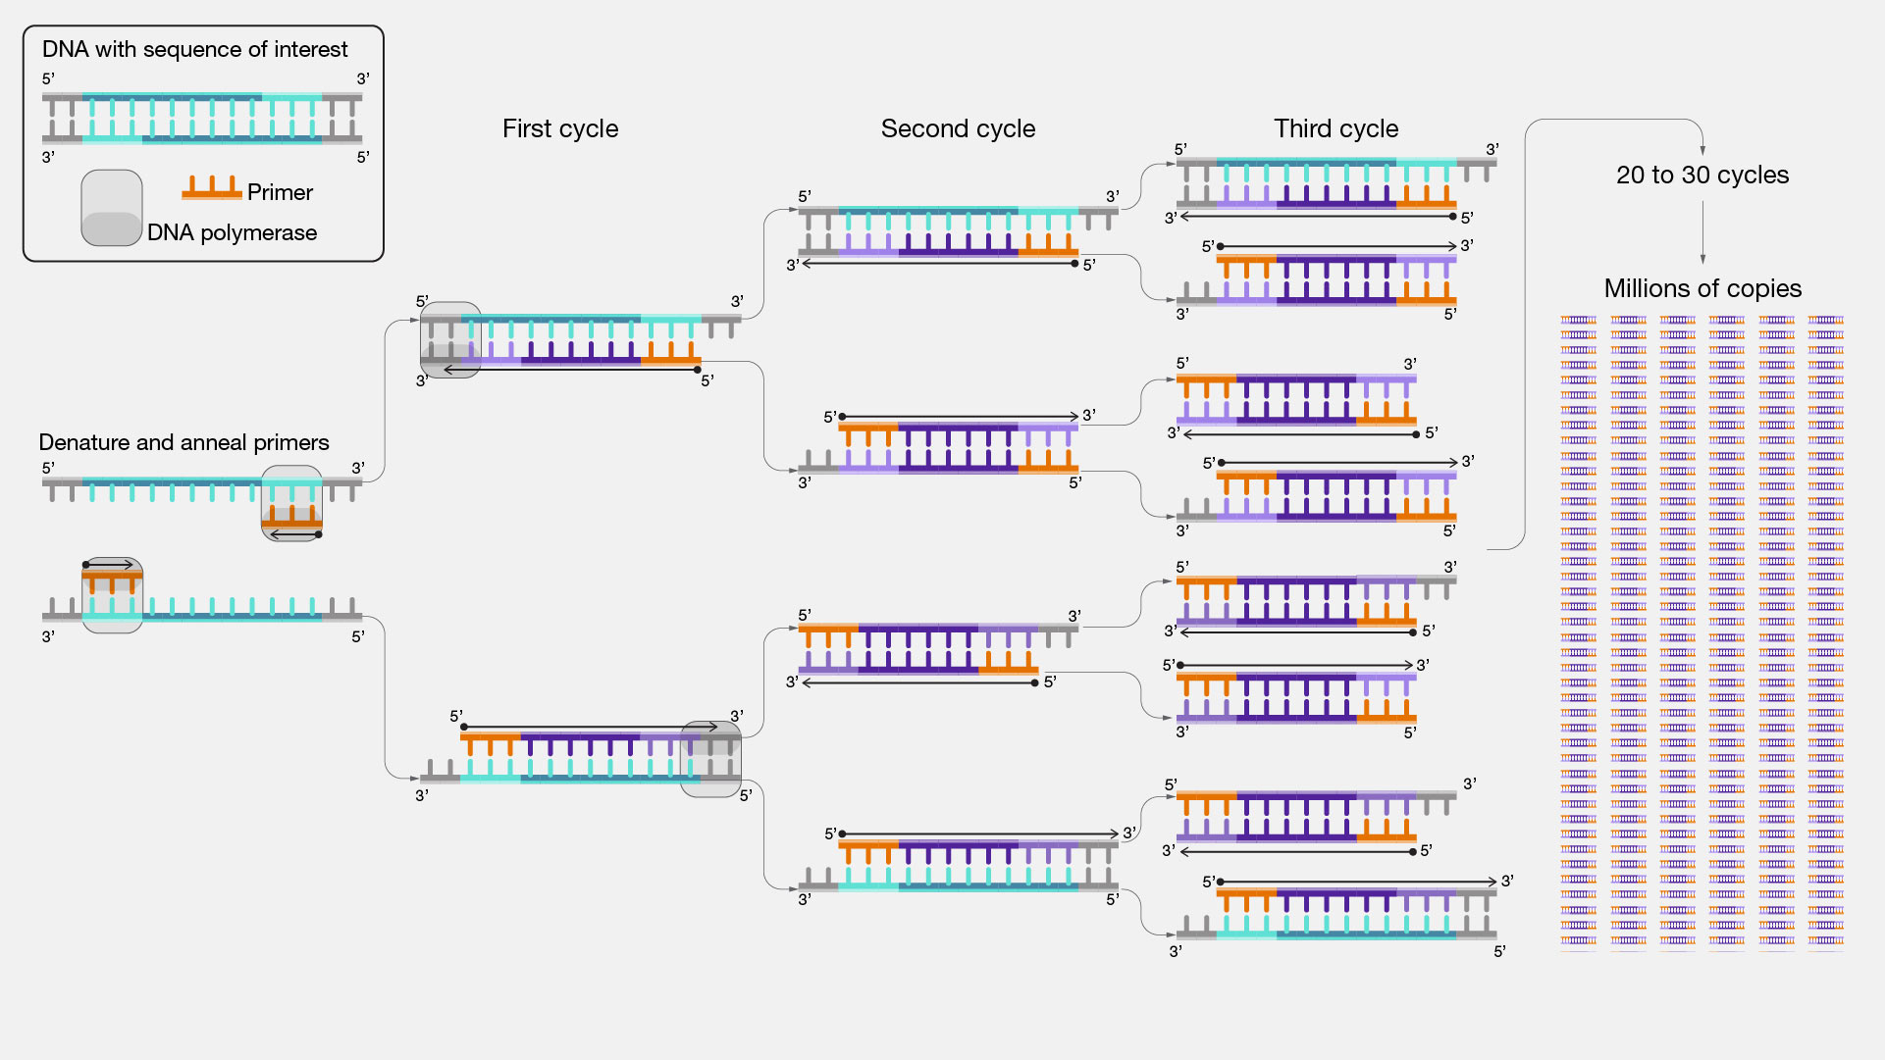
Notes:
https://www.genome.gov/genetics-glossary/Polymerase-Chain-Reaction

Slide 3
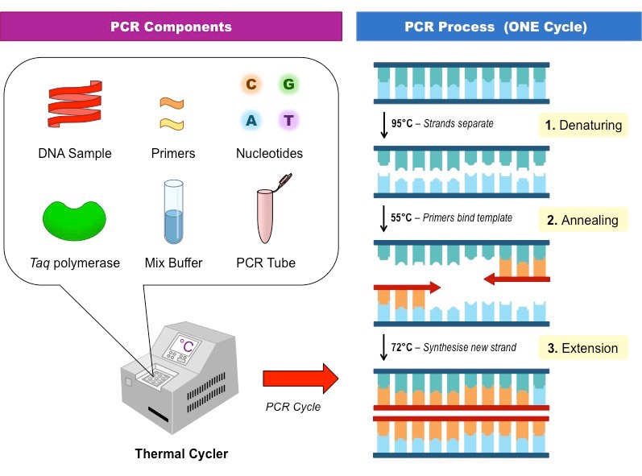
MAIN ways to clone DNA
PCR (Polymerase Chain Reaction)
Recombinant DNA Technology
Notes:
https://facellitate.com/advantages-and-disadvantages-of-pcr-technology/

Slide 4
Why do we need cloning?

Slide 5
PCR (Polymerase Chain Reaction):
The purpose of this technique, is to amplify a specific segment of DNA (sequence). It allows scientists to make millions or billions of copies of a particular DNA sequence.
method developed by Kary Mullis in the 1980s
Principle:
The principle of PCR (Polymerase Chain Reaction) is based on the ability of DNA polymerase enzymes to synthesize new DNA strands(target sequence) using a DNA template and short DNA primers. PCR allows for the amplification of a specific target DNA sequence(in the template), generating millions or billions of copies of that sequence.

Slide 6
PCR components:
1- DNA template (contain the target DNA to be amplified),
2- Primers (short DNA sequences that flank the target region),
3- nucleotides (building blocks of new DNA) (dNTPs or deoxynucleotide triphosphates)
4- DNA polymerase enzyme (such as Taq polymerase, which can withstand high temperatures). amplification. This enzyme is extremely heat resistant, its optimal temperature (72°C). Note that DNA polymerase, can add a nucleotide only onto a pre-existing (3'-OH group).
5-Water free nucleases.
6-Mgcl2\ KCl
(template)
(d-NDPs)

Slide 7
Working with PCR we need to,
1- Determine the target sequence (to be amplified) in the DNA template.
2-Design the primers , for that specific sequence in the template DNA. (for both strands , so two primers Reverse and Forword?) they act as starting points for the amplification to start.
3- Set the suitable PCR device conditions for your sample.
4-Visualize your result.

Slide 8
There are three main steps of PCR:
Step 1
Step 2
Step 3
Denaturation of the DNA template:
The DNA sample is heated to a high temperature, typically around 95°C, to separate the double-stranded DNA into two single strands.
Annealing:
The temperature is lowered, usually to around 50-65°C, allowing short DNA primers to bind to the complementary sequences on each single-stranded DNA template.
Extension:
The temperature is raised to around 72°C, and a heat-stable DNA polymerase enzyme extends the primers by adding new nucleotides, synthesizing new DNA strands.

Slide 9
Notes:
https://blog.labtag.com/a-brief-history-of-pcr-and-its-derivatives/

Slide 10
Denaturation of the DNA template:
The DNA sample is heated to a high temperature, typically around 95°C, to separate the double-stranded DNA into two single strands.
Notes:
https://blog.labtag.com/a-brief-history-of-pcr-and-its-derivatives/

Slide 11
b. Annealing: The temperature is lowered, usually to around 50-65°C, allowing short DNA primers to bind to the complementary sequences on each single-stranded DNA template.

Slide 12
c. Extension:
The temperature is raised to around 72°C, and a heat-stable DNA polymerase enzyme extends the primers by adding new nucleotides, synthesizing new DNA strands.
Reverse primer
Forward primer

Slide 14
Cycling:
PCR is a cyclical process. After one cycle of denaturation, annealing, and extension, the process is repeated multiple times (usually 25-35 cycles). Each cycle doubles the amount of DNA, resulting in an exponential amplification of the target sequence.
Number of target sequence DNA= 2^{no. of cycles}

Slide 15
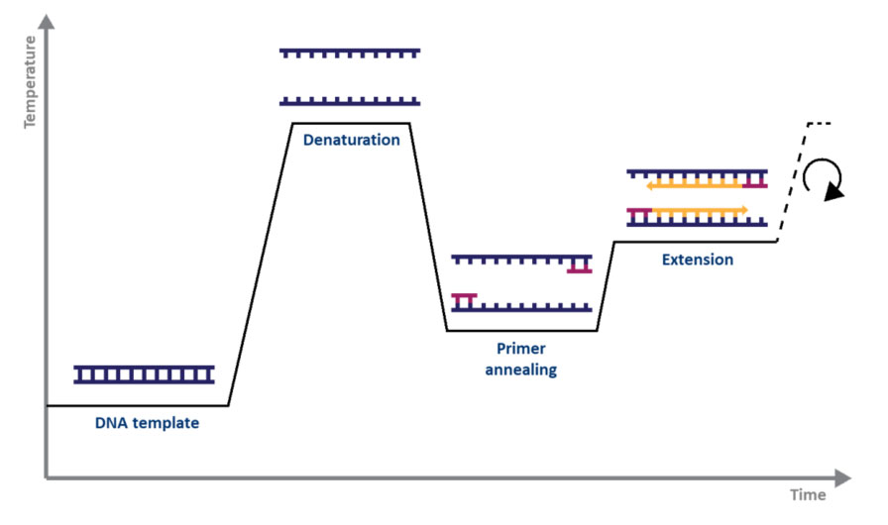
…..min
No. cycles
…..min
…..min
Figure 1. Schematic representation of a cycle of amplification by PCR.
Notes:
https://www.enzolifesciences.com/science-center/technotes/2017/march/what-are-the-differences-between-pcr-rt-pcr-qpcr-and-rt-qpcr?/

Slide 16
To start working with PCR,
1- determine the target sequence in the DNA template.
2-design the primers , for that specific sequence in the template DNA. (for both strands , so two primers Reverse and Forword?)
3- set the suitable PCR device conditions for your sample.
4-visualize your result.

Slide 17
Applications: there are wide range of applications for PCR, such as DNA sequencing, genetic testing, medical diagnostics, forensic analysis, and studying gene expression.
Importance of Contamination Prevention: Stress the critical importance of maintaining a sterile and controlled environment to avoid contamination, as even a small amount of foreign DNA can interfere with the PCR reaction.

Slide 18
Visualization of Results:
PCR products are often visualized using agarose gel electrophoresis or other methods to determine if the target DNA was successfully amplified.
Figure 2. Amplification of a DNA template by PCR and analysis by agarose gel electrophoresis.

