Slide 1
Orthopedic investigations
Dr. Abdulrahman Algarni, MD, SSC (Ortho), ABOS
Assistant Professor
Consultant Orthopedic and Arthroplasty Surgeon

Slide 2
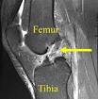
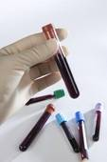
Radiological
Non Radiological (Laboratory)

Slide 3
Radiological
Non invasive
Simple
Almost needed
Quick answer
Types:
X-rays
CT Scan
MRI
Bone scan

Slide 4
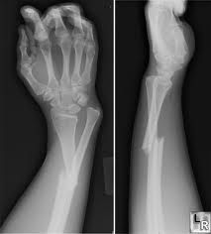
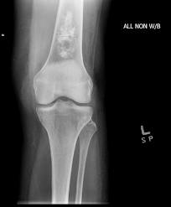
X-rays
Whole bone
Two views
Two joints
Two occasions ( in pediatric cases)

Slide 5
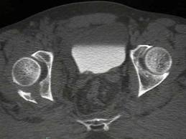
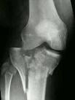
CT Scan
Some times
Some cases which is
Complicated
pelvic fracture
Intra articular
Others
Advanced
Tumors
infection

Slide 6
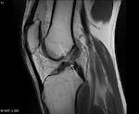
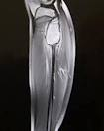
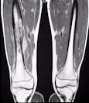
MRI
For soft tissue
No radiation
Cases
Ligament injury
Tumors
infection

Slide 7
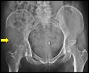
Bone scan
Screening for skeletal lesion
Some cases
Tumor
infection

Slide 8
Non Radiological
Blood
Biopsy
Aspiration
Arthroscopy

Slide 9
Blood
CBC
HB
WBC
Nutrophils
ESR
CRP
Blood culture

Slide 10
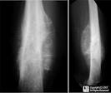
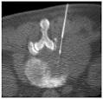
Biopsy
why?
Tumor
Infection
How?
Orthopedic surgeon supervision and decision
Complete aseptic technique
Pre op planning
CT, US-guided

Slide 11
Aspiration
From joint
Why?
Infection
Malignancy
How?
Aseptic technique
Orthopedic supervision
In ER or OR ?

Slide 12
Arthroscopy
To the joints
Visualizing the joint from inside
Diagnostic vs. therapeutic
Light camera
fluid
suction + tools

