Slide 1
OSTEOARTHROSIS
Dr. Abdulrahman Algarni, MD, SSC (Ortho), ABOS
Assistant Professor
Consultant Orthopedic and Arthroplasty Surgeon

Slide 2
Definition
A non-inflammatory (Degenerative) disease affecting articular cartilage of joints

Slide 3
Etiology
Primary
Intrinsic defect (mechanical, vascular, cartilage, hereditary-generalized O.A)
Secondary
Secondary to local or systemic disease

Slide 4
Etiology
Increased load: obesity(hips and knees take 3-4 body weight with each step)
Trauma: osteochondral, malunion, sport injury
Congenital/developmental: CDH, multiple epiphyseal dysplasia
Infection

Slide 5
Etiology
Necrosis: Perth’s disease, osteonecrosis, steroids
Hematologic: SCD, hemophelia
Endocrine: DM, acromegaly

Slide 6
Etiology
Metabolic: crystaline deposition disease(gout, CPPD), Paget’s disease
Inflammatory: RA, SLE, Reiter’s syndrome
Neuropathic: DM, tabes dorsalis

Slide 7
Epidemiology
Common in our community esp. knees
Much more in females ;esp. obese
Presents earlier than in West
About 90% of those over 40 have asymptomatic degeneration of weight bearing joints
Commonest joints are knee, hip, C-Spine & L-Spine,1st CMJ,1st MTPJ and IPJ

Slide 8
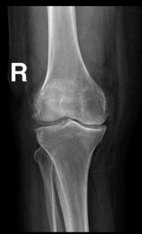
Pathophysiology
Increased water content: swelling and softening of cartilage
Depletion of Proteoglycans
Chondrocyte damage and synovitis › proteolytic enzymes› collagen disruption
Fibrillation on weight bearing surfaces
Loss of cartilage height and exposed bone› Decreased joint space

Slide 9
Pathophysiology
Attempts of repair: SUBCHONDRAL SCLEROSIS
eburnation (ivory-like bone)
Fissuring (cracks): synovial fluid pumped into subchondral bone ›SUBCHONDRAL CYST
Hypervascularity of synovium and subchondral bone
›proliferation of adjacent cartilage › enchondral ossification› OSTEOPHYTE

Slide 10
fissuring
Osteophytes and eburnation

Slide 11
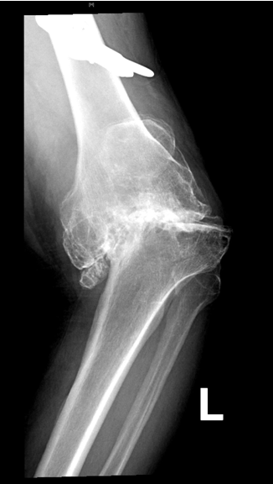
Pathophysiology
Synovial and capsular thickening
Progressive bone erosion› BONE COLLAPSE
Fragmented osteophyte› LOOSE BODIES
Loss of height and ligamentous laxity› MALALIGNMENT

Slide 12
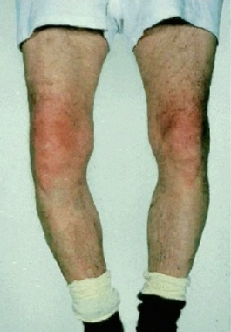
Clinical picture
SYMPTOMS
Pain, inability to bear weight, stiffness, limping, deformity, instability
SIGNS
Effusion, Swelling, tenderness, crepitus, deformity-malalignment

Slide 13
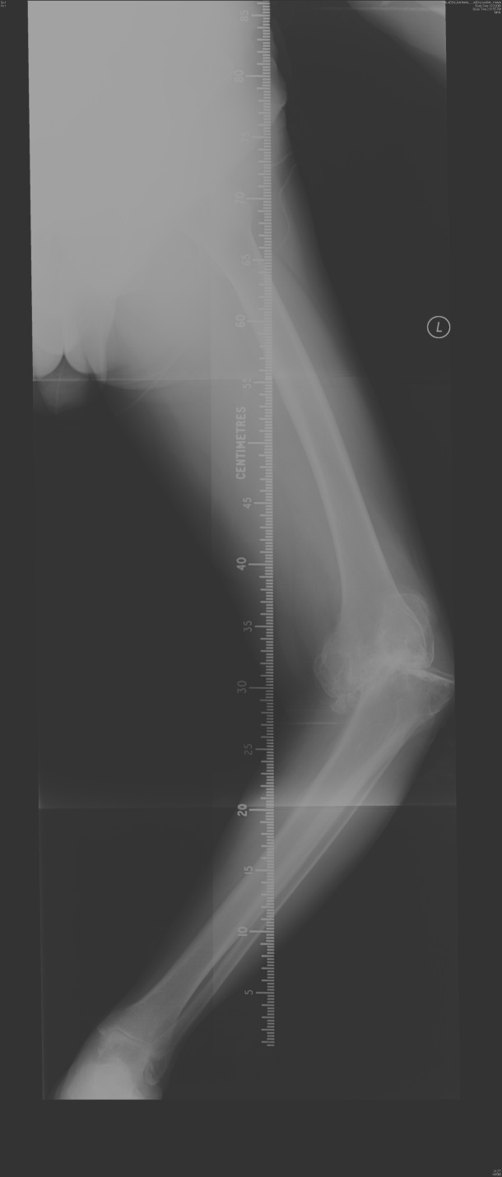
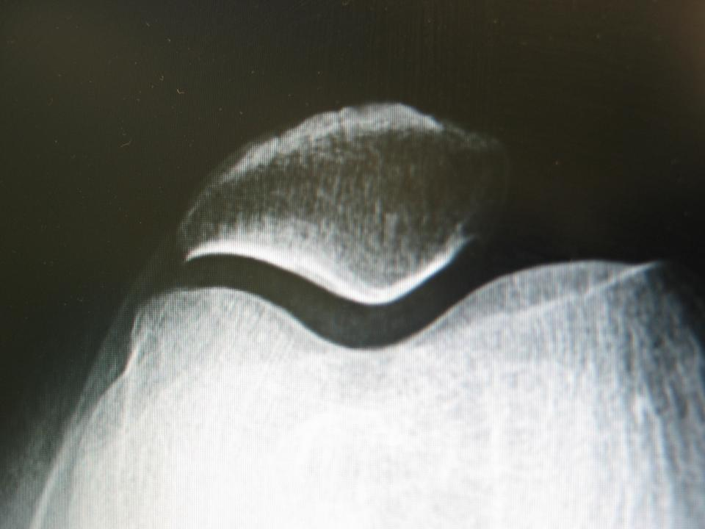
INVESTIGATIONS
X-ray (STANDING in lower limb)
Loss of space
Sclerosis
Cysts
Osteophytes
Loose bodies
Malalignment
Subluxation
synovial analysis (in differential diagnosis)

Slide 14
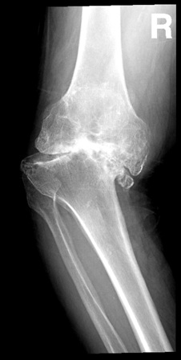
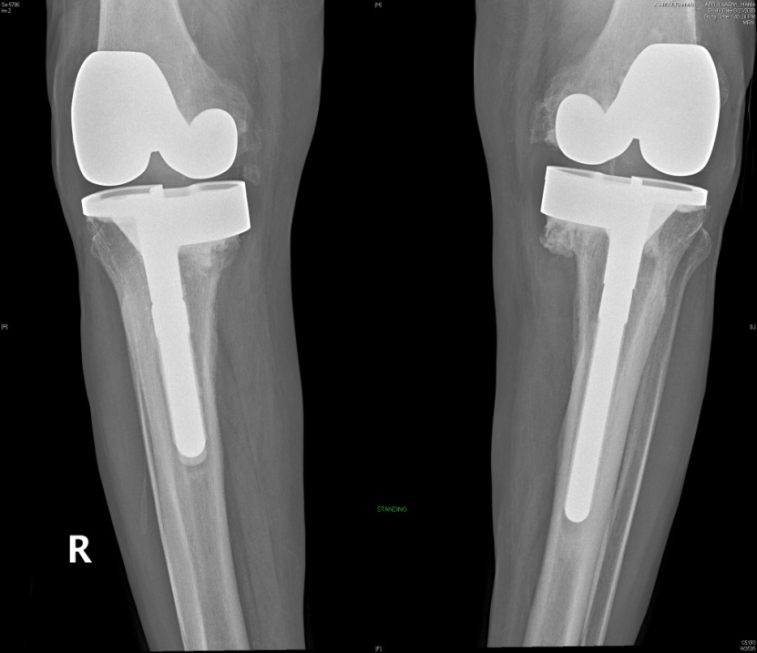
Management
History
Examination
Investigations

Slide 15
Conservative treatment
Decrease load (stick, brace, reduce weight)
Modify activity
Physiotherapy:
prevent contractures
muscle strengthening
range of motion
Medications
systemic
local

Slide 16
Surgical treatment
Joint Debridement
Corrective Osteotomy
What? varus/valgus, abd./add.
Why? realign axis and redistribute weight

Slide 17
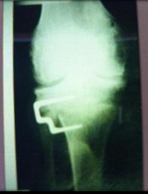
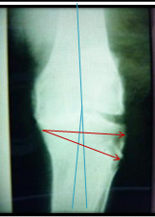
Surgical treatment
Which joint? knee/hip
What joint? mobile, stable, minimally deformed
Which patient? young, thin, active

Slide 18
Surgical treatment
Arthrodesis:
Why? transfer painful stiff into painless stiff joint
Which joint? wrist, ankle, C-Spine, L-Spine, hand
hips and knees (LESS COMMON)

Slide 19
Surgical treatment
When?
failed TKR(infection)
Neuropathic
paralytic (flail)
Loss of quad.
Stiff in young

Slide 20
Surgical treatment
When NOT?
Ipsilateral disease
Contralateral hip disease
bilateral joint disease
TRANSFER LOAD TO DISTAL and CONTRALATERAL JOINTS

Slide 21
Surgical treatment
Excision Arthroplasty
what? remove part of joint to allow movement
Disadvantage:
weakness
shortening
walking aid

Slide 22
Surgical treatment
Which joint? Hip; post infection(girdle stone)
1st MTPJ
Partial Joint Replacement
Which joint?
hip (fracture)
knee
shoulder(SCD, RA)

Slide 23
Surgical treatment
When?
necrosis
degenerative
trauma
Inflammatory (ONLY SHOULDER)
When NOT?
infection
young
inflammatory

Slide 24
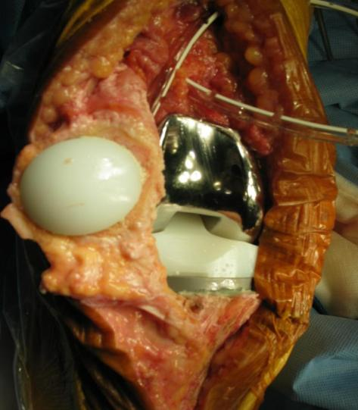
Surgical treatment
TOTAL REPLACEMENT
Which?
knees , hips, shoulders, ankles and elbow
When?
painful, deformed stiff joint, old patient!!

Slide 25
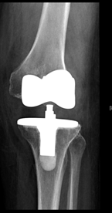
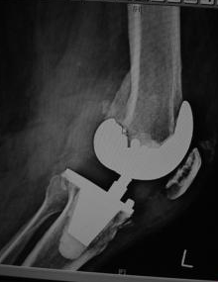
Surgical treatment
When NOT?
neuropathic
infection
paralytic
young, active(RELATIVE)

