Slide 1
Neutralization test
ASO test

Slide 2
Toxin - Antitoxin Neutralization test
In Vivo (Schick test):
Schick test - used to determine whether or not a person is susceptible to diphtheria (Corynebacterium diphtheria).
Named after its inventor, Béla Schick (1877-1967)
It is a simple procedure.

Slide 3
A small amount (0.1 ml) of diluted (1/50 MLD) diphtheria toxin is injected intradermally into the arm of the person.
Minimum lethal dose (MLD, also LDmin) is the least amount of drug that can produce death in a given animal species under controlled conditions
If a person does not have enough antibodies to fight it off, the skin around the injection will become red and swollen, indicating a positive result.
This swelling disappears after a few days.
If the person has immunity, then little or no swelling and redness will occur, indicating a negative result.

Slide 4
Results can be interpreted as:
Positive: when the test results in a red necrotic area of 5-10 mm diameter
Pseudo-positive: when there is only a red colored inflammation and it disappears rapidly
Negative reaction: No Wheel and erythema

Slide 5
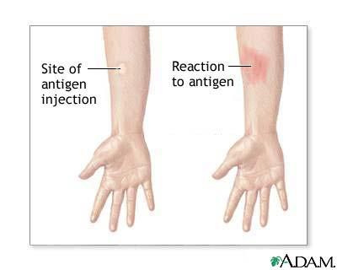

Slide 6
2-In Vitro (Antistreptolysin “O” titration)
ASO titer is used for the serological diagnosis of Group A beta- hemolytic streptococcal post complications
ASO antibodies will be raised after infection with streptococci.
Levels equal or greater than 200 units per ml are considered significant

Slide 7
Measurement of ASO can be useful diagnostically to determine if patient has high risk of post streptococcal complications.
Diseases include:
Rheumatic fever
Post streptococcal glomerulonephritis
Scarlet fever

Slide 8
Principle of ASO test
Ag is streptolysin O =SO (immunogenic)
Ab ( May be present or absent in patient sample)
RBC’s act as Indicator
After diluting patient serum, Streptolysin O is added. After an incubation period, RBC’s are added followed by incubation at 37 c.(why)

Slide 9
Principle
If Ab ( ASO) is present in patient serum , it will bind to SO thus not free to react with indicator RBC’s, the result appears as no hemolysis.
If Ab is absent , Streptolysin O is free to react with RBC’s resulting in hemolysis
The serum sample of each patient will be diluted 1:10 and 1:50.

Slide 10
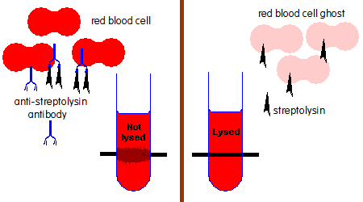
ASO Principle

Slide 11
Procedure
Deliver 50ul of Aso buffer to wells 2-8 in Row A, and wells 2-9 in Row B. Put 75ul of Aso buffer in well A9.
Deliver 50 ul of 1:10 diluted patient serum to wells 1,2 in row A. Do the same for 1:50 patient serum of row B.
Make serial doubling dilutions from well 2 till 8 and discard 50ul from well 8 in both rows.
Add 25ul of streptolysin O(Ag) to wells 1-8 in row A and wells 1-9 in row B. Incubate at 37c for 10-15 min.
Add 25ul of 3% washed sheep red blood cells to all wells and incubate at 37c for 1 hour. Read Ab titer.

Slide 12
Procedure Outline Row A
1 2 3 4 5 6 7 8 9 10 11 12
 |  |  | 75ul ASO buffer |  |  |  |  |  |  | 50ul ASO buffer
 |  |  |  |  |  |  |  |  |  | Serum1:10 50ul | Serum 1:10 50ul
 |  |  |  |  |  |  |  |  |  | 25ul | Streptolysin O
 |  |  |  |  |  |  |  |  |  | 25ul | 3% RBC
 |  |  | No lysis | 1:1280 |  |  |  |  |  | 1:20 | 1:10

Slide 13
Procedure Outline Row B
1 2 3 4 5 6 7 8 9 10 11 12
 |  |  |  |  |  |  |  |  |  | 50ul ASO buffer
 |  |  |  |  |  |  |  |  |  | Serum1:50 50ul | Serum 1:50 50ul
 |  |  |  |  |  |  |  |  |  | 25ul | Streptolysin O
 |  |  |  |  |  |  |  |  |  | 25ul | 3% RBC
 |  |  | lysis | 1:6400 |  |  |  |  |  | 1:100 | 1:50

Slide 14
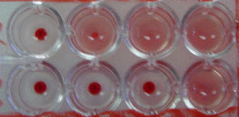
Results
Lysis
NO lysis
Ab titer

Slide 15
Reading of results
There will one serum sample,2 starting dilutions (1:10,1:50 )and one Ab titer for each patient sample
Check controls ( A9,B9)
A9= red cell control +Aso buffer=no lysis (Why used)
B9= streptolysin control+ red cells= lysis (Why used)
Ab titers < 50 IU/ml considered –ve
Ab titers <200 and > 50 IU/ml are equivocal
Ab titers >= 200 IU/ml are considered to have high risk of post streptococcal complications.

Slide 16
Notes
This test is a secondary serological test(why)
RBC are used as indicator.
Streptolysin have to be prepared immediately before use , it is O2 labile.
RBC’s have to prepared fresh, since spontaneous lysis may occur.

