Slide 1
NET 445 – Setup Virtual Box and Ubuntu
Semester II –2020-2021

Slide 2
Setup Virtual Box
https://www.virtualbox.org/wiki/Downloads

Slide 3
Download Ubuntu Mate
Install Ubuntu mate 18
https://ubuntu-mate.org/download/

Slide 4
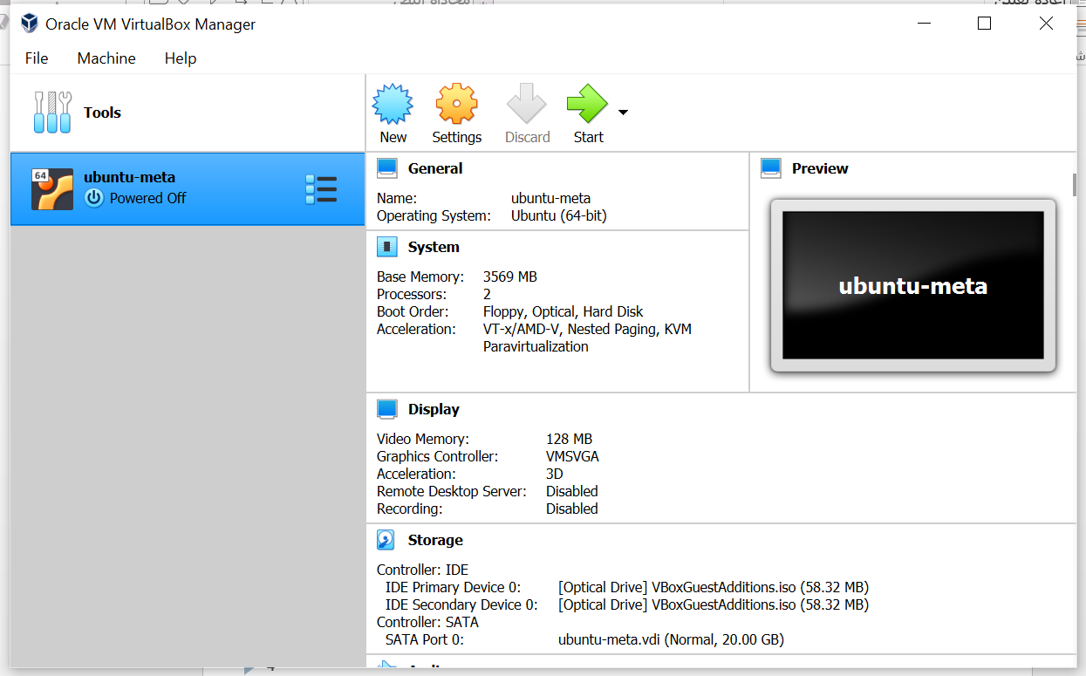
Start the VM and install Ubuntu

Slide 5
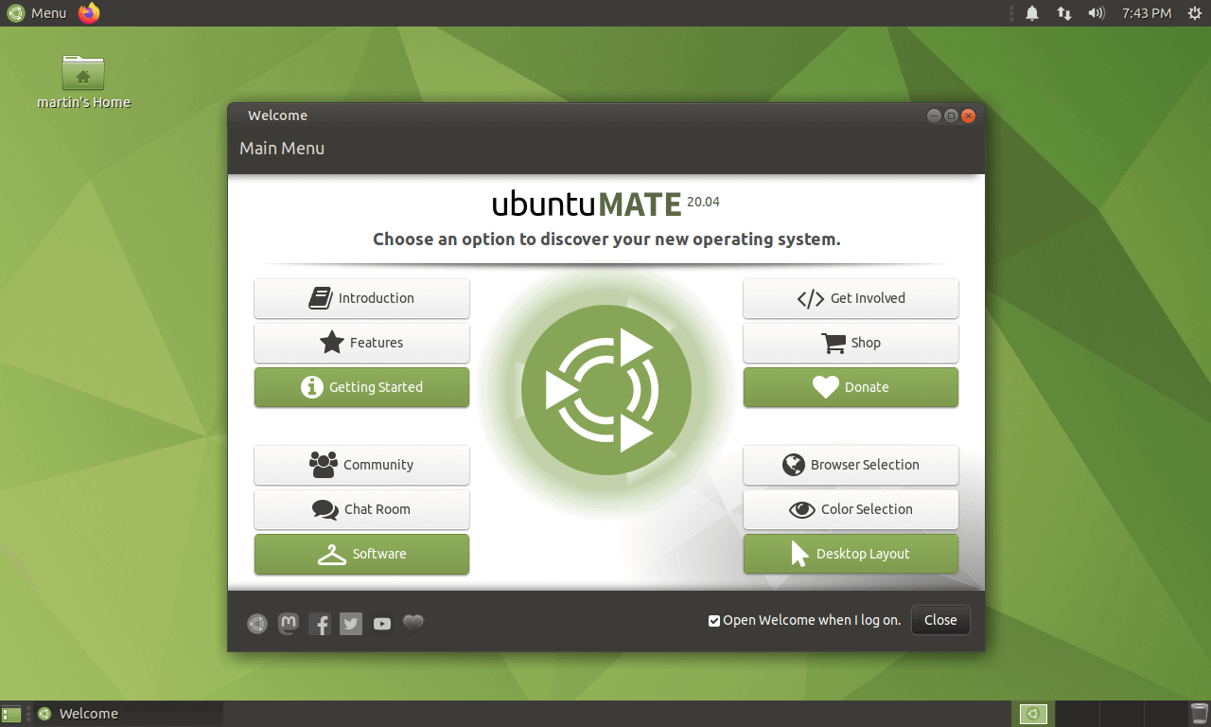
Explore Ubuntu mate GUI

Slide 6
Geany IDE
Geany IDE was developed to provide a small and faster IDE for users for editing files.
Features:
Geany has a large number of features which is useful for use, below is the list of few basic features:
Syntax highlighting
Code completion
Auto completion of constructs
Geany supported filetypes like C, Java, PHP, HTML, Python, Perl, Pascal

Slide 7
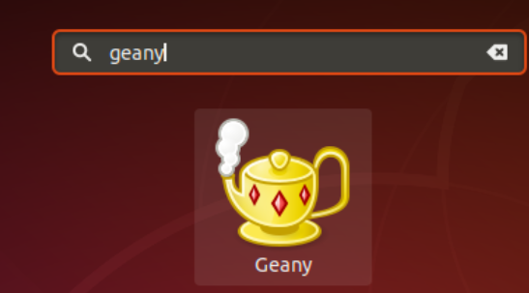
Download Geany IDE on Ubuntu
Open your terminal and run the following command:
To start Geany IDE go to dashboard home search box and type “Geany”

Slide 8
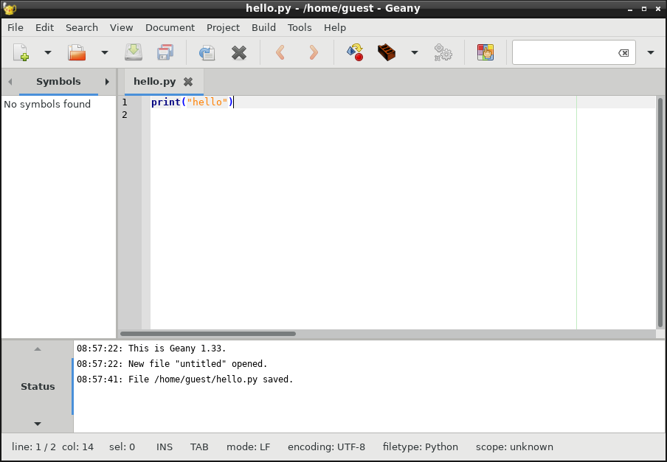
Lunch Geany IDE

