Slide 1
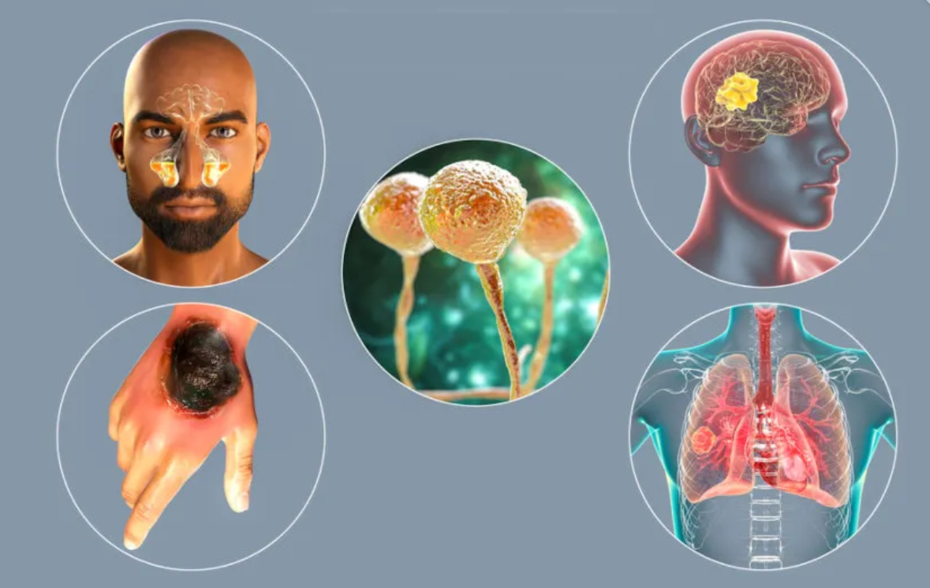
Mucormycosis

Slide 2
Mucormycosis
Mucormycosis is also known as Zygomycosis
Invasive infection caused by filamentous fungi of the Mucoraceae family.
These molds are commonly found in the environment, particularly in soil
It is spread by spores, most often through inhalation, contaminated food, or contamination of open wounds.
Most common species are…Rhizopus sp , Mucor sp.( common bread molds !!)
Opportunistic fungal infection with high mortality rate.

Slide 3
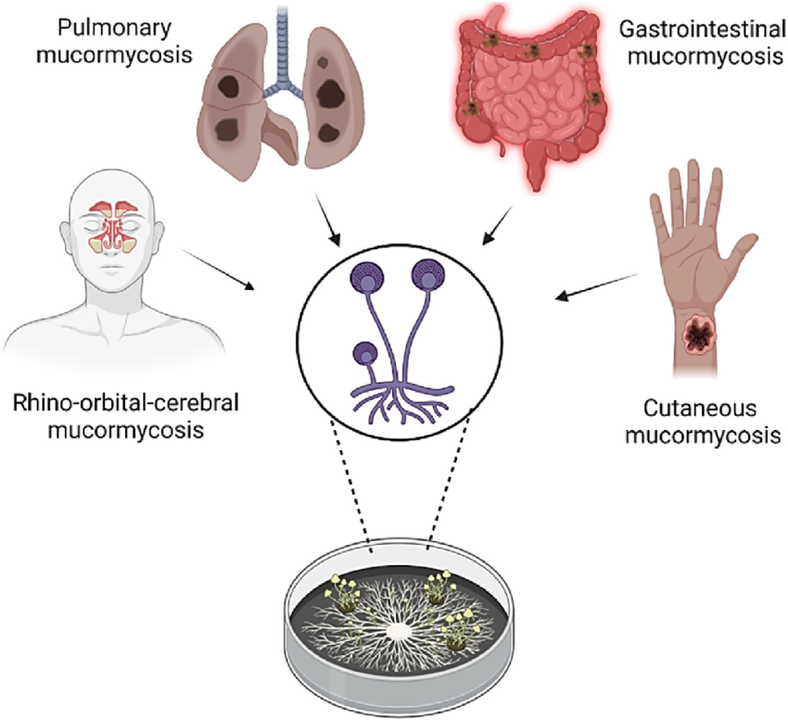
Mucormycosis Clinical Presentation/forms )
Clinical forms of mucormycosis :
Rhino cerebral ((Sinuses and brain) , it has the highest frequency and mortality)
Pulmonary/Lung
Gastrointestinal (GI)
Cutaneous/Skin

Slide 4
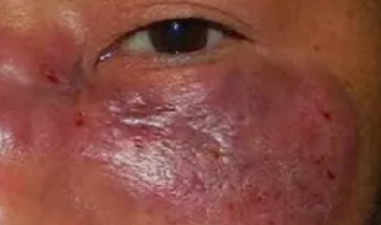
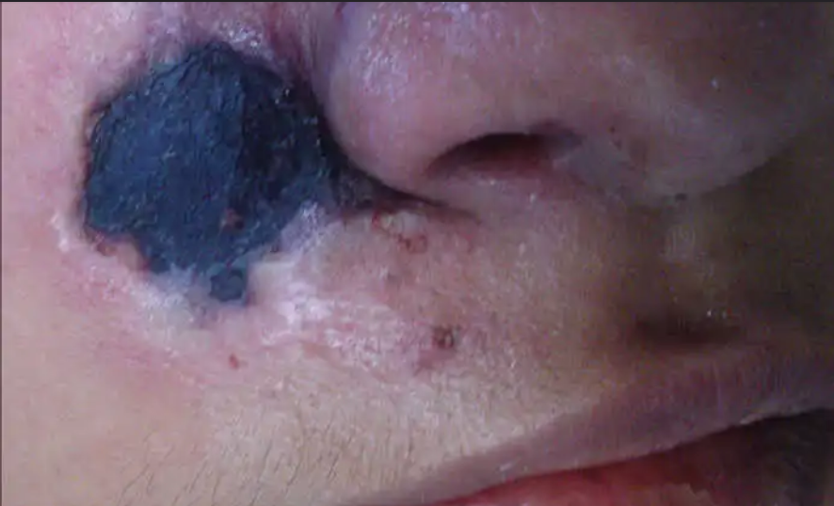
Symptoms of Mucormycosis
Rhinocerebral mucormycosis: headache, red and swollen skin over nose and sinuses, dark scabbing in the nose by the eye(s), visual problems, eye(s) swelling, facial pain (This type of infection occurs in the sinuses and can spread to the brain)
Pulmonary (lung) mucormycosis: coughing sometimes with bloody or dark fluid production, shortness of breath

Slide 5
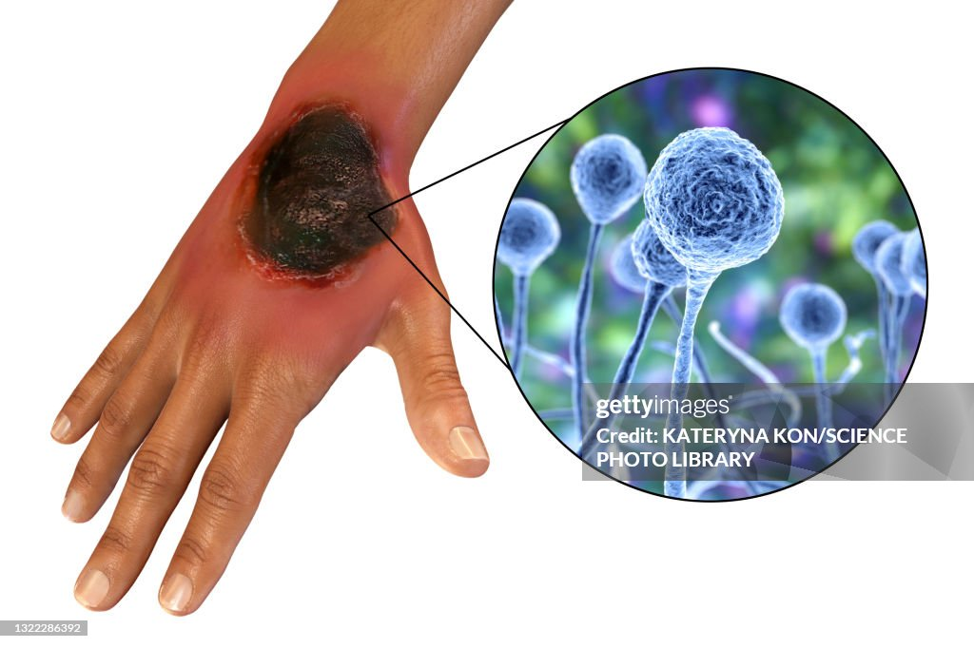
Symptoms of Mucormycosis
GI mucormycosis: abdominal pain, bloody and sometimes dark vomitus, abdominal distension (swelling)
Cutaneous mucormycosis: red and swollen skin, that becomes an ulcer with a dark center and sharply defined edges

Slide 6
During the second wave of COVID 19, an increase in the number of mucormycosis cases has been observed across India.
This increase was as a result of uncontrolled diabetes, and high fungal spores in the environment

Slide 7
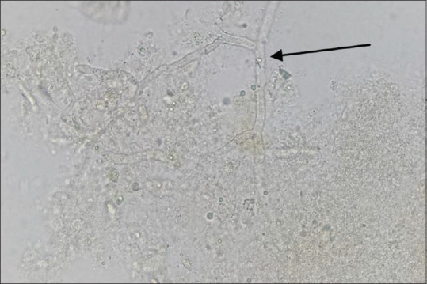
Diagnosis of Mucormycosis
Potassium hydroxide (KOH) wet mount:
A small piece of the excised tissue or BAL/sputum are kept in the 20% KOH.
The Mucorales hyphae is (coenocytic/aseptate) and branched

Slide 8
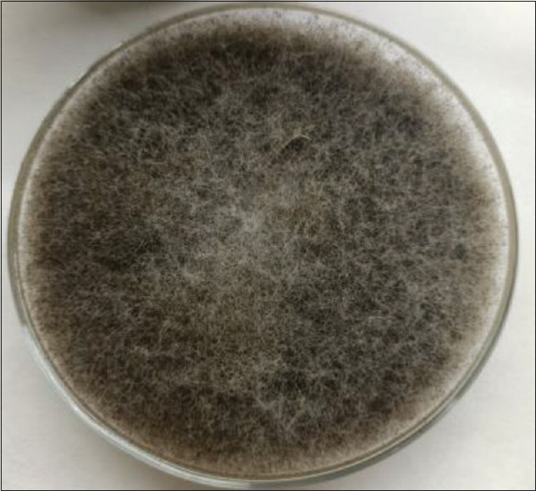
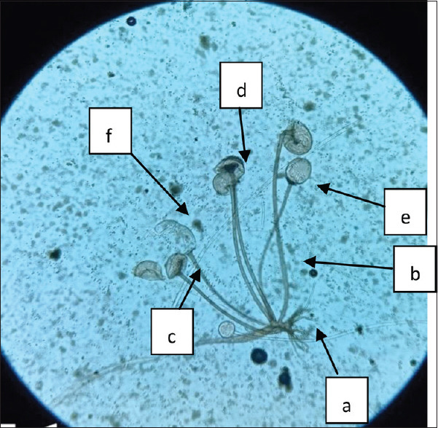
Diagnosis of Mucormycosis
B) Culture
Cottony-fluffy growth of Rhizopus arrhizus on SDA agar
(SDA) is most widely used to cultivate the fungal pathogen.
Mucorales grow rapidly at 25-37°C,
The fungal growth is cottony fluffy and usually observed within 72hrs.
The causative fungal pathogen is identified by standard mycological procedures including colony characteristics, morphological features (characteristics) on lactophenol cotton blue dye
morphological features (characteristics) on lactophenol cotton blue dye

Slide 9
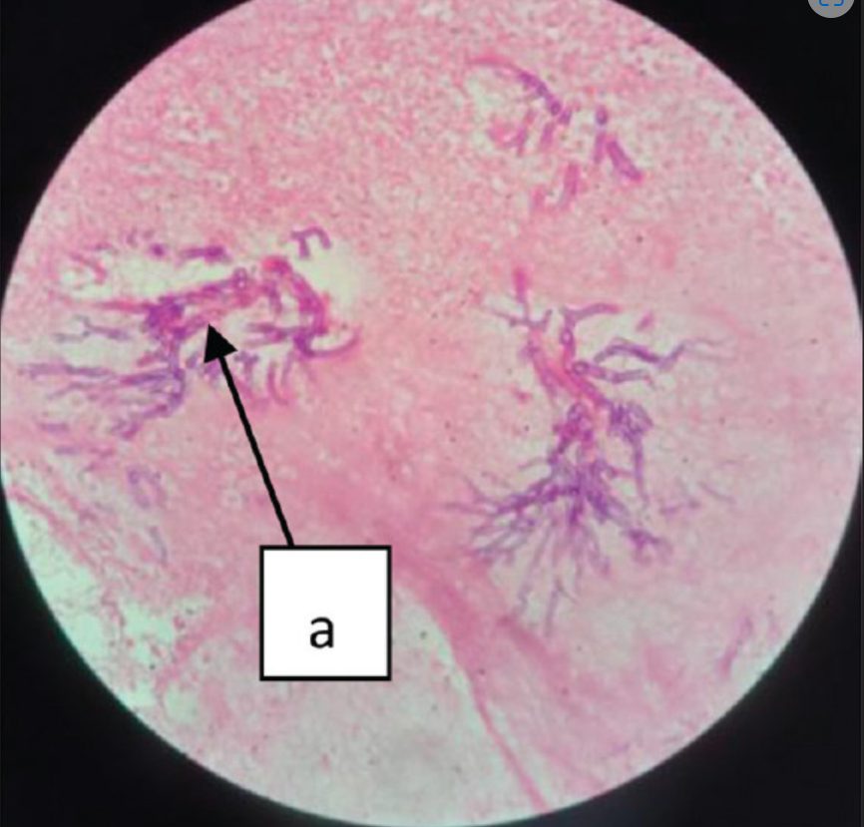
Diagnosis of Mucormycosis
C) Histopathological examination:
The infected tissue is to be sent in a sterile container having 10% formalin which preserves the tissue
it is cut into multiple small pieces which undergo paraffin embedding
the embedded paraffin block is cut into multiple 4-5 micrometer thickness parts, and stained by Hematoxylin and Eosin (H&E) staining.
On microscopic examination, tissues from the suspected case of mucormycosis show 1-tissue damage, 2-inflammatory infiltrate and 3-fungal hyphae.
(H&E) staining showing the fungal hyphae

