Slide 1



عمادة تطوير المهارات
Discrete Mathematics
Chapter 02
Logic
إعداد وتقديم
دكتور أحمد السيد
كلية العلوم- قسم الرياضيات -جامعة الملك سعود
aalsayedmm@gmail.com
0559596720

Slide 2


Slide 3








استراتيجيات التعليم
التطبيق العملي
العصف الذهني
العرض التقدمي
المناقشة
البحث والاستقصاء
الاكتشاف
المحاضرة
فكر- زاوج -شارك

Slide 4
Course code: 153 Math
Course name: Discrete Mathematics
Level: 1
Third Semester 2st Year / B.Sc.
Course Credit: 3 +2 credits

Slide 5
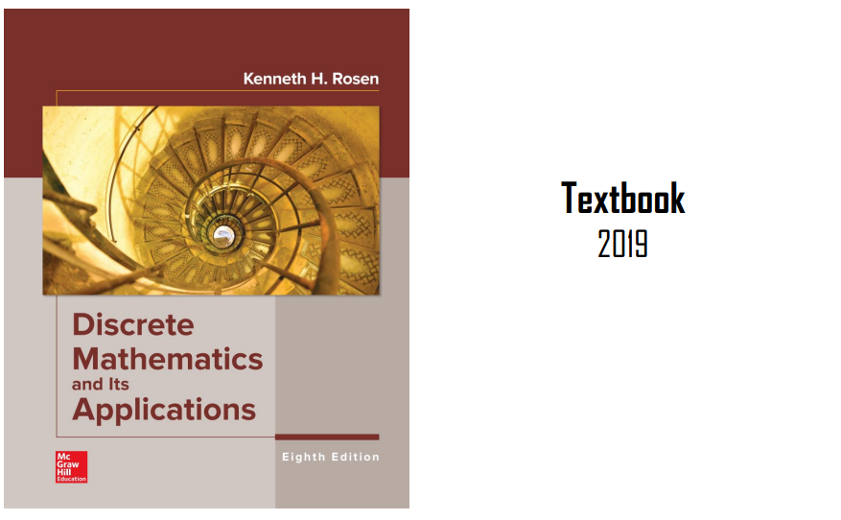
Lectures Reference

Slide 6
Course Outcomes
Learn how to think mathematically.
Grasp the basic logical and reasoning mechanisms of mathematical thought.
Acquire logic and proof as the basics for abstract thinking.
Improve problem-solving skills.
Grasp the basic elements of induction, recursion, combination and discrete structures.
Summarize the basic concepts of mathematical logic.

Slide 7
Content
Week | Basic and support material to be covered
(4) | Logic: Proposition calculus and connectives,
(5) | Logic: Truth tables, Propositional Equivalence.

Slide 8
Introduction to Propositional Logic (1/4)
What is Logic?
Logic is the discipline that deals with the methods of reasoning.
On an elementary level, logic provides rules and techniques for determining whether a given argument is valid.
Logical reasoning is used in mathematics to prove theorems.

Slide 9
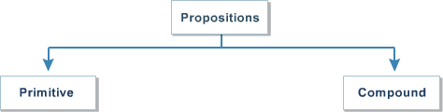
Introduction to Propositional Logic (2/4)
The basic building blocks of logic is Proposition
A proposition (or statement) is a declarative sentence
that is either true or false, but not both.
The area of logic that deals with propositions is called
propositional logics.
Notes:
المنطق الافتراضي بدائي ومجمع

Slide 10
Introduction to Propositional Logic (3/4)
Examples:
Propositions | Truth value
2 + 3 = 5 | True
5 − 2 = 1 | False
Today is Friday | False
𝑥 + 3 = 7 , for 𝑥 = 4 | True
Cairo is the capital of Egypt | True
Sentences | Is a Proposition
What time is it? | Not propositions
Read this carefully. | Not propositions
𝑥 + 3 = 7 | Not propositions

Slide 11
Introduction to Propositional Logic (4/4)
We use letters to denote propositional variables
𝒑, 𝒒, 𝒓, 𝒔, …
The truth value of a proposition is true, denoted by T, if it is a true proposition and false, denoted by F, if it is a false proposition.

Slide 12
Compound Propositions (1/23)
Compound Proposition
Compound Propositions are formed propositions using logical operators.
from
existing

Slide 13
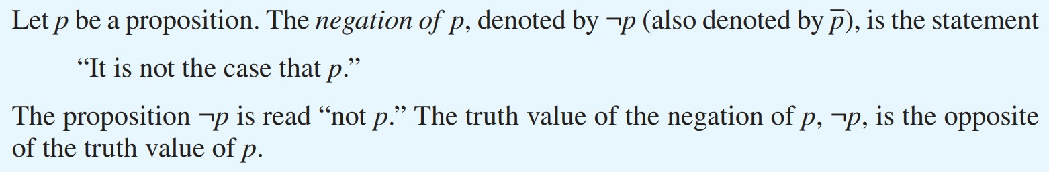
Compound Propositions (2/23)
Negation
Other notations you might see are

Slide 14
Compound Propositions (3/23)
Example
Find the negation of the proposition
𝑝: “Cairo is the capital of Egypt”
P: Riyadh is the capital of Saudi Arabia

Slide 15
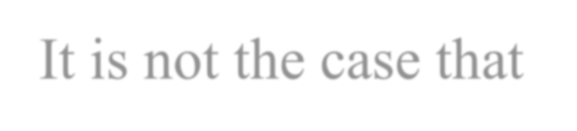
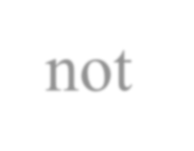
Compound Propositions (4/23)
Example: Solution
Find the negation of the proposition
𝑝: “Cairo is the capital of Egypt” The negation is
¬𝑝: “It is not the case that Cairo is the capital of Egypt”
This negation can be more simply expressed as
¬𝑝: “Cairo is not the capital of Egypt”

Slide 16
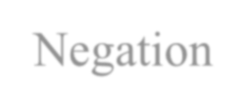


Compound Propositions (5/23)
Truth Table
Truth Table: is a table that gives the truth values of a compound statement.
The Truth Table for the Negation of a Proposition
𝒑 |  |  | ¬𝒑
 | 𝑇
 | 𝐹
Proposition
Truth Values

Slide 17
Compound Propositions (5/23)
Truth Table
Truth Table: is a table that gives the truth values of a compound statement.
The Truth Table for the Negation of a Proposition
𝒑 |  |  | ¬𝒑
 |  |  | 𝐹
 | 𝑇
 | 𝐹 |  | 𝑇
Proposition
Truth Values

Slide 18
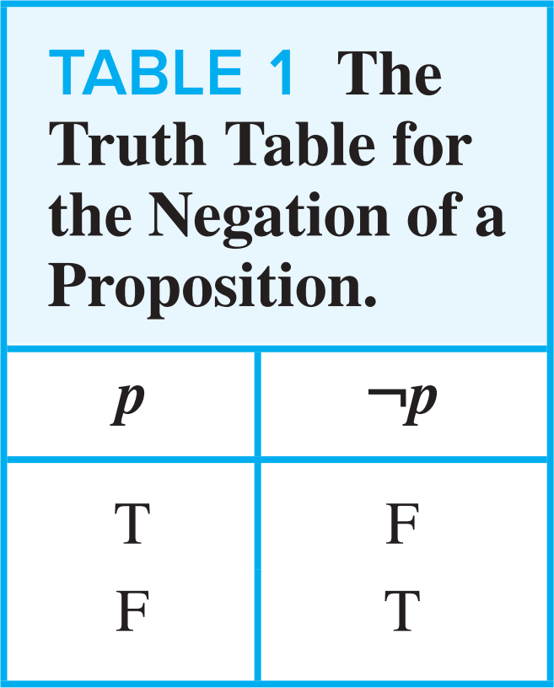
Compound Propositions (6/23)
Negation

Slide 19
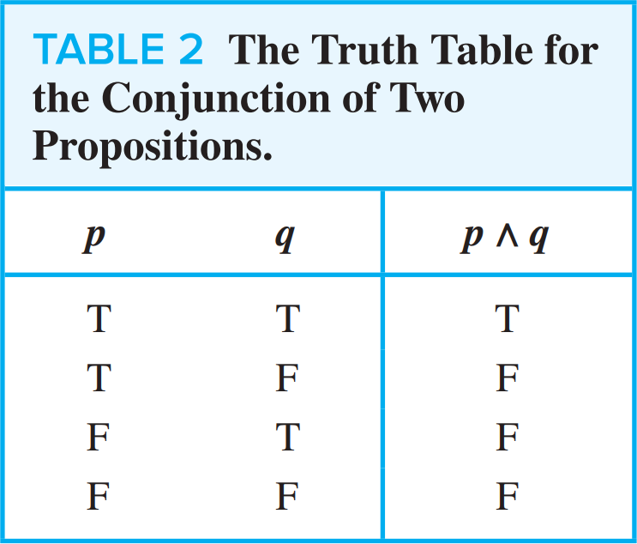
Compound Propositions (7/23)
Logical Connectives
Example
𝑝:
𝑞:
Today is Friday.
It is raining today.
𝑝 𝖠 𝑞: Today is Friday and it is raining today.

Slide 20

Compound Propositions (8/23)
Logical Connectives
Example
𝑝:
𝑞:
Today is Friday.
It is raining today.
𝑝 ∨ 𝑞: Today is Friday or it is raining today.

Slide 21
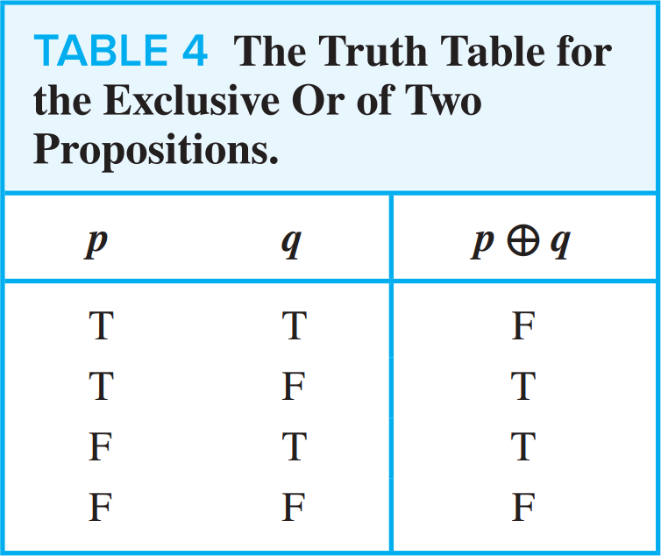
Compound Propositions (9/23)
Logical Connectives
Example
p : They are parents.
q : They are children.
p ⊕ q : They are parents or children but not both.

Slide 22
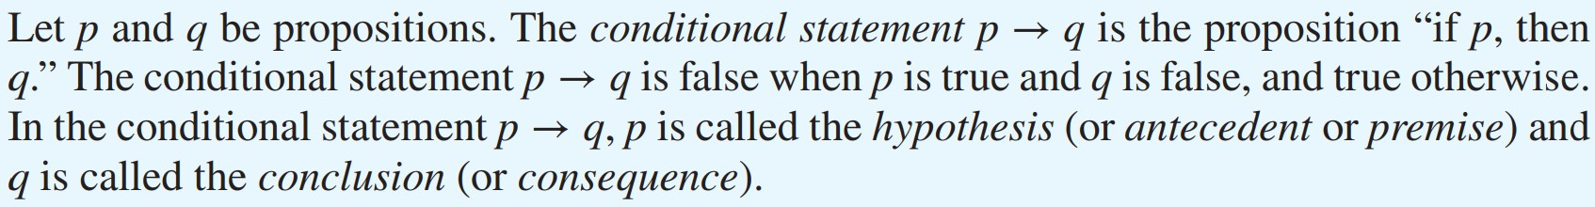
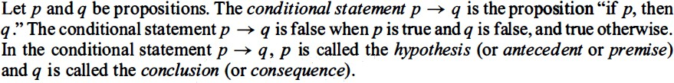
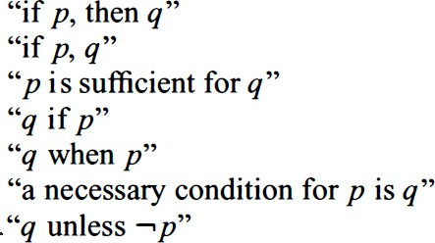
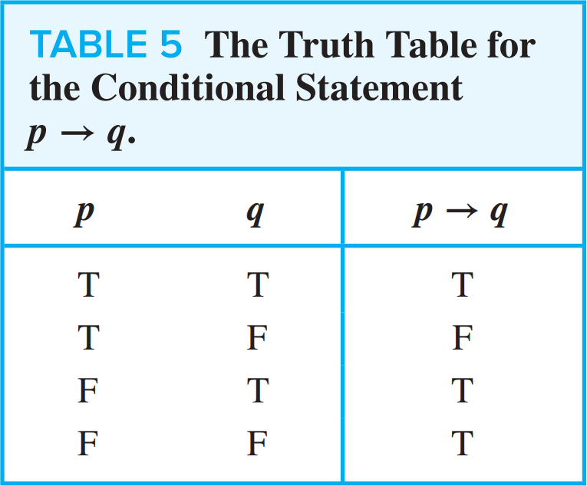
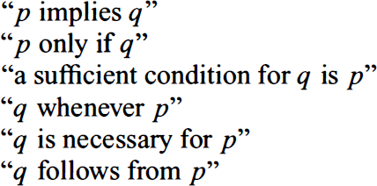
Compound Propositions (10/23)
Logical Connectives

Slide 23
Compound Propositions (10/23)
Logical Connectives

Slide 24
Compound Propositions (11/23)
Logical Connectives
1

Slide 25
Compound Propositions (12/23)
Logical Connectives
2

Slide 26
Compound Propositions (12/23)
Logical Connectives
2

Slide 27
Compound Propositions (13/23)
Logical Connectives
EXAMPLE3

Slide 28
Compound Propositions (13/23)
Logical Connectives

Slide 29
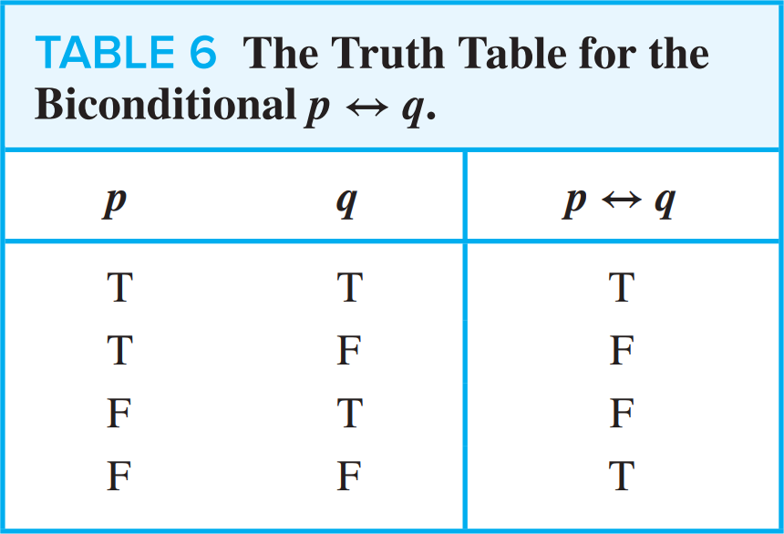
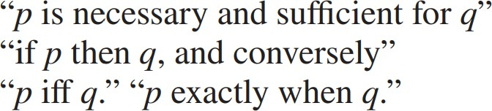
Compound Propositions (14/23)
Logical Connectives

Slide 30
Compound Propositions (15/23)
Truth Tables of Compound Propositions
1

Slide 31
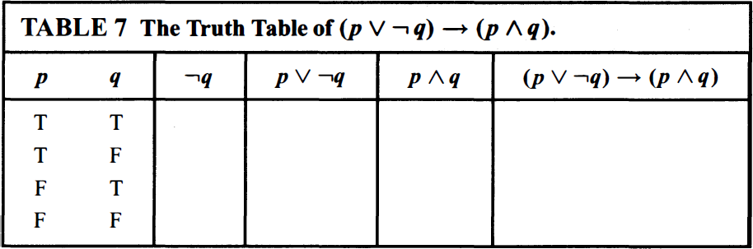
Compound Propositions (16/23)
Truth Tables of Compound Propositions
1

Slide 32
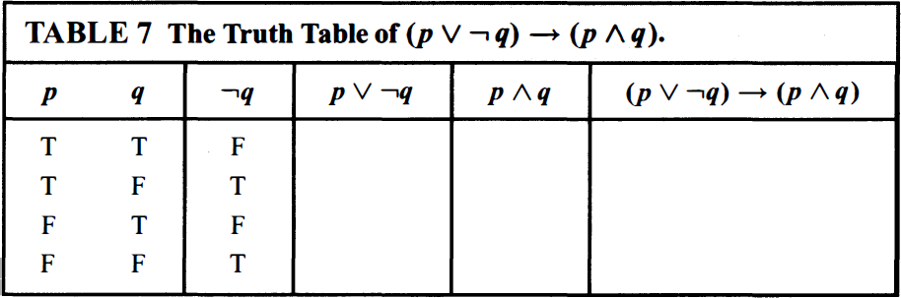
Compound Propositions (16/23)
Truth Tables of Compound Propositions
1

Slide 33
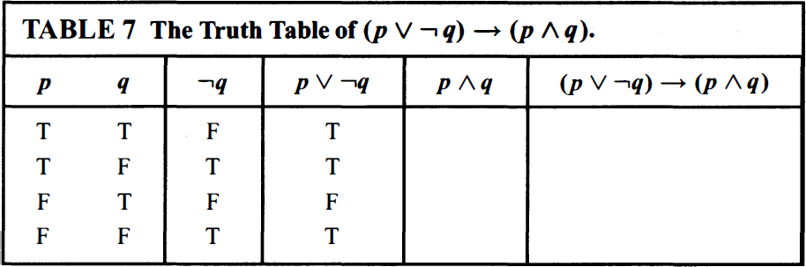
Compound Propositions (16/23)
Truth Tables of Compound Propositions
1

Slide 34
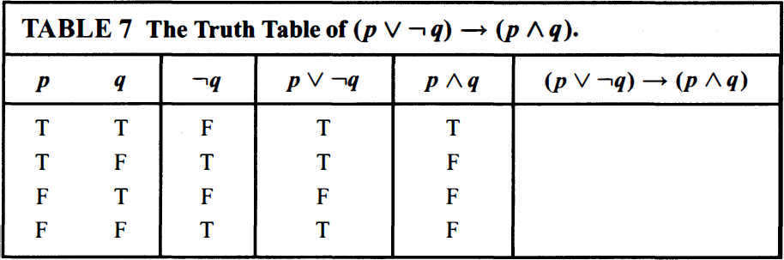
Compound Propositions (16/23)
Truth Tables of Compound Propositions
1

Slide 35
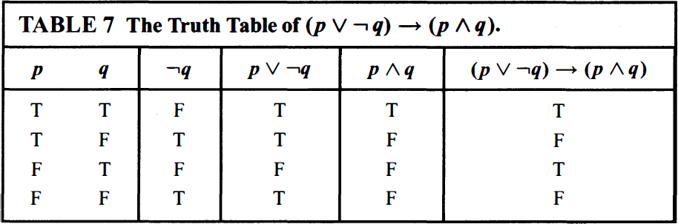
Compound Propositions (16/23)
Truth Tables of Compound Propositions
1

Slide 36
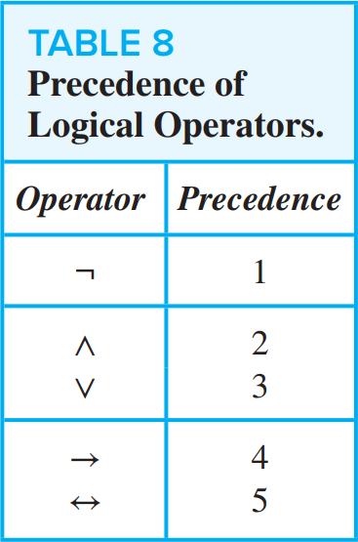
Compound Propositions (17/23)
Precedence of Logical Operators

Slide 37

Compound Propositions (18/23)
Truth Tables of Compound Propositions
2

Slide 38
Compound Propositions (19/23)
Truth Tables of Compound Propositions
2
𝒑 | 𝒒 | 𝒓 | ¬𝒒 | 𝒑 𝖠 ¬𝒒 | 𝒑 𝖠 ¬𝒒 → 𝒓

Slide 39
Compound Propositions (19/23)
Truth Tables of Compound Propositions
2
𝒑 | 𝒒 | 𝒓 | ¬𝒒 | 𝒑 𝖠 ¬𝒒 | 𝒑 𝖠 ¬𝒒 → 𝒓
𝐓 | 𝐓 | 𝐓
𝐓 | 𝐓 | 𝐅
𝐓 | 𝐅 | 𝐓
𝐓 | 𝐅 | 𝐅
𝐅 | 𝐓 | 𝐓
𝐅 | 𝐓 | 𝐅
𝐅 | 𝐅 | 𝐓
𝐅 | 𝐅 | 𝐅

Slide 40
Compound Propositions (19/23)
Truth Tables of Compound Propositions
2
𝒑 | 𝒒 | 𝒓 | ¬𝒒 | 𝒑 𝖠 ¬𝒒 | 𝒑 𝖠 ¬𝒒 → 𝒓
𝐓 | 𝐓 | 𝐓 | 𝐅
𝐓 | 𝐓 | 𝐅 | 𝐅
𝐓 | 𝐅 | 𝐓 | 𝐓
𝐓 | 𝐅 | 𝐅 | 𝐓
𝐅 | 𝐓 | 𝐓 | 𝐅
𝐅 | 𝐓 | 𝐅 | 𝐅
𝐅 | 𝐅 | 𝐓 | 𝐓
𝐅 | 𝐅 | 𝐅 | 𝐓

Slide 41
Compound Propositions (19/23)
Truth Tables of Compound Propositions
2
𝒑 | 𝒒 | 𝒓 | ¬𝒒 | 𝒑 𝖠 ¬𝒒 | 𝒑 𝖠 ¬𝒒 → 𝒓
𝐓 | 𝐓 | 𝐓 | 𝐅 | 𝐅
𝐓 | 𝐓 | 𝐅 | 𝐅 | 𝐅
𝐓 | 𝐅 | 𝐓 | 𝐓 | 𝐓
𝐓 | 𝐅 | 𝐅 | 𝐓 | 𝐓
𝐅 | 𝐓 | 𝐓 | 𝐅 | 𝐅
𝐅 | 𝐓 | 𝐅 | 𝐅 | 𝐅
𝐅 | 𝐅 | 𝐓 | 𝐓 | 𝐅
𝐅 | 𝐅 | 𝐅 | 𝐓 | 𝐅

Slide 42
Compound Propositions (19/23)
Truth Tables of Compound Propositions
2
𝒑 | 𝒒 | 𝒓 | ¬𝒒 | 𝒑 𝖠 ¬𝒒 | 𝒑 𝖠 ¬𝒒 → 𝒓
𝐓 | 𝐓 | 𝐓 | 𝐅 | 𝐅 | 𝐓
𝐓 | 𝐓 | 𝐅 | 𝐅 | 𝐅 | 𝐓
𝐓 | 𝐅 | 𝐓 | 𝐓 | 𝐓 | 𝐓
𝐓 | 𝐅 | 𝐅 | 𝐓 | 𝐓 | 𝐅
𝐅 | 𝐓 | 𝐓 | 𝐅 | 𝐅 | 𝐓
𝐅 | 𝐓 | 𝐅 | 𝐅 | 𝐅 | 𝐓
𝐅 | 𝐅 | 𝐓 | 𝐓 | 𝐅 | 𝐓
𝐅 | 𝐅 | 𝐅 | 𝐓 | 𝐅 | 𝐓

Slide 43
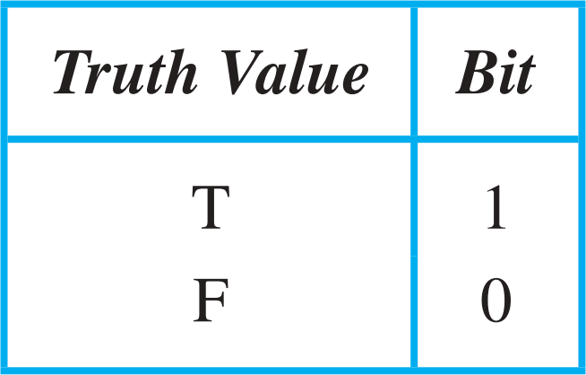
Compound Propositions (20/23)
Logic and Bit Operations
Computers represent information using bits. A bit is a symbol with two possible values, namely, 0 (zero) and 1 (one).

Slide 44
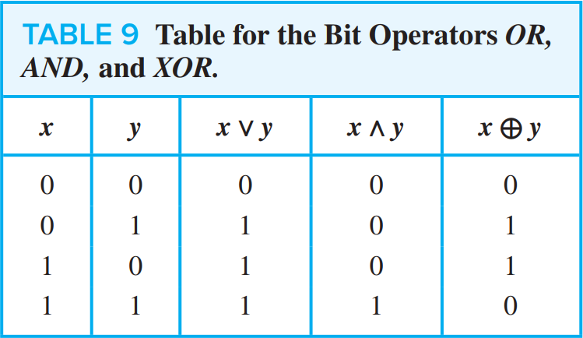
Compound Propositions (21/23)
Computer Bit Operations
We will also use the notation OR, AND, and XOR for the operators ∨, 𝖠, and ⊕, as is done in various programming languages.

Slide 45
Compound Propositions (22/23)
Bit Strings
Information is often represented using bit strings, which are lists of zeros and ones. When this is done, operations on the bit strings can be used to manipulate this information.

Slide 46
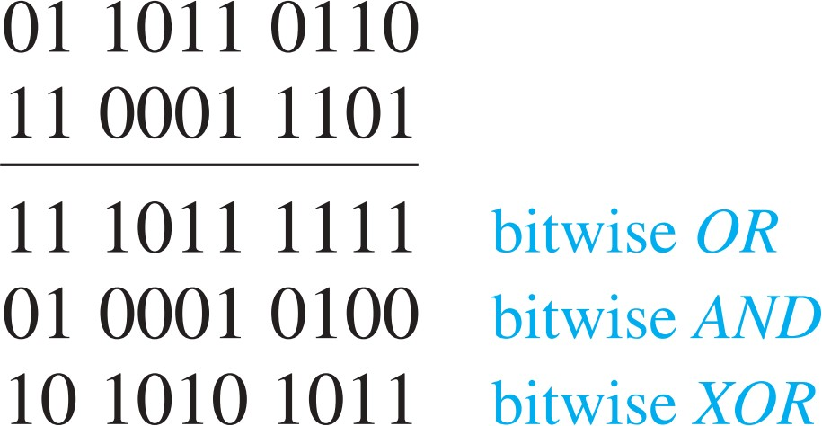
Compound Propositions (23/23)
Example
Find the bitwise OR, bitwise AND, and bitwise XOR of the bit strings 01 1011 0110 and 11 0001 1101

Slide 47
Revision

Slide 48
Propositional Logic
Introduction
A proposition is a declarative sentence (a sentence that declares a fact) that is either true or false, but not both.
Are the following sentences propositions?
  Riyadh is the capital of Saudi Arabia.
  Read this carefully.
  1+2=3
  x+1=2
  What time is it?
(Yes)
(No)
(Yes)
(No)
(No)
Notes:
الاقتراح عبارة عن جملة تصريحية (جملة تعلن حقيقة) تكون إما صحيحة أو خاطئة ، ولكن ليس كلاهما.هل الجمل التالية اقتراحات؟الرياض هي عاصمة المملكة العربية السعودية.اقرأ هذا بعناية.1 + 2 = 3س + 1 = 2أي ساعة؟

Slide 49
DEFINITION
  Let p be a proposition. The negation of p, denoted by ¬p, is the statement “It is not the case that p.”
  The proposition ¬p is read “not p.” The truth value of the negation of p, ¬p is the opposite of the truth value of p.
Example
  Find the negation of the proposition “Today is Friday.” and express this in simple English.
Solution: The negation is “It is not the case that today is Friday.”
In simple English, “Today is not Friday.” or “It is not Friday today.”

Slide 50
Note: Always assume fixed times, fixed places, and particular people unless otherwise noted.
Truth table:
Logical operators are used to form new propositions from two or more existing propositions. The logical operators are also called connectives.
The Truth Table for the Negation of a Proposition.
p | ¬p
T F | F T

Slide 51
DEFINITION
  Let p and q be propositions. The conjunction of p and q, denoted by
  p Λ q, is the proposition “p and q”. The conjunction p Λ q is true when both p and q are true and is false otherwise.
Example
  Find the conjunction of the propositions p and q where p is the proposition “Today is Friday.” and q is the proposition “It is raining today.”, and the truth value of the conjunction.
Solution: The conjunction is the proposition “Today is Friday and it is raining today.” The proposition is true on rainy Fridays.

Slide 52
DEFINITION
  Let p and q be propositions. The disjunction of p and q, denoted by
  p ν q, is the proposition “p or q”. The conjunction p ν q is false when both p and q are false and is true otherwise.
Note:
inclusive or : The disjunction is true when at least one of the two
propositions is true.
  E.g. “Students who have taken calculus or computer science can take this class.” – those who take one or both classes.
  exclusive or : The disjunction is true only when one of the
  proposition is true.
  E.g. “Students who have taken calculus or computer science, but not both, can take this class.” – only those who take one of them.

Slide 53
DEFINITION
  Let p and q be propositions. The exclusive or of p and q, denoted by p q, is the proposition that is true when exactly one of p and q is true and is false otherwise.
The Truth Table for the Conjunction of Two Propositions.
p q | p Λ q
T T T F F T F F | T F F F
The Truth Table for the Disjunction of Two Propositions.
p q | p ν q
T T T F F T F F | T T T F

Slide 54
Conditional Statements
DEFINITION
  Let p and q be propositions. The conditional statement p → q, is the proposition “if p, then q.” The conditional statement is false when p is true and q is false, and true otherwise. In the conditional statement
  p → q, p is called the hypothesis (or antecedent or premise) and q is called the conclusion (or consequence).
A conditional statement is also called an implication.
Example: “If I am elected, then I will lower taxes.” p → q
implication:
elected, lower taxes. T T | T
not elected, lower taxes. F T | T
not elected, not lower taxes. F F | T
elected, not lower taxes. T F | F

Slide 55
Example:
  Let p be the statement “Omar learns discrete mathematics.” and q the statement “Omar will find a good job.” Express the statement p → q as a statement in English.
Solution: Any of the following -
“If Omar learns discrete mathematics, then he will find a good job.
“Omar will find a good job when he learns discrete mathematics.”
“For Omar to get a good job, it is sufficient for him to learn discrete mathematics.”
“Omar will find a good job unless he does not learn discrete mathematics.”

Slide 56
Other conditional statements:
  Converse of p → q : q → p
  Contrapositive of p → q : ¬ q → ¬ p
  Inverse of p → q : ¬ p → ¬ q

Slide 57
DEFINITION
  Let p and q be propositions. The biconditional statement p ↔ q is the proposition “p if and only if q.” The biconditional statement p ↔ q is true when p and q have the same truth values, and is false otherwise. Biconditional statements are also called bi-implications.
p ↔ q has the same truth value as (p → q) Λ (q → p)
“if and only if” can be expressed by “iff”
Example:
  Let p be the statement “You can take the flight” and let q be the statement “You buy a ticket.” Then p ↔ q is the statement
  “You can take the flight if and only if you buy a ticket.”
  Implication:
  If you buy a ticket you can take the flight.
  If you don’t buy a ticket you cannot take the flight.

Slide 58
The Truth Table for the Biconditional p ↔ q.
p q | p ↔ q
T T T F F T F F | T F F T

Slide 59
Truth Tables of Compound Propositions
We can use connectives to build up complicated compound propositions involving any number of propositional variables, then use truth tables to determine the truth value of these compound propositions.
Example: Construct the truth table of the compound proposition
(p ν ¬q) → (p Λ q).
The Truth Table of (p ν ¬q) → (p Λ q).
p q | ¬q | p ν ¬q | p Λ q | (p ν ¬q) → (p Λ q)
T T T F F T F F | F T F T | T T F T | T F F F | T F T F

Slide 60
Translating English Sentences
English (and every other human language) is often ambiguous. Translating sentences into compound statements removes the ambiguity.
Example: How can this English sentence be translated into a logical expression?
“You cannot ride the roller coaster if you are under 4 feet
tall unless you are older than 16 years old.”
Solution: Let q, r, and s represent “You can ride the roller coaster,”
“You are under 4 feet tall,” and “You are older than
16 years old.” The sentence can be translated into:
(r Λ ¬ s) → ¬q.

Slide 61
Example: How can this English sentence be translated into a logical expression?
“You can access the Internet from campus only if you are a
computer science major or you are not a freshman.”
Solution: Let a, c, and f represent “You can access the Internet from
campus,” “You are a computer science major,” and “You are
a freshman.” The sentence can be translated into:
a → (c ν ¬f).

Slide 62
2.2 Logic and Bit Operations
Computers represent information using bits.
A bit is a symbol with two possible values, 0 and 1.
By convention, 1 represents T (true) and 0 represents F (false).
A variable is called a Boolean variable if its value is either true or false.
Bit operation – replace true by 1 and false by 0 in logical operations.
Table for the Bit Operators OR, AND, and XOR.
x | y | x ν y | x Λ y | x y
0 0 1 1 | 0 1 0 1 | 0 1 1 1 | 0 0 0 1 | 0 1 1 0

Slide 63
DEFINITION
  A bit string is a sequence of zero or more bits. The length of this string is the number of bits in the string.
Example: Find the bitwise OR, bitwise AND, and bitwise XOR of the bit string 01 1011 0110 and 11 0001 1101.
Solution:
01 1011 0110
11 0001 1101
-------------------
11 1011 1111 bitwise OR
01 0001 0100 bitwise AND
10 1010 1011 bitwise XOR

Slide 64
2.3 Logical Equivalences
DEFINITION
  The compound propositions p and q are called logically equivalent if p ↔ q is a tautology. The notation p ≡ q denotes that p and q are logically equivalent.
Compound propositions that have the same truth values in all possible cases are called logically equivalent.
Example: Show that ¬p ν q and p → q are logically equivalent.
Truth Tables for ¬p ν q and p → q .
p | q | ¬p | ¬p ν q | p → q
T T F F | T F T F | F F T T | T F T T | T F T T

Slide 65
Example: Show that ¬(p → q ) and p Λ ¬q are logically equivalent.
Example: Show that (p Λ q) → (p ν q) is a tautology.

Slide 71
شكرًا لحسن استماعكم
Thank you

