Slide 1
Major and Minor Losses in Pipes
Trans-Alaska Pipeline System
Length 1287 km, D=1.22 m

Slide 2
Major and Minor Losses in Pipes
Energy Considerations in Pipe Flow
$$\left(\frac{p_{1}}{ρ}+\frac{α_{1}{\overline{V}}_{1}^{2}}{2}+gz_{1}\right)−\left(\frac{p_{2}}{ρ}+\frac{α_{2}{\overline{V}}_{2}^{2}}{2}+gz_{2}\right)=h_{l_{T}}$$
This equation enables us to calculate the losses occurring in a section of the pipe. The values of $α$ are usually close to 1.
Each term in the equation has dimensions of $\frac{L^{2}}{t^{2}}$ , so if we divide by $g$, it would have dimensions of length $L$.
$$\left(\frac{p_{1}}{ρg}+\frac{α_{1}{\overline{V}}_{1}^{2}}{2g}+z_{1}\right)−\left(\frac{p_{2}}{ρg}+\frac{α_{2}{\overline{V}}_{2}^{2}}{2g}+z_{2}\right)=\frac{h_{l_{T}}}{g}=H_{l_{T}}$$
$$\left(p_{1}+\frac{α_{1}ρ{\overline{V}}_{1}^{2}}{2}+z_{1}\right)−\left(p_{2}+\frac{α_{2}ρ{\overline{V}}_{2}^{2}}{2}+{ρgz}_{2}\right)=ρh_{l_{T}}=K\frac{ρ{\overline{V}}^{2}}{2}$$

Slide 3
Major and Minor Losses in Pipes
Energy Considerations in Pipe Flow
$$\left(p_{1}+\frac{α_{1}ρ{\overline{V}}_{1}^{2}}{2}+z_{1}\right)−\left(p_{2}+\frac{α_{2}ρ{\overline{V}}_{2}^{2}}{2}+{ρgz}_{2}\right)=ρh_{l_{T}}=K\frac{ρ{\overline{V}}^{2}}{2}$$
Major losses are due to friction between fluid and pipe, hence we can write the losses as,
$$h_{l}=f\frac{L}{D}\frac{{\overline{V}}^{2}}{2}$$
Where L and D are the pipe length and diameter, respectively.
Minor losses are due to fittings and or area changes
Inlets/Exits
Enlargements and Contractions
Pipe Bends
Valves and fittings
$$h_{l}=K\frac{{\overline{V}}^{2}}{2}=f\frac{L_{e}}{D}\frac{{\overline{V}}^{2}}{2}$$
We can define L_{e}, equivalent length, for each type of fitting.

Slide 4
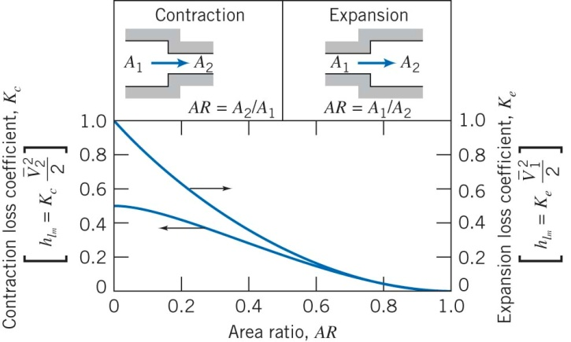
Major and Minor Losses in Pipes
Fittings: Area Change

Slide 5
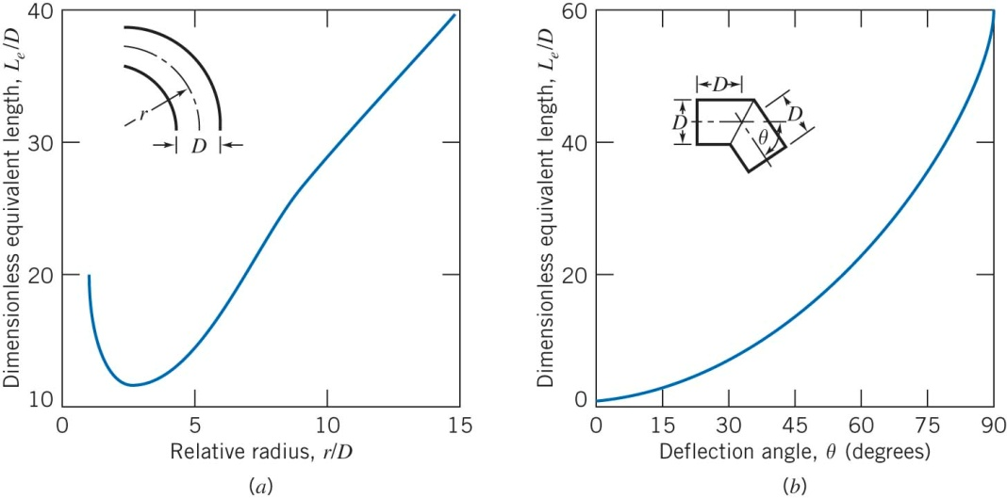
Major and Minor Losses in Pipes
Fittings: Bends

Slide 6
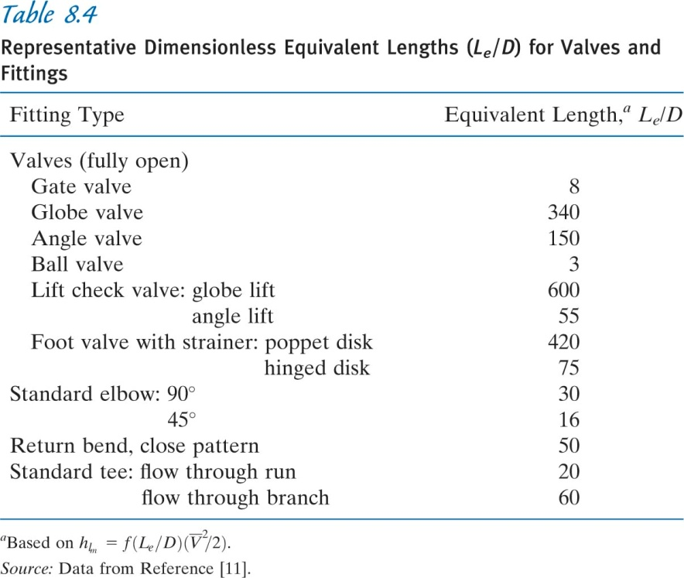
Major and Minor Losses in Pipes
Fittings: Equivalent Length
The equivalent length
is calculated using the
flow velocity and Reynolds
number to get an estimate
for f using Moody chart
Using the estimated
value of K we can estimate
Le/D

