Slide 1
MIS 215 Lab Revision
MSQL Server Installation
Create a New Database
Create a New Table
Relationships

Slide 2
MSQL Server Installation
Open the (.ISO) file located in the CD Drive
Then open the (.exe) file to start the installation process

Slide 3
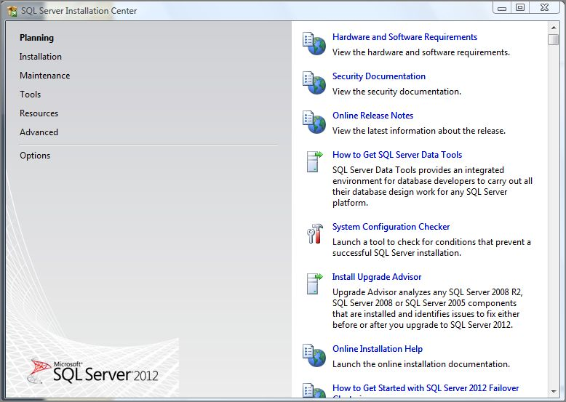
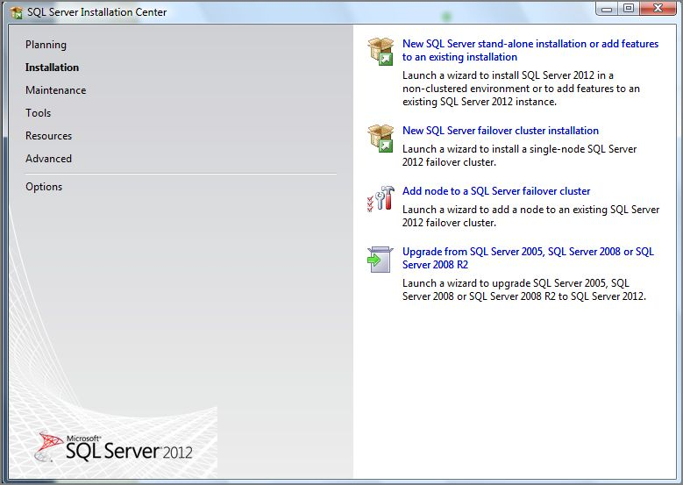
This window will appear
Select “Installation”
Then select the first option from the Right menu

Slide 4
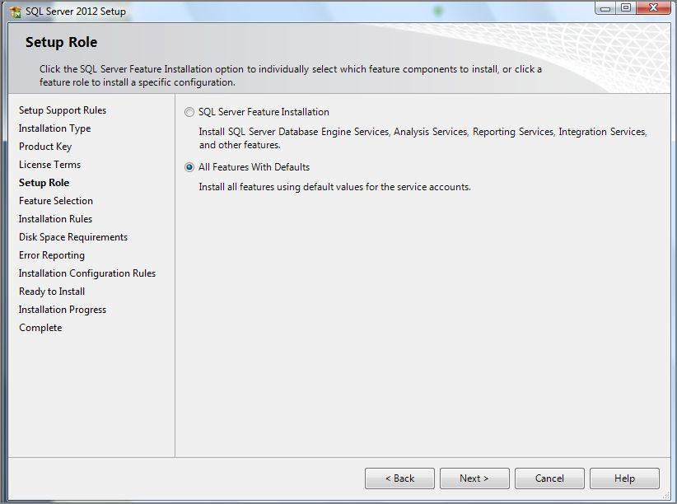
Click on the Next button until you reach the “Setup Role”
Make sure to select the second option
When you see any thing like this picture click on the “Add Current User” button
Continue to press Next.

Slide 5
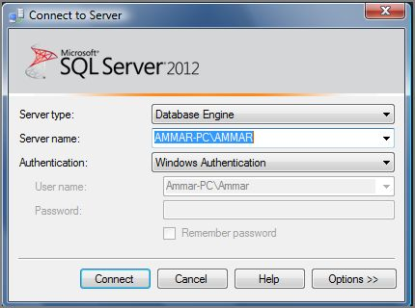
Create a New Database:
Contact with the server by clicking on the contact button

Slide 6
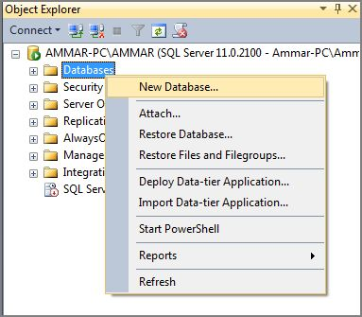
Right click on the Databases file and select “New Database”

Slide 7
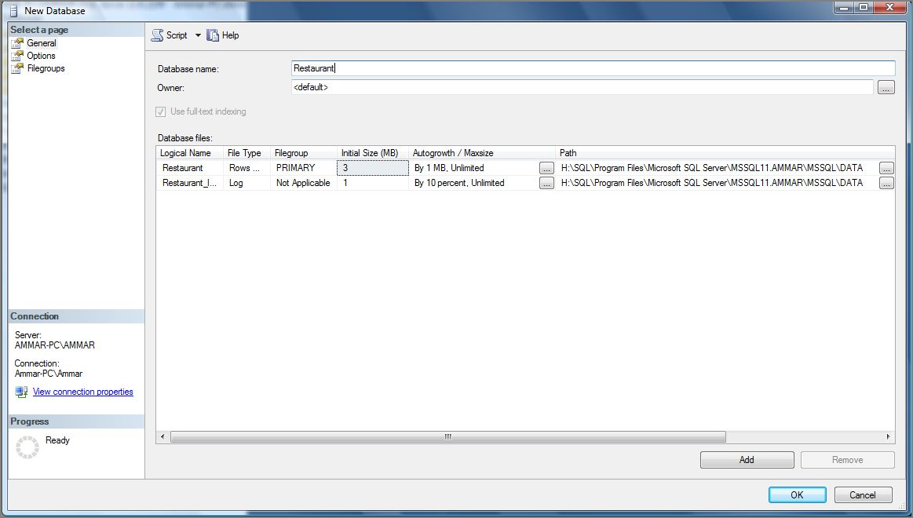
Enter the database name here
If you want to change the Files location click on those buttons

Slide 8
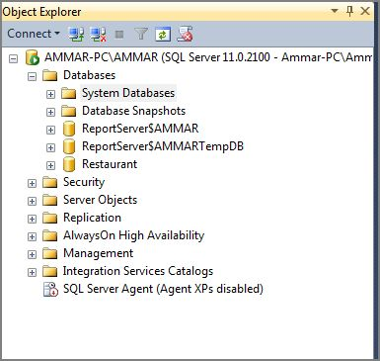
The New Database will appear under the “Databases file”
If it did not appear try clicking the refresh button

Slide 9
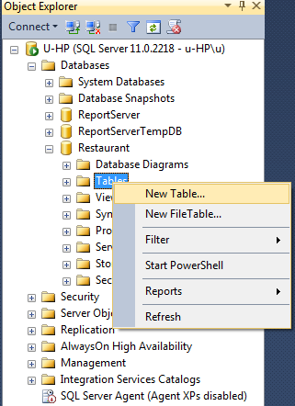
Create a New Table:
Right click on the Tables file and select “New Table”

Slide 10
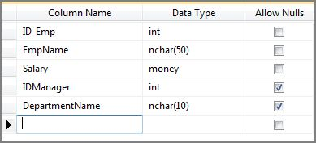
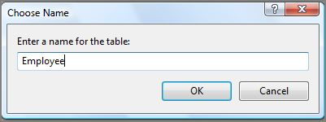
Fill the “Column Name” and the “Data Type” of the table that you want to create
Then save you're table by clicking on the save button
Name you’re table and press OK

Slide 11
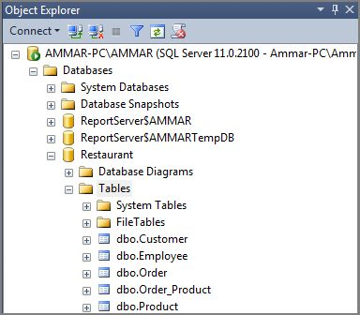
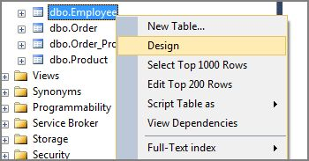
The New Table will appear under the file “Tables” of the database you’re working on which is the database “Restaurant”
If it did not appear try clicking the refresh button
If you want to Edit the tables “Right click” on the table and select “Design” from the list.

Slide 12
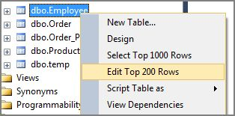
Filling The Tables:
“Right click” on the table and select “Edit Top 200 Rows” from the list.
Then fill the tables

Slide 13
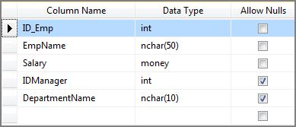
Relationships:
Primary keys:
First make sure that the primary keys are set on the tables you’re working on.
Select the Row you want to make as a primary key
Click on the “Key” button
It will look like this

Slide 14
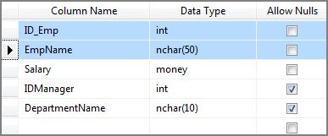
Composite Primary key:
Make sure to select the row not part of it
by clicking on the “Blank Column”.
Select two or more Rows using “Ctrl+Left click” on each one.
Click on the “Key” button
It will look like this

Slide 15
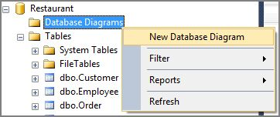
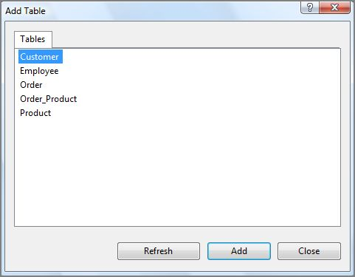
Relationship Diagrams:
Right click on the “Database Diagrams” file
Select “New Database Diagram”
Then Add the tables you want in you’re Diagram by clicking on the Add button

Slide 16
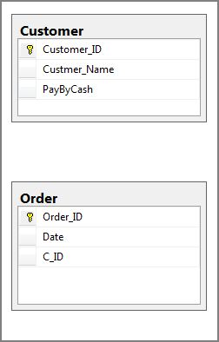
Left click on the Customer_ID and drag it to C_ID and drop it there
And that will give us a one to many relationship
Make sure that the primary keys are set
And the primary key is contacted to a Column with “the same data type”

Slide 17
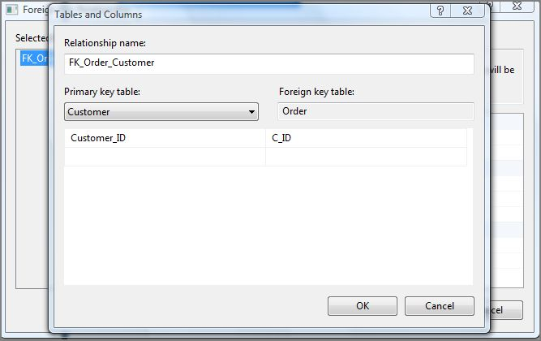
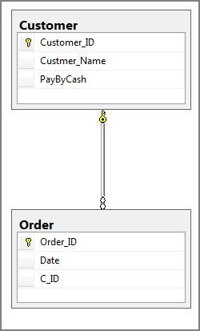
This two window will appear
Press the OK button “two times”
The relationship should look like this

Slide 18
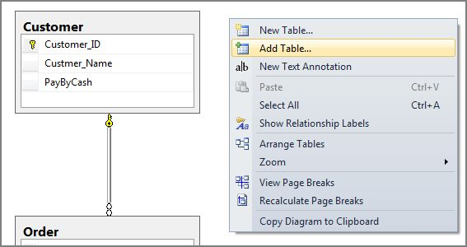
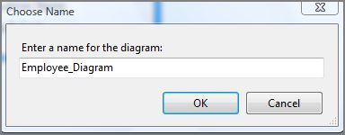
To add more tables to the Diagram Right click on the blank space of the diagram and select Add Table
Then save you’re Diagram after naming it and press OK

