Slide 1
MICROSCOPY
Prepared by : Reem Aldossari

Slide 2
APPLICATIONS OF COMPOUND
MICROSCOPE
It is used to study cells parts.
The organization of tissues and the structure of developing embryos, among many other important applications
And such more ….

Slide 3
Parts of the Microscope:
The parts of the microscope can be grouped in three systems:
1. The magnification system.
2. The mounting and movement system.
3. The illumination system.

Slide 4
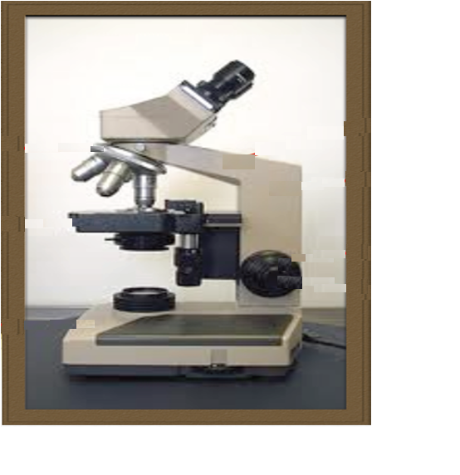
The body tube:
carries the ocular lenses
The nose piece:
Carries the objective lenses and
move them accordingly above the
stage
The arm:
Supports and connects the
upper part of the microscope
The stage:
Horizontal platform upon which
the slide of interest rest
The coarse focusing knob:
for stage movement
The fine focusing knob:
for image sharpness
The base:
Supports the microscope
The mounting and movement system

Slide 5
THE MAGNIFICATION SYSTEM
The ocular lenses:
5X, 10X, and 15X
The objective lenses:
Scanning lens: 3.5X or 4X or 5X
Low power lens: 10X
High power lens: 40X
Oil immersion lens: 100X
How to calculate the magnification power?
Magnification power = ocular lens xobjective lens.
(e.g.) 10X x 40X = 400X hint: Don’t forget the unit

Slide 6
The iris diaphragm:
controls the amount of light
reaching the slide
The illuminator:
light source
The condenser:
collects and concentrate the light
THE ILLUMINATION SYSTEM

Slide 7
THE CELL
It is the functional and structural unit in organisms.
different cell structures depending on their location
and function in the body.
3 major cell components:
Genetic material.
Cytoplasm.
Cell membrane.

Slide 8
CELL TYPES
Two major cell types depending on the arrangement
of the genetic material inside the cell:
Prokaryotic cells (pro = before; Karyone = nucleus):
Nucleus is absent. The region where the DNA is
located in the cytoplasm is called nucleoid
Eukaryotic cells (True nucleated cells):
Nucleus is present. DNA is associated with
protein making chromatin

Slide 9
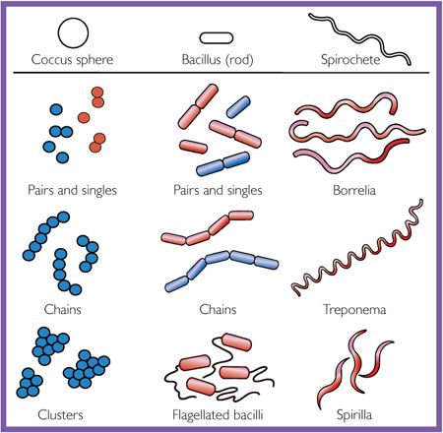
PROKARYOTES: BACTERIA
Bacillus:
Rod shape and occur in strands.
Coccus:
Rounded and occur in colonies or strands.

Slide 10
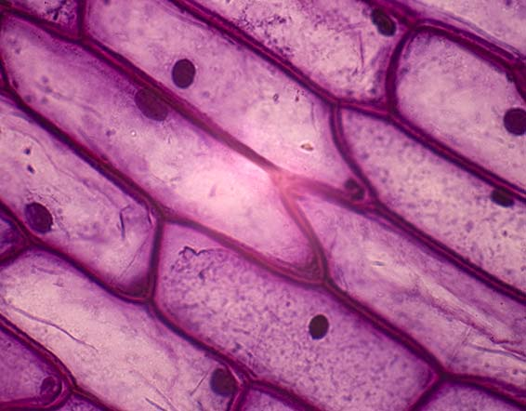
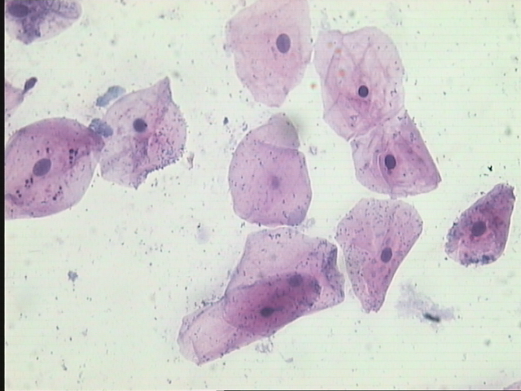
EUKARYOTES
Plant cells:
Have cell wall.
example: onion cells.
Rectangular with eccentric nucleus .
Onion cells
Animal cells :
Does NOT have cell wall.
Animal cells

Slide 11
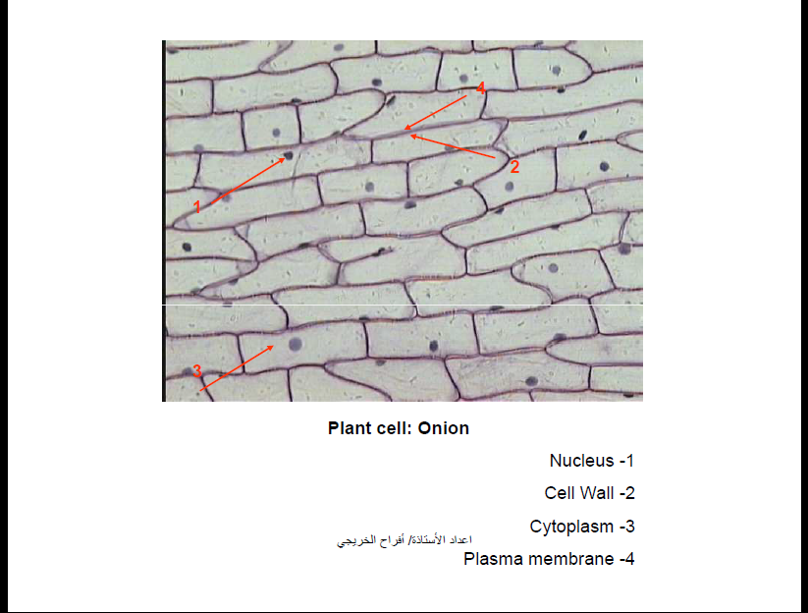

Slide 12
Simple Squamous Epithelium ( Lining of mouth )
1- Cell membrane
2- Cytoplasm
3- Nucleus

Slide 13
Thank you
for your attention

