Slide 1

Course: MBIO 240
Laboratory Skills

Slide 2
Course: MBIO 240
Introduction to Biosafety in Biological Laboratories.
Aim of the Experiment:
To understand the importance of biosafety in biological laboratories and learn how it reduces risks for individuals and the environment.

Slide 3
Course: MBIO 240
Introduction to Biosafety in Biological Laboratories.
What is Biosafety?
Biosafety refers to the precautions and safety measures taken to minimize the risk of infection from microorganisms within laboratories.
Its goal is to protect laboratory workers, maintain a clean work environment, and prevent contamination from spreading to the wider community.

Slide 4
Course: MBIO 240
Introduction to Biosafety in Biological Laboratories.
Key Terms in Biosafety
Biosecurity: Refers to measures that prevent the loss, theft, misuse, or intentional release of pathogens and toxins.
Infection: The invasion and growth of microorganisms like bacteria, viruses, or fungi in the body, potentially causing immune reactions or disease symptoms.
Bio-risk: The likelihood of harmful events such as accidental exposure, unauthorized access, or intentional misuse of biological agents, leading to harm or infection.
Containment: Procedures designed to prevent the release of microorganisms from the laboratory to the outside environment, including the use of personal protective equipment and physical barriers.
Biohazard: Biological materials, such as infectious samples, that pose potential risks to human health.

Slide 5
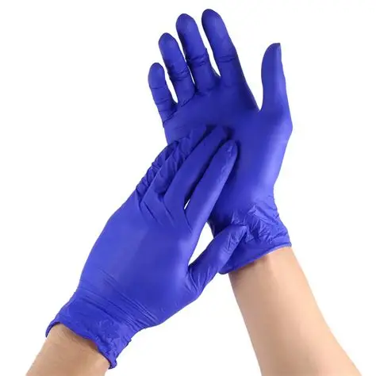
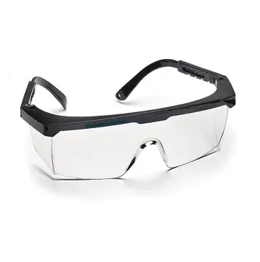

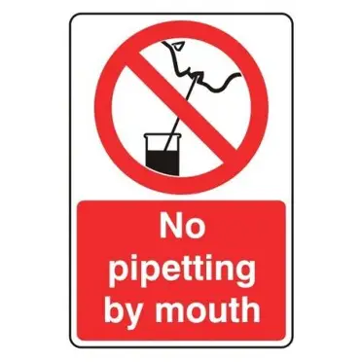
Basic tools for personal protection and decontamination.
Always wear appropriate personal protective equipment (PPE) such as gloves, lab coats, googles
Wash hands before and after handling specimens or leaving the lab.
Avoid eating, drinking, or using mobile phones in the laboratory.
Properly label all samples and materials to prevent cross-contamination
Keep your workspace free of all unnecessary materials.
Never pipette by mouth. Use the safety pipetting devices which are provided

Slide 6
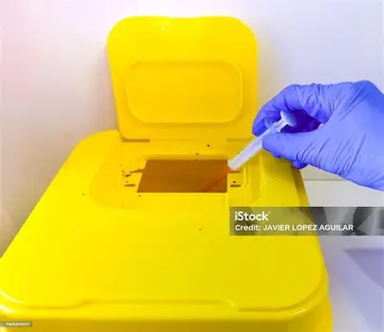
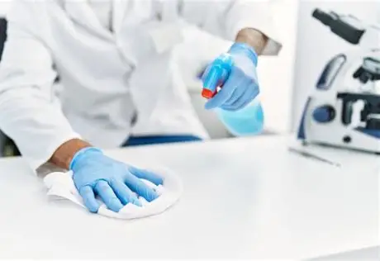
Basic tools for personal protection and decontamination: Waste Disposal:
Any infectious material/spilled or broken culture plates which may accidentally fall from pipettes to the laboratory bench or floor should be covered with a disinfectant and reported to any instructor immediately
Replace caps on reagents, solution bottles, and bacterial cultures after use.
Dispose of biohazard waste in designated bins with biohazard labels.
Decontaminate reusable tools and equipment by autoclaving or using chemical disinfectants.
Throw off used pipettes in the appropriate containers..
Make sure the burners are switched off

Slide 7
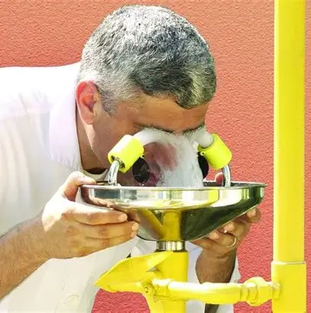
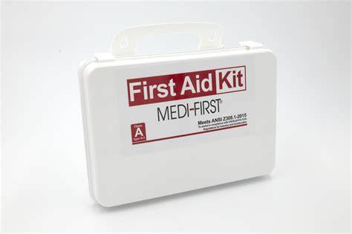
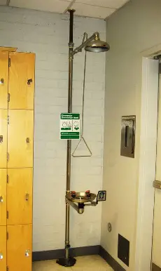
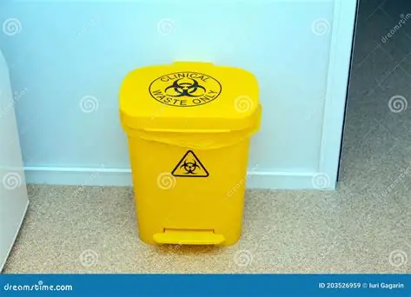
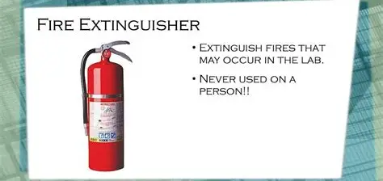
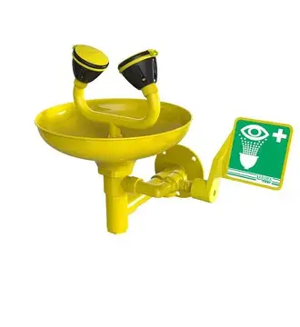
Laboratory safety equipment and emergency response
Know the location and proper use of safety equipment like : eyewash stations, lab shower, fire extinguishers, and spill kits, biohazard baskets.
Eyewash station
Fire extinguisher
Lab shower
Biohazard container
First aid box

Slide 8
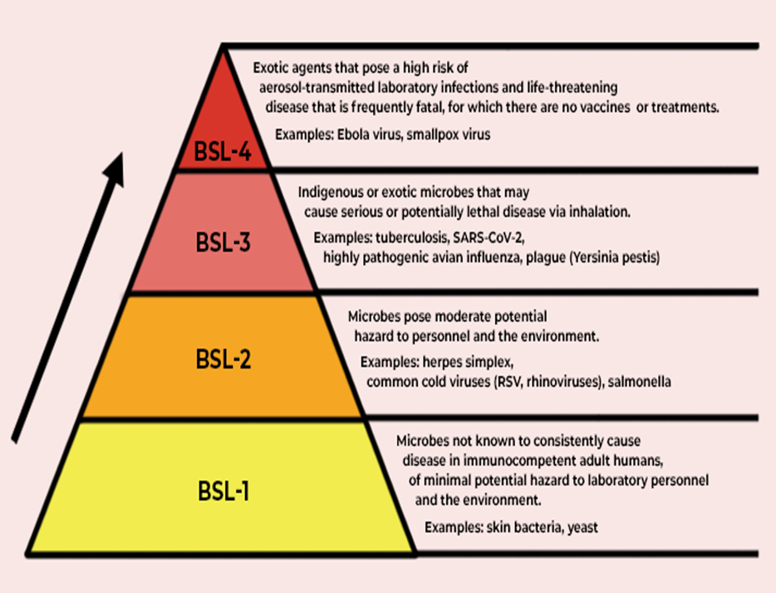
Course: MBIO 240
Biosafety Levels (BSL):
BSL-1:
Handles non-harmful microorganisms like E. coli K-12—minimal safety precautions required.
BSL-2:
Handles moderate-risk pathogens like Salmonella spp. Requires lab coats, gloves, and proper disposal.
BSL-3:
Deals with airborne pathogens like Mycobacterium tuberculosis. Requires restricted access, HEPA filters, and protective suits.
BSL-4:
Reserved for life-threatening pathogens like Ebola virus. Maximum containment facilities and full-body suits are necessary.

Slide 9
Decontamination Techniques:
Use autoclaving (high-pressure steam) or chemical disinfectants like bleach for sterilizing materials.
Regularly clean work surfaces with appropriate disinfectants before and after experiments.

Slide 10
2. Introduction to Essential Instruments in a Microbiology Laboratory

Slide 11
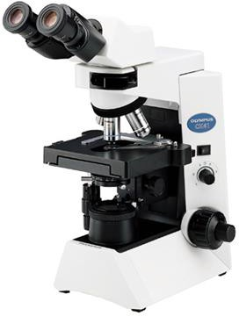
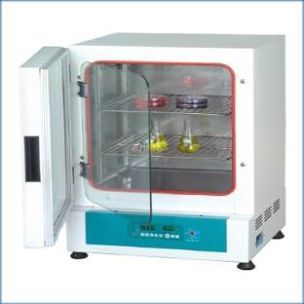
Apparatus and Equipment
Microscope: Used to observe very small organisms
Incubator: Provide suitable temperature for the growth of organism

Slide 12
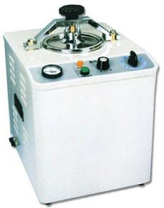
Apparatus and Equipment
Autoclave: It is a wet air type sterilizer.
It is used to sterilize culture media, glassware etc.
Usually autoclave operates at 15 lb/sq. inch steam pressure (121.5) for 15 min.

Slide 13
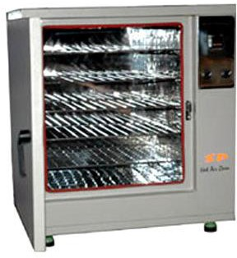
Apparatus and Equipment
Hot Air Oven: It is a dry air type sterilizer.
It is used for sterilizing laboratory glass ware.
It operates at a temperature of 160 to 180 º C
for one and a half hour.

Slide 14
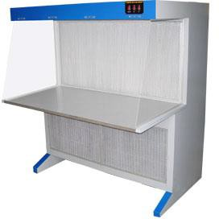
Apparatus and Equipment
Laminar Air Flow: It is a chamber which provides a microbe free environment
It is used for transfer of media for culturing bacteria or fungi or any microbes.

Slide 15
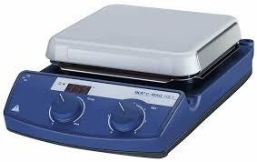
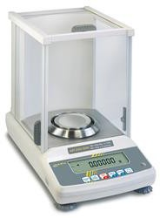
Apparatus and Equipment
Hot plate: In laboratory, hot plates are generally used to heat glassware or its contents.
Weighing scales are devices used to measure weight or calculate mass.

Slide 16
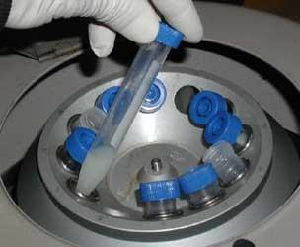
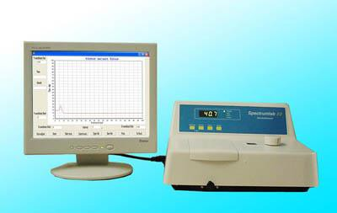
Apparatus and Equipment
Centrifuge: It spins liquid samples to separate their
components
Spectrophotometer: It is a device which uses a wavelength to determine the concentration of a compound or particles in a solution or suspension.

Slide 17
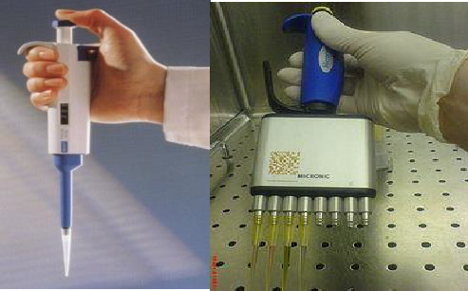
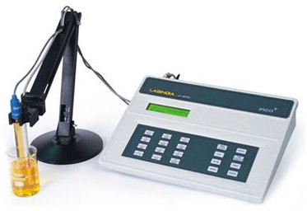
Apparatus and Equipment
Micropipettes: Pipettes are used to accurately measure and dispense small volumes of liquid.
pH meter: It is a device used for measuring the pH, which is either the concentration or the activity of hydrogen ions, of an aqueous solution.

Slide 18
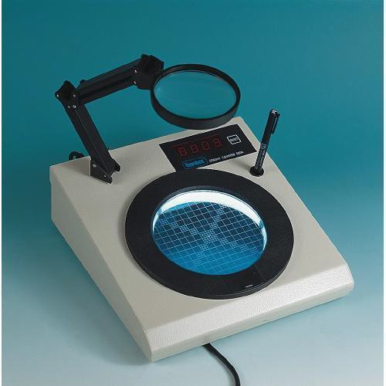
Apparatus and Equipment
Colony counter: Instrument is used for counting of
bacterial colonies growing on agar in petri dishes.

Slide 19
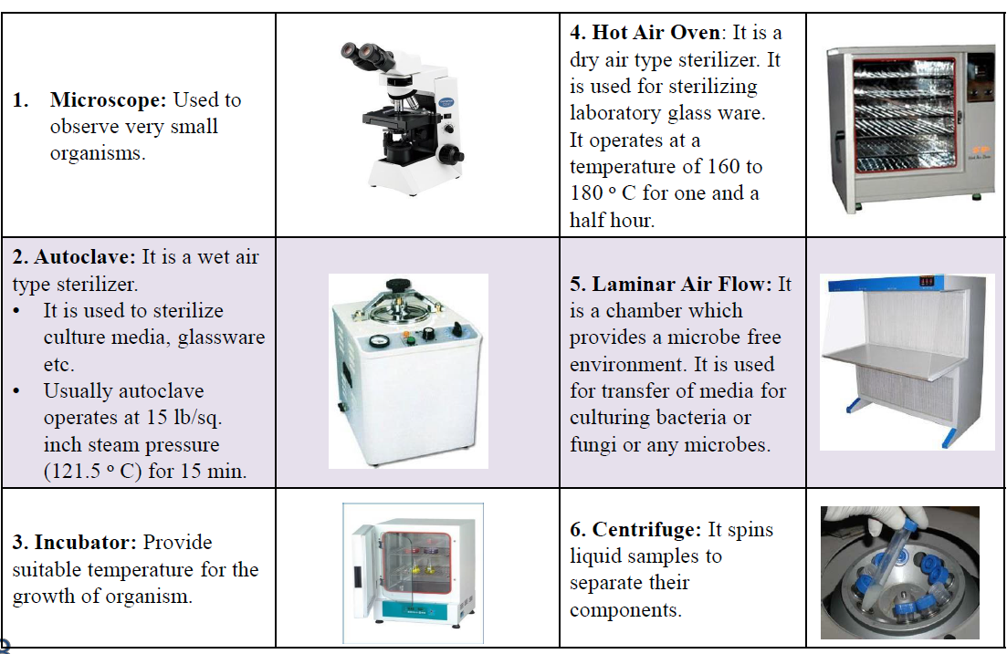
Apparatus and Equipment

Slide 20
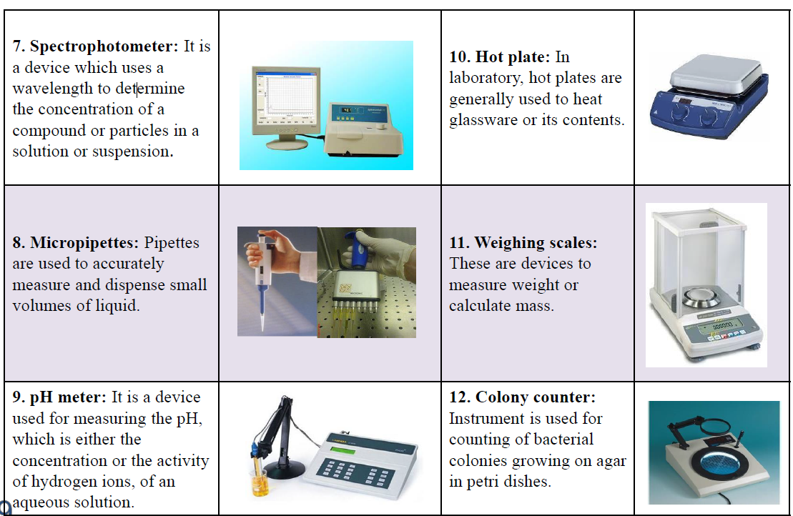
Apparatus and Equipment

Slide 21
Reference
Meechan, P. J., & Potts, J. (2020). Biosafety in Microbiological and Biomedical Laboratories. Centers for Disease Control and Prevention (CDC) Biosafety Guidelines.
Cappuccino James, G. (2002). Microbiology: A Laboratory Manual, San Francisco: Benjamin Cummings.
Lorrence, H Green, Emanuel Goldman. (2021). Practical Handbook of Microbiology. CRC Press. Pages – 975.
John Grainger, Janet Hurst, Dariel Burdass. (2001). Basic Practical Microbiology. The Society for General Microbiology.

