Slide 1
MBI 561
Advanced Microbial Physiology
By
Prof. Dr. Ali Bahkali

Slide 2
Chapter 1. Prokaryote metabolism
How prokaryotes get energy and nutrients. Chemotrophs and phototrophs. Heterotrophs and autotrophs.

Slide 3
Key points:
Some prokaryotes are phototrophs, getting energy from the sun. Others are chemotrophs, getting energy from chemical compounds.
Some prokaryotes are autotrophs, fixing carbon from CO2. Others are heterotrophs, getting carbon from organic compounds of other organisms.
Prokaryotes may perform aerobic (oxygen-requiring) or anaerobic (non-oxygen-based) metabolism, and some can switch between these modes.
Some prokaryotes have special enzymes and pathways that let them metabolize nitrogen- or sulfur-containing compounds.
Prokaryotes play key roles in the cycling of nutrients through ecosystems.

Slide 4
Introduction
Prokaryotes (bacteria and archaea) are way more diverse than humans in their nutritional strategies – that is, the ways they obtain fixed carbon (fuel molecules) and energy. Some species consume organic material like dead plants and animals. Others live off of inorganic compounds in rocks. One bacterium, Thiobacillus concretivorans, consumes metal-melting sulfuric acid.
In this chapter, we will take a closer look at the many ways that prokaryotes obtain and metabolize food, and how they can influence cycling of nutrients.

Slide 5
Nutritional modes
We can divide prokaryotes (and other organisms) into four different categories based on their energy and carbon sources:
Nutritional mode | Energy source | Carbon source
Photoautotroph | Light | Carbon dioxide (or related compounds)
Photoheterotroph | Light | Organic compounds
Chemoautotroph | Chemical compounds | Carbon dioxide (or related compounds)
Chemoheterotroph | Chemical compounds | Organic compounds

Slide 6
Aerobic and anaerobic respiration
Another metabolic area in which prokaryotes differ from humans (and are much more diverse than us!) is their need for oxygen. Some need it, some are poisoned by it, and some can take it or leave it depending on availability.
  Prokaryotes that need Oxygen in order to metabolize are called obligate aerobes. Humans are also obligate aerobes (as you've found out if you've tried to hold your breath for too long). [Why do these organisms need oxygen?]
  Prokaryotes that can't tolerate Oxygen and only perform anaerobic metabolism are called obligate anaerobes. C. botulinum, the bacterium that causes botulism (a form of food poisoning) when it grows in canned food, is an obligate anaerobe – which is why it multiplies well inside of sealed cans. [How do these organisms metabolize without oxygen?]
  Facultative anaerobes use aerobic metabolism when Oxygen is present, but switch to anaerobic metabolism if it's absent. The bacteria that cause staph and strep infections are examples of facultative anaerobes.

Slide 7
Sulfur and nitrogen metabolism
Some bacteria and archaea have metabolic pathways that allow them to metabolize nitrogen and sulfur in ways that eukaryotes cannot. In some cases, they use nitrogen- or sulfur-containing molecules to obtain energy, but in other cases, they expend energy to convert these molecules from one form to another.

Slide 8
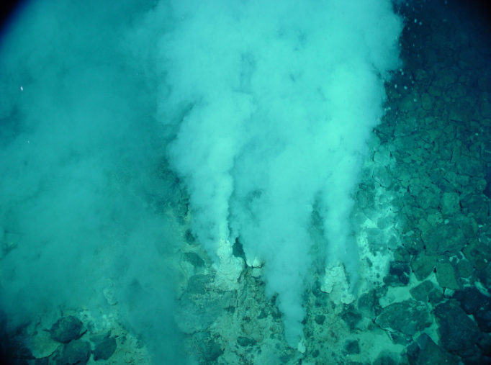
Sulfur metabolism
Some fascinating examples of sulfur-metabolizing prokaryotes are found in deep-sea ecosystems. For instance, certain prokaryotic species can oxidize hydrogen sulfide from piping hot hydrothermal vents. They use energy released in this process to fix inorganic carbon from the water into sugars and other organic molecules in a process called chemosynthesis.
Sulfur-metabolizing prokaryotes form the basis of food chains in their deep-sea habitats (where not the tiniest ray of light can reach to support photosynthesis). The sulfur metabolizers support entire communities of organisms, including worms, crabs, and shrimp, thousands of meters below the ocean surface.

Slide 9
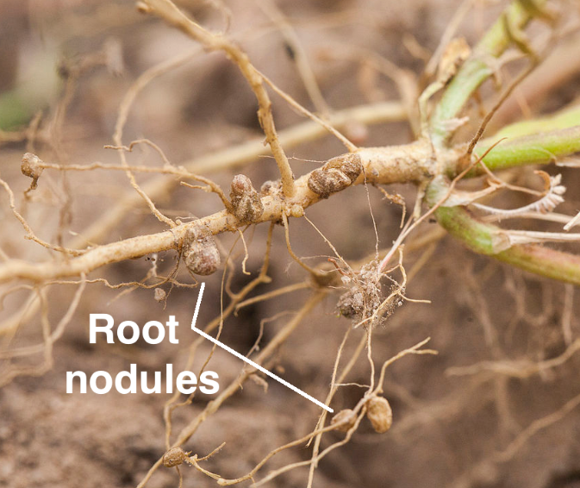
Nitrogen metabolism
Nitrogen-metabolizing prokaryotes include nitrogen fixers, nitrifiers, and denitrifiers. They play key roles in the nitrogen cycle by converting nitrogen compounds from one chemical form to another.
Nitrogen-fixing prokaryotes convert (“fix”) atmospheric nitrogen into ammonia, which plants and other organisms can incorporate into organic molecules. Some plant species in the legume family, such as peas, form mutually beneficial relationships (mutualisms) with nitrogen-fixing bacteria. The plants house and feed the bacteria in structures called root nodules, and the bacteria provide fixed nitrogen to the roots.
Other prokaryotes in the soil, called nitrifying bacteria, convert the ammonia into other types of compounds (nitrates and nitrites), which may also be absorbed by plants. Denitrifying prokaryotes do more or less the reverse, turning nitrates into N2 gas.

Slide 10
Biogeochemical cycles
The constant recycling of chemical elements is vital to the functioning of ecosystems. In Earth's biogeochemical cycles, chemical elements are converted among various different forms in a repeating cycle.
By virtue of their diverse metabolisms, prokaryotes play important roles in many global cycles. Here, we'll take a closer look at their function in two of these: the nitrogen and carbon cycles.

Slide 11
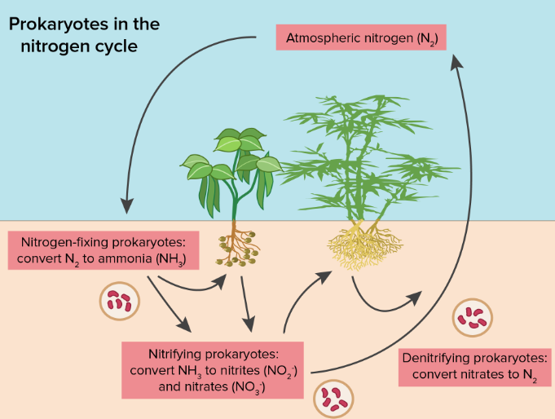
Nitrogen cycle
As we saw in the last section, nitrogen-fixing prokaryotes convert (“fix”) atmospheric nitrogen into ammonia. Plants and other organisms can then use the ammonia to build molecules such as amino acids and nucleotides.
Other prokaryotes in the soil, the nitrifying bacteria, convert ammonia into other types of compounds (nitrates and nitrites), which may also be absorbed by plants. The denitrifying prokaryotes, which convert nitrates into N2, move nitrogen atoms from the soil back to the atmosphere.

Slide 12
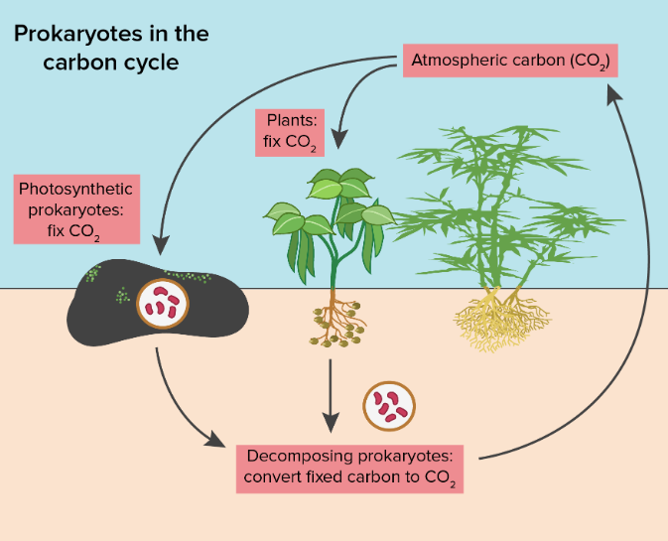
Carbon cycle
Prokaryotes are also important in the carbon cycle. Photosynthetic prokaryotes, such as cyanobacteria, use light energy to remove CO2 from the atmosphere and fix it into organic molecules. This is the same basic process carried out by photosynthetic plants.
Prokaryotic decomposers, on the other hand, move carbon in the opposite direction. When they break down dead organic material (from previously living plants and animals), they return CO2​ to the atmosphere via cellular respiration. Decomposition also releases a variety of other elements and inorganic molecules for reuse.

Slide 13
Chapter 2. Energy and Metabolism

Slide 14
cell’s metabolism
Scientists use the term bioenergetics to describe the concept of energy flow through living systems, such as cells. Cellular processes such as the building and breaking down of complex molecules occur through stepwise chemical reactions. Some of these chemical reactions are spontaneous and release energy, whereas others require energy to proceed. Just as living things must continually consume food to replenish their energy supplies, cells must continually produce more energy to replenish that used by the many energy-requiring chemical reactions that constantly take place. Together, all of the chemical reactions that take place inside cells, including those that consume or generate energy, are referred to as the cell’s metabolism.

Slide 15
Metabolic Pathways
Consider the metabolism of sugar. This is a classic example of one of the many cellular processes that use and produce energy. Living things consume sugars as a major energy source, because sugar molecules have a great deal of energy stored within their bonds. For the most part, photosynthesizing organisms like plants produce these sugars. During photosynthesis, plants use energy (originally from sunlight) to convert carbon dioxide gas (CO₂) into sugar molecules (like glucose: C₆H₁₂O₆). They consume carbon dioxide and produce oxygen as a waste product. This reaction is summarized as:
6CO₂ + 6H₂O + energy ——-> C₆H₁₂O₆+ 6O₂

Slide 16
Metabolic Pathways
Because this process involves synthesizing an energy-storing molecule, it requires energy input to proceed. During the light reactions of photosynthesis, energy is provided by a molecule called adenosine triphosphate (ATP), which is the primary energy currency of all cells. Just as the dollar is used as currency to buy goods, cells use molecules of ATP as energy currency to perform immediate work. In contrast, energy-storage molecules such as glucose are consumed only to be broken down to use their energy. The reaction that harvests the energy of a sugar molecule in cells requiring oxygen to survive can be summarized by the reverse reaction to photosynthesis. In this reaction, oxygen is consumed and carbon dioxide is released as a waste product. The reaction is summarized as:
C₆H₁₂O₆ + 6O₂ ——> 6CO₂ + 6H₂O + energy

Slide 17
Metabolic Pathways
Both of these reactions involve many steps.
The processes of making and breaking down sugar molecules illustrate two examples of metabolic pathways. A metabolic pathway is a series of chemical reactions that takes a starting molecule and modifies it, step-by-step, through a series of metabolic intermediates, eventually yielding a final product. In the example of sugar metabolism, the first metabolic pathway synthesized sugar from smaller molecules, and the other pathway broke sugar down into smaller molecules. These two opposite processes—the first requiring energy and the second producing energy—are referred to as anabolic pathways (building polymers) and catabolic pathways (breaking down polymers into their monomers), respectively. Consequently, metabolism is composed of synthesis (anabolism) and degradation (catabolism)

Slide 18
Metabolic Pathways
It is important to know that the chemical reactions of metabolic pathways do not take place on their own. Each reaction step is facilitated, or catalyzed, by a protein called an enzyme. Enzymes are important for catalyzing all types of biological reactions—those that require energy as well as those that release energy.

Slide 19
Energy/Chemical Energy
In general, energy is defined as the ability to do work, or to create some kind of change. Energy exists in different forms. For example, electrical energy, light energy, and heat energy are all different types of energy.
The challenge for all living organisms is to obtain energy from their surroundings in forms that they can transfer or transform into usable energy to do work. Living cells have evolved to meet this challenge. Chemical energy stored within organic molecules such as sugars and fats is transferred and transformed through a series of cellular chemical reactions into energy within molecules of ATP. Energy in ATP molecules is easily accessible to do work. Examples of the types of work that cells need to do include building complex molecules, transporting materials, powering the motion of cilia or flagella, and contracting muscle fibers to create movement.

Slide 20
Energy/Chemical Energy
If energy is released during a chemical reaction, then the change in free energy, signified as ∆G (delta G) will be a negative number. A negative change in free energy also means that the products of the reaction have less free energy than the reactants, because they release some free energy during the reaction. exergonic means energy is exiting the system. Reactions that have a negative change in free energy and consequently release free energy are called exergonic reactions.
If a chemical reaction absorbs energy rather than releases energy on balance, then the ∆G for that reaction will be a positive value. In this case, the products have more free energy than the reactants. Thus, the products of these reactions can be thought of as energy-storing molecules. These chemical reactions are called endergonic reactions and they are non-spontaneous. An endergonic reaction will not take place on its own without the addition of free energy.

Slide 21
activation energy
There is another important concept that must be considered regarding endergonic and exergonic reactions. Exergonic reactions require a small amount of energy input to get going, before they can proceed with their energy-releasing steps. These reactions have a net release of energy, but still require some energy input in the beginning. This small amount of energy input necessary for all chemical reactions to occur is called the activation energy.

Slide 22
Enzymes
A substance that helps a chemical reaction to occur is called a catalyst, and the molecules that catalyze biochemical reactions are called enzymes. Most enzymes are proteins and perform the critical task of lowering the activation energies of chemical reactions inside the cell. Most of the reactions critical to a living cell happen too slowly at normal temperatures to be of any use to the cell. Without enzymes to speed up these reactions, life could not persist. Enzymes do this by binding to the reactant molecules and holding them in such a way as to make the chemical bond-breaking and -forming processes take place more easily. It is important to remember that enzymes do not change whether a reaction is exergonic (spontaneous) or endergonic. This is because they do not change the free energy of the reactants or products. They only reduce the activation energy required for the reaction to go forward. In addition, an enzyme itself is unchanged by the reaction it catalyzes. Once one reaction has been catalyzed, the enzyme is able to participate in other reactions.

Slide 23
Enzymes
The chemical reactants to which an enzyme binds are called the enzyme’s substrates. There may be one or more substrates, depending on the particular chemical reaction. In some reactions, a single reactant substrate is broken down into multiple products. In others, two substrates may come together to create one larger molecule. Two reactants might also enter a reaction and both become modified, but they leave the reaction as two products. The location within the enzyme where the substrate binds is called the enzyme’s active site. The active site is where the “action” happens. Since enzymes are proteins, there is a unique combination of amino acid side chains within the active site. Each side chain is characterized by different properties. They can be large or small, weakly acidic or basic, hydrophilic or hydrophobic, positively or negatively charged, or neutral. The unique combination of side chains creates a very specific chemical environment within the active site. This specific environment is suited to bind to one specific chemical substrate (or substrates).

Slide 24
Enzymes
Active sites are subject to influences of the local environment. Increasing the environmental temperature generally increases reaction rates, enzyme-catalyzed or otherwise. However, temperatures outside of an optimal range reduce the rate at which an enzyme catalyzes a reaction. Hot temperatures will eventually cause enzymes to denature, an irreversible change in the three-dimensional shape and therefore the function of the enzyme. Enzymes are also suited to function best within a certain pH and salt concentration range, and, as with temperature, extreme pH, and salt concentrations can cause enzymes to denature.

Slide 25
Enzymes
For many years, scientists thought that enzyme-substrate binding took place in a simple “lock and key” fashion. This model asserted that the enzyme and substrate fit together perfectly in one instantaneous step. However, current research supports a model called induced fit . The induced-fit model expands on the lock-and-key model by describing a more dynamic binding between enzyme and substrate. As the enzyme and substrate come together, their interaction causes a mild shift in the enzyme’s structure that forms an ideal binding arrangement between enzyme and substrate.

Slide 26
Enzymes
When an enzyme binds its substrate, an enzyme-substrate complex is formed. This complex lowers the activation energy of the reaction and promotes its rapid progression in one of multiple possible ways. On a basic level, enzymes promote chemical reactions that involve more than one substrate by bringing the substrates together in an optimal orientation for reaction. Another way in which enzymes promote the reaction of their substrates is by creating an optimal environment within the active site for the reaction to occur. The chemical properties that emerge from the particular arrangement of amino acid R groups within an active site create the perfect environment for an enzyme’s specific substrates to react.
The enzyme-substrate complex can also lower activation energy by compromising the bond structure so that it is easier to break. Finally, enzymes can also lower activation energies by taking part in the chemical reaction itself. In these cases, it is important to remember that the enzyme will always return to its original state by the completion of the reaction. One of the hallmark properties of enzymes is that they remain ultimately unchanged by the reactions they catalyze. After an enzyme has catalyzed a reaction, it releases its product(s) and can catalyze a new reaction.

Slide 27
Enzymes
It would seem ideal to have a scenario in which all of an organism’s enzymes existed in abundant supply and functioned optimally under all cellular conditions, in all cells, at all times. However, a variety of mechanisms ensures that this does not happen. Cellular needs and conditions constantly vary from cell to cell, and change within individual cells over time. The required enzymes of stomach cells differ from those of fat storage cells, skin cells, blood cells, and nerve cells. Furthermore, a digestive organ cell works much harder to process and break down nutrients during the time that closely follows a meal compared with many hours after a meal. As these cellular demands and conditions vary, so must the amounts and functionality of different enzymes.
Since the rates of biochemical reactions are controlled by activation energy, and enzymes lower and determine activation energies for chemical reactions, the relative amounts and functioning of the variety of enzymes within a cell ultimately determine which reactions will proceed and at what rates. This determination is tightly controlled in cells. In certain cellular environments, enzyme activity is partly controlled by environmental factors like pH, temperature, salt concentration, and, in some cases, cofactors or coenzymes.

Slide 28
Enzymes
Enzymes can also be regulated in ways that either promote or reduce enzyme activity. There are many kinds of molecules that inhibit or promote enzyme function, and various mechanisms by which they do so. In some cases of enzyme inhibition, an inhibitor molecule is similar enough to a substrate that it can bind to the active site and simply block the substrate from binding. When this happens, the enzyme is inhibited through competitive inhibition, because an inhibitor molecule competes with the substrate for binding to the active site.

Slide 29
Enzymes
On the other hand, in noncompetitive inhibition, an inhibitor molecule binds to the enzyme in a location other than the active site, called an allosteric site, but still manages to block substrate binding to the active site. Some inhibitor molecules bind to enzymes in a location where their binding induces a conformational change that reduces the affinity of the enzyme for its substrate. This type of inhibition is called allosteric inhibition. Most allosterically regulated enzymes are made up of more than one polypeptide, meaning that they have more than one protein subunit. When an allosteric inhibitor binds to a region on an enzyme, all active sites on the protein subunits are changed slightly such that they bind their substrates with less efficiency. There are allosteric activators as well as inhibitors. Allosteric activators bind to locations on an enzyme away from the active site, inducing a conformational change that increases the affinity of the enzyme’s active site(s) for its substrate(s)

Slide 30
Chapter 3. Catabolism and ANABOlISM

Slide 31
Glycolysis
Glycolysis is the first step in the breakdown of glucose to extract energy for cellular metabolism. Glycolysis consists of an energy-requiring phase followed by an energy-releasing phase.
Glycolysis is a series of reactions that extract energy from glucose by splitting it into two three-carbon molecules called pyruvates. Glycolysis is an ancient metabolic pathway, meaning that it evolved long ago, and it is found in the great majority of organisms alive today.
In organisms that perform cellular respiration, glycolysis is the first stage of this process. However, glycolysis doesn’t require oxygen, and many anaerobic organisms—organisms that do not use oxygen—also have this pathway.

Slide 32
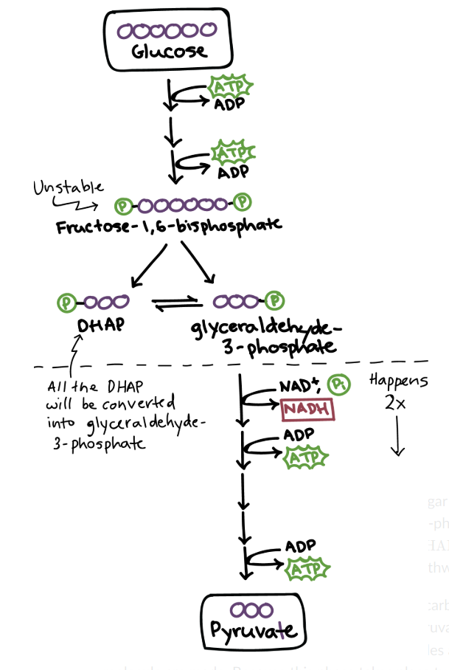
Highlights of glycolysis
Glycolysis takes place in the cytosol of a cell, and it can be broken down into two main phases: the energy-requiring phase, above the dotted line in the image below, and the energy-releasing phase, below the dotted line.
Energy-requiring phase. In this phase, the starting molecule of glucose gets rearranged, and two phosphate groups are attached to it. The phosphate groups make the modified sugar—now called fructose-1,6-bisphosphate—unstable, allowing it to split in half and form two phosphate-bearing three-carbon sugars. Because the phosphates used in these steps come from ATP, two ATP molecules get used up.

Slide 33
Highlights of glycolysis
The three-carbon sugars formed when the unstable sugar breaks down are different from each other. Only one—glyceraldehyde-3-phosphate—can enter the following step. However, the unfavorable sugar, DHAP, can be easily converted into the favorable one, so both finish the pathway in the end
Energy-releasing phase. In this phase, each three-carbon sugar is converted into another three-carbon molecule, pyruvate, through a series of reactions. In these reactions, two ATP molecules and one NADH molecule are made. Because this phase takes place twice, once for each of the two three-carbon sugars, it makes four ATP and two NADH overall.

Slide 34
Highlights of glycolysis
Each reaction in glycolysis is catalyzed by its own enzyme. The most important enzyme for regulation of glycolysis is phosphofructokinase, which catalyzes formation of the unstable, two-phosphate sugar molecule, fructose-1,6-bisphosphate. Phosphofructokinase speeds up or slows down glycolysis in response to the energy needs of the cell.
Overall, glycolysis converts one six-carbon molecule of glucose into two three-carbon molecules of pyruvate. The net products of this process are two molecules of ATP (4 ATP produced – 2 ATP used up) and two molecules of NADH.

Slide 35
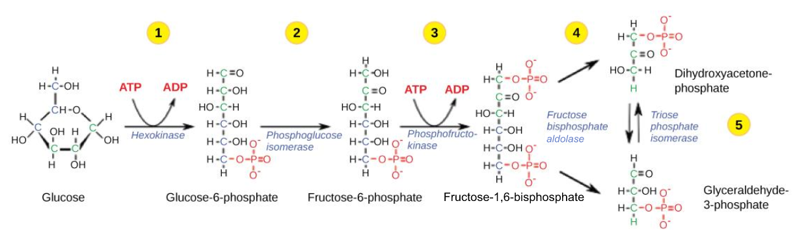
Detailed steps: Energy-requiring phase

Slide 36
Detailed steps: Energy-requiring phase
Step 1. A phosphate group is transferred from ATP to glucose, making glucose-6-phosphate. Glucose-6-phosphate is more reactive than glucose, and the addition of the phosphate also traps glucose inside the cell since glucose with a phosphate can’t readily cross the membrane.
Step 2. Glucose-6-phosphate is converted into its isomer, fructose-6-phosphate.
Step 3. A phosphate group is transferred from ATP to fructose-6-phosphate, producing fructose-1,6-bisphosphate. This step is catalyzed by the enzyme phosphofructokinase, which can be regulated to speed up or slow down the glycolysis pathway.
Step 4. Fructose-1,6-bisphosphate splits to form two three-carbon sugars: dihydroxyacetone phosphate (DHAP) and glyceraldehyde-3-phosphate. They are isomers of each other, but only one—glyceraldehyde-3-phosphate—can directly continue through the next steps of glycolysis.
Step 5. DHAP is converted into glyceraldehyde-3-phosphate. The two molecules exist in equilibrium, but the equilibrium is “pulled” strongly downward, in the scheme of the diagram above, as glyceraldehyde-3-phosphate is used up. Thus, all of the DHAP is eventually converted.

Slide 37
Detailed steps: Energy-releasing phase
In the second half of glycolysis, the three-carbon sugars formed in the first half of the process go through a series of additional transformations, ultimately turning into pyruvate. In the process, four ATP molecules are produced, along with two molecules of NADH.

Slide 38
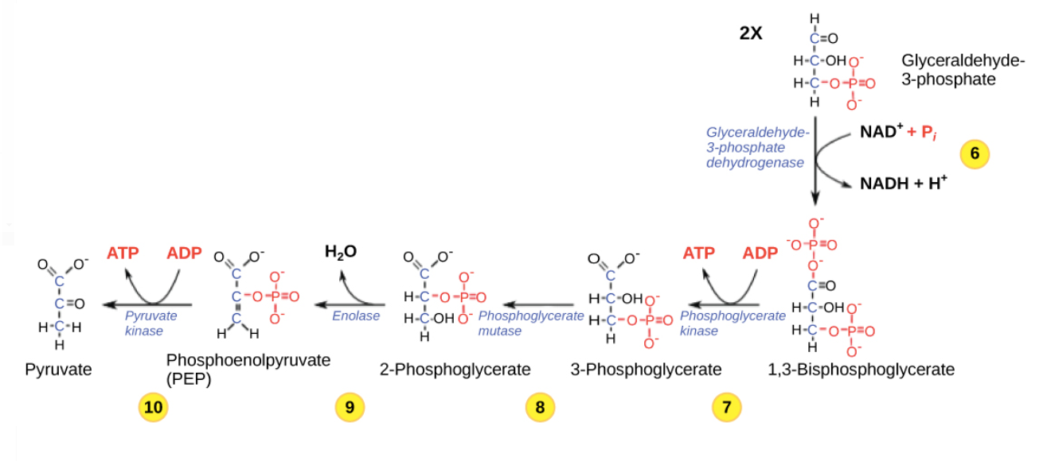
Detailed steps: Energy-releasing phase

Slide 39
Detailed steps: Energy-releasing phase
Step 6. Two half reactions occur simultaneously: 1) Glyceraldehyde-3-phosphate (one of the three-carbon sugars formed in the initial phase) is oxidized, and 2) NAD+ is reduced to NADH and \H+. The overall reaction is exergonic, releasing energy that is then used to phosphorylate the molecule, forming 1,3-bisphosphoglycerate.
Step 7. 1,3-bisphosphoglycerate donates one of its phosphate groups to ADP, making a molecule of ATP and turning into 3-phosphoglycerate in the process.
Step 8. 3-phosphoglycerate is converted into its isomer, 2-phosphoglycerate.
Step 9. 2-phosphoglycerate loses a molecule of water, becoming phosphoenolpyruvate (PEP). PEP is an unstable molecule, poised to lose its phosphate group in the final step of glycolysis.
Step 10. PEP readily donates its phosphate group to ADP, making a second molecule of ATP. As it loses its phosphate, PEP is converted to pyruvate, the end product of glycolysis.

Slide 40

What happens to pyruvate and NADH?
At the end of glycolysis, we’re left with two ATP, two NADH, and two pyruvate molecules. If oxygen is available, the pyruvate can be broken down (oxidized) all the way to carbon dioxide in cellular respiration, making many molecules of ATP.
What happens to the NADH? It can't just sit around in the cell, piling up. That's because cells have only a certain number of NAD+ molecules, which cycle back and forth between oxidized (NAD+) and reduced (NADH) states:

Slide 41
What happens to pyruvate and NADH?
Glycolysis needs NAD, start superscript, plus, end superscript to accept electrons as part of a specific reaction. If there’s no NAD, start superscript, plus, end superscript around (because it's all stuck in its NADH form), this reaction can’t happen and glycolysis will come to a halt. So, all cells need a way to turn NADH back into NAD, start superscript, plus, end superscript to keep glycolysis going.
There are two basic ways of accomplishing this. When oxygen is present, NADH can pass its electrons into the electron transport chain, regenerating NAD, start superscript, plus, end superscript for use in glycolysis. (Added bonus: some ATP gets made!)
When oxygen is absent, cells may use other, simpler pathways to regenerate NAD, start superscript, plus, end superscript. In these pathways, NADH donates its electrons to an acceptor molecule in a reaction that doesn’t make ATP but does regenerate NAD, start superscript, plus, end superscript so glycolysis can continue. This process is called fermentation.

Slide 42
Krebs Cycle/The citric acid cycle
The citric acid cycle, also known as the tricarboxylic acid cycle (TCA cycle) or the Krebs cycle, is a series of chemical reactions used by all aerobic organisms to generate energy through the oxidation of acetate—derived from carbohydrates, fats, and proteins—into carbon dioxide. The cycle provides precursors including certain amino acids as well as the reducing agent NADH that is used in numerous biochemical reactions. Its central importance to many biochemical pathways suggests that it was one of the earliest established components of cellular metabolism; it may have originated abiogenically.

Slide 43
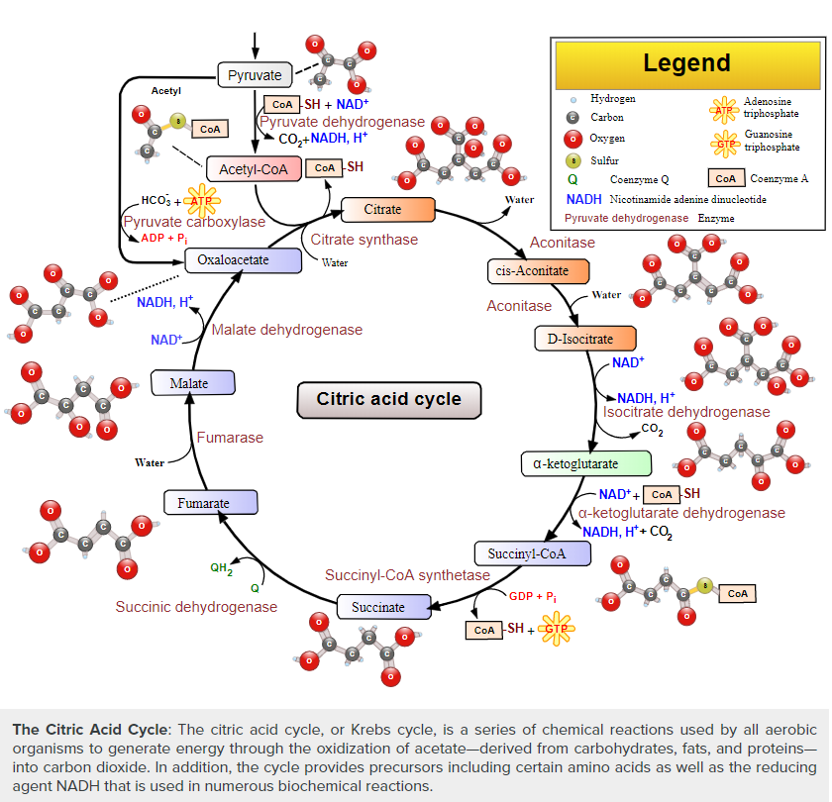

Slide 44
Krebs Cycle
The name of this metabolic pathway is derived from citric acid, a type of tricarboxylic acid that is first consumed and then regenerated by this sequence of reactions to complete the cycle. The cycle consumes acetate (in the form of acetyl-CoA) and water, reduces NAD⁺ to NADH, and produces carbon dioxide. The NADH generated by the TCA cycle is fed into the oxidative phosphorylation pathway. The net result of these two closely linked pathways is the oxidation of nutrients to produce usable energy in the form of ATP.
Components of the TCA cycle were derived from anaerobic bacteria, and the TCA cycle itself may have evolved more than once. Theoretically there are several alternatives to the TCA cycle, however the TCA cycle appears to be the most efficient. If several alternatives independently evolved, they all rapidly converged to the TCA cycle.

Slide 45
Krebs Cycle
The citric acid cycle is a key component of the metabolic pathway by which all aerobic organisms generate energy. Through the catabolism of sugars, fats, and proteins, a two carbon organic product acetate in the form of acetyl-CoA is produced. Acetyl-CoA along with two equivalents of water (H₂O) are consumed by the citric acid cycle, producing two equivalents of carbon dioxide (CO₂) and one equivalent of HS-CoA. In addition, one complete turn of the cycle converts three equivalents of nicotinamide adenine dinucleotide (NAD⁺) into three equivalents of reduced NAD⁺ (NADH), one equivalent of ubiquinone (Q) into one equivalent of reduced ubiquinone (QH₂), and one equivalent each of guanosine diphosphate (GDP) and inorganic phosphate (P_{i}) into one equivalent of guanosine triphosphate (GTP). The NADH and QH₂ that is generated by the citric acid cycle is used by the oxidative phosphorylation pathway to generate energy-rich adenosine triphosphate (ATP).

Slide 46
Krebs Cycle
One of the primary sources of acetyl-CoA is sugars that are broken down by glycolysis to produce pyruvate that, in turn, is decarboxylated by the enzyme pyruvate dehydrogenase. This generates acetyl-CoA according to the following reaction scheme:
The product of this reaction, acetyl-CoA, is the starting point for the citric acid cycle.

Slide 47
Other aspect of Catabolism
LIPIDS
Lipids are available to the body from three sources. They can be ingested in the diet, stored in the adipose tissue of the body, or synthesized in the liver. Fats ingested in the diet are digested in the small intestine. The triglycerides are broken down into monoglycerides and free fatty acids, then imported across the intestinal mucosa. Once across, the triglycerides are resynthesized and transported to the liver or adipose tissue. Fatty acids are oxidized through fatty acid or β-oxidation into two-carbon acetyl CoA molecules, which can then enter the Krebs cycle to generate ATP. If excess acetyl CoA is created and overloads the capacity of the Krebs cycle, the acetyl CoA can be used to synthesize ketone bodies. When glucose is limited, ketone bodies can be oxidized and used for fuel. Excess acetyl CoA generated from excess glucose or carbohydrate ingestion can be used for fatty acid synthesis or lipogenesis. Acetyl CoA is used to create lipids, triglycerides, steroid hormones, cholesterol, and bile salts. Lipolysis is the breakdown of triglycerides into glycerol and fatty acids, making them easier for the body to process.

Slide 48
Other aspect of Catabolism
Amino Acids
Amino acids can also be used as a source of energy, especially in times of starvation. Because the processing of amino acids results in the creation of metabolic intermediates, including pyruvate, acetyl CoA, acetoacyl CoA, oxaloacetate, and α-ketoglutarate, amino acids can serve as a source of energy production through the Krebs cycle.

Slide 49
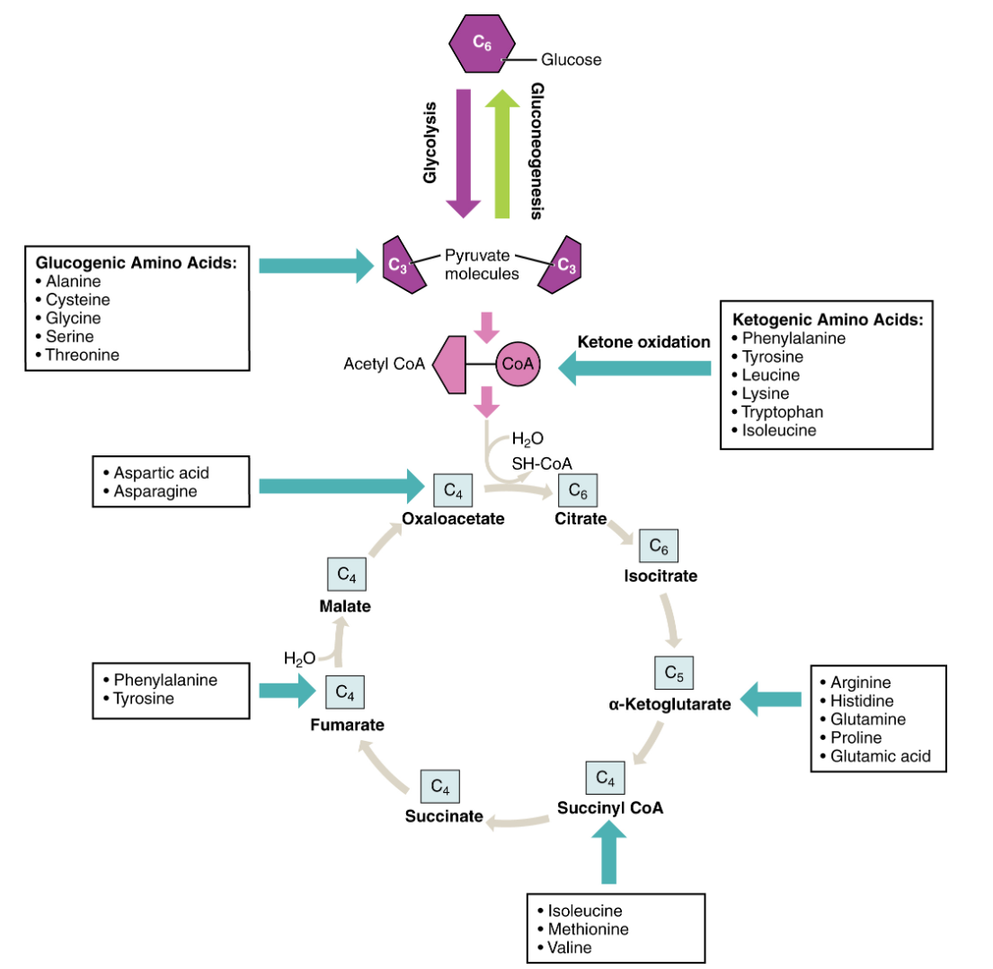
Energy from Amino Acids
Energy from Amino Acids. Amino acids can be broken down into precursors for glycolysis or the Krebs cycle. Amino acids (in bold) can enter the cycle through more than one pathway.

Slide 50
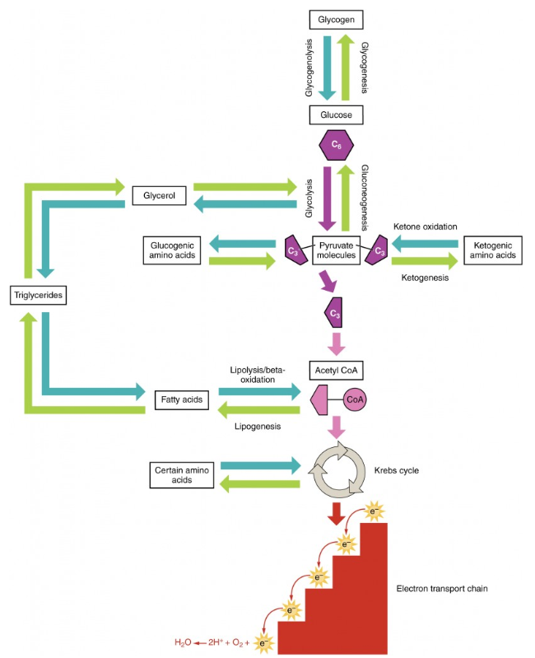
Catabolic and Anabolic Pathways
This figure summarizes the pathways of catabolism and anabolism for carbohydrates, lipids, and proteins.
Catabolic and Anabolic Pathways. Nutrients follow a complex pathway from ingestion through anabolism and catabolism to energy production.

Slide 51
Anabolic Pathways
Anabolic pathways require an input of energy to synthesize complex molecules from simpler ones. One example of an anabolic pathway is Photosynthesis, the synthesis of sugar from CO₂. Other examples include the synthesis of large proteins from amino acid building blocks and the synthesis of new DNA strands from nucleic acid building blocks. These processes are critical to the life of the cell, take place constantly, and demand energy provided by ATP and other high-energy molecules like NADH (nicotinamide adenine dinucleotide) and NADPH.

Slide 52
The light-dependent reactions and the Calvin cycle
Photosynthesis in the leaves of plants involves many steps, but it can be divided into two stages: the light-dependent reactions and the Calvin cycle.
The light-dependent reactions take place in the thylakoid membrane and require a continuous supply of light energy. Chlorophylls absorb this light energy, which is converted into chemical energy through the formation of two compounds, ATP—an energy storage molecule—and NADPH—a reduced (electron-bearing) electron carrier. In this process, water molecules are also converted to oxygen gas—the oxygen we breathe!
The Calvin cycle, also called the light-independent reactions, takes place in the stroma and does not directly require light. Instead, the Calvin cycle uses ATP and NADPH from the light-dependent reactions to fix carbon dioxide and produce three-carbon sugars—glyceraldehyde-3-phosphate, or G3P, molecules—which join up to form glucose.

Slide 53
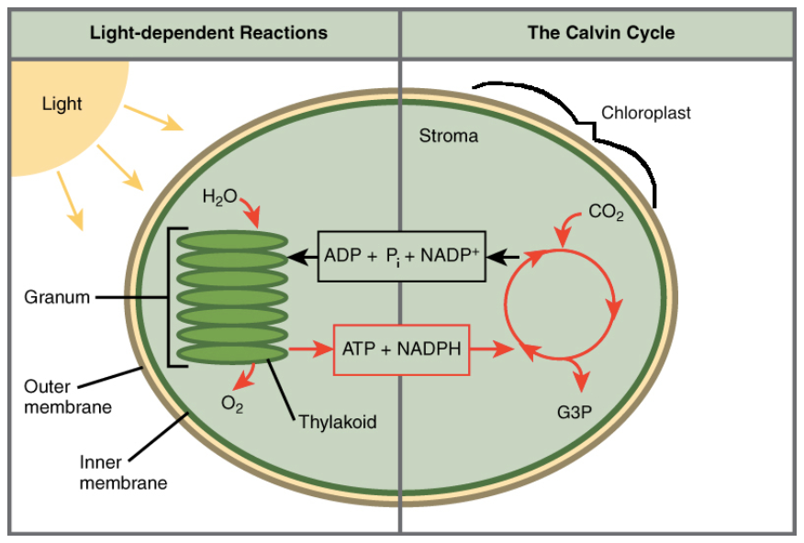
The light-dependent reactions and the Calvin cycle

Slide 54
The light-dependent reactions and the Calvin cycle
Overall, the light-dependent reactions capture light energy and store it temporarily in the chemical forms of ATP and NADPH. There, ATP is broken down to release energy, and NADPH donates its electrons to convert carbon dioxide molecules into sugars. In the end, the energy that started out as light winds up trapped in the bonds of the sugars.

Slide 55
Chapter 4. CELLULAR Respiration

Slide 56
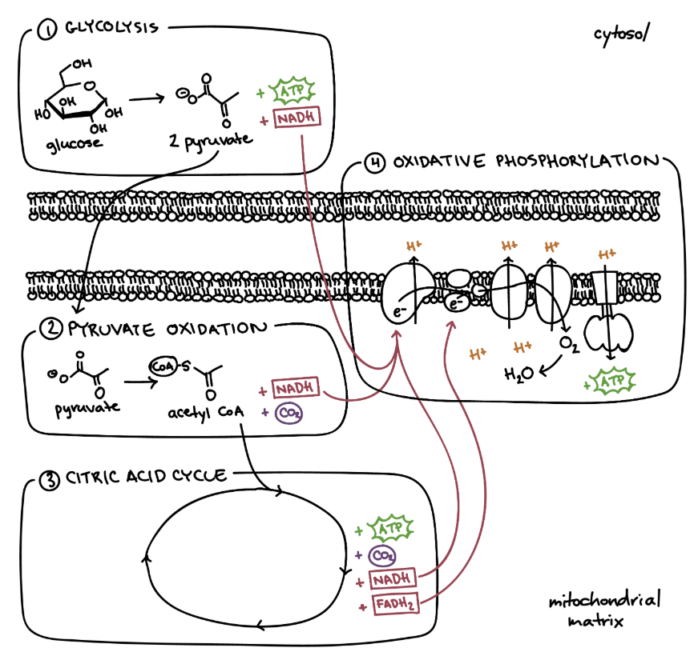
CELLULAR Respiration
Cellular respiration is a metabolic pathway that breaks down glucose and produces ATP. The stages of cellular respiration include glycolysis, pyruvate oxidation, the citric acid or Krebs cycle, and oxidative phosphorylation.

Slide 57
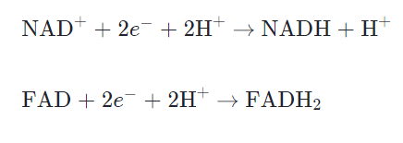
CELLULAR Respiration
During cellular respiration, a glucose molecule is gradually broken down into carbon dioxide and water. Along the way, some ATP is produced directly in the reactions that transform glucose. Much more ATP, however, is produced later in a process called oxidative phosphorylation. Oxidative phosphorylation is powered by the movement of electrons through the electron transport chain, a series of proteins embedded in the inner membrane of the mitochondrion.
These electrons come originally from glucose and are shuttled to the electron transport chain by electron carriers NAD+ and FAD, which become NADH and FADH2 when they gain electrons. To be clear, this is what's happening in the diagram above when it says + NADH or + FADH2. The molecule isn't appearing from scratch, it's just being converted to its electron-carrying form:

Slide 58
CELLULAR Respiration
To see how a glucose molecule is converted into carbon dioxide and how its energy is harvested as ATP and NADH/FADH2 in one of your body's cells, let’s walk step by step through the four stages of cellular respiration.
1. Glycolysis. In glycolysis, glucose—a six-carbon sugar—undergoes a series of chemical transformations. In the end, it gets converted into two molecules of pyruvate, a three-carbon organic molecule. In these reactions, ATP is made, and NAD+ is converted to NADH.
2. Pyruvate oxidation. Each pyruvate from glycolysis goes into the mitochondrial matrix—the innermost compartment of mitochondria. There, it’s converted into a two-carbon molecule bound to Coenzyme A, known as acetyl CoA. Carbon dioxide is released and NADH is generated.

Slide 59
CELLULAR Respiration
3. Citric acid cycle. The acetyl CoA made in the last step combines with a four-carbon molecule and goes through a cycle of reactions, ultimately regenerating the four-carbon starting molecule. ATP, NADH, and FADH2 are produced, and carbon dioxide is released.
4. Oxidative phosphorylation. The NADH and FADH2 made in other steps deposit their electrons in the electron transport chain, turning back into their "empty" forms (NAD+ and FAD). As electrons move down the chain, energy is released and used to pump protons out of the matrix, forming a gradient. Protons flow back into the matrix through an enzyme called ATP synthase, making ATP. At the end of the electron transport chain, oxygen accepts electrons and takes up protons to form water.

Slide 60
CELLULAR Respiration
Glycolysis can take place without oxygen in a process called fermentation. The other three stages of cellular respiration—pyruvate oxidation, the citric acid cycle, and oxidative phosphorylation—require oxygen in order to occur. Only oxidative phosphorylation uses oxygen directly, but the other two stages can't run without oxidative phosphorylation.

Slide 61
Fermentation and anaerobic respiration
Anaerobic cellular respiration is similar to aerobic cellular respiration in that electrons extracted from a fuel molecule are passed through an electron transport chain, driving ATP synthesis. Some organisms use sulfate as the final electron acceptor at the end ot the transport chain, while others use nitrate, sulfur, or one of a variety of other molecules.
What kinds of organisms use anaerobic cellular respiration? Some prokaryotes—bacteria and archaea—that live in low-oxygen environments rely on anaerobic respiration to break down fuels. For example, some archaea called methanogens can use carbon dioxide as a terminal electron acceptor, producing methane as a by-product. Methanogens are found in soil and in the digestive systems of ruminants, a group of animals including cows and sheep.
Similarly, sulfate-reducing bacteria and Archaea use sulfate as a terminal electron acceptor, producing hydrogen sulfide (H2​S) as a byproduct.

Slide 62
Fermentation
Fermentation is another anaerobic (non-oxygen-requiring) pathway for breaking down glucose, one that's performed by many types of organisms and cells. In fermentation, the only energy extraction pathway is glycolysis, with one or two extra reactions tacked on at the end.
Fermentation and cellular respiration begin the same way, with glycolysis. In fermentation, however, the pyruvate made in glycolysis does not continue through oxidation and the citric acid cycle, and the electron transport chain does not run. Because the electron transport chain isn't functional, the NADH made in glycolysis cannot drop its electrons off there to turn back into NAD+
The purpose of the extra reactions in fermentation, then, is to regenerate the electron carrier NAD+ from the NADH produced in glycolysis. The extra reactions accomplish this by letting NADH drop its electrons off with an organic molecule (such as pyruvate, the end product of glycolysis). This drop-off allows glycolysis to keep running by ensuring a steady supply of NAD+.

Slide 63
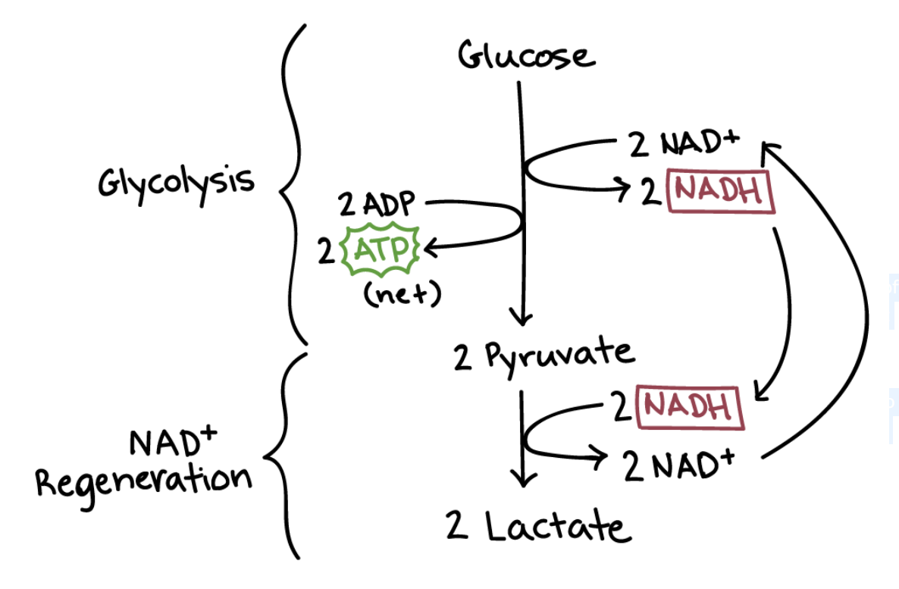
Lactic acid fermentation
In lactic acid fermentation, NADH transfers its electrons directly to pyruvate, generating lactate as a byproduct. Lactate, which is just the deprotonated form of lactic acid, gives the process its name. The bacteria that make yogurt carry out lactic acid fermentation, as do the red blood cells in your body, which don’t have mitochondria and thus can’t perform cellular respiration.

Slide 64
Lactic acid fermentation
Muscle cells also carry out lactic acid fermentation, though only when they have too little oxygen for aerobic respiration to continue—for instance, when you’ve been exercising very hard. It was once thought that the accumulation of lactate in muscles was responsible for soreness caused by exercise, but recent research suggests this is probably not the case.
Lactic acid produced in muscle cells is transported through the bloodstream to the liver, where it’s converted back to pyruvate and processed normally in the remaining reactions of cellular respiration.

Slide 65
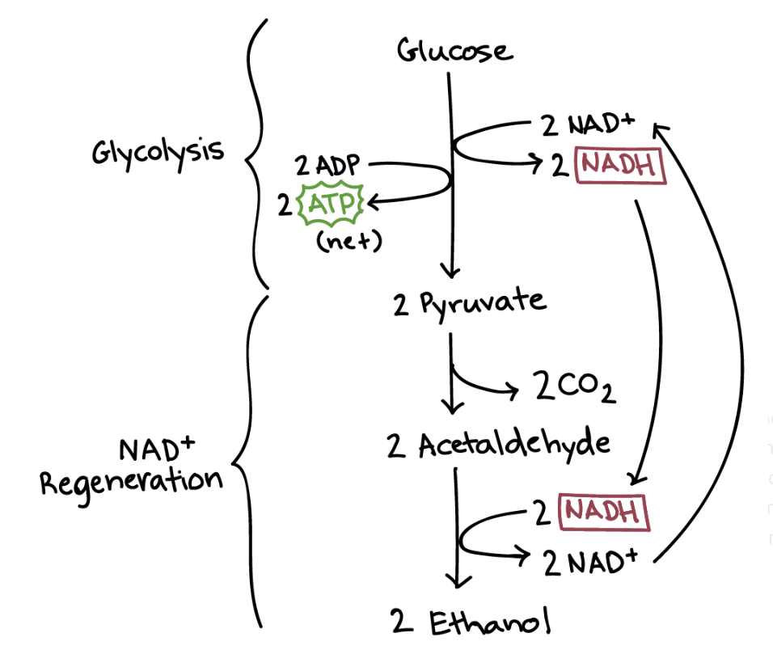
Alcohol fermentation
Another familiar fermentation process is alcohol fermentation, in which NADH donates its electrons to a derivative of pyruvate, producing ethanol.
Going from pyruvate to ethanol is a two-step process. In the first step, a carboxyl group is removed from pyruvate and released in as carbon dioxide, producing a two-carbon molecule called acetaldehyde. In the second step, NADH passes its electrons to acetaldehyde, regenerating NAD+ and forming ethanol.

Slide 66
Alcohol fermentation
Alcohol fermentation by yeast produces the ethanol found in alcoholic drinks like beer and wine. However, alcohol is toxic to yeasts in large quantities (just as it is to humans), which puts an upper limit on the percentage alcohol in these drinks. Ethanol tolerance of yeast ranges from about 5 percent to 21 percent, depending on the yeast strain and environmental conditions.

Slide 67
Chapter 5. Nitrogen Metabolism and Extreme Microbes

Slide 68
Nitrogen Metabolism
Nitrogen is one of the primary nutrients critical for the survival of all living organisms. It is a necessary component of many biomolecules, including proteins, DNA, and chlorophyll. Although nitrogen is very abundant in the atmosphere as dinitrogen gas (N₂), it is largely inaccessible in this form to most organisms, making nitrogen a scarce resource and often limiting primary productivity in many ecosystems. Only when nitrogen is converted from dinitrogen gas into ammonia (NH₃) does it become available to primary producers, such as plants.
In addition to N₂ and NH₃, nitrogen exists in many different forms, including both inorganic (e.g., ammonia, nitrate) and organic (e.g., amino and nucleic acids) forms. Thus, nitrogen undergoes many different transformations in the ecosystem, changing from one form to another as organisms use it for growth and, in some cases, energy. The major transformations of nitrogen are nitrogen fixation, nitrification, denitrification, anammox, and ammonification (Figure 1). The transformation of nitrogen into its many oxidation states is key to productivity in the biosphere and is highly dependent on the activities of a diverse assemblage of microorganisms, such as bacteria, archaea, and fungi.

Slide 69
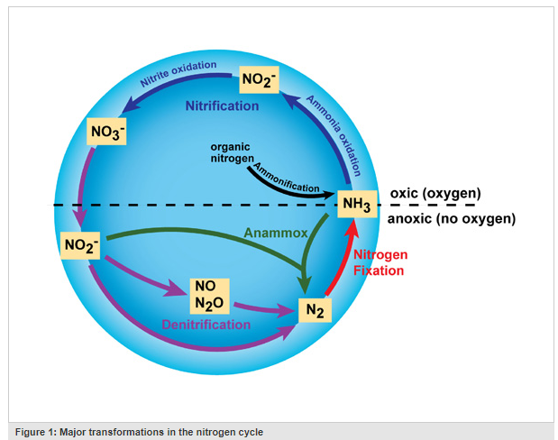
Nitrogen Metabolism

Slide 70
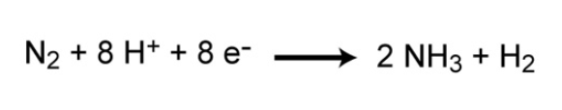
Nitrogen Fixation
Nitrogen gas (N₂) makes up nearly 80% of the Earth's atmosphere, yet nitrogen is often the nutrient that limits primary production in many ecosystems. Why is this so? Because plants and animals are not able to use nitrogen gas in that form. For nitrogen to be available to make proteins, DNA, and other biologically important compounds, it must first be converted into a different chemical form. The process of converting N₂ into biologically available nitrogen is called nitrogen fixation. N₂ gas is a very stable compound due to the strength of the triple bond between the nitrogen atoms, and it requires a large amount of energy to break this bond. The whole process requires eight electrons and at least sixteen ATP molecules. As a result, only a select group of prokaryotes are able to carry out this energetically demanding process. Although most nitrogen fixation is carried out by prokaryotes, some nitrogen can be fixed abiotically by lightning or certain industrial processes, including the combustion of fossil fuels.

Slide 71
Nitrogen Fixation
Some nitrogen-fixing organisms are free-living while others are symbiotic nitrogen-fixers, which require a close association with a host to carry out the process. Most of the symbiotic associations are very specific and have complex mechanisms that help to maintain the symbiosis. For example, root exudates from legume plants (e.g., peas, clover, soybeans) serve as a signal to certain species of Rhizobium, which are nitrogen-fixing bacteria. This signal attracts the bacteria to the roots, and a very complex series of events then occurs to initiate uptake of the bacteria into the root and trigger the process of nitrogen fixation in nodules that form on the roots.

Slide 72
Nitrogen Fixation
Some of these bacteria are aerobic, others are anaerobic; some are phototrophic, others are chemotrophic (i.e., they use chemicals as their energy source instead of light). Although there is great physiological and phylogenetic diversity among the organisms that carry out nitrogen fixation, they all have a similar enzyme complex called nitrogenase that catalyzes the reduction of N₂ to NH₃ (ammonia), which can be used as a genetic marker to identify the potential for nitrogen fixation. One of the characteristics of nitrogenase is that the enzyme complex is very sensitive to oxygen and is deactivated in its presence. This presents an interesting dilemma for aerobic nitrogen-fixers and particularly for aerobic nitrogen-fixers that are also photosynthetic since they actually produce oxygen. Over time, nitrogen-fixers have evolved different ways to protect their nitrogenase from oxygen. For example, some cyanobacteria have structures called heterocysts that provide a low-oxygen environment for the enzyme and serves as the site where all the nitrogen fixation occurs in these organisms. Other photosynthetic nitrogen-fixers fix nitrogen only at night when their photosystems are dormant and are not producing oxygen.

Slide 73
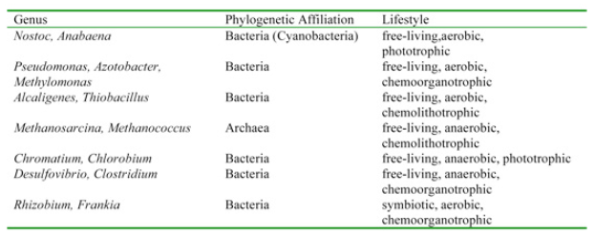
Nitrogen Fixation
Genes for nitrogenase are globally distributed and have been found in many aerobic habitats (e.g., oceans, lakes, soils) and also in habitats that may be anaerobic or microaerophilic (e.g., termite guts, sediments, hypersaline lakes, microbial mats, planktonic crustaceans) (Zehr et al. 2003). The broad distribution of nitrogen-fixing genes suggests that nitrogen-fixing organisms display a very broad range of environmental conditions, as might be expected for a process that is critical to the survival of all life on Earth.

Slide 74
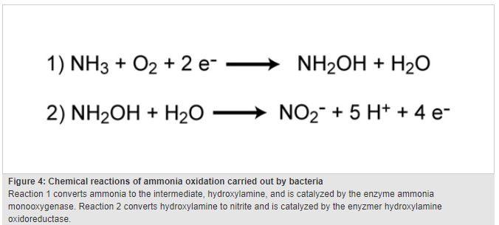
Nitrification
Nitrification is the process that converts ammonia to nitrite and then to nitrate and is another important step in the global nitrogen cycle. Most nitrification occurs aerobically and is carried out exclusively by prokaryotes. There are two distinct steps of nitrification that are carried out by distinct types of microorganisms. The first step is the oxidation of ammonia to nitrite, which is carried out by microbes known as ammonia-oxidizers. Aerobic ammonia oxidizers convert ammonia to nitrite via the intermediate hydroxylamine, a process that requires two different enzymes, ammonia monooxygenase and hydroxylamine oxidoreductase (Figure 4). The process generates a very small amount of energy relative to many other types of metabolism; as a result, nitrosofiers are notoriously very slow growers. Additionally, aerobic ammonia oxidizers are also autotrophs, fixing carbon dioxide to produce organic carbon, much like photosynthetic organisms, but using ammonia as the energy source instead of light.

Slide 75
Nitrification
Unlike nitrogen fixation that is carried out by many different kinds of microbes, ammonia oxidation is less broadly distributed among prokaryotes. Until recently, it was thought that all ammonia oxidation was carried out by only a few types of bacteria in the genera Nitrosomonas, Nitrosospira, and Nitrosococcus. However, in 2005 an archaeon was discovered that could also oxidize ammonia (Koenneke et al. 2005). Since their discovery, ammonia-oxidizing Archaea have often been found to outnumber the ammonia-oxidizing Bacteria in many habitats. In the past several years, ammonia-oxidizing Archaea have been found to be abundant in oceans, soils, and salt marshes, suggesting an important role in the nitrogen cycle for these newly-discovered organisms. Currently, only one ammonia-oxidizing archaeon has been grown in pure culture, Nitrosopumilus maritimus, so our understanding of their physiological diversity is limited.

Slide 76
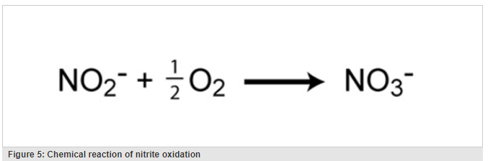
Nitrification
The second step in nitrification is the oxidation of nitrite (NO₂⁻) to nitrate (NO₃⁻) (Figure 5). This step is carried out by a completely separate group of prokaryotes, known as nitrite-oxidizing Bacteria. Some of the genera involved in nitrite oxidation include Nitrospira, Nitrobacter, Nitrococcus, and Nitrospina. Similar to ammonia oxidizers, the energy generated from the oxidation of nitrite to nitrate is very small, and thus growth yields are very low. In fact, ammonia- and nitrite-oxidizers must oxidize many molecules of ammonia or nitrite in order to fix a single molecule of CO₂. For complete nitrification, both ammonia oxidation and nitrite oxidation must occur.

Slide 77
Nitrification
Ammonia-oxidizers and nitrite-oxidizers are ubiquitous in aerobic environments. They have been extensively studied in natural environments such as soils, estuaries, lakes, and open-ocean environments. However, ammonia- and nitrite-oxidizers also play a very important role in wastewater treatment facilities by removing potentially harmful levels of ammonium that could lead to the pollution of the receiving waters. Much research has focused on how to maintain stable populations of these important microbes in wastewater treatment plants. Additionally, ammonia- and nitrite-oxidizers help to maintain healthy aquaria by facilitating the removal of potentially toxic ammonium excreted in fish urine.

Slide 78
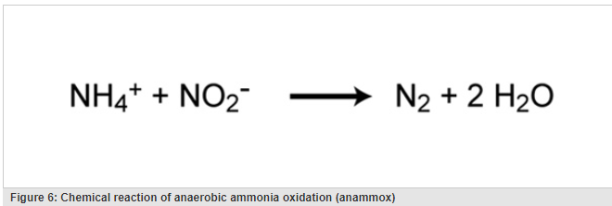
Anammox
Traditionally, all nitrification was thought to be carried out under aerobic conditions, but recently a new type of ammonia oxidation occurring under anoxic conditions was discovered. Anammox (anaerobic ammonia oxidation) is carried out by prokaryotes belonging to the Planctomycetes phylum of Bacteria. The first described anammox bacterium was Brocadia anammoxidans. Anammox bacteria oxidize ammonia by using nitrite as the electron acceptor to produce gaseous nitrogen (Figure 6). Anammox bacteria were first discovered in anoxic bioreactors of wasterwater treatment plants but have since been found in a variety of aquatic systems, including low-oxygen zones of the ocean, coastal and estuarine sediments, mangroves, and freshwater lakes. In some areas of the ocean, the anammox process is considered to be responsible for a significant loss of nitrogen. However, Ward et al. (2009) argue that denitrification rather than anammox is responsible for most nitrogen loss in other areas. Whether anammox or denitrification is responsible for most nitrogen loss in the ocean, it is clear that anammox represents an important process in the global nitrogen cycle.
Ward, B. B. et al. Denitrification as the dominant nitrogen loss process in the Arabian Sea. Nature 460, 78–81 (2009).

Slide 79
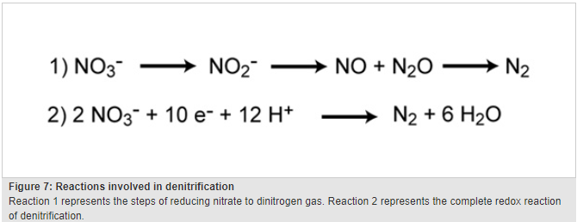
Denitrification
Denitrification is the process that converts nitrate to nitrogen gas, thus removing bioavailable nitrogen and returning it to the atmosphere. Dinitrogen gas (N₂) is the ultimate end product of denitrification, but other intermediate gaseous forms of nitrogen exist (Figure 7). Some of these gases, such as nitrous oxide (N₂O), are considered greenhouse gasses, reacting with ozone and contributing to air pollution.

Slide 80
Denitrification
Unlike nitrification, denitrification is an anaerobic process, occurring mostly in soils and sediments and anoxic zones in lakes and oceans. Similar to nitrogen fixation, denitrification is carried out by a diverse group of prokaryotes, and there is recent evidence that some eukaryotes are also capable of denitrification. Some denitrifying bacteria include species in the genera Bacillus, Paracoccus, and Pseudomonas. Denitrifiers are chemoorganotrophs and thus must also be supplied with some form of organic carbon.
Denitrification is important in that it removes fixed nitrogen (i.e., nitrate) from the ecosystem and returns it to the atmosphere in a biologically inert form (N₂). This is particularly important in agriculture where the loss of nitrates in fertilizer is detrimental and costly. However, denitrification in wastewater treatment plays a very beneficial role by removing unwanted nitrates from the wastewater effluent, thereby reducing the chances that the water discharged from the treatment plants will cause undesirable consequences (e.g., algal blooms).

Slide 81
Ammonification
When an organism excretes waste or dies, the nitrogen in its tissues is in the form of organic nitrogen (e.g. amino acids, DNA). Various fungi and prokaryotes then decompose the tissue and release inorganic nitrogen back into the ecosystem as ammonia in the process known as ammonification. The ammonia then becomes available for uptake by plants and other microorganisms for growth.
Nitrogen is arguably the most important nutrient in regulating primary productivity and species diversity in both aquatic and terrestrial ecosystems. Microbially-driven processes such as nitrogen fixation, nitrification, and denitrification, constitute the bulk of nitrogen transformations, and play a critical role in the fate of nitrogen in the Earth's ecosystems. However, as human populations continue to increase, the consequences of human activities continue to threaten our resources and have already significantly altered the global nitrogen cycle.

Slide 82
Extremophile/Extreme Microbes
An extremophile (from Latin extremus meaning "extreme" and Greek philiā (φιλία) meaning "love") is an organism with optimal growth in environmental conditions considered extreme in that it is challenging for a carbon-based life form with water as a solvent, such as all life on Earth, to survive. This is not the same as a more anthropocentric and non-scientific view which considers an extremophile to be an organism that lives in environments uncomfortable to humans. In contrast, organisms that live in more moderate environmental conditions, according to an anthropocentric view, may be termed mesophiles or neutrophiles.

Slide 83
Extreme Microbes
In the 1980s and 1990s, biologists found that microbial life has great flexibility for surviving in extreme environments—niches that are acidic or extraordinarily hot, for example—that would be completely inhospitable to complex organisms. Some scientists even concluded that life may have begun on Earth in hydrothermal vents far under the ocean's surface.
According to astrophysicist Steinn Sigurdsson, "There are viable bacterial spores that have been found that are 40 million years old on Earth—and we know they're very hardened to radiation." Some bacteria were found living in the cold and dark in a lake buried a half-mile deep under the ice in Antarctica, and in the Marianas Trench, the deepest place in Earth's oceans. Some microorganisms have been found thriving inside rocks up to 1,900 feet (580 m) below the sea floor under 8,500 feet (2,600 m) of ocean off the coast of the northwestern United States. According to one of the researchers, "You can find microbes everywhere—they're extremely adaptable to conditions, and survive wherever they are." A key to extremophile adaptation is their amino acid composition, affecting their protein folding ability under particular conditions. Studying extreme environments on Earth can help researchers understand the limits of habitability on other worlds.
Tom Gheysens from Ghent University in Belgium and some of his colleagues have presented research findings that show spores from a species of Bacillus bacteria survived and were still viable after being heated to temperatures of 420 °C (788 °F).

Slide 84
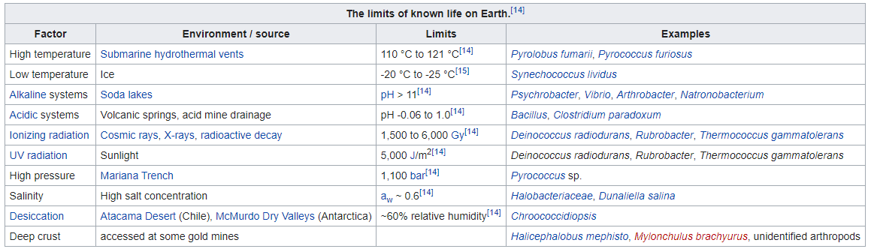
Extreme Microbes
There are many classes of extremophiles that range all around the globe; each corresponding to the way its environmental niche differs from mesophilic conditions. These classifications are not exclusive. Many extremophiles fall under multiple categories and are classified as polyextremophiles. For example, organisms living inside hot rocks deep under Earth's surface are thermophilic and piezophilic such as Thermococcus barophilus. A polyextremophile living at the summit of a mountain in the Atacama Desert might be a radioresistant xerophile, a psychrophile, and an oligotroph. Polyextremophiles are well known for their ability to tolerate both high and low pH levels.

Slide 85
Chapter 6. Bacterial Metabolism

Slide 86
Heterotrophic metabolism
As stated above, heterotrophic (or organotrophic) bacteria require organic molecules to provide their carbon and energy. The energy-yielding catabolic reactions can be of many different types, although they all involve electron-transfer reactions in which the movement of an electron from one molecule to another is coupled with an energy-trapping reaction that yields ATP. Some heterotrophic bacteria can metabolize sugars or complex carbohydrates to produce energy. These bacteria must produce a number of specific proteins, including enzymes that degrade the polysaccharides into their constituent sugar units, a transport system to accumulate the sugar inside the cell, and enzymes to convert the sugar into one of the central intermediates of metabolism, such as glucose-6-phosphate. There are several central pathways for carbohydrate utilization, including the Embden-Meyerhof pathway of glycolysis and the pentose phosphate pathway, both of which are also present in eukaryotic cells. Some bacteria possess the Entner-Doudoroff pathway, which converts glucose primarily to pyruvate, as well as other pathways that accomplish the conversion of glucose into smaller compounds with fewer enzyme-catalyzed steps.

Slide 87
Heterotrophic metabolism
Sugar metabolism produces energy for the cell via two different processes, fermentation and respiration. Fermentation is an anaerobic process that takes place in the absence of any external electron acceptor. The organic compound, such as a sugar or amino acid, is broken down into smaller organic molecules, which accept the electrons that had been released during the breakdown of the energy source. These catabolic reactions include a few steps that result in the direct formation of ATP. When glucose is broken down to lactic acid, as occurs in some Lactococcus and Lactobacillus species, as well as in muscle cells in higher eukaryotes, each molecule of glucose yields only two molecules of ATP, and considerable quantities of glucose must be degraded to provide sufficient energy for bacterial growth. Because organic molecules are only partially oxidized during fermentation, the growth of fermentative bacteria results in the production of large quantities of organic end products and a relatively small output of energy per glucose molecule consumed. Few bacteria produce only lactic acid, which is fairly toxic for bacteria and limits the growth of a colony. A variety of additional fermentation pathways are used by specific bacteria to break down glucose; the characteristic end products of these pathways assist in the identification of the bacteria. These end products are often less toxic than lactic acid or are formed with the harnessing of additional metabolic energy. For example, the products of mixed-acid fermentation in E. coli include lactic acid, succinic acid, acetic acid, formic acid, ethyl alcohol, carbon dioxide, and hydrogen gas. Enterobacter aerogenes produces most of the same set of fermentation products, as well as large amounts of 2,3-butylene glycol, which is nonacidic and permits more bacterial growth.

Slide 88
Heterotrophic metabolism
Considerably more energy is available to the cell from respiration, a process in which the electrons from molecules of sugar are transferred not to another organic molecule but to an inorganic molecule. The most familiar respiratory process (aerobic respiration) uses oxygen as the final electron acceptor. The sugar is completely broken down to carbon dioxide and water, yielding a maximum of 38 molecules of ATP per molecule of glucose. Electrons are transferred to oxygen using the electron transport chain, a system of enzymes and cofactors located in the cell membrane and arranged so that the passage of electrons down the chain is coupled with the movement of protons (hydrogen ions) across the membrane and out of the cell. Electron transport induces the movement of positively charged hydrogen ions to the outside of the cell and negatively charged ions to its interior. This ion gradient results in the acidification of the external medium and an energized plasma membrane with an electrical charge of 150 to 200 millivolts. The generation of ion gradients, including this protonmotive force (gradient of protons), is a common aspect of energy generation and storage in all living organisms. The gradient of protons is used directly by the cell for many processes, including the active transport of nutrients and the rotation of flagella. The protons also can move from the exterior of the cell into the cytoplasm by passing through a membrane enzyme called the F1F0-proton-translocating ATPase, which couples this proton movement to ATP synthesis in a process identical to that which occurs in the mitochondria of eukaryotic cells (see metabolism: The combustion of food materials).

Slide 89
Heterotrophic metabolism
Bacteria that are able to use respiration produce far more energy per sugar molecule than do fermentative cells, because the complete oxidation (breakdown) of the energy source allows complete extraction of all of the energy available as shown by the substantially greater yield of ATP for respiring organisms than for fermenting bacteria. Respiring organisms achieve a greater yield of cell material using a given amount of nutrient; they also generate fewer toxic end products. The solubility of oxygen in water is limited, however, and the growth and survival of populations of aerobic bacteria are directly proportional to the available supply of oxygen. Continuous supplies of oxygen are available only to bacteria that come into contact with air, as occurs when bacteria are able to float on a surface that exposes them to air or when the medium in which the bacteria live is stirred vigorously.

Slide 90
Heterotrophic metabolism
Respiration can also occur under anaerobic conditions by processes called anaerobic respiration, in which the final electron acceptor is an inorganic molecule, such as nitrate (NO3−), nitrite (NO2−), sulfate (SO42−), or carbon dioxide (CO2). The energy yields available to the cell using these acceptors are lower than in respiration with oxygen—much lower in the case of sulfate and carbon dioxide—but they are still substantially higher than the energy yields available from fermentation. The ability of some bacteria to use inorganic molecules in anaerobic respiration can have environmental significance. E. coli can use oxygen, nitrate, or nitrite as an electron acceptor, and Pseudomonas stutzeri is of major global importance for its activity in denitrification, the conversion of nitrate to nitrite and dinitrogen gas (N2). Desulfovibrio and Desulfuromonas reduce sulfate and elemental sulfur (S), respectively, yielding sulfide (S2−), and the bacterium Acetobacterium woodii and methanogenic archaea, such as Methanothermobacter thermautotrophicus, reduce carbon dioxide to acetate and methane, respectively. The Archaea typically use hydrogen as an electron donor with carbon dioxide as an electron acceptor to yield methane or with sulfate as an electron acceptor to yield sulfide.

Slide 91
Autotrophic metabolism
Autotrophic bacteria synthesize all their cell constituents using carbon dioxide as the carbon source. The most common pathways for synthesizing organic compounds from carbon dioxide are the reductive pentose phosphate (Calvin) cycle, the reductive tricarboxylic acid cycle, and the acetyl-CoA pathway. The Calvin cycle, elucidated by American biochemist Melvin Calvin, is the most widely distributed of these pathways, operating in plants, algae, photosynthetic bacteria, and most aerobic lithoautotrophic bacteria. The key step in the Calvin cycle is the reaction of ribulose 1,5-bisphosphate with carbon dioxide, yielding two molecules of 3-phosphoglycerate, a precursor to glucose. This cycle is extremely expensive for the cell in terms of energy, such that the synthesis of one molecule of glyceraldehyde-3-phosphate requires the consumption of nine molecules of ATP and the oxidation of six molecules of the electron donor, the reduced form of nicotinamide adenine dinucleotide phosphate (NADPH). Autotrophic behaviour depends on the ability of the cell to carry out photosynthetic or aerobic respiratory metabolism, which are the only processes able to deliver sufficient energy to maintain carbon fixation.

Slide 92
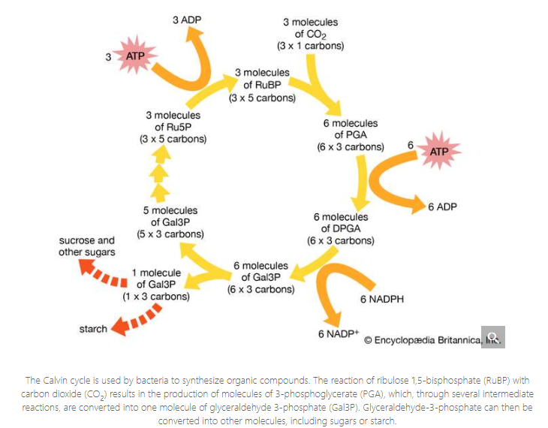
Autotrophic metabolism

Slide 93
Autotrophic metabolism
The aerobic nonphotosynthetic lithoautotrophs are those bacteria that not only use carbon dioxide as their sole carbon source but also generate energy from inorganic compounds (electron donors) with oxygen as an electron acceptor. These bacteria are taxonomically diverse and are usually defined by the electron donor that they use. For example, Nitrosomonas europaea oxidizes ammonia (NH4+) to nitrite, and Nitrobacter winogradskyi oxidizes nitrite to nitrate. Thiobacillus oxidizes thiosulfate and elemental sulfur to sulfate, and A. ferrooxidans oxidizes ferrous ions to the ferric form. This diverse oxidizing ability allows A. ferrooxidans to tolerate high concentrations of many different ions, including iron, copper, cobalt, nickel, and zinc. All of these types of bacteria appear to be obligate lithotrophs and are unable to use organic compounds to a significant degree. Carbon monoxide (CO) is oxidized to carbon dioxide by Oligotropha carboxidovorans, and hydrogen gas (H2) is oxidized by Alcaligenes eutrophus and, to a lesser degree, by many other bacteria.

Slide 94
Autotrophic metabolism
Metabolic energy is made available from the oxidation of these electron donors in basically the same way as that used by respiring heterotrophs, which transfer electrons from an organic molecule to oxygen. As electrons are passed along the electron transport chain to oxygen, a proton gradient is generated across the cell membrane. This gradient is used to generate molecules of ATP. Other reactions present in lithoautotrophs are those used for the removal of electrons from the inorganic donor and for carbon dioxide fixation.

Slide 95
Phototrophic metabolism
Life on Earth is dependent on the conversion of solar energy to cellular energy by the process of photosynthesis. The general process of photosynthesis makes use of pigments called chlorophylls that absorb light energy from the Sun and release an electron with a higher energy level. This electron is passed through an electron transport chain, with the generation of energy by formation of a proton gradient and concomitant ATP synthesis. The electron ultimately returns to the chlorophyll. This cyclic reaction path can fulfill the energy needs of the cell. For the cell to grow, however, the Calvin cycle of carbon dioxide fixation must be activated, and electrons must be transferred to the cofactor NADP to form NADPH, which is needed in large amounts for the operation of the cycle. Thus, phototrophic cell growth requires that a source of electrons be available to replace the electrons that are consumed during biosynthetic reactions.

Slide 96
Phototrophic metabolism
Photosynthetic organisms are divided into two broad groups according to the nature of the source of these electrons. One group includes the higher plants, eukaryotic algae, and the cyanobacteria (blue-green algae); these organisms contain the pigment chlorophyll a and use water as their electron source in reactions that generate oxygen. It is thought that by 1.8 billion years ago predecessors of the cyanobacteria had produced enough oxygen globally to begin to allow for the development of higher forms of life. Oxygen-evolving photosynthesis requires the action of two separate light-absorbing systems to raise the energy of the electrons from water to a level high enough for their transfer to NADP. Thus, two distinct photoreaction centres are present in these organisms, one for the oxygen-generating reaction and the other for the cyclic process for energy generation. In the cyanobacteria, both photoreaction centres contain chlorophyll a. Their photosynthetic apparatus also contains other light-absorbing pigments that serve as antennae to capture light energy and transfer it to the reaction centres. Cyanobacterial antennae include additional molecules of chlorophyll a, which transfer energy to the cyclic reaction centre, and phycobilisomes, which are protein pigments that absorb light of short, high-energy wavelengths and transmit this energy to the oxygen-evolving reaction centre. In almost all cyanobacteria, the photosynthetic apparatus is contained in an extensive intracellular system of flattened membranous sacs, called thylakoids, the outer surfaces of which are studded with regular arrays of phycobilisome granules. This arrangement, in which pigment aggregates exist on the thylakoid surfaces, is called a photosystem.

Slide 97
Phototrophic metabolism
Other photosynthetic bacteria contain only a single type of reaction centre with a different pigment, called bacteriochlorophyll, which absorbs light of long, low-energy wavelengths. These organisms require an electron donor other than water and do not release oxygen. The green bacteria (Chlorobiaceae) and purple sulfur bacteria (Chromatiaceae) use elemental sulfur, sulfide, thiosulfate, or hydrogen gas as electron donor, whereas the purple nonsulfur bacteria use electrons from hydrogen or organic substrates. These bacteria require anaerobic conditions for photosynthetic activity. The photosystem in green bacteria is related to photosystem I of higher plants, whereas that in purple bacteria is related to photosystem II, which provides some indication of an evolutionary trail from bacteria to plants (see photosynthesis: The process of photosynthesis: the light reactions).

Slide 98
Biosynthetic pathways of bacteria
Many prokaryotes are able to convert any given carbon source into biosynthetic building blocks—e.g., amino acids, purines, pyrimidines, lipids, sugars, and enzyme cofactors. The amount and activity of each enzyme in these biosynthetic pathways are carefully regulated so that the cell produces only as much of any compound as is needed at any time.
During the process of evolution, some bacteria have lost genes that encode certain biosynthetic reactions and are hence likely to require nutritional supplements. For example, Mycoplasma, whose DNA content is about one-quarter the size of that of E. coli, has many nutritional requirements and has even lost the ability to make a cell wall.

Slide 99
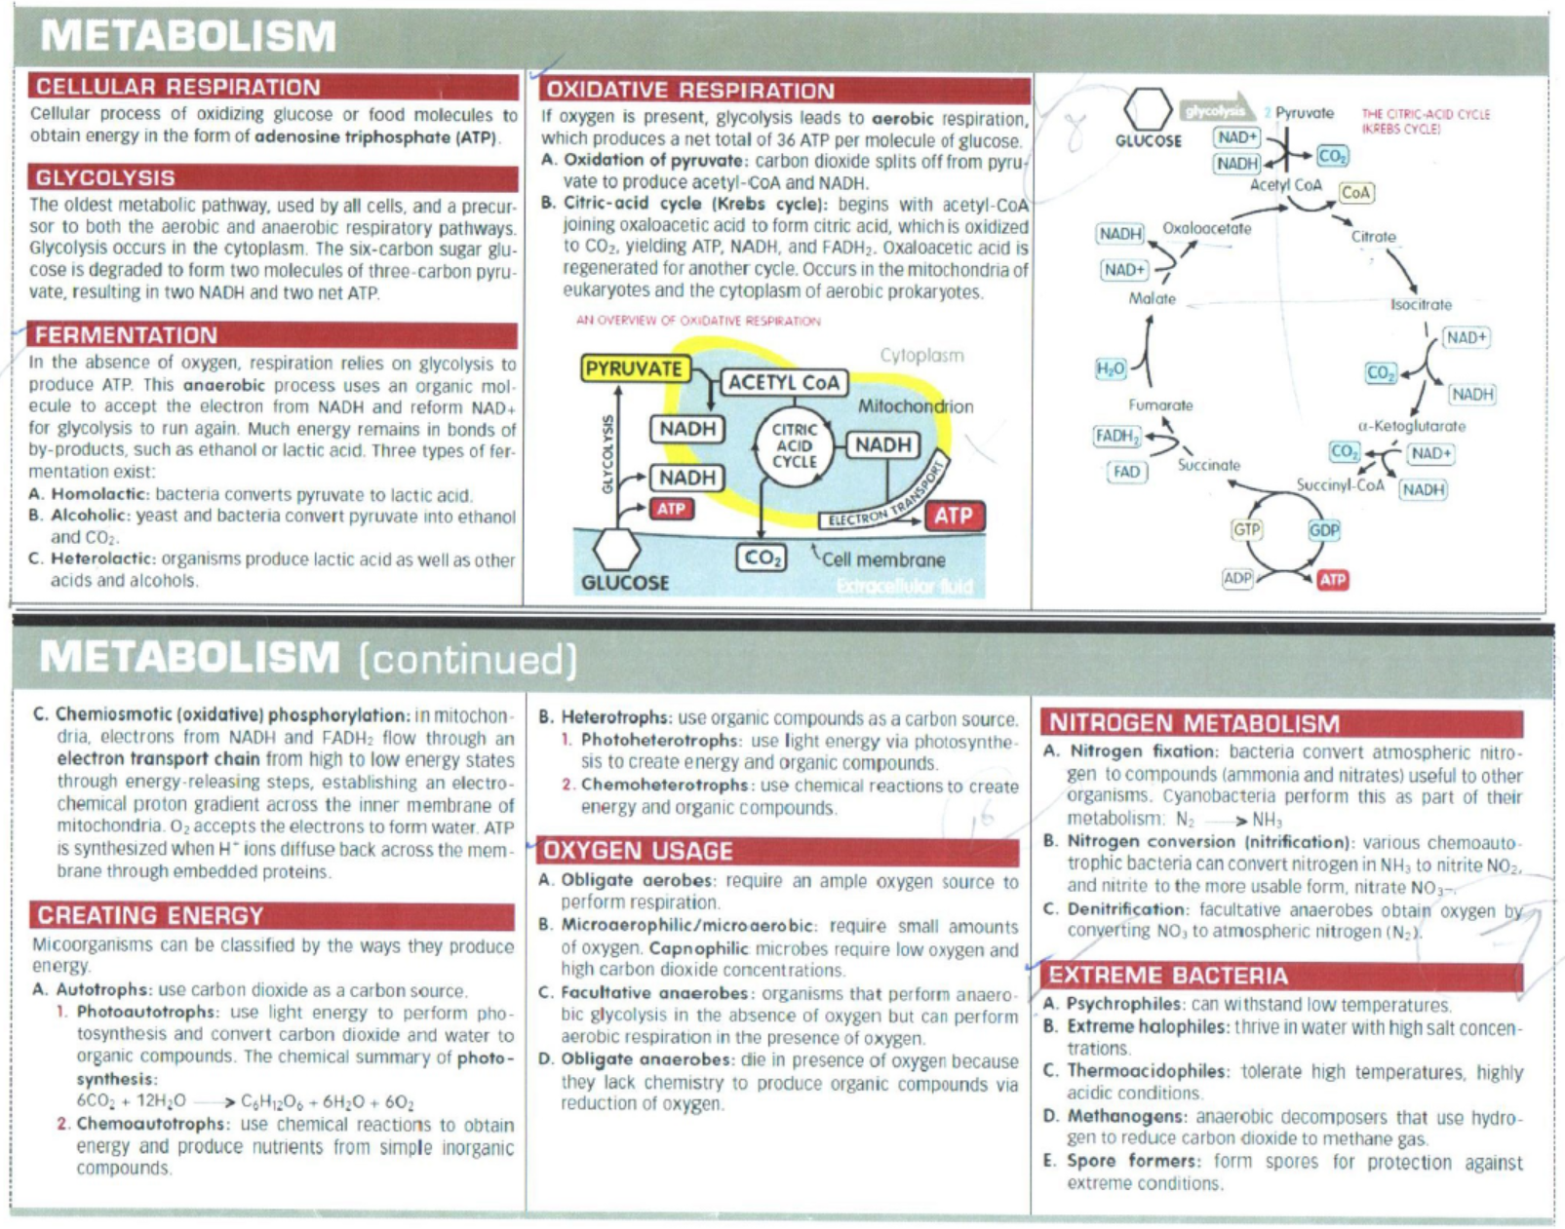

Slide 100
Chapter 7. Quorum Sensing and Signal Transduction

Slide 101
Quorum Sensing
Quorum sensing is the regulation of gene expression in response to fluctuations in cell-population density. Quorum sensing bacteria produce and release chemical signal molecules called autoinducers that increase in concentration as a function of cell density. The detection of a minimal threshold stimulatory concentration of an autoinducer leads to an alteration in gene expression. Gram-positive and Gram-negative bacteria use quorum sensing communication circuits to regulate a diverse array of physiological activities. These processes include symbiosis, virulence, competence, conjugation, antibiotic production, motility, sporulation, and biofilm formation.

Slide 102
Quorum Sensing
In general, Gram-negative bacteria use acylated homoserine lactones as autoinducers, and Gram-positive bacteria use processed oligo-peptides to communicate. Recent advances in the field indicate that cell-cell communication via autoinducers occurs both within and between bacterial species. Furthermore, there is mounting data suggesting that bacterial autoinducers elicit specific responses from host organisms. Although the nature of the chemical signals, the signal relay mechanisms, and the target genes controlled by bacterial quorum sensing systems differ, in every case the ability to communicate with one another allows bacteria to coordinate the gene expression, and therefore the behavior, of the entire community. Presumably, this process bestows upon bacteria some of the qualities of higher organisms. The evolution of quorum sensing systems in bacteria could, therefore, have been one of the early steps in the development of multicellularity.

Slide 103
Quorum Sensing
Some of the best-known examples of quorum sensing come from studies of bacteria. Bacteria use quorum sensing to regulate certain phenotype expressions, which in turn, coordinate their behaviors. Some common phenotypes include biofilm formation, virulence factor expression, and motility. Certain bacteria are able to use quorum sensing to regulate bioluminescence, nitrogen fixation and sporulation.
The quorum-sensing function is based on the local density of the bacterial population in the immediate environment. It can occur within a single bacterial species, as well as between diverse species. Both Gram-positive and gram-negative bacteria use quorum sensing, but there are some major differences in their mechanisms.

Slide 104
Quorum Sensing Mechanism
For the bacteria to use quorum sensing constitutively, they must possess three characteristics: to secrete a signaling molecule, an autoinducer, to detect the change in concentration of signaling molecules, and to regulate gene transcription as a response. This process is highly dependent on the diffusion mechanism of the signaling molecules. QS Signaling molecules are usually secreted at a low level by individual bacteria. At low cell density, the molecules may just diffuse away. At high cell density, the local concentration of signaling molecules may exceed its threshold level, and trigger changes in gene expressions.
Gram-positive Bacteria
  Gram-positive bacteria use autoinducing peptide (AIP) as their autoinducers.
  When gram-positive bacteria detect high concentration of AIP in their environment, AIP binds to a receptor to activate a kinase. The kinase phosphorylates a transcription factor, which regulates gene transcription. This is called a two-component system.
  Another possible mechanism is that AIP is transported into the cytosol, and binds directly to a transcription factor to initiate or inhibit transcription.
Gram-negative Bacteria
  Gram-negative bacteria produce N-acyl homoserine lactones (AHL) as their signaling molecule. Usually AHLs do not need additional processing, and bind directly to transcription factors to regulate gene expression.
  Some gram-negative bacteria may use the two-component system as well.

Slide 105
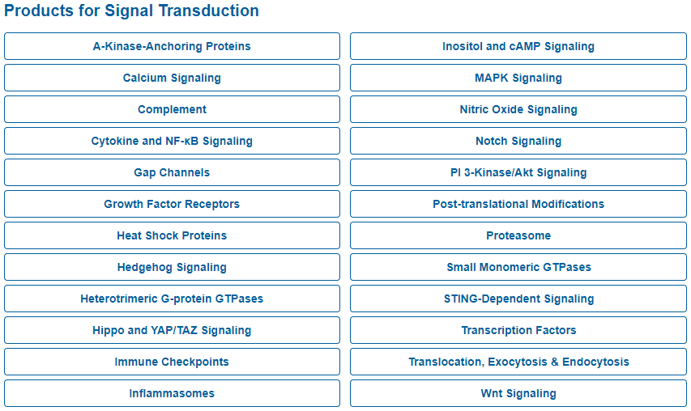
Signal Transduction
Signal transduction (also known as cell signaling) is the transmission of molecular signals from a cell's exterior to its interior. Signals received by cells must be transmitted effectively into the cell to ensure an appropriate response. This step is initiated by cell-surface receptors.

Slide 106
Signal Transduction Pathways
Transmission is continued either by a series of biochemical changes within the cell or by modification of the cell membrane potential by the movement of ions in or out of the cell. Receptors that initiate biochemical changes can do so either directly via intrinsic enzymatic activities within the receptor or by activating intracellular messenger molecules.
Signal transducing receptors are of four general classes:
  Receptors that penetrate the plasma membrane and have intrinsic enzymatic activity or are enzyme associated (Enzyme-linked Receptors)
  Receptors that are coupled, inside the cell, to G proteins (7-TM Receptors)
  Receptors that are found intracellularly and upon ligand binding directly alter gene transcription (Nuclear Receptors)
  Ligand-gated ion channels
The intracellular component of signal transduction is highly receptor specific, thereby maintaining the specificity of the incoming signal inside the cell. Signal transduction pathways amplify the incoming signal by a signaling cascade using a network of enzymes that act on one another in specific ways to ultimately generate a precise and appropriate physiological response by the cell. Signal transduction involves altering the behavior of proteins in the cascade, in effect turning them on or off like a switch. Adding or removing phosphates is a fundamental mechanism for altering the shape, and therefore the behavior, of a protein. Several small molecules within the cell act as intracellular messengers (also known as second messengers). These include cAMP, cGMP, nitric oxide, lipids and Ca2+ ions. Activated receptors stimulate second messenger production, which in turn activate other enzymes and so the cascade continues.

Slide 107
Physiology and Disease
One of the most important functions of cell signaling is to control and maintain normal physiological balance within the body. Activation of different signaling pathways leads to diverse physiological responses, such as cell proliferation, death, differentiation, and metabolism. In the last few years signal transduction therapy has become one of the most important areas of modern drug research. In a healthy organism, the processes of cellular growth and differentiation are tightly controlled, but in the pathological state, are uncoupled in such a way as to result in further damage-causing signals, or the growth of the malfunctioning cells. Proliferation of damaged or malfunctioning cells is often a key factor in the generation of disorders such as cancer, infectious diseases, inflammation, arteriosclerosis, arthritis, and neurodegenerative diseases.

Slide 108
Chapter 8 Microbial Growth

Slide 109
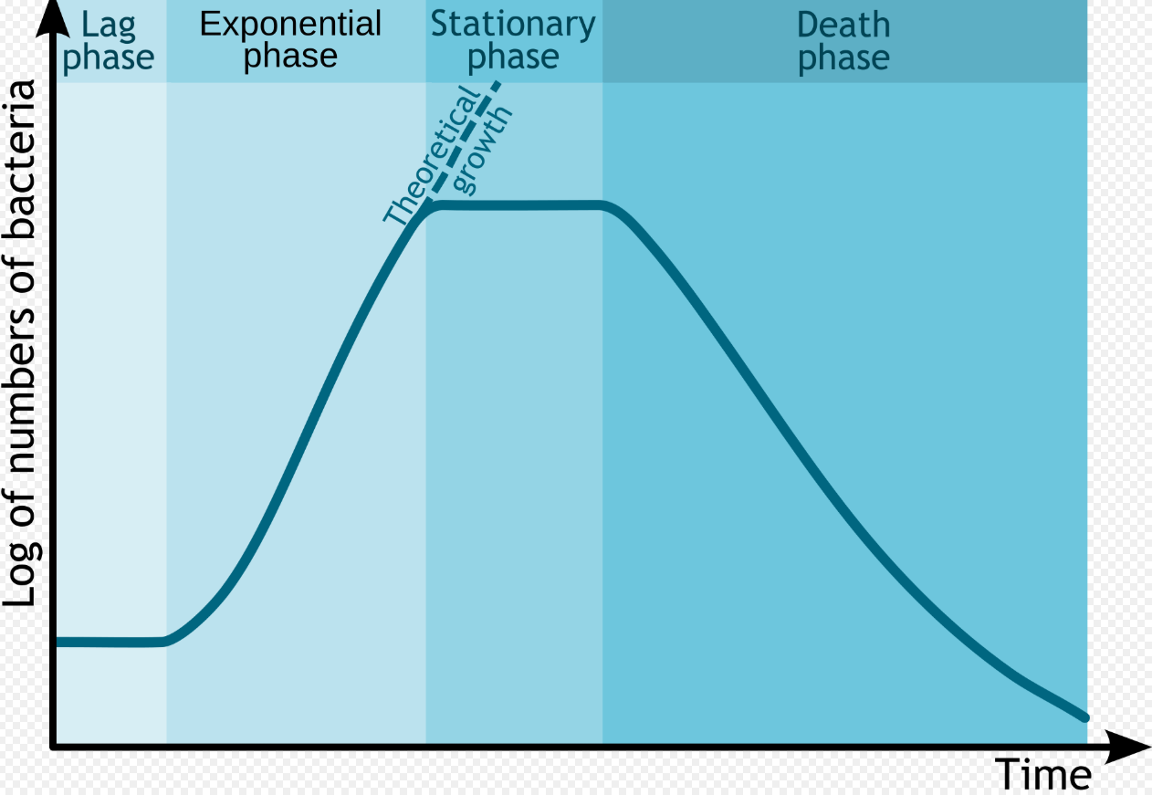
In autecological studies, the growth of bacteria (or other microorganisms, as protozoa, microalgae or yeasts) in batch culture can be modeled with four different phases: lag phase (A), log phase or exponential phase (B), stationary phase (C), and death phase (D).

Slide 110
Microbial Growth
During lag phase, bacteria adapt themselves to growth conditions. It is the period where the individual bacteria are maturing and not yet able to divide. During the lag phase of the bacterial growth cycle, synthesis of RNA, enzymes and other molecules occurs. During the lag phase cells change very little because the cells do not immediately reproduce in a new medium. This period of little to no cell division is called the lag phase and can last for 1 hour to several days. During this phase cells are not dormant.
The log phase (sometimes called the logarithmic phase or the exponential phase) is a period characterized by cell doubling. The number of new bacteria appearing per unit time is proportional to the present population. If growth is not limited, doubling will continue at a constant rate so both the number of cells and the rate of population increase doubles with each consecutive time period. For this type of exponential growth, plotting the natural logarithm of cell number against time produces a straight line. The slope of this line is the specific growth rate of the organism, which is a measure of the number of divisions per cell per unit time. The actual rate of this growth (i.e. the slope of the line in the figure) depends upon the growth conditions, which affect the frequency of cell division events and the probability of both daughter cells surviving. Under controlled conditions, cyanobacteria can double their population four times a day and then they can triple their population. Exponential growth cannot continue indefinitely, however, because the medium is soon depleted of nutrients and enriched with wastes.

Slide 111
Microbial Growth
The stationary phase is often due to a growth-limiting factor such as the depletion of an essential nutrient, and/or the formation of an inhibitory product such as an organic acid. Stationary phase results from a situation in which growth rate and death rate are equal. The number of new cells created is limited by the growth factor and as a result the rate of cell growth matches the rate of cell death. The result is a “smooth,” horizontal linear part of the curve during the stationary phase. Mutations can occur during stationary phase. Bridges et al. (2001) presented evidence that DNA damage is responsible for many of the mutations arising in the genomes of stationary phase or starving bacteria. Endogenously generated reactive oxygen species appear to be a major source of such damages.
At death phase (decline phase), bacteria die. This could be caused by lack of nutrients, environmental temperature above or below the tolerance band for the species, or other injurious conditions.

Slide 112
Microbial Growth
This basic batch culture growth model draws out and emphasizes aspects of bacterial growth which may differ from the growth of macrofauna. It emphasizes clonality, asexual binary division, the short development time relative to replication itself, the seemingly low death rate, the need to move from a dormant state to a reproductive state or to condition the media, and finally, the tendency of lab adapted strains to exhaust their nutrients. In reality, even in batch culture, the four phases are not well defined. The cells do not reproduce in synchrony without explicit and continual prompting (as in experiments with stalked bacteria) and their exponential phase growth is often not ever a constant rate, but instead a slowly decaying rate, a constant stochastic response to pressures both to reproduce and to go dormant in the face of declining nutrient concentrations and increasing waste concentrations.
Near the end of the logarithmic phase of a batch culture, competence for natural genetic transformation may be induced, as in Bacillus subtilis and in other bacteria. Natural genetic transformation is a form of DNA transfer that appears to be an adaptation for repairing DNA damages.

Slide 113
Microbial Growth
Batch culture is the most common laboratory growth method in which bacterial growth is studied, but it is only one of many. It is ideally spatially unstructured and temporally structured. The bacterial culture is incubated in a closed vessel with a single batch of medium. In some experimental regimes, some of the bacterial culture is periodically removed and added to fresh sterile medium. In the extreme case, this leads to the continual renewal of the nutrients. This is a chemostat, also known as continuous culture. It is ideally spatially unstructured and temporally unstructured, in a steady state defined by the rates of nutrient supply and bacterial growth. In comparison to batch culture, bacteria are maintained in exponential growth phase, and the growth rate of the bacteria is known. Related devices include turbidostats and auxostats. When Escherichia coli is growing very slowly with a doubling time of 16 hours in a chemostat most cells have a single chromosome.
Bacterial growth can be suppressed with bacteriostats, without necessarily killing the bacteria. In a synecological, true-to-nature situation in which more than one bacterial species is present, the growth of microbes is more dynamic and continual.
Liquid is not the only laboratory environment for bacterial growth. Spatially structured environments such as biofilms or agar surfaces present additional complex growth models.

Slide 114
Environmental conditions
Environmental factors influence rate of bacterial growth such as acidity (pH), temperature, water activity, macro and micro nutrients, oxygen levels, and toxins. Conditions tend to be relatively consistent between bacteria with the exception of extremophiles. Bacterium have optimal growth conditions under which they thrive, but once outside of those conditions the stress can result in either reduced or stalled growth, dormancy (such as formation spores), or death. Maintaining sub-optimal growth conditions is a key principle to food preservation.

Slide 115
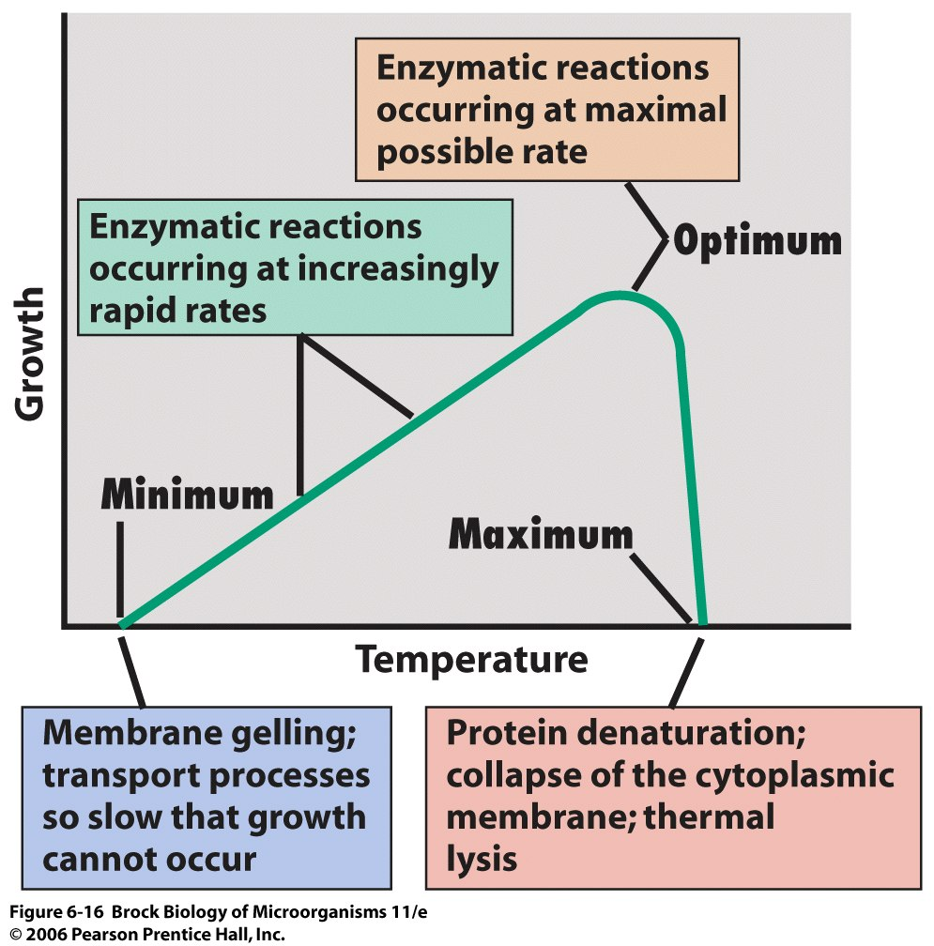
Environmental conditions
Temperature
Temperature is a major environmental factor controlling microbial growth. The cardinal temperatures are the minimum, optimum, and maximum temperatures at which each organism grows.

Slide 116
Environmental conditions
Low temperatures tend to reduce growth rates which has led to refrigeration being instrumental in food preservation. Depending on temperature, bacteria can be classified as:
  Psychrophiles
    Psychrophiles are extremophilic cold-loving bacteria or archaea with an optimal temperature for growth at about 15 °C or lower (maximal temperature for growth at 20 °C, minimal temperature for growth at 0 °C or lower). Psychrophiles are typically found in Earth's extremely cold ecosystems, such as polar ice-cap regions, permafrost, polar surface, and deep oceans.
  Mesophiles
    Mesophiles are bacteria that thrive at moderate temperatures, growing best between 20° and 45 °C. These temperatures align with the natural body temperatures of humans, which is why many human pathogens are mesophiles.
  Thermophiles
    Survive under temperatures of 45° - 60 °C

Slide 117
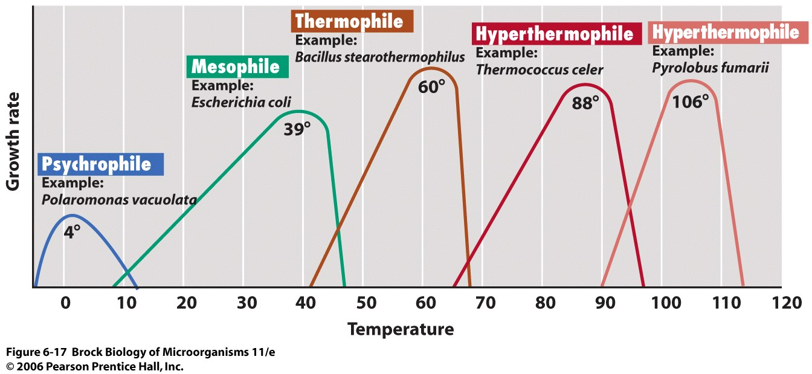
Microorganisms can be grouped by the temperature ranges they require.

Slide 118
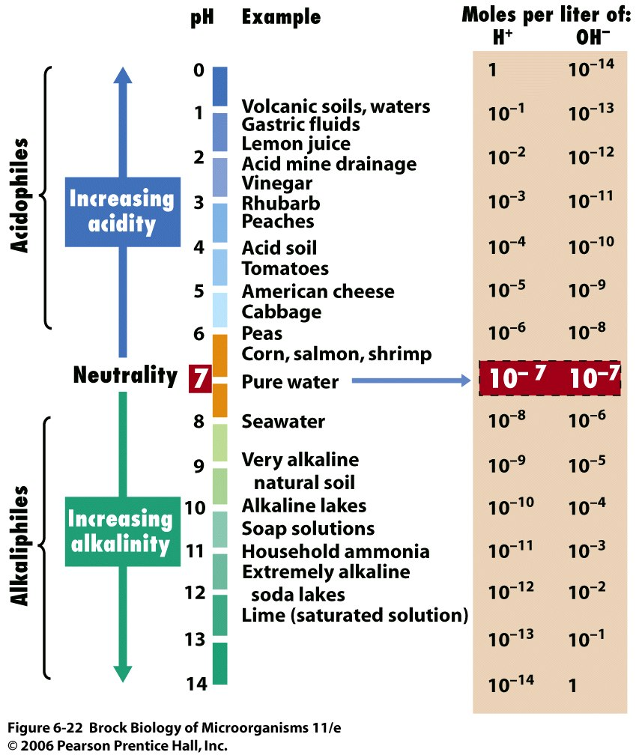
Environmental conditions
Acidity
The acidity or alkalinity of an environment can greatly affect microbial growth.
Optimal acidity for bacteria tends to be around pH 6.5 to 7.0 with the exception of acidophiles. Some bacteria can change the pH such as by excreting acid resulting in sub-optimal conditions. The internal pH of a cell must stay relatively close to neutral even though the external pH is highly acidic or basic.
Organisms that grow best at low pH are called acidophiles; those that grow best at high pH are called alkaliphiles.

Slide 119
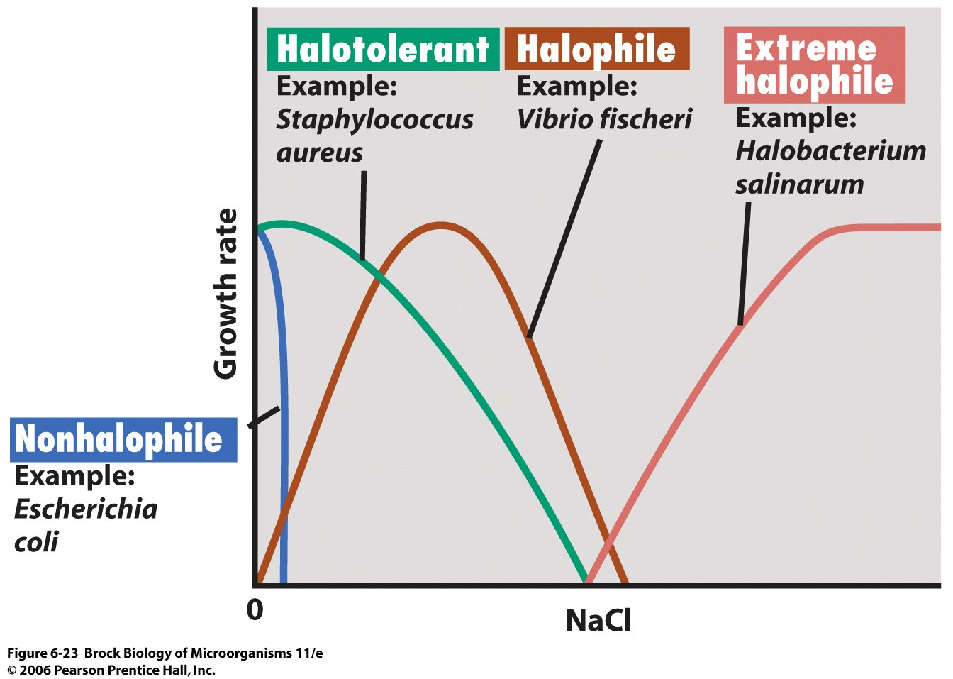
Environmental conditions
Salinity
Some microorganisms (halophiles) have evolved to grow best at reduced water potential, and some (extreme halophiles) even require high levels of salts for growth.

Slide 120
Environmental conditions
Oxygen
  Bacteria can be aerobes or anaerobes. depending on the degree of oxygen required bacteria can fall into the following classes;
    1.facultative-anaerobes-ie aerotolerant absence or minimal oxygen required for their growth
    2.obligate-anaerobes grow only in complete absence of oxygen
    3.facultative aerobes-can grow either in presence or minimal oxygen
    4.obligate aerobes-grow only in the presence of oxygen
Toxic compounds
  Toxic compounds such as ethanol can hinder growth or kill bacteria. This is used beneficially for disinfection and in food preservation.

Slide 121
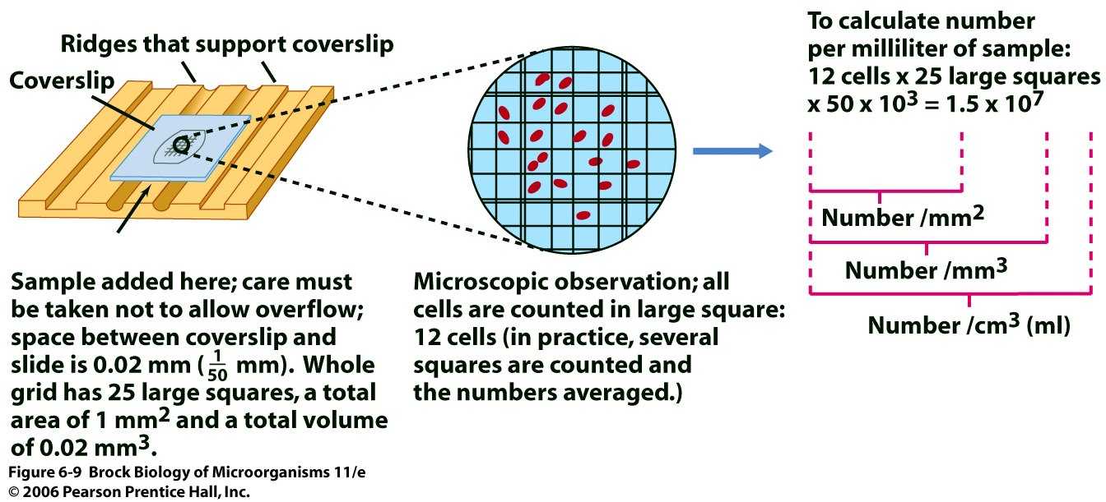
Direct Counting
Growth is measured by the change in the number of cells over time. Cell counts done microscopically measure the total number of cells in a population, whereas viable cell counts (plate counts) measure only the living, reproducing population.

Slide 122
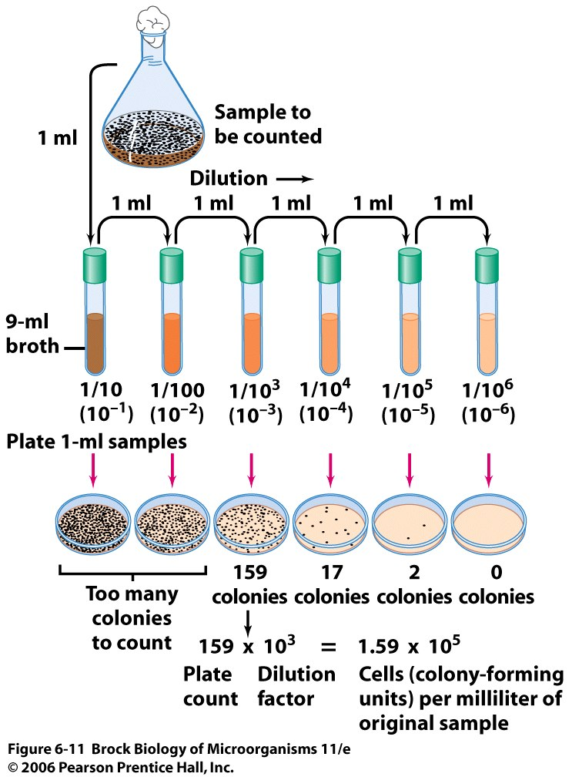
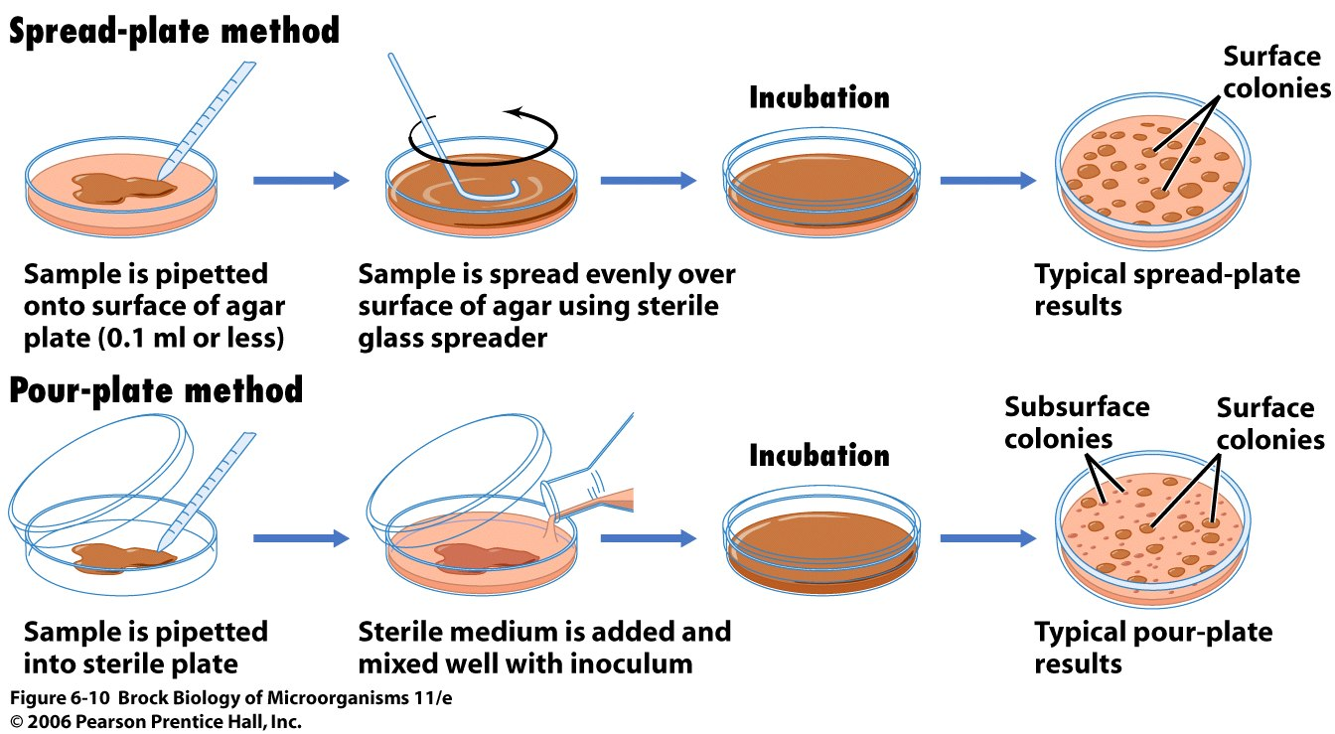

Slide 123
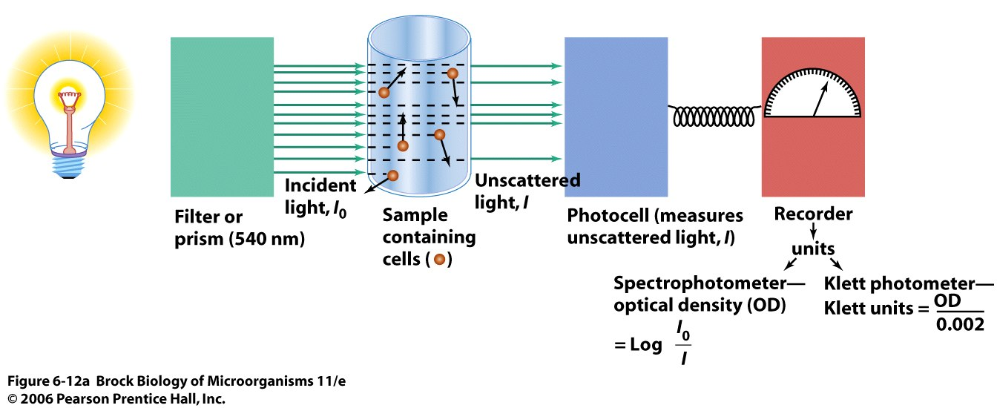
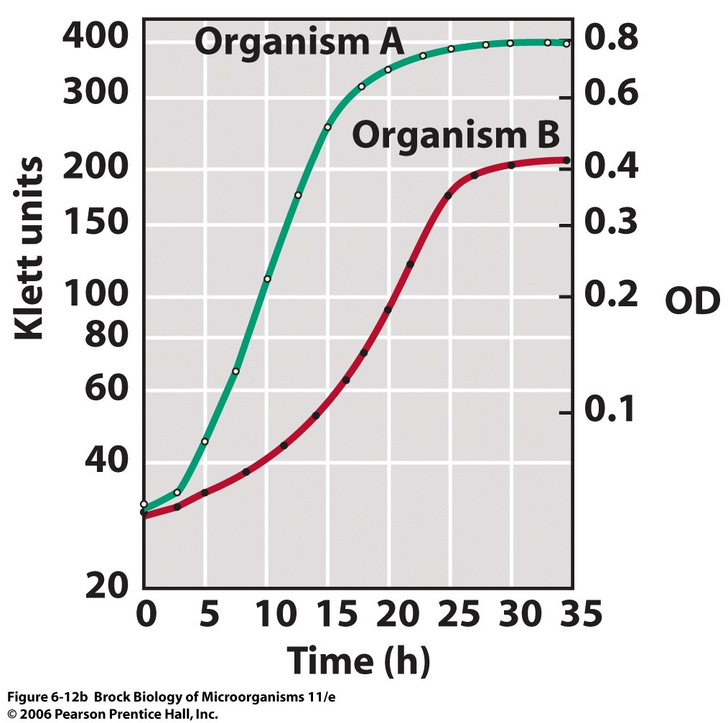
Indirect Counting
Turbidity measurements are an indirect but very rapid and useful method of measuring microbial growth. However, to relate a direct cell count to a turbidity value, a standard curve must first be established.

Slide 124
Chapter 9. Cell Structure

Slide 125
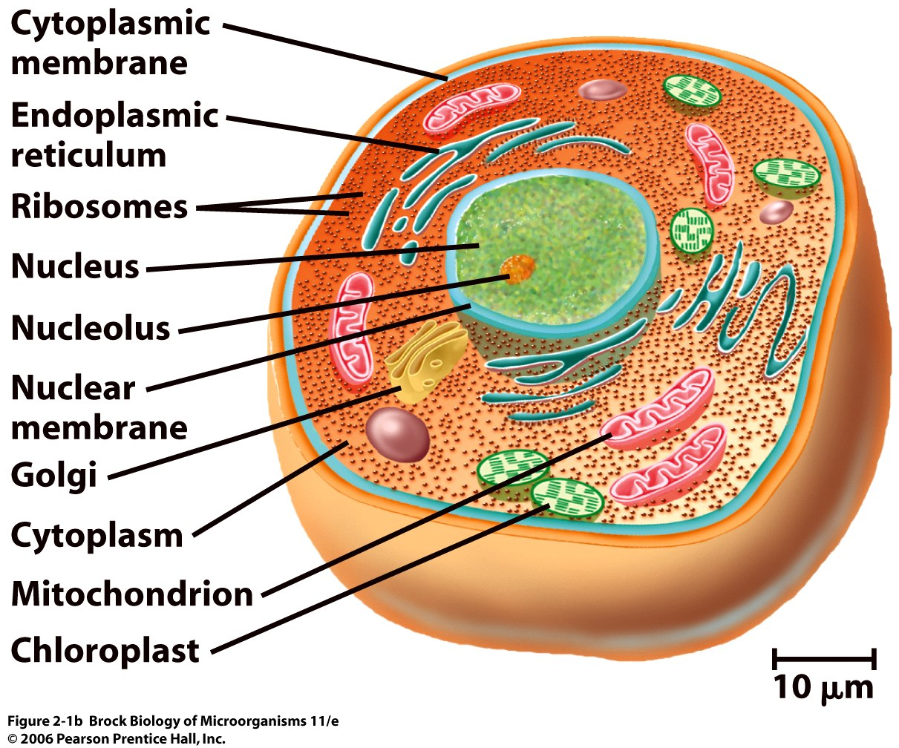
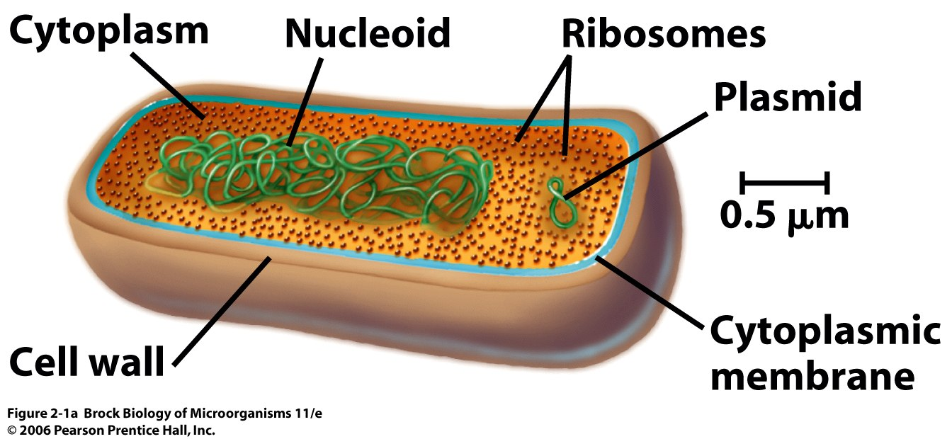
Two structural types of cells are recognized: the prokaryote and the eukaryote. Prokaryotic cells have a simpler internal structure than eukaryotic cells, lacking membrane-enclosed organelles.

Slide 126
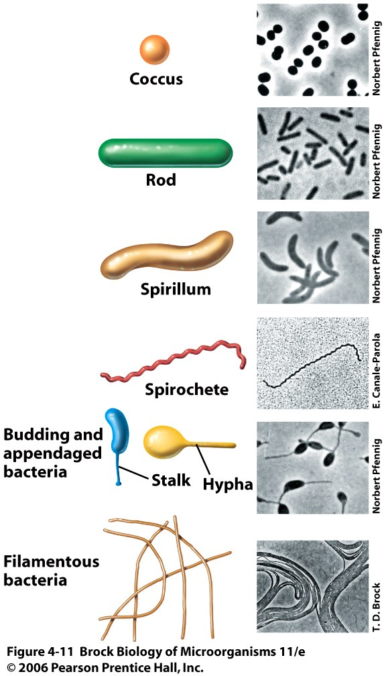
Bacterial Morphology
Some typical bacterial morphologies include coccus, rod, spirillum, spirochete, appendaged, and filamentous.

Slide 127
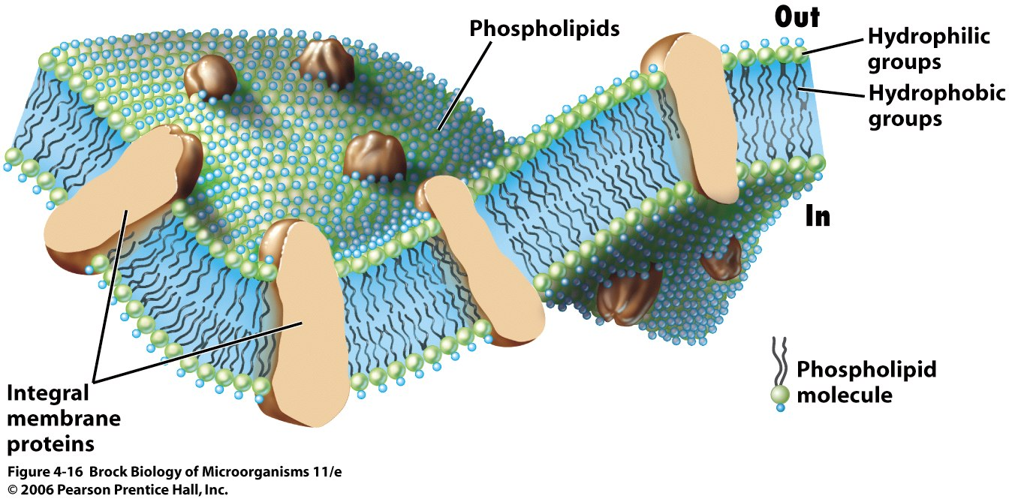
Cytoplasmic Membrane
The cytoplasmic membrane is a highly selective permeability barrier constructed of lipids and proteins that forms a bilayer with hydrophilic exteriors and a hydrophobic interior.

Slide 128
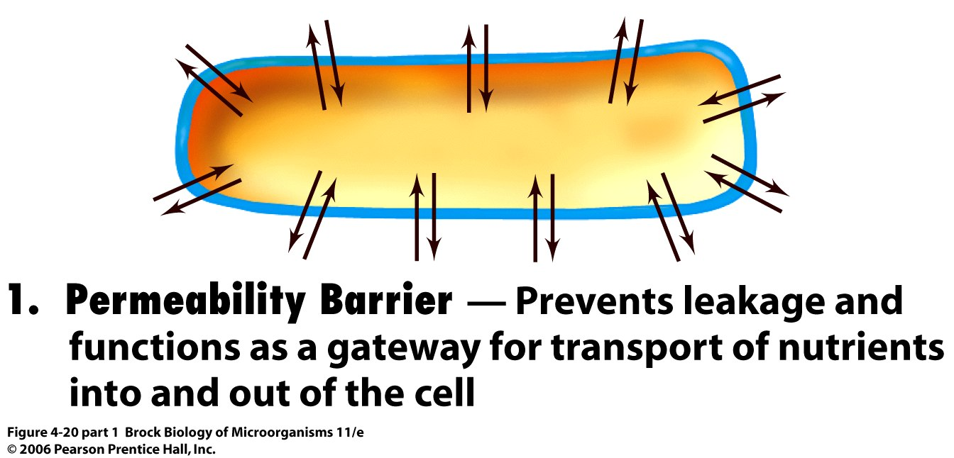
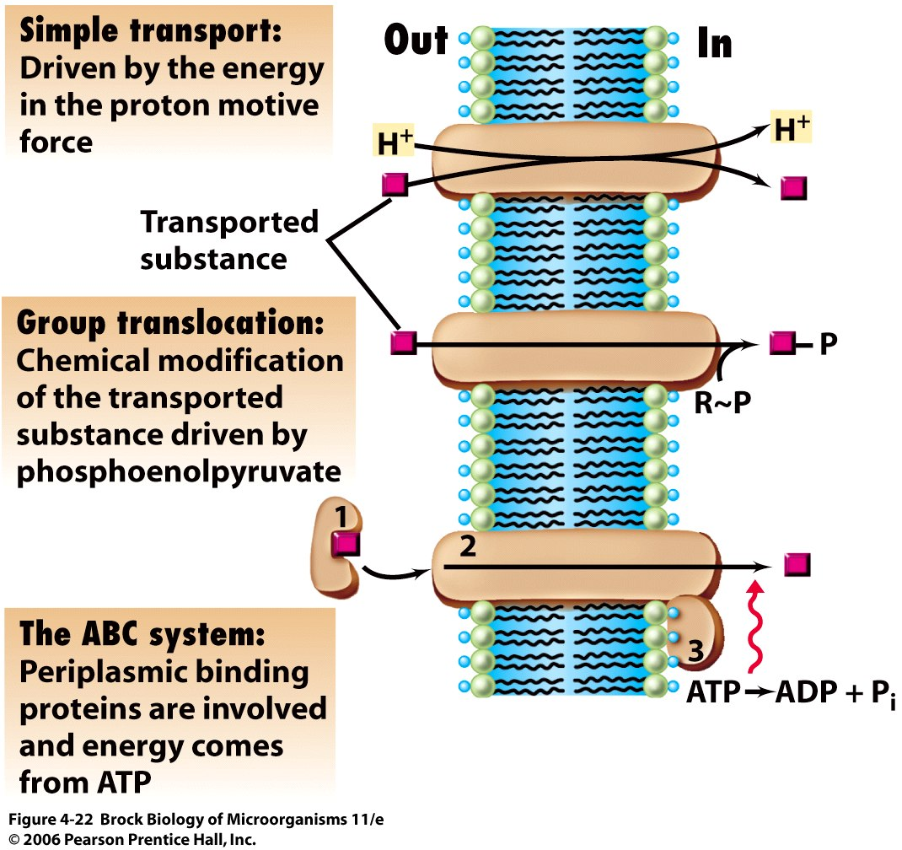
The major function of the cytoplasmic membrane is to act as a permeability barrier, preventing leakage of cytoplasmic metabolites into the environment.

Slide 129
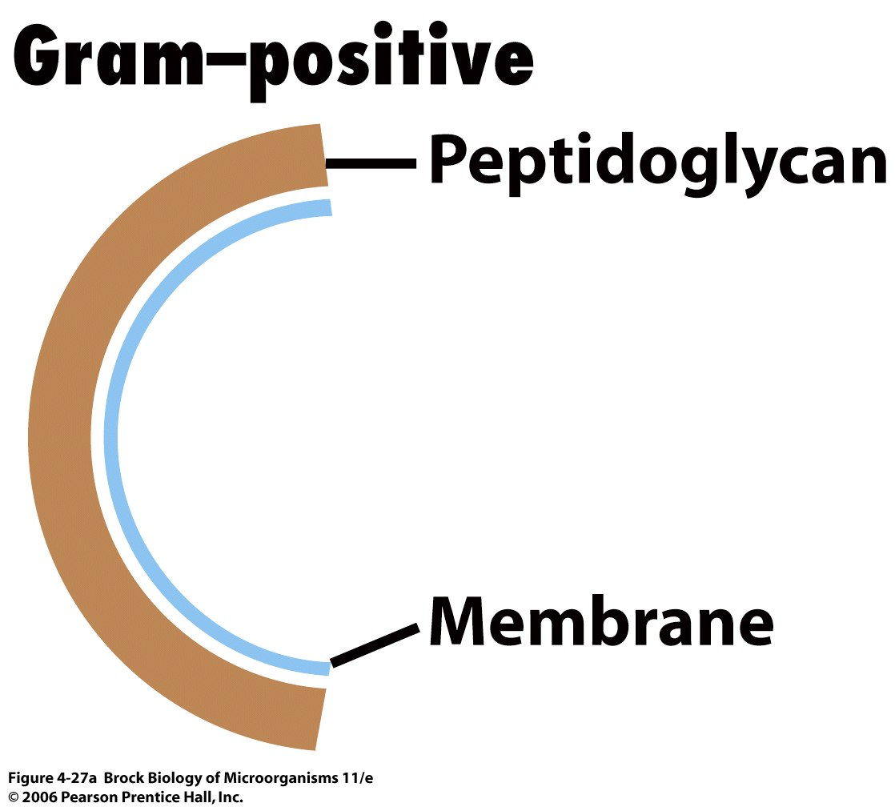
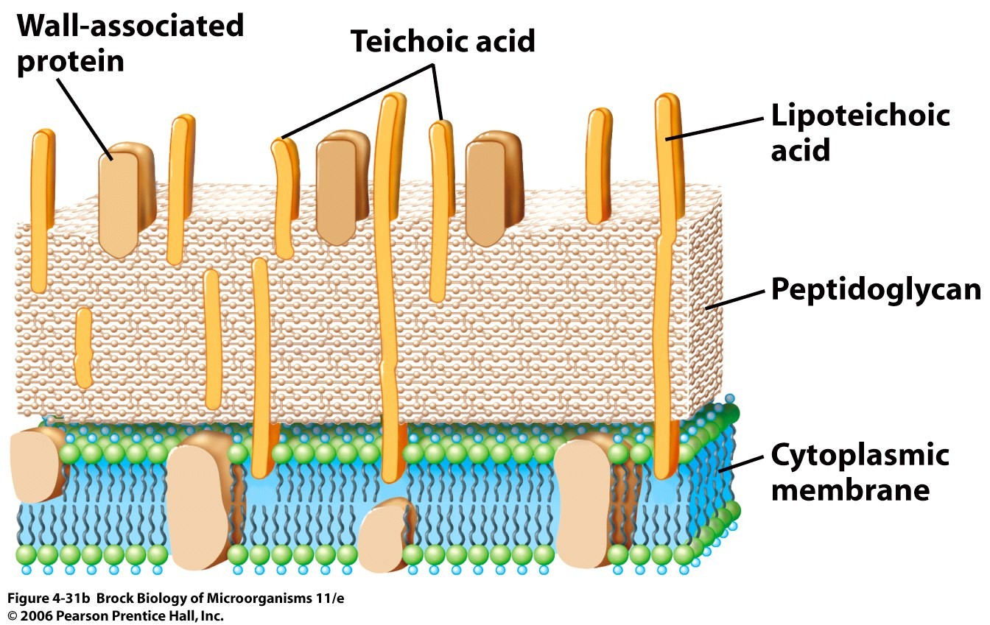
Cell Wall
Gram-negative Bacteria have only a few layers of peptidoglycan , but gram-positive Bacteria have several layers.

Slide 130
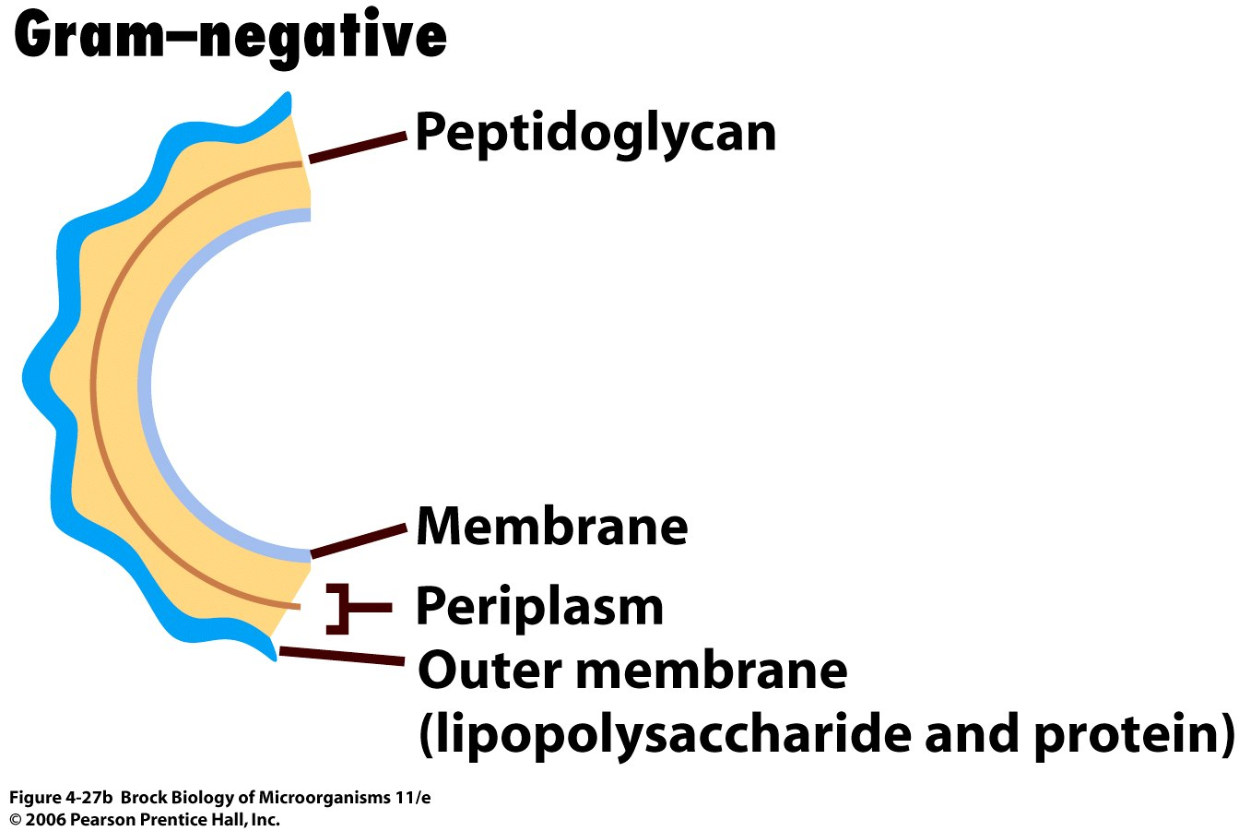
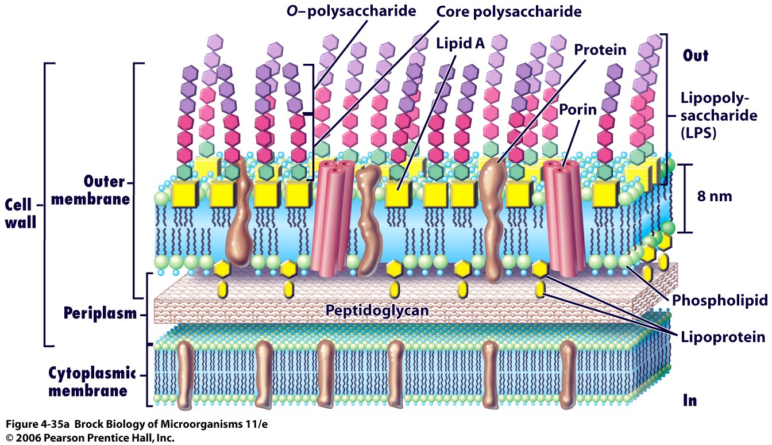
Cell Wall
In addition to peptidoglycan, gram-negative Bacteria contain an outer membrane consisting of lipopolysaccharide (LPS), protein, and lipoprotein.

Slide 131
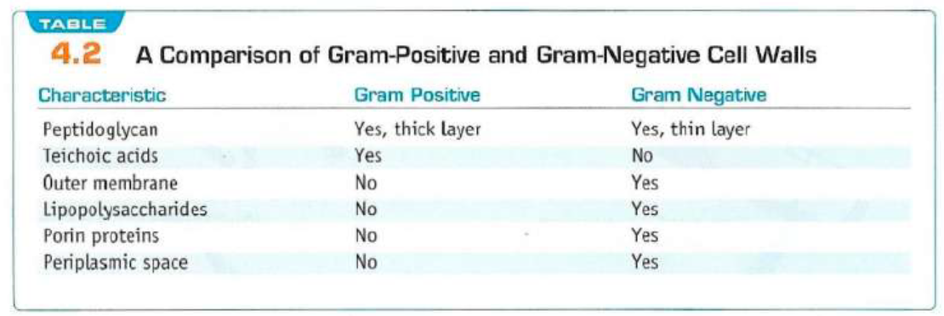
Cell Wall

Slide 132
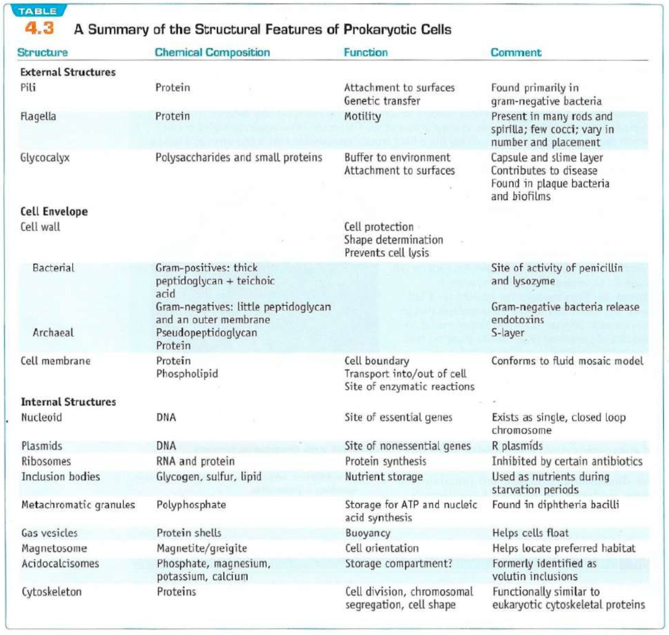

Slide 133
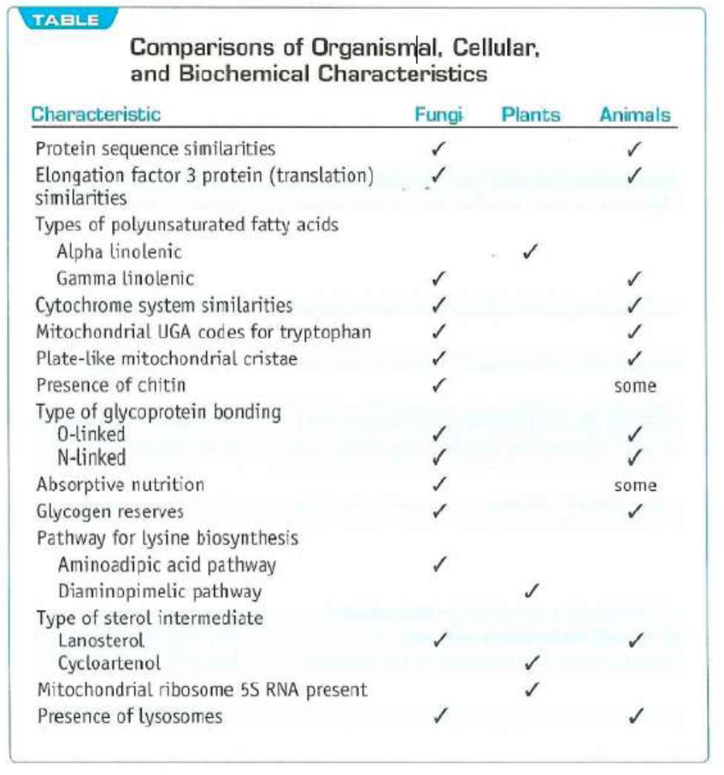

Slide 134
Chapter 10. Chemiosmosis, Industrial and Environmental Microbiology

Slide 135
Chemiosmosis
Chemiosmosis is the movement of ions across a semipermeable membrane, down their electrochemical gradient. An example of this would be the generation of adenosine triphosphate (ATP) by the movement of hydrogen ions (H+) across a membrane during cellular respiration or photosynthesis.
Peter D. Mitchell proposed the chemiosmotic hypothesis in 1961. The theory suggests essentially that most adenosine triphosphate (ATP) synthesis in respiring cells comes from the electrochemical gradient across the inner membranes of mitochondria by using the energy of NADH and FADH2 formed from the breaking down of energy-rich molecules such as glucose.

Slide 136
Chemiosmosis
Molecules such as glucose are metabolized to produce acetyl CoA as an energy-rich intermediate. The oxidation of acetyl coenzyme A (acetyl-CoA) in the mitochondrial matrix is coupled to the reduction of a carrier molecule such as nicotinamide adenine dinucleotide (NAD) and flavin adenine dinucleotide (FAD). The carriers pass electrons to the electron transport chain (ETC) in the inner mitochondrial membrane, which in turn pass them to other proteins in the ETC. The energy available in the electrons is used to pump protons from the matrix across the stroma, storing energy in the form of a transmembrane electrochemical gradient. The protons move back across the inner membrane through the enzyme ATP synthase. The flow of protons back into the matrix of the mitochondrion via ATP synthase provides enough energy for ADP to combine with inorganic phosphate to form ATP. The electrons and protons at the last pump in the ETC are taken up by oxygen to form water.
This was a radical proposal at the time, and was not well accepted. The prevailing view was that the energy of electron transfer was stored as a stable high potential intermediate, a chemically more conservative concept. The problem with the older paradigm is that no high energy intermediate was ever found, and the evidence for proton pumping by the complexes of the electron transfer chain grew too great to be ignored. Eventually the weight of evidence began to favor the chemiosmotic hypothesis, and in 1978 Peter Mitchell was awarded the Nobel Prize in Chemistry.
Chemiosmotic coupling is important for ATP production in mitochondria, chloroplasts and many bacteria and archaea.

Slide 137
Industrial microbiology
Industrial microbiology is a branch of applied microbiology in which microorganisms are used in industrial processes; for example, in the production of high-value products such as drugs, chemicals, fuels and electricity.
Industrial microbiology includes the use of microorganisms to manufacture food or industrial products in large quantities. Numerous microorganisms are used within industrial microbiology; these include naturally occurring organisms, laboratory selected mutants, or even genetically modified organisms (GMOs). Currently, the debate in the use of genetically modified organisms (GMOs) in food sources is gaining both momentum, with more and more supporters on both sides. However, the use of microorganisms at an industrial level is deeply rooted into today’s society. The following is a brief overview of the various microorganisms that have industrial uses, and of the roles they play.

Slide 138
Industrial microbiology
Archaea are specific types of prokaryotic microbes that exhibit the ability to sustain populations in unusual and typically harsh environments. Those suriving in the most hostile and extreme settings are known as extremophile archaea. The isolation and identification of various types of Archaea, particularly the extremophile archaea, have allowed for analysis of their metabolic processes, which have then been manipulated and utilized for industrial purposes.
Extremophile archaea species are of particular interest due to the enzymes and molecules they produce that allow them to sustain life in extreme climates, including very high or low temperatures, extremely acid or base solutions, or when exposed to other harmful factors, including radiation. Specific enzymes which have been isolated and used for industrial purposes include thermostable DNA polymerases from the Pyrococcus furiosus. This type of polymerase isa common tool in molecular biology; it is capable of withstanding the high temperatures that are necessary to complete polymerase chain reactions. Additional enzymes isolated from Pyrococcus speciesinclude specific types of amylases and galactosidases which allow food processing to occur at high temperatrues as well.

Slide 139
Industrial microbiology
Corynebacteria are characterized by their diverse origins. They are found in numerous ecological niches and are most often used in industry for the mass production of amino acids and nutritional factors. In particular, the amino acids produced by Corynebacterium glutamicum include the amino acid glutamic acid. Glutamic acid is used as a common additive in food production, where it is known as monosodium glutamate (MSG). Corynebacterium can also be used in steroid conversion and in the degradation of hydrocarbons. Steroid conversion is an important process in the development of pharmaceuticals. Degradation of hydrocarbons is key in the breakdown and elimination of environmental toxins. Items such as plastics and oils are hydrocarbons; the use of microorganisms which exhibit the ability to breakdown these compounds is critical for environmental protection.

Slide 140
Industrial microbiology
Xanthomonas, a type of Proteobacteria, is known for its ability to cause disease in plants. The bacterial species which are classified under Xanthomonas exhibit the ability to produce the acidic exopolysaccharide commonly marketed as xanthan gum, used as a thickening and stabilizing agent in foods and in cosmetic ingredients to prevent separation.
Another type of microorganism utilized by industry includes various species of Aspergillus. Thisgenusincludes several hundred types of mold. Aspergillus has become a key component in industrial microbiology, where it is used in the production of alcoholic beverages and pharmaceutical development. Aspergillus niger is most commonly used to produce citric acid, which is used in numerous products ranging from household cleaners, pharmaceuticals, foods, cosmetics, photography and construction. Aspergillus is also commonly used in large-scale fermentation in the production of alcoholic beverages such as Japanese sake.

Slide 141
Industrial microbiology
Bacterial metabolism can be classified into three major categories: the kind of energy used for growth, the carbon source, and the electron donors used for growth. Pathogenic bacteria are capable of exhibiting various types of metabolism. Metabolites, the intermediates and products of metabolism, are typically characterized by small molecules with various functions. Metabolites can be categorized into both primary and secondary metabolites. These metabolites can be used in industrial microbiology to obtain amino acids, develop vaccines and antibiotics, and isolate chemicals necessary for organic synthesis.

Slide 142
Primary Metabolites
Primary metabolites are involved in growth, development, and reproduction of the organism. The primary metabolite is typically a key component in maintaining normal physiological processes; thus, it is often referred to as a central metabolite. Primary metabolites are typically formed during the growth phase as a result of energy metabolism, and are deemed essential for proper growth. Examples of primary metabolites include alcohols such as ethanol, lactic acid, and certain amino acids. Within the field of industrial microbiology, alcohol is one of the most common primary metabolites used for large-scale production. Specifically, alcohol is used for processes involving fermentation which produce products like beer and wine. Additionally, primary metabolites such as amino acids– including L-glutamate and L-lysine, which are commonly used as supplements– are isolated via the mass production of a specific bacterial species, Corynebacteria glutamicum. Another example of a primary metabolite commonly used in industrial microbiology includes citric acid. Citric acid, produced by Aspergillus niger, is one of the most widely used ingredients in food production. It is commonly used in pharmaceutical and cosmetic industries as well.

Slide 143
Secondary Metabolites
Secondary metabolites are typically organic compounds produced through the modification of primary metabolite synthases. Secondary metabolites do not play a role in growth, development, and reproduction like primary metabolites do, and are typically formed during the end or near the stationary phase of growth. Many of the identified secondary metabolites have a role in ecological function, including defense mechanism(s), by serving as antibiotics and by producing pigments. Examples of secondary metabolites with importance in industrial microbiology include atropine and antibiotics such as erythromycin and bacitracin. Atropine, derived from various plants, is a secondary metabolite with important use in the clinic. Atropine is a competitive antagonist for acetycholine receptors, specifically those of the muscarinic type, which can be used in the treatment of bradycardia. Antibiotics such as erythromcyin and bacitracin are also considered to be secondary metabolites. Erythromycin, derived from Saccharopolyspora erythraea, is a commonly used antibiotic with a wide antimicrobial spectrum. It is mass produced and commonly administered orally. Lastly, another example of an antibiotic which is classified as a secondary metabolite is bacitracin. Bacitracin, derived from organisms classified under Bacillus subtilis, is an antibiotic commonly used a topical drug. Bacitracin is synthesized in nature as a nonribosomal peptide synthetase that can synthesize peptides; however, it is used in the clinic as an antibiotic.

Slide 144
Recombinant Products
Fermentation is also utilized in the mass production of various recombinant products. These recombinant products include numerous pharmaceuticals such as insulin and hepatitis B vaccine. Insulin, produced by the pancreas, serves as a central regulator of carbohydrate and fat metabolism and is responsible for the regulation of glucose levels in the blood. Insulin is used medically to treat individuals diagnosed with diabetes mellitus. Specifically, individuals with type 1 diabetes are unable to produce insulin and those with type 2 diabetes often develop insulin resistance where the hormone is no longer effective.
The increase in individuals diagnosed with diabetes mellitus has resulted in an increase in demand for external insulin. The mass production of insulin is performed by utilizing both recombinant DNA technology and fermentation processes. E. coli, which has been genetically altered to produce proinsulin, is grown to a large amount to produce sufficient amounts in a fermentation broth. The proinsulin is then isolated via disruption of the cell and purified. There is further enzymatic reactions that occur to then convert the proinsulin to crude insulin which can be further altered for use as a medicinal compound.
An additional recombinant product that utilizes the fermentation process to be produced is the hepatitis B vaccine. The hepatitis B vaccine is developed to specifically target the hepatitis B virus infection. The creation of this vaccine utilizes both recombinant DNA technology and fermentation. A gene, HBV, which is specific for hepatitis B virus, is inserted into the genome of the organism yeast. The yeast is used to grow the HBV gene in large amounts and then harvested and purified. The process of fermentation is utilized to grow the yeast, thus promoting the production of large amounts of the HBV protein which was genetically added to the genome.

Slide 145
Environmental Microbiology
Microbial life is amazingly diverse and microorganisms quite literally cover the planet. In fact, it has been estimated that there are 100,000,000 times more microbial cells on the planet than there are stars in the observable universe! Microbes live in all parts of the biosphere where there is liquid water, including soil, hot springs, the ocean floor, acid lakes, deserts, geysers, rocks, and even the mammalian gut.
By virtue of their omnipresence, microbes impact the entire biosphere; indeed, microbial metabolic processes (including nitrogen fixation, methane metabolism, and sulfur metabolism) collectively control global biogeochemical cycling. The ability of microbes to contribute substantially to the function of every ecosystem is a reflection their tremendous biological diversity.

Slide 146
Environmental Microbiology
Microbes are vital to every ecosystem on Earth and are particularly important in zones where light cannot approach (that is, where photosynthesis cannot be the basic means to collect energy). Microorganisms participate in a host of fundamental ecological processes including production, decomposition, and fixation. They can also have additional indirect effects on the ecosystem through symbiotic relationships with other organisms. In addition, microbial processes can be co-opted for biodegradation or bioremediation of domestic, agricultural, and industrial wastes, making the study of microbial ecology particularly important for biotechnological and environmental applications.
Each species in an ecosystem is thought to occupy a separate, unique niche. The ecological niche of a microorganism describes how it responds to the distribution of resources and competing species, as well as the ways in which it alters those same factors in turn. In essence, the niche is a complex description of the ways in which a microbial species uses its environment.

Slide 147
Environmental Microbiology
The precise ecological niche of a microbe is primarily determined by the specific metabolic properties of that organism. For example, microbial organisms that can obtain energy from the oxidation of inorganic compounds (such as iron-reducing bacteria ) will likely occupy a different niche from those that obtain energy from light (such as cyanobacteria). Even among photosynthetic bacteria, there are various species that contain different photosynthetic pigments (such as chlorophylls and carotenoids) that allow them to take advantage of different portions of the electromagnetic spectrum; therefore, even microbes with similar metabolic properties may inhabit unique niches.

Slide 148
Environmental Microbiology
Microorganisms play a vital role in every ecological community by serving both as producers and as decomposers. Although plants are the most common primary producers, autotrophic photosynthetic microbes (such as cyanobacteria and algae) can harness light energy to generate organic matter. Additionally, in zones where light cannot penetrate (and thus photosynthesis cannot be the basic means to produce energy), chemosynthetic microbes provide energy and carbon to the other organisms in the ecosystem. Other microbes are decomposers, with the ability to recycle nutrients from dead organic matter and other organisms’ waste products. Decomposition is critical as most of the carbon and energy incorporated into plant tissues during photosynthesis remains uneaten when the plant tissue dies (and therefore must be broken down before it can be made available for recycling).

