Slide 1
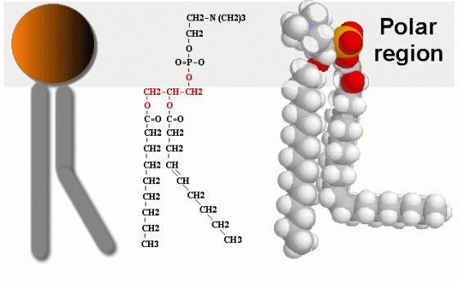
Lipids-I
BCH202 [Practical]

Slide 2
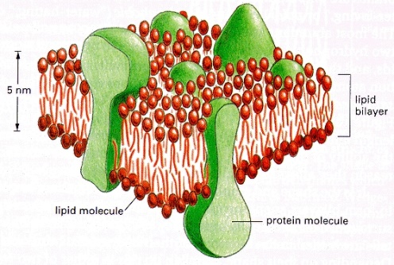
Lipids:
It can be defined as: nonpolar organic compound insoluble in polar solvent , but soluble in organic solvents such as benzene ,ether, chloroform (nonpolar solvents).
Fatty acids (F.A) are lipids’ building blocks.
Biological role of lipids:
It represents in cell structure and has a structural function in the cell : it presents in cell membranes.
An essential source of energy in the body. It give more energy than carbohydrate and proteins.

Slide 3
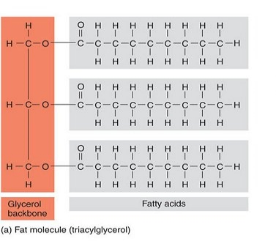
-Fatty acids (F.A) are lipids’ building blocks.
-Lipids are esters of long chain fatty acids and alcohols.

Slide 4
Fatty Acid:

Slide 5
Classification of Lipids:
Lipids can be divided according to their chemical composition to:
Simple lipids.
Compound (conjugated) lipids.
Derived lipids.

Slide 6
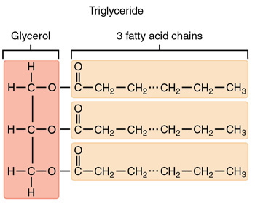
I. Simple lipids:
These compounds are esters of fatty acids with alcohol.
The triacylglycerol (TAG), is the simplest and most common fat. It is the form in which lipids are stored in the cell.

Slide 7
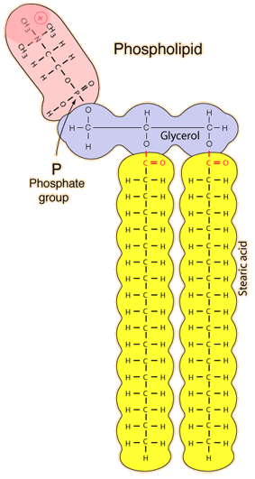
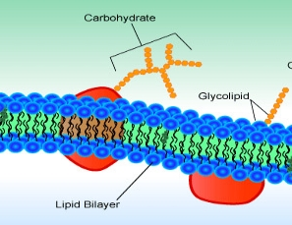
II. Compound (conjugated) lipids:
Lipids are linking with other compounds:
a) Phospholipids:
Most phospholipids contain diglyceride, and phosphate group.
b) Glycolipids:
Lipids with a carbohydrate attached.
c) Proteolipids :
Any of a group of proteins to which a lipid molecule is attached.

Slide 8
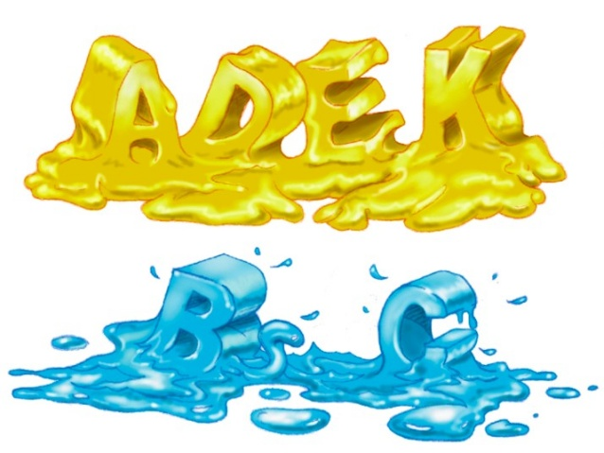
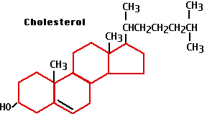
III. Derived lipids:
They are substances that are soluble in lipid or derived from the lipids by hydrolysis; for examples, cholesterol and fat-soluble vitamins (A, K, E and D) .

Slide 9
Practical Part

Slide 10
Test of lipids:
Solubility test.
Saponification test.
Separation of soap from the solution by salting out.
Formation of insoluble soap.
1
2
3
4

Slide 11
Experiment 1: Solubility test
Objective:
To test the solubility of oils in different solvent.
Principle:
Fats are not dissolved in water due to their nature, which is non-polar (hydrophobic), but it is soluble in organic solvents such as chloroform, benzene, and boiling alcohol.
Different lipids have ability to dissolve in different organic solvent ➔This property enable us to separate a mixture of fat.

Slide 12
Experiment 1: Solubility test
Not Dissolved
Dissolved

Slide 13
Experiment 2 : Saponification test
Objective:
To form the soap.
Principle:
Saponification is a process of hydrolysis of oils or fat with strong alkaline (such as NaOH or KOH) and result in glycerol and salts of fatty acids (soap).
TAG can be hydrolyzed into their component fatty acids and alcohols. This reaction can also be carried out in the laboratory by a saponification.
Soap can be defined as mineral salts of fatty acids.
The soap is soluble in water but insoluble in ether. Soap works on emulsification of oils and fats in the water .

Slide 14
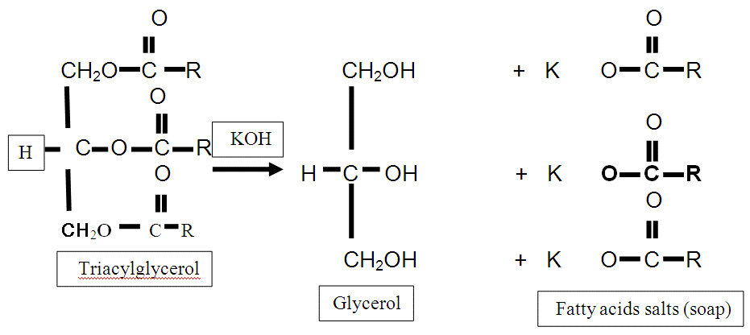
Heat

Slide 15
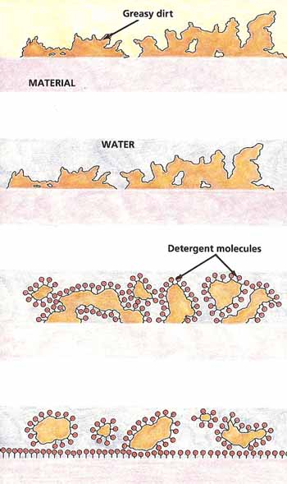
Soap works on emulsification of oils and fats in the water as it works to reduce the attraction surface of the solution.
When soap molecules are dissolved in water, the water-repelling hydrophobic tails cluster together while hydrophilic heads surround them arranging themselves in a spherical form toward water molecules.

Slide 16
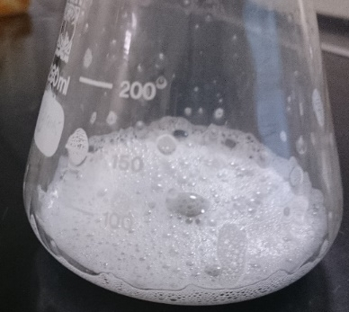
Experiment 2 : Saponification test

Slide 17
Experiment 3: Testing the separation of soap from the solution by salting out
Objective:
To investigate the effect of salt like (NaCl) on soap solubility.
Principle:
To get the soap out of solution by salting out, when added solid sodium chloride to the solution until saturation; separated soap in the form of insoluble and floats above the surface.
The NaCl solution provides Na+ and Cl- ions that bind to the polar water molecules, and help separate the water from the soap.
This process is called salting out the soap.

Slide 18
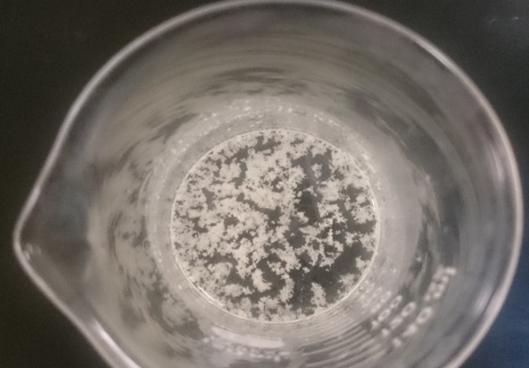
Experiment 3: Testing the separation of soap from the solution by salting out

Slide 19
Experiment 4: Test formation insoluble fatty acids salt (insoluble soaps)
Objective:
To investigate the effect of different cations on soap solubility.
Principle:
Calcium, magnesium, lead or iron ions, precipitate the soap and make it insoluble in water as these dissolved ions replace the sodium ions or potassium ions present in the soap. For this reason, the hard water can not produce foam.
Due to the hard water to contain significant quantities of Ca2+ , Mg2+ and some Fe3+ that react with the charged ends of the soaps to form insoluble salts of fatty acid.
The insoluble salts of fatty acid that Ca2+ and Mg2+ form with soap anions cause white precipitate to from.
K⁺ soap + Ca⁺²sulfate=> Ca⁺² soap + K⁺ sulfate.
Potassium soap + calcium sulfate ➔ calcium soap + potassium sulfate.
(a white precipitate from calcium stearate or oleate is formed).

Slide 20
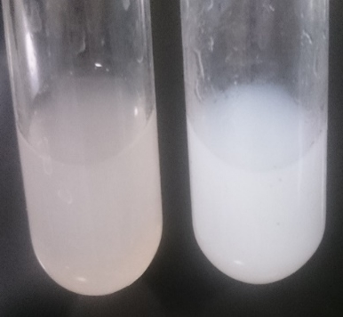
Experiment 4: Test formation insoluble fatty acids salt (insoluble soaps)
The result is the disappearance of foam and the formation of a white precipitate.

