Slide 1
CARBOHYDRATES
CLS 101: Chemistry for Nursing

Slide 2
Carbohydrates
Carbohydrates are compounds containing carbon, hydrogen, and oxygen in which the ratio of C:H:O is 1:2:1. They are carbon hydrates with a general empirical formula of: Cn(H2O)n.
e.g. Glucose C6H12O6 or (CH2O)6 or C6(H2O)6

Slide 3
Origin of Carbohydrates
Carbohydrates are formed by plants where the CO2 is taken from air and water (H2O) from soil to form sugar in a process called: Photosynthesis.

Slide 4
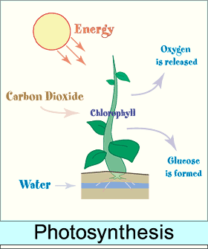

Slide 5
Functions of Carbohydrates
Energy source.
Storage form.
Structural form.

Slide 6
Classification of Carbohydrates
Carbohydrates, also known as saccharides
There are four major classes:
Monosaccharides or (simple sugar).
Disaccharides: contain 2 monosaccharides.
Oligosaccharides: contain 3-12 monosaccharides.
Polysaccharides (complex sugars): contain more than 12 monosaccharides.

Slide 7
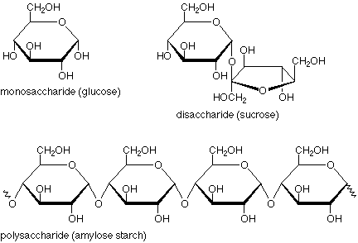

Slide 8
Classification of Monosaccharides
Monosaccharides are single sugars that cannot be broken down into other sugars.
Monosaccharides are classified according to different characteristics:
-The placement of its carbonyl group,
-The number of carbon atoms it contains,

Slide 9
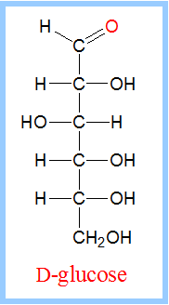
Aldose or Ketose
Classification according to the placement of its carbonyl group(C=O)
If the carbonyl group is an aldehyde, the monosaccharide is an aldose; C=O at the end of the chain.

Slide 10
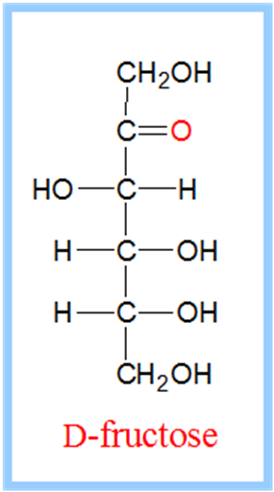
If the carbonyl group is a ketone, the monosaccharide is a ketose. C=O in the middle
of the chain.

Slide 11
What are Isomers, Epimers, and Anomers?

Slide 12
Isomers
Isomers are compounds that have the same chemical formula but different structural formula.
They all have the same chemical formula
C6H12O6
but different structure.

Slide 13
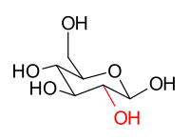
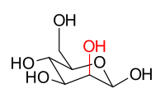
Epimers
Epimers are two monosaccharides that have different configurations around one carbon atom.
e.g. Glucose and mannose are C2 epimers
β-D-glucose β-D-mannose

Slide 14
Anomers
An anomer is a special type of epimer, it is one of two structures of a cyclic saccharide that differs only in its configuration at the aldose or ketose carbon, also called the anomeric carbon.

Slide 15
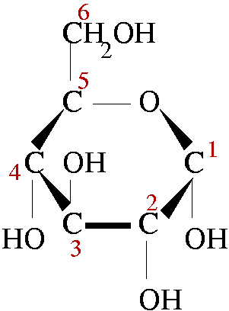
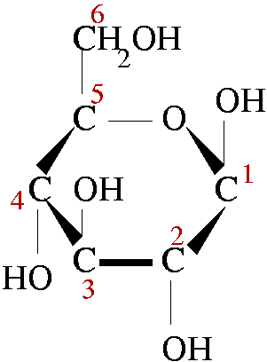
β
α
e.g. α-D-glucose β-D-glucose
C1 is the anomeric carbon

Slide 16
Monosaccharides
Classification according to the number of carbon atoms:
Trios: 3 carbons.
Tetrose: 4 carbons.
Pentose: 5 carbons.
Hexose: 6 carbons.
Heptose: 7 carbons.

Slide 17
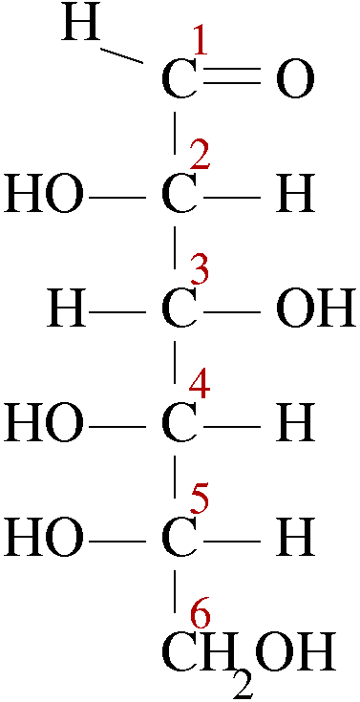
Monosaccharides
All carbon atoms in the monosaccharide are linked together by a single bond.
And all are attached to –H and
–OH groups except one carbon
that has –O double bonded to it.
Structure of Glucose

Slide 18
Monosaccharides
Monosaccharides with 5 or more carbon atoms can form a ring structure. This sugar will be in the cyclic form.
Cyclic Glucose

Slide 19
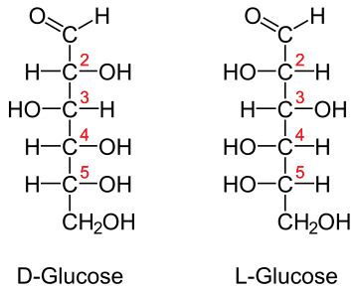
Monosaccharides
The majority of sugars exist in the D-configuration.
Mirror images

Slide 20
Structural representation of sugar
Fischer projections
Haworth projection

Slide 21
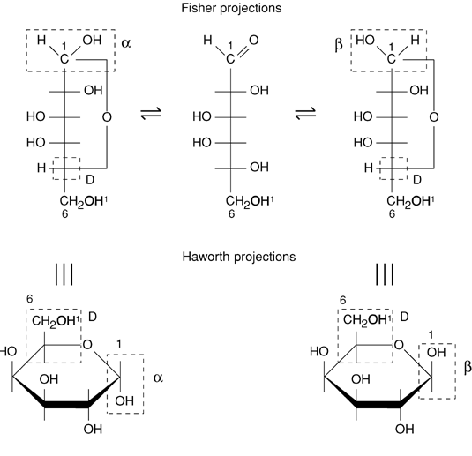
Cyclic Monosaccharide Conformation
GALACTOSE

Slide 23
Common Monosaccharides
The most common monosaccharides are hexoses: glucose, fructose, and galactose.
Glucose is an aldohexose that is known as grape sugar. It is the most important sugar in our body present in blood or stored in tissues.
Galactose is also an aldohexose.
Fructose is a ketohexose that is known as fruit sugar.

Slide 24
Reducing Properties of Monosaccharides
Hexose sugars with a free or potentially free aldehyde or ketone group have reducing properties in alkaline solutions. These reducing sugars can reduce cupric ions (Cu+2) into cuprous ions (Cu+1).
Reducing + Benedict’s Cu2O + Oxidation
Sugar Reagent Product
(Cu+2) Brick Red ppt.
heat
pH 10.5

Slide 25
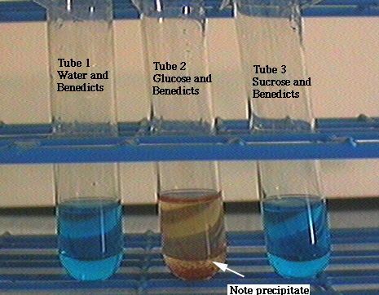

Slide 26
Disaccharides
Disaccharides are formed by the combination of two monosaccharides by a glycosidic bond. This bond is formed when a water molecule is removed, -H from the anomeric carbon of one sugar and –OH from any other carbon of the second sugar.

Slide 27
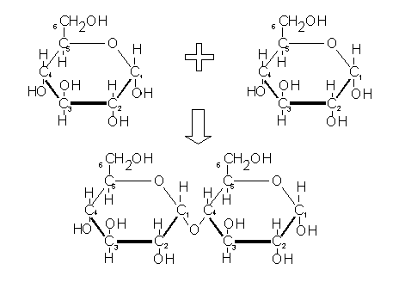
H2O
Glycosidic Bond

Slide 28
Common Disaccharides
There are three common disaccharides: Sucrose (cane sugar/ at home), Maltose (malt sugar), and Lactose (milk sugar).
Sucrose α-Glucose + β-Fructose linked
by α-1,2 glycosidic bond.
Maltose α-Glucose + β-Glucose linked
by α-1,4 glycosidic bond.
Lactose β-Galactose + (α/β)-Glucose
linked by β-1,4 glycosidic bond.

Slide 29
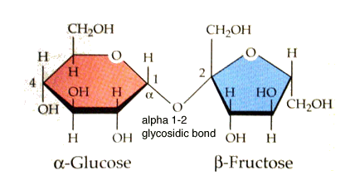
Sucrose

Slide 30
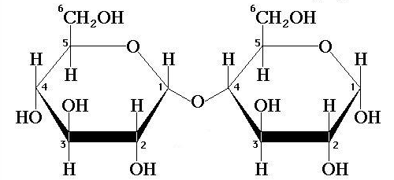
Maltose
α-1,4 glycosidic bond

Slide 31
β-1,4 glycosidic bond

Slide 32
Reducing Properties of Disaccharides
Maltose and Lactose are reducing sugars because they have free aldehyde group while Sucrose is not a reducing sugar because it lacks a free aldehyde or ketone group.

Slide 33
Polysaccharides
Polysaccharides are polymers of monosaccharides.
There are two types of polysaccharides:
Homopolysaccharides: contain one kind of monosaccharide.
Heteropolysaccharides: contain different kinds of monosaccharides.

Slide 34
Common Polysaccharides
The most common polysaccharides are: Starch, cellulose, glycogen, and dextrin.
All these polysaccharides are only made up of
glucose.
Plants store their food as starch.
Plants use cellulose as supporting and structural parts (wood, cotton, paper).
Animals store their food as glycogen. And in our body, glucose is stored in the liver and muscles as glycogen.

Slide 35
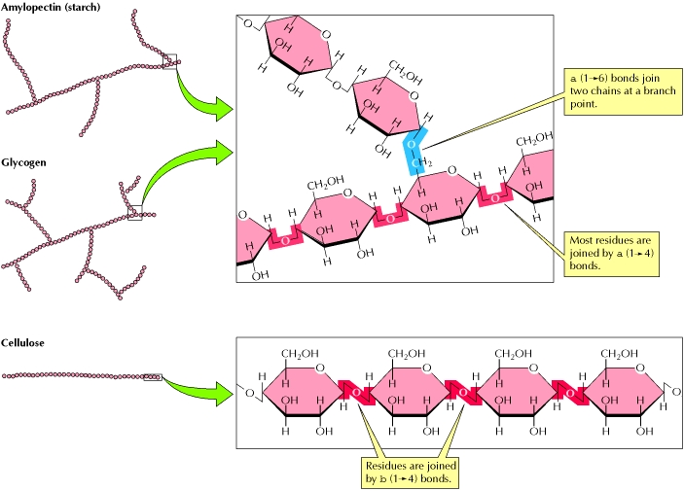

Slide 36
Properties of Polysaccharides
They differ from mono- and disaccharides in many properties:
Property | Mono- and Disaccharides | Polysaccharides
Molecular Mass | Low | Very high
Taste | Sweet | Tasteless
Solubility in Water | Soluble | Insoluble
Filtration through membranes | Pass | Do not Pass
Reducing property | Yes | No

