Slide 1
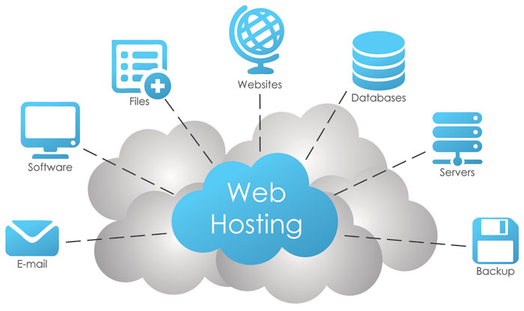
Web Hosting

Slide 2
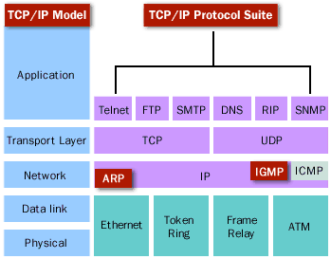
Learning Objectives
TCP/IP Suite Protocols.
Internet Protocols/ports.
FTP, DNS and HTTP Protocols.

Slide 3
Part 1 Internet Protocols Suite

Slide 4
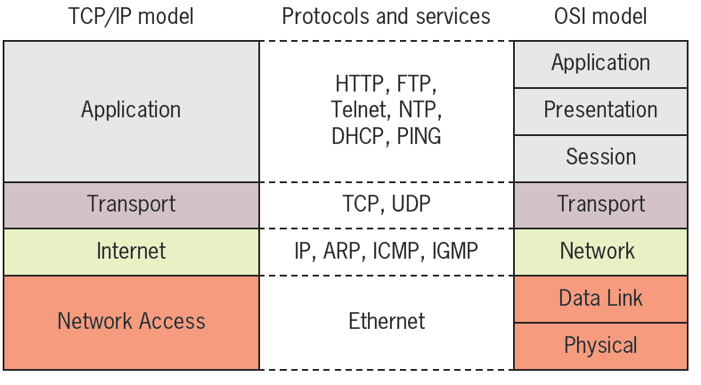
Internet Protocols Suite

Slide 5
The TCP/IP Core Protocols
TCP/IP suite subprotocols.
Operate in Transport or Network layers of OSI model.
Provide basic services to protocols in other layers.
Most significant protocols in TCP/IP suite.
TCP.
IP.

Slide 6
Characteristics of TCP/IP
Protocol Suite
(Transmission Control Protocol/Internet Protocol).
Referred to as “IP” or “TCP/IP”.
Subprotocols include TCP, IP, UDP, ARP.

Slide 7
Characteristics of TCP/IP
Advantages of TCP/IP:
Open nature, costs nothing to use.
Flexible.
Runs on virtually any platform.
Connects dissimilar operating systems and devices.
Routable.
and Suitable for large networks.

Slide 8
TCP (Transmission Control Protocol)
Transport layer protocol
Provides reliable data delivery services
Connection-oriented subprotocol.
Establish connection before transmitting
Uses sequencing and checksums.
Provides flow control.
TCP segment format.

Slide 9
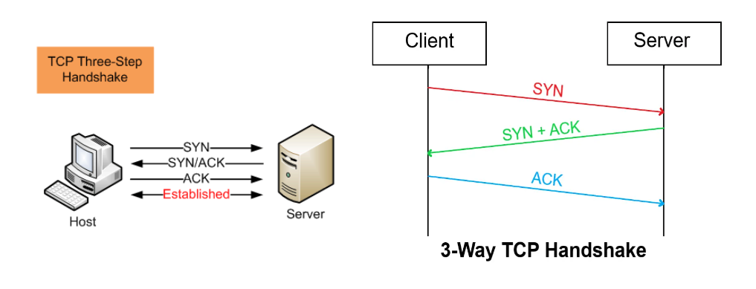
TCP (Transmission Control Protocol)
Establishing a TCP connection: the three-way handshake
After the connection is established, TCP works by breaking down transmitted data into segments, each of which is packaged into a datagram and sent to its destination.

Slide 10
UDP (User Datagram Protocol)
Transport layer protocol
Provides unreliable data delivery services
Connectionless transport service.
No assurance packets received in correct sequence.
No guaranteed packets received at all.
No error checking, sequencing.
Lacks sophistication.
More efficient than TCP.
Useful situations
Great volume of data transferred quickly.
Notes:
Lacks sophistication: يفتقر للتطور

Slide 11
UDP (User Datagram Protocol)
An alternative to TCP in networking is the User Datagram Protocol (UDP).
Used to establish low-latency connections between applications and decrease transmissions time.
UDP does not provide error connection or packet sequencing nor does it signal a destination before it delivers data.
UDP is less reliable but less expensive.
It is a good option for time-sensitive situations, such as Domain Name System (DNS) lookup, Voice over Internet Protocol (VoIP), and streaming media.

Slide 12
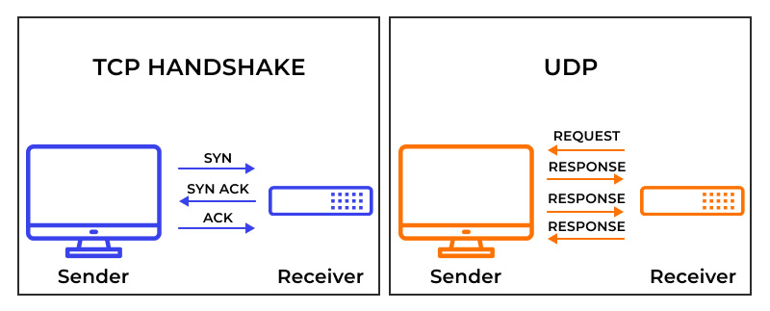
TCP Vs. UDP

Slide 13
Internet Protocol (IP)
IP is responsible for routing and addressing packets of data so that they can travel across multiple networks and reach their intended destinations.
It defines how devices on a network are assigned unique IP addresses and how packets are forwarded between routers.
IP is the foundation of the Internet and enables global connectivity by facilitating the exchange of data packets between devices regardless of their physical location.
It forms the basis for the entire TCP/IP protocol suite.

Slide 14
Internet Protocol (IP)
The Internet Protocol (IP) is the method for sending data from one device to another across the internet.
Every device has an IP address that uniquely identifies it and enables it to communicate with and exchange data with other devices connected to the internet.
Today, it’s considered the standard for fast and secure communication directly between mobile devices.

Slide 15
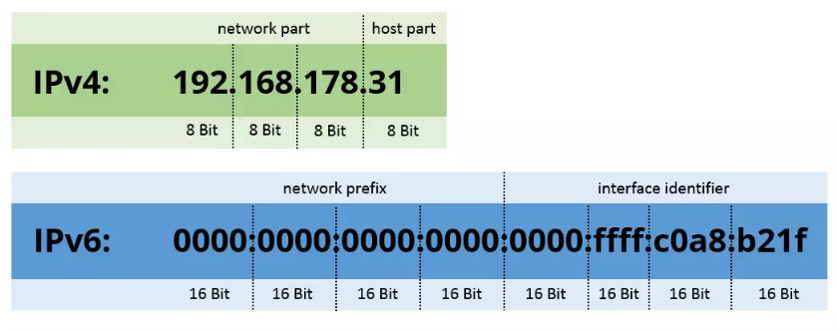
Internet Protocol (IP)

Slide 16
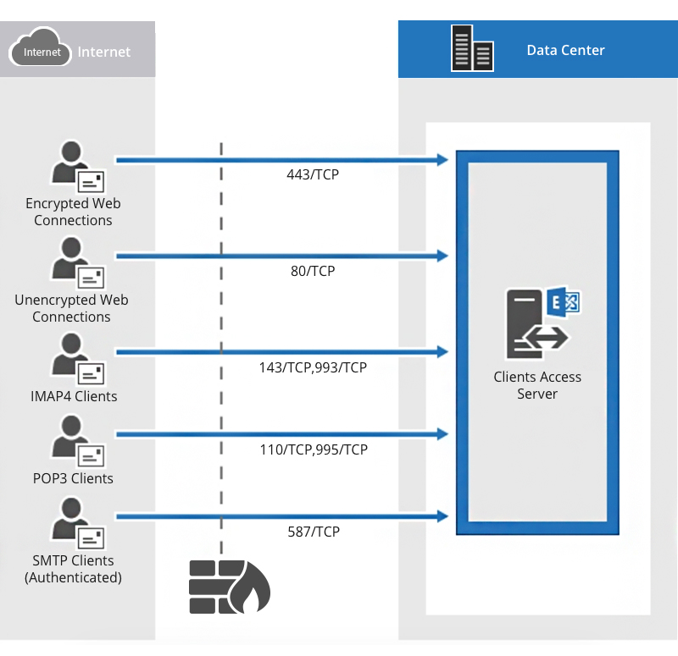
Part 2 Protocols and Ports

Slide 17
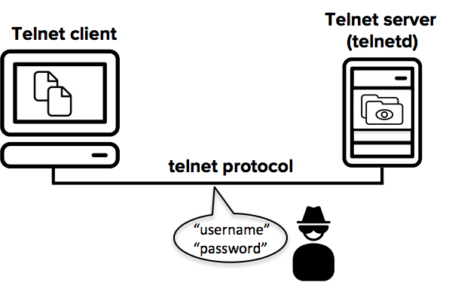
Telnet Protocol / Port (------)
Terminal emulation protocol
Log on to remote hosts
Using TCP/IP protocol suite.
Provides bidirectional text-oriented communication using a virtual terminal connection.
Often connects two dissimilar systems.
Insecure.

Slide 18
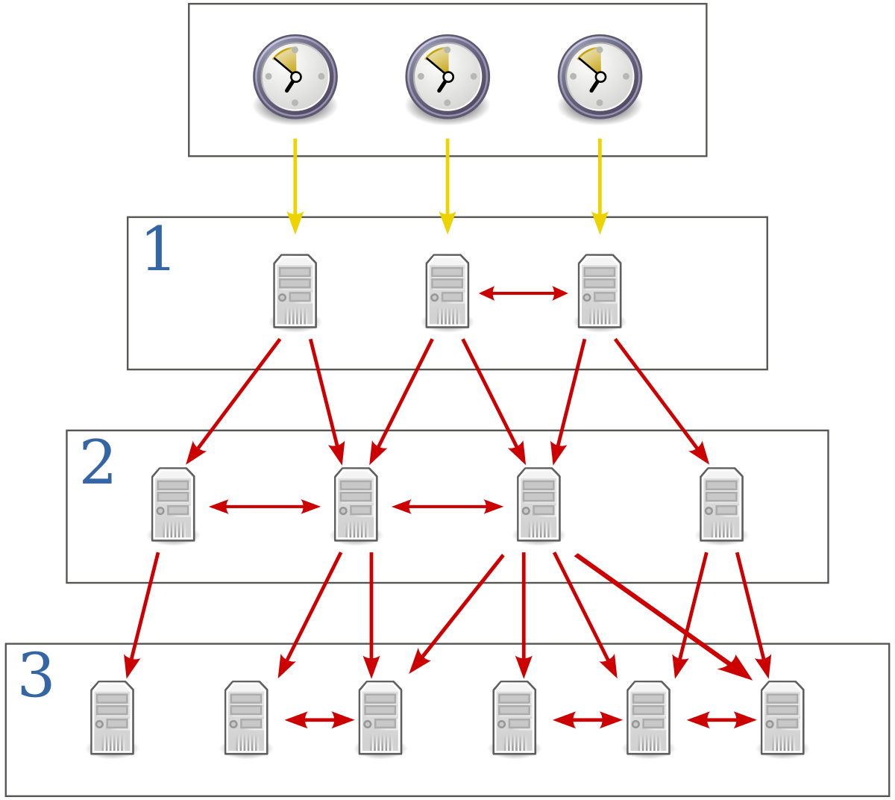
Network Time Protocol (NTP) / Port (-----)
One of the oldest parts of the TCP/IP suite, created in 1985.
Provides clock synchronization between computer systems over packet-switched, variable-latency data networks.
Depends on UDP Transport layer services.

Slide 19
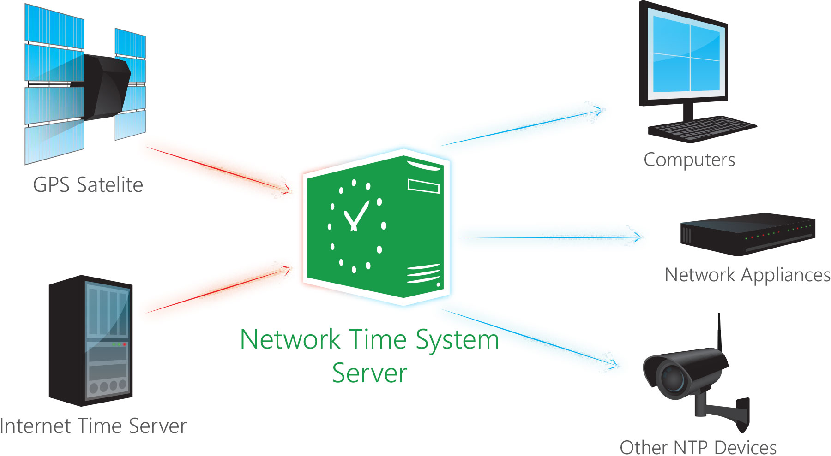
Network Time Protocol (NTP) / Port (-----)
Benefits from UDP’s quick, connectionless nature.
Time synchronization importance:
Routing.
Time-stamped security methods.
Maintaining accuracy, consistency between multiple storage systems.
Notes:
الطوابع الزمنية مهمة للاحتفاظ بسجلات وقت تبادل المعلومات أو إنشاؤها أو حذفها عبر الإنترنت، فهي تسجل تاريخ ووقت الحدث فنقول إنه مخطط زمنيًا، من أمثلتها:
تسجل الكاميرا الرقمية وقت وتاريخ التقاط الصورة.
تسجيل وقت وتاريخ حفظ المستند وتحريره على الحاسب.
تسجيل تاريخ ووقت منشور على وسائل التواصل الاجتماعي.

Slide 20
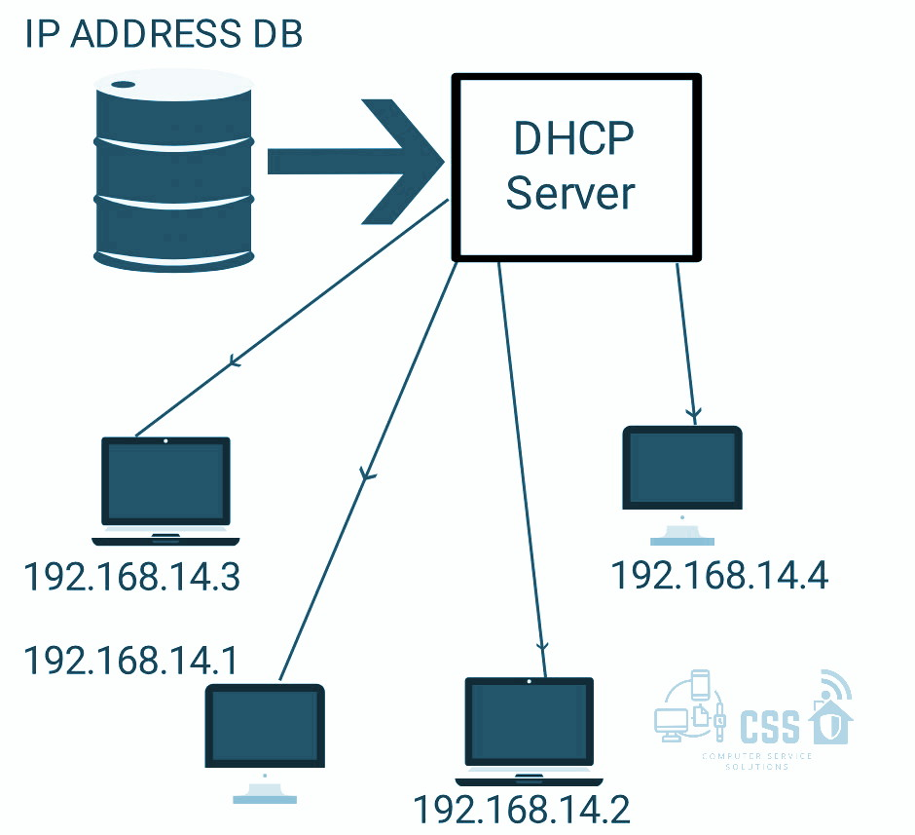
Dynamic Host Configuration Protocol (DHCP)/Port (-----, -----)
DHCP server dynamically assigns an IP address and other network configuration parameters to a client.
Enables computers to request IP addresses and networking parameters automatically.
Reduces burden on network administrators.

Slide 21
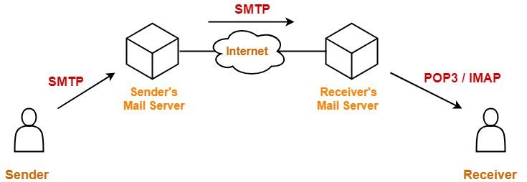
Simple Mail Transfer Protocol (SMTP) / Port (-----)
SMTP is a protocol used for sending email messages between mail servers.
It defines how email clients communicate with mail servers to send outgoing messages and how mail servers relay messages to their intended recipients.
SMTP is essential for the reliable delivery of email across the Internet.
It enables users to send and receive electronic messages efficiently, facilitating communication in both personal and business settings.

Slide 22
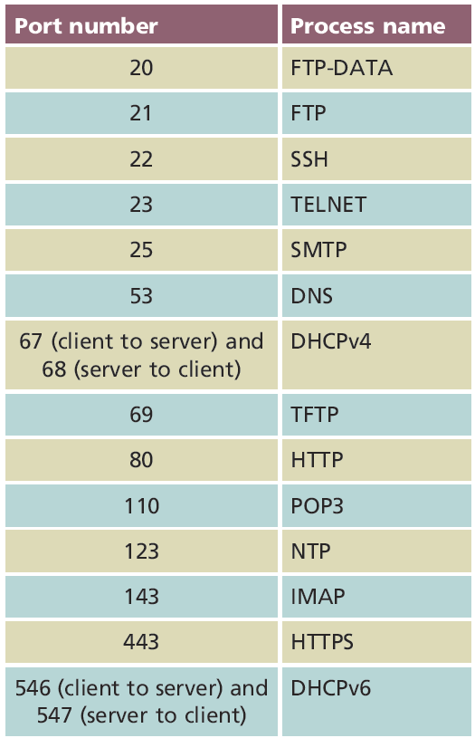
H.W1
Research Project (5 Marks).

Slide 23
Part 3 FTP, DNS, HTTP, SSL Protocols

Slide 24
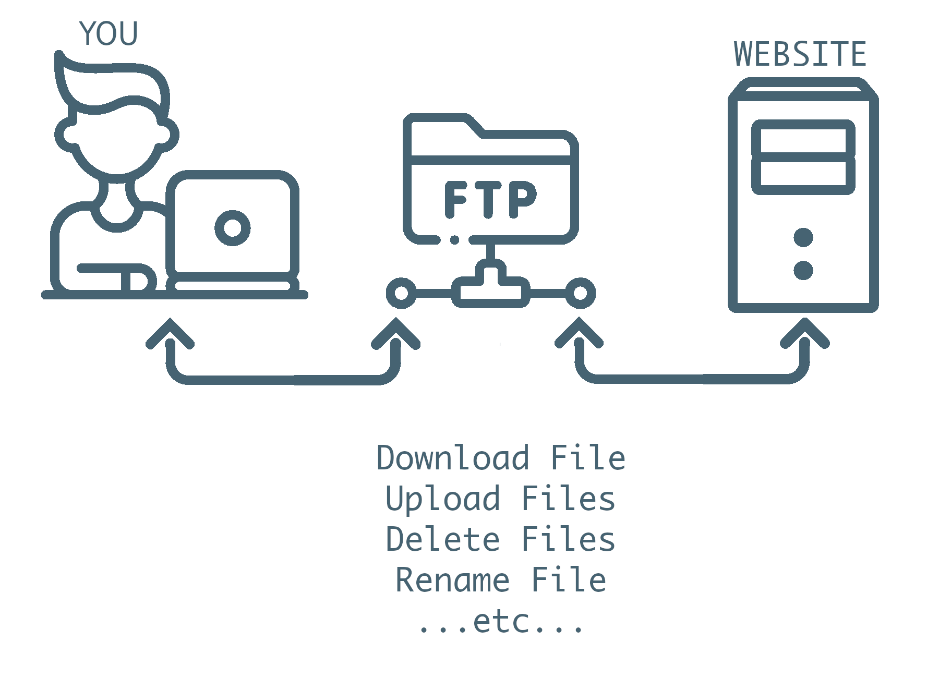
File Transfer Protocol (FTP) / Port (-------, -------)
Transfers computer files between a client and server on a computer network.
Unsecure method.
Data transferred in the clear.
FTP hosts allow anonymous logons.
Secure FTP (SFTP)
More secure version of FTP.

Slide 25
File Transfer Protocol (FTP) / Port (-------, -------)
FTP is a protocol used for transferring files between computers over a network. It allows users to upload, download, and manage files on remote servers using FTP client software.
FTP facilitates the exchange of large files and directories between users and servers.
It is commonly used for website maintenance, software distribution, and remote file storage, providing a convenient way to transfer data over the Internet.

Slide 26
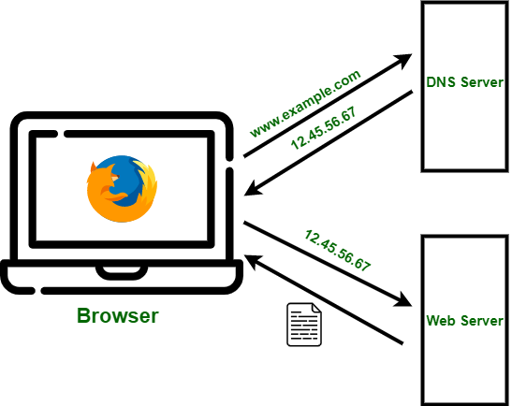
Domain Name Service (DNS) / Port (-----)
Hierarchical decentralized naming system for computers, services, or other resources connected to the Internet or a private network.
DNS translates/converts domain names (e.g., www.example.com) into IP addresses that computers can understand.

Slide 27
Domain Name Service (DNS) / Port (-----)
It maintains a distributed database of domain names and their corresponding IP addresses, enabling users to access websites using human-readable names.
DNS is fundamental for navigating the Internet and accessing online resources.
It plays a vital role in the resolution of domain names, ensuring seamless connectivity and efficient resource allocation on the global network.

Slide 28
Hypertext Transfer Protocol (HTTP)
HTTP is an application-layer protocol used for transmitting and retrieving hypertext documents, typically web pages, over the Internet. It operates in a client-server model where a web browser acts as the client and requests resources from web servers.
HTTP is the primary protocol for accessing and navigating the World Wide Web. It enables users to browse websites, interact with web applications, and access online content seamlessly, driving the modern digital economy.

Slide 29
Hypertext Transfer Protocol (HTTP)
The Hypertext Transfer Protocol (HTTP) is the foundation of the World Wide Web, and is used to load webpages using hypertext links.
HTTP is an application layer protocol designed to transfer information between networked devices and runs on top of other layers of the network protocol stack.
A typical flow over HTTP involves a client machine making a request to a server, which then sends a response message.

Slide 30
Secure Socket Layer/Transport Layer Security (SSL/TLS)
SSL/TLS protocols provide secure communication over a network by encrypting data transmitted between clients and servers.
They establish a secure connection, authenticate parties involved, and ensure data integrity and confidentiality.
SSL/TLS protocols are crucial for securing sensitive information such as personal data, financial transactions, and confidential communications over the Internet.
They are widely used in e-commerce, online banking, and secure communication platforms.

Slide 31
Secure Socket Layer/Transport Layer Security (SSL/TLS)
Secure Sockets Layer (SSL) is a protocol used to establish secured connections, typically between a server and web browser.
All information sent through a SSL connection is encrypted, so it can only be accessed by the intended recipient.
This facilitates the secure exchange of sensitive data, including login details, credit card information and email content.

Slide 32
Secure Socket Layer/Transport Layer Security (SSL/TLS)
As of 2015, the last version of SSL (3.0) was officially deprecated.
It has been replaced by TLS (Transport Layer Security), which provides stronger encryption while serving a similar function.
However, the original name has stuck; many still refer to TLS as “SSL/TLS” or simply “SSL”.

Slide 33
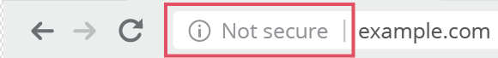
Secure Hypertext Transfer Protocol (HTTPS)
Hypertext transfer protocol secure (HTTPS) is the secure version of HTTP.
HTTPS is encrypted in order to increase security of data transfer.
This is particularly important when users transmit sensitive data (bank account, email service,…etc.)
Website those require login credentials, should use HTTPS.
Modern web browsers that do not use HTTPS are marked differently than those that are.
Look for a padlock in the URL bar to signify the webpage is secure.

Slide 34
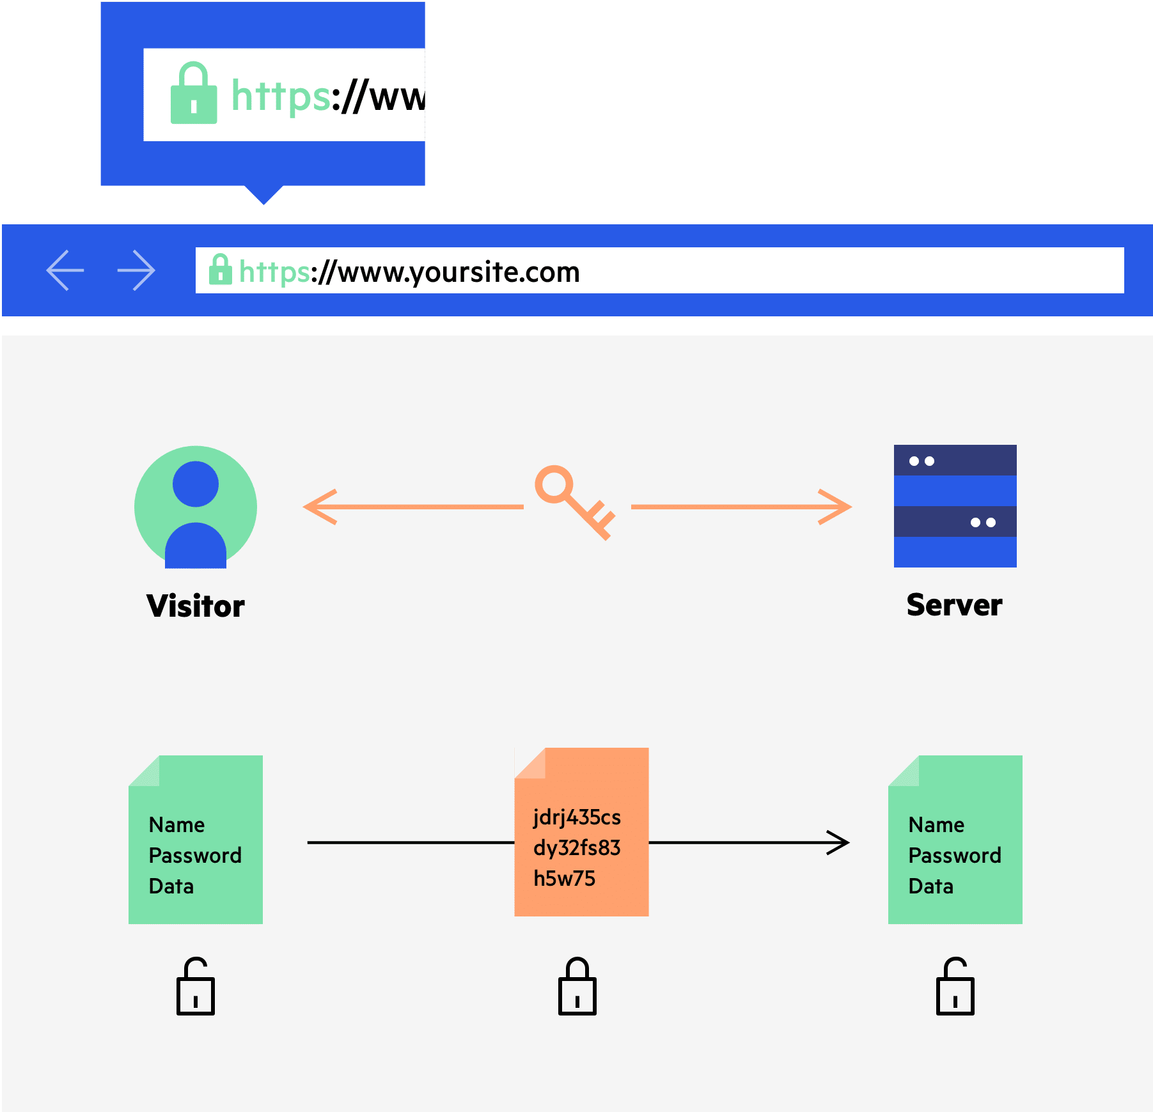
Secure Hypertext Transfer Protocol (HTTPS)

Slide 35
H.W
Research Project (5 Marks).
The Project at A4 (4 - 6 pages).
Text size (Headers 16 points, Paragraphs 14 points), and Sakkal Majalla Font.
Project document begins with a cover page (Project title, and students' name).
Project should include one videos links added from YouTube (preferred QR-Code) & References (websites - books - magazines... etc.).
Project should send in Word & PDF format (to the instructor E-mail).

