Slide 1
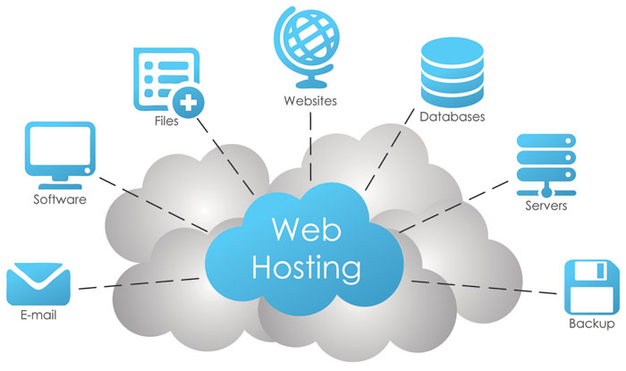
Web Hosting

Slide 2
Learning Objectives
What is cPanel?
cPanel’s Features.
Using cPanel.

Slide 3
Part 1 What is cPanel?

Slide 4
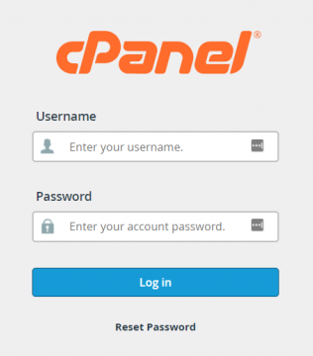
What is cPanel?
cPanel is a popular web hosting control panel that allows website owners to manage their hosting account with ease.

Slide 5
What is cPanel?
cPanel includes a variety of features that make website management simple, including:
Ability to manage files.
A user-friendly interface (Preferences).
Ability to manage databases.
Softaculous apps installer.
Software.
Metrics.
Security.
E-mail.

Slide 6
Part 2 cPanel's Features

Slide 7
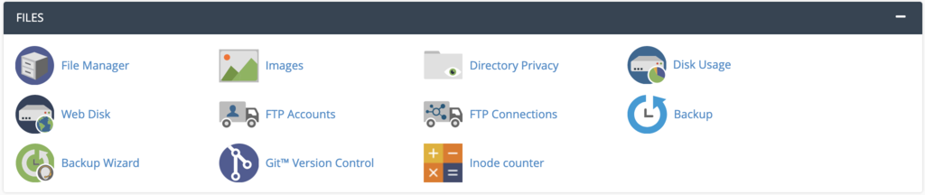
What is cPanel?
Files
Used to:
Contains features for direct file management.
Upload files without an FTP client.
Specify privacy levels.
Set up a backup wizard.

Slide 8
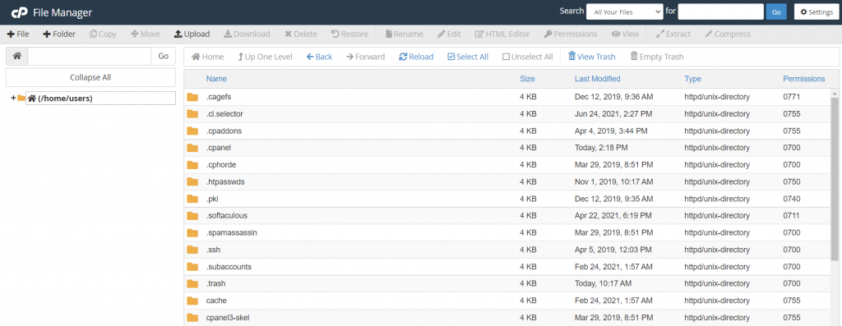
What is cPanel?
Files
Using File Manager
cPanel includes an easy-to-use file manager that works like desktop file explorer applications, users can easily edit, remove, or add files and folders.

Slide 9
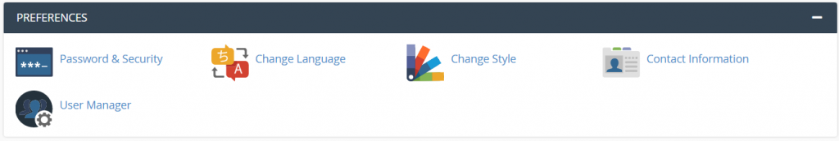
What is cPanel?
Preferences
Used to:
Configure various aspects of the cPanel dashboard (language, theme, and user information).
Includes features to add a new cPanel account and manage the password.

Slide 10
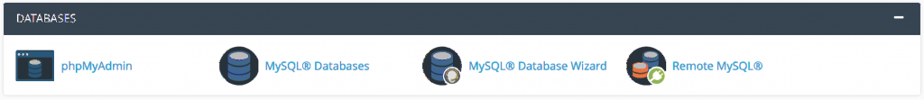
What is cPanel?
Databases
If your website uses a content management system (CMS) like WordPress, it will need a database to store all the important data and information, such as usernames, passwords, and posts.
This section is all about managing the databases – its tasks are mostly done via MySQL Databases and phpMyAdmin.

Slide 11
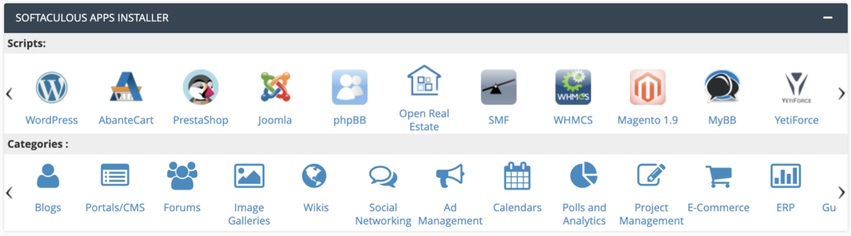
What is cPanel?
Softaculous apps installer
Softaculous is a script library that automates the installation processes of various applications. The most popular software includes WordPress, phpBB, Joomla, and Drupal.
Thanks to the seamless integration with cPanel, you can directly install any software right from the dashboard.

Slide 12
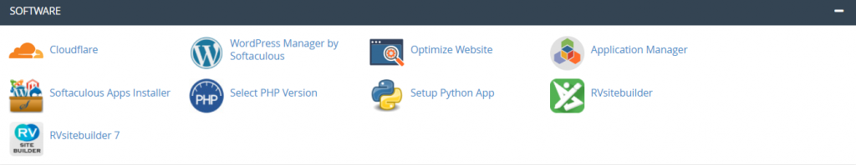
What is cPanel?
Software
Since this section mainly deals with programming languages, such as PHP, Ruby, and Perl, it is mostly used by advanced users.

Slide 13
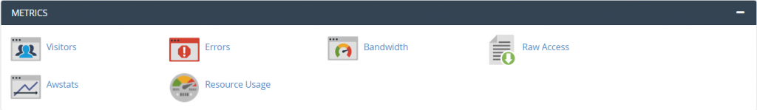
What is cPanel?
Metrics
Used to:
Work to track website statistics (number of visitors, to monitoring resource usage).
These metrics give you access to insights that can help you make decisions to improve your website.

Slide 14
What is cPanel?
Security
Security is a big concern for every site owner, especially if you store sensitive information such as credit card details.
There are multiple features to optimize your site security:
Including SSH Access to connect to your server via SSH and SSL/TLS to enable SSL certificates for extra security.
Another essential feature is the Hotlink Protection which prevents other sites from stealing your site resources.
1- SSH (Secure Shell) access provides a secure method for remotely managing computer systems. It establishes an encrypted connection between a client and a server, allowing for secure remote login, command execution, and file transfers over an unsecured network.
2- TLS, or Transport Layer Security, is a security protocol that encrypts communications over the internet to protect data privacy and security.

Slide 15
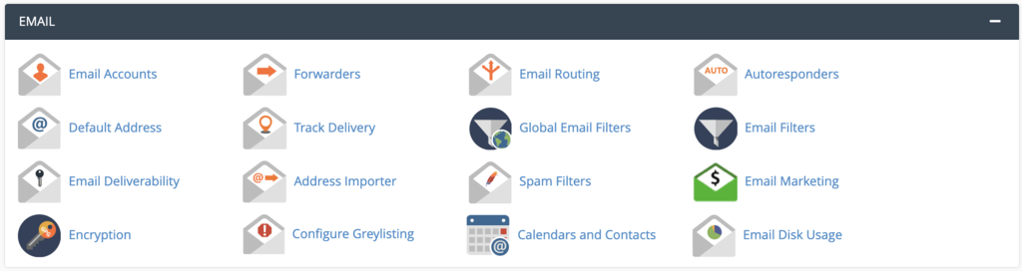
What is cPanel?
Email
If your plan includes both email and cPanel, this is where you’ll administer all email-related tasks.
From setting auto-responders to creating custom email accounts, these features will help complete those tasks efficiently.

Slide 16
Part 3 Using cPanel

Slide 17
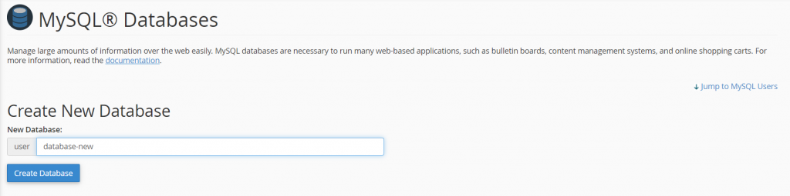
How to Create Databases
Create databases and manage MySQL users
Click on MySQL Databases.
On the New Database section, enter your desired database username and click Create Database.

Slide 18
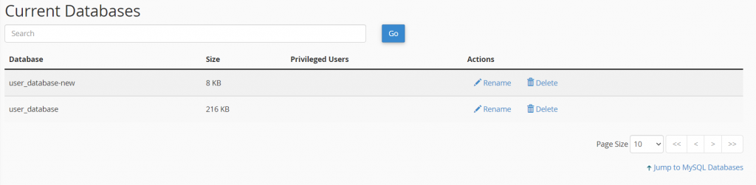
How to Create Databases
A new database will be added to the Current Databases list.
To add a new MySQL user, scroll down to the MySQL Users section.

Slide 19
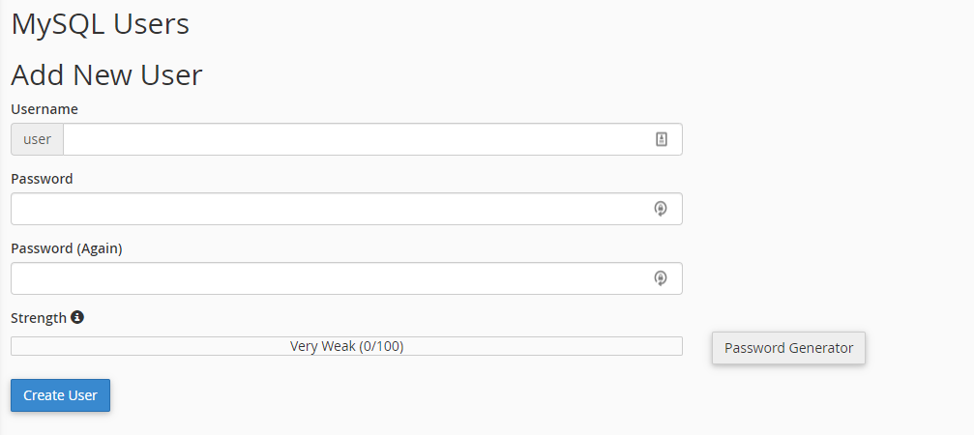
How to Create Databases
There, enter the username and password and click Create User.

Slide 20
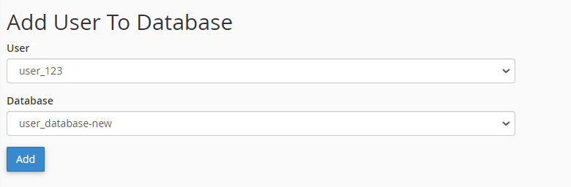
How to Create Databases
When you’re done, navigate to the Add User to Database section.
Click on the dropdown menu and choose the new user and database; this will grant the user access to the selected database.

Slide 21
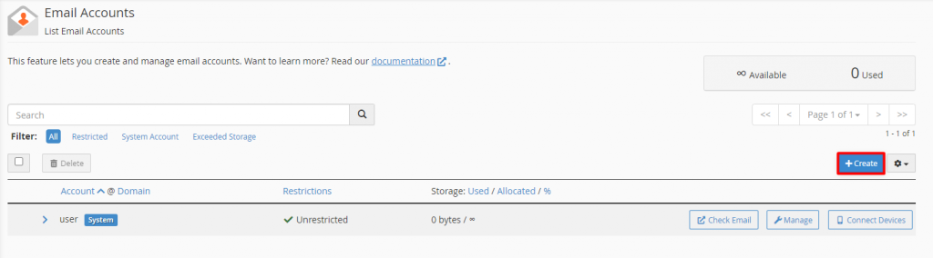
How to Create & Manage Email
Create an email account
Use the Email Account feature to create, delete, and manage email accounts from the cPanel dashboard.
Clicking on the icon will open a list of active email addresses on your website.
To add a new one, click Create.

Slide 22
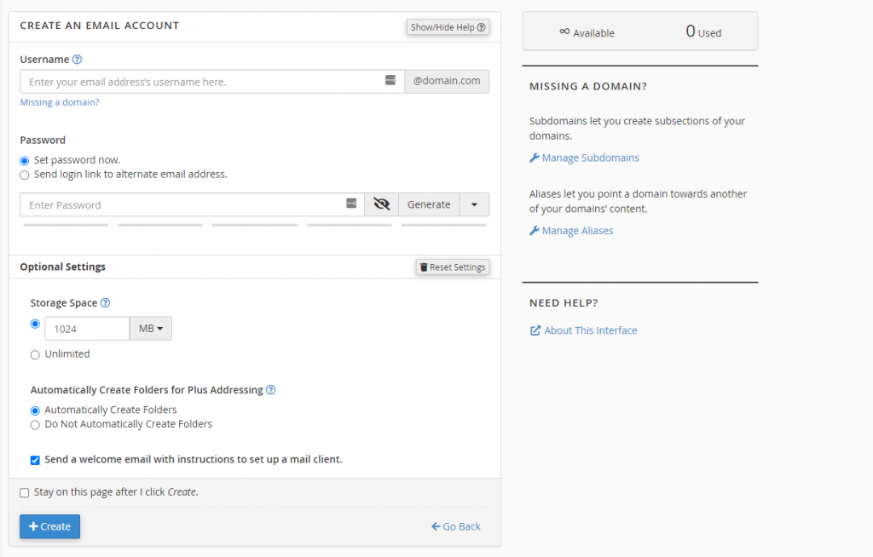
How to Create & Manage Email
Create an email account
A new window will open.
Start by filling in the requested information.
Once you’re done, click the Create button.

