Slide 1
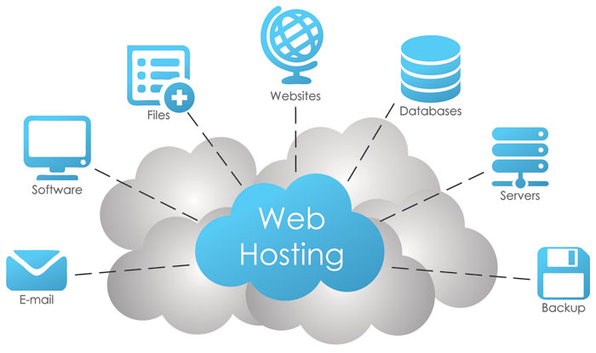
Web Hosting

Slide 2
Part 1 Types of Web Hosting

Slide 3
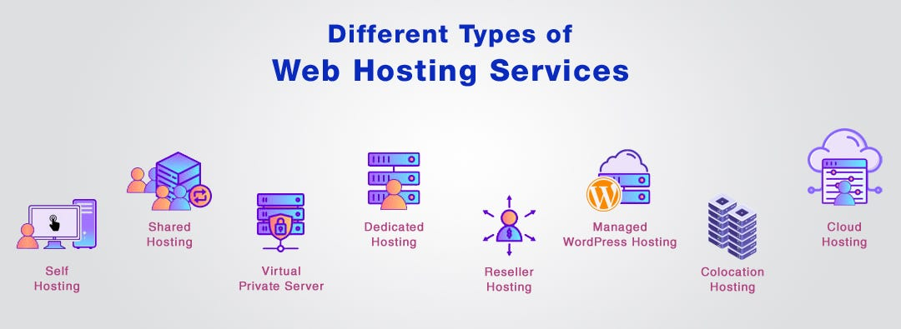
Types of Web Hosting
There are various types of web hosting services available to host your website. Before signing up for web hosting services, it is important to understand what kind of service your website needs, the kind of server you or your business needs, your budget, and what type of services the web host offers.

Slide 4
Types of Web Hosting
Shared hosting
A service provider hosts the website along with others on a shared server.
Server resources such as CPU, RAM, storage space and web server software are shared and allocated across several sites.
Shared hosting plans tend to be less expensive.

Slide 5
Types of Web Hosting
Virtual private server (VPS) hosting
Takes advantage of the partitioning capabilities of virtual servers to divide the computing power of a physical server.
Multiple virtual servers share the resources of the same physical server.
Virtual servers have the ability to run on an independent operating system.

Slide 6
Types of Web Hosting
Dedicated hosting
Provides exclusive access to a physical server.
Companies get full control over system and application software.
Because resources are not shared, the demands of other tenants do not impact service and security.

Slide 7
Types of Web Hosting
Managed hosting
You have access to a dedicated server.
Don’t have the same administrative options.
Managed hosting leaves security and maintenance responsibilities with your provider.

Slide 8
Types of Web Hosting
Cloud hosting
A newer option that uses resource sharing and scale to drive down costs.
It reduces the risk of noticeable service disruptions.
It can be more affordable compared to other options.

Slide 9
Types of Web Hosting
Free/Self hosting
Recommended for personal web hosting only.
Minimum guarantees about the server uptime, features supported, tech support, etc.

Slide 10
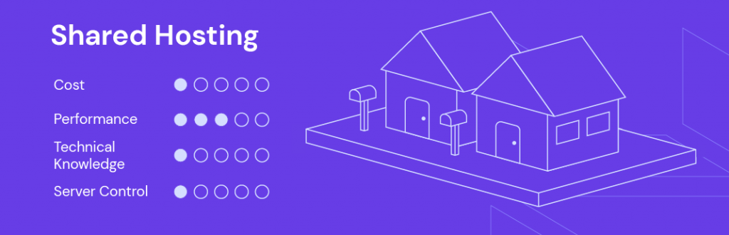
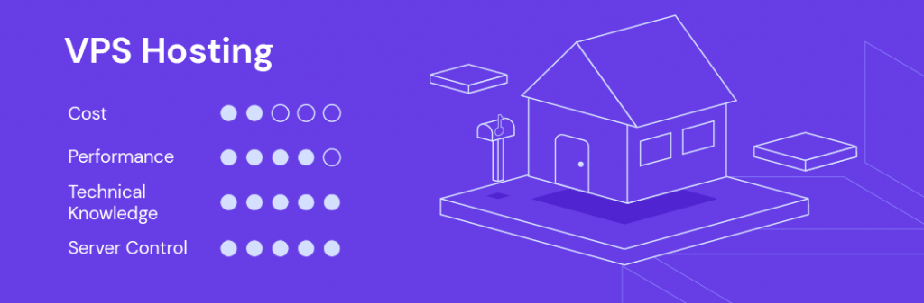
Types of Web Hosting
Hosting types Comparison

Slide 11
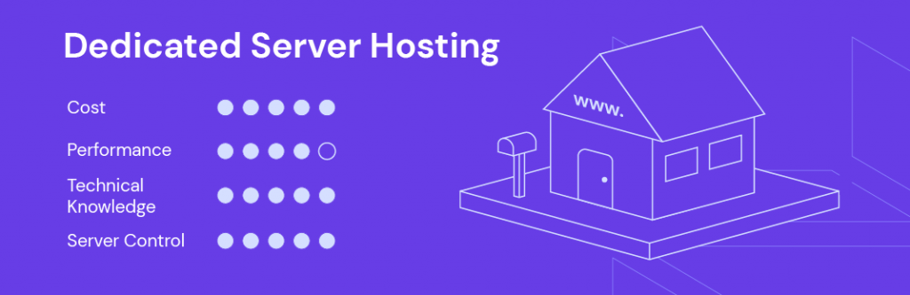
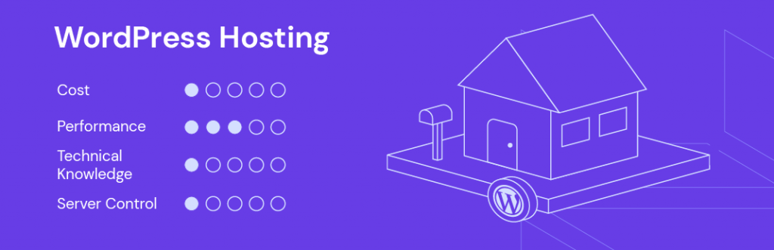
Types of Web Hosting
Hosting types Comparison

Slide 12
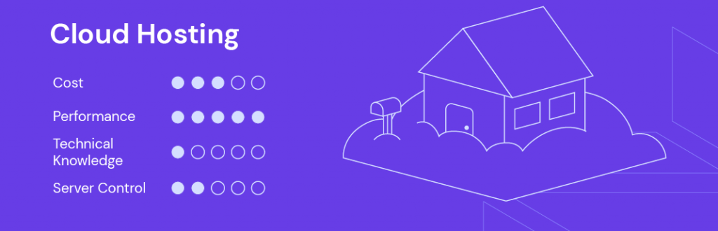
Types of Web Hosting
Hosting types Comparison

Slide 13
Part 2 Server-Side Technologies

Slide 14
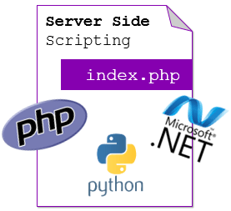
What are Sever-Side Technologies?
Server side technologies are a set of processes and frameworks that operate on the server rather than the client's device.
They play a crucial role in web development, handling application logic, database interactions, user authentication.
Common examples of server side technologies include:
PHP
Java
ASP.NET
Python

Slide 15
Sever-Side Technologies
The essential combination of technologies required to build a service is known as a 'software-solution stack‘.
The stack must include four components:
Operating system.
Web-server instance.
Database management system.
Server-side scripting language.

Slide 16
Sever-Side Technologies
The original and most commonly used web-service software solution stack is known as LAMP (An acronym for Linux, Apache, MySQL and PHP).
The components of the stack are interchangeable and hundreds of other acronyms exist to encompass different technologies (WAMP uses Windows for example, MAMP uses Mac OS X).

Slide 17
LAMP (Linux, Apache, MySQL and PHP)
L – This component refers to the server's operating system, in the case Linux.
Now commonly interchangeable with Windows (WAMP), or Mac OS X (MAMP).
A – Apache is still the most commonly used web-server software.
M – MySQL is an open-source and widely used Relational Database Management System (RDBMS).
P – PHP is a server side scripting language that has the ability to connect to and query a database using query language.
PHP has extensive functionality and is now interchangeable with other server-side scripting languages such as Ruby, Python or Perl.

Slide 18
Key Features of Server Side Web Technologies
Dynamic Content Generation: They can create web pages that change based on user input or database information.
User Authentication: Secure login processes can be implemented, ensuring that users' data is protected.
Backend Processing: Heavy computations or data manipulation tasks can be carried out effectively on the server rather than on the client’s device.
Database Integration: Most server side technologies provide native ways to interact with various databases, allowing for efficient data storage and retrieval.
Notes:
Native: محلي

Slide 19
Explanation of Server Side Processes
Server side processes involve multiple steps to deliver content and services to users. The typical flow can be described as follows:
The client sends a request to the server, usually through a web browser.
The server receives this request and determines how to process it.
Relevant server side scripts might be executed. These scripts can fetch or manipulate data stored in a database.
After processing, the server generates a response and sends it back to the client.
Notes:
Native: محلي

