Slide 1
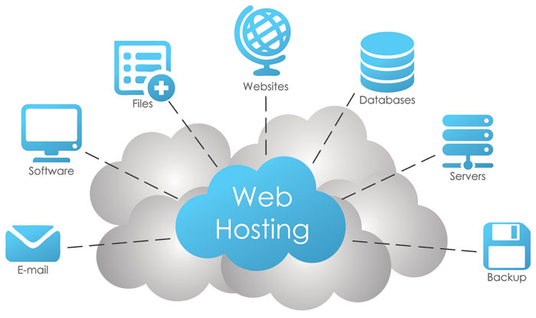
Web Hosting

Slide 2
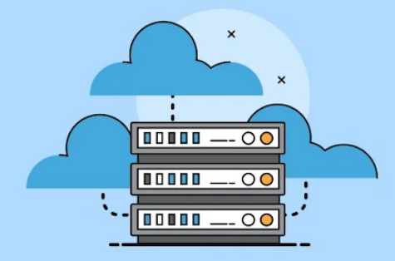
Part 1 Where do Website files live?

Slide 3
Where do your Website files live?
Every Website is made up of files images, code, text and styles.
These Website files need a secure, accessible place to live so others can view it.
That’s where Web hosting company comes in.
So you rent a server space on a physical server that stays connected to the internet 24/7.
This server holds all your site’s files, making them available anytime someone visits your domain name.

Slide 4
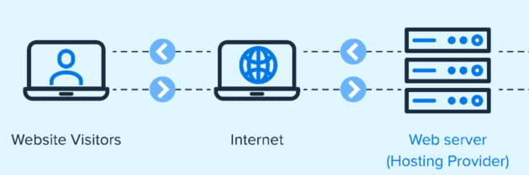
Where do your Website files live?
The host is responsible for maintaining the servers, ensuring the site is always online.
The host provides the necessary resources for your website to function and be accessible to visitors.

Slide 5
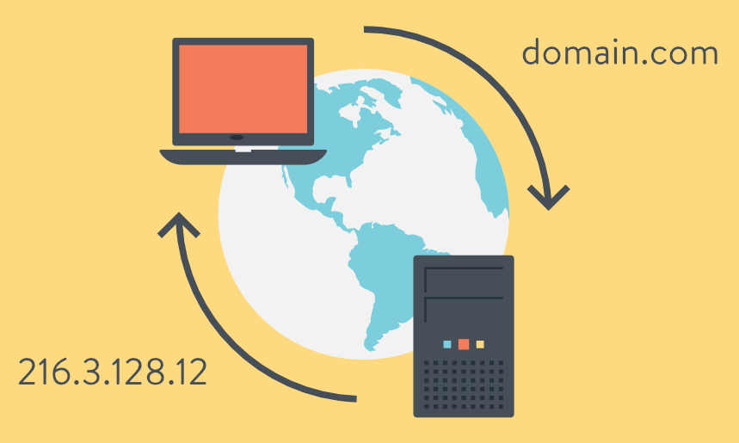
Part 2 How do domain names work?

Slide 6

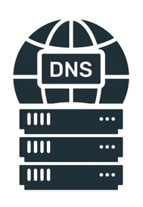

How do domain names work?
When you type a domain name in your browser, it searches through a global network called the Domain Name System (DNS).
1
Web browser

Slide 7
How do domain names work?
The browser checks one DNS server, and if it doesn't find the address there, it tries another.
1
2
Web browser

Slide 8
How do domain names work?
The DNS server that has the correct IP address sends it back to the browser.
3
1
2
Web browser

Slide 9
How do domain names work?
The browser then requests the site data from the hosting server. Once the data is received, the browser displays it as a web page.
4
3
1
2
Web browser

Slide 10
Part 3 How Web hosting works?

Slide 11
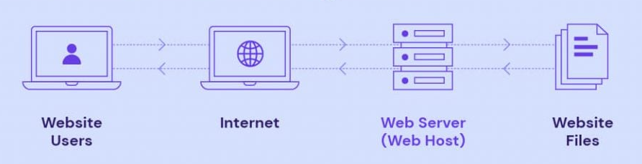
How Web hosting works?
1- You Upload Your Website Files
You create your website's content, such as HTML, CSS, and image files, and then you upload them to the space provided by your web hosting provider.
1

Slide 12
How Web hosting works?
2- The Server Stores the Files
Your files are stored on a web server (a powerful computer that is permanently connected to the internet).
2
1

Slide 13
How Web hosting works?
3- A User Requests Your Website
When someone enters your domain name (like www.ahmad2004.com) into their web browser, the browser sends a request to the web server.
3
2
1

Slide 14
How Web hosting works?
4- The Server Delivers the Files
The server responds to this request by locating the necessary files and transferring them to the user's browser.
3
4
2
1

Slide 15
How Web hosting works?
5- The Website is Displayed
The user's browser then assembles these files to display the website on their screen, making it accessible to them.
5
3
4
2
1

