Slide 1
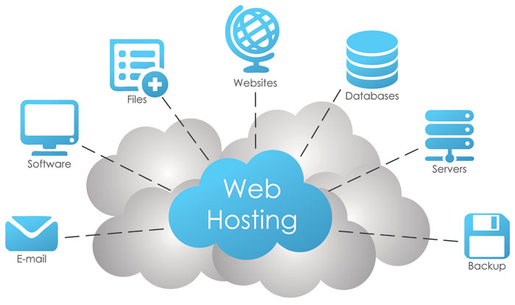
Web Hosting

Slide 2
Part 1 What is Web Hosting? How web hosting works?

Slide 3
How do I get started with a website?
Register a domain: You’ll buy this from a domain name registrar like Domain.com, Bluehost, HostGator, GoDaddy, or Google Domain, just to name a few.
Nameservers (DNS): The nameserver is the middle man that points your website visitors toward the correct IP address. Some common ones are CloudFlare, OpenDNS, CleanBrowsing, and Google Public DNS.
Web hosting: The actual files that make up the website reside in a server maintained by your web hosting company.
Notes:
Comprise: يتألف من

Slide 4
What is Web Hosting?
Web hosting is a cloud (Online) service in which a service provider stores all the files that comprise a website on a server and makes the website accessible on the internet.
Websites are built by using files, code, images and applications, all of which needed to be stored on servers.
Web hosts provide, configure and maintain the physical or virtual servers that store all the resources needed to build and run a website.
In practice, it usually refers to the service you get from a web hosting provider like one.com.
Notes:
Comprise: يتألف من

Slide 5
What is Web Hosting?
Individuals, small businesses, startups, large enterprises and government organizations all use web hosting platforms.
Web hosting providers generally offer features such as scalable storage, compute and bandwidth, security protocols, backups, technical support.

Slide 6
How web hosting works?
Web hosting plans are offered by internet service providers (ISP), specialized web hosting service providers and cloud service providers.
A web hosting provider creates space on a server, or provides a dedicated server, to host a client’s website or web applications.
The hosting provider provides a dashboard where the client can manage their websites and applications.
The provider also provides access to resources such as CPU, RAM, bandwidth, security features, email management and more.

Slide 7
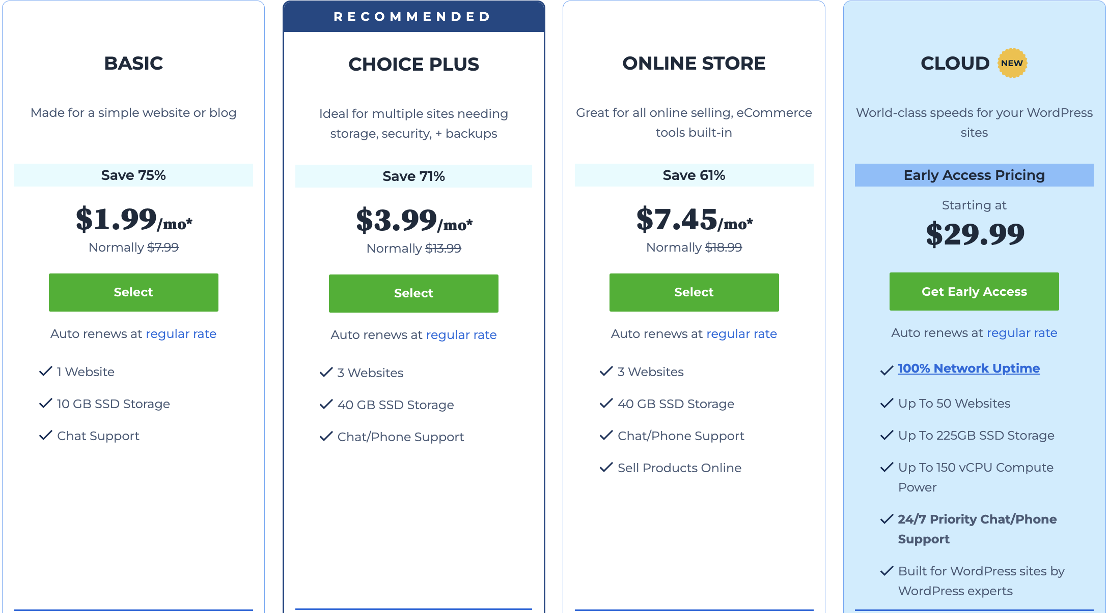
How web hosting works?
Hosting options vary depending on workloads, the technical requirements of a business or website and business objectives.
When choosing a web hosting solution, enterprises can decide between several hosting options including shared hosting, dedicated hosting and virtual private server (VPS) hosting.

Slide 8
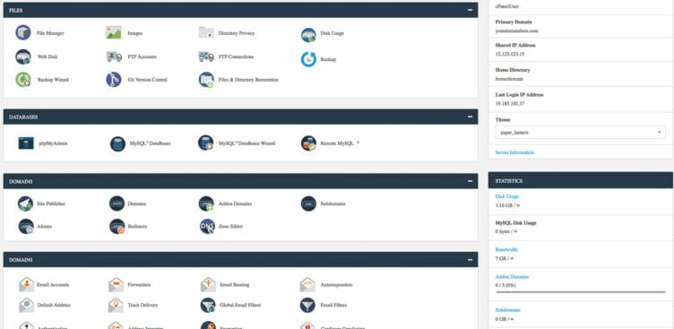
How web hosting works?
Individuals, small businesses, startups, large enterprises and government organizations all use web hosting platforms.
Web hosting providers generally offer features such as:
Storage and compute resources.
Control panel or dashboard.
Bandwidth allowance.
Uptime guarantees.
Security.
Email management.
File transfer protocol.
Content management system.
Technical support.

Slide 9
Part 2 Web hosting features

Slide 10

How web hosting works?
Storage and compute resources
Web hosts outline the disk space and compute resources provided, as well as the scalability of both storage and compute power.
Organizations whose business involves large data sets or complex computing demands might require more storage and processing power.

Slide 11
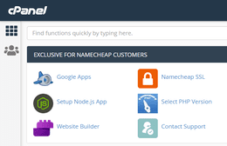
How web hosting works?
Control panel or dashboard
Web hosts provide a centralized dashboard that enables clients to access and manage different aspects of their hosting account and associated websites.
A control panel or “cPanel” enables users to:
Change basic system configurations.
Manage passwords.
Access and oversee the email accounts.

Slide 12
How web hosting works?
Bandwidth allowance
Bandwidth is a measurement of the volume of data that can pass through a network at any particular time.
Higher bandwidth generally results in faster websites and improved network reliability.
It can also factor into SEO page ranking, which plays a large role in how new users discover a website through search engines

Slide 13

How web hosting works?
Bandwidth allowance
Organizations do not want to overpay for bandwidth they don’t need.
When determining the necessary bandwidth allowance, IT teams consider expected traffic volumes.
Insufficient bandwidth can cause a site to crash or lead to high latency, negatively impacting website performance and user experience.

Slide 14

How web hosting works?
Uptime guarantees
Uptime is a measurement of the amount of time a website is available without a service interruption.
It is usually measured as a percentage over a period of time, often a year.
Every provider aims to keep uptime as high as possible and different organizations have their own uptime requirements.

Slide 15

How web hosting works?
Security
Web hosting platforms use protocols that protect network communications, such as secure sockets layer certificates (SSL certificates), to help keep customer sites secure.

Slide 16
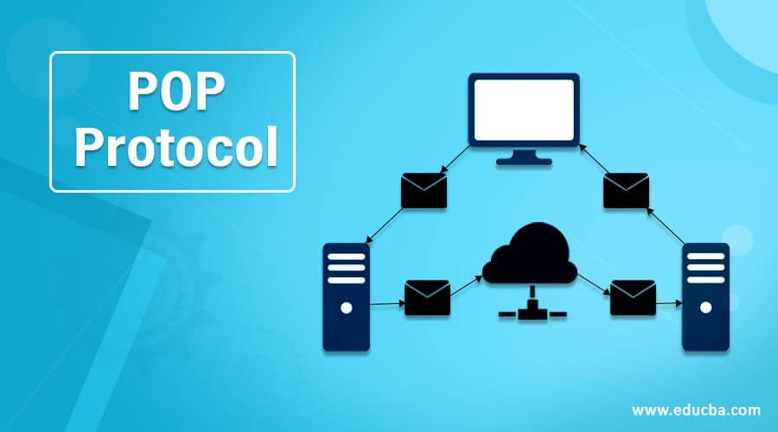
How web hosting works?
Email management
Web hosts provide users with domain-specific email addresses.
The number of email addresses a host provides varies by pricing plan.
Web hosts also connect users to an email server by using the POP3 protocol.
The P0P3 protocol enables the checking, sending, receiving and forwarding of emails from a server to a device such as a computer.

Slide 17
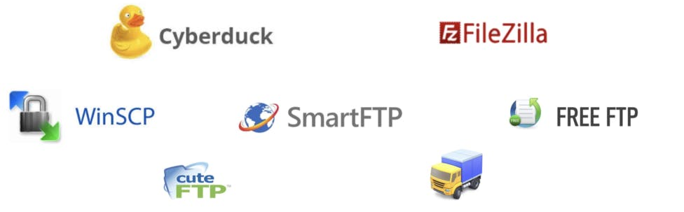
How web hosting works?
File transfer protocol (FTP) access
FTP is a network protocol that enables file transfer between a computer and a server.
FTP access enables a website user to download content such as images, videos and PDFs from the site.

Slide 18
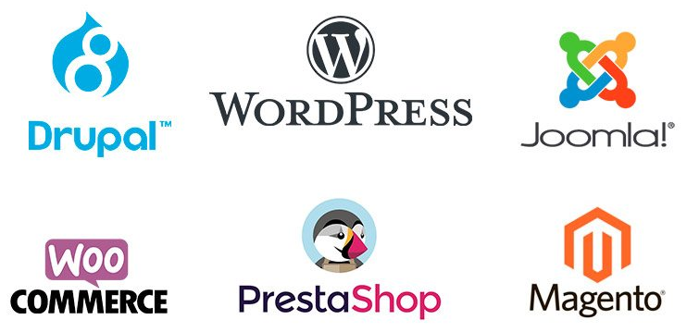
How web hosting works?
Content management systems (CMS)
Content management systems enable website contributors to manage digital content and create and edit web pages from a unified dashboard.
CMS platforms such as WordPress offer templates and other tools that simplify web design and maintenance.

Slide 19

How web hosting works?
Technical support
Ideally, a web service provider offers on-demand support 24 hours a day, seven days a week.
The amount of time it takes a customer support team to respond to questions or issues can impact website performance and overall user satisfaction.

