Slide 1
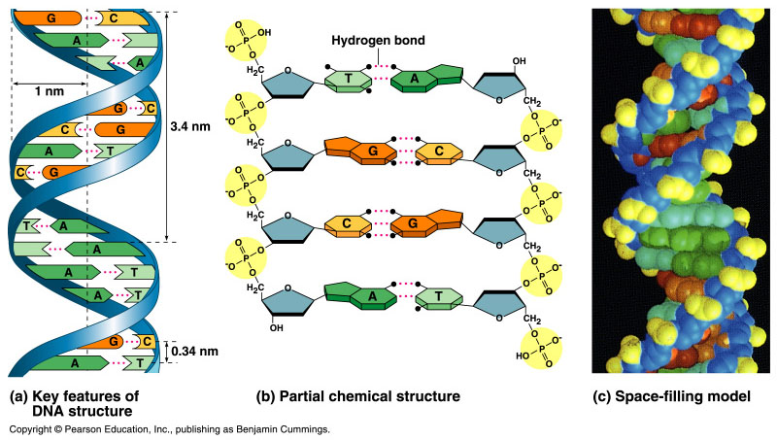
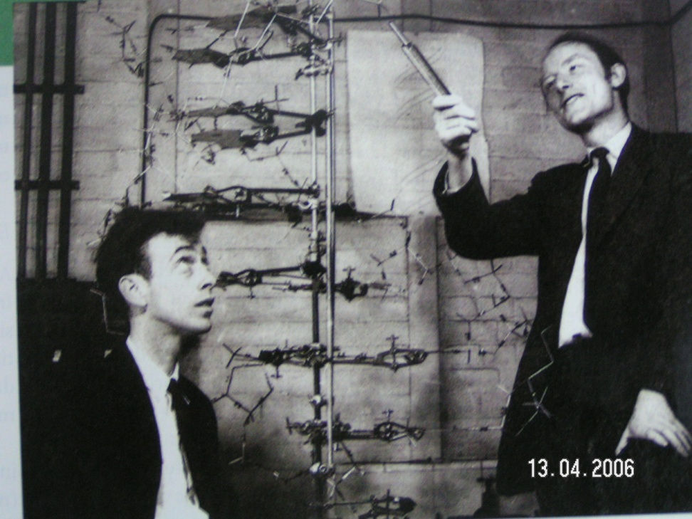
DNA as the Genetic Material
In April 1953, James Watson and Francis Crick established the double-helical model for the structure of deoxyribonucleic acid or DNA.

Slide 2
Introduction
The amino acid sequence of a polypeptide is programmed by a gene.
A gene is a small region in the DNA.
Nucleic acids store and transmit hereditary information.
There are two types of nucleic acids: ribonucleic acid (RNA) and deoxyribonucleic acid (DNA).
DNA also directs mRNA synthesis, thus, controls protein synthesis.
Organisms inherit DNA from their parents.
  DNA molecule consists of hundreds to thousands of genes.
  When a cell divides, DNA is copied and passed to the next generation of cells.
The mRNA interacts with ribosomes to direct the synthesis of amino acids in a polypeptide (protein)

Slide 3
Structures of nucleic acids (DNA & RNA)
Bases
3
5
o
Phosphate group
o
P
o
o
DNA nucleotide
Adenine (A)
o
Base
5
CH₂
Purine
4
H
H
1
H
Guanine (G)
3
2
H
H
o
Deoxyribose
o
P
o
o
Base
Cytosine (C)
o
CH₂
Pyrimidine
H
H
H
H
Thymine (T)
5
3
3
H
Sugar-phosphate backbone

Slide 4
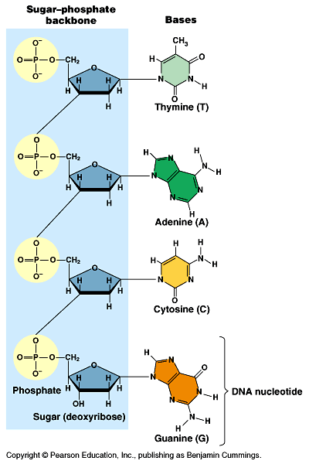
  The PO₄³⁻ group of one nucleotide is attached to the sugar of the next nucleotide in line .
  The result is a “backbone” of alternating phosphates and sugars, from which the bases starts.

Slide 5
Nitrogenous bases
3
5
Hydrogen bonds
Cytosine (C)
Guanine (G)
Nitrogenous bases
Thymine (T)
Adenine (A)
Uracil (U)
Pyrimidines
Purine
5
3
Sugar-phosphate backbones

Slide 6
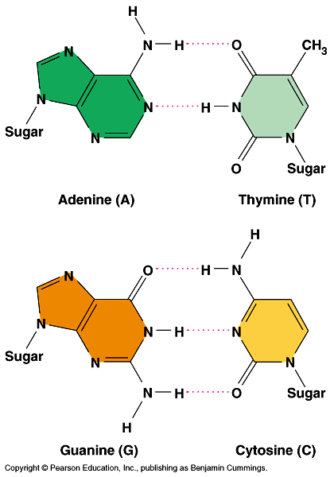
DNA
  Adenine (A) would
  form 2 hydrogen bonds only with thymine (T)
  Guanine (G) would form 3 hydrogen bonds only with
  cytosine (C).

Slide 7
DNA & RNA
o
CH₂
o
CH₂
H
H
H
H
H
H
H
H
H
OH
Deoxyribose sugar (O on C2 is missed)
Ribose sugar (no missed O)
Deoxiribo-Nucleic-Acid
Ribo-Nucleic-Acid
Double stranded nucleic acid
Single stranded nucleic acid
Bases: A, G, C, T
Bases: A, G, C, U

Slide 8
The nucleic acid strand is a polymer of nucleotides
Nucleic acids are polymers of monomers called nucleotides.
Each nucleotide consists of three parts: a nitrogen base, a pentose sugar, and a phosphate group.
The nitrogen bases (rings of carbon and nitrogen) come in two types: Purines and Pyrimidines.
The pentose sugar joined to the nitrogen base is ribose in nucleotides of RNA and deoxyribose in DNA.
The only difference between the sugars is the lack of an oxygen atom on carbon 2 in deoxyribose.

Slide 9
Polynucleotides are synthesized by connecting the sugars of one nucleotide to the phosphate of the next with a phosphodiester link.
This creates a repeating backbone of sugar-phosphate units with the nitrogen bases as appendages.
The sequence of nitrogen bases along a DNA or mRNA polymer is unique for each gene.
Genes are normally hundreds to thousands of nucleotides long.
The linear order of bases in a gene specifies the order of amino acids (the monomers of a protein).

Slide 10
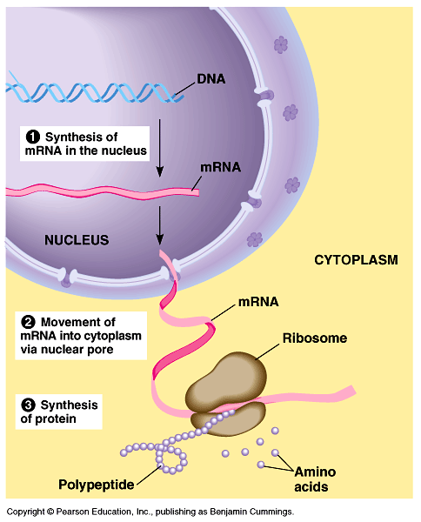
The flow of genetic information is from DNA mRNA protein.
  Protein synthesis occurs
  in ribosomes.
  In eukaryotes, DNA is
  located in the nucleus,
  but most ribosomes are
  in the cytoplasm with
  mRNA as an
  intermediary.

Slide 11
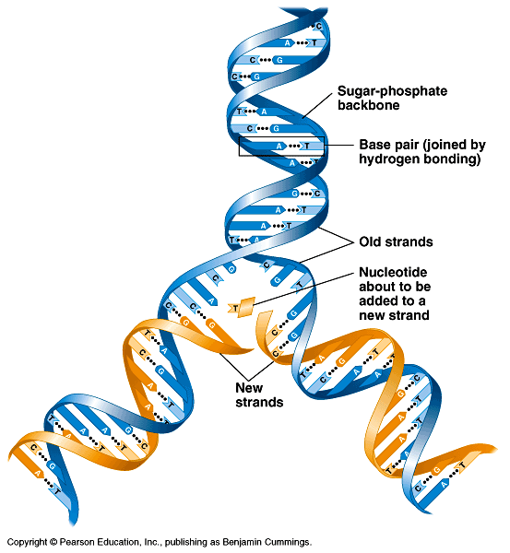
Inheritance is based on replication of the DNA double helix
The sugar-phosphate backbones of the two polynucleotides are on the outside of the helix.
Pairs of nitrogenous
bases (one from each
strand) connect the
polynucleotide chains
with hydrogen bonds.
Most DNA molecules
have thousands to
millions of base pairs (bP).

Slide 12
Because of their shapes, only some bases are compatible with each other.
  Adenine (A) always pairs with thymine (T) and guanine (G) with cytosine (C).
With these base-pairing rules, if we know the sequence of bases on one strand, we know the sequence on the opposite strand.
The two strands are complementary.
During preparations for cell division each of the strands serves as a template to order nucleotides into a new complementary strand.
This results in two identical copies of the original double-stranded DNA molecule.
  The copies are then distributed to the daughter cells.
This mechanism ensures that the genetic information is transmitted to the new cells.

Slide 13
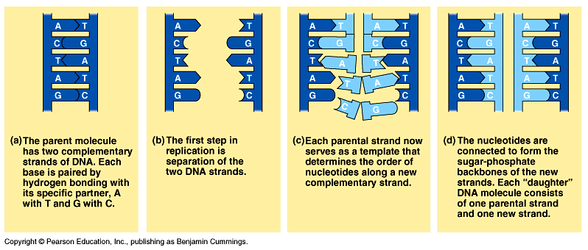
When a cell copies a DNA molecule, each strand serves as a template for ordering nucleotides into a new complimentary strand.
  Nucleotides line up along the template strand according to the base-pairing rules.
  The nucleotides are linked to form new strands (complementary).

Slide 14
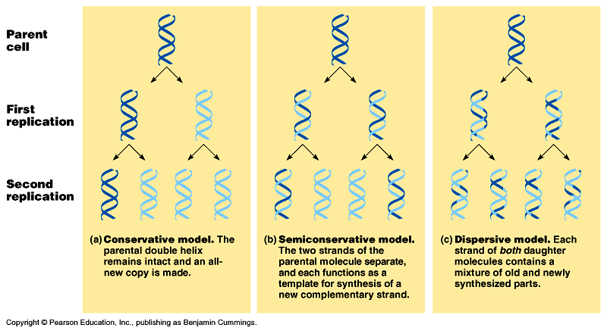
Types of DNA replication
Semiconservative replication (the most common and accepted by Watson and Crick). The double helix replicates each of the daughter molecules and will have one old strand and one newly made strand.
The other two models are the conservative and the dispersive models

Slide 15
Semiconservative DNA Replication
During DNA replication, base pairing enables existing DNA strands to serve as templates for new complimentary strands
Several enzymes and other proteins carry out DNA replication:
Helicase,
Primase,
Polymerase,
Ligase.
The ends of DNA molecules are replicated by a special mechanism.

Slide 16
2. A large team of enzymes and other proteins carries out DNA replication: The Replication Mechanism
It takes E. coli less than an hour to copy each of the 5 million base pairs in its single chromosome and divide to form two identical daughter cells.
A human cell can copy its 6 billion base pairs and divide into daughter cells in only a few hours.
This process is remarkably accurate, with only one error per billion nucleotides.
A helicase; untwists and separates the template DNA strands at the replication fork.
Single-strand binding proteins; keep the unpaired template strands apart during replication.

Slide 17
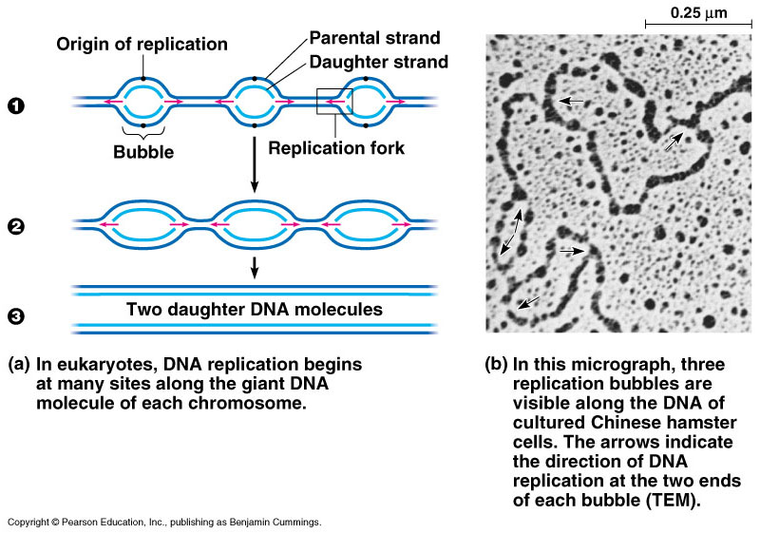
The replication of a DNA molecule begins at special site called origin of replication which is a single specific sequence of nucleotides that is recognized by the replication enzymes.
Replication enzymes separate the strands, forming a replication “bubble”.
  Replication proceeds in both directions until the entire molecule is copied.
In eukaryotes, there may be hundreds or thousands of bubbles (each has origin sites for replication) per chromosome.
  At the origin sites, the DNA strands separate forming a replication “bubble” with replication forks at each end.
  The replication bubbles elongate as the DNA is replicated and eventually fuse.

Slide 18
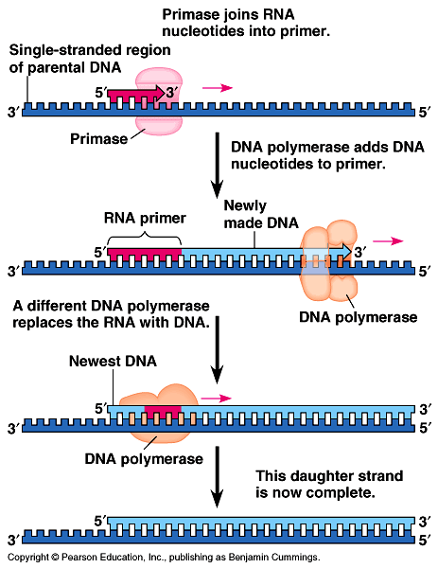
Primer: (a short segment of RNA, 10 nucleotides long) is required to start a new chain.
Primase: (an RNA polymerase) links ribonucleotides that are complementary to the DNA template into the primer.
DNA polymerases: catalyze the elongation of new DNA at a replication fork. After formation of the primer, DNA polymerases can add deoxyribonucleotides to the 3’ end of the ribonucleotide chain.
Another DNA polymerase later replaces the primer ribonucleotides with
deoxyribonucleotides
complimentary to the template.

Slide 19
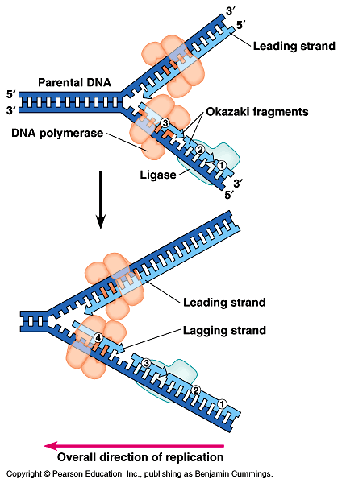
DNA polymerases can only add nucleotides to the free 3’ end of a growing DNA strand.
A new DNA strand can only elongate in the 5’->3’ direction.
At the replication fork, one parental strand (3’-> 5’ into the fork), the leading strand, can be used by polymerases as a template for a continuous complimentary strand.
The other parental strand (5’->3’ into the fork), the lagging strand, is copied away from the fork in short segments
(Okazaki fragments).
Okazaki fragments (each about 100-200 nucleotides) are joined by DNA ligase to form the sugar-phosphate backbone of a single DNA strand.

Slide 20
SUMMARY OF DNA REPLICATION MECHANISM
Step 1
Helicases: Enzymes that separate the DNA strands
Helicase move along the strands and breaks the hydrogen bonds between the complimentary nitrogen bases
Replication Fork: the Y shaped region that results from the separation of the strands
Step 2
DNA Polymerase: enzymes that add complimentary nucleotides.
Nucleotides are found floating freely inside the nucleus
Covalent bonds form between the phosphate group of one nucleotide and the deoxyribose of another
Hydrogen bonds form between the complimentary nitrogen bases
Step 3
DNA polymerases finish replicating the DNA and fall off.
The result is two identical DNA molecules that are ready to move to new cells in cell division.
Semi-Conservative Replication: this type of replication where one strand is from the original molecule and the other strand is new
Notes:
20

Slide 21
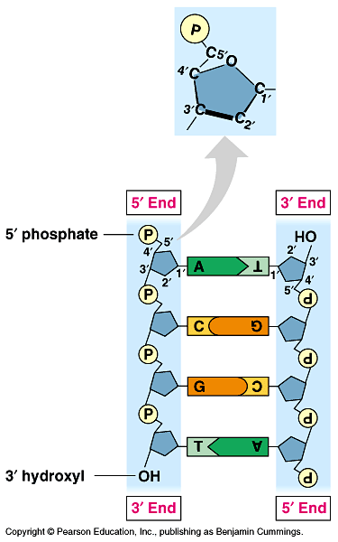
Each strand is making its own new strand.
DNA synthesis is occurring in two different directions
One strand is being made towards the replication fork and the other is being made away from the fork. The strand being made away from the fork has gaps.
Gaps are later joined by another enzyme, DNA ligase
The strands in the double helix are antiparallel.
The sugar-phosphate backbones run in opposite directions.
  Each DNA strand has a 3’ end with a free OH group attached to deoxyribose and a 5’ end with a free phosphate group attached to
  deoxyribose.
  The 5’ -> 3’ direction of one strand runs counter to مُعاكس لـ the 3’ -> 5’ direction of the other strand.
Notes:
21

Slide 22
SUMMARY OF DNA REPLICATION MECHANISM
The two DNA-strands separate forming replication bubbles.
Each strand functions as a template for synthesizing new complementary & lagging strands via primers, polymerase and ligase.
5
3
T
A
C
T
G
A
C
A
G
A
G
G
G
A
T
A
C
T
Primer
T
C
T
3
5
Complementary (leading) strand
Templates
Polymerase
Ligase
T
A
C
T
G
A
C
3
5
Lagging strand (complementary)
Okazaki fragments

Slide 23
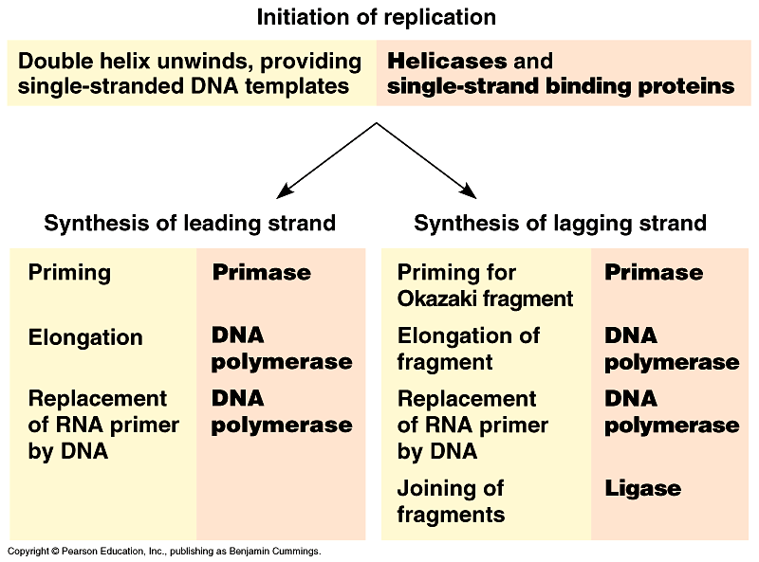
1
2
3
4

Slide 24
Helicase: untwists the double helix to separate the DNA strands by forming
replication bubbles.
Replication enzymes: separates DNA strands, forming a replication “bubble”.
Replication bubble: formed at the origin sites of replication as DNA strands
separate, and hence, replication forks formed at each end.
Replication site: it is also called origin of replication which is a single specific
sequence of nucleotides that is recognized by the replication enzymes
and at which replication starts.
Primer: is a short piece of RNA (10 nucleotide long) which is synthesised
by primase and used to initiate the leading strands of the new DNA.
DNA-polymerase: builds up the new DNA strand by adding nucleotides to
the primer (from 5’ to 3’ end).
Leading strand: the elongation strand (5’ 3’ into the fork) that initiate the
new DNA after recognizing the sequence of the primer by special proteins.
Lagging strand: Is the other parental strand (5’ 3’ into the fork), is copied
away from the fork in short segments (Okazaki fragments).
Okazaki fragments: the newly formed segments (5’ 3’, away from the fork)
then, form the lagging strand when connected by ligase towards the fork.
DNA-ligase: joins the Okazaki fragments of the newly formed bases to form
the new lagging DNA strand.

Slide 25
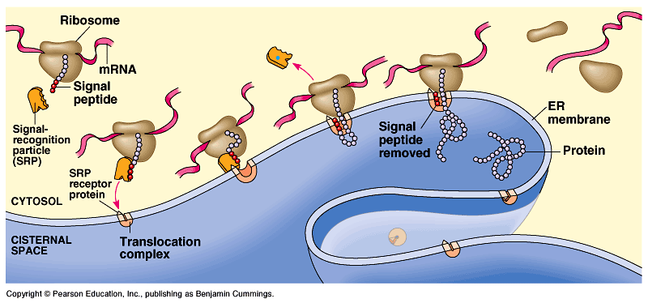
FROM GENE TO PROTEIN
The Connection Between Genes and Proteins
http://highered.mcgraw-hill.com/sites/9834092339/student_view0/chapter15/mrna_synthesis__transcription_.html
http://www.sinauer.com/cooper5e/animation0702.html

Slide 26
Types of RNAs
mRNA: is the carrier of the genetic “message” from the DNA to the cytosol.
rRNA: is the major component of ribosomes.
tRNA: is the carrier of specific amino acids from the cytosol to ribosimes thus help to form polypeptides.

Slide 27
RNA transcription and translation are the two main processing that link gene to protein
The information content of DNA is in the form of specific sequences of nucleotides along the DNA strands.
The DNA inherited by an organism leads to specific traits by dictating the synthesis of proteins.
Proteins are the links between genotype and phenotype.
  For example, Mendel’s dwarf pea plants lack a functioning copy of the gene that specifies the synthesis of gibberellins (which stimulate the normal elongation of stems).
Genes provide the instructions for making specific proteins.
The bridge between DNA and protein synthesis is RNA.
The specific sequence of hundreds or thousands of nucleotides in each gene carries the information for the primary structure of a protein, the linear order of the 20 possible amino acids.

Slide 28
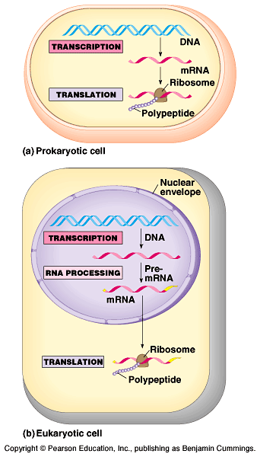
During RNA transcription, a DNA strand provides a template for the synthesis of a complementary RNA strand.
Transcription of a gene produces a messenger RNA (mRNA) molecule.
During RNA translation (at ribosomes), the information contained in the order of nucleotides in mRNA is used to determine the amino acid sequence of a polypeptide.
The basic mechanics of transcription and translation are similar in eukaryotes and prokaryotes.
Because bacteria lack nuclei, transcription and translation are coupled.
Ribosomes attach to the leading end of a mRNA molecule while transcription is still in progress.

Slide 29
In a eukaryotic cell, all transcription occurs in the nucleus and translation occurs mainly at ribosomes in the cytoplasm.
In addition, before the primary transcript can leave the nucleus it is modified in various ways during RNA processing before the finished mRNA go to the cytoplasm.
To summarize, genes program protein synthesis via genetic messenger RNA.
The molecular chain of command in a cell is :
Transcription
Translation
DNA
mRNA
Protein

Slide 30
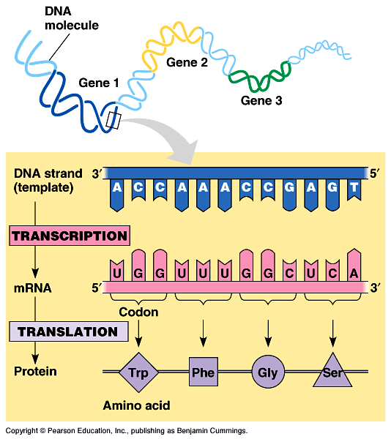
In the genetic code, nucleotide triplets specify amino acids
Triplets of nucleotide bases are the smallest units that can code for all the amino acid.
In the triplet code three consecutive bases specify an amino acid.
The genetic instructions for a polypeptide chain are written in DNA as a series of three-nucleotidewords (triplets).
During transcription, one DNA strand (the template strand) provides an RNA template.
The complementary RNA molecule is synthesized according to base-pairing rules, except that uracil is the complementary base
to adenine.
During translation, blocks
of three nucleotide bases (codons), are decoded into a sequence of amino acids.

Slide 31
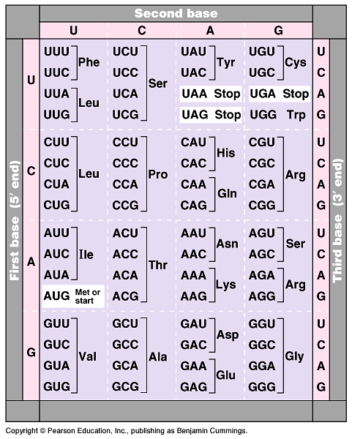
During translation, the codons are read in the 5’->3’ direction along the mRNA.
The codon UUU coded for the amino acid phenylalanine.
The codon AUG not only codes for the amino acid methionine but also indicates the start of translation.
A specific codon indicates a specific corresponding amino acid, but the amino acid may be the translation of several possible codons.
The reading frame and subsequent codons are read in groups of three nucleotide bases (codon).
In summary, genetic information is encoded as a sequence of base triplets (codons) which is translated into a specific amino acid during protein synthesis.

Slide 32
A)- The Transcription and Processing of mRNA
mRNA is transcribed from the template strand of a gene.
RNA polymerase separates the DNA strands at the suitable point and bonds the RNA nucleotides as they base-pair along the DNA template.
Like DNA polymerases, RNA polymerases can add nucleotides only to the 3’ end of the growing polymer.
Specific sequences of nucleotides along the DNA mark where gene transcription begins and ends.
  RNA polymerase attaches and initiates transcription at the promotor, at the beginning of the transcription unit (gene) on the DNA.
  The terminator ends the transcription.
Bacteria have a single type of RNA polymerase that synthesizes all RNA molecules.
In contrast, eukaryotes have three RNA polymerases (I, II, and III) in their nuclei.
  RNA polymerase II is used for mRNA synthesis.

Slide 33
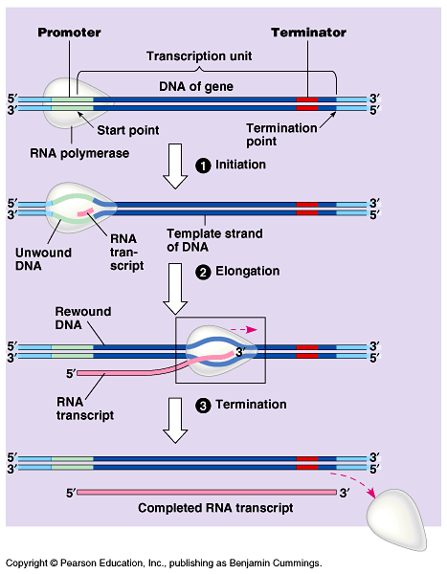
Transcription
can be separated
into three stages:
1- initiation
2- elongation,
3- termination.
Promotor contains the starting point for the transcription of a gene.
Promotor also includes a binding site for RNA polymerase.
Thus, RNA- polymerase can recognize and bind directly to the promotor region.

Slide 34
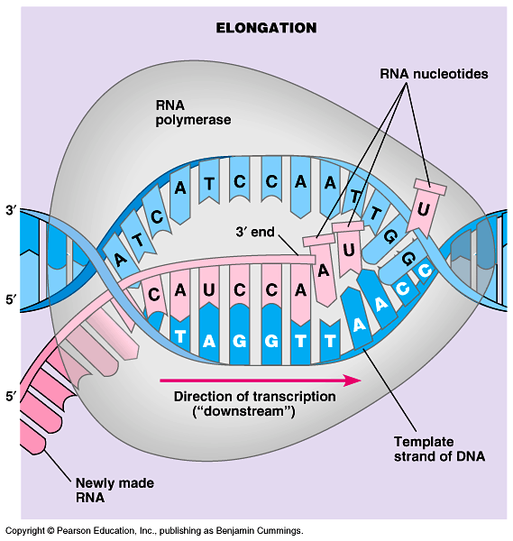
As RNA polymerase moves along the DNA, it untwists the double helix, 10 to 20 bases at time.
The enzyme adds
nucleotides to the
3’ end of the
growing strand.
Behind the point
of RNA synthesis,
the double helix
re-forms and the
RNA molecule
moves away.
Transcription proceeds until after the RNA polymerase transcribes a terminator sequence in the DNA.

Slide 35
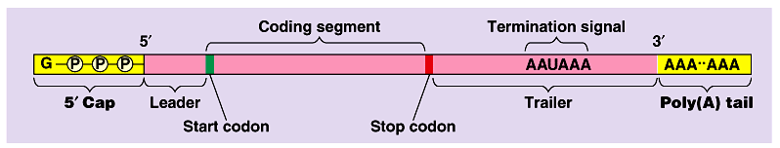
Eukaryotic cells modify RNA after transcription
Enzymes in the eukaryotic nucleus modify pre-mRNA before the genetic messages are dispatched to the cytoplasm.
At the 5’ end of the pre-mRNA molecule, a modified form of guanine is added, the 5’ cap which function as:
  protect mRNA from hydrolytic enzymes.
  a translation start point for ribosomes.
At the 3’ end, an enzyme adds 50 to 250 adenine nucleotides, the poly(A) tail.
The poly(A) tail facilitate the export of mRNA from the nucleus.

Slide 36
Summary of RNA Transcription Mechanism
1) Transcription begins when the enzyme RNA polymerase binds to DNA at a promoter region.
2) The enzyme separates the DNA strands by breaking the hydrogen bonds, and then uses one strand of DNA as a template from which nucleotides are assembled into a strand of RNA.
3) RNA polymerase pairs up free floating RNA nucleotides with DNA template and joins the nucleotides together to form the backbone of the new mRNA strand.
4) When mRNA hits a termination sequence, it separates from the DNA
5) mRNA editing occurs in the nucleus: before the mRNA leaves the nucleus, it is called pre-mRNA and it gets “edited.” Parts of the pre-mRNA that are not involved in coding for proteins are called introns and are cut out. The remaining mRNA pieces are called exons (because they are expressed) and are spliced (combine) back together to form the mRNA.
6) Then the final mRNA leaves the nucleus through the nuclear pores and enters the cytoplasm headed to the ribosomes.
Notes:
36

Slide 37
RNA transcription & translation
Bubble
5
3
T
A
C
T
G
A
C
RNA
polumerase
T
A
G
A
G
T
C
T
A
T
G
A
C
A
T
C
C
U
C
U
C
G
A
G
A
A
T
G
A
C
T
G
T
G
A
A
T
G
A
C
T
G
Promoter
Ribosome
Protein

Slide 38
Codons or triplet code: it is a block of three consecutive nucleotide bases that specify a particular amino acid.
Start codon: a codon that specifies the start of RNA translation.
Stop codon: a codon that specifies the end of RNA translation.
RNA polymerases: RNA transcription enzyme that first separates the DNA strands at the suitable point then start to add nucleotides to the 3’ end of the growing RNA polymer until completed.
Transcription unit (the gene): a specific sequences of nucleotides along the DNA that marks where RNA transcription begins and ends.
Promotor : a specific short sequence on DNA at which RNA polymerase attaches and initiates transcription at the beginning of the transcription unit.
Terminator : a specific short sequence on DNA at which RNA transcription ends (the end of the gene).

Slide 39
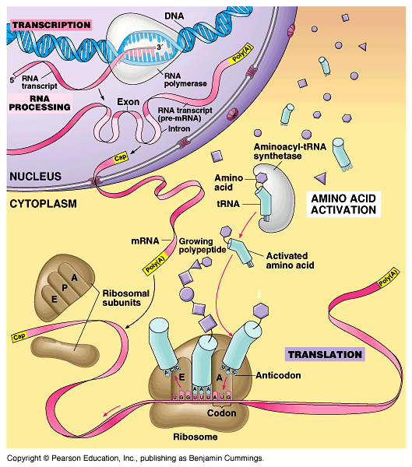
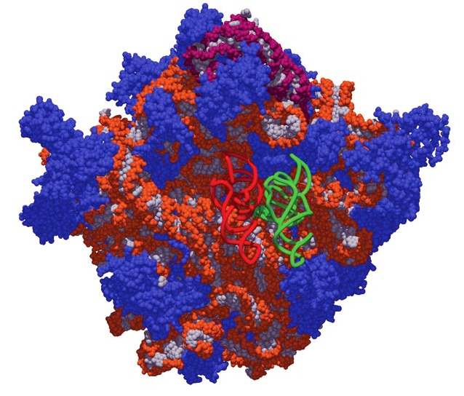
FROM GENE TO PROTEIN
B)- The Synthesis of Protein
http://www.sumanasinc.com/webcontent/animations/content/translation.html
http://highered.mcgraw-hill.com/sites/9834092339/student_view0/chapter15/mutation_by_base_substitution.html

Slide 40
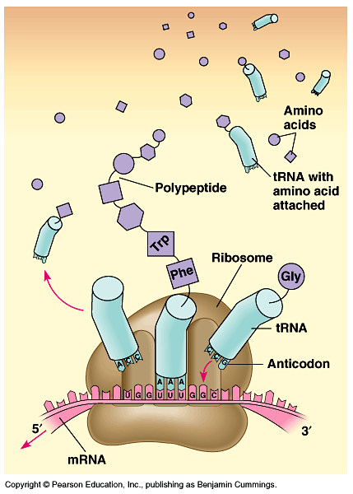
Translations is the RNA-directed synthesis of a polypeptide
In the process of translation, a cell sends a series of codons along a mRNA molecule.
Transfer RNA (tRNA)
transfers amino acids from the cytoplasm to a ribosome.
The ribosome adds each
amino acid carried by tRNA to the growing end of the polypeptide chain.

Slide 41
During translation, each type of tRNA links a mRNA codon with the appropriate amino acid.
Each tRNA arriving at the ribosome carries a specific amino acid at one end and has a specific nucleotide triplet, an anticodon, at the other end.
The anticodon base-pairs with a complementary codon on mRNA.
  If the codon on mRNA is UUU, a tRNA with an AAA anticodon and carrying phenyalanine will bind to it.
Codon by codon, tRNAs deposit amino acids in the prescribed order and the ribosome joins them into a polypeptide chain.
Fig. 17.12, Page 314

Slide 42
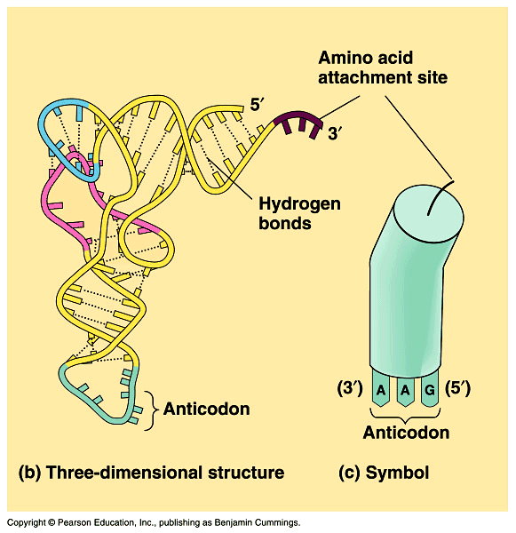
tRNA molecules: are transcribed from DNA in the nucleus.
Once it reaches the cytoplasm, each tRNA is used repeatedly for the following functions:-
  to pick up its relevant amino acid in the cytosol,
  to deposit the amino acid at the ribosome
  to return to the cytosol to pick up another copy of that amino acid.
The anticodons of some tRNAs recognize more than one codon.

Slide 43
Ribosomes: the protein making machine
facilitate the coupling of the tRNA anticodons with mRNA codons.
  Each ribosome has a large and a small subunit formed in the nucleolus.
  Ribosome is composed of proteins and ribosomal RNA (rRNA), the most abundant RNA in the cell.
rRNA is transcribed in the nucleus, then bind to special proteins to form the ribosomal subunits in the nucleolus.
The subunits exit the nucleus via nuclear pores.
The large and small subunits join to form a functional ribosome only when they attach to an mRNA molecule.

Slide 44
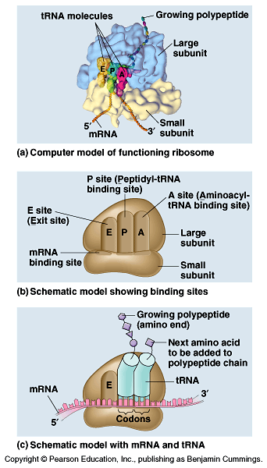
Each ribosome has a binding site for mRNA and three binding sites for tRNA molecules.
  The P site holds the tRNA carrying the growing polypeptide chain.
  The A site carries the tRNA with the next amino acid.
  The E site at which the discharged tRNA leave the ribosome.

Slide 45
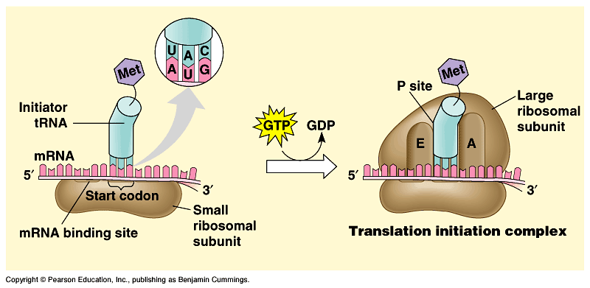
Translation occurs in three stages:
1- initiation of translation
2- elongation of polypeptide chain
3- termination of translation
Initiation: brings together mRNA, a tRNA (with the first amino acid) and the two ribosomal subunits (large & small).
  First, a small ribosomal subunit binds with mRNA and a special initiator tRNA, which carries methionine and attaches to the start codon.
  Initiation factors bring in the large subunit such that the initiator tRNA occupies the P site.
Methionine
Guanosine triphosphate

Slide 46
Elongation:
Consists of a series of three step cycles as each amino acid is added to the proceeding one in 3 steps:-
Codon recognition, an elongation factor assists hydrogen bonding between the mRNA codon under the A site with the corresponding anticodon of tRNA carrying the appropriate amino acid [This step requires the hydrolysis of two guanosine triphosphate (GTP)].
Peptide bond formation: an rRNA molecule catalyzes the formation of a peptide bond between the polypeptide in the P site with the new amino acid in the A site. This step separates the tRNA at the P site from the growing polypeptide chain and transfers the chain, now one amino acid longer, to the tRNA at the A site.
Translocation of tRNA: the ribosome moves the tRNA with the attached polypeptide from the A site to the P site.

Slide 47
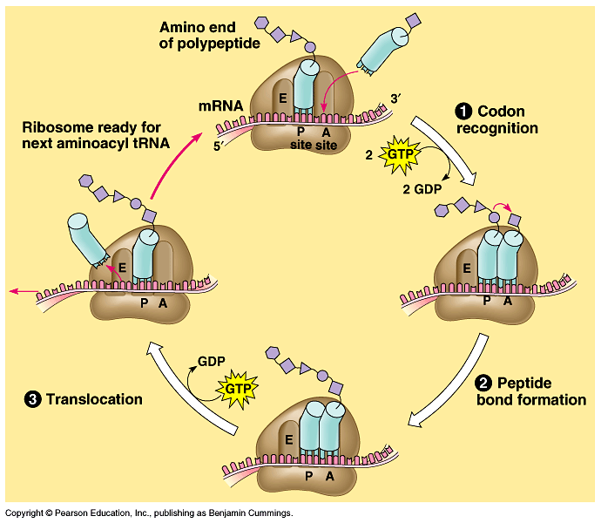
The three steps of elongation continue codon by codon to add amino acids until the polypeptide chain is completed.

Slide 48
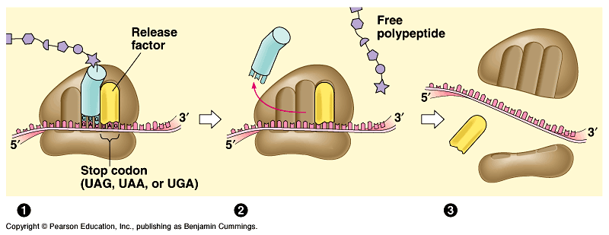
Termination: Occurs when one of the three stop codons reaches the A site.
A release factor binds to the stop codon and hydrolyzes the bond between the polypeptide and its tRNA in the P site.
This frees the polypeptide and the translation complex disassembles.
Fig. 17.19
The free and bound ribosomes are both active participants in protein synthesis.

Slide 49
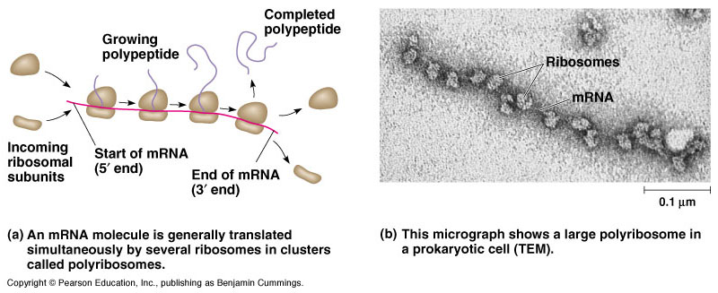
Polyribosomes :
A ribosome requires less than a minute to translate an average-sized mRNA into a polypeptide.
Multiple ribosomes, polyribosomes, may trail along the same mRNA.
Thus, a single mRNA is used to make many copies of a polypeptide simultaneously.

Slide 50
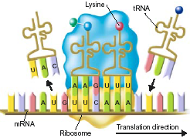
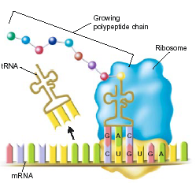
Summary of mRNA Translation Mechanism
1
1) mRNA attaches to a ribosome at the AUG, which is the start codon. This begins translation.
2) The transfer RNA (tRNA) bonds with the correct amino acid and becomes “charged.” (in the cytoplasm)
3) The tRNA carries the amino acid to the ribosome. Each tRNA has an anticodon whose bases are complementary to a codon on the mRNA strand. The tRNA brings the correct amino acid to the ribosome.
4) The ribosome moves along the mRNA and adds more amino acids to the growing polypeptide or protein
2
5) The process continues until the ribosome reaches one of the three stop codons on the mRNA, and then the ribosome falls off the mRNA.
6) The result is a polypeptide chain or protein that is ready for use in the cell.
3
Notes:
50

Slide 51
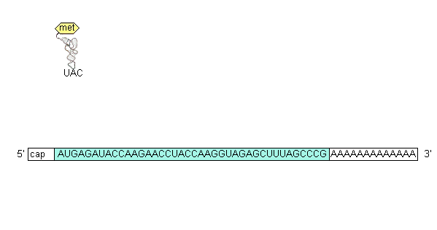
Animations: RNA-translation

Slide 52
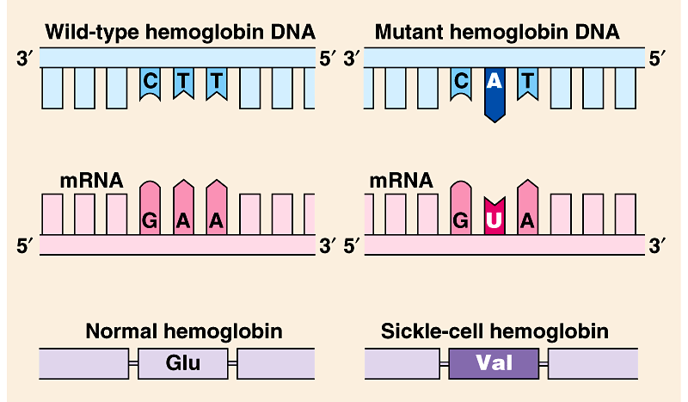
Mutations:
Affect protein structure and function
Mutations are changes in the genetic material of a cell (or virus).
These include large-scale mutations in which long segments of DNA are affected (e.g., translocations, duplications, and inversions).
Point mutation : is a chemical change in just one base pair of a gene.
If these occur in cells producing gametes, they may be transmitted to future generations (offspring).
Sickle-cell disease, a mutation of a single base pair in the gene that codes one of hemoglobin polypeptides.
- A change in a single nucleotide from T to A in the DNA template leads to an abnormal protein.

Slide 53
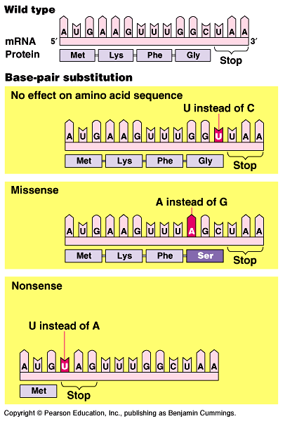
A)- Base-pair substitution
It is a point mutation that results in replacement of a pair of complimentary nucleotides with another nucleotide pair.
Silent mutation: some base-pair substitutions (point mutation) have little or no impact on protein function which lead to switches from one amino acid to another with similar properties.
Other base-pair substitutions cause a detectable change in a protein which impactfunction.
Missense mutations: a point mutation that still code for an amino acid but change the resulting protein.
Nonsense mutations: change an amino acid codon into a stop codon, nearly always leading to a nonfunctional protein.

Slide 54
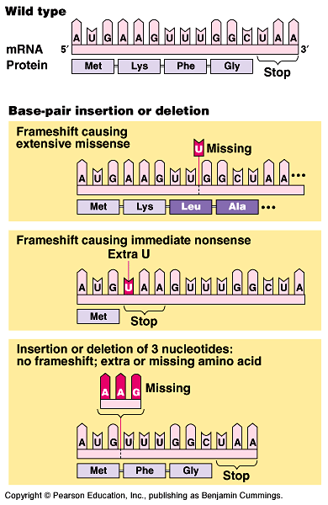
B)- Insertions and deletions
It is a mutation in which additions or losses of nucleotide pairs occurs and causes Frameshift mutation.
  These have a disastrous effect on the resulting protein
When frameshift occurs, all the nucleotides downstream of the deletion or insertion will be improperly grouped into new codons.
  The result will be extensive missense, ending sooner or later in nonsense - premature termination.

Slide 55
Mutations can occur in a number of ways.
  Errors can occur during DNA replication, DNA repair, or DNA recombination.
  These can lead to base-pair substitutions, insertions, or deletions, as well as mutations affecting longer stretches of DNA.
  These are called spontaneous mutations.
Mutagens : are chemical or physical agents that interact with DNA to cause mutations.
Physical agents include high-energy radiation like X-rays and ultraviolet light.
Chemical agents may operate in several ways.
  Some chemicals are base analogues that may be substituted into DNA, but that pair incorrectly during DNA replication.
  Other mutagens interfere with DNA replication by inserting into DNA and distorting the double helix.
  Still others cause chemical changes in bases that change their pairing properties.

