Slide 1

The Effects Of Chemical Agents/Antibiotics On Bacteria

Slide 2
The Effects Of Chemical Agents/Antibiotics On Bacteria
Microbial control using antibiotics and disinfectants has become a key aspect of microbiology.
Chemical agents include:
Microbicidal agents:
These agents are designed to kill microorganisms, and their effect is irreversible.
B) Microbiostatic agents:
These agents are designed to inhibit microbial growth, and their effect is reversible.
C) Antiseptics
Antiseptics are chemical agents that slow or stop the growth of microorganisms on external body surfaces, such as the skin.
They are distinct from disinfectants, which are used on non-living objects.

Slide 3
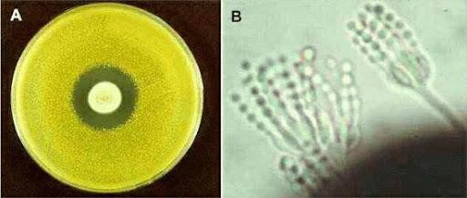
Antibiotics:
Antibiotics have become a standard method used by physicians to treat bacterial diseases.
The first antibiotic, penicillin, was discovered by Alexander Fleming. It is produced by the fungus Penicillium species.
Since the discovery of penicillin, many other effective antibiotics have been developed.
When a disease-causing bacterium is isolated from a patient, the physician must determine the most suitable antibiotic to administer for treatment.

Slide 4
Kirby- Bauer Method
(Disc Diffusion Method)
Purpose:
This test is designed to determine the susceptibility (sensitivity) or resistance of pathogenic aerobic and facultative anaerobic bacteria to various antimicrobial agents.
It is a critical step in monitoring antimicrobial resistance and helps guide clinicians in selecting the most appropriate antimicrobial treatment.

Slide 5
Kirby- Bauer Method
(Disc Diffusion Method)
Test standardization
All aspects of the Kirby–Bauer procedure are standardized to ensure consistent and accurate results.
Thus, laboratories must adhere to these standards.
Mueller–Hinton agar is the best medium to use for routine susceptibility testing of non-fastidious bacteria
The pH level of the media must be between 7.2 and 7.4.
Bacterial inoculum must be fresh (overnight culture), and pure.
Bacterial inoculum is prepared by diluting a broth culture to match a 0.5 McFarland standard which is equivalent to approximately 150 million cells per mL
Disc Diffusion (Kirby-Bauer) Antimicrobial Susceptibility Testing (youtube.com)
1.42 (how to prepare bacterial inoculum = 0.5 McFarland turbidity )
Click here

Slide 6
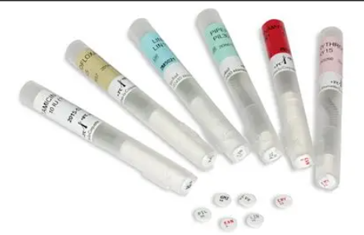
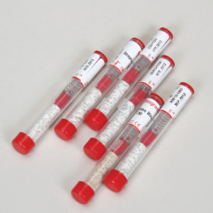
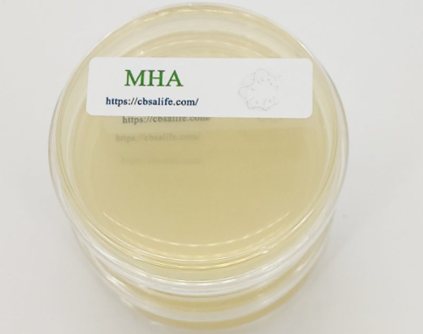
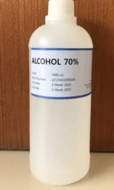

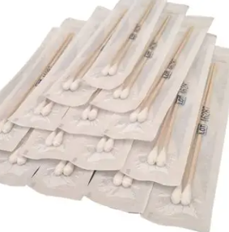
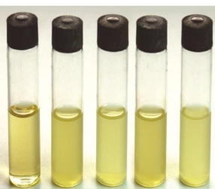
Procedure
Materials Required
Mueller- Hinton agar
Antibiotic discs
Cotton swabs
Inoculum (0.5 McFarland Turbidity)
Forceps/70% alcohol
Metric ruler or caliper

Slide 7
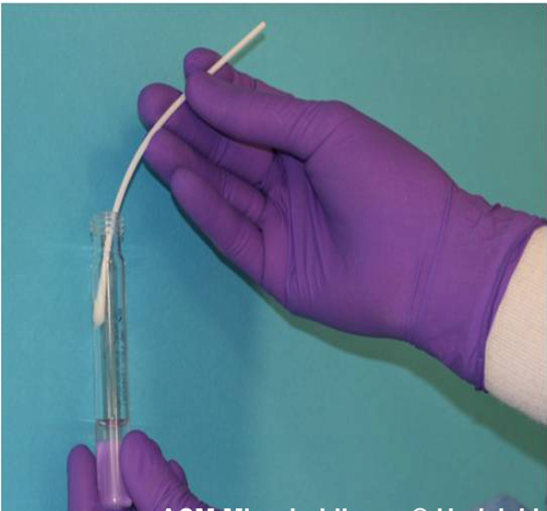
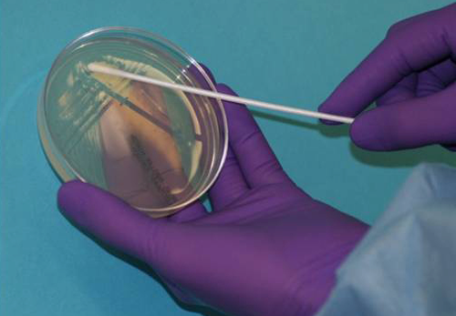
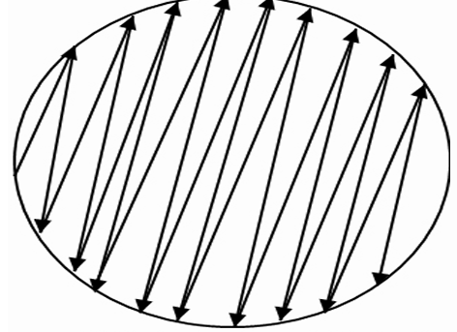
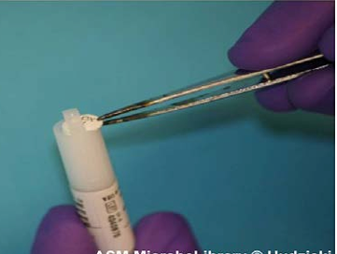
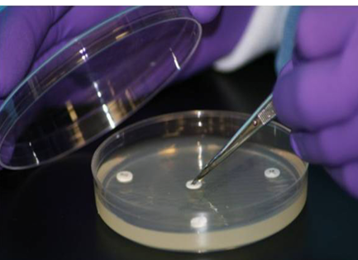
Procedure
Sterilize the area with disinfectant and open burner before performing the test.
A sterile cotton swab is dipped into the inoculum and remove excess medium by pressing the swab onto the wall of the tube.
Swab the entire surface of the plate by rotating it. This technique is called lawn culture or carpet culture
4.Sterilize the forceps with alcohol before picking up antibiotic discs.
Discs should be placed at a distance of 24mm.
5.Lightly touch each disc with forceps to ensure that it is in good contact to avoid misplacement.
6.Incubate the plate upside down for 24 hours at 37ºC.
1
2
3
4
Disc Diffusion (Kirby-Bauer) Antimicrobial Susceptibility Testing (youtube.com)
2.38 (procedure)
Click here

Slide 8
Disk placement
Disks should not be placed closer than 2.4 cm (center to center) on the MH agar plate.
No more than 5 disks on a 100-mm plate.
You should avoid placing disks close to the edge of the plate as the zones will not be fully round and can be difficult to measure.
Each disk must be pressed down with forceps to ensure complete contact with the agar surface or irregular zone shapes may occur.

Slide 9
1 2
3 4
Notes:
3

Slide 10
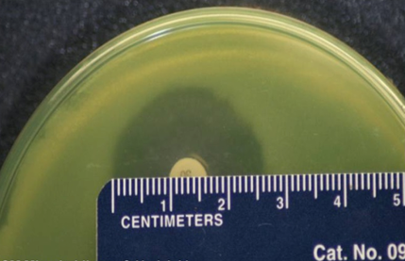
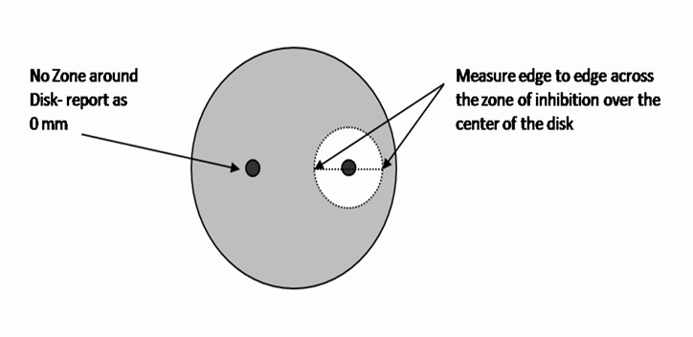
Result and Interpretation of Kirby Bauer Disc Diffusion Method
After 18-24 hours of incubation, use a metric ruler to measure the zone of inhibition and include the diameter of the disc in the measurement.
Record the zone size
NOTE: If the placement of the disk or the size of the zone does not allow you to read the diameter of the zone, measure from the center of the disk to a point on the circumference of the zone where a distinct edge is present (the radius) and multiply the measurement by 2 to determine the diameter
Compare the result with the Clinical and Laboratory Standards Institute (CLSI)
guidelines to report the result.
The results are reported as Susceptible (S), Intermediate (I), or Resistant (R).

Slide 11
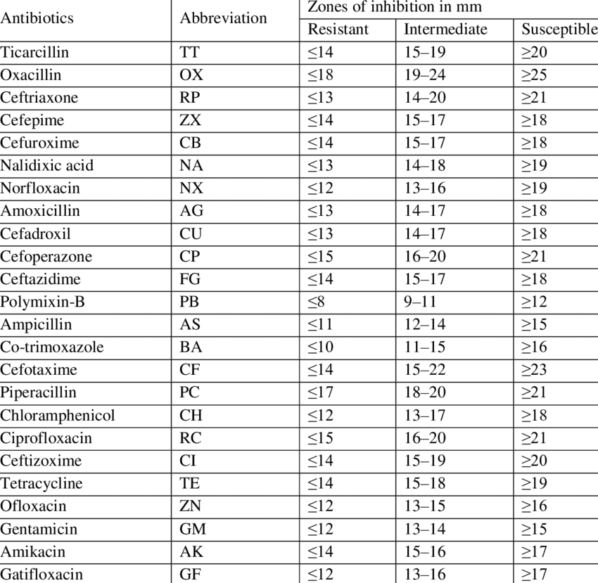
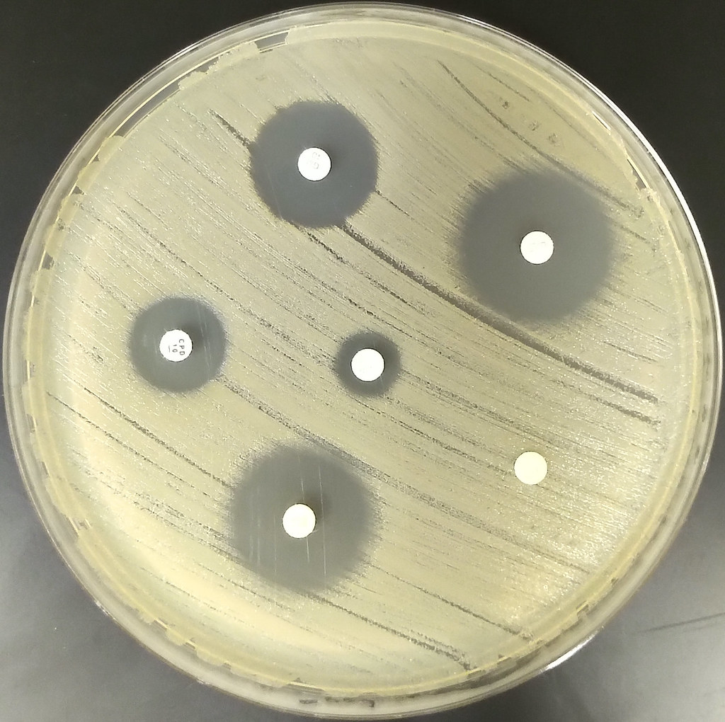
Susceptible
Resistant
Kirby-Bauer-Interpretation-chart
There are different charts for different organisms.

Slide 12
Streptomycin
Ampicillin
Penicillin
This Bacteria is Susceptible to Streptomycin
Less Susceptible to Ampicillin and resistant to Penicillin

Slide 13
Microbial enzymatic activity

Slide 14
Microbial enzymatic activity
The biochemical transformations that occur both inside and outside bacterial cells are controlled by biological catalysts called enzymes.
Kinds of bacterial enzymatic reactions:
1.Hydrolysis of starch into maltose and glucose (ex: amylase)
2.The breakdown of toxic wastes such as hydrogen peroxide (H2O2) or urea (ex: catalase)
3.Hydrolysis of protein (casein) to amino acids (ex: proteases)
4.The reduction of nitrate or oxygen (ex: nitrate reductase).
5.The degradation of specific amino acids (ex: tryptophanase).

Slide 15
Amylase production test /Starch hydrolysis test
Objectives of Starch Hydrolysis Test
To determine the ability of bacteria to produce amylase enzyme
To determine the ability of bacteria to hydrolyze starch
To differentiate and identify bacteria based on their ability to hydrolyze starch:
*** It is commonly used to differentiate species of Bacillus, Clostridium, Streptococcus, Enterococcus, and Pseudomonas genus.

Slide 16
Amylase production test /Starch hydrolysis test
Amylase is an exoenzyme that hydrolyses starch.
Starch consist of long chain of glucose molecules linked by glycosidic bonds.
Amylase breaks the glycosidic bonds, producing small oligosaccharides and free glucose.
Principle :
Starch agar is commonly used for the detection of starch hydrolysis
Normally, when iodine is added to the starch medium, it turns dark blue in the presence of starch.
Bacteria that produce amylase can break down starch into smaller sugars like glucose and maltose.
If the bacteria produce amylase, the starch around the colonies is hydrolyzed. No blue color appears, forming a clear zone, which indicates positive amylase activity.
If the bacteria do not produce amylase, the starch remains intact. A dark blue color appears around the colonies, indicating negative amylase activity.

Slide 17
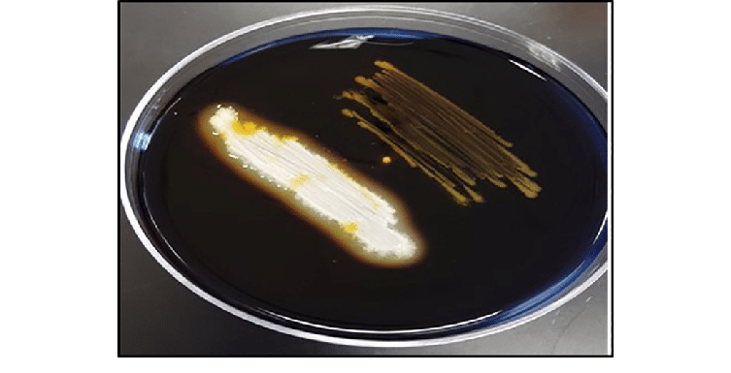
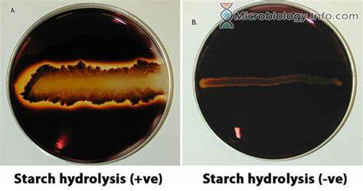
Amylase production test /Starch hydrolysis test
Procedure
1.Streak each organism across a small portion of the starch agar surface.
2.Incubate at 37 o C for 48 hours ( as testing earlier may give a false negative result)
3.Cover the surface with iodine. Rotate to distribute the iodine into a thin layer.
4.Iodine will turn dark blue when it reacts with starch.
5.A clear zone will be seen where starch has been digested.
Positive: Bacillus subtilits
Negative: E.coli
Notes:
Star

Slide 18
Catalase Activity
Catalase is an enzyme that plays a crucial role in protecting bacteria from oxidative stress by
breaking down the harmful hydrogen peroxide (H₂O₂) into water (H₂O) and oxygen O₂
**Importance in Microbiology
Catalase activity is very useful in differentiating between groups of bacteria.
***For example, the morphologically similar Enterococcus (catalase negative) and Staphylococcus (catalase positive) can be differentiated using the catalase test.

Slide 19
Catalase Activity
Procedure
Slide Catalase Test
Transfer a small amount of bacterial colony to a surface of a clean, dry glass slide.
NOTE:
Culture should be 18 to 24 hours old
Hydrogen peroxide must be fresh as it is very unstable
Place a drop of 3% H₂O₂ onto the slide and mix.
Result:
Catalase positive reaction: Catalase-positive reaction is indicated by immediate bubble formation (O₂)
Catalase negative reaction: No bubble formation

Slide 20
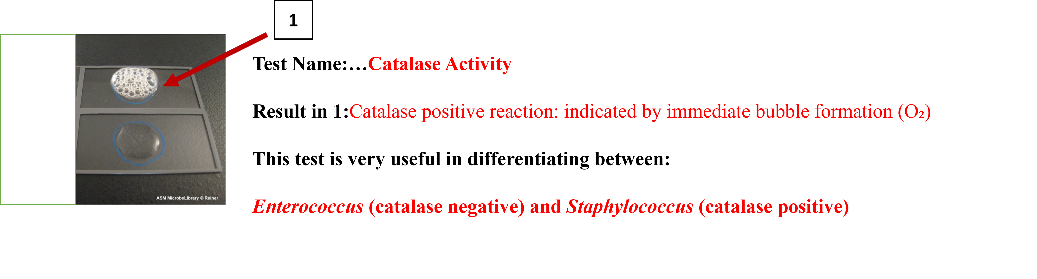
1
Test Name:…Catalase Activity
Result in 1:Catalase positive reaction: indicated by immediate bubble formation (O₂)
This test is very useful in differentiating between:
Enterococcus (catalase negative) and Staphylococcus (catalase positive)
Notes:
2

Slide 21
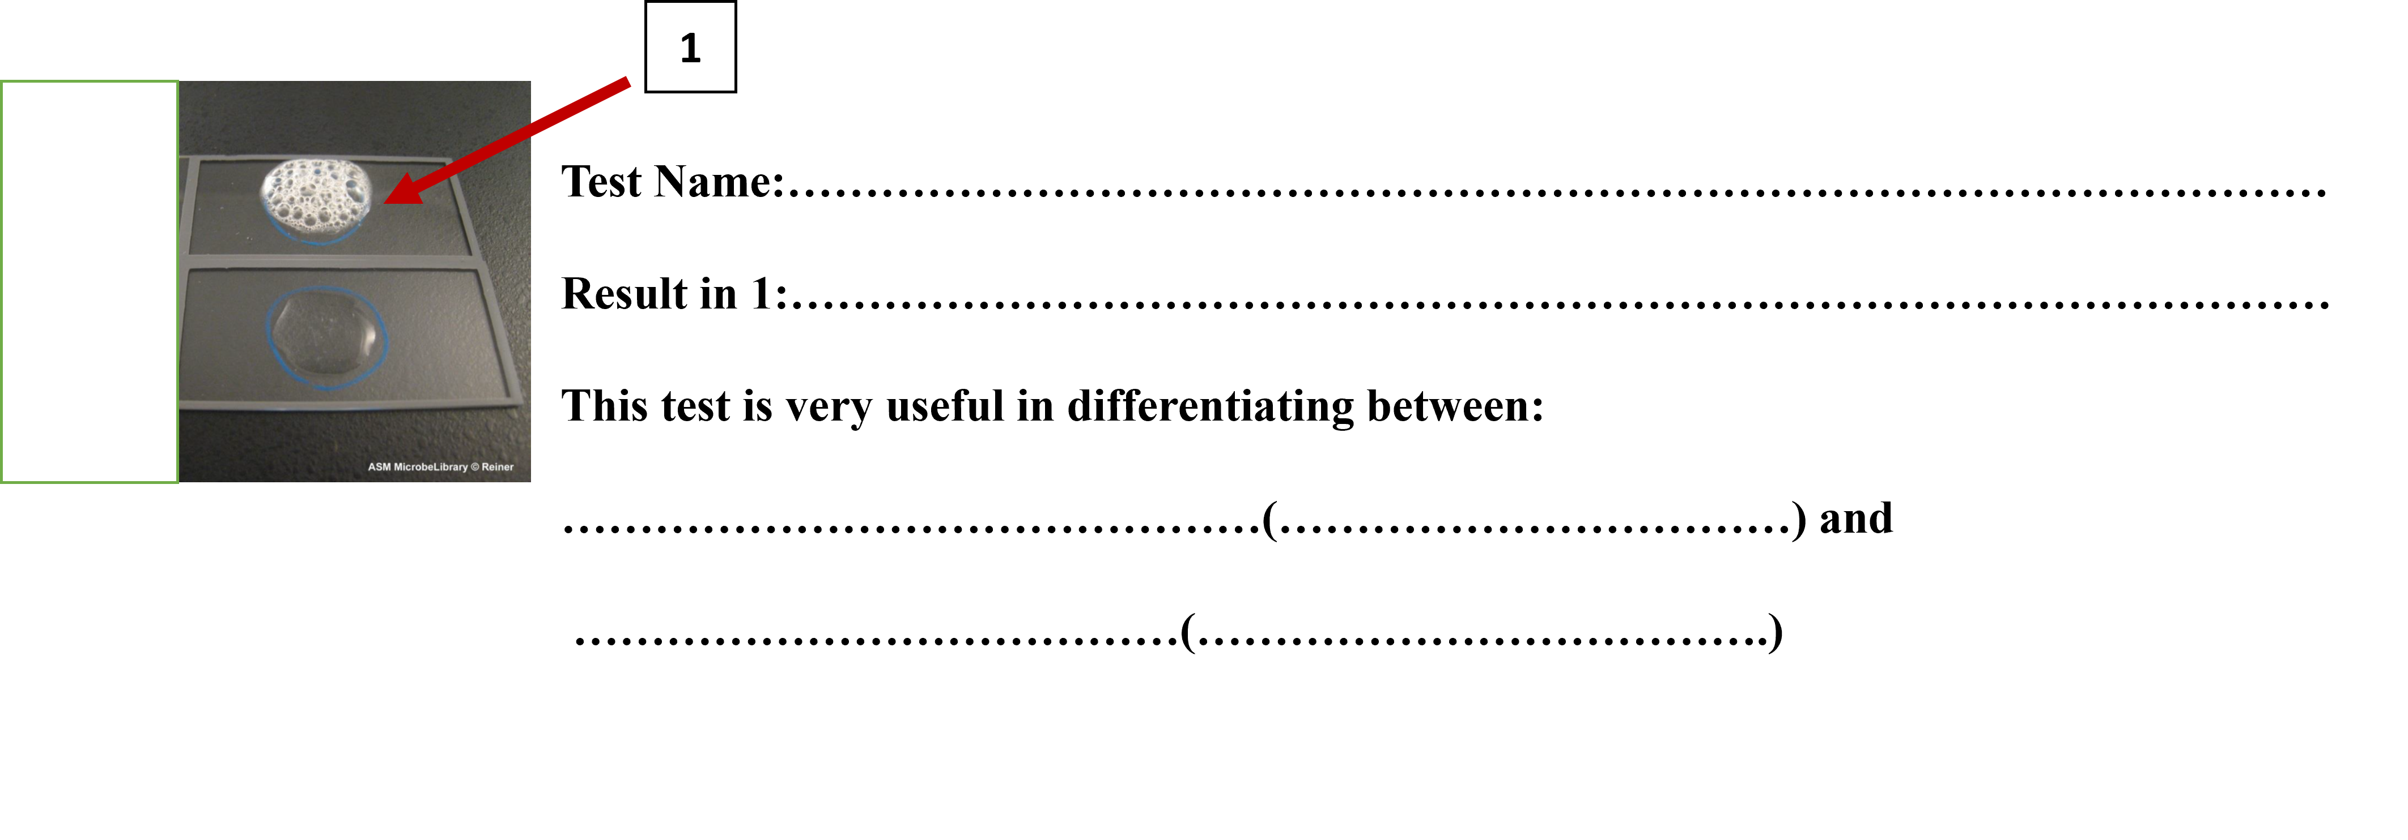

Slide 22
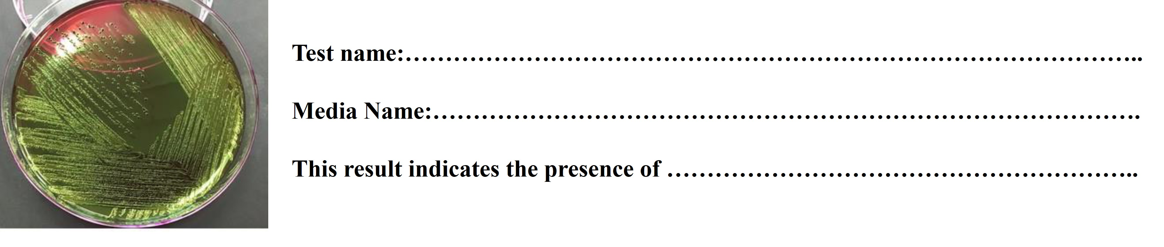
Test name: Most Probable Number (MPN) Test (Completed Test)
Media Name: Eosin Methylene Blue agar
This result indicates the presence of Coliform Bacteria

