Slide 1
Genetics Engineering (Zoo-455)
Principle and steps involved in CDS cloning of a gene
Lecture-6

Slide 2
Principle of CDS cloning:
Primers design for cloning (Refer to Lecture 2).
Isolation of mRNA (Refer to Lecture 5)
Synthesis of cDNA (Refer to Lecture 5).
PCR Amplification (Refer to Lecture 5).
Loading of PCR product onto agarose gel electrophoresis (Refer to Lecture 5).
Digestion of PCR insert by restriction enzyme (Refer to Lecture 3).
Digestion of vector with the same restriction enzyme used in PCR insert.
Calculation the insert and vector molar ratio for ligation.
Ligation of digested PCR insert and vector
Transformation of recombination vector into competent E. coli cells.
PCR colony screening.
Purification and digestion of recombinant vector from E. coli
Confirming the orientation and DNA sequencing of insert.

Slide 3
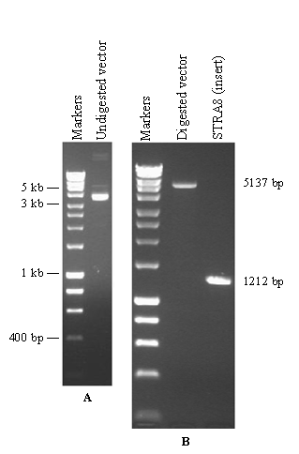
Digestion of PCR insert and vector with XhoI restriction enzyme
Figure. Amplification of STRA8 CDS from the testis cDNA. Agarose gel picture showing undigested (panel (A)). Panel (B) (right) shows the vector after digestion by XhoI restriction enzyme and purification. The enzyme linearizes the 5137 bp plasmid into one single fragment. The right side of gel B displays the amplification of the STAR8 CDS sequence from the testis cDNA. This band was digested with the same restriction enzyme, XhoI, and then underwent purification.

Slide 4
Calculation the insert and vector molar ratio for ligation
The amount of insert and vector needed was calculated using the following formula:
The amount of insert = Amount of vector in ng × Length of insert in bp × molar ratio / length of vector in bp
For example:
If the concentration of vector = 20 ng/μL, and volume = 50 μL. Calculate the amount of vector !!.
For typical cloning, 50 ng of the vector is recommended.
If the concentration of insert = 10 ng/μL
Length of insert (STRA8) = 1212 bp
Length of vector (pcDNA5/FRT/TO) = 5137 bp
For insert of similar size to the vector, a 1:1 molar ratio of insert to vector is recommended.
If the insert is smaller than the vector, a 3:1 molar ratio of insert to vector is recommended
The amount of insert = 50 × 1212 × 3/5137 = 35 ng
35 ng of insert = 35 × 1/10 = 3.5 μL

Slide 5
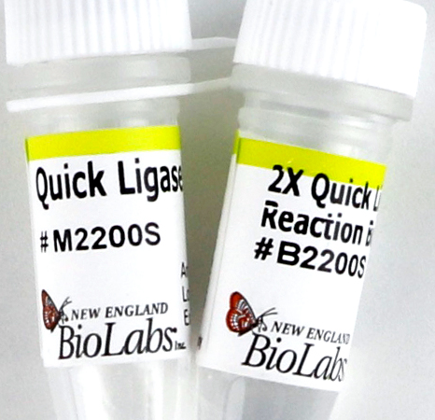
Ligation of digested PCR insert and vector
Ligation reaction:
Add 3.5 μL of insert
Add 2.5 μL of vector
Add 4 μL of nuclease-free water
Add 10 μL of 2x quick ligation buffer and mix
Add 1 μL of quick T4 DNA ligase and mix thoroughly
Centrifuge briefly and incubate at RT (25°C) for 5 min
Chill on ice for 1 min and then transform or store at -20°C
T4 DNA Ligase:
Derived from the T4 bacteriophage representing the most commonly used ligases in cloning protocol.
Formation of a phosphodiester bond between 5'-phosphate and 3'-hydroxyl.

Slide 6
Features and types of the host cells for cloning vectors:
Ideal host cells should be:
Capable of rapid growth in inexpensive medium
Nonpathogenic
Capable of incorporating DNA
Genetically stable in culture
Equipped with appropriate enzymes to allow replication of the vector
Escherichia coli, Bacillus subtilis, Saccharomyces cerevisiae
E. coli is one of the most commonly used hosts in gene cloning.

Slide 7
Transformation of recombination vector into competent E. coli cells
Inserting a gene into a vector is an important first step in the gene cloning process.
If the ultimate goal is to produce a large amount of a particular protein, the vector must replicate to make sure that there are many copies of the gene to produce the encoded protein.
A process of inserting recombinant vector into E. coli bacteria is called transformation.
E. coli bacteria have complex plasma membranes that separate the external environment from the internal environment of the cell and carefully regulate which substances can enter and exit the cell.
In addition, the cell wall is negatively charged and repels negatively charged DNA molecules.
Competent E. coli cells can be made by treating the bacteria with a calcium solution.
Calcium ions are positively charged, and will neutralize the negatively charged outer membrane on the E. coli bacteria.
With the positive charge now coating the membrane, the negatively charged DNA molecules will move through the plasma membranes and into the cell.

Slide 8
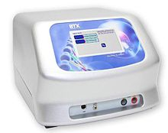
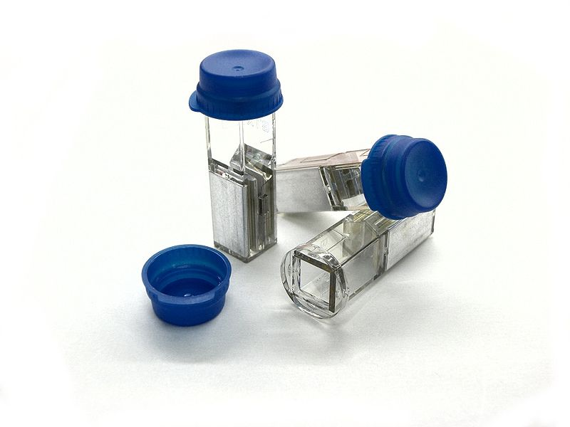
Methods of Transformations:
Electroporation: The use of high-voltage electric shock to create tiny holes in the bacteria cell wall that allow recombinant DNA to eneter.
Chemical transformation:
Treat bacterial cells with calcium chloride
The use of heating shock to introduce recombinant DNA into E. coli cells (Put the cells on ice, follow by heating shock at 42°C and then place the cells on ice.

Slide 9
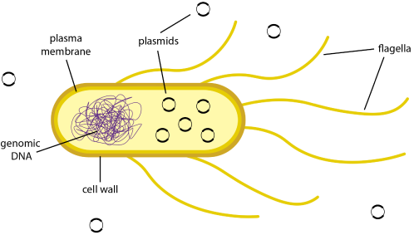
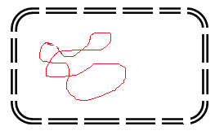
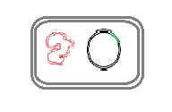
Calcium chloride treatment:
To permeabilize the bacterial cell membrane
Figure. Bacterial transformation.
Transformed bacteria

Slide 10
Types of selection methods of recombinant bacteria after transformation:
Selection is a process designed to facilitate the identification of recombinant bacteria while preventing the growth of non-transformed bacteria and bacteria that contain plasmid without foreign DNA.
Antibiotic selection: plate transformed cells on Petri dishes plates containing a specific antibiotic to identify recombinant bacteria and non-transformed bacteria.
Blue-white selection:
The lacZ gene activity results in the production of β-galactoisdase enzyme that metabolizes the lactose.
DNA insert is cloned into the restriction site in the lacZ gene of the vector.
The lacZ gene is disrupted by the insertion of foreign DNA and cannot produce β-galactosidase.
When X-gal (artificial lactose) is added to the plate, if functional lacZ is present = blue colony
The β-galactosidase enzyme can break down the X-gal into galactose and an insoluble blue pigment.
Non-functional lacZ= white colony = clone = genetically identical bacterial cells each containing copies of recombinant plasmid.
The presence of lactose in the surrounding environment triggers the lacZ gene in E. coli.

Slide 11
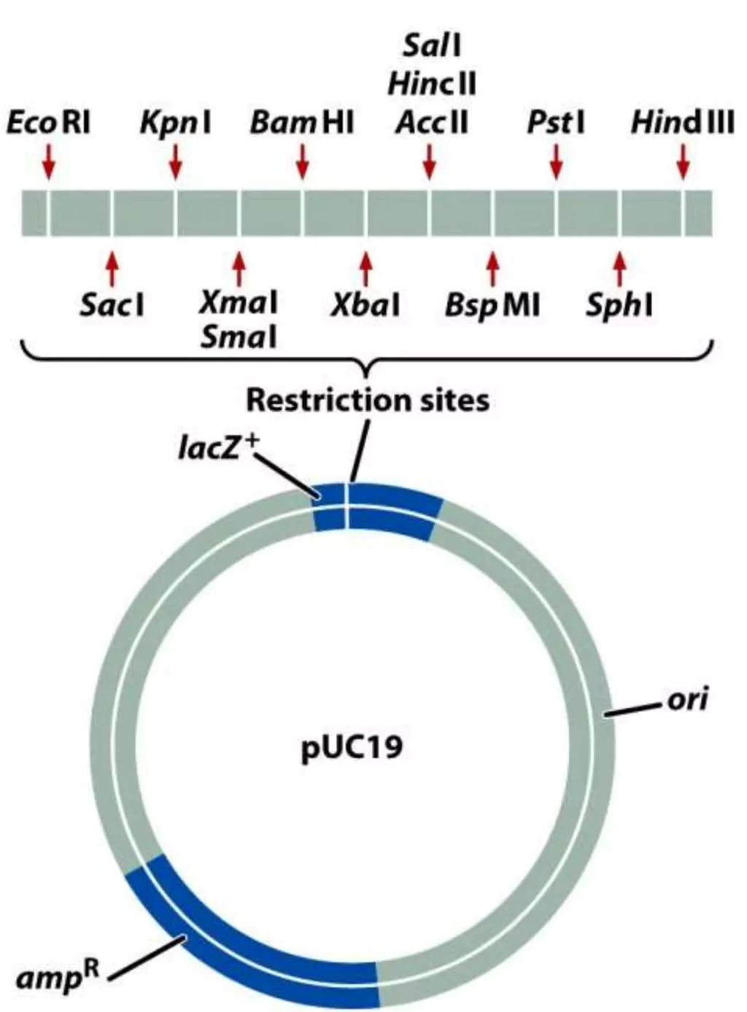
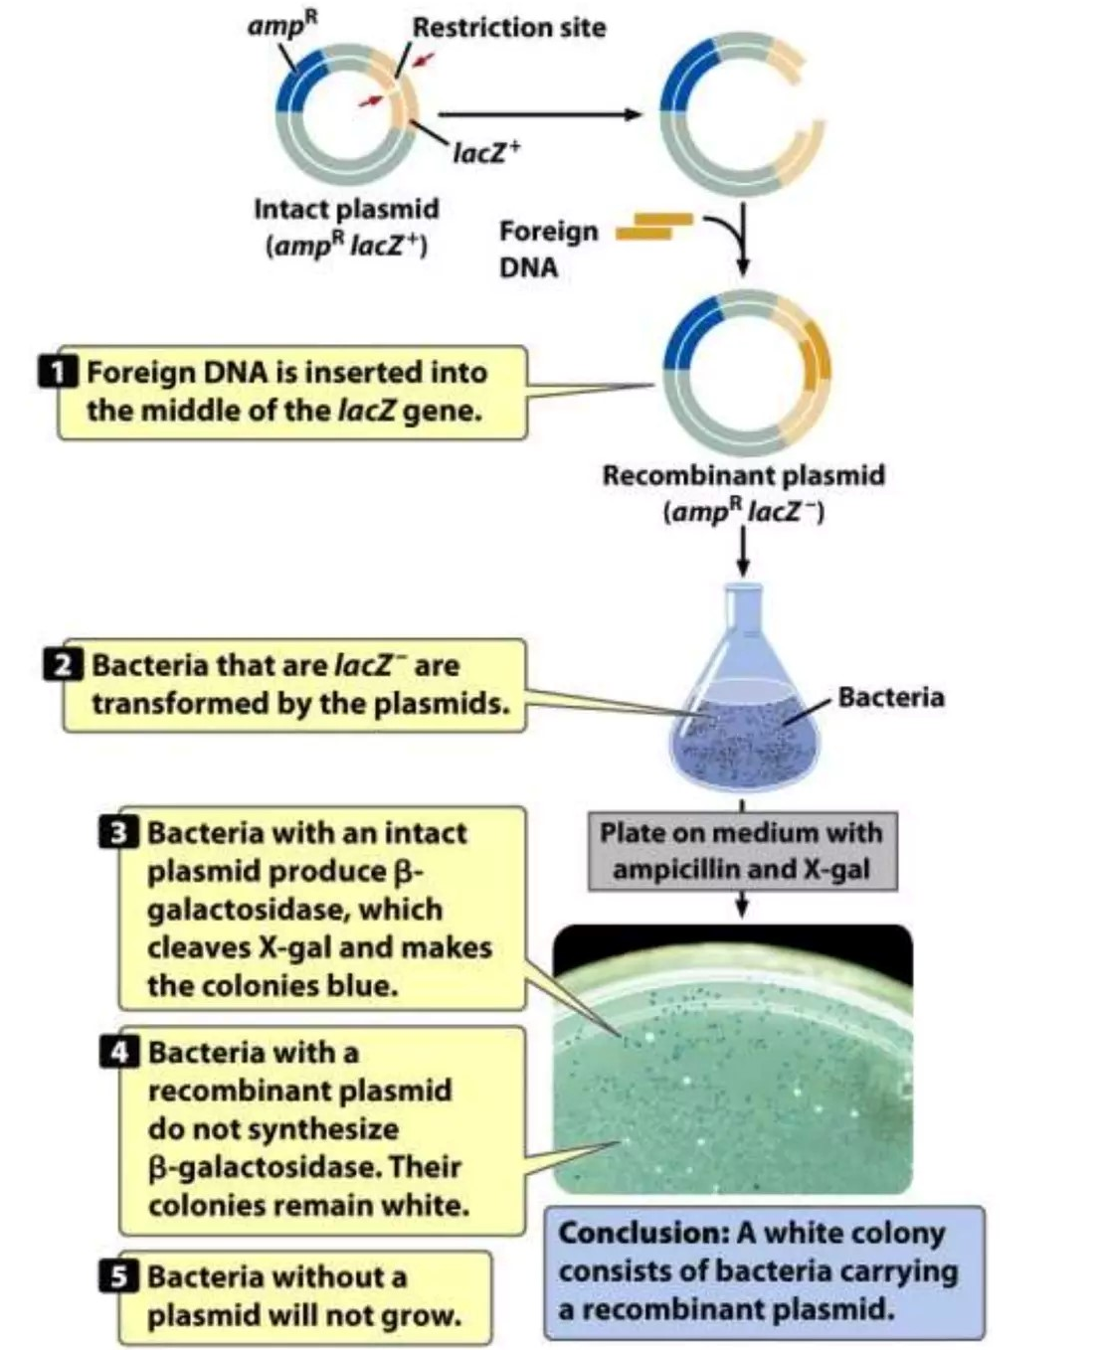
Blue colonies (β-galactosidase
active)
White colonies (β-galactosidase
inactive)

Slide 12
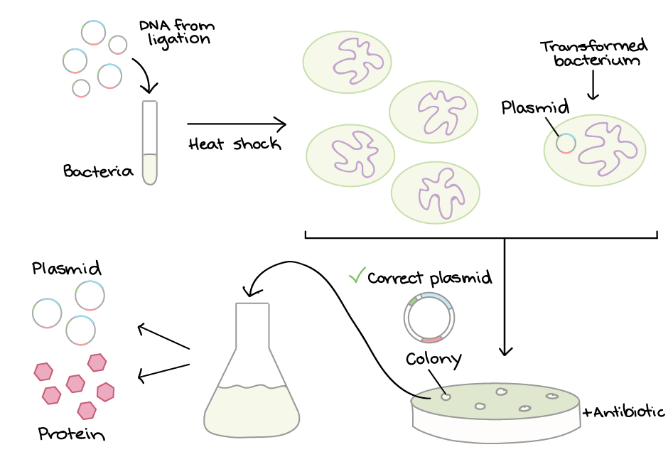
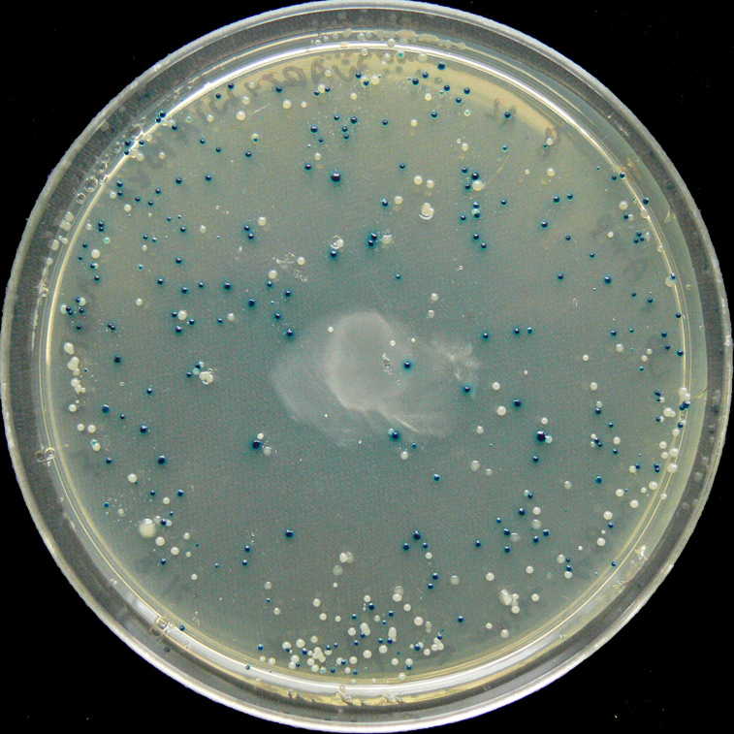
Steps of bacterial transformation and selection:

Slide 13
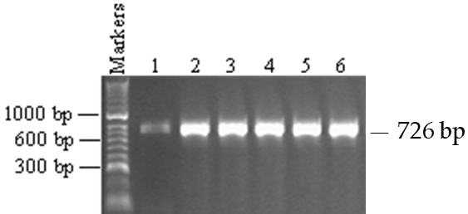
PCR colony screening:
One colony was picked from the overnight plates by using a micropipette tip and rinsing it into a new Eppendorf tube containing medium with antibiotic (ampicillin).
PCR screening is directly carried out.
Figure. PCR screening of colonies for the cloning of STRA8. Agarose gel picture showing PCR screening of E. coli colonies for the cloning of STRA8 into vector using an internal primer for the STAR8 gene. The results show that all the 6 samples contain a STRA8 insert of the expected size, 726 bp.

Slide 14
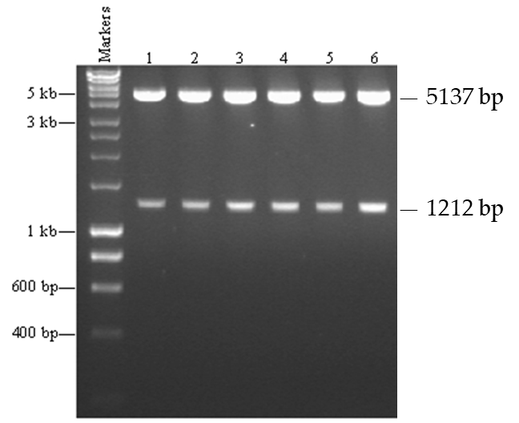
Purification and digestion of recombinant vector from E. coli:
Vector
Insert
Confirming the orientation of insert
Confirming the DNA sequencing of insert
Figure. Digestion of recombinant vectors. Agarose gel picture showing the digestion of the recombinant purified vectors by the XhoI restriction enzyme.
Two bands are formed for all the recombinants. The upper bands show a vector of 5137 bp, while the lower bands show the full open reading frame of the STRA8 gene of 1209 bp in size. All the samples in lanes 1-6 show successful cloning of STRA8 CDS.

Slide 15
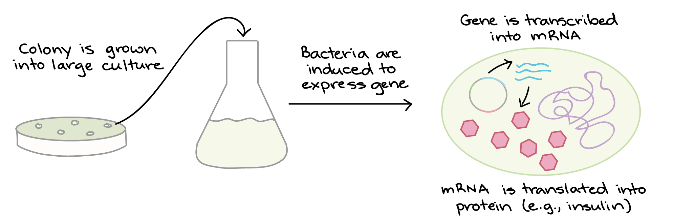
Protein production:
Once we have found a bacterial colony with the right vector, we can grow a large culture of bacteria. Then, we give the bacteria a chemical signal that instructs them to make the target protein.
The bacteria serve as factories to produce large amounts of protein. For instance, if our vector contained the human insulin gene, the bacteria would start transcribing the gene and translating the mRNA to produce many molecules of human insulin protein.
The target protein must be purified, or separated from the other contents of the cells by biochemical techniques.

Slide 16

Questions?

