Slide 1
EE 202 Electric Circuits
Lecture 5 (4-September)
First Semester 2023-2024
Dr. Anmar Arif

Slide 2
CH6: Operational Amplifiers 2
Slides prepared by Dr. Faris Alfaris (falfaris@ksu.edu.sa)

Slide 3
Op Amp example (1):
1

Slide 4
Op Amp example (1):
$$KVL for loop1 and lopp2:$$
$$2−20k i_{1}−40k \left(i_{1}+i_{2}\right)=0$$
$$(1)$$
$$−5−40k i_{2}−40k \left(i_{1}+i_{2}\right)=0$$
$$(2)$$
$$V_{2}$$
$$I_{1}$$
$$V_{1}$$
$$loop1$$
$$I=0$$
$$I_{2}$$
$$loop2$$
The output current wont enter the loops because there is no way to go back to node b. Therefore, it goes to the ground and return to node b through the ground of the Amp supply.
1

Slide 5
Op Amp example (1):
$$KVL for loop1 and lopp2:$$
$$2−20k i_{1}−40k \left(i_{1}+i_{2}\right)=0$$
$$(1)$$
$$−5−40k i_{2}−40k \left(i_{1}+i_{2}\right)=0$$
$$(2)$$
$$V_{2}$$
$$By solving the above eqs. we get:$$
$$I_{1}$$
$$V_{1}$$
$$loop1$$
$$→ I_{1}=0.1125 mA and I_{2}=−0.11875 mA$$
$$I=0$$
$$I_{2}$$
$$loop2$$
The output current wont enter the loops because there is no way to go back to node b. Therefore, it goes to the ground and return to node b through the ground of the Amp supply.
1

Slide 6
Op Amp example (1):
$$KVL for loop1 and lopp2:$$
$$2−20k i_{1}−40k \left(i_{1}+i_{2}\right)=0$$
$$(1)$$
$$−5−40k i_{2}−40k \left(i_{1}+i_{2}\right)=0$$
$$(2)$$
$$V_{2}$$
$$By solving the above eqs. we get:$$
$$I_{1}$$
$$V_{1}$$
$$loop1$$
$$→ I_{1}=0.1125 mA and I_{2}=−0.11875 mA$$
$$I=0$$
$$V_{a}=2v$$
$$I_{2}$$
$$V_{b}=2v−20k \left(0.1125mA\right)=−0.25$$
$$loop2$$
$$V_{1}=V_{2}=V_{b}=−0.25v$$
$$V_{c}=−5v$$
$$V_{e}=V_{1}=−0.25v$$
The output current wont enter the loops because there is no way to go back to node b. Therefore, it goes to the ground and return to node b through the ground of the Amp supply.
$$V_{d}=V_{e}+9k\left(\frac{V_{e}}{1k}\right)=−2.5v$$
1

Slide 7
Op Amp example (2):
2

Slide 8
Op Amp example (2):
$$always: V_{1}=V_{2} and i_{1}=i_{2}=0$$
From the above conditions:
$$→ V_{2b}=5.8v=V_{1b}$$
$$V_{2a}$$
$$→ V_{2a}=5.8v+2v=7.8v=V_{1a}$$
Note that voltages drop on ALL 6Ω is zero because the current through them =0
$$i=0$$
$$i=0$$
$$V_{1a}$$
$$V_{y}=V_{1a}=7.8v and { V}_{x}=V_{1b}=5.8v$$
$$V_{y}$$
$$V_{x}$$
$$i=0$$
$$V_{1b}$$
$$i=0$$
$$V_{2b}$$
2

Slide 9
Op Amp example (2):
$$always: V_{1}=V_{2} and i_{1}=i_{2}=0$$
From the above conditions:
$$→ V_{2b}=5.8v=V_{1b}$$
$$V_{2a}$$
$$→ V_{2a}=5.8v+2v=7.8v=V_{1a}$$
Note that voltages drop on ALL 6Ω is zero because the current through them =0
$$i=0$$
$$i=0$$
$$V_{1a}$$
$$I_{A}$$
$$V_{y}=V_{1a}=7.8v and { V}_{x}=V_{1b}=5.8v$$
$$V_{y}$$
$$I_{B}=\frac{V_{y}−V_{x}}{4000}=\frac{7.8−5.8}{4000}=0.5 mA$$
$$I_{B}$$
$$V_{x}$$
$$I_{A}=I_{B}=I_{C}=0.5 mA$$
$$i=0$$
$$V_{1b}$$
$$I_{C}$$
Again, because all currents through ALL 6Ω =0
$$i=0$$
$$V_{2b}$$
2

Slide 10
Op Amp example (2):
$$always: V_{1}=V_{2} and i_{1}=i_{2}=0$$
From the above conditions:
$$→ V_{2b}=5.8v=V_{1b}$$
$$V_{2a}$$
$$→ V_{2a}=5.8v+2v=7.8v=V_{1a}$$
Note that voltages drop on ALL 6Ω is zero because the current through them =0
$$i=0$$
$$i=0$$
$$V_{1a}$$
$$I_{A}$$
$$V_{y}=V_{1a}=7.8v and { V}_{x}=V_{1b}=5.8v$$
$$+$$
$$V_{y}$$
$$I_{B}=\frac{V_{y}−V_{x}}{4000}=\frac{7.8−5.8}{4000}=0.5 mA$$
$$I_{B}$$
$$V_{out}$$
$$V_{x}$$
$$I_{A}=I_{B}=I_{C}=0.5 mA$$
$$i=0$$
$$V_{1b}$$
$$I_{C}$$
$$−$$
Again, because all currents through ALL 6Ω =0
$$i=0$$
$$V_{out}=I_{B} \left(8000+4000+8000\right)=10v$$
$$V_{2b}$$
$$I_{o}=\frac{10}{4000}=2.5 mA$$
2

Slide 11
Op Amp example (3):
3

Slide 12
Op Amp example (3):
$$V_{o}=−\frac{5}{3}V_{s}+5$$
3

Slide 13
Op Amp example (3):
$$V_{x}=V_{1a}=V_{2a}=\frac{20k}{20k+5k}V_{s}$$
$$V_{1a}$$
$$V_{x}$$
$$V_{2a}$$
$$V_{1b}$$
$$V_{2b}$$
$$V_{o}=−\frac{5}{3}V_{s}+5$$
3

Slide 14
Op Amp example (3):
$$V_{x}=V_{1a}=V_{2a}=\frac{20k}{20k+5k}V_{s}=\frac{20}{25} V_{s}$$
$$V_{1b}=V_{2b}=V_{b}$$
$$KCL at A: \frac{V_{x}−V_{b}}{30k}=\frac{V_{b}−V_{o}}{R_{4}}$$
$$V_{x}$$
$$A$$
$$V_{1a}$$
$$V_{2a}$$
$$V_{1b}$$
$$→ \frac{V_{o}}{R_{4}}={−V}_{x}\left(\frac{1}{30k}\right)+V_{b}\left(\frac{1}{30k}+\frac{1}{R_{4}}\right)$$
$$V_{2b}$$
$$→ V_{o}={−V}_{s}\left(\frac{20 R_{4}}{\left(25\right)30k}\right)+V_{b}\left(\frac{R_{4}}{30k}+1\right)$$
$$V_{o}=−\frac{5}{3}V_{s}+5$$
3

Slide 15
Op Amp example (3):
$$V_{x}=V_{1a}=V_{2a}=\frac{20k}{20k+5k}V_{s}=\frac{20}{25} V_{s}$$
$$V_{1b}=V_{2b}=V_{b}$$
$$KCL at A: \frac{V_{x}−V_{b}}{30k}=\frac{V_{b}−V_{o}}{R_{4}}$$
$$V_{x}$$
$$A$$
$$V_{1a}$$
$$V_{2a}$$
$$V_{1b}$$
$$→ \frac{V_{o}}{R_{4}}={−V}_{x}\left(\frac{1}{30k}\right)+V_{b}\left(\frac{1}{30k}+\frac{1}{R_{4}}\right)$$
$$V_{2b}$$
$$→ V_{o}={−V}_{s}\left(\frac{20 R_{4}}{\left(25\right)30k}\right)+V_{b}\left(\frac{R_{4}}{30k}+1\right)$$
$$→ {−V}_{s}\left(\frac{20 R_{4}}{\left(25\right)30k}\right)=−\frac{5}{3}V_{s} → R_{4}=62.5 kΩ$$
$$V_{o}=−\frac{5}{3}V_{s}+5$$
$$→ V_{b}\left(\frac{R_{4}}{30k}+1\right)=5 → V_{b}=1.62v$$
3

Slide 16
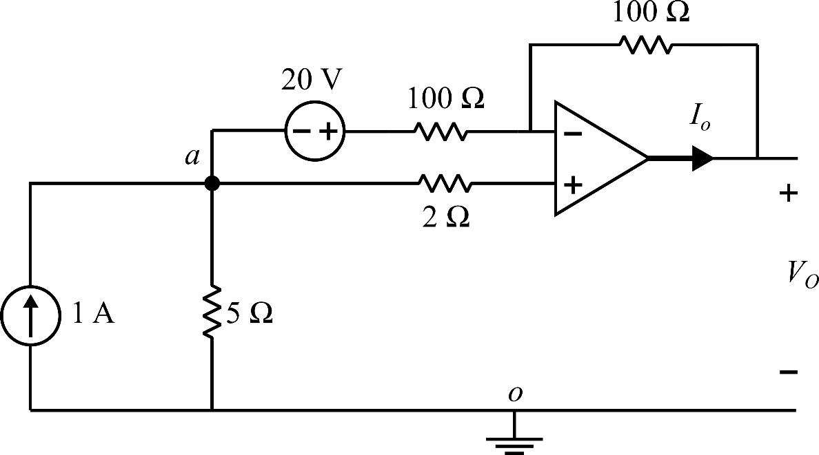
Op Amp example (4):
For the following circuit, find the output voltage and current.
4

Slide 17
Op Amp example (4):
For the following circuit, find the output voltage and current.
$$i_{y}$$
$$i_{y}$$
$$V_{2}$$
$$V_{1}$$
$$i=0$$
$$+$$
$$i_{x}$$
$$−$$
4

Slide 18
Op Amp example (4):
For the following circuit, find the output voltage and current.
$$V_{1}=V_{a}$$
$$i_{y}$$
$$V_{2}=V_{a}+20−100 i_{y}$$
$$i_{y}$$
$$V_{1}=V_{2}$$
$$→ V_{a}=V_{a}+20−100 i_{y}$$
$$V_{2}$$
$$→ i_{y}=\frac{20}{100}=0.2A$$
$$V_{1}$$
$$i=0$$
$$+$$
$$→ i_{x}=1−i_{y}=0.8 A$$
$$i_{x}$$
$$−$$
$$→ V_{a}=\left(5\right)\left(0.8\right)=4 v$$
4

Slide 19
Op Amp example (4):
For the following circuit, find the output voltage and current.
$$V_{1}=V_{a}$$
$$i_{y}$$
$$V_{2}=V_{a}+20−100 i_{y}$$
$$i_{y}$$
$$V_{1}=V_{2}$$
$$→ V_{a}=V_{a}+20−100 i_{y}$$
$$V_{2}$$
$$→ i_{y}=\frac{20}{100}=0.2A$$
$$V_{1}$$
$$i=0$$
$$+$$
$$→ i_{x}=1−i_{y}=0.8 A$$
$$i_{x}$$
$$−$$
$$→ V_{a}=\left(5\right)\left(0.8\right)=4 v$$
$$→ V_{o}=4−100 \left(0.2\right)=−16 v$$
$$→ i_{o}=− i_{y}=−0.2 A$$
4

