Slide 1
EE 201 CH 7: Series & Parallel Circuit Analysis Examples

Slide 3
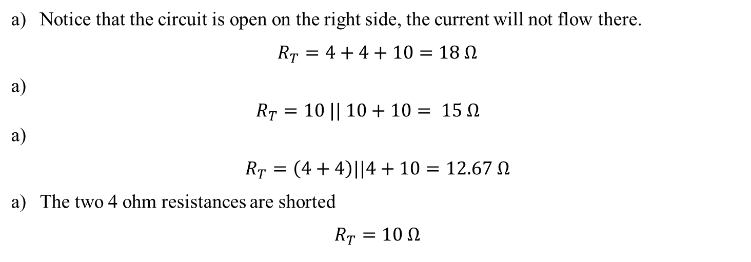
Notice that the circuit is open on the right side, the current will not flow there.
$$R_{T}=4+4+10=18 Ω$$
$$R_{T}=10 || 10+10= 15 Ω$$
$$R_{T}=\left(4+4\right)||4+10=12.67 Ω$$
The two 4 ohm resistances are shorted
$$R_{T}=10 Ω$$

Slide 4
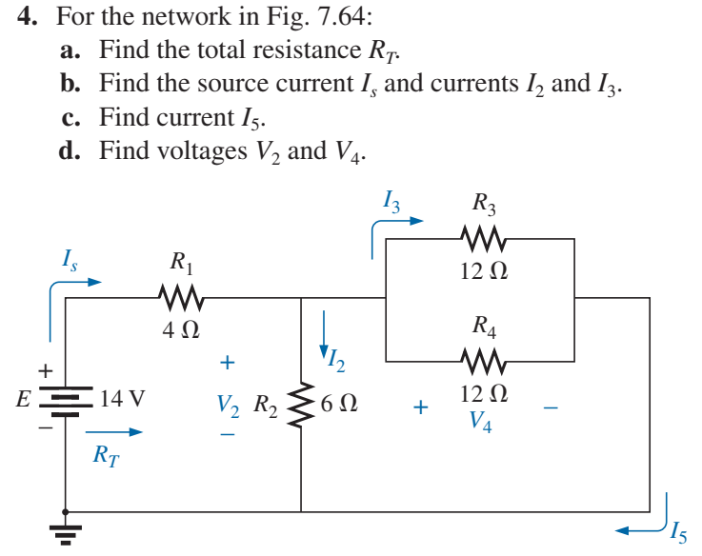

Slide 5
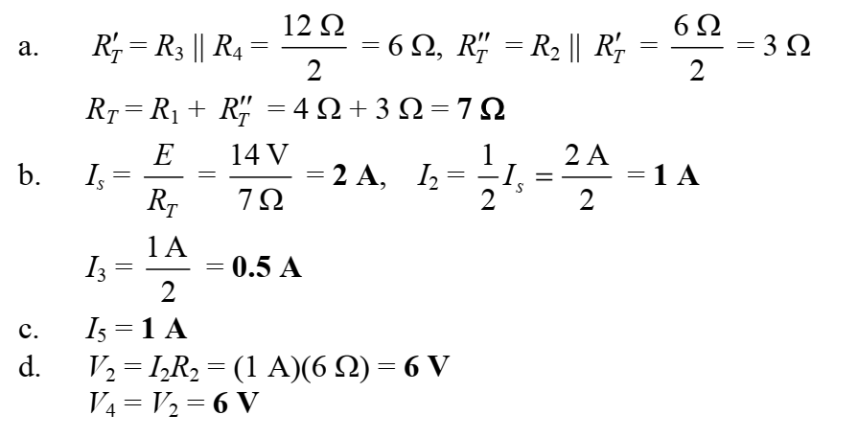

Slide 6
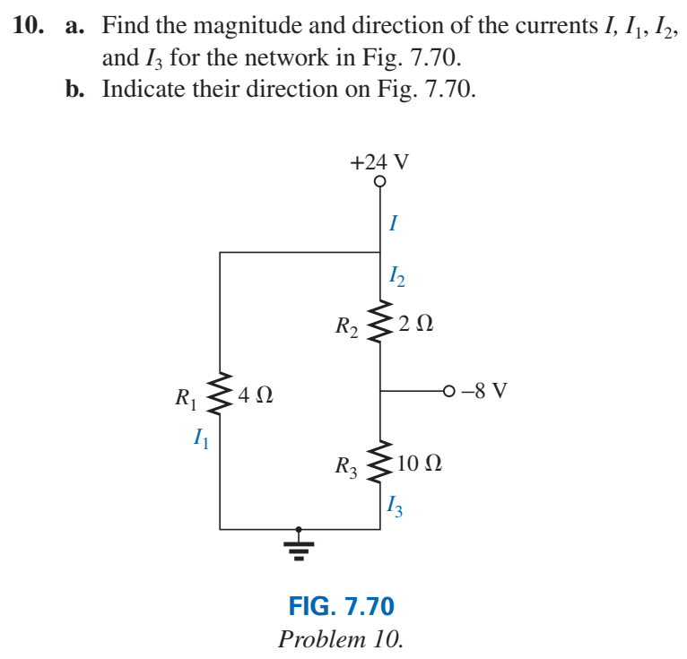

Slide 8
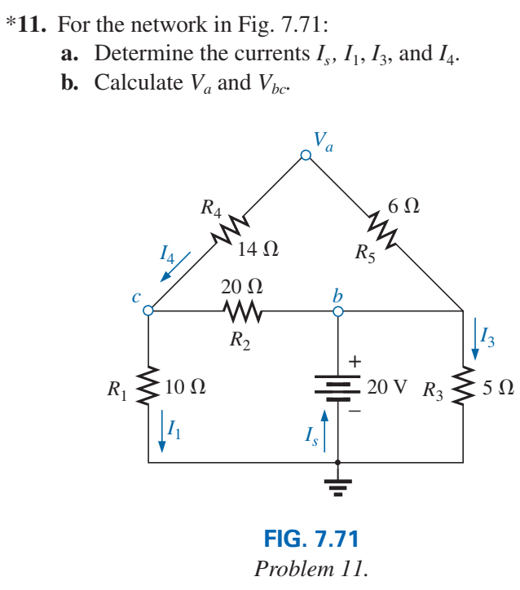

Slide 9
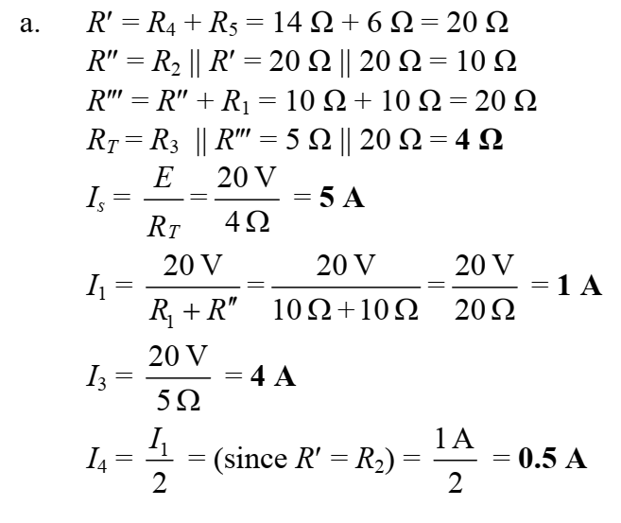

Slide 10
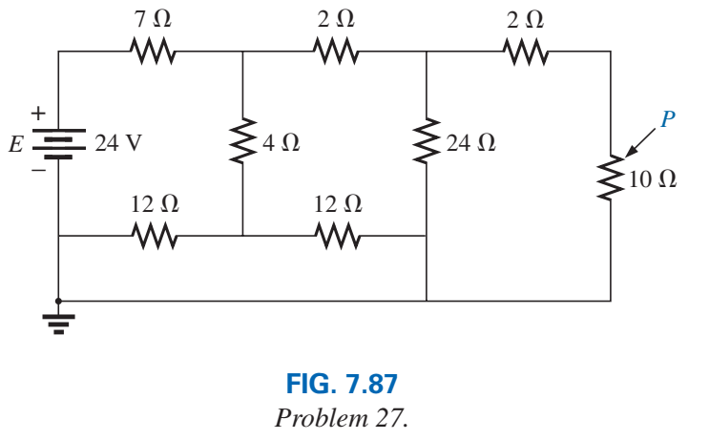

$$I_{s}=\frac{24}{12}=2 A$$
$$V_{7Ω}=14 V$$
$$V_{10Ω}=10 V$$
$$V_{8Ω}=10∗\frac{8}{10}=8 V$$
$$V=8∗\frac{10}{12}=\frac{20}{3}$$
$$P=\frac{\frac{{20}^{2}}{3^{2}}}{10}=4.44 W$$

