Slide 1
Genetics Engineering (Zoo-455)
DNA analysis methods
Lecture-5

Slide 2
Polymerase Chain Reaction (PCR) and PCR primer:
PCR or Polymerase Chain Reaction is a technique used in molecular biology to create several copies of a small segment of DNA.
This technique was discovered in 1983 by Kary Mullis, an American biochemist.
The DNA polymerase typically used in PCR is called Taq polymerase, which it was isolated (Thermus aquaticus).
PCR primers are short pieces of single-stranded DNA, usually around 20 nucleotides
Two primers are used in each PCR reaction (Refer to Lecture 2).
The primers bind to the template by complementary base pairing.

Slide 3
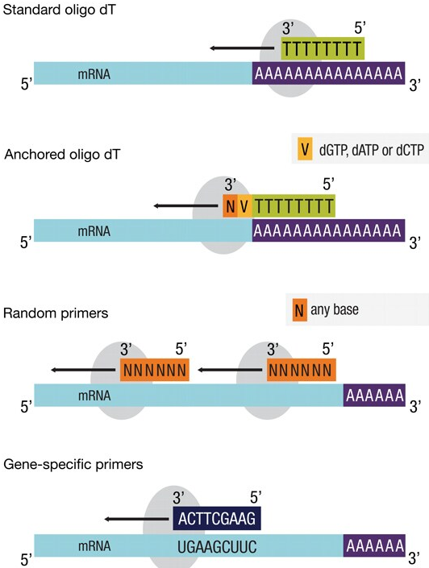
Reverse Transcription PCR (RT-PCR):
The mRNA is first converted to complementary DNA (cDNA) by reverse transcriptase enzyme.
Three different types of primers are used in RT-PCR:
Oligo (dT) Primers: They are oligonucleotides, mostly of 12 – 18 nucleotides, containing a segment of repeating deoxythymidine (dT) which binds at the polyA tail of mRNA.
Random Primers: These are the short single-stranded sequences of 6 to 8 nucleotides that bind at the complementary site of RNAs with or without poly(A) for cDNA synthesis using reverse transcriptase.
Specific Primers: These are the short single-stranded sequences of nucleotides that bind to the specific region of interest of the sample RNA.

Slide 4
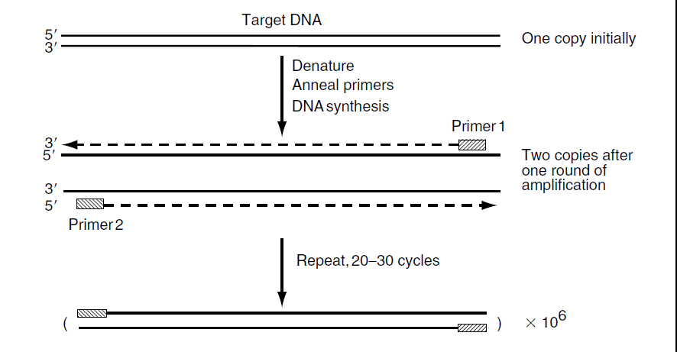
Components Of PCR:
DNA template: The DNA target sequence.
Taq DNA polymerase: Adds nucleotides complimentary to template strand at 3’-OH of the bound primers and synthesizes new strands of DNA complementary to the target sequence.
PCR Buffers.
Forward and Reverse Primers: Primers are synthetic DNA strands of nucleotides complementary to 3’ end of the template strand. The forward primer binds to the 3’ end of antisense strand (3’-5’; bottom strand) and the reverse primer binds to the 3’ end of sense strand (5’-3’; top strand ).
Nucleotides: Adenine (A), Guanine (G), Cytosine (C), Thymine (T).
Thermocycler (PCR Machine).
Top (Sense) strand
↓
↑
Bottom (Antisense) strand

Slide 5
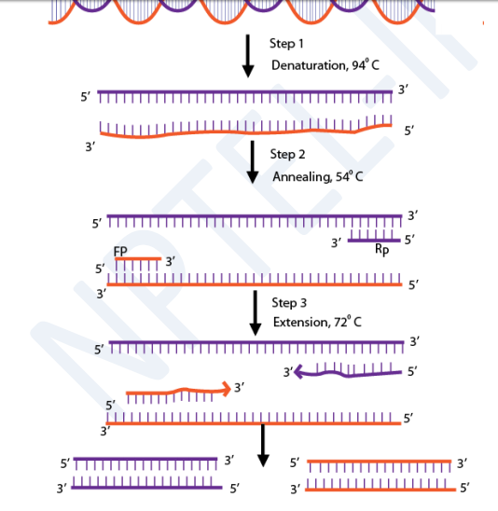
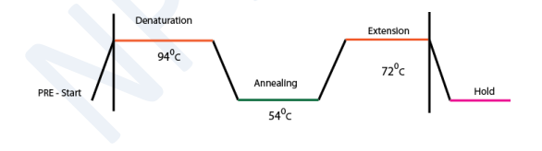
PCR steps: Involves three major cyclic reactions:
Denaturation step: Heat the reaction strongly to separate, or denature, the DNA double stranded. This breaks the hydrogen bonds between the two strands of DNA and converts it into a single-stranded DNA.
Annealing step: Cool the reaction temperature so the primers bind to their complementary sequences on the single-stranded template DNA
Extension step: Raise the reaction temperature so Taq polymerase extends the primers, synthesizing new strands of DNA. Taq DNA polymerase can add a nucleotide only onto a 3'-OH group.

Slide 6
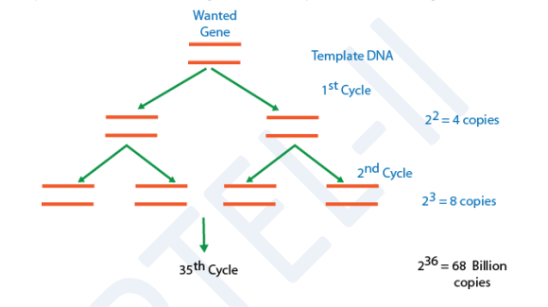
PCR-an exponential cycle:

Slide 7
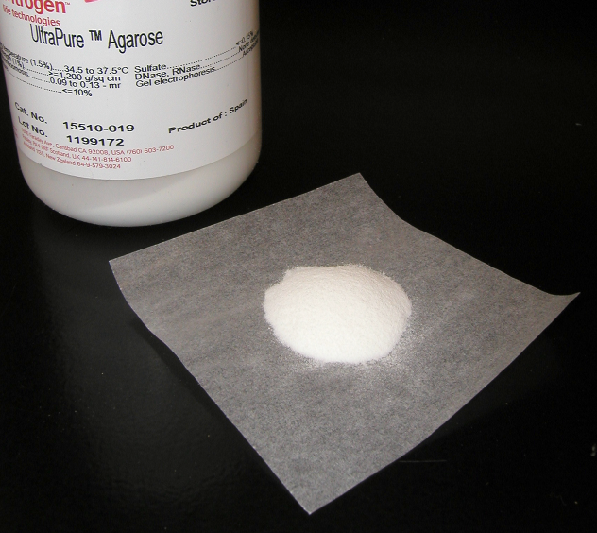
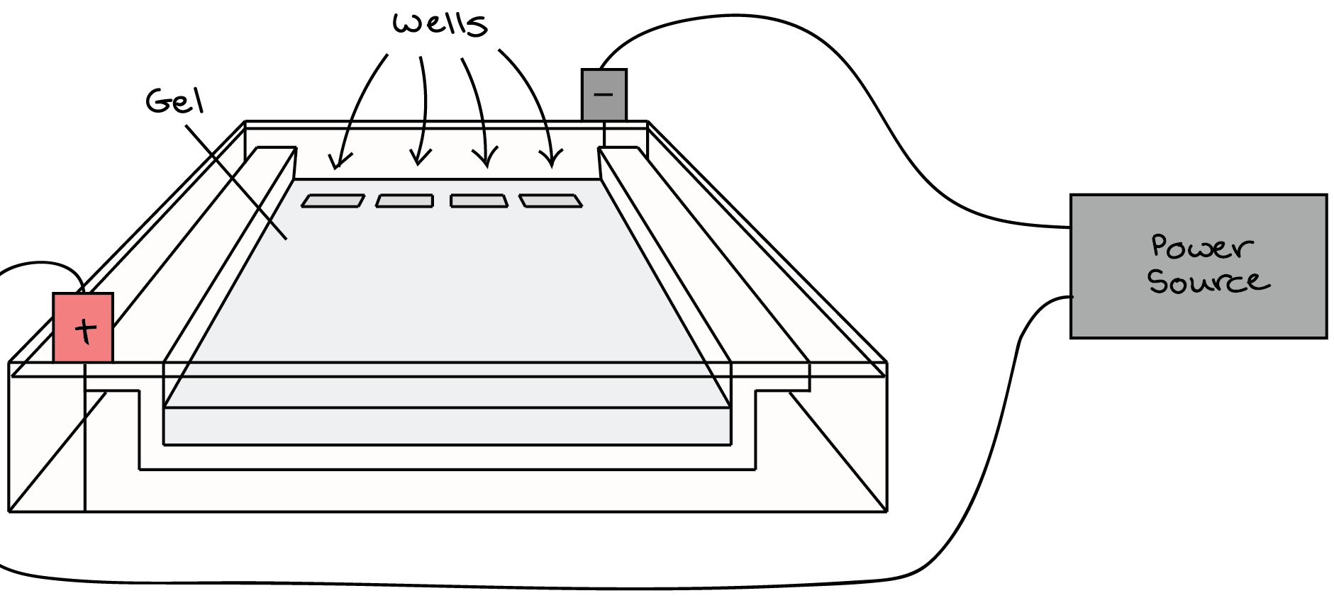
Agarose Gel electrophoresis:
Agarose is a carbohydrate (a polysaccharide)
extracted from Seaweed.
Agarose gel electrophoresis is a technique used to:
Separate DNA fragments of PCR product.
Determine the sizes of DNA fragments.
Determine the presence of DNA.
Analyze restriction digestion products.
DNA is negatively charged. Why?
When placed in an electrical field, DNA will migrate toward the positive pole (anode).

Slide 8
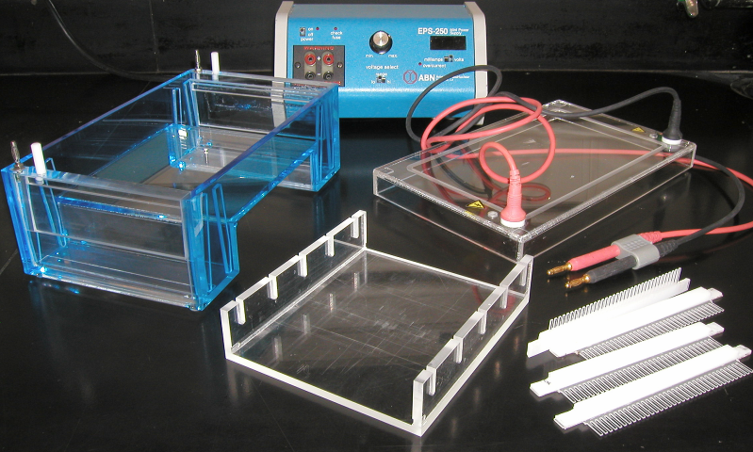
Electrophoresis Equipment:
Power supply→
Gel tank→
Cover
Electrical leads
↓
Casting tray
Gel combs
Gel combs

Slide 9
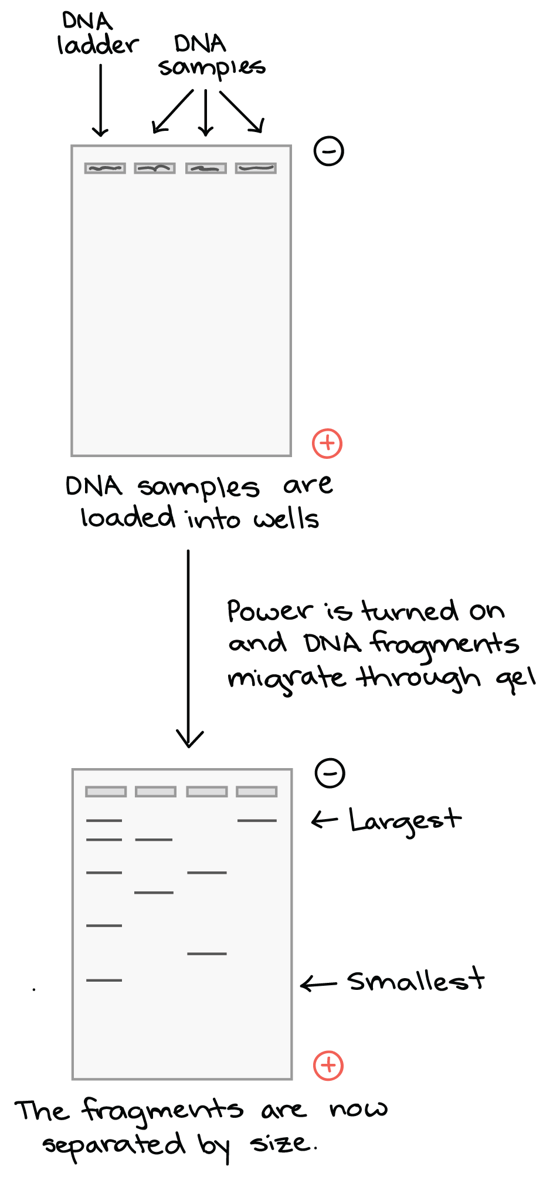
Shorter pieces of DNA will travel through the pores of the gel matrix faster than longer ones.
After the gel has run for awhile, the shortest pieces of DNA will be close to the positive end of the gel, while the longest pieces of DNA will remain near the wells.

Slide 10
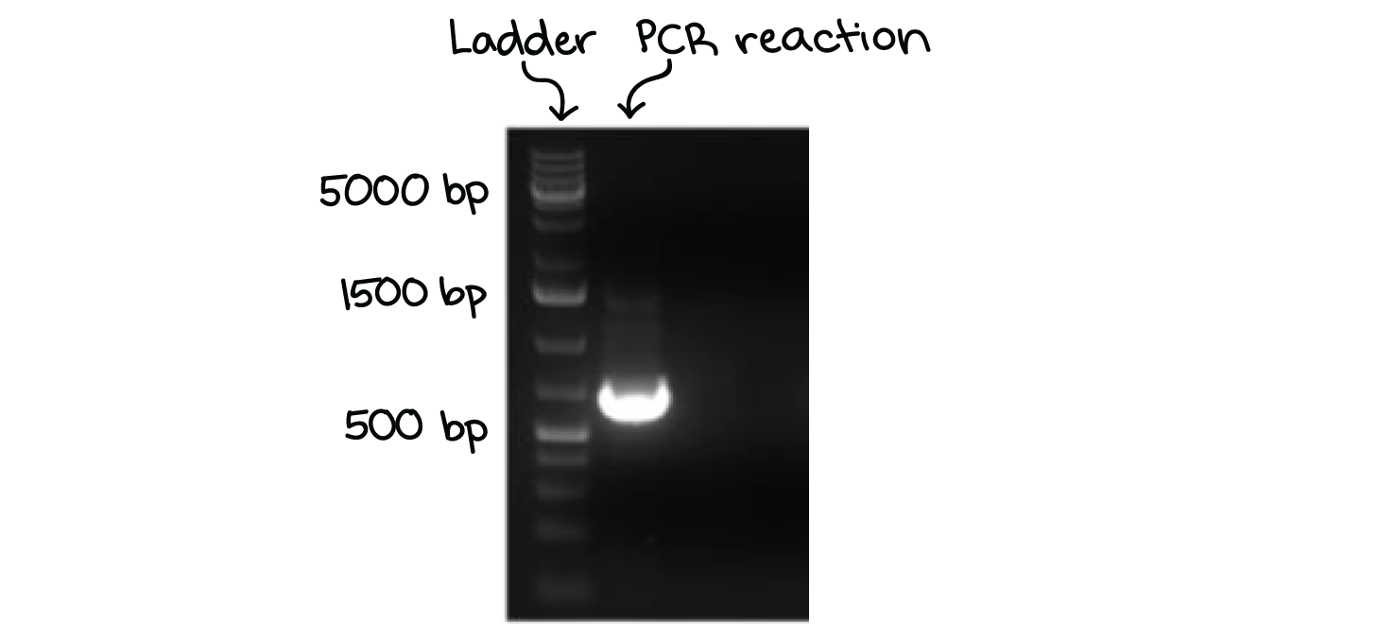
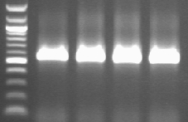
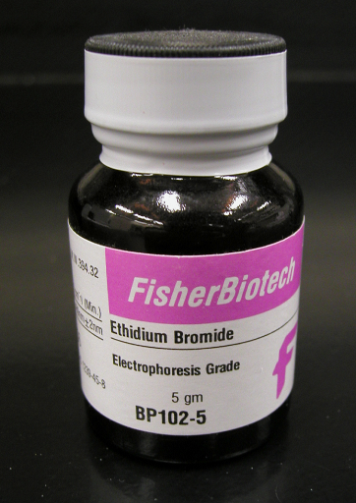
Gel can be stained with a DNA-binding dye (example; Ethidium bromide) and DNA can be visualized under UV light.
DNA ladder (DNAs of know sizes): Determine the sizes of unknown DNAs .
1000 bp —
500 bp —
— 553 bp
400 bp —
300 bp —
200 bp —
100 bp —

Slide 11
Applications of PCR:
Medicine:
Testing of genetic disease mutations.
Monitoring the gene in gene therapy.
Detecting disease-causing genes in the parents.
Forensic Science
Used as a tool in genetic fingerprinting.
Identifying the criminal from millions of people.
Paternity tests.
Research and Genetics
Compare the genome of two organisms in genomic studies.
Analysis of gene expression.
Gene Mapping.
Analysis of gene cloning

Slide 12

Questions?

