Slide 1



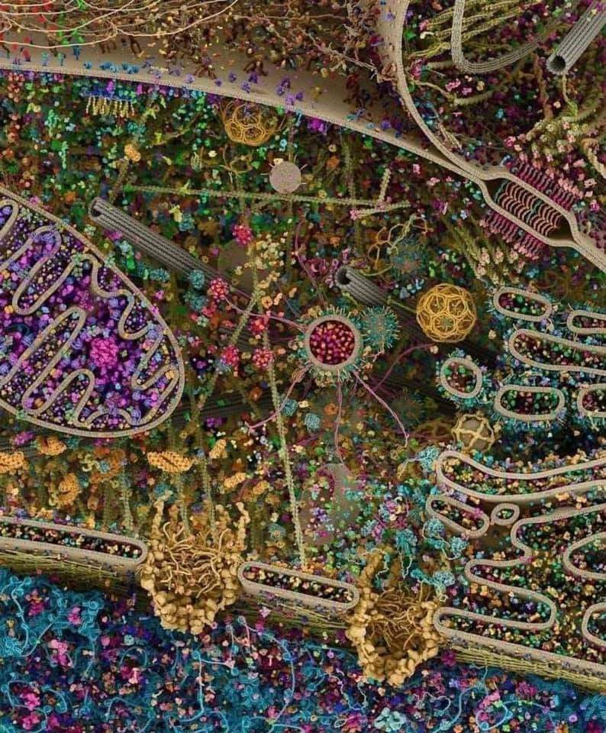
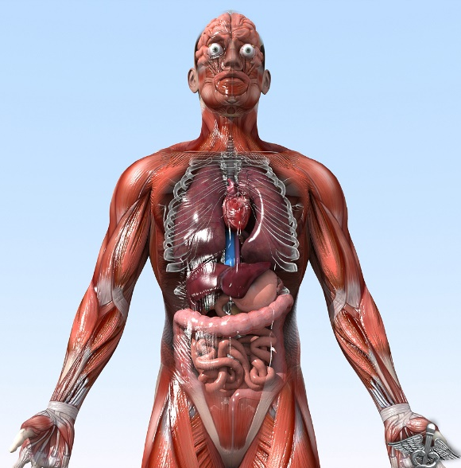

General Animal Biology
Zoo-109
علم الأحياء
109- حــيـن
College of Science,
Zoology Department
For Pre-Medical Students
Common First Year
السنة الأولى المشتركة - المسار الصحي
1447-H - 2025
Reference: Campbell, N. A. and Reece, J. B. (2014). Biology (10th edition). Pearson Education. Inc. USA.

Slide 2


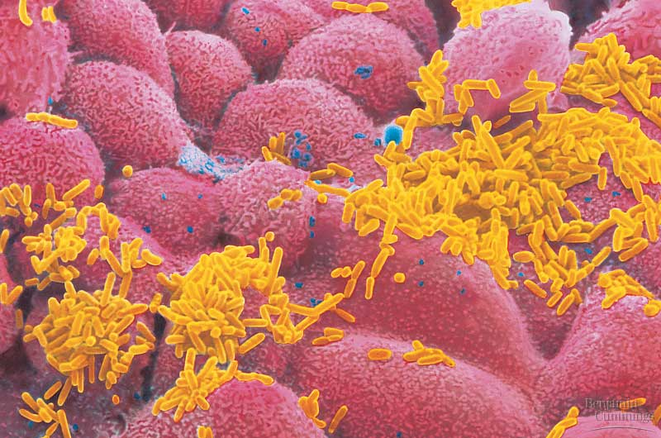
The Cell
Copyright © 2002 Pearson Education, Inc., publishing as Benjamin Cummings

Slide 3
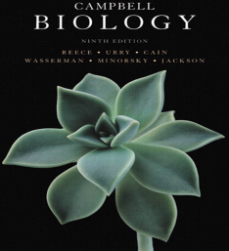

Objectives
The Cell: Discovery of the Cell
The Cell Theory.
Types of cells.
The two main Domains of Living Organisms (Prokaryotes and Eukaryotes ).
Similarities between Prokaryotic and Eukaryotic Cells
Differences between Prokaryotic and Eukaryotic Cells

Slide 4
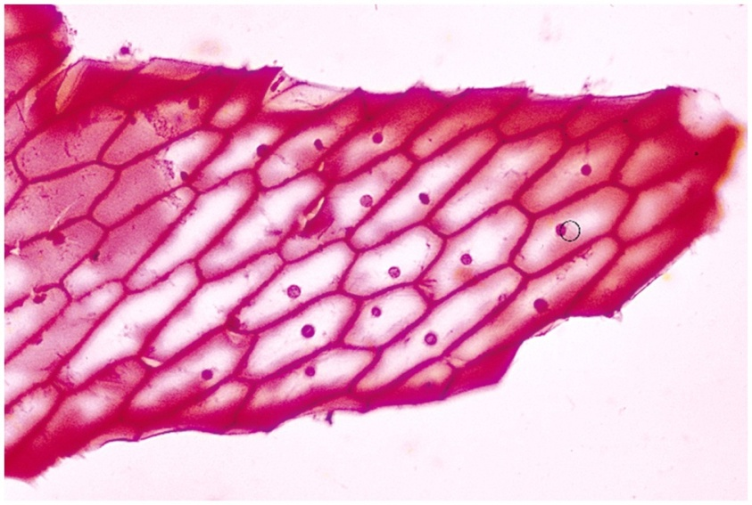
The Cell: Discovery of the Cell
The first person to see cells was Robert Hooke in 1665.
He was looking at a thin slice of cork through a microscope
He found what he described as "tiny rooms" that he called cells
Copyright © 2002 Pearson Education, Inc., publishing as Benjamin Cummings

Slide 5
The Cell Theory
In 1838, the German botanist Matthias Schleiden concluded that all plants were composed of cells
In 1839, Theodor Schwann concluded the same thing for animals
In 1855, Rudolf Virchow noted that all cells come from other cells
The cell theory states that:
all living organisms are made of one or more cells,
cells are the basic units of structure and function, and
cells come only from pre-existing cells.
A cell is the smallest unit that can carry on all of the processes of life

Slide 6
Living
Cells
Types of cells
حقيقية النواة
بدائية النواة
Prokaryotic
Eukaryotic
Bacteria and related micro-organisms
All other forms of life
البكتيريا وكائنات دقيقة شبيهة بها
6

Slide 7




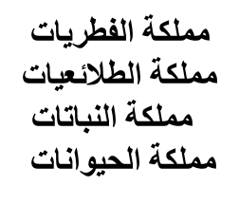
Domains of life
A)- Prokaryota
Contains 2 Kingdoms:
Archaea,
Bacteria (Eubacteria),
B)- Eukaryota
Contains 4 Kingdoms:
Fungi
Protista
Plantae
Animalia

Slide 8
Prokaryotic and eukaryotic cells differ in size and complexity
Similarities أوجه التشابه
All cells are surrounded by a plasma membrane غشاء بلازمى.
The semi-fluid substance المادة شبه السائلة within the cell is called “cytosol”, السيتوبلازم containing the cell organelles عِضيات الخلية.
All cells contain chromosomes which have genes in the form of DNA.
All cells have tiny organelles عضيات صغيرة called “Ribosomes” that make proteins.

Slide 9
Prokaryotic and eukaryotic cells differ in size and complexity
Differences أوجه الإختلاف
Eukaryotes have a nucleus, while prokaryotes do not.
Eukaryotes have membrane-bound organelles, while prokaryotes do not.
Eukaryotic cells are, on average, ten times the size of prokaryotic cells.
The DNA of eukaryotes is much more complex and therefore much more extensive than the DNA of prokaryotes.
The DNA of prokaryotes floats freely inside the cell; the DNA of eukaryotes is held within its nucleus and associated with histones (proteins)
Prokaryotes have a cell wall composed of peptidoglycan. Many types of eukaryotic cells also have cell walls, but none made of peptidoglycan.
Eukaryotes undergo mitosis and meiosis; while prokaryotes divide by binary fission (simple cell division)

Slide 11
Comparison and Contrast
Prokaryotes
Eukaryotes
Nucleus
Endoplasmic reticulum
Golgi apparatus
Lysosomes
Vacuoles
Mitochondria
Cytoskeleton
Plasma membrane
Ribosomes
Cytosol
Cell wall

Slide 12
A)- Prokaryotes:
What are Prokaryotes?
Prokaryotes are single-celled (Unicellular) organisms that do not have a membrane-bound true nucleus, and can live in nearly every environment on earth.
Although tiny, prokaryotes differ greatly in their genetic traits, their modes of nutrition, however, their habitats are similar.
Based on genetic differences, prokaryotes are grouped into two major Domains:
Domain Archaea
Domain Bacteria.
Copyright © 2002 Pearson Education, Inc., publishing as Benjamin Cummings

Slide 13
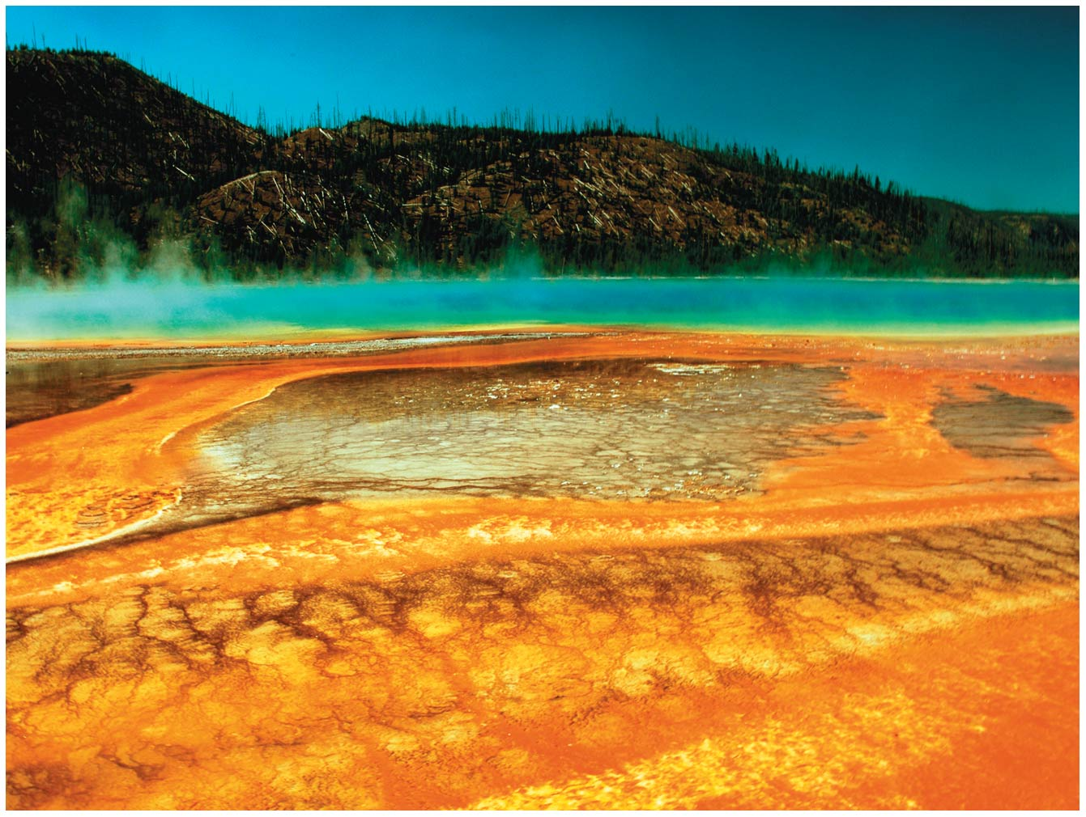
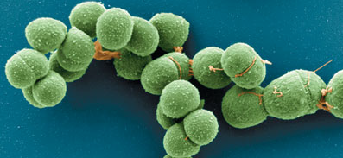
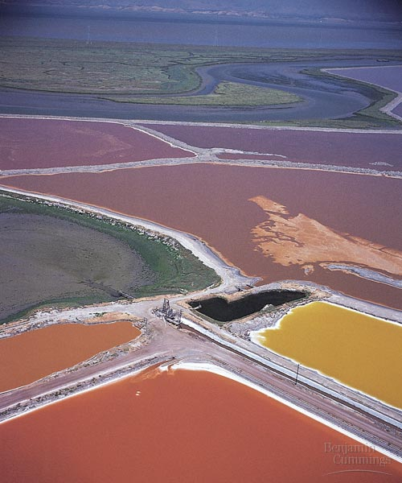
1. Domain: Archaea
Archaea are extremophiles, “مُحب للظروف القاسية” of extreme environments and can be classified into:
a)- Extreme halophilesمُحب للملوحة :
live in such saline places as the Great Salt Lake and the Dead Sea.
Some species require an extremely saltyشديدة الملوحة environment to grow.
b)- Extreme thermophilesمُحب للحرارة live in hot environments.
The optimal temperatures for most thermophiles are 60 - 80°C.

Slide 14

College of Science,
Zoology Department
General Animal Biology
(Zoo-109)
Zoology Department

