Slide 1
Genetics Engineering (Zoo-455)
Cloning Vectors
Lecture-4

Slide 2
Cloning vectors:
Most vectors are derived from plasmids or viruses
DNA molecule which is able to replicate several time in its self when a foreign DNA is integrated and produces a plenty copy of the recombinant DNA
Types of cloning vectors:
Plasmids.
Bacteriophages.
Bacterial artificial chromosomes.
Yeast artificial chromosomes.
Mammalian artificial chromosomes.

Slide 3
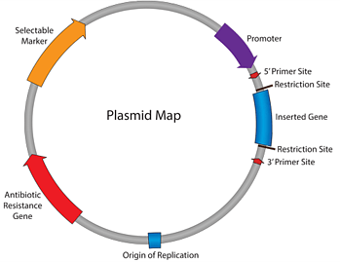
Common structure of vectors:
Every plasmid has following essential elements:
Origin of replication (OR) : This refers to a specific location in the strand where the replication process begins. In plasmids, this region is A=T rich region as it is easier to separate the strands during replication.
Selectable marker site :This region consists of antibiotic resistance genes which are useful in the identification and selection of bacteria that contain plasmids.
Promoter region : This drives the transcription of the foreign insert.
Primer binding site: This is the short sequence of single-strand DNA which is useful in DNA amplification and DNA sequencing.
Multiple cloning sites (Polylinker): Short segment containing a several restriction enzyme sites enabling easy insertion of foreign DNA.

Slide 4
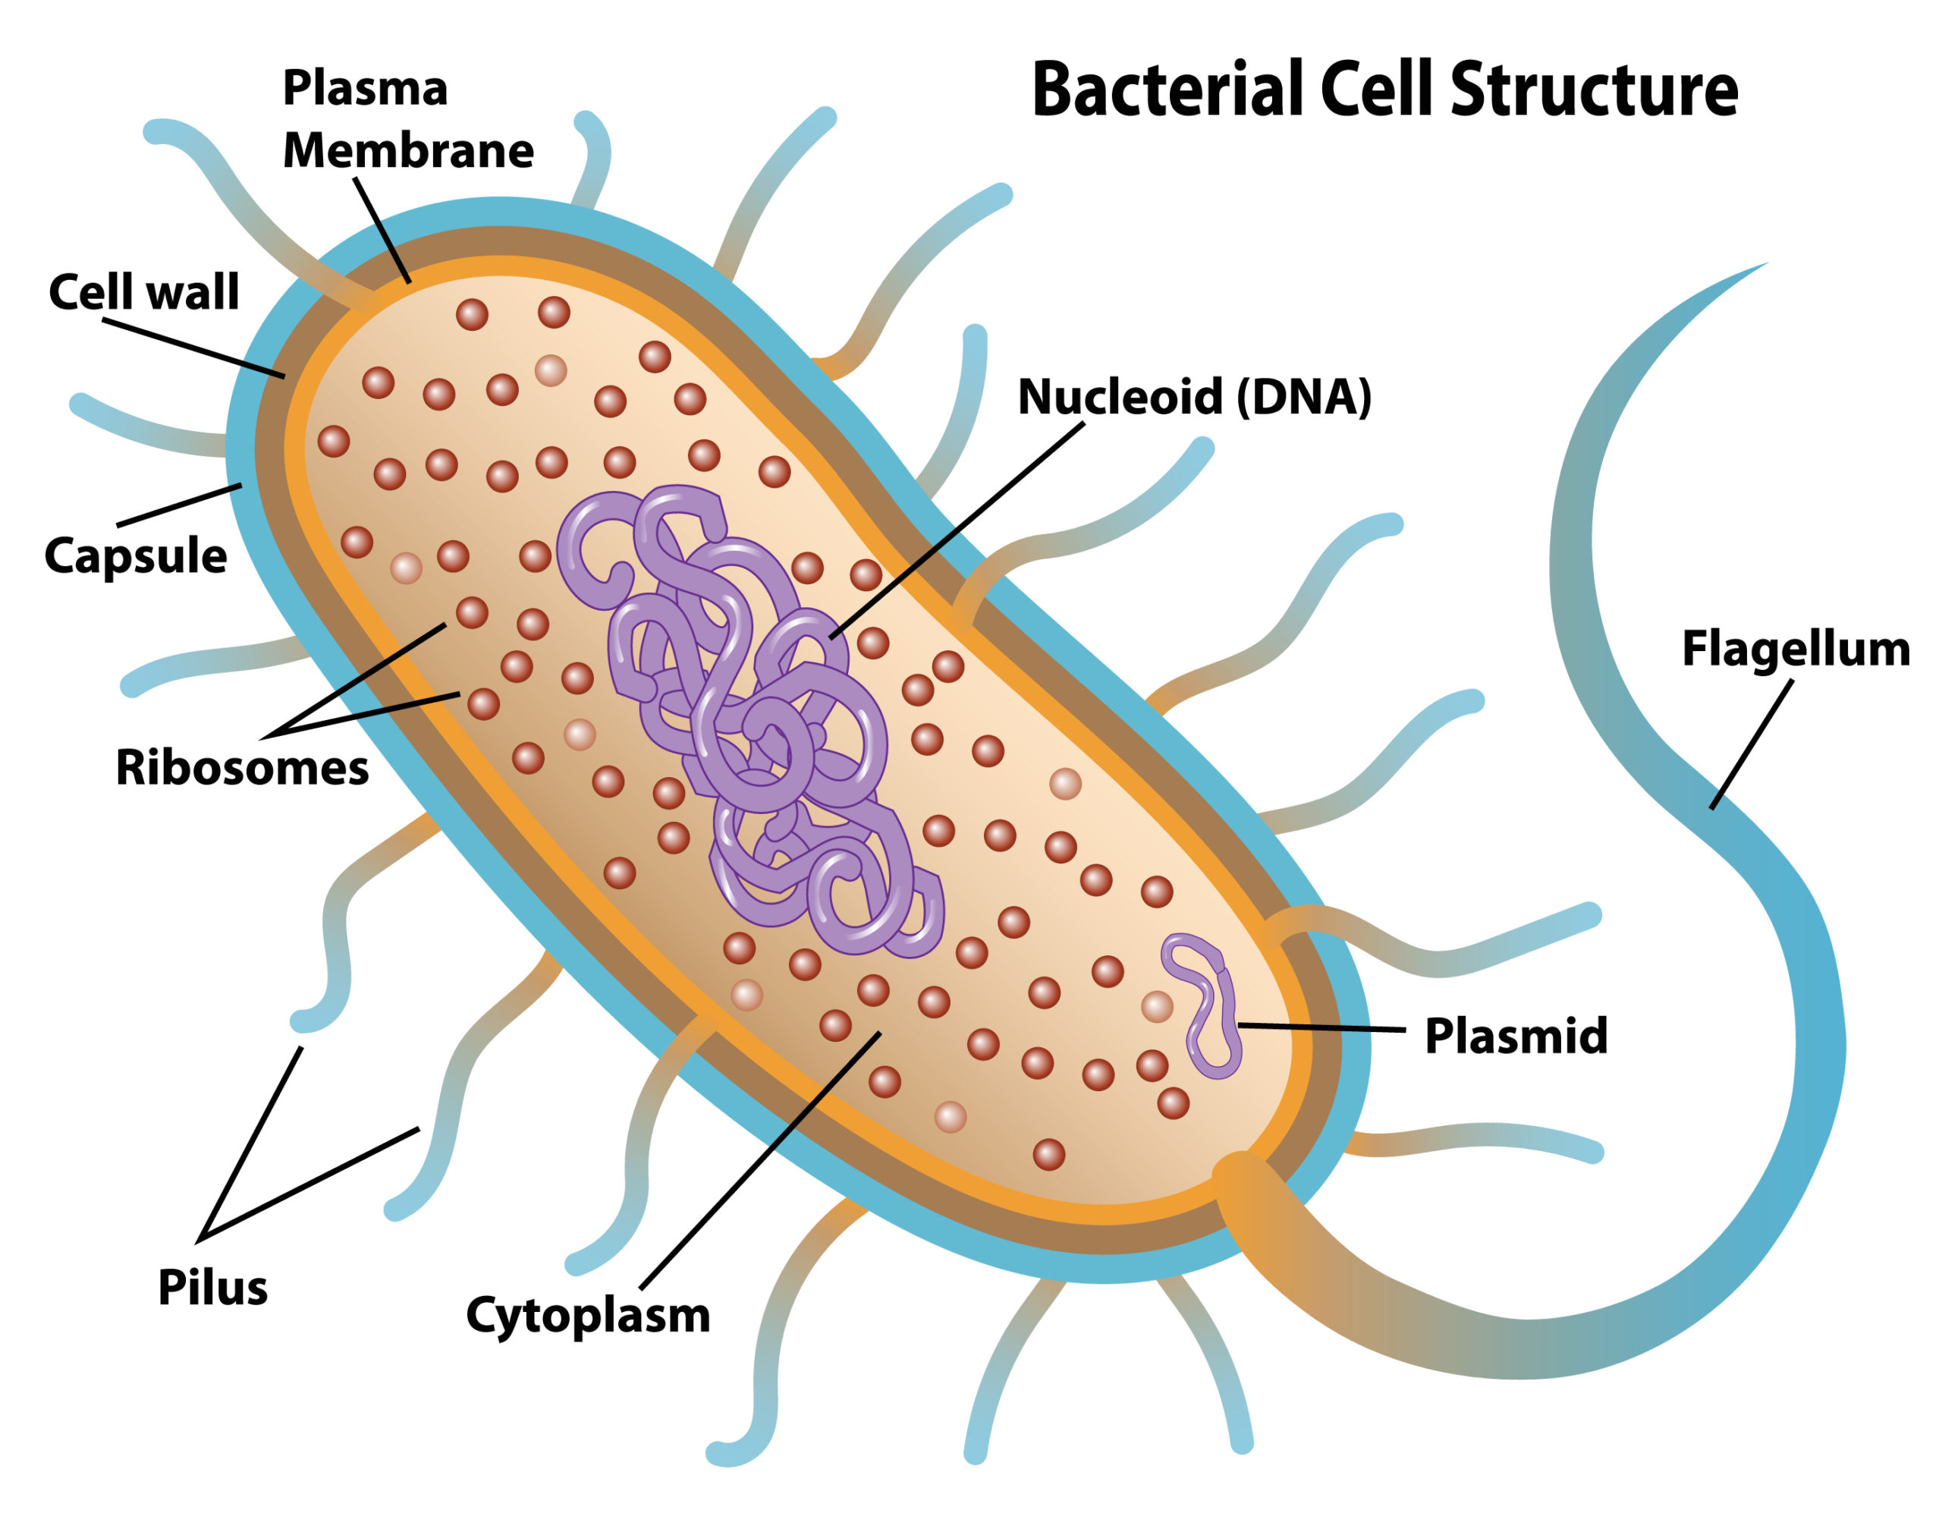
1- Properties of Plasmids:
Present in bacterial cells.
The first vectors used in gene cloning
It is a small extra circular DNA, double stranded, self-replicating.
Can be inserted into bacterial cells by a process called transformation.
Up to 15 kb DNA fragment can be inserted into the plasmid.
Carry a marker gene for antibiotic resistance.
Cell that contains the plasmid will grow in presence of the selectable corresponding antibiotic supplied in the media.
pBR322, pUC19, are examples of some plasmid vectors

Slide 5
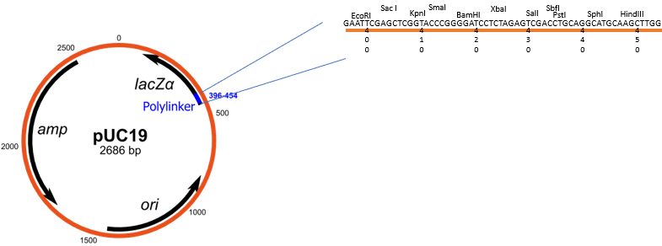
pUC19 full form:
p = plasmid
UC = University of California
19 = numerical designation
pUC19 is a common cloning vector.
A small double-stranded circle
Contains 2686 bp in length.
    Contains ampicillin resistance and lacZ gene.
    Contains 54 base-pair polylinker (multiple cloning site) within lacZ gene.
    Contains origin of replication (ori).

Slide 6
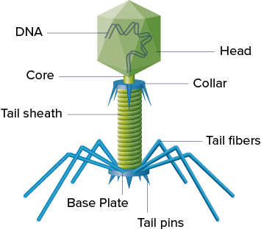
2- Properties of Bacteriophages:
It is the viruses that infect bacteria.
They are not able to infect eukaryotic cell.
They are more efficient than plasmids for cloning large DNA inserts.
Using bacteriophage as a vector, a DNA fragment of size up to 50 kb can be transformed.
Phage λ (Lambda) and M13 phage are commonly used bacteriophages in gene cloning
Lambda has 49 kb (double-stranded DNA).
If Lambda crosses cell membrane of E. coli, then it will degrade by restriction enzyme before adding methyl group.
If methylase add first methyl group to the lambda, the lambda DNA then will not recognize by restriction enzyme; therefore, it will continue to grow.

Slide 7
3- Bacterial artificial chromosomes (BACs):
BAC vectors are DNA constructs that are used for cloning DNA in bacteria.
The length of inserted gene 75-300 kb can be inserted into the BAC vectors.
Bacterial machinery does not have post-translational mechanism.
4- Yeast artificial chromosomes (YACs):
YAC vectors are DNA constructs that are used for cloning DNA in yeasts.
The length of inserted gene 100-3000 kb can be inserted in these vectors.
Yeast machinery has post-translational mechanisms that are useful in the expression of eukaryotic proteins.

Slide 8
5- Mammalian artificial chromosomes (MACs):
MACs are still under development.
MACs are microchromosomes that can act as a new chromosome in a population of human cells
MACs range in size from 6 to 10 Mb that carry new genes introduced by human researchers.
MACs can be used as vectors in transfer of new genes, studying their.

Slide 9
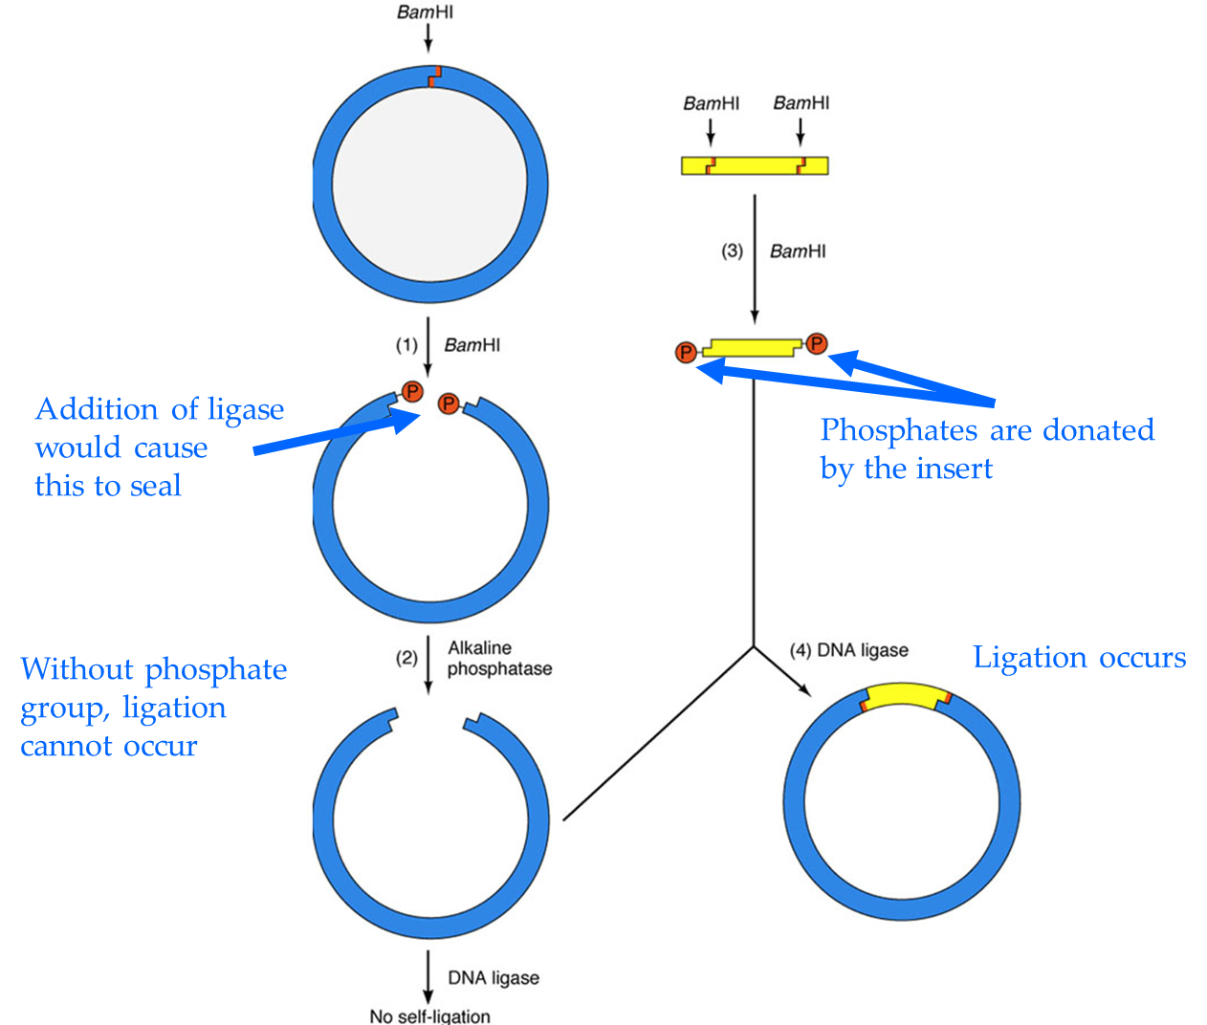
Digestion and ligation of insert DNA into plasmid:
Dephosphorylation is necessary to prevent self ligation.
Alkaline phosphatase an enzyme that removes 5'-phosphate groups from DNA end.

Slide 10

Questions?

