Slide 1
EE 202 Electric Circuits
Lecture 30 August
First Semester 2023-2024
Dr. Anmar Arif

Slide 2
CH5 Problems

Slide 3
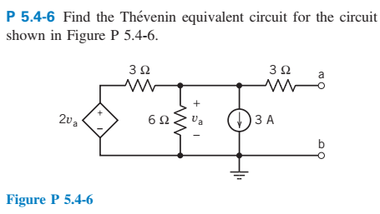

Slide 4
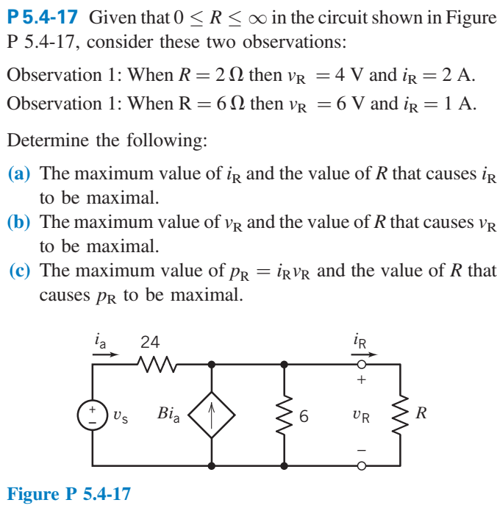

Slide 5
