Slide 1
Genetics Engineering (Zoo-455)
Restriction enzymes & DNA ligase
Lecture-3

Slide 2

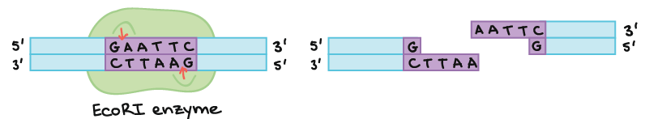
Restriction enzymes:
Restriction enzymes were discovered in bacteria in 1978.
Restriction enzymes are called restriction endonucleases, because it cuts inside of the DNA sequences (in the middle), but exonucleases always cut at the end of DNA sequences
They help the bacteria to destroy viral DNA (bacteriophages) as a defense mechanism.
They recognize and bind to specific sequences of DNA, typically 4 to 8 base pairs in length, called restriction sites.
They cut between specific bases (letters) of the double stranded DNA molecule
As an example of how a restriction enzyme recognizes and cuts at a DNA sequence, let's consider EcoRI, a common restriction enzyme used in labs. EcoRI cuts at the following site:

Slide 3
Restriction enzymes - purposes:
Researchers rely on restriction enzymes to assist with many processes in laboratories around the world:
Making recombinant DNA (For research, medicine and agriculture)
DNA profile analysis (For disease diagnosis, family relationship testing, and forensics)

Slide 4
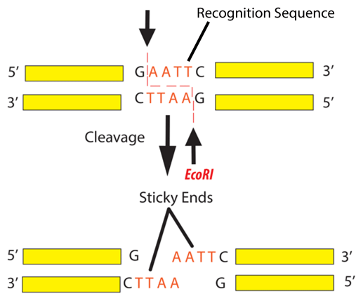
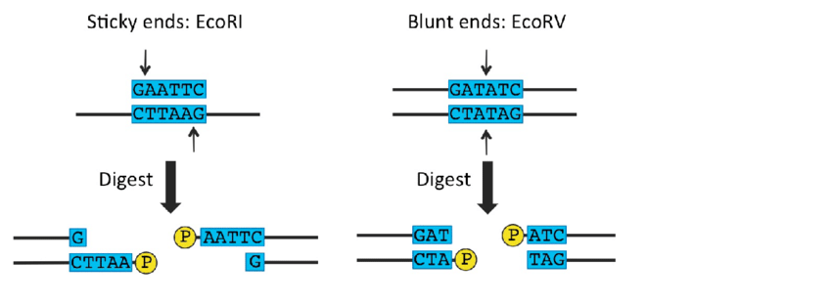
Restriction enzyme site:
Restriction enzymes are DNA-cutting enzymes.
Each enzyme recognizes one or a few target sequences and cuts DNA at or near those sequences.
Many restriction enzymes make sticky" or "cohesive" ends cuts, producing ends with single-stranded DNA overhangs.
Some produce blunt ends with straight cuts through both DNA strands.
If two DNA molecules have matching ends, they can be joined by the enzyme DNA ligase.

Slide 5
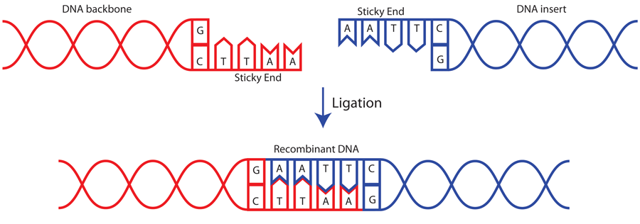
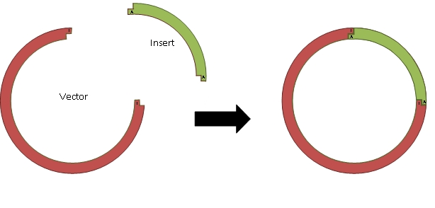
Making recombinant DNA using a restriction enzyme with sticky ends:
When you cut two separate molecules of DNA with the same restriction enzyme, the fragments will have matching sticky ends.
This is how recombinant DNA is created.

Slide 6
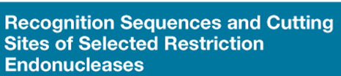
HindIII was discovered in Haemophilus influenzae, d (strain designation), III (3rd restriction enzyme isolated from H. influenzae)
EcoRI was discovered in Escherichia coli, strain R
BamHI was discovered in Bacillus amyloliquefaciens
EcoRV was discovered in Escherichia coli
PstI was discovered in Providencia stuartii
Hin
dIII
5'AAGCTT3'
5'A3' 5'AGCTT3'
Sticky end
3'TTCGAA5'
3'TTCGA5' 3'A5'
Eco
RI
5'GAATTC3'
5'G3' 5'AATTC3'
Sticky end
3'CTTAAG5'
3'CTTAA5' 3'G5'
Bam
HI
5'GGATCC3'
5'G3' 5'GATCC3'
Sticky end
3'CCTAGG5'
3'CCTAG5 3'G5'
Eco
RV
5'GATATC3'
5'GAT3' 5'ATC3'
Blunt end
3'CTATAG5'
3'CTA5' 3'TAG5'
Pst
I
5'CTGCAG3'
5'CTGCA3' 5'G3'
Sticky end
3'GACGTC5'
3'G5' 3'ACGTC5'

Slide 7
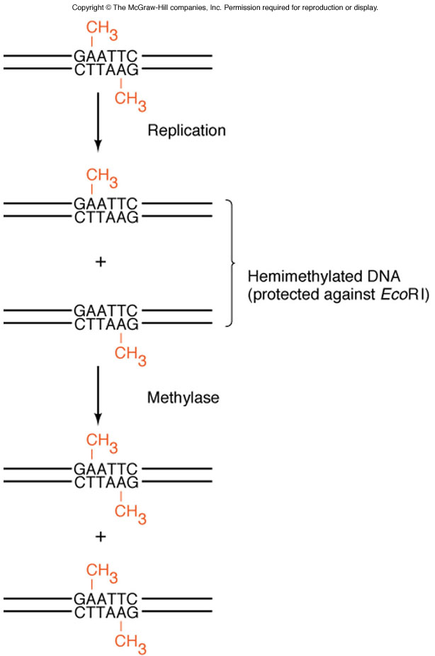
Methylation of the bacterial DNA prevents the restriction enzyme from cutting the host genome, as the enzyme can only recognize and cleave unmethylated DNA.
This protective mechanism allows the bacteria to differentiate between its own DNA (methylated) and foreign DNA (unmethylated).
As a result, the restriction enzyme selectively targets and cleaves foreign DNA without harming the bacterial genome.

Slide 8
Example sequence. Cut with EcoRI.
T C C A G C T G G A C G A A T T C T T C A G A T G A A T T C A A A
A G G T C G A C C T G C T T A A G A A G T C T A C T T A A G T T T
Number of fragments: 3
Size of each fragment: 12 bp, 9 bp, 4 bp

Slide 9
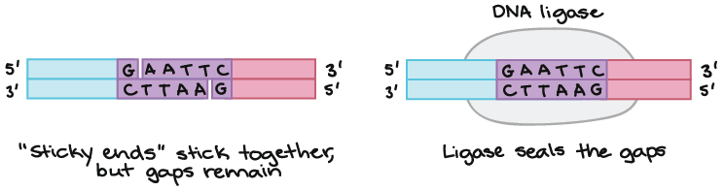
DNA ligase:
DNA ligase is a DNA-joining enzyme.
If two pieces of DNA have matching ends, ligase can link them to form a single molecule of DNA.
In DNA cloning, restriction enzymes and DNA ligase are used to insert genes and other pieces of DNA into plasmids.

Slide 10
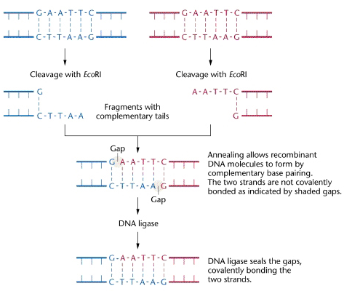

Slide 11
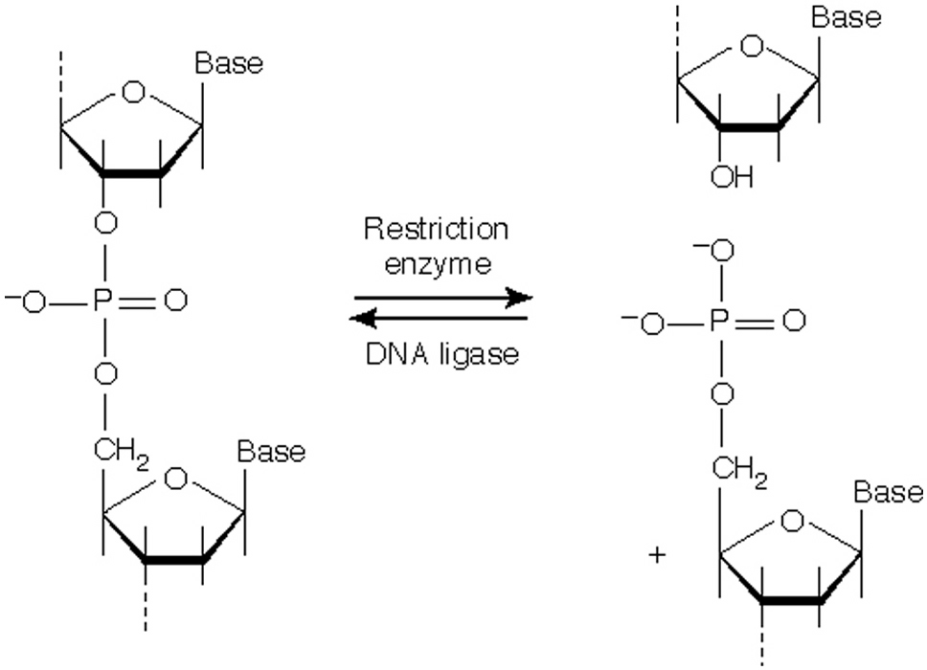

Slide 12

Questions?

