Slide 1
EE 202 Electric Circuits
Lecture 28 August
First Semester 2023-2024
Dr. Anmar Arif

Slide 2
Announcements
Midterm Exam 1: 16 October 2023
Midterm Exam 2: 9 November 2023
Quiz 1 today
Quiz 2 Wednesday

Slide 3
Thevenin’s and Norton’s Theorems

Slide 4
Example 1
(Ex. 5.4-2 page 183) Determine the thevenin & Norton eq. cct. at terminal ab.
superposition
V_{th}
Node analysis
Mesh analysis
loop1
4

Slide 5
Example 1
(Ex. 5.4-2 page 183) Determine the thevenin & Norton eq. cct. at terminal ab.
superposition
V_{th}
Node analysis
Mesh analysis
loop1
from the open circuit part:
KVL at loop1:
$$10 \left(4.5i_{a}−i_{a}\right)+12−40i_{a}=0 →i_{a}=\frac{12}{5} A$$
$$→V_{th}=\frac{12}{5}. 40=96 v$$
4

Slide 6
Example 1
(Ex. 5.4-2 page 183) Determine the thevenin & Norton eq. cct. at terminal ab.
superposition
V_{th}
Node analysis
Mesh analysis
loop1
from the open circuit part:
KVL at loop1:
$$10 \left(4.5i_{a}−i_{a}\right)+12−40i_{a}=0 →i_{a}=\frac{12}{5} A$$
$$→V_{th}=\frac{12}{5}. 40=96 v$$
4

Slide 7
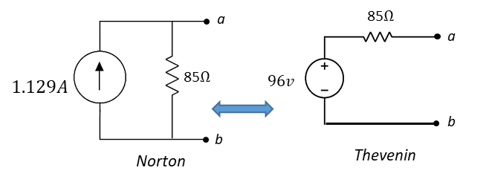
Example 1
(Ex. 5.4-2 page 183) Determine the thevenin & Norton eq. cct. at terminal ab.
superposition
V_{th}
Node analysis
Mesh analysis
loop1
from the open circuit part:
KVL at loop1:
$$10 \left(4.5i_{a}−i_{a}\right)+12−40i_{a}=0 →i_{a}=\frac{12}{5} A$$
$$→V_{th}=\frac{12}{5}. 40=96 v$$
from the short circuit part:
$$V_{5Ω}=V_{40Ω} (in parallel) →{40 I_{a,new}=5 I_{sc} → I}_{sc}=8{ I}_{a,new}$$
KVL at loop1:
$$10 \left(4.5i_{a,new}−9i_{a,new}\right)+12−40i_{a,new}=0$$
$$→I_{a,new}=0.1412 A →I_{sc}=1.129 A=I_{th}$$
$$→R_{th}=\frac{V_{th}}{I_{th}}=85 Ω$$
$$I_{sc}$$
4

Slide 8
Example 2
E
RL
RL
5

Slide 9
Example 2
KVL at loop1:
$$E+{6i}_{a1}−2i_{a1}=0 → i_{a1}=\frac{−E}{4}$$
$${→ V}_{th}=E+6\left(\frac{−E}{4}\right)=\frac{−E}{2}={2i}_{a1}$$
E
RL
RL
KVL at loop2:
$$E+{6i}_{a2 }−2i_{a2}=0$$
$$→ i_{a2}=\frac{−E}{4} → I_{sc}=I_{th}=\frac{{2i}_{a2}}{3}=\frac{−2E}{12}=\frac{−E}{6}$$
$$−$$
$$+$$
$$+$$
$$−$$
i=0
E
$$R_{th}=\frac{V_{th}}{I_{th}}=\frac{−6E}{−2E}=3Ω$$
loop1
Note: NOT always equals to
$$I_{a2}$$
$$I_{a1}$$
$$−$$
$$+$$
$$+$$
$$−$$
3Ω
Isc
E
$$\frac{−E}{2}$$
RL
loop2
5

Slide 10
Maximum Power Transfer
$$Rt$$
A load will receive maximum power from a network when its resistance is exactly equal to the Thévenin resistance of the network applied to the load.
$$Vs$$
RL
6

Slide 11
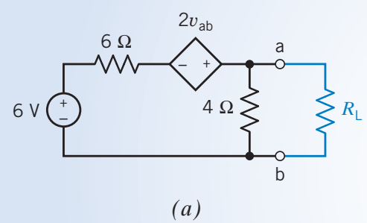
Example
6

Slide 12
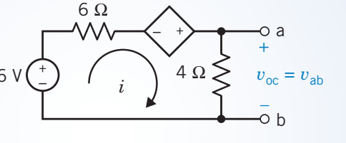
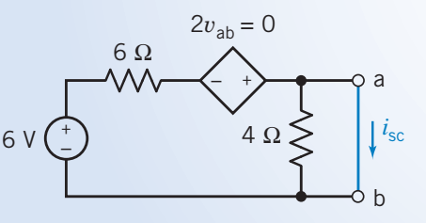
Example
6

Slide 13
Example
6

Slide 14
Dependent sources problems

Slide 15
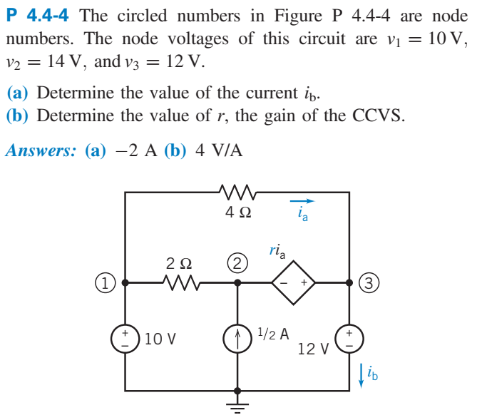

Slide 16
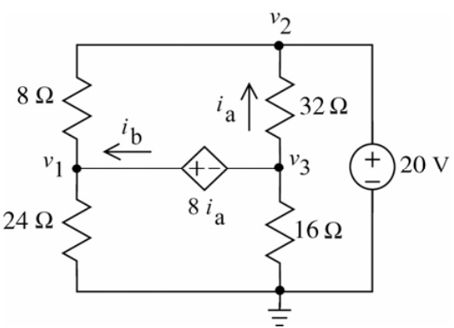

Slide 17
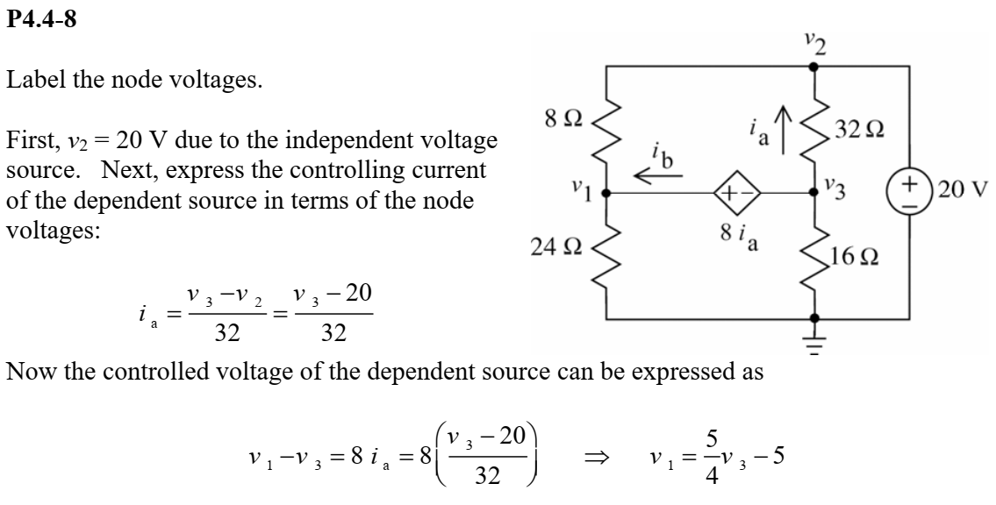
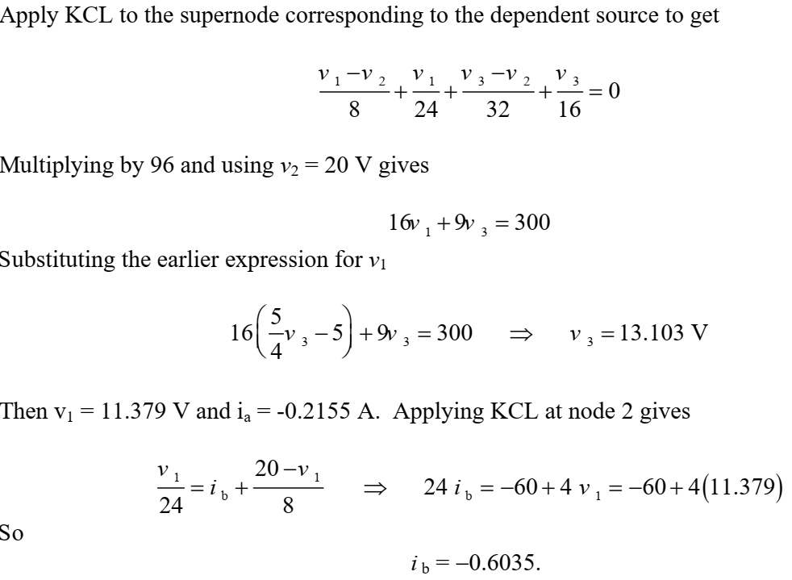

Slide 18
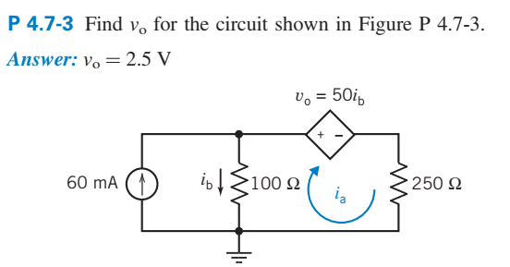

Slide 19
