Slide 1
EE 201 CH 6: Parallel Circuit

Slide 2
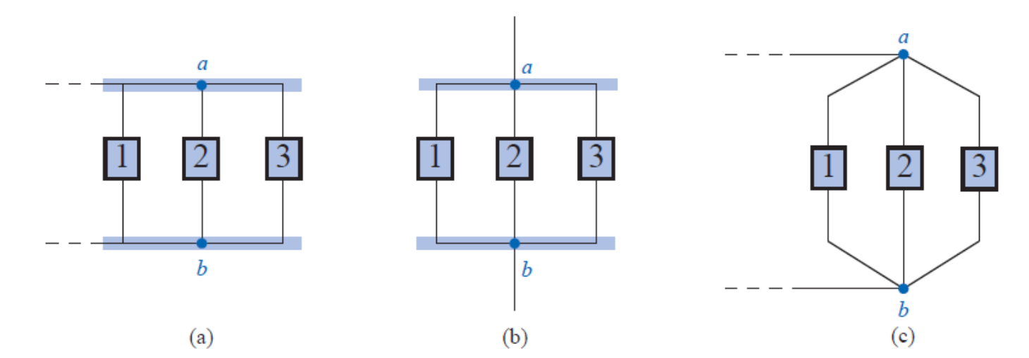
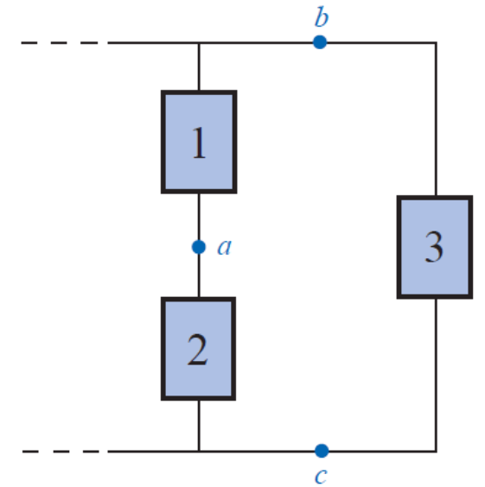
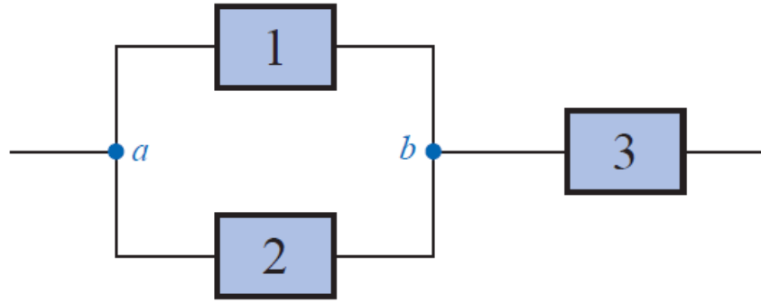
Parallel Circuit
Two elements, branches, or networks are in parallel if they have two points/nodes/terminal in common.

Slide 3
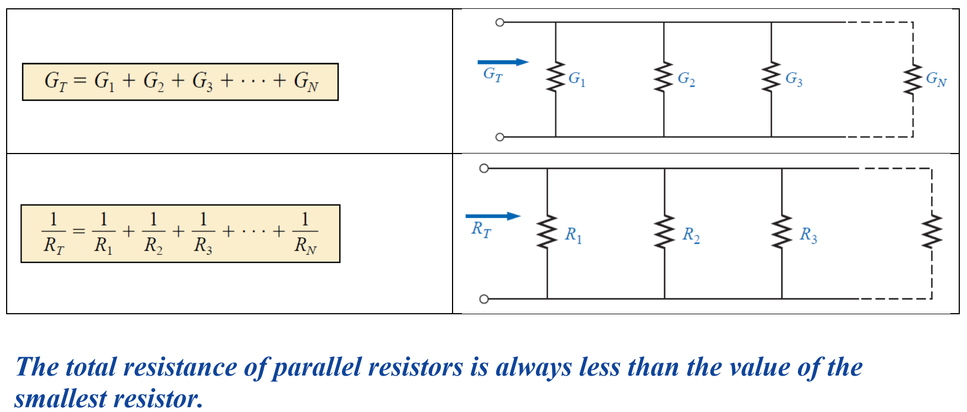
Conductance
Conductance is the degree to which an object conducts electricity

Slide 4
Adding parallel resistance

Slide 5
Adding parallel resistance

Slide 6
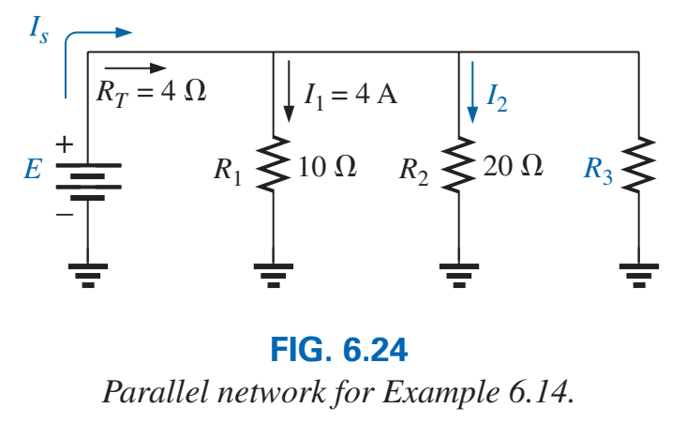
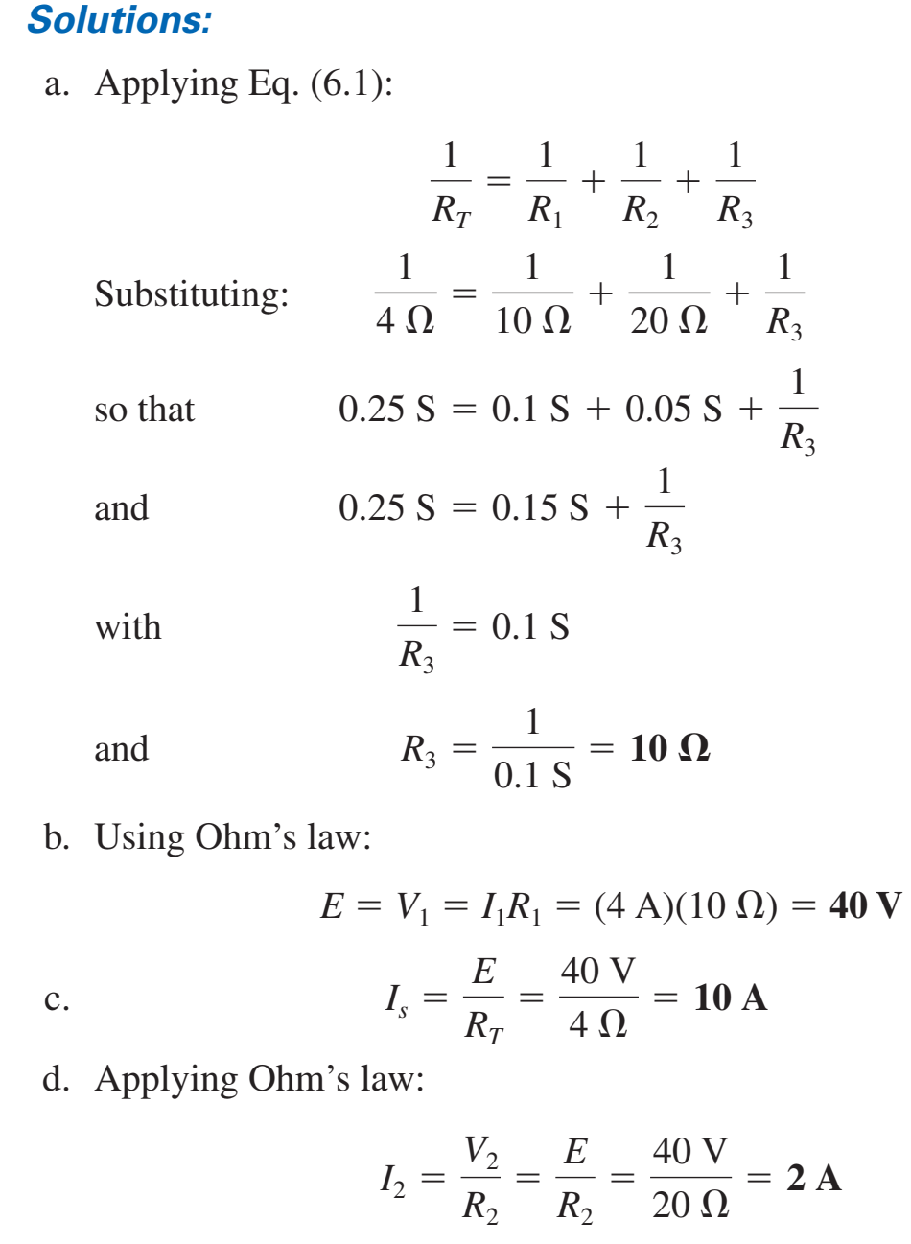
Example

Slide 7
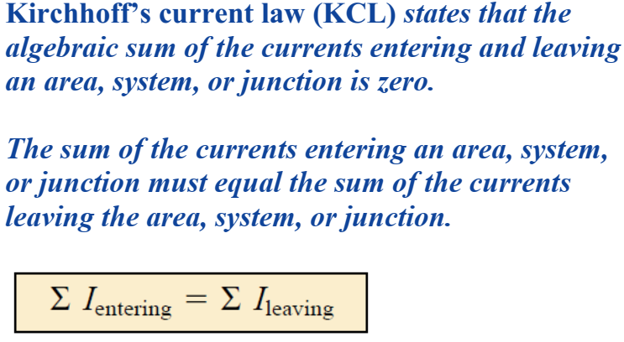
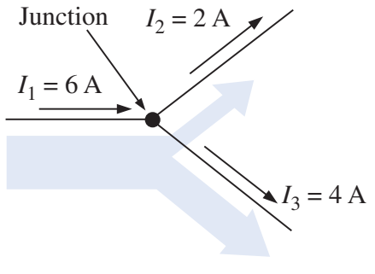
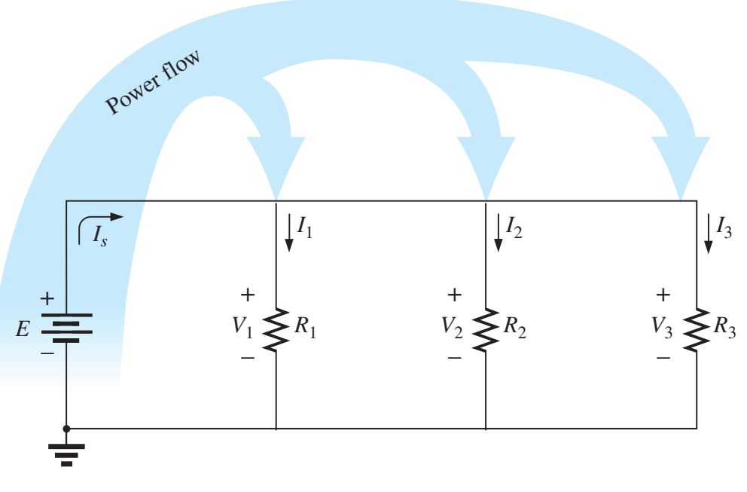
Kirchhoff’s Current Law

Slide 8
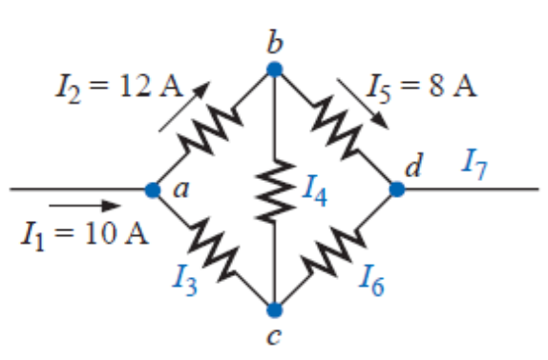
Example
$I_{3}=12−10=2 A$
$I_{4}=12−8=4 A$
$I_{6}=4−2=2 A$
$I_{7}=10 A$

Slide 9
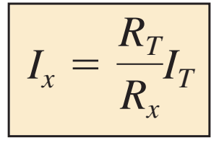
Current Divider Rule
$V=I_{T} R_{T}$
$V=I_{1} R_{1}→I_{1} R_{1}=I_{T}R_{T}$
$I_{1}=I_{T} ×\frac{R_{T}}{R_{1}}$

Slide 10
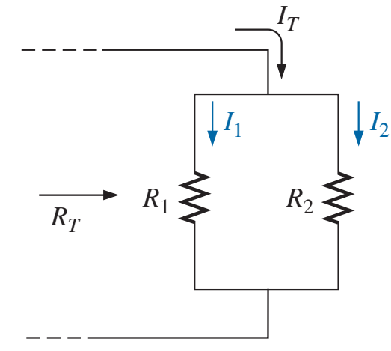
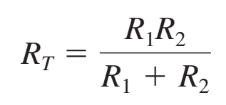
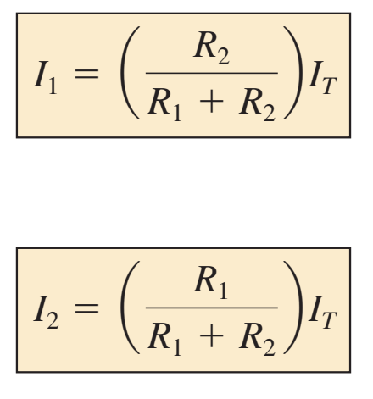
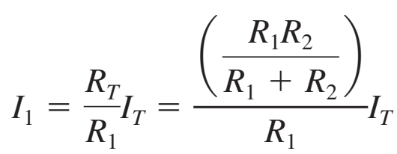
Current Divider Rule

Slide 11
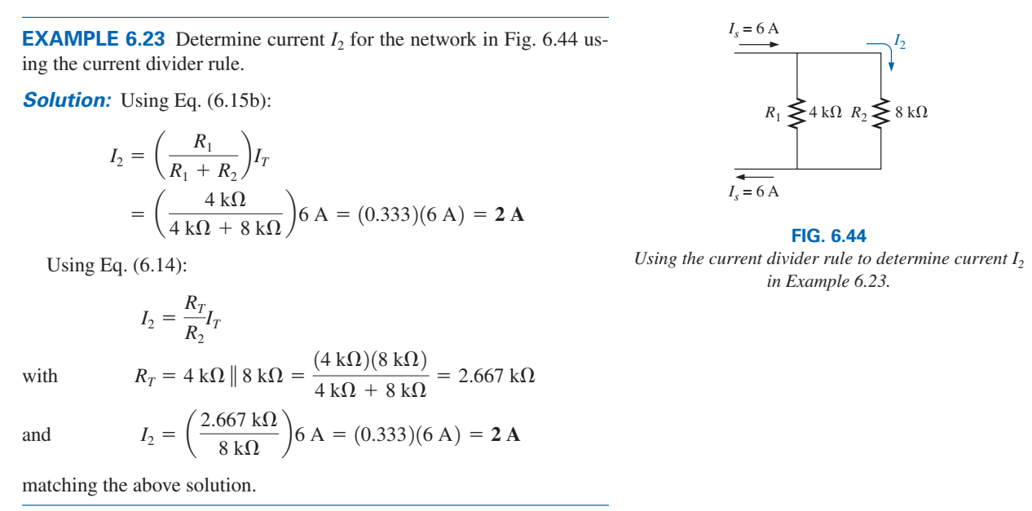
Example

Slide 12
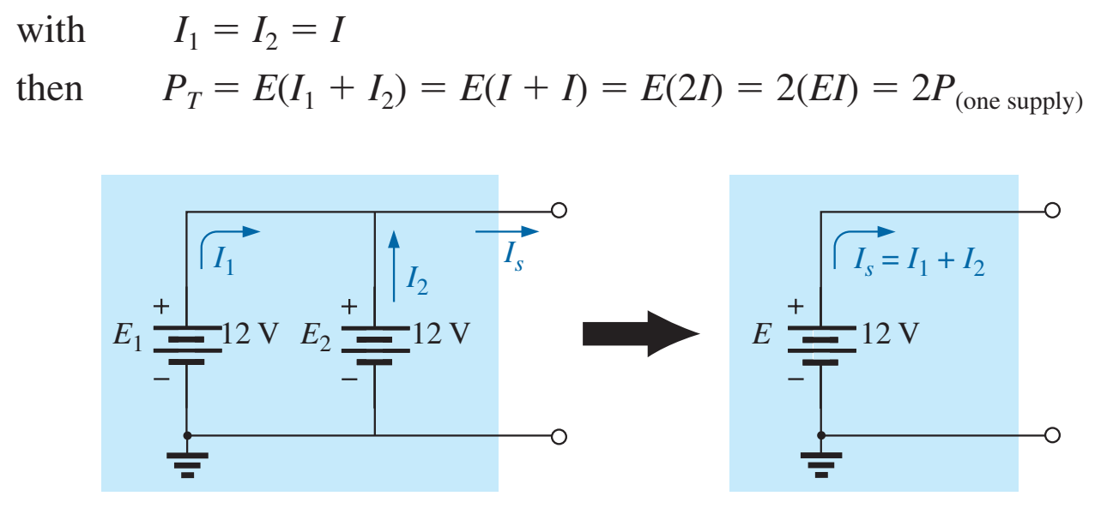
Parallel Voltage Sources
Voltage source are placed in parallel only if they have the same voltage rating.
Primary reason to increase the current rating, increase power.
If two batteries of different terminal voltages were placed in parallel, both would be left ineffective or damaged:

Slide 13
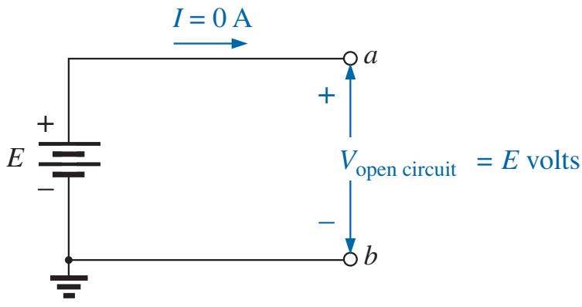
Open circuit

Slide 14
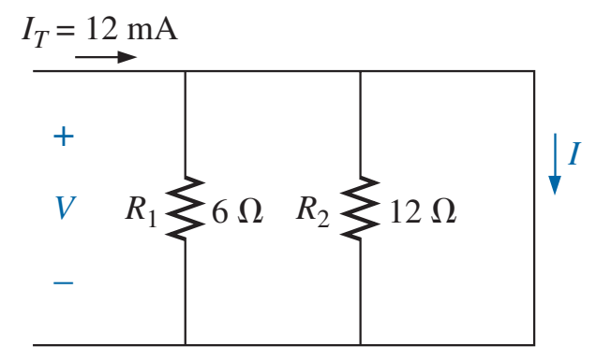
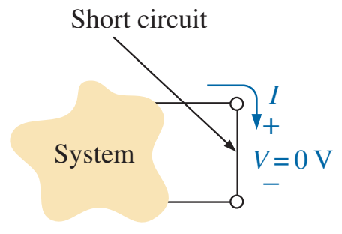
Short circuit

Slide 15
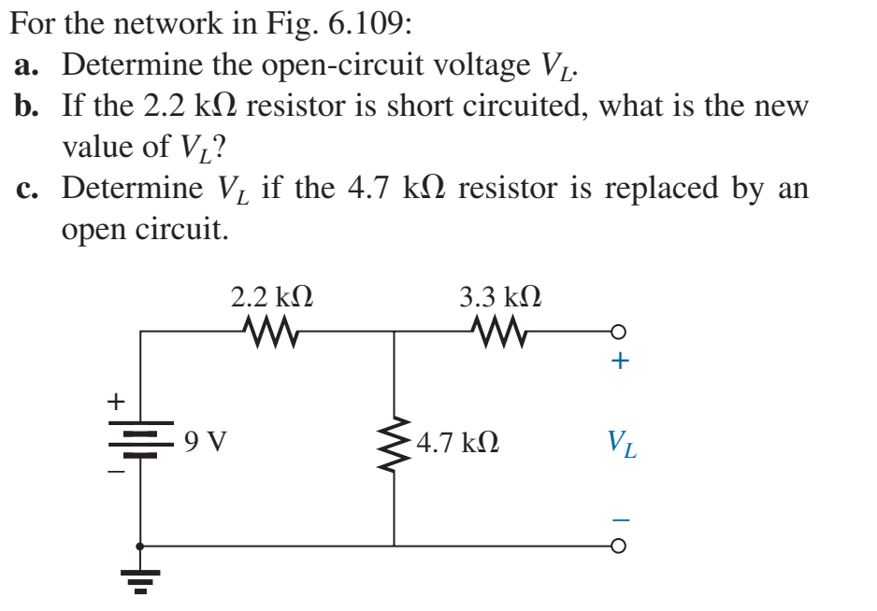
Example
$V_{L}=9×\frac{4.7}{4.7+2.2}=6.13 V$
$V_{L}=9 V$
$V_{L}=9 V$

Slide 16
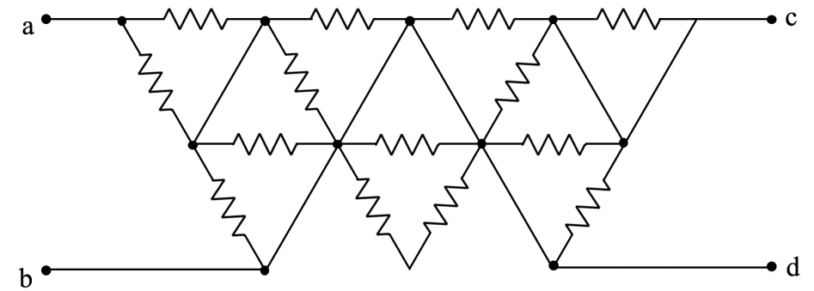
Exercise
Find $R_{ab}$, if all resistors equal to $R$

Slide 17
Exercise
Find $R_{ab}$, if all resistors equal to $R$

Slide 18
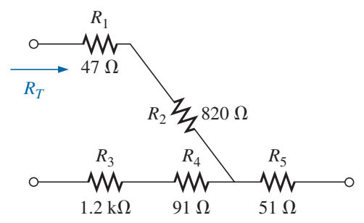
Problem 2 – CH5

Slide 19
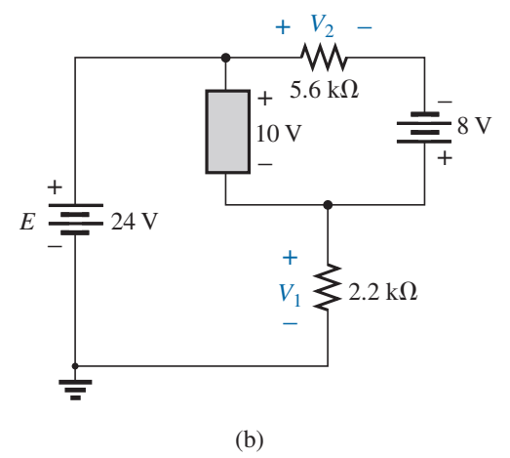
Problem 22 – CH5

Slide 20
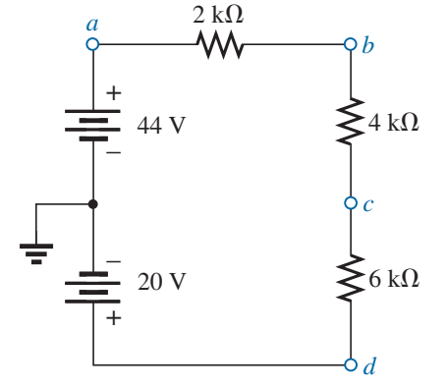
Problem 41 – CH5

Slide 21
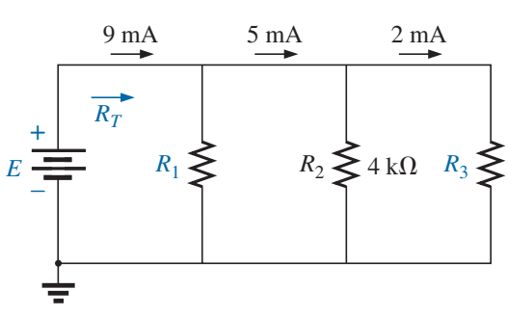
Problem 27 – CH6

Slide 22
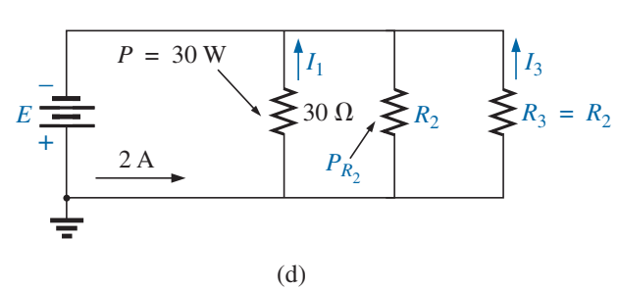
Problem 28 – CH6

Slide 23
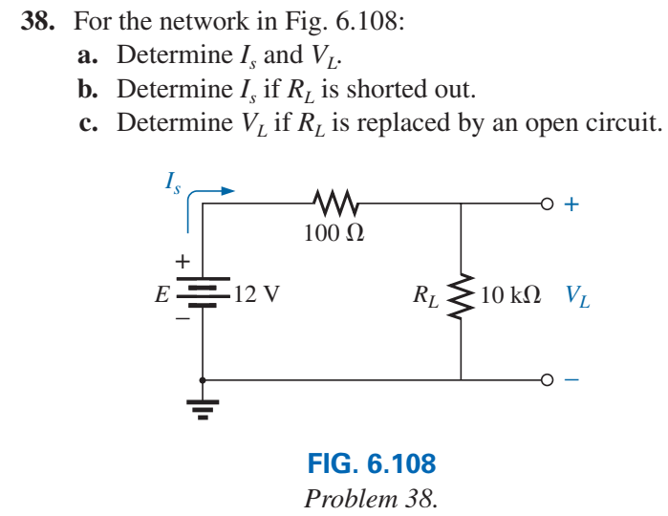
Problem 38 – CH6

Slide 24
Next Lecture
Introduction to LT Spice
Quiz 1: CH5 and CH6
See Quiz Practice 1

