Slide 1



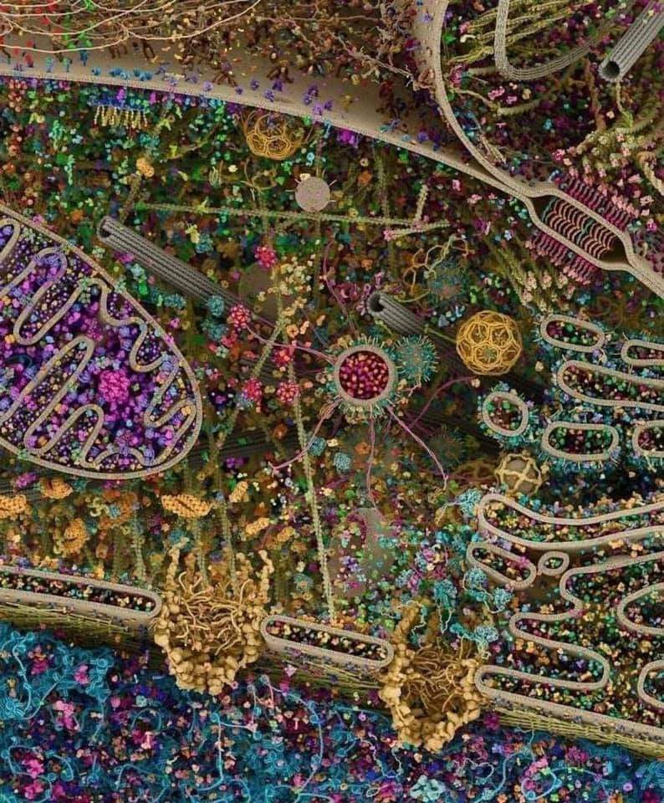
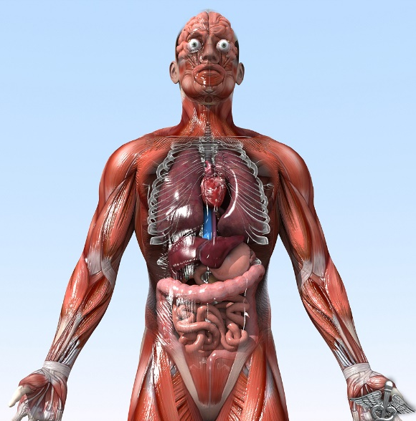
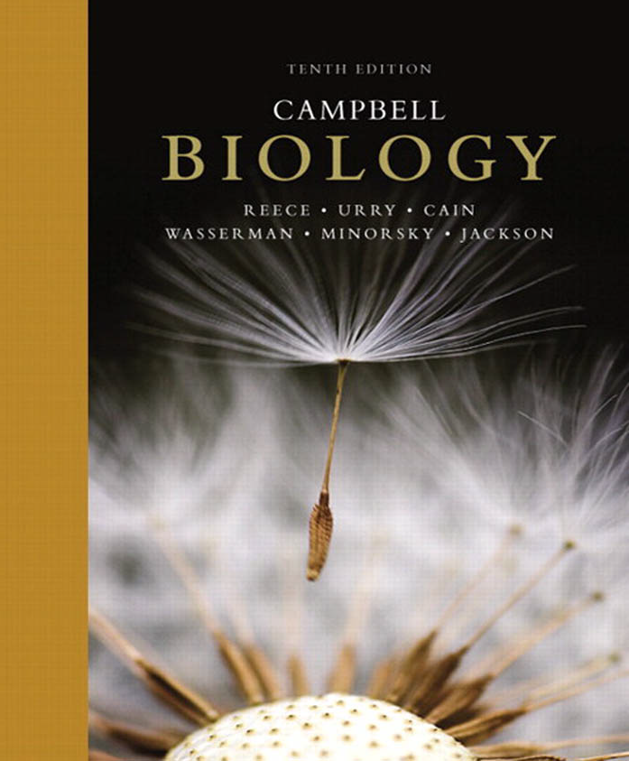
General Animal Biology
Zoo-109
علم الأحياء
109- حــيـن
College of Science,
Zoology Department
For Pre-Medical Students
Common First Year
السنة الأولى المشتركة - المسار الصحي
1444-H - 2023
Reference: Campbell, N. A. and Reece, J. B. (2014). Biology (10th edition). Pearson Education. Inc. USA.

Slide 2



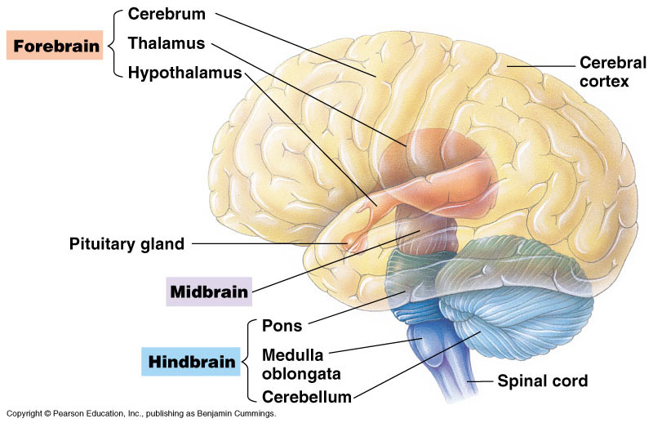
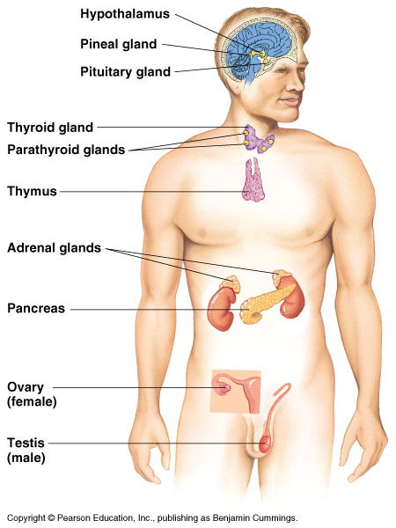
CHEMICAL SIGNALS IN ANIMALS
Copyright © 2002 Pearson Education, Inc., publishing as Benjamin Cummings

Slide 3
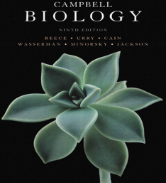

Objectives
CHEMICAL SIGNALS (Hormones) IN ANIMALS
Function and Secretion of Hormones.
Classes of Hormones and Mechanism of Chemical Signaling.
Pituitary gland:
  Follicle-stimulating hormone (FSH) and luteinizing hormone (LH)
  Thyroid-stimulating hormone (TSH)
  Adrenocorticotropic hormone (ACTH)
  Prolactin
  Growth hormone (GH)
  Melanocyte-stimulating hormone (MSH).
  Endorphins.
  Oxytocin
  Antidiuretic hormone (ADH)
Pineal gland

Slide 4
Function and Secretion
Hormones: are substances secreted by cells (secretory) that act to regulate the activity of other cells (target) in the body.
  Hormones affect all cells in the body and are made and secreted by endocrine glands.
Endocrine glands: are ductless organs that secret hormones either into the bloodstream or the fluid around cells.
The endocrine glands can be found throughout the body and are collectively known as the endocrine system.
Endocrine glands, such as the pancreas, can also be exocrine glands.
Exocrine glands: secrete substances through ducts to specific locations inside and outside the body.
Copyright © 2002 Pearson Education, Inc., publishing as Benjamin Cummings

Slide 5
Function and Secretion
Nervous and endocrine systems are the main internal communication and regulation systems.
The hormone-secreting cells constitute the endocrine system.
The secretory cell: is the site that secrets hormone into blood stream and regulates communicating messages within the body.
The target cell: is the site that is reached by the hormone to which it responds.
Complete changes in the body is regulated by hormones (e.g. metamorphosis in insects).
Types of hormones:
Polypeptide hormone,
Amino acid derivatives hormone,
Steroid hormone
(Protein hormones)
(Lipid hormones)

Slide 6
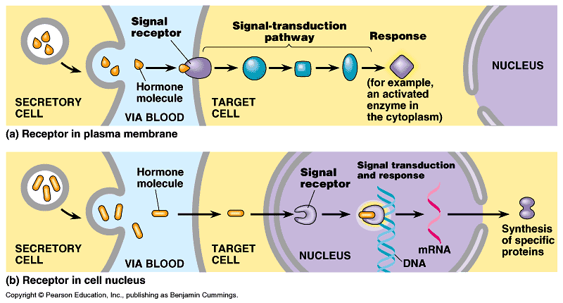
Types of Hormones and Mechanism of chemical signaling:
As mentioned in the last slide, hormones can either be amino acid-based hormones or steroid hormones.
  Amino acid based-hormones (protein hormones): are made of amino acids, either a single modified amino acid or a protein made of 3-200 amino acids, and are water soluble.
  Steroid hormones: are lipid hormones that the body makes from cholesterol, and are fat soluble.
    Similar to steroid hormones are thyroid hormones.
I): Protein hormones:
Bind to a receptor protein on the surface of the target cell which
will trigger signal transduction pathway.
6

Slide 7
Mode of action of protein hormone
Video: plays in LMS

Slide 8
Types of Hormones and Mechanism of chemical signaling:
II) Steroid hormones:
Penetrate the cell and bind to a receptor protein inside the target cell. This also will trigger signal transduction pathway (for triggering mRNA transcription for synthesizing a specific protein).
  Usually, the intracellular receptor activated by a hormone is a transcription factor.
8

Slide 9
Mode of action of steroid hormone
Video: plays in LMS
Source: http://highered.mcgraw-hill.com/sites/dl/free/0072437316/120060/ravenanimation.html

Slide 10
Types of Hormones and Mechanism of chemical signaling:
Tropic hormones: الهرمونات المحفزة (المنبهة)
Target other endocrine glands and are important to understanding chemical coordination.
Many endocrine organs contain specialized nerve cells called neurosecretory cells that secret hormones.
The hormone epinephrine has two functions:
  As a hormone of the endocrine system.
  As a signal in the nervous system.
Feedback is common in regulation of the activity of both endocrine and nervous systems (homeostasis):
  Calcitonin and parathyroid hormones play an important role in maintaining the concentration of the blood calcium constant.
  They are secreted from thyroid and parathyroid glands, respectively.
Hormones regulate the development of invertebrates (e.g. insects)

Slide 11




The Vertebrate Endocrine System
The human has 9 endocrine glands.
Fig. 45.5, Page 960

Slide 12
The hypothalamus and pituitary integrate many functions of human endocrine system
The hypothalamus and the pituitary gland, control the initial release of many hormones of the endocrine system.
  The hypothalamus is the area of the brain that coordinates many activities of the nervous and endocrine systems.
  The pituitary gland has two parts, anterior and posterior. It stores and releases hormones that are produced (synthesized) by the hypothalamus.
  Based on the function, hormones produced by the hypothalamus are classified as:
    Releasing hormones: stimulate the pituitary (adenohypophysis) to secrete hormones.
    Inhibiting hormones prevent the pituitary from secreting hormones.
Hypothalamus
Anterior
pituitary
Posterior
pituitary

Slide 13

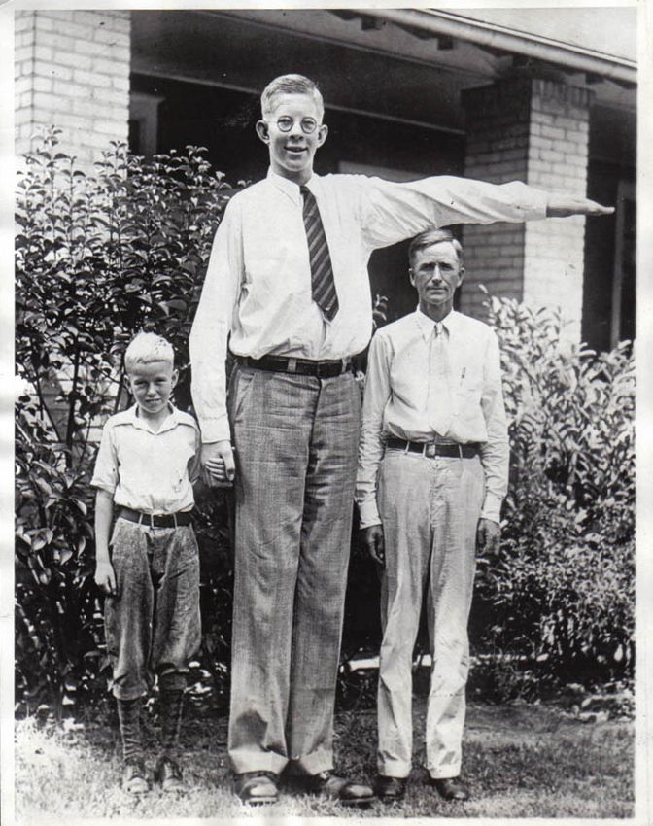
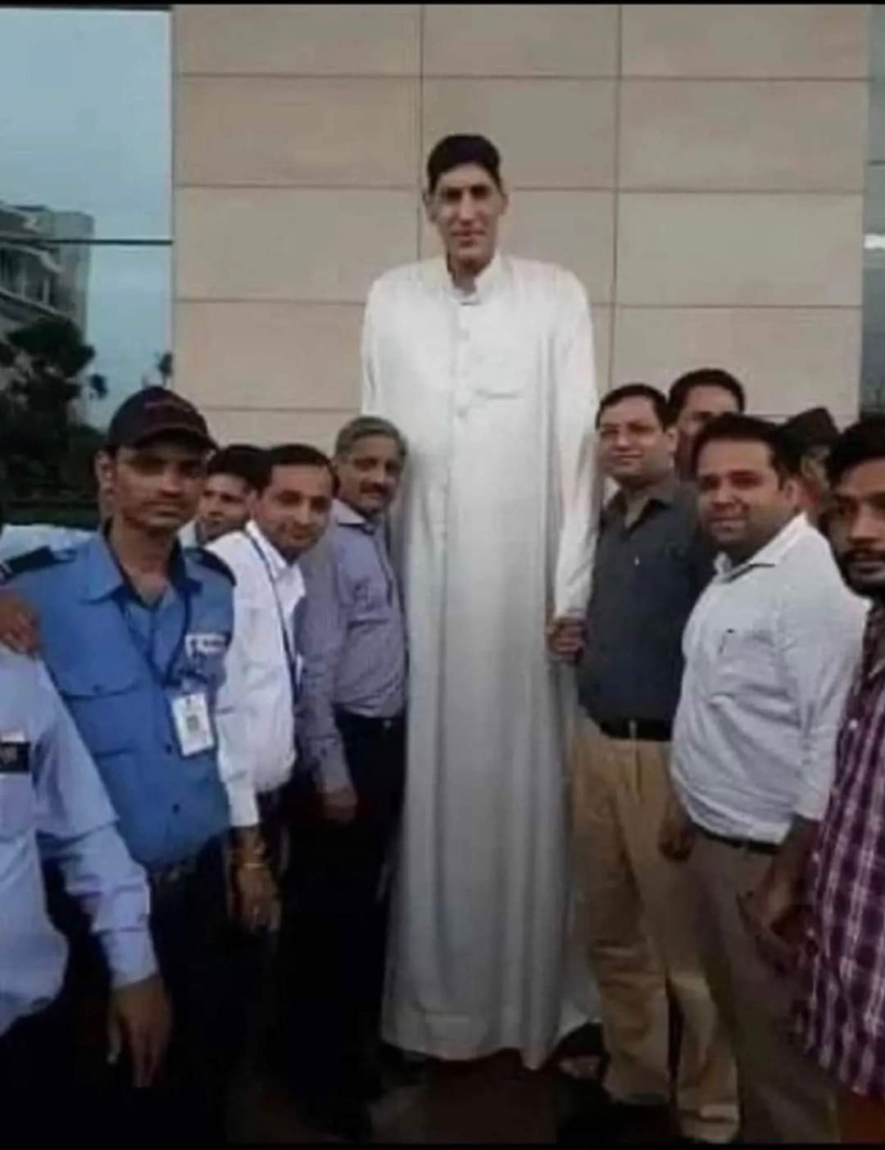

1)- Pituitary gland: Secrets 9 hormones ( 7 hormones by the anterior part and 2 hormones by the posterior part).
A)- Anterior pituitary hormones.
  Growth hormone (GH): a protein.
    Stimulates growth and metabolism.
    Secretion is regulated by hypothalamic hormones.
    Acts directly on boon tissues or acts via growth factors.
    Gigantism: العملقة excessive GH during development.
    Acromegaly: excessive GH production during adulthood.
    Hypopituitary dwarfism القزمية: childhood GH deficiency.
Gigantism
  Prolactin (PRL): a protein.
    Stimulates milk production and secretion from mammary gland الغدد اللبنية.
    This secretion is regulated by hypothalamic hormones.

Slide 14
A)- Anterior pituitary hormones.
  Gonadotropins (Gonotropic محفز للمناسل): glyocoproteins.
    Follicle-stimulating hormone (FSH).
      Stimulates production of sperms and ova.
      Secretion is regulated by hypothalamic hormones.
    Luteinizing hormone (LH) المُحفز لتكوين الجسم الأصفر.
      Stimulates ovaries and testes.
      Secretion is regulated by hypothalamic hormones.
  Thyroid-stimulating hormone (TSH): a glycoprotein.
    Stimulates the thyroid gland.
    Secretion is regulated by thyroxine in blood.
    Secretion is also regulated by hypothalamic hormones.
  Adrenocorticotropic hormone (ACTH): a peptide
    Stimulates adrenal cortex secretion of glucocorticoids
    Secretion is regulated by glucocorticoids and hypothalamic hormones.
  Melanocyte-stimulating hormone (MSH): a peptide.
    May play a role in fat metabolism.
    Endorphins: peptides.
    Inhibit pain perception.
    Effects mimicked by heroin and other opiate drugs.

Slide 15
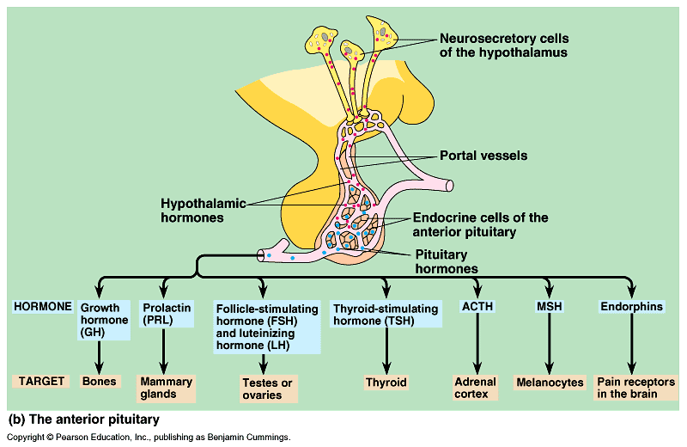
The anterior pituitary gland hormones
Melanocyte-stimulating H.
Adrenocorticotropic
Also called gonadotropin hormones هرمونات المناسل

Slide 16
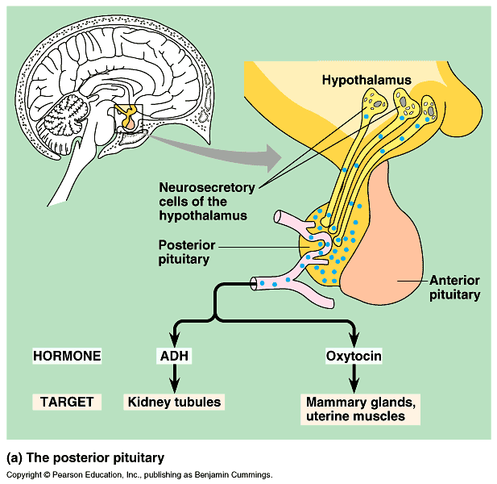
B)- Posterior pituitary hormones.
  Oxytocin: a peptide.
    Stimulates contraction of the uterus and mammary glands.
    Secretion is regulated by the nervous system.
  Antidiuretic hormone (ADH): مُضاد لإدرار البول a peptide.
    Promotes retention of water by the kidneys (in Kidney tubules).
    High level decreases urination and vice versa.
    Secretion regulated by water/salt balance.
Both ADH and Oxytocin are synthesized by the hypothalamus, then stored in and released by the posterior pituitary.
Antidiuretic H

Slide 17
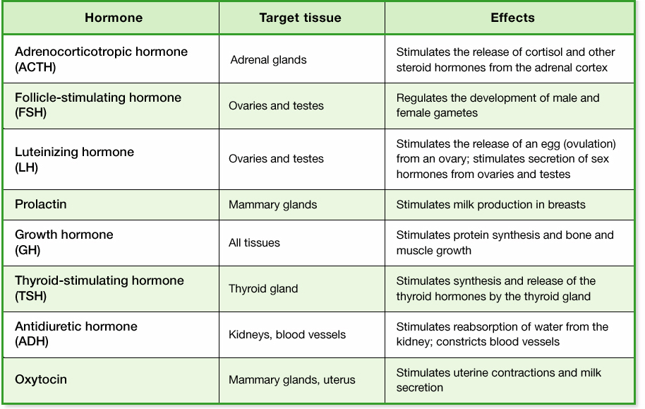
Summary of Hormones Secreted by the Pituitary Gland

Slide 18
2- Pineal gland: الغدة الصنوبرية
It is a small mass of tissue near the center of the mammalian brain and is involved in biorhythms.
  The pineal gland secretes the hormone, melatonin, an amine.
    Involved in biological rhythms associated with reproduction.
    Secretion is regulated by light/dark cycles.
Pineal gland
Pituitary gland

Slide 19

College of Science,
Zoology Department
General Animal Biology
(Zoo-109)
Zoology Department

