Slide 1

EE 202
Electric Circuits
Lecture 23 August
First Semester 2023-2024
Dr. Anmar Arif

Slide 2
My Schedule

Slide 3
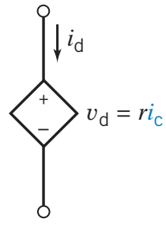
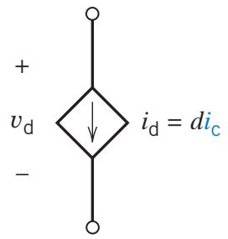
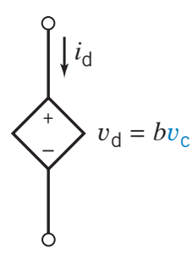
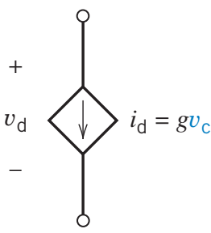
Dependent sources
Current-Controlled Voltage Source (CCVS)
Current-Controlled Current Source (CCCS)
Voltage-Controlled Voltage Source (VCVS)
Voltage-Controlled Current Source (VCCS)

Slide 4
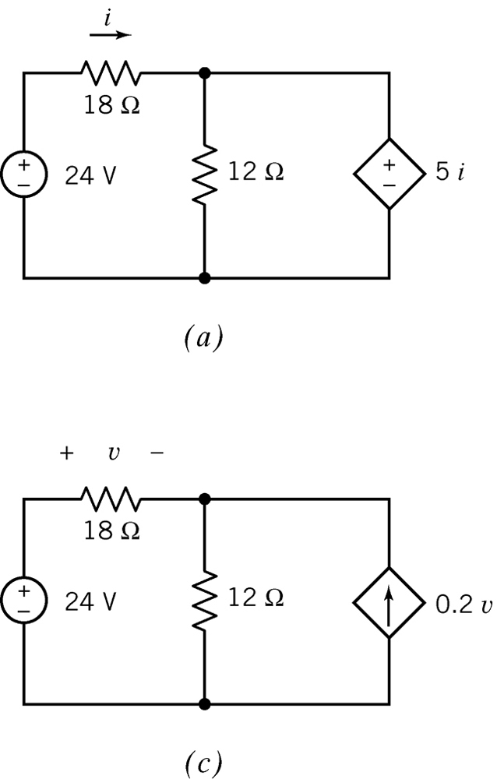
Dependent sources

Slide 5
Lecture
Node voltage analysis with dependent sources (Section 4.4)
Mesh current analysis with depndent sources (Section 4.7)
Superposition (Section 5.3)
Thevenin’s Theorem (Section 5.4)
Norton’s Equivalent Circuit (Section 5.5)
Maximum power transfer (Section 5.6)

Slide 6
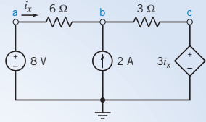
Node Voltage Analysis (1)
Find the nodal voltages.

Slide 7

Node Voltage Analysis (1)
Find the nodal voltages.
Go to node a first:
  $V_{a}=8 V$
Now node b:
$\frac{V_{a}−V_{b}}{6}=i_{x}→8−V_{b}=6i_{x}$
$\frac{V_{b}−V_{c}}{3}=2+i_{x}$
Now node c:
  $V_{c}=3i_{x}→V_{b}−3i_{x}=6+3i_{x}→V_{b}−6i_{x}=6$
$$V_{b}=7 V$$
$$i_{x}=\frac{1}{6}A$$
$$V_{c}=\frac{1}{2}V$$

Slide 8
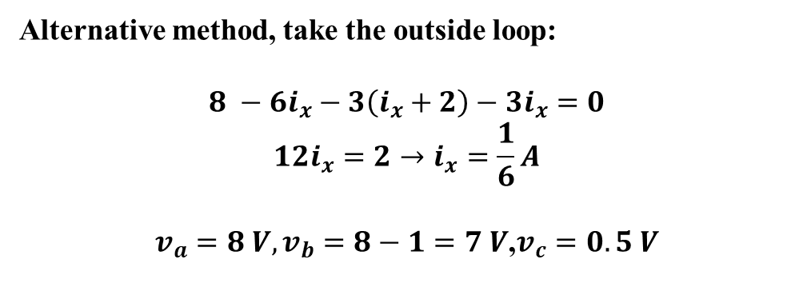
Node Voltage Analysis (1)
Alternative method, take the outside loop:
$$8 −6i_{x}−3\left(i_{x}+2\right)−3i_{x}=0$$
$$12i_{x}=2→i_{x}=\frac{1}{6}A$$
$v_{a}=8 V, v_{b}=8−1=7 V$,$v_{c}=0.5 V$

Slide 9
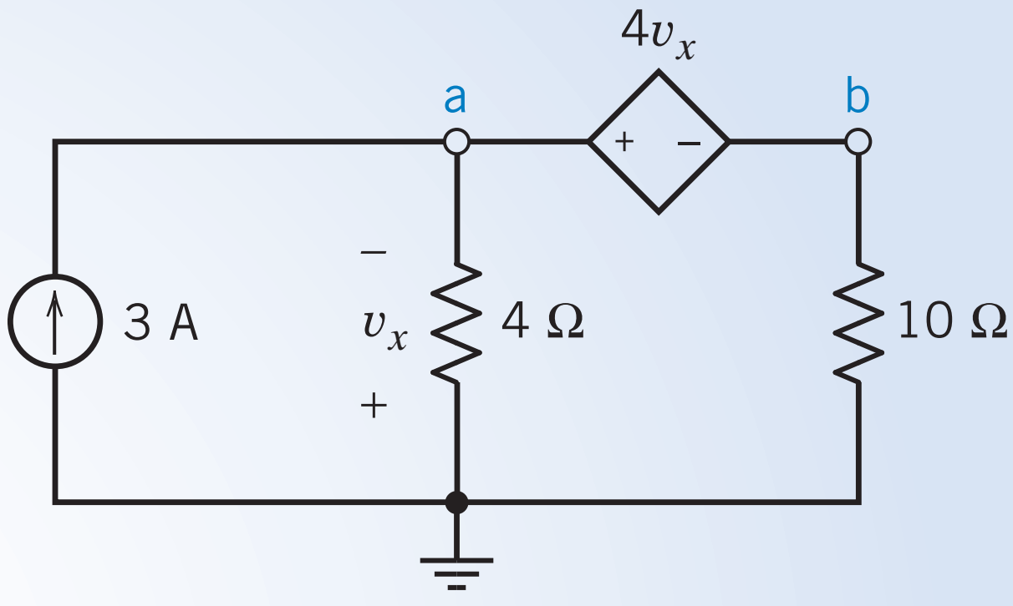
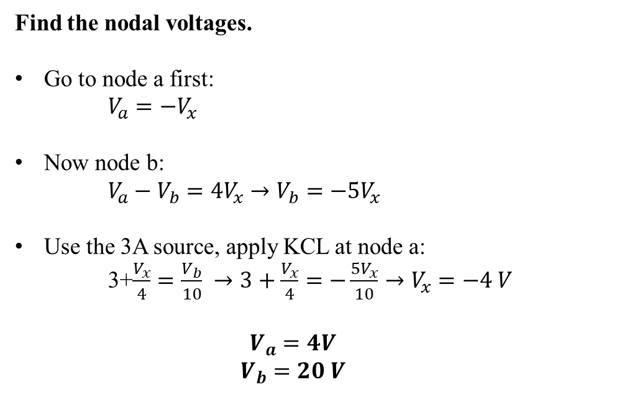
Node Voltage Analysis (2)
Find the nodal voltages.
Go to node a first:
  $V_{a}=−V_{x}$
Now node b:
$V_{a}−V_{b}=4V_{x}→V_{b}=−5V_{x}$
Use the 3A source, apply KCL at node a:
  3+$\frac{V_{x}}{4}=\frac{V_{b}}{10} →3+\frac{V_{x}}{4}=−\frac{{5V}_{x}}{10}→V_{x}=−4 V$
  $$V_{a}=4V$$
  $$V_{b}=20 V$$

Slide 10
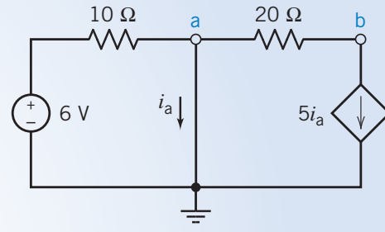

Node Voltage Analysis (3)
Find the nodal voltages.
Go to node a first:
  $V_{a}=0 V$
Now node b:
$\frac{V_{a}−V_{b}}{20}=5i_{a}→V_{b}=−100i_{a}$
Apply KCL at node a:
  $\frac{6}{10}=i_{a}+5i_{a}→i_{a}=\frac{1}{10} A$
  $$V_{b}=−10 V$$

Slide 11
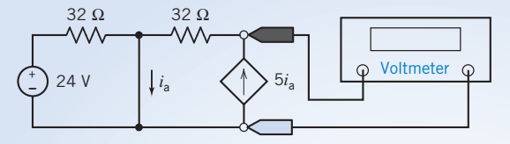
Mesh Current Analysis (1)

Slide 12
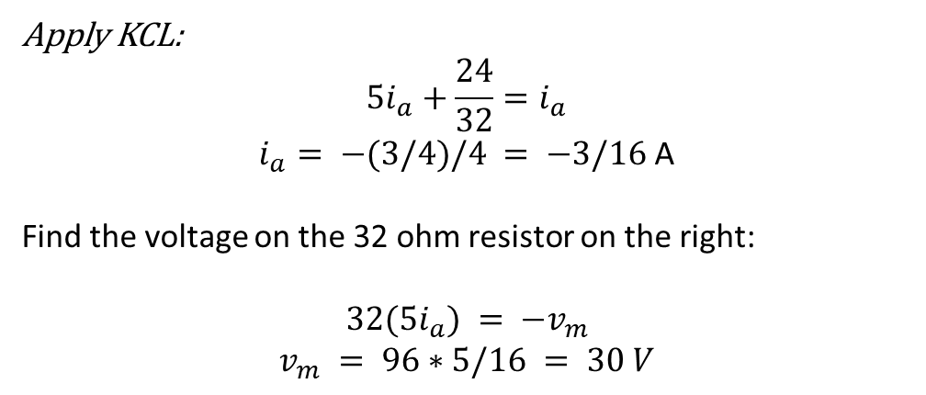
Mesh Current Analysis (1)
Apply KCL:
$$5i_{a}+\frac{24}{32}=i_{a}$$
$i_{a}= −(3/4)/4 = −3/16$A
Find the voltage on the 32 ohm resistor on the right:
$$32(5i_{a}) = −v_{m}$$
$$v_{m} = 96∗5/16 = 30 V$$

Slide 13
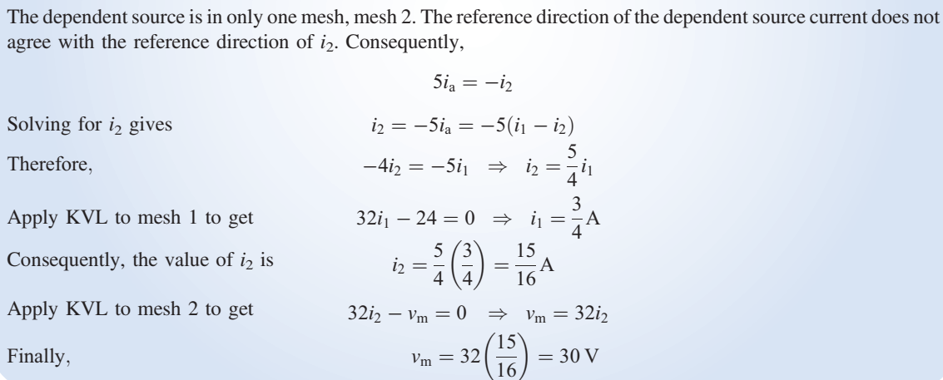
Mesh Current Analysis (1)

Slide 14
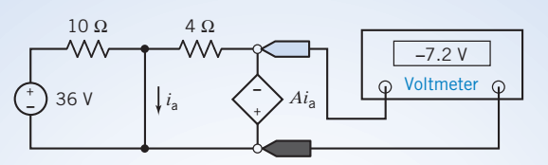
Mesh Current Analysis (2)

Slide 15
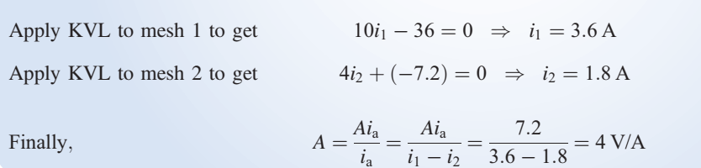
Mesh Current Analysis (2)

Slide 16
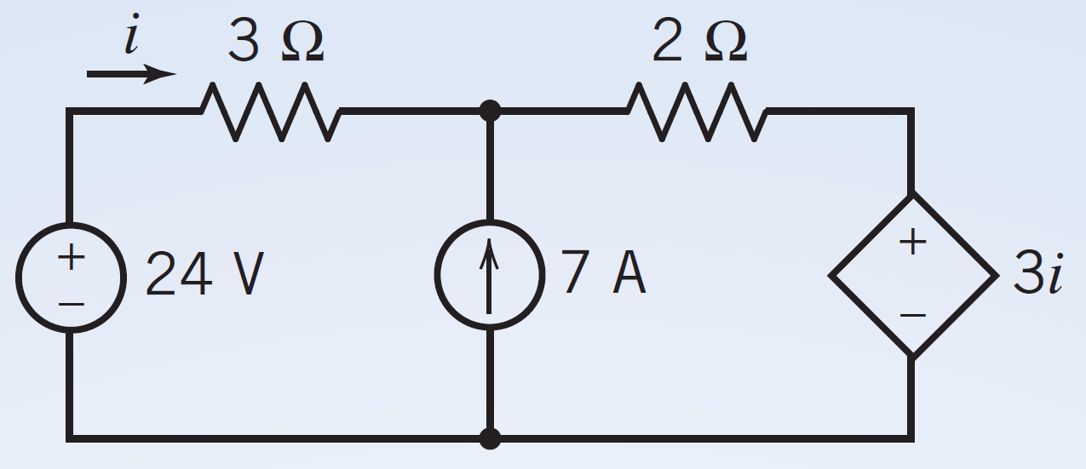
Superposition (1)
Find i using superposition theorem.
We have to keep the dependent source, to keep the relationship between the dependent source and its controller variable.
The new dependent source will be dependent on the new variable.

Slide 17




Superposition (1)
Find i using superposition theorem.
$$I_{1}$$
$${3I}_{1}$$
$$I_{2}$$
$${3I}_{2}$$

Slide 18
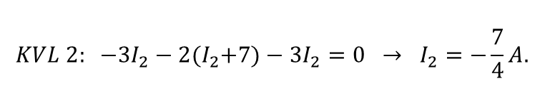

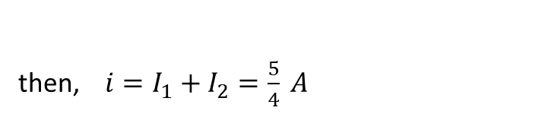
Superposition (1)
Find i using superposition theorem.
$${KVL 1: 24−3I}_{1}−2I_{1}−3I_{1}=0 → I_{1}=3A.$$
$$I_{1}$$
$${3I}_{1}$$
$${KVL 2: −3I}_{2}−2{(I}_{2}+7)−3I_{2}=0 → I_{2}=−\frac{7}{4}A.$$
$$I_{2}$$
then, $i=I_{1}+I_{2}=\frac{5}{4} A$
$${3I}_{2}$$

Slide 19
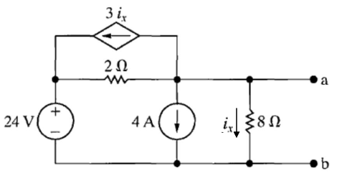
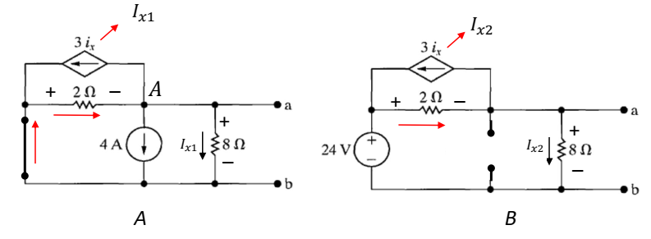
Superposition (2)

Slide 20

Superposition (2)
$$Circuit A:$$
Apply KCL:
$$4+I_{x1}+3I_{x1}=\frac{{−V}_{A}}{2}$$
Also, $V_{A}=8 I_{x1}→ 4+I_{x1}+3I_{x1}=−4I_{x1}→I_{x1}=−\frac{1}{2}A$

Slide 21
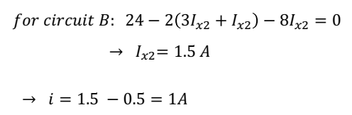
Superposition (2)

Slide 22
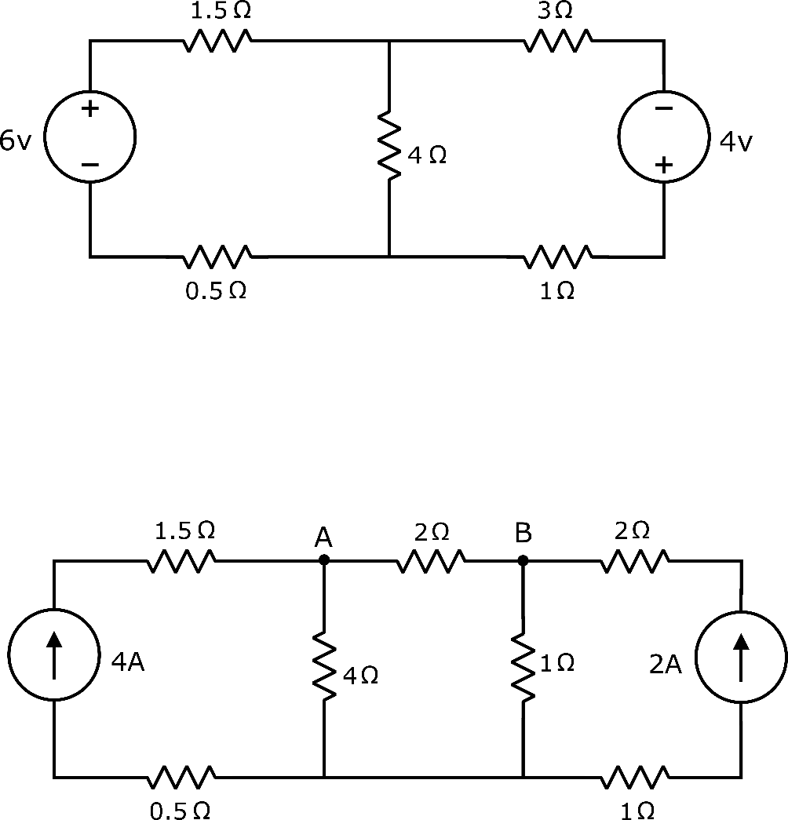
Thevenin’s and Norton’s Theorems

Slide 23





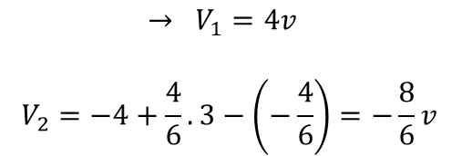
Thevenin’s and Norton’s Theorems
$$→ R_{th}=4 2=\frac{8}{6}=\frac{4}{3}Ω$$
//
+
+
+
+
V1
V2
_
_
_
_
$$→ V_{1}=4v$$
$$V_{2}=−4+\frac{4}{6}.3−\left(−\frac{4}{6}\right)=−\frac{8}{6}v$$
$$\frac{4}{3}Ω$$
$$→ V_{th}=V_{oc}=4−\frac{8}{6}=\frac{16}{6}v$$
$$\frac{16}{6}$$
4$Ω$

Slide 24
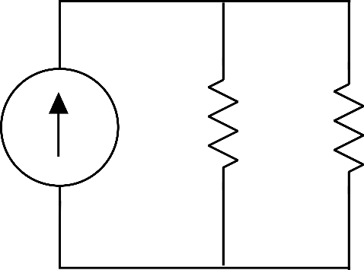







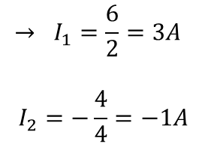

Thevenin’s and Norton’s Theorems
$$→ R_{th}=4 2=\frac{8}{6}=\frac{4}{3}Ω$$
//
$$I_{1}$$
$$I_{2}$$
$$→ I_{1}=\frac{6}{2}=3A$$
$$I_{2}=−\frac{4}{4}=−1A$$
$$\frac{4}{3}Ω$$
$$→ I_{th}=I_{sc}=3−1=2A$$
$$\frac{4}{3}Ω$$
$$\frac{16}{6}$$
$$2A$$
4$Ω$
4$Ω$
$$→ {V_{th}=I}_{th}.R_{th}$$

